Slide 1
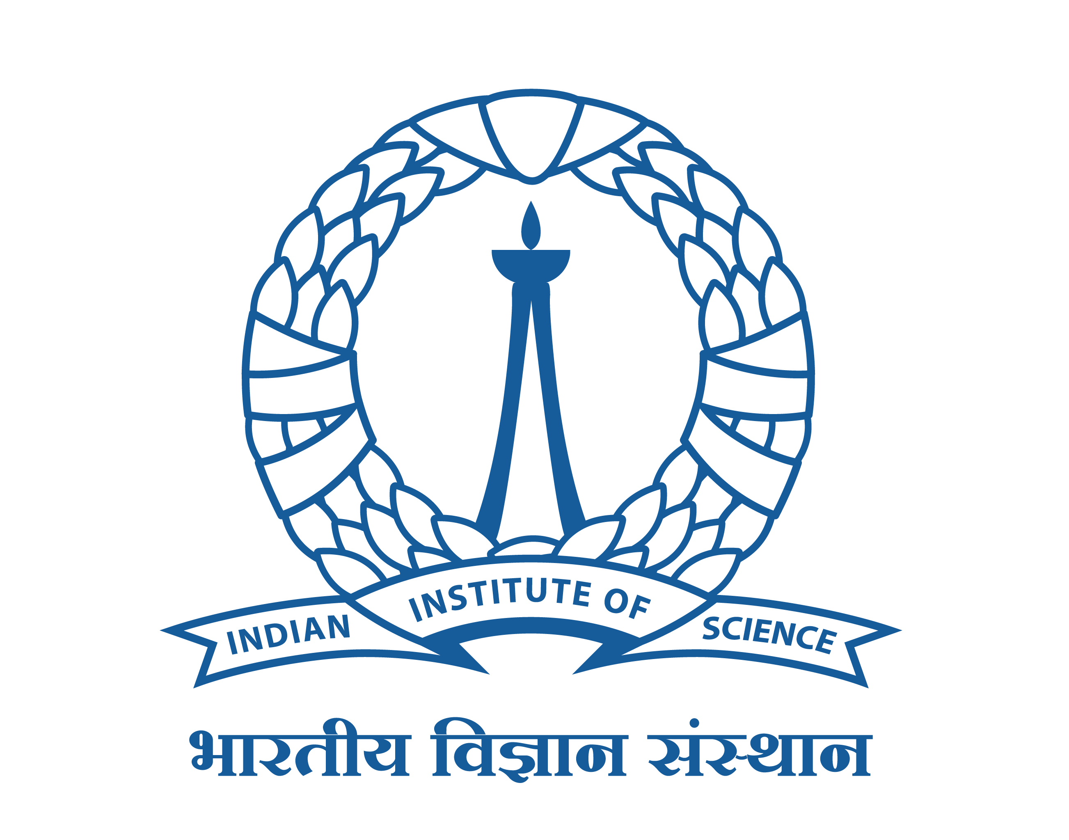

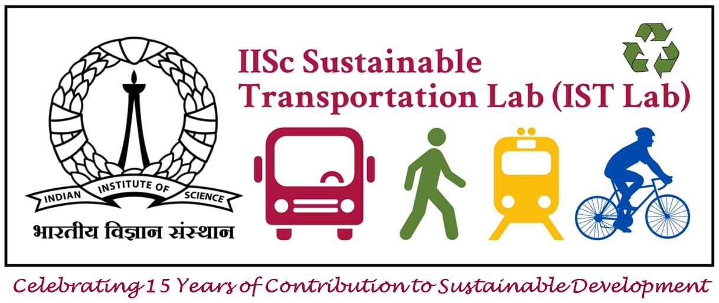
INDIAN INSTITUTE OF SCIENCE BANGALORE
18th Urban Mobility India Conference cum Exhibition 2025
Paper ID: 3342
Balancing Affordability and Sustainability:
Evaluating the Impact of Public Transport Fare Hikes in Bengaluru
Santhosh Kumar B V¹, Rohit Singh Nitwal² and Ashish Verma³ ¹Research Scholar, IISc Sustainable Transportation Lab. (IST Lab.), Department of Civil Engineering, IISc Bangalore
²Postdoctoral Research Associate, IST Lab, Department of Civil Engineering, IISc Bangalore
³Professor, IST Lab, Department of Civil Engineering, IISc Bangalore

Slide 2
Presentation Outline
Introduction
Objective and Methodology
Study Area and Data Collection
Result
Planning Implications of the Study
Conclusions
Limitations and Future Scope
Reference

Slide 3





Introduction
Public transport plays a vital role in sustaining the functioning of large urban agglomerations.
Ridership levels depend on key factors such as service quality, system performance, and fare structure.
Fare structure and pricing policies significantly influence travel behaviour and mode choice decisions.
Many states introduce passenger-oriented schemes to promote efficient and equitable use of public transport.
Periodic fare revisions are often necessary for financial sustainability but can negatively affect affordability and ridership.
In fare of public transportation in Bengaluru has been increased uoto 20% in bused and upto 505 in metros
Andhra Pradesh,
Delhi,
Karnataka,
Punjab,
Tamil Nadu,
Telangana
Maharashtra

Slide 4
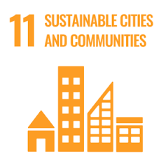




Introduction
Bus and metro ridership are important indicators for developing sustainable transportation indices
Fare policies and fare hikes directly and indirectly influence multiple Sustainable Development Goals (SDGs).
Directly
In-Directly

Slide 5
Objective and Methodology
Literature Review
Study Area (BMR)
Impact of recent fare hikes in Bengaluru’s metro and bus services, with a focus on how rising ticket prices affect travel behaviour, affordability, and overall quality of life.
Statistical methods such as the McNemar’s test and the multinomial logit model were used to evaluate changes in mode share and user preferences.
Understanding PT Fare Hike Impacts
Primary Survey Data Collection
Mode Share Analysis (using MNL Model)
Data Preprocessing
Business-As-Usual Scenario (No PT Fare Hike)
PT Fare Hike Scenario
(With and Without Government Subsidy Schemes)
Non-parametric McNemar’s Test
Mode Shifts for each scenario
Results and Discussion
Implications and Recommendations
Overall Framework

Slide 6
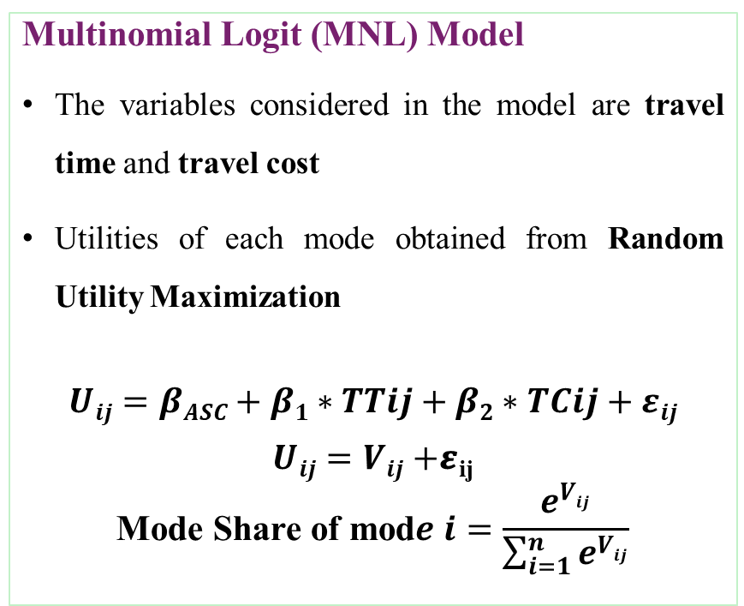
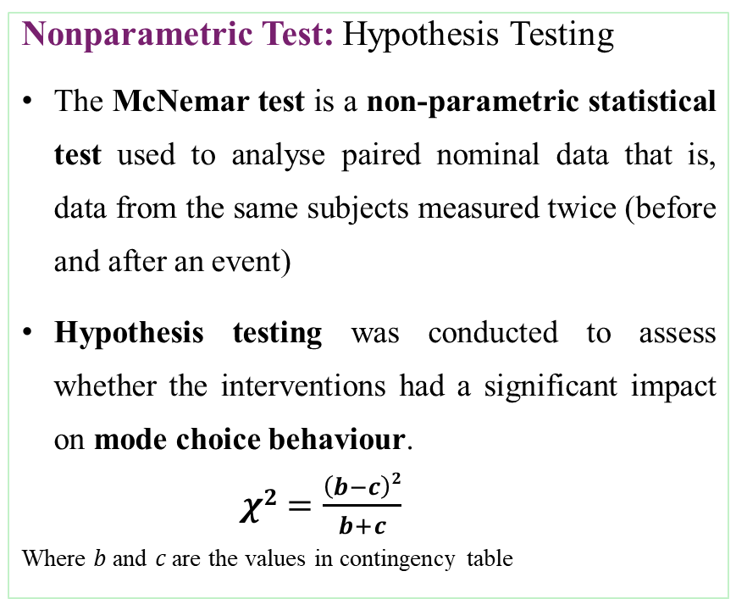
Objective and Methodology
Models Used
Nonparametric Test: Hypothesis Testing
The McNemar test is a non-parametric statistical test used to analyse paired nominal data that is, data from the same subjects measured twice (before and after an event)
Hypothesis testing was conducted to assess whether the interventions had a significant impact on mode choice behaviour.
$χ2=\frac{\left(b−c\right)2}{b+c}$
Where 𝑏 and 𝑐 are the values in contingency table
Multinomial Logit (MNL) Model
The variables considered in the model are travel time and travel cost
Utilities of each mode obtained from Random Utility Maximization
$$Uij=βASC+β1∗TTij+β2∗TCij+εij$$
$Uij=Vij+$𝜺_{ij}
$$\text{Mode} \text{Share} \text{of} \text{mod}e i=\frac{e^{Vij}}{\sum_{i=1}^{n}{e^{Vij}}}$$
Where, 𝑖 is the mode
j is the decision maker
𝑈_{𝑖𝑗} is the utility of mode 𝑖 for individual j
𝛽_{𝐴𝑆𝐶} is the alternate specific constant
𝛽₁ 𝑎𝑛𝑑 𝛽₂ are coefficients of TT and TC

Slide 7
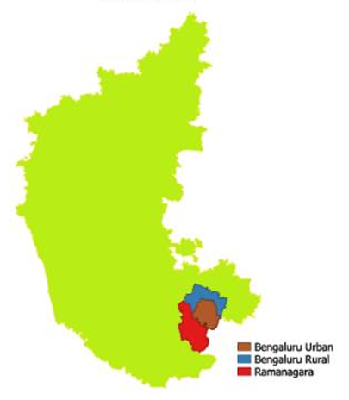
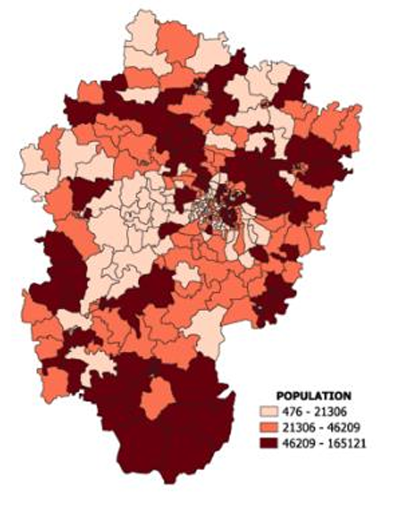
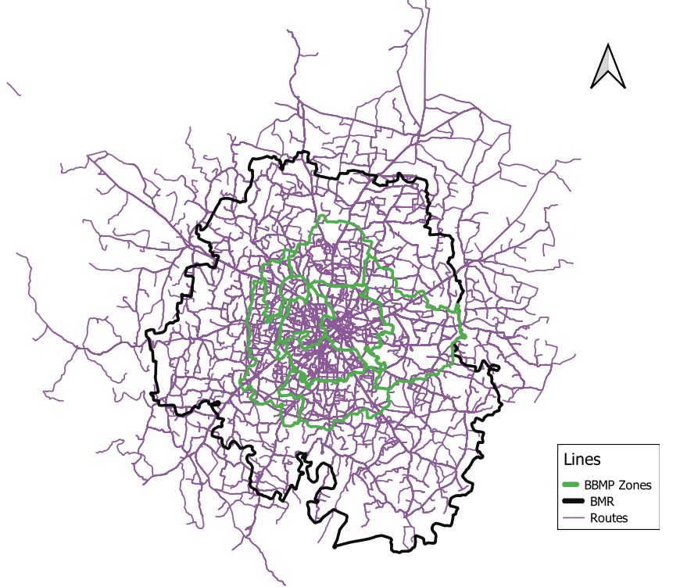
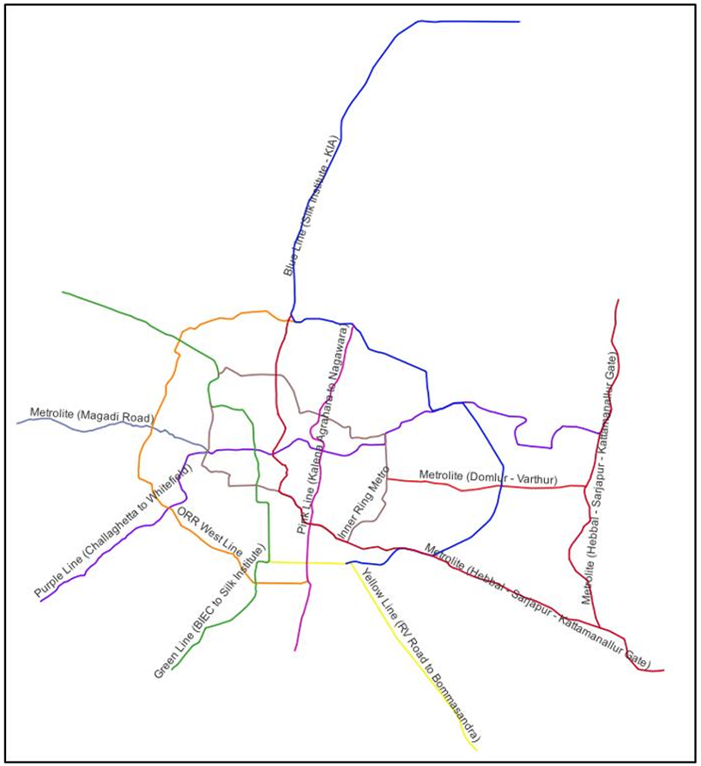
Study Area and Data Collection
Bangalore Metropolitan Region (BMR), which comprises three districts: Bengaluru Urban, Bengaluru Rural, and Ramanagara.
BMR has a population of approximately 15.4 million and covers an area of 8,005 square km.
The Bangalore Metropolitan Transport Corporation (BMTC) operates the city’s bus services, whereas the Bangalore Metro Rail Corporation Limited (BMRCL) operates the metro system.
Karnataka
BMR zones
BMTC bus routes
Metro lines network
Study Area

Slide 8
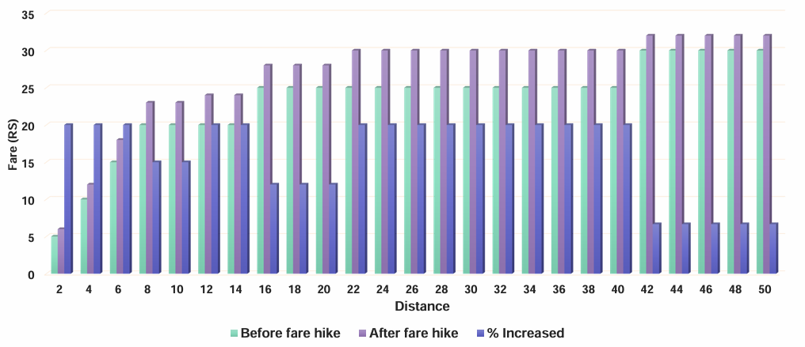
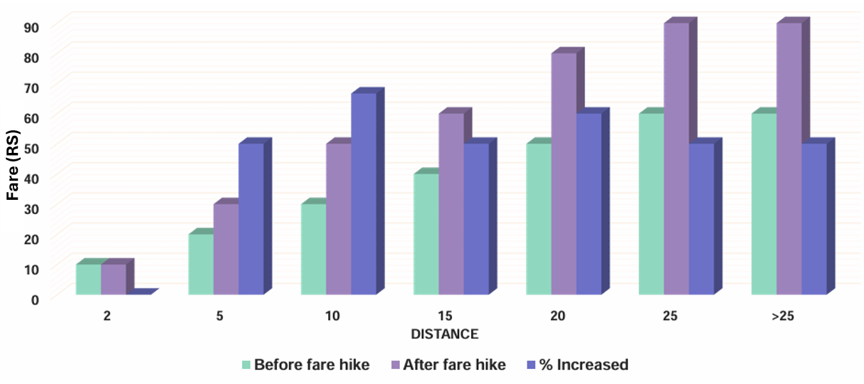
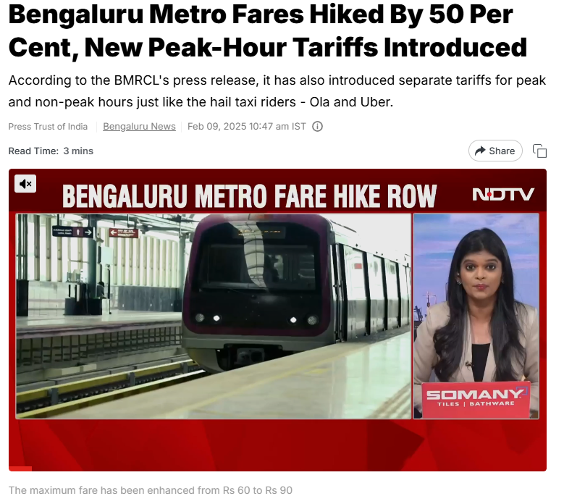
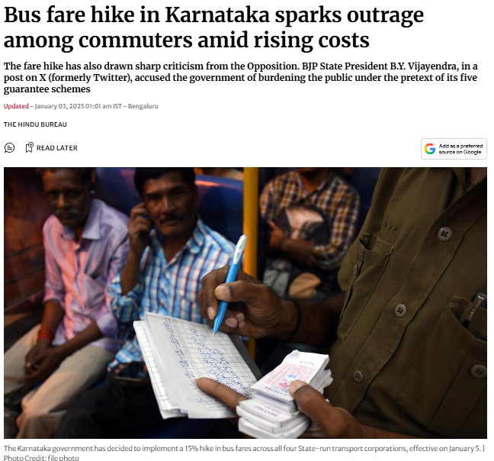
In the early quarter of the year, the Government of Karnataka
increased the fares of both buses and metros.
Data Collection:
A questionnaire was developed to explore the major aspects of transportation accessibility, affordability, and policymaking.
Collected on Open day, IISc Bangalore
Sample size : 184
Sampling unit : Bangalore commuters
The mode share data for assessing conditions before and after the fare hike were obtained from Vajjarapu et al., (2023).
M
c
N
e
m
a
r
BMTC Bus Fare (Before and After)
BMRCL Metro Fare (Before and After)
M
N
L
News Article related to Fare Hike

Slide 9




Result
Descriptive Statistics

Slide 10
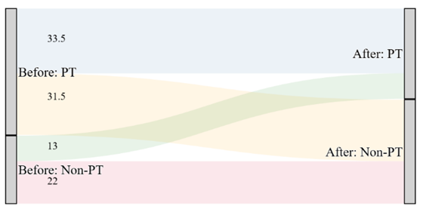
Result
Fare Hike Impacts using McNemar’s Test
The McNemar test was employed to examine marginal homogeneity between two dichotomous variables, namely public transport (PT) usage before and after the fare increase.
Hypothesis Formulated: There is a significant shift of commuters from public transport modes to non-public transport modes (such as private cars, two-wheelers, ride-hailing services, and non-motorised options)
This hypothesis was further tested across different gender and income groups.
The findings indicated a statistically significant change (p < 0.05), confirming a behavioural shift in travel choices after the fare revision.
Percentage of Mode Shift in Public Transportation, Before and After the Fare Hike

Slide 11
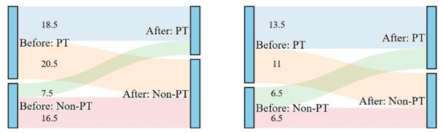
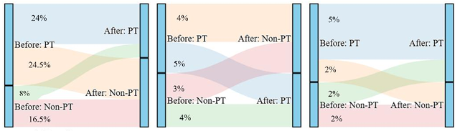
Result
A gender-based breakdown, among male commuters, a statistically significant change in public transport (PT) usage was observed (p < 0.05), whereas female commuters did not exhibit a significant difference (p > 0.05).
Low-income commuters exhibited a statistically significant reduction in PT use following the fare revision (p < 0.05), reflecting their heightened price sensitivity.
In contrast, middle and high-income groups showed no statistically significant variation (p > 0.05).
(a) Male
(b) Female
Percentage of Mode Shift in Public Transportation with respect to Gender
(a) Low-income
(b) Medium income
(c) High income
Mode Shift Before and After Fare Hike by Income Group

Slide 12
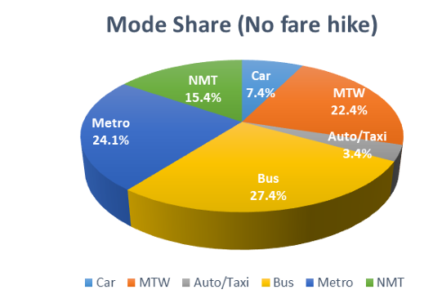
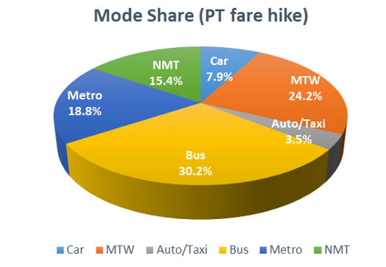






Result
Fare Hike Impacts using MNL model
The MNL model was developed for two scenarios Business-as-Usual (BAU) and Public Transport Fare Hike.
Calibrated coefficients (BAU Scenario):
𝛽ASC = 1.144, 𝛽₁ = −0.0076, 𝛽₂ = −0.0242
Calibrated coefficients (PT Fare Hike Scenario):
𝛽ASC = 1.189, 𝛽₁ = −0.0058, 𝛽₂ = −0.0248
Mode share changes after fare hike:
(a) BAU Scenario (No Fare Hike)
Car: +0.5%
MTW: +1.8%
Auto/Taxi: +0.1%
(b) PT Fare Hike Scenario
Bus: +2.8%
Metro: −5.3%
Mode Share

Slide 13
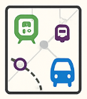



Planning Implications of the Study
Promote Complementarity Between Modes
Address Mode Diversion and Sustainability
Ensure Equity in Fare Policies
Integrate Gender-Sensitive Planning
Adopt Data-Driven and SDG-Aligned Fare Reforms

Slide 14



Conclusions
Fare hikes significantly influenced mode shift behaviour, particularly among low-income male commuters, leading to an increase in private mode usage.
Metro ridership declined (−5.3%), while bus usage increased (+2.8%), highlighting differences in fare sensitivity across modes.
The Shakti Scheme offering free bus travel for women substantially altered gender-based travel patterns, with many female commuters shifting from metro to bus.
The study emphasizes the importance of balancing financial sustainability with equity, ensuring fare policies remain inclusive for vulnerable groups.
Findings align with SDGs 1.5, 5, 10.2, 11.2, 11.5, and 17.18, reinforcing the link between affordable transport, gender equality, and social inclusion.

Slide 15





Limitations and Future Scope
The small sample size limits the generalizability of findings; larger, city-wide surveys are needed for stronger results.
Age bias in the sample (majority young participants) highlights the need for broader representation across all demographic groups.
Future studies should collect location-specific details to enable targeted, area-based transport interventions.
Research should assess the long-term sustainability impacts of fare hikes, including mode shifts toward private vehicles and their emission effects.
Travel demand modelling under BAU and fare hike scenarios can help quantify environmental and social implications, supporting equitable fare policy design.

Slide 16
References
Chen, R., & Zhou, J. (2022). Fare adjustment’s impacts on travel patterns and farebox revenue: An empirical study based on longitudinal smartcard data. Transportation Research Part A: Policy and Practice, 164, 111–133. https://doi.org/10.1016/j.tra.2022.08.003
El-Geneidy, A., Levinson, D., Diab, E., Boisjoly, G., Verbich, D., & Loong, C. (2016). The cost of equity: Assessing transit accessibility and social disparity using total travel cost. Transportation Research Part A: Policy and Practice, 91, 302–316. https://doi.org/10.1016/j.tra.2016.07.003
Litman, T. (2022). Evaluating Transportation Equity: Guidance for Incorporating Distributional Impacts in Transport Planning. In ITE Journal. https://vtpi.org/Litman_ITEJ_Equity_Apr2022.pdf.
Nitwal, R. S., Allirani, H., & Verma, A. (2025). A composite index for assessing sustainability of urban transport interventions. Sustainable https://doi.org/10.1080/29941849.2025.2497277
Vajjarapu, H., Verma, A., & Allirani, H. (2023). Evaluating the Climate Change Mitigation Potential of Sustainable Urban Transport Measures in India. Journal of Urban Planning and Development, 149(1). https://doi.org/10.1061/(asce)up.1943-5444.0000890
Verma, A., Rahul, T. M., & Dixit, M. (2015). Sustainability impact assessment of transportation policies - A case study for Bangalore city. Case Studies on Transport Policy, 3(3), 321–330. https://doi.org/10.1016/j.cstp.2014.06.001
Zhao, P., & Zhang, Y. (2019). The effects of metro fare increase on transport equity: New evidence from Beijing. Transport Policy, 74(January 2018), 73–83. https://doi.org/10.1016/j.tranpol.2018.11.009

Slide 17
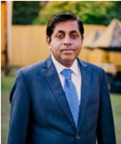
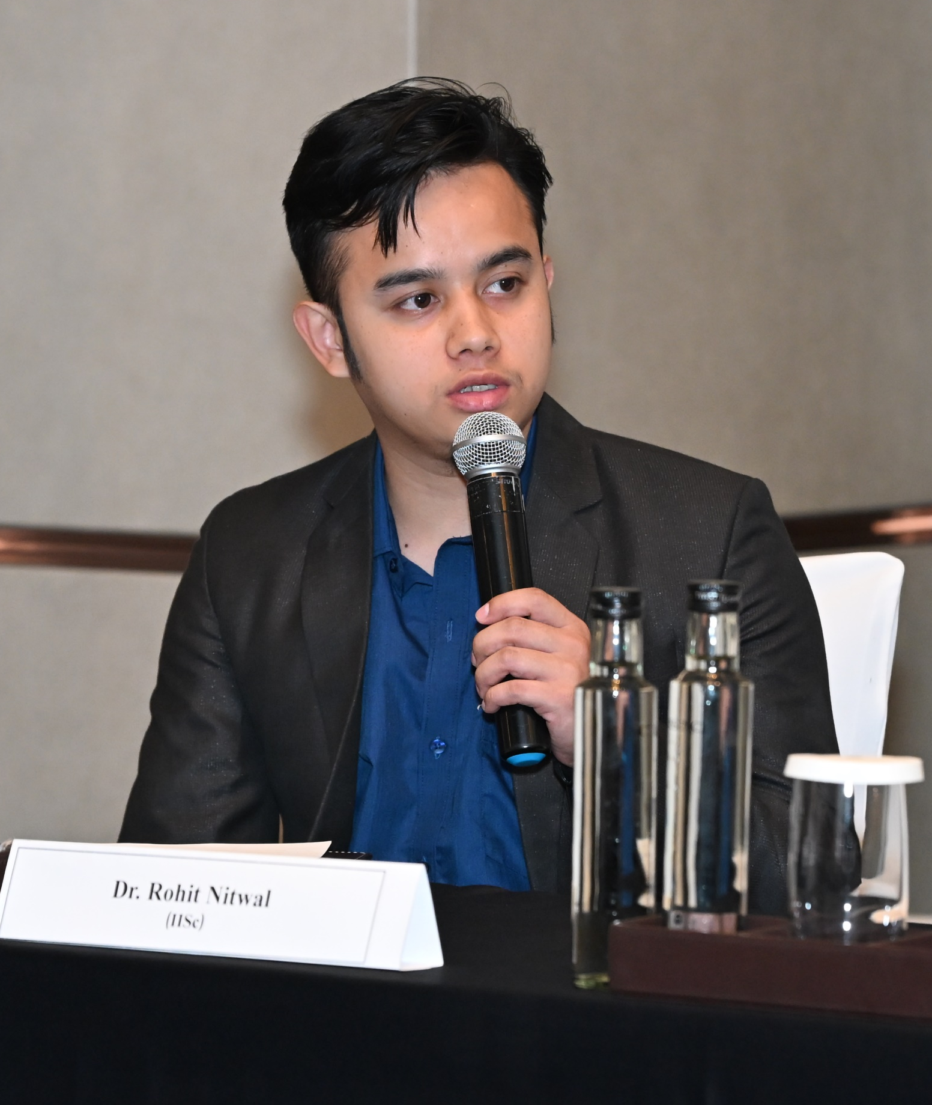
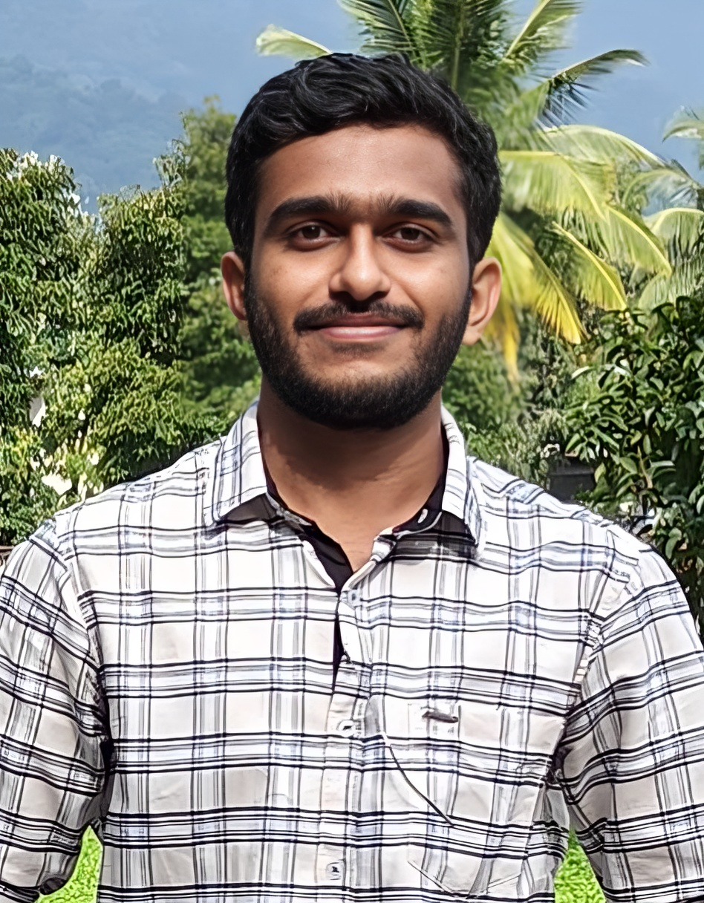
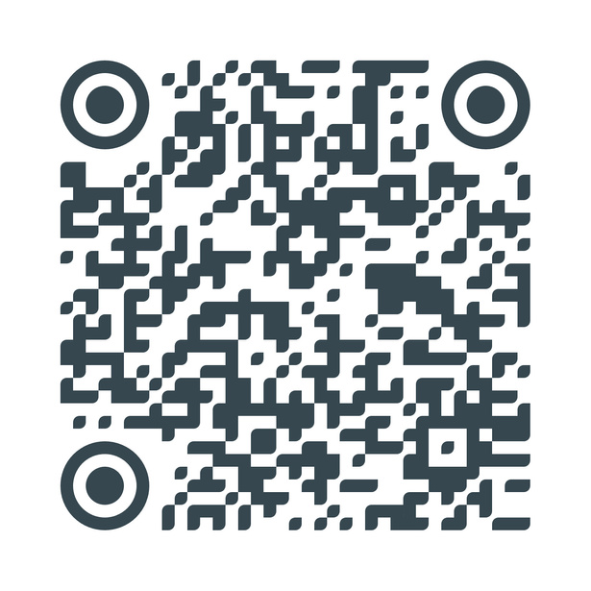
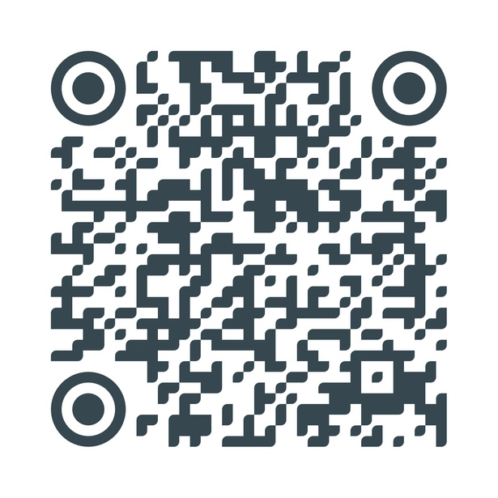
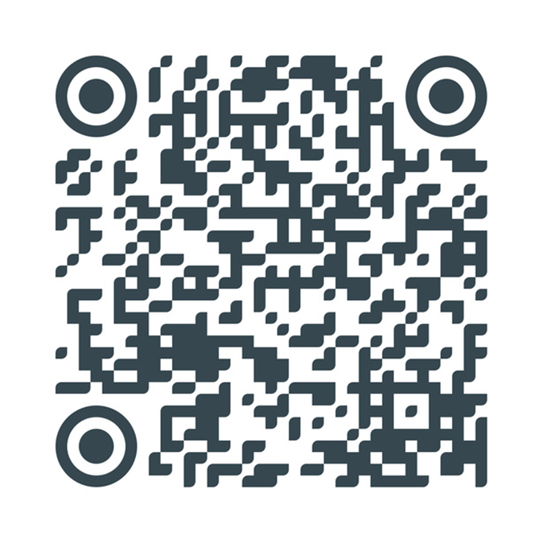
Thank You
C
Contact Us at:
Dr. Ashish Verma
Professor
IST Lab, IISc
ashishv@iisc.ac.in
Dr. Rohit Singh Nitwal
Postdoctoral Research Associate
IST Lab, IISc
rohitnitwal@iisc.ac.in
Santhosh Kumar B V
Research Scholar
IST Lab, IISc
santhoshbv@iisc.ac.in

Slide 18
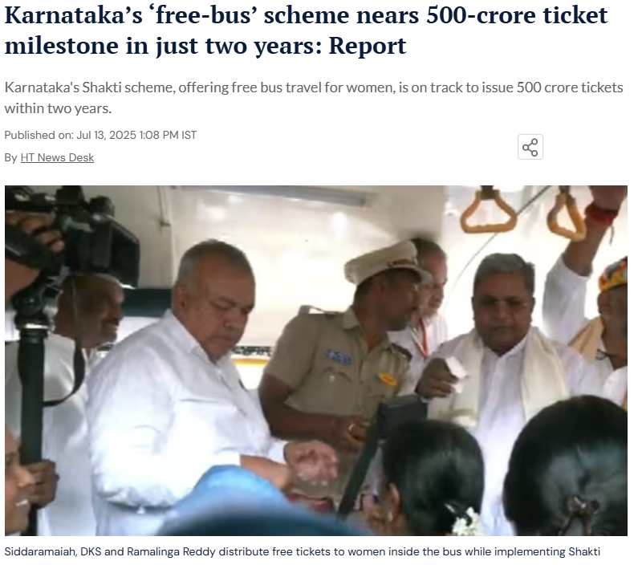
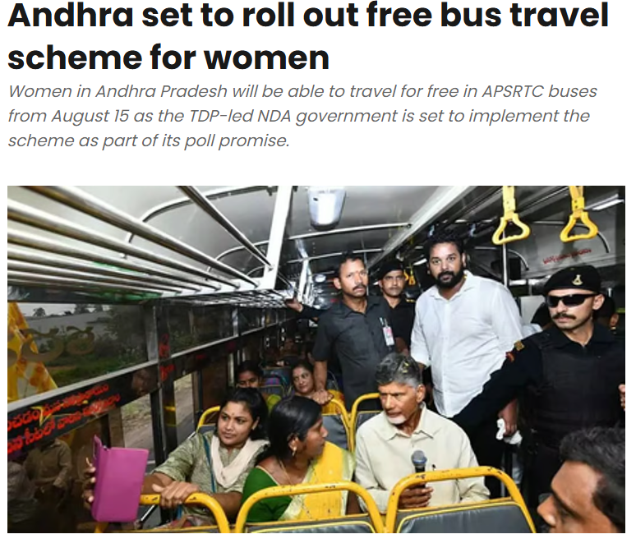
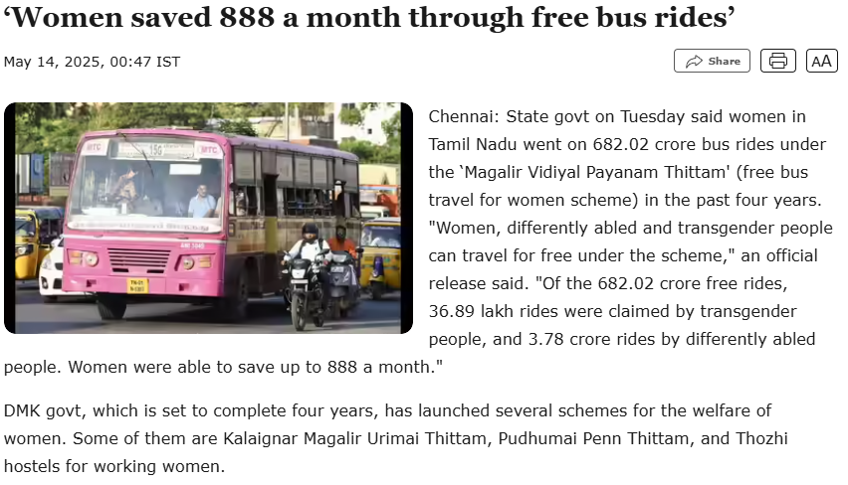
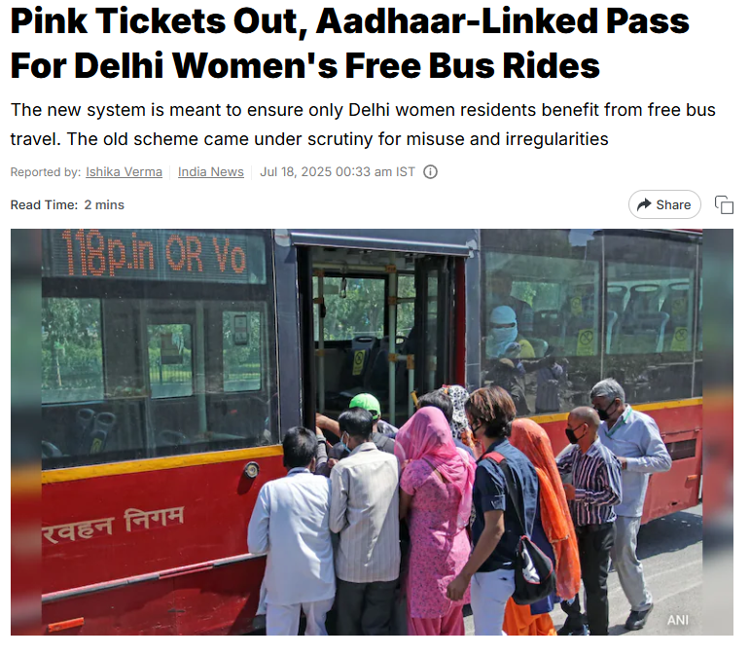
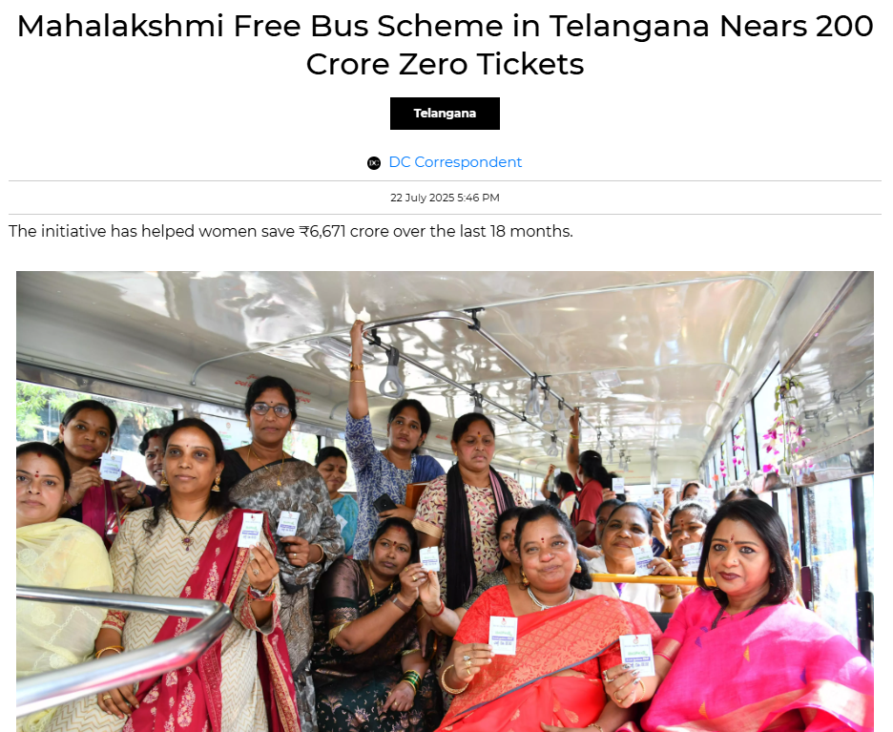
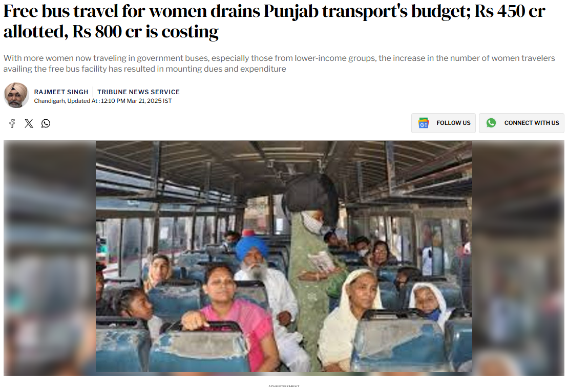
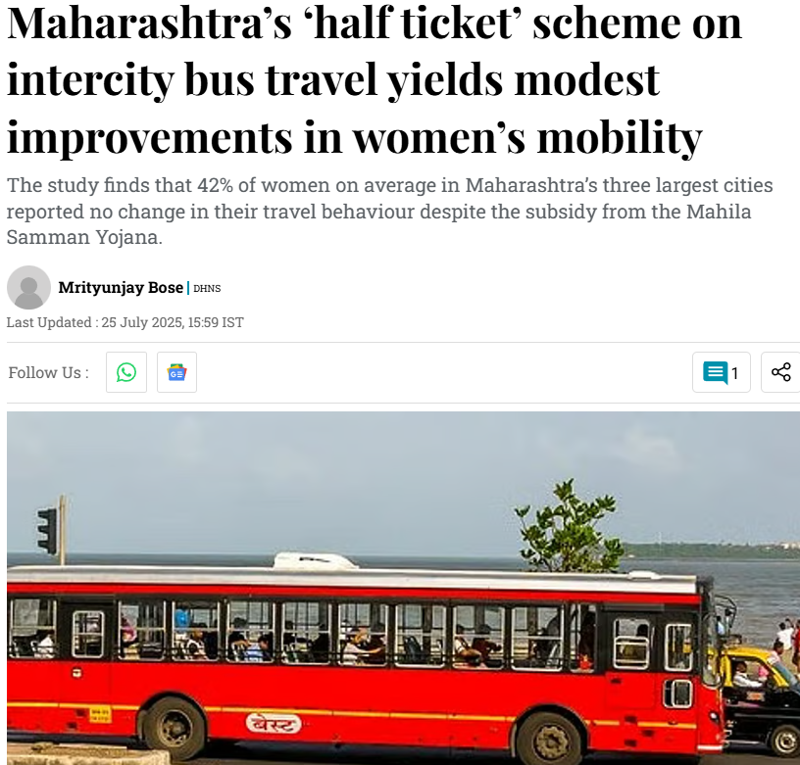
Many states, including Andhra Pradesh, Delhi, Karnataka, Punjab, Tamil Nadu, and Telangana,
offer free bus travel for women to enhance their mobility and safety. Maharashtra provides a
50% fare concession for women on state transport buses.

Slide 19
Planning Implications of the Study
Promote Complementarity Between Modes: Metro and bus systems should be coordinated rather than competing, through integrated ticketing, differential pricing, and synchronized scheduling to enhance multimodal efficiency and accessibility.
Address Mode Diversion and Sustainability: Shifts from metro to private vehicles can increase congestion, emissions, and energy use; policies must encourage continued reliance on high-occupancy public transport.
Ensure Equity in Fare Policies: Fare structures must balance affordability and revenue goals, preventing cost burdens from disproportionately affecting low-income, male, student, or elderly commuters.
Integrate Gender-Sensitive Planning: Schemes like the Shakti free-bus policy improve female mobility but may shift financial pressure elsewhere; planners should assess gendered trade-offs to maintain fairness across user groups
Adopt Data-Driven and SDG-Aligned Fare Reforms: Use elasticity estimates and disaggregated data (income, gender, trip purpose) to design inclusive fare policies aligned with SDGs 3, 11, and 13, ensuring affordability and sustainability in the long term.

