Slide 1
Mobility-as-a-Service: Insights from Global Practices and Implications for Indian Cities (Paper ID: 8118)
Presentation
on
Authors
Shiksha Singh, IIT Roorkee
Prof. Ramesh Anbanandam, IIT Roorkee
Prof. Debadutta Parida, IIT Roorkee

Slide 2
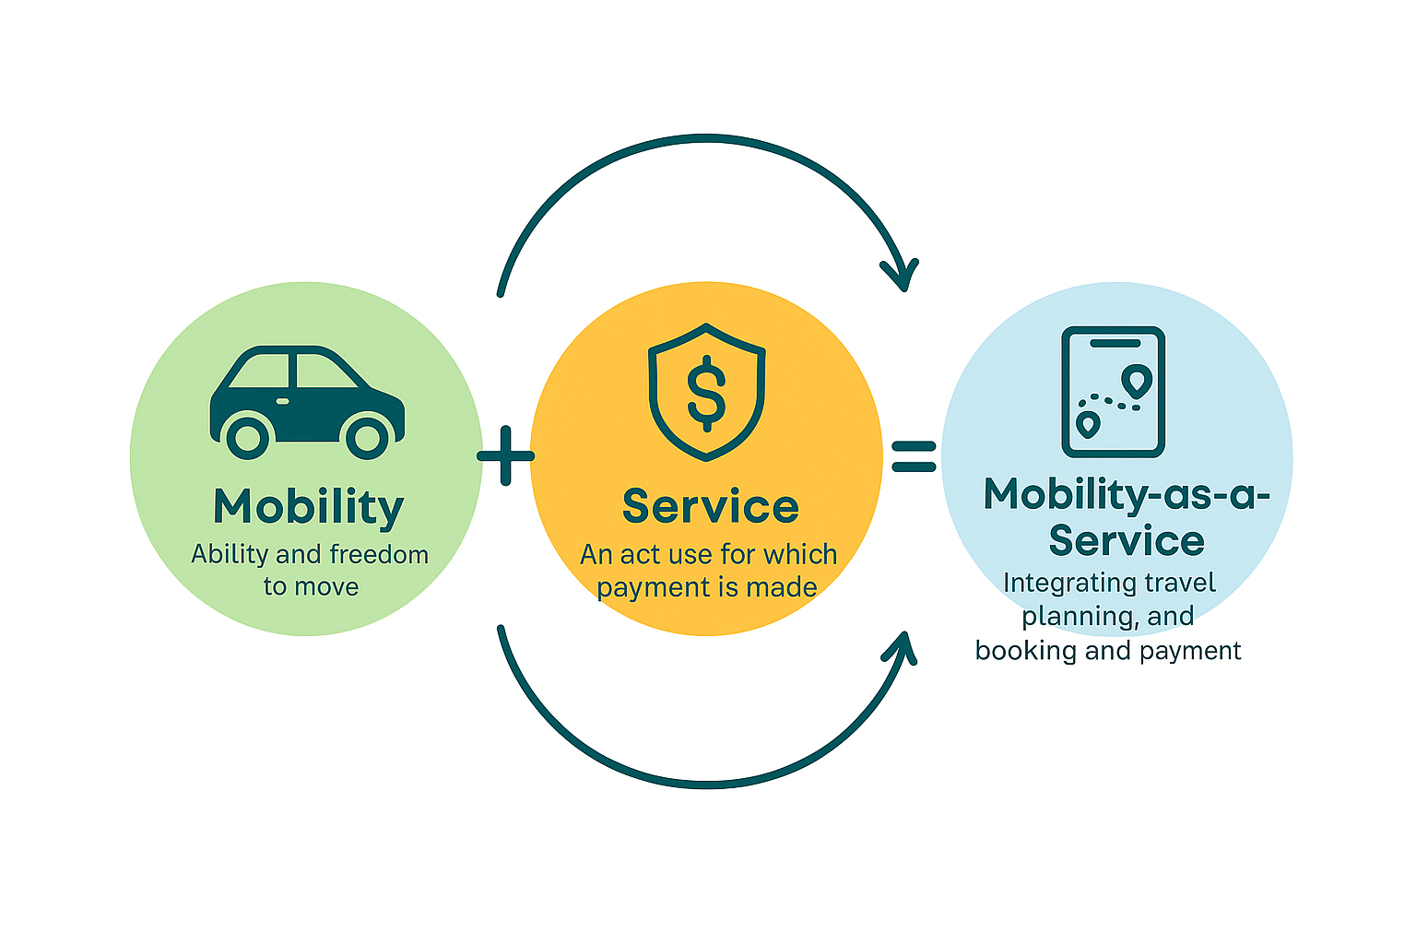


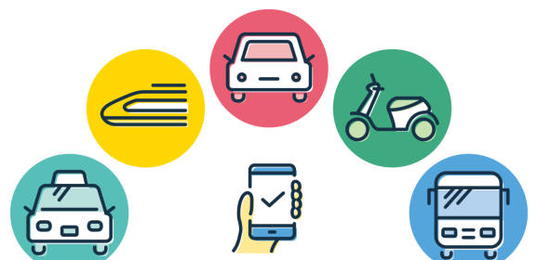
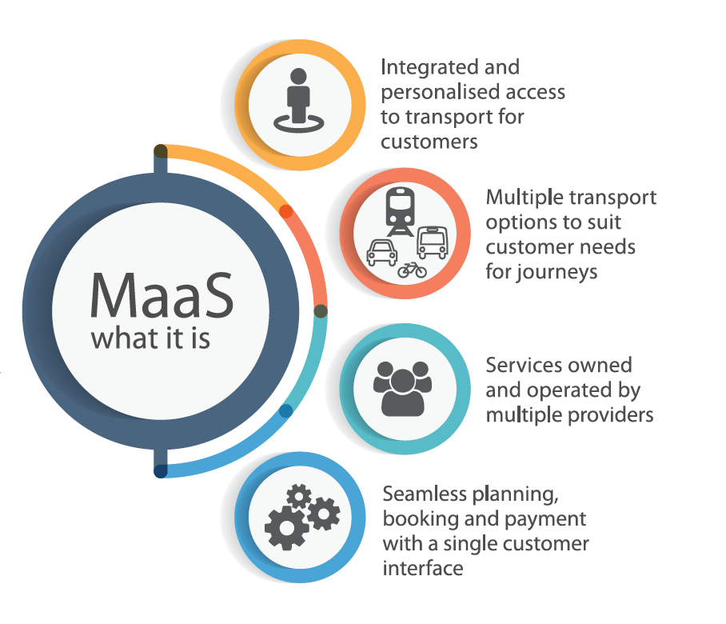
Introduction
Mobility
Services
Mobility-as-a-Service
Ability and freedom to move
An act for which payment is made
Integrating travel planning, booking and payment
A promising solution that enhances the attractiveness of mobility services, particularly public transport, thereby reducing reliance on privately owned vehicles (Batur et al., 2024).
Three core dimensions of MaaS:
the integration of multiple modes
the provision of seamless access through a unified platform
the emergence of new business and governance models
Source: https://www.itf-oecd.org/policy/mobility-as-a-service
https://www.itf-oecd.org/sites/default/files/repositories/pricing-efficient-public-transport-supply-maas.pdf

Slide 3

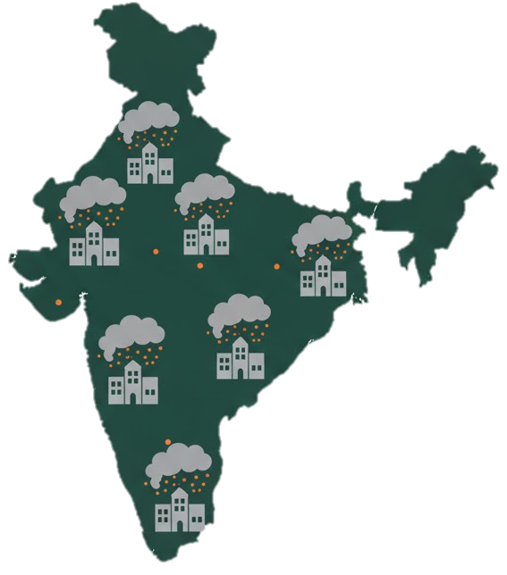
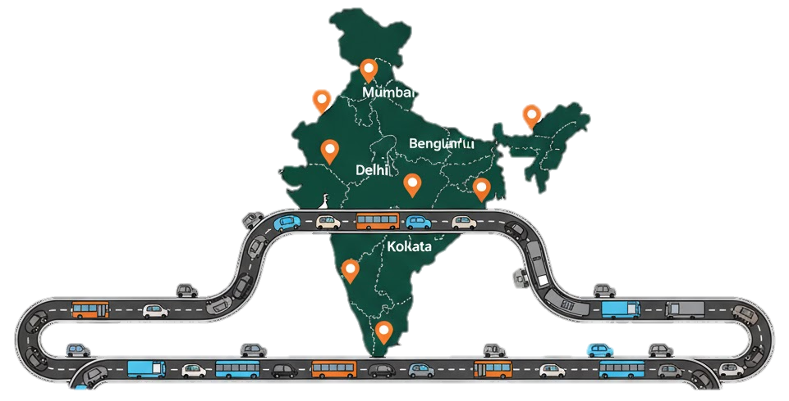

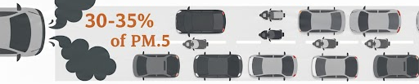

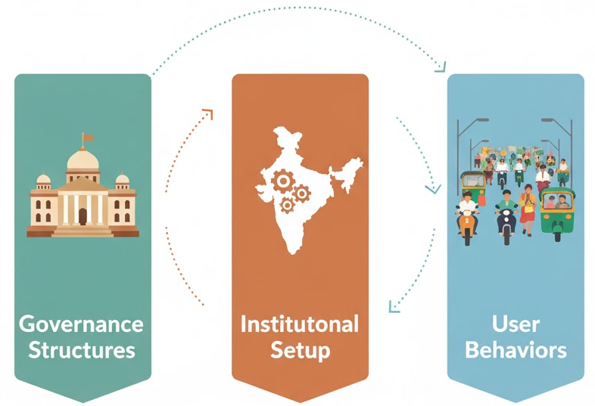
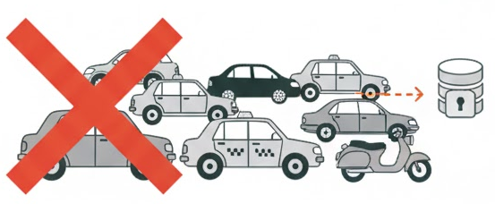
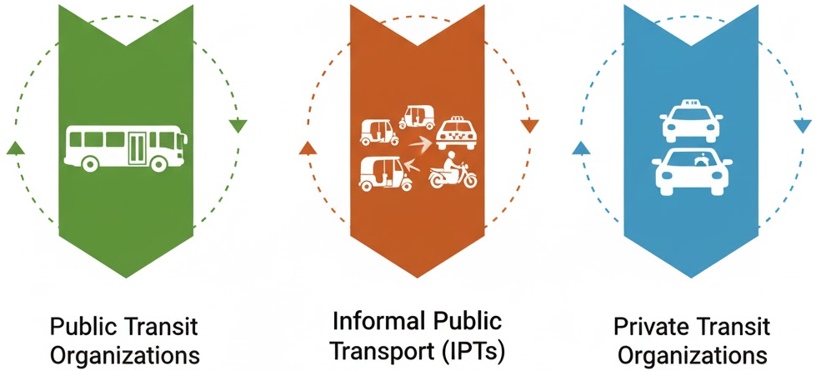
Research Problem and Gaps
Major Problems
India’s transport demand
Grown by almost 8 times since 1980
Vehicles: significant contributor to PM_{2.5}
High no. of private vehicles on road
Most polluted cities in the world (WHO study)
14 out of the top 15
Major Indian cities
ranked amongst the world’s most congested cities
MaaS optimizes infrastructure use, reduce congestion, lowers emissions, and enhances urban living
Predominantly implemented in cities of the Global North
Directly applying from the Global North to Indian cities is not feasible
Challenge in acquiring data from different transport operators
Indian cities- Distinct Features
Varieties of organization
Research Gaps
Lack of concept knowledge, institutional, financial, and social barriers, hinder the successful implementation of MaaS
Limited information of MaaS projects results in less conceptual understanding and lack of research on frameworks for MaaS-friendly environments.
Source: https://www.niti.gov.in/sites/default/files/2023-02/Mobility-data.pdf
https://e-amrit.niti.gov.in/assets/admin/dist/img/new-fronend-img/report-pdf/BCG.pdf
MaaS-Alliance, "Data Makes MaaS Happen – MaaS Alliance Vision Paper on Data," Retrieved from https://maas-alliance.eu/wpcontent/uploads/sites/7/2018/11/Data-MaaS-FINAL-after-plenary-1.pdf

Slide 4





Research Question, Aim & Objectives
Research Question
What are the defining characteristics of global MaaS initiatives and how do Indian cities currently position themselves in relation to these characteristics?
To identify best practices through a scoping review of global MaaS implementations
2. To analyse these cases to extract key characteristics
3. To apply these characteristics to the case of Bengaluru in order to identify context-specific barriers and opportunities for MaaS adoption
Aim
To synthesize existing knowledge on MaaS practices worldwide and assess their applicability to the Indian context.

Slide 5
Methodology
Scoping Review
Mobility-as-a-Service OR MaaS OR Multimodal-integration OR Mode-integration
WoS
(N=13016)
Relevant articles
(N=605)
Papers included MaaS implemented cities
(N=103)
Aims to identify the nature and extent of research evidence.
Search string
To identify and map the available evidence (Grant & Booth, 2009).
Search hits
Identify key characteristics or factors related to a concept
Screening on the basis of Title & Abstract
Data Analysis
Global MaaS Projects
Screening on the basis of Full paper
Identification of Key Characteristics
Case Selection- Bengaluru
Comparative analysis
Barriers & Opportunities
Key Recommendations

Slide 6
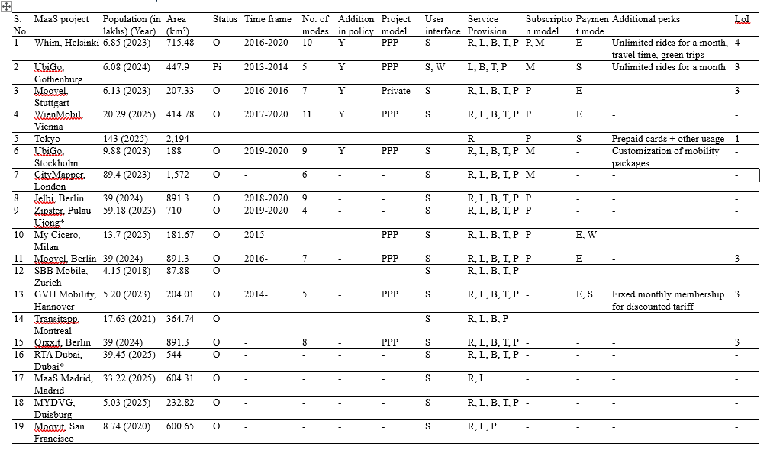
Identification of MaaS best practices
Table note: *: Global South, [Status- O: Operational, P: Pilot, PL: Planned], [User interface- S: Smart phone apps & W: Web alternatives], [Service Provision- R: Real-time information, L: Trip planning, B: Booking, T: Ticketing, P: Payment], [Subscription model- P: Pay-as-you-go, M: Mobility package], [Payment mode- E: ePay, P: PayiQ, S: Smart card, W: eWallet], LoI: Level of Integration, “-”: Data not available.

Slide 7
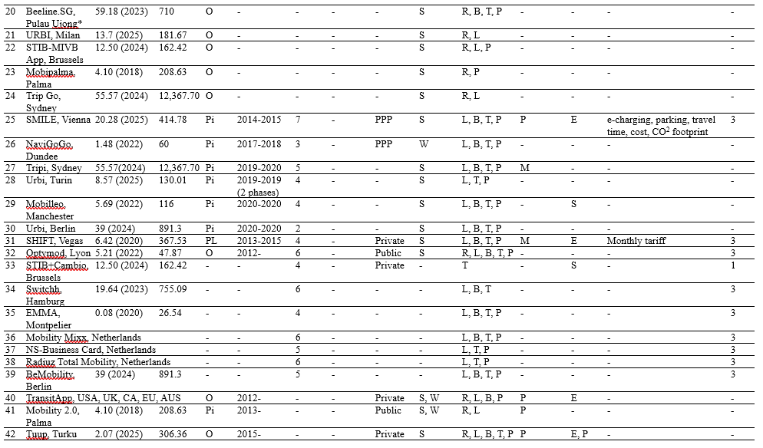
Identification of MaaS best practices
Table note: *: Global South, [Status- O: Operational, P: Pilot, PL: Planned], [User interface- S: Smart phone apps & W: Web alternatives], [Service Provision- R: Real-time information, L: Trip planning, B: Booking, T: Ticketing, P: Payment], [Subscription model- P: Pay-as-you-go, M: Mobility package], [Payment mode- E: ePay, P: PayiQ, S: Smart card, W: eWallet], LoI: Level of Integration, “-”: Data not available.

Slide 8
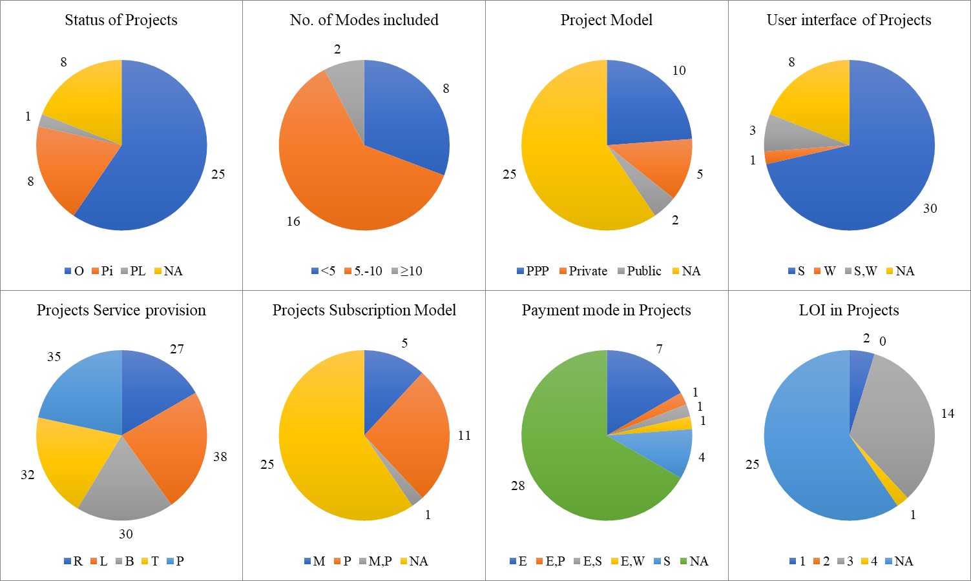
Review of MaaS best practices
Note: [Status- O: Operational, P: Pilot, PL: Planned], [User interface- S: Smart phone apps & W: Web alternatives], [Service Provision- R: Real-time information, L: Trip planning, B: Booking, T: Ticketing, P: Payment], [Subscription model- P: Pay-as-you-go, M: Mobility package], [Payment mode- E: ePay, P: PayiQ, S: Smart card, W: eWallet], LoI: Level of Integration, NA: Data not available.

Slide 9
Analysis of MaaS Projects
Regional imbalance: Only 3 projects were found of Global South
Scale & Type of Projects
Large cities (>1M): Operational, 8–11 modes, hybrid subscription, higher LoI (3–4).
Small cities (<500K): Pilot projects, 3–4 modes, pay-per-use models.
National-scale projects (Netherlands, Germany): PPP-led integration.
Dense areas (e.g., Dubai 35 sq km): Focus on public efficiency.
Sprawling ones (Sydney 12,145 sq km): Include pilots with limited features.
Integration Insights
No direct link between number of modes and LoI → quality of coordination matters more.
Operational projects: Offers complete set of service provision (Real-time information, trip planning, ticketing, booking, payment).
Pilot projects: Real-time information often missing → gap in data sharing.
Technology & Business Models
Smartphone apps dominate; few web-only pilots.
Subscription models: Mix of pay-as-you-go and mobility packages.
Mobility package → associated with projects that offer additional perks.
ePay & smart cards: Most common payment modes.
Governance & Policy Link
High-performing projects: Whim, UbiGo, WienMobil
New addition of policy, operational, PPP-led and exhibit high numbers of modes and LoI.

Slide 10









Identified Analytical Characteristics
Key Characteristics
Range of Modes
Payment Systems
Addition of Policy
Project Model
User Interface
Subscription Model
Private initiative
Public & Shared modes included
ITS Action Plan, ITS Directive, Delegated Regulation
Act on Transport Services, data availability, data sharing (formats), and data quality
Public- private Partnership
Public initiative
Smart phone apps
Web alternatives
ePay
Smart card payments
eWallet
PayiQ
Pay-as-you-go
Mobility Packages
Level of Integration
Level 1: Information Integration
Level 2: Integration of Booking and payment
Level 3: Integration of the service offer (Bundling)
Level 4: Integration of Societal Goals
Additional Perks
Unlimited rides for a month, travel time, Green trips
Customization of mobility packages
Cards used for shopping, and of prepaid type
e-charging and parking solutions
Service Provision
Real-time information
Trip planning
Booking
Ticketing
Payment
No. of modes

Slide 11
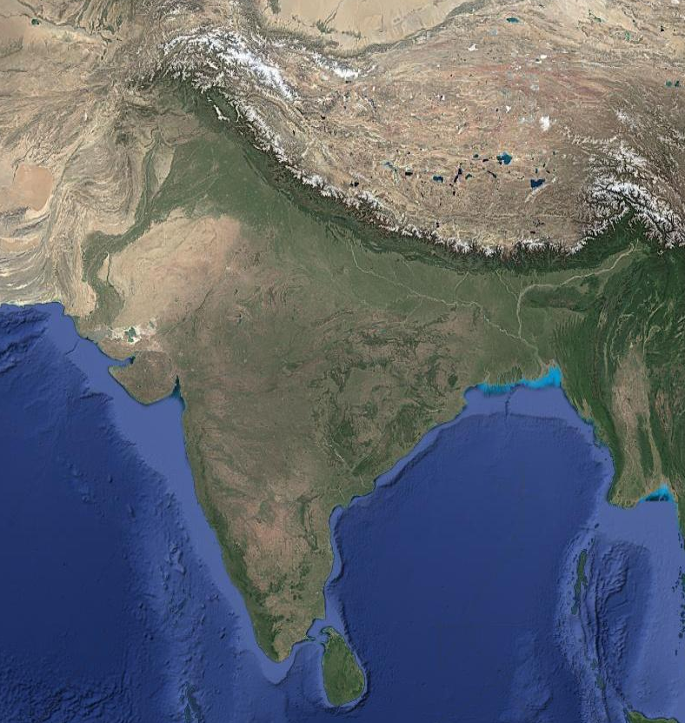
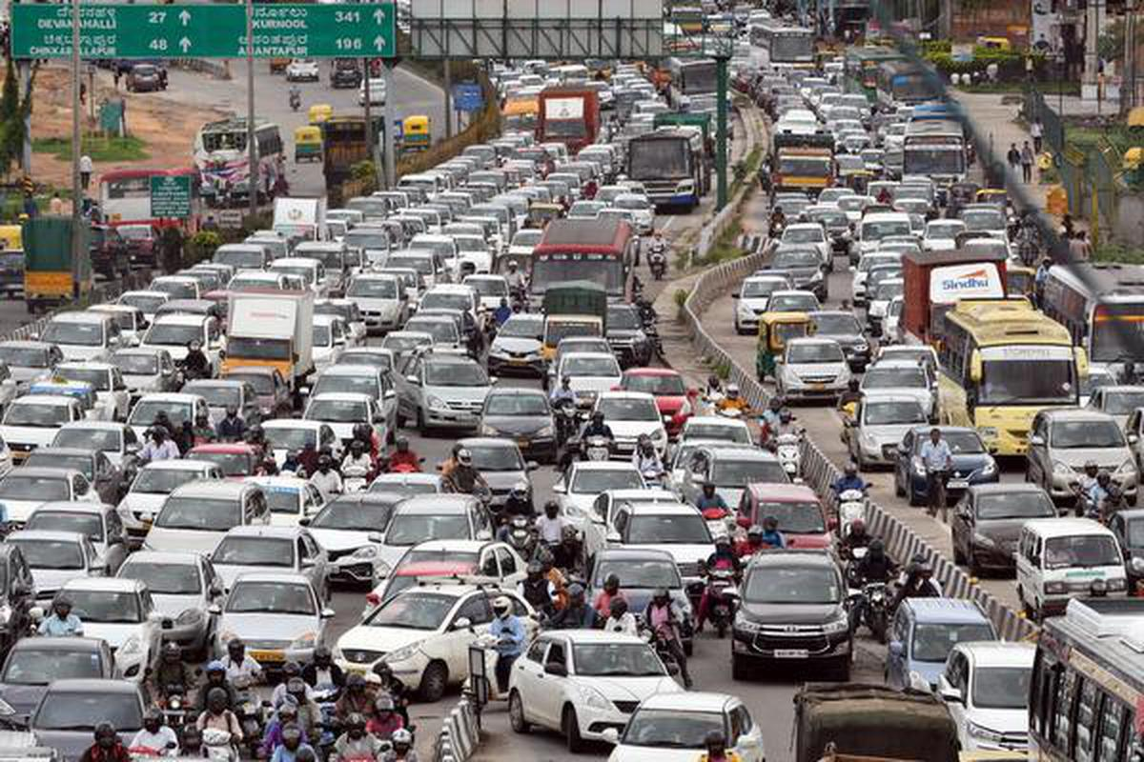
Case Study - Bengaluru
Population: 8 million
Area: 741 square kilometers
Modes: Private, IPTs, Private & Public Buses, Metro
Transport Authorities:
BMLTA (Bengaluru Metropolitan Land Transport Authority)
Bangalore Development Authority (BDA)
Bengaluru Metropolitan Transport Corporation (BMTC)
Bruhat Bengaluru MahanagaraPalike (BBMC)
Bangalore Metro Rail Corporation Limited (BMRCL)
State’s Transport Department
Sharing Vehicle Companies
Bengaluru
Rapid urbanisation and motorisation: Pollution and road congestion ↑
Public transport share: 42% (2007) to 27% (2011)
Rising private vehicle ownership: ≈10 million, 85% two-wheelers
Poor first/last-mile connectivity, weak multimodal integration

Slide 12

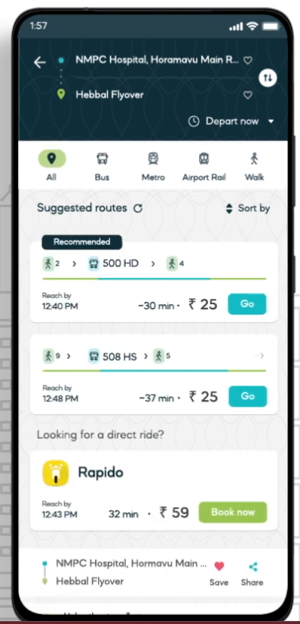

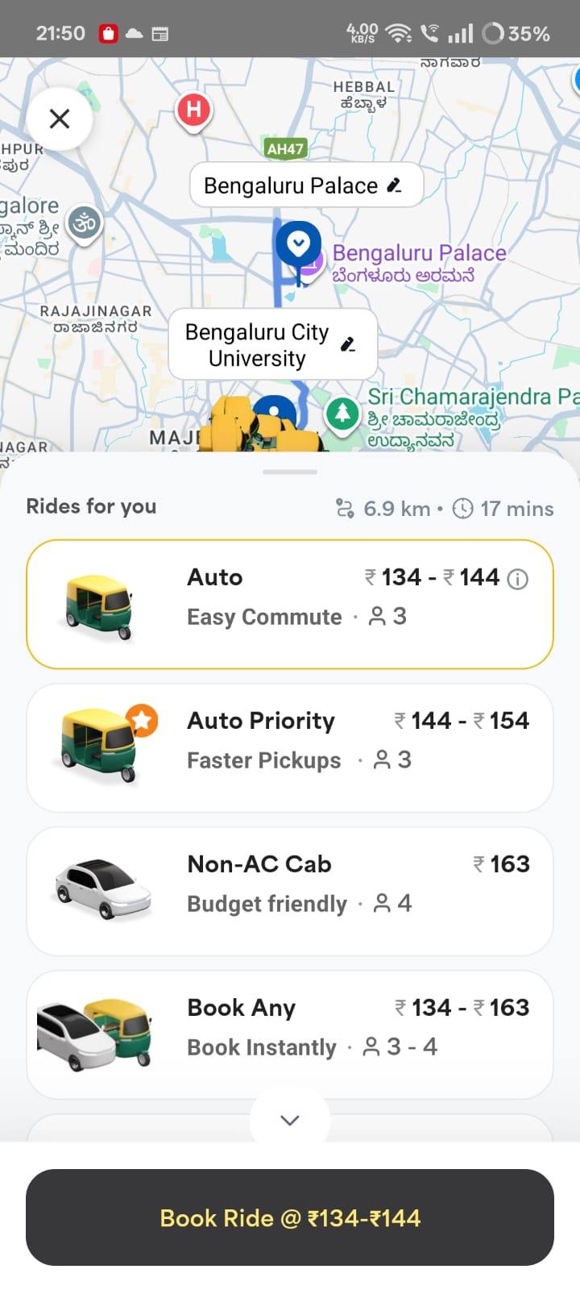
Recent actions towards MaaS implementation
Policy & Institutional Support
Transit-Oriented Development (TOD) Policy, 2022
Promotes high-density, mixed-use development along metro corridors to boost public transport use.
Bengaluru Metropolitan Land Transport Authority (BMLTA)
Aims to coordinate planning among transport agencies and improve multimodal integration.
Tummoc, 2021: Public transport
Real-time information and ticketing
Namma Yatri: Auto and cabs
Open mobility platform
Namma Transit: A new feature Integrates metro

Slide 13
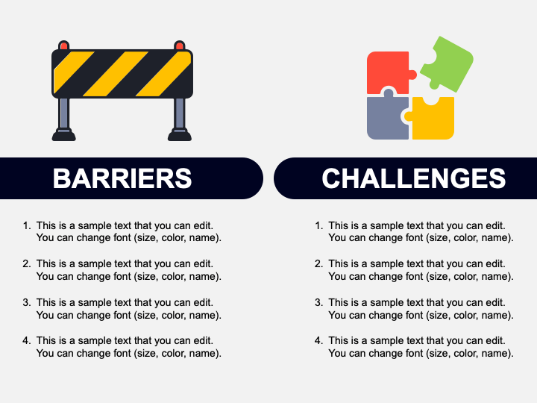

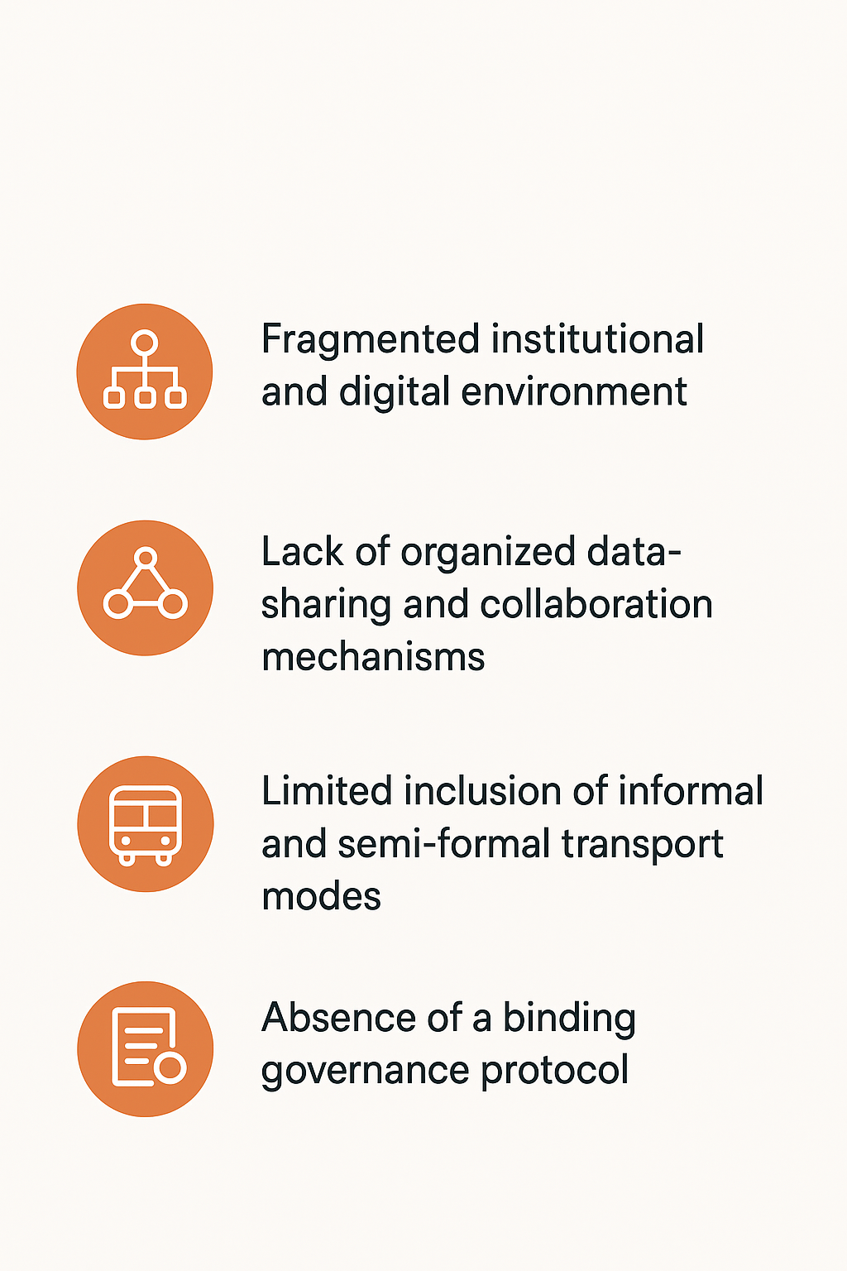
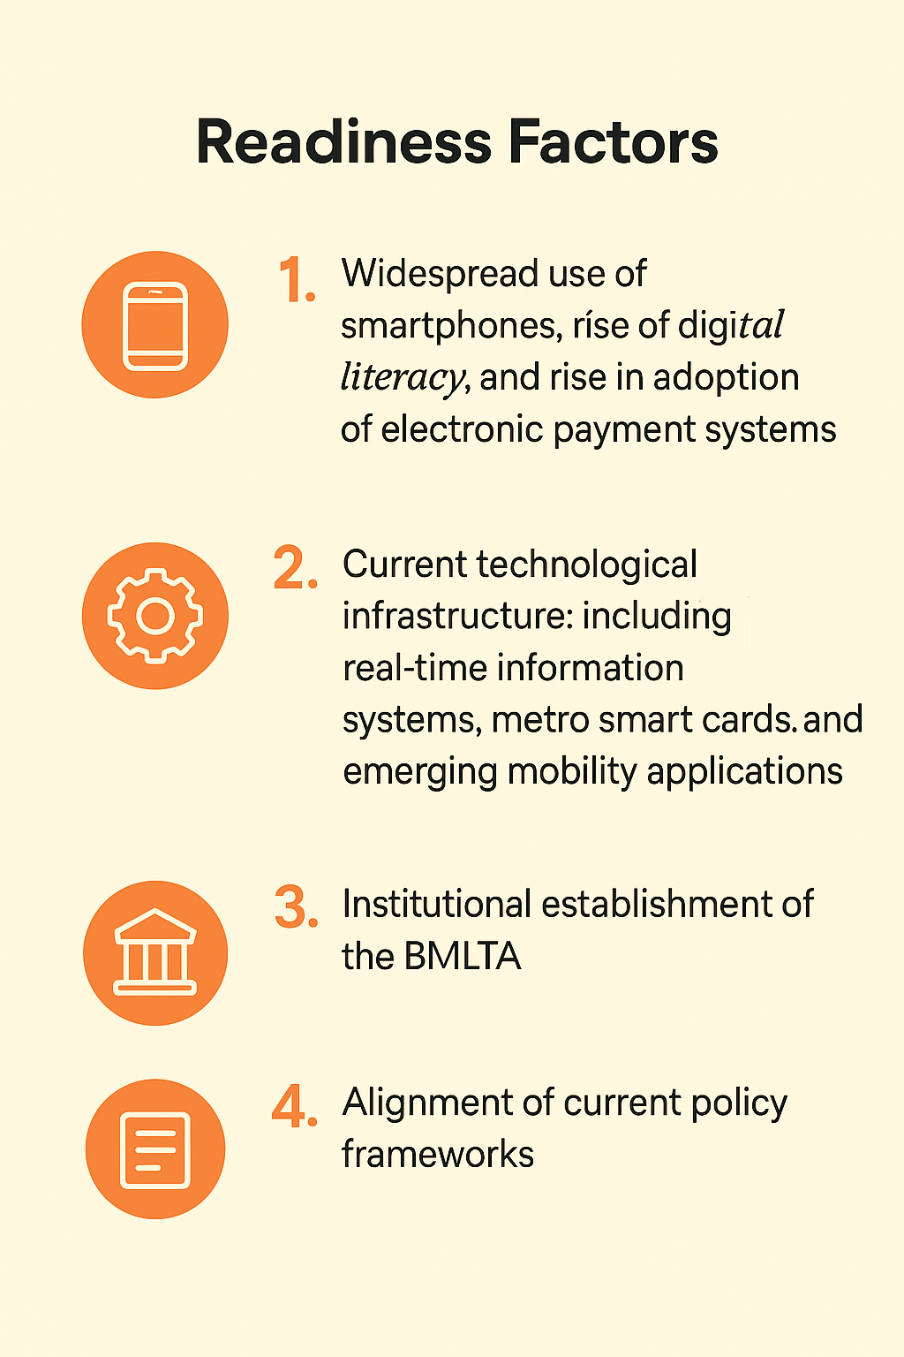
Barriers and Opportunities
Fragmented institutional and digital environment
Current technological infrastructure
Lack of organized data-sharing and collaboration mechanisms
Institutional establishment of the BMLTA
Limited inclusion of informal and semi-formal transport modes
Alignment of current policy frameworks
Absence of a binding governance protocol
Widespread use of smartphones, rise of digital literacy, & adoption of electronic payment systems

Slide 14
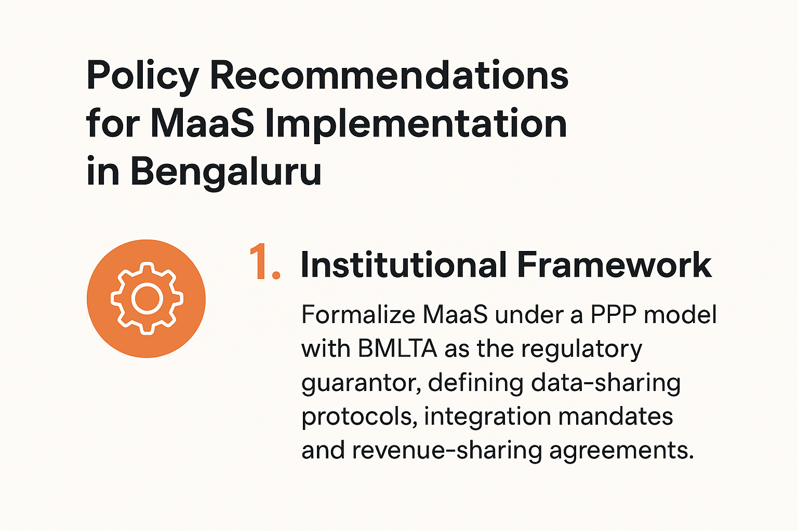
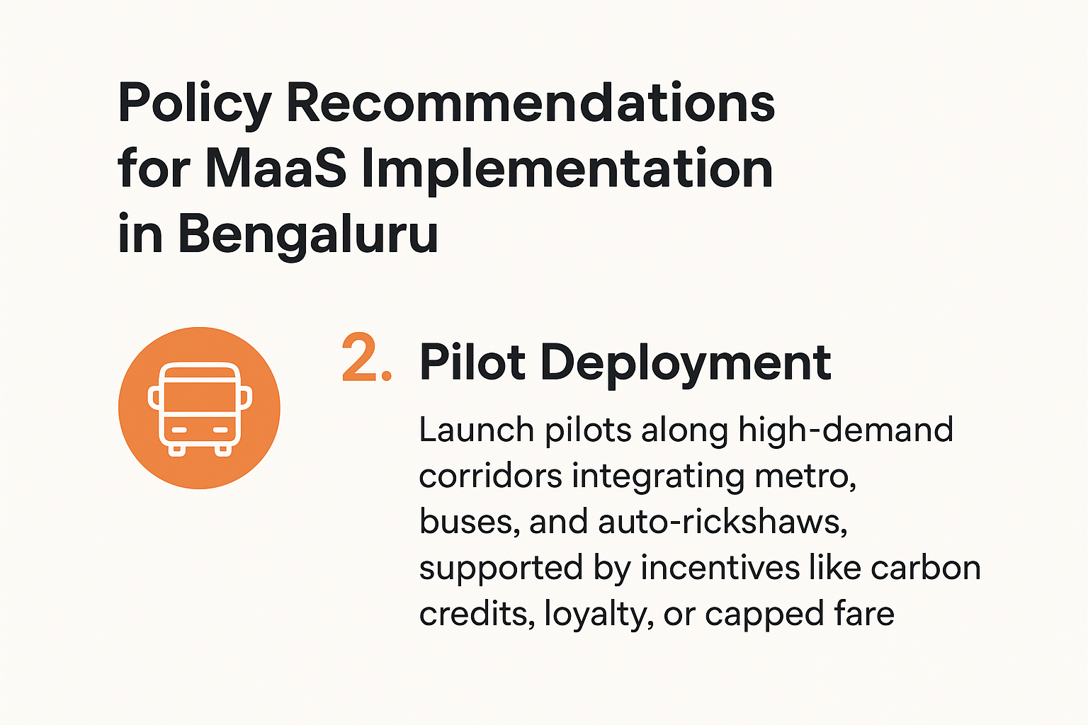

Recommendations

Slide 15
Conclusion
Mobility-as-a-Service (MaaS) is a promising concept to solve the issues of congestion and pollution.
Research gaps: Lack of concept knowledge, limited information of MaaS projects results in less conceptual understanding and lack of research on frameworks for MaaS-friendly environments.
Scoping review: 42 global projects identified.
The analysis highlights nine key characteristics of successful initiatives
Range of modes, supportive policy frameworks, project model, user interface, service provision, subscription model, payment systems, LoI, and additional perks.
MaaS projects: Evolving nature.
Positive-performing systems: Tended to be organized by PPP models in which government ensures interoperability, private sector drives innovation.
Requires a supportive governance environment that facilitates data sharing, fair revenue distribution, and regulatory consistency, which a formal policy can provide.
Success of MaaS rely less on technological sophistication and more on institutional arrangement, policy support, and bundling of user-friendly services.

Slide 16
References
Aba, A., & Esztergár-Kiss, D. (2024). Creation of the MaaS readiness index with a modified AHP-ISM method. Communications in Transportation Research, 4, 100122. https://doi.org/10.1016/j.commtr.2024.100122
Achariyaviriya, W., Hayashi, Y., Takeshita, H., Kii, M., Vichiensan, V., & Theeramunkong, T. (2021). Can Space–Time Shifting of Activities and Travels Mitigate Hyper-Congestion in an Emerging Megacity, Bangkok? Effects on Quality of Life and CO2 Emission. Sustainability, 13(12), 6547. https://doi.org/10.3390/su13126547
Aguiléra, A., & Pigalle, E. (2021). The Future and Sustainability of Carpooling Practices. An Identification of Research Challenges. Sustainability, 13(21), 11824. https://doi.org/10.3390/su132111824
Akyelken, N., Banister, D., & Givoni, M. (2018). The Sustainability of Shared Mobility in London: The Dilemma for Governance. Sustainability, 10(2), Article 2. https://doi.org/10.3390/su10020420
Batur, I., Dirks, A. C., Mondal, A., Bhat, C. R., & Pendyala, R. M. (2024). Does Ridehailing Use Affect Vehicle Ownership or Vice Versa? An Exploratory Investigation of the Relationship Using a Latent Market Segmentation Approach. Transportation Research Record: Journal of the Transportation Research Board, 2678(3), 252–265. https://doi.org/10.1177/03611981231179470
BDA. Revised Master Plan for Bengaluru-2031. Bangalore Development Authority. https://data-opencity.sgp1.cdn.digitaloceanspaces.com/Documents/Recent/Bengaluru-BDA-RMP-2031-Volume_4_PlanningDistrictReport.pdf
Chi, S., & Mazzer, S. (2022). Identifying MaaS schemes that maximise economic benefits through an economic appraisal. European Journal of Transport and Infrastructure Research, 22(4). https://doi.org/10.18757/ejtir.2022.22.4.6379
Christensen, T. H., Friis, F., & Nielsen, M. V. (2022). Shifting from ownership to access and the future for MaaS: Insights from car sharing practices in Copenhagen. Case Studies on Transport Policy. Scopus. https://doi.org/10.1016/j.cstp.2022.02.011
Daniela, A.-M., Juan Carlos, G.-P., & Javier, G. (2023). On the path to mobility as a service: A MaaS-checklist for assessing existing MaaS-like schemes. Transportation Letters, 15(2), 142–151. https://doi.org/10.1080/19427867.2022.2038987
Fielbaum, A., & Alonso-Mora, J. (2020). Unreliability in ridesharing systems: Measuring changes in users’ times due to new requests. Transportation Research Part C: Emerging Technologies. Scopus. https://doi.org/10.1016/j.trc.2020.102831
Ghanbari, A., San-Jaime, O. Á., Casey, T., & Markendahl, J. (2015). Repositioning in value chain for smart city ecosystems: A viable strategy for historical telecom actors.
Grant, M. J., & Booth, A. (2009). A typology of reviews: An analysis of 14 review types and associated methodologies. https://onlinelibrary.wiley.com/doi/10.1111/j.1471-1842.2009.00848.x
Hensher, D. A. (2017a). Future bus transport contracts under a mobility as a service (MaaS) regime in the digital age: Are they likely to change? Transportation Research Part A: Policy and Practice. Scopus. https://doi.org/10.1016/j.tra.2017.02.006

Slide 17
References
Hensher, D. A. (2017b). Future bus transport contracts under a mobility as a service (MaaS) regime in the digital age: Are they likely to change? Transportation Research Part A: Policy and Practice, 98, 86–96. https://doi.org/10.1016/j.tra.2017.02.006
Hensher, D. A. (2018). Tackling road congestion – What might it look like in the future under a collaborative and connected mobility model? Transport Policy, 66, A1–A8. https://doi.org/10.1016/j.tranpol.2018.02.007
Hensher, D. A., Mulley, C., & Nelson, J. D. (2021). Mobility as a service (MaaS) – Going somewhere or nowhere? Transport Policy. Scopus. https://doi.org/10.1016/j.tranpol.2021.07.021
Ho, C. Q., Hensher, D. A., Mulley, C., & Wong, Y. Z. (2018). Potential uptake and willingness-to-pay for Mobility as a Service (MaaS): A stated choice study. Transportation Research Part A: Policy and Practice. Scopus. https://doi.org/10.1016/j.tra.2018.08.025
Holmberg, P.-E., Collado, M., Sarasini, S., & Williander, M. (2016). Mobility as a Service - MaaS: Describing the framework. Tuesday, February 16, 2016. https://urn.kb.se/resolve?urn=urn:nbn:se:ri:diva-26060
House of Commons. (2018). Mobility as a Service.
Infrastructure Development Corporation (Karnataka) Limited. (2020). Comprehensive Mobility Plan for Bengaluru. Directorate of Urban Land Transport, Urban Development Department, Government of Karnataka. https://dult.karnataka.gov.in/assets/front/pdf/Comprehensive_Mobility_Plan.pdf
Jittrapirom, P., Caiati, V., Feneri, A.-M., Ebrahimigharehbaghi, S., González, M. J. A., & Narayan, J. (2017). Mobility as a Service: A Critical Review of Definitions, Assessments of Schemes, and Key Challenges | Article | Urban Planning. https://www.cogitatiopress.com/urbanplanning/article/view/931
Kamargianni, M., Li, W., Matyas, M., & Schäfer, A. (2016a). A Critical Review of New Mobility Services for Urban Transport. Transportation Research Procedia. Scopus. https://doi.org/10.1016/j.trpro.2016.05.277
Kamargianni, M., Li, W., Matyas, M., & Schäfer, A. (2016b). A Critical Review of New Mobility Services for Urban Transport. Transportation Research Procedia, 14, 3294–3303. https://doi.org/10.1016/j.trpro.2016.05.277
Keller, E., Aguilar, A., & Hanss, D. (2018). Car Sharers’ Interest in Integrated Multimodal Mobility Platforms: A Diffusion of Innovations Perspective. Sustainability, 10(12), 4689. https://doi.org/10.3390/su10124689
König, D., Eckhardt, J., Aapaoja, A., Sochor, J., & Karlsson, M. (2016). Business and operator models for MaaS: MAASiFiE Deliverable Nr 3. Conference of European Directors of Roads (CEDR).
MaaS-Alliance, M. (2017). MaaS Projects – MAAS-Alliance. https://maas-alliance.eu/maas-projects/
Macha, B. E., & Pandit, D. (2024). Need for a Context-Sensitive Approach to TOD in India. In M. Manoj & D. Roy (Eds.), Urban Mobility Research in India (pp. 461–472). Springer Nature. https://doi.org/10.1007/978-981-97-8116-4_32

Slide 18
References
Mulley, C. (2017). Mobility as a Services (MaaS) – does it have critical mass? Transport Reviews, 37(3), 247–251. https://doi.org/10.1080/01441647.2017.1280932
Mulley, C., & Kronsell, A. (2018). Workshop 7 report: The “uberisation” of public transport and mobility as a service (MaaS): Implications for future mainstream public transport. Research in Transportation Economics, 69, 568–572. https://doi.org/10.1016/j.retrec.2018.08.007
Narayanan, S., & Antoniou, C. (2023). Shared mobility services towards Mobility as a Service (MaaS): What, who and when? Transportation Research Part A: Policy and Practice, 168, 103581. https://doi.org/10.1016/j.tra.2023.103581
Papaioannou, G., Polydoropoulou, A., Tsirimpa, A., & Pagoni, I. (2023). Development of Mobility as a Service (MaaS) for intercity travel & rural/island areas: The case study of Greece. European Transport Research Review, 15(1), 48. https://doi.org/10.1186/s12544-023-00619-9
Polydoropoulou, A., Pagoni, I., & Tsirimpa, A. (2020). Ready for Mobility as a Service? Insights from stakeholders and end-users. Travel Behaviour and Society, 21, 295–306. https://doi.org/10.1016/j.tbs.2018.11.003
Pucher, J., Korattyswaropam, N., Mittal, N., & Ittyerah, N. (2005). Urban transport crisis in India. Transport Policy, 12(3), 185–198. https://doi.org/10.1016/j.tranpol.2005.02.008
Reddy, B. S. (1995). Transportation, Energy and Environment: A Case Study of Bangalore. Economic and Political Weekly, 30(3), 161–170.
Reddy, L. S., & Ramasamy. (2020). The significant challenges in Bangalore—An introspection. Adalya Journal, 9(4). https://doi.org/10.37896/aj9.4/026
RITES. Comprehensive Traffic & Transportation Plan for Bengaluru. https://dult.karnataka.gov.in/assets/front/pdf/CTTP.pdf
Singh, M. (2020). India’s shift from mass transit to MaaS transit: Insights from Kochi. Transportation Research Part A: Policy and Practice, 131, 219–227. https://doi.org/10.1016/j.tra.2019.09.037
Sochor, J., Strömberg, H., & Karlsson, I. C. M. (2015). Implementing Mobility as a Service: Challenges in Integrating User, Commercial, and Societal Perspectives. Transportation Research Record: Journal of the Transportation Research Board, 2536(1), 1–9. https://doi.org/10.3141/2536-01
Tanwar, R., & Agarwal, P. K. (2025). Strategies to optimise feeder services for accessible multimodal transit in Bhopal. Proceedings of the Institution of Civil Engineers - Municipal Engineer, 178(2), 71–87. https://doi.org/10.1680/jmuen.24.00032
Tiwari, G. (2007). URBAN TRANSPORT IN INDIAN CITIES.
Vaidyanathan, V., & Rathi, S. (2018). Urban Transport Planning in Bengaluru. 16.
Veeneman, W. (2019). Public transport in a sharing environment. In Advances in Transport Policy and Planning. Scopus. https://doi.org/10.1016/bs.atpp.2019.10.002
Verma, A., Rahul, T. M., & Dixit, M. (2015). Sustainability impact assessment of transportation policies – A case study for Bangalore city. Case Studies on Transport Policy, 3(3), 321–330. https://doi.org/10.1016/j.cstp.2014.06.001

Slide 19
Thank You
Shiksha Singh
Ph.D. Scholar
CTRANS, IIT Roorkee
+91 86307 43411
shiksha_s@ct.iitr.ac.in

