Slide 1
Scaling Up Electric Vehicles in NCR – An Ecological Imperative
An urgent call for action to tackle pollution and accelerate sustainable mobility

Slide 2

Why the Time to Act is Now
• NCR cities are among the most polluted in the world, choking millions.
• Toxic air is cutting lives short and crippling public health.
• The ecological clock is ticking — urgent transition to EVs is essential.

Slide 3
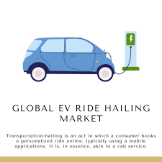
Global EV orientation
Uber: Uber has committed to ensuring 100% of its rides will take place in EVs by 2030 in the US, Canada, and Europe.
Lyft: Setting a benchmark, Lyft aims to operate a fully electric fleet by 2030.
Bolt: European ride-hailing giant Bolt has made strides towards green transportation by introducing "Green Plan" in 2020. The company's goal is to have more than half of its rides in electric vehicles by 2025.
Didi Chuxing: Didihas expressed intentions to operate over a million electric vehicles on its platform by the end of 2022.

Slide 4
Challenges Hindering EV Scale-Up
Vehicle costs:
The upfront investment for EVs is higher than conventional vehicles. Resale market indeterminate
While the costs are expected to decline, they remain a significant barrier, especially for DCO with low credit worthiness
Infrastructure gaps:
Adequate charging infrastructure is pivotal for large-scale EV adoption.
Currently, there's a mismatch between EV growth and the growth of charging facilities in many regions.
Range anxiety:
The fear of running out of battery before reaching a charging station is real, especially in areas where charging points are sparse.
Advances in battery technology and more rapid charging solutions
Governmental support:
Financial incentives, tax breaks, and grants can play a crucial role in accelerating the transition

Slide 5
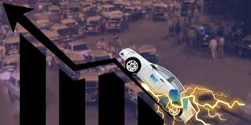
Case Study: Blue Smart’s Decline
• Blue Smart started strong with high consumer satisfaction.
• Despite efficiency, high costs and limited ecosystem support led to decline.
• Its failure caused a downward spiral in EV availability on ride-hailing platforms.

Slide 6
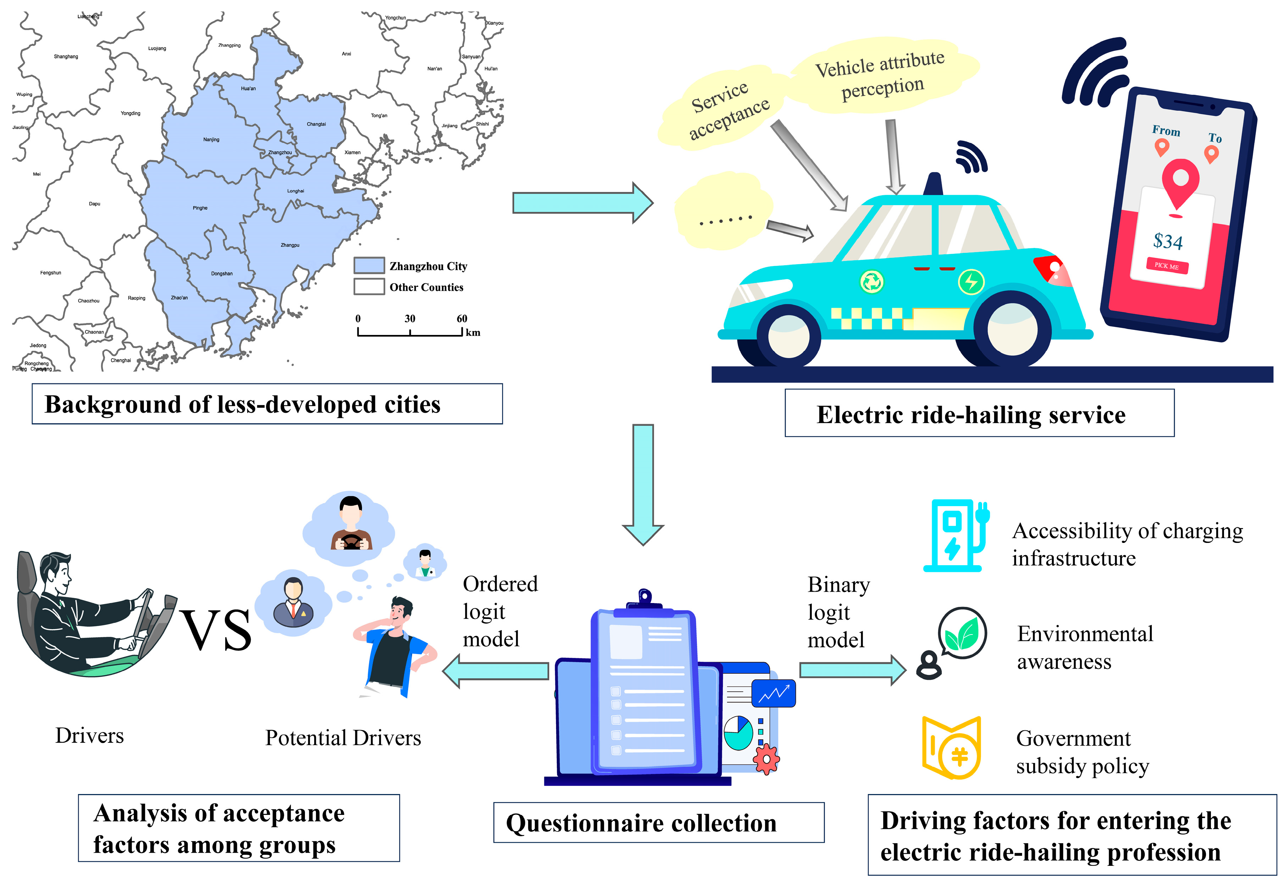
Driving Sustainable Mobility: Adoption and Willingness in Electric Ride-Hailing
• Despite multiple new entrants (Vinfast, Tata, BYD), EV adoption remains slow.
• Platforms falling short of EV acquisition targets due to:
- Financing and leasing barriers
- Slow charging turnaround
- Low resale value and residual risk
- Fragmented regulatory incentives

Slide 7
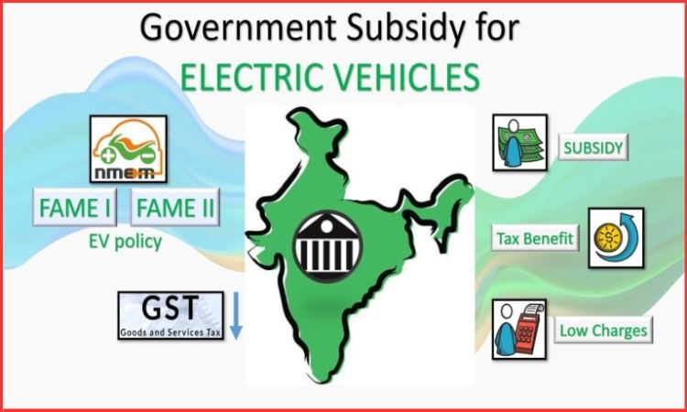
Policy Pathway: Carrot Over Stick
• Transition requires both enforcement (stick) and inducements (carrot).
• Incentives such as tax waivers, low-interest loans, and toll exemptions can accelerate EV adoption sustainably.
Real-time, verifiable public dashboards are essential.

Slide 8
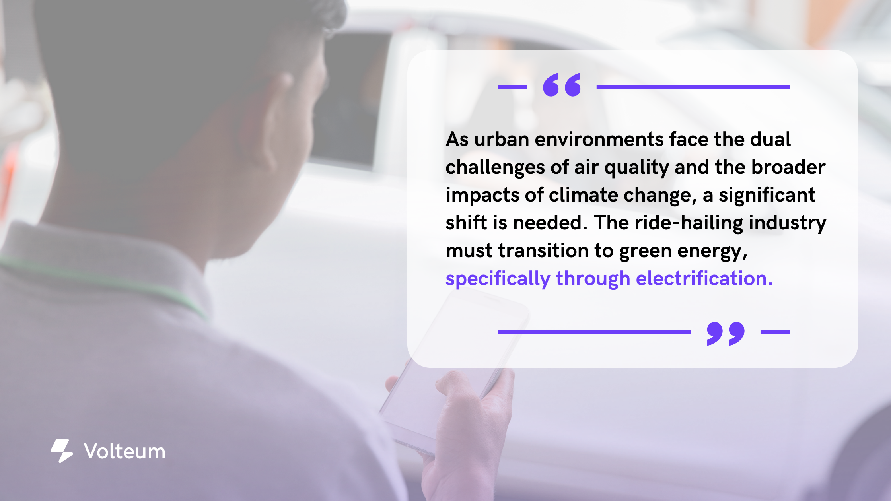
The Way Forward: Practical Suggestions
• Provide Opex support — e.g., waive interstate tolls for commercial EVs.
• Strengthen battery-swapping and charging infrastructure.
• Enable innovative financing and leasing models.
• Create PPPs for infrastructure development.
• Harmonize state and central EV policies for scale.

Slide 9
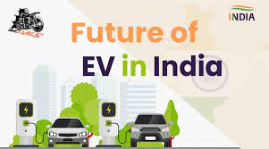
Conclusion
NCR cannot afford further delay. Pollution is not a statistic — it’s a survival threat.
A collaborative push combining incentives, infrastructure, and innovation can make electric mobility the new normal.

