Slide 1



Self-Organisation Behaviour Index for Vehicular Traffic
Mehraab Nazir*
PhD Student
 | Authors
Yawar Aliª | Mehraab Nazir^{a*} | K. Ramachandra Rao^{b}
ª Transportation Research and Injury Prevention Centre, Indian Institute of Technology Delhi ^{b} Department of Civil Engineering, Associate Faculty Transportation Research and Injury Prevention Centre, Indian Institute of Technology Delhi

Slide 2

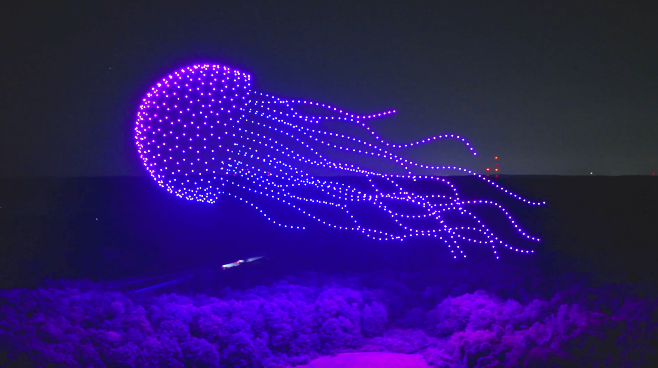
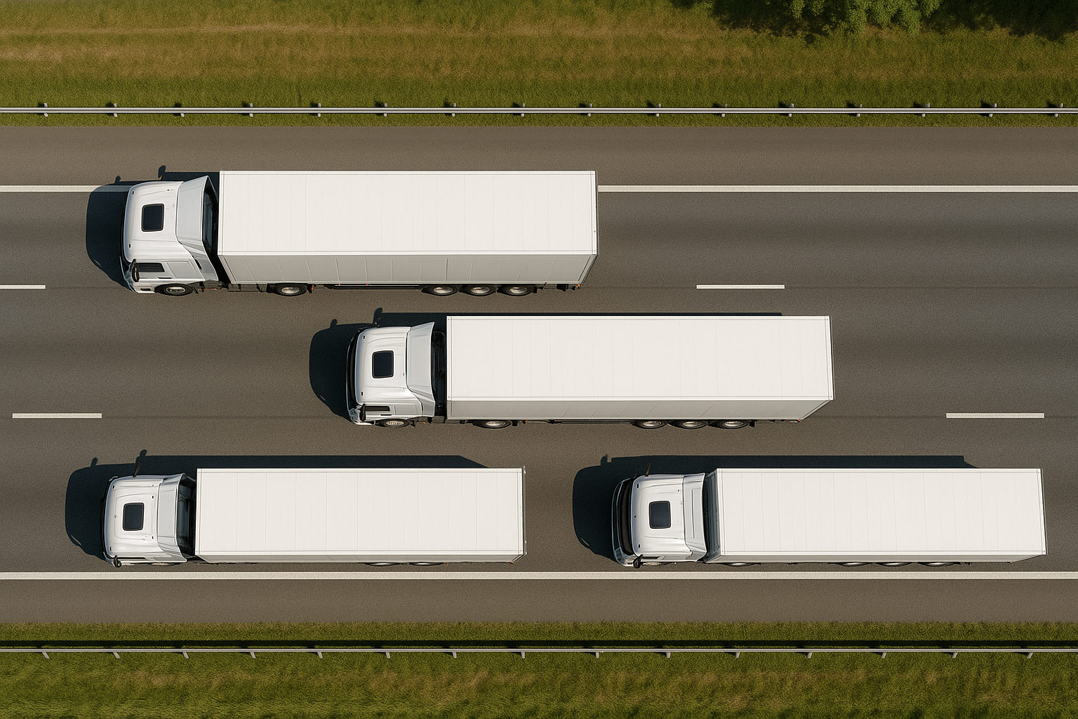
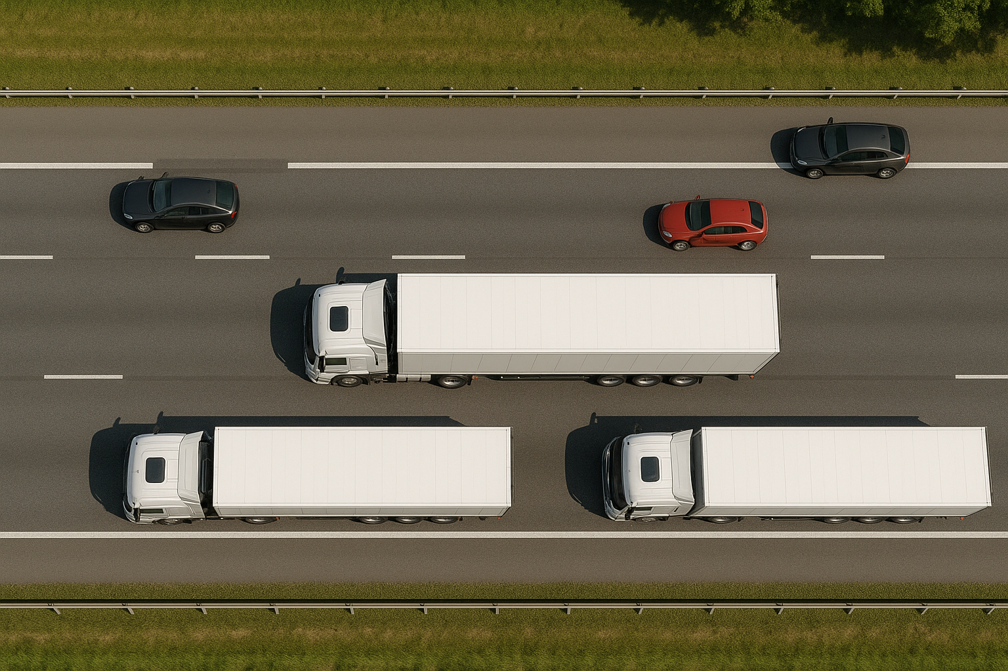
Introduction
Self-Organisation
The emergence of structured and stable patterns from the local interactions of many agents, without centralised control
In natural and artificial systems, this principle explains a wide range of phenomena, from flocking in birds to the coordinated behaviour of robots
  Traffic exhibits self-organised patterns, such as platoons and waves, which are common in nature but seldom measured in traffic studies
Notes:
---
This slide references information from the following file: https://d.docs.live.net/7D1A824BA6CA3DA7/Microsoft%20Copilot%20Chat%20Files/Full_Paper_UMI.pdf
The presentation titled 'Self-Organisation Behaviour Index for Vehicular Traffic' was developed for the 18th Urban Mobility India Conference 2025. It introduces a novel index called SORT-I, designed to quantify self-organisation in vehicular traffic using microscopic vehicle trajectory data. The abstract outlines the emergence of traffic patterns such as platoons and waves, which are examples of self-organisation. These patterns are typically observed in nature and pedestrian movement but are rarely measured in structured traffic studies, especially in heterogeneous and area-based traffic settings common in developing countries. The study aims to fill this gap by presenting SORT-I, which evaluates traffic behaviour based on speed and intervehicle distance patterns. The index categorizes traffic into three levels: high self-organisation, moderate deviation, and no self-organisation. It is applicable across various traffic conditions and includes tools for observing side-to-side movement, platoon formation, and coordination in weak lane discipline scenarios.

Slide 3
How was this behaviour quantified?
Limitations of Existing Metrics
  Current metrics, such as Traffic Performance Index and clustering, lack integration of structural alignment and spacing stability
Role of Coefficient of Variation
  The coefficient of variation in speed measures consistency but is often underutilized in traffic studies analysis
SORT-I : Self-Organising Road Traffic-Index
A novel index quantifying self-organisation in vehicular traffic using microscopic trajectory data
The index categorizes traffic into high self-organisation, moderate deviation, and no self-organisation levels
SORT-I enables classification into near-ideal, deviated, and no self-organisation traffic categories for practical analysis
Notes:
---
This slide references information from the following file: https://d.docs.live.net/7D1A824BA6CA3DA7/Microsoft%20Copilot%20Chat%20Files/Full_Paper_UMI.pdf
The presentation titled 'Self-Organisation Behaviour Index for Vehicular Traffic' was developed for the 18th Urban Mobility India Conference 2025. It introduces a novel index called SORT-I, designed to quantify self-organisation in vehicular traffic using microscopic vehicle trajectory data. The abstract outlines the emergence of traffic patterns such as platoons and waves, which are examples of self-organisation. These patterns are typically observed in nature and pedestrian movement but are rarely measured in structured traffic studies, especially in heterogeneous and area-based traffic settings common in developing countries. The study aims to fill this gap by presenting SORT-I, which evaluates traffic behaviour based on speed and intervehicle distance patterns. The index categorizes traffic into three levels: high self-organisation, moderate deviation, and no self-organisation. It is applicable across various traffic conditions and includes tools for observing side-to-side movement, platoon formation, and coordination in weak lane discipline scenarios.

Slide 4
Data AND Methodology
Notes:
---
This slide references information from the following file: https://d.docs.live.net/7D1A824BA6CA3DA7/Microsoft%20Copilot%20Chat%20Files/Full_Paper_UMI.pdf
Data Collection and Site Description, SORT-I Formulation and Scaling

Slide 5
Data Sources
Location | Traffic Setting | Coded Name | Data Source
Delhi, India | Heterogeneous Area-Based | IND 1 | Collected at Site
Delhi, India | Heterogeneous Area-Based | IND 2 | Collected at Site
Delhi, India | Heterogeneous Area-Based | IND 3 | Collected at Site
Chennai, India | Heterogeneous Area-Based | IND 4 | (Kanagaraj et al., 2015)
Surat, India | Heterogeneous Area-Based | IND 5 | (Raju et al., 2021)
China | Homogeneous Lane-Based | CHN | (Wang et al., 2024)
I-24, USA | Homogeneous Lane-Based | USA 1 | (Gloudemans et al., 2023)
I-80, USA | Homogeneous Lane-Based | USA 2 | (U.S. Department of Transportation, 2016)
US-101, USA | Homogeneous Lane-Based | USA 3 | (U.S. Department of Transportation, 2016)
Athens, Greece | Heterogeneous Lane-Based | GRC | (Barmpounakis and Geroliminis, 2020)

Slide 6
Data Description
Location | Speed (kmph) |  |  | Minimum Intervehicle Distance (m) |  |  | Flow (Veh/hr)
 | Mean | Median | S.D. | Mean | Median | S.D.
IND 1 | 33.6 | 34.2 | 8.1 | 6.4 | 3.9 | 6.1 | 6884
IND 2 | 34.9 | 35.6 | 11.9 | 8.1 | 5 | 6.8 | 2785
IND 3 | 33.8 | 34.5 | 10.1 | 8.6 | 6.1 | 6.6 | 2292
IND 4 | 21.1 | 20.9 | 5 | 5.8 | 3.1 | 5.8 | 6010
IND 5 | 43.81 | 44.03 | 16.8 | 12 | 10.9 | 7.8 | 1700
CHN | 32.7 | 30.7 | 14.1 | 8.6 | 6.7 | 6.1 | 5849
USA 1 | 56.4 | 56.9 | 14.5 | 12.75 | 12.1 | 5.9 | 7479
USA 2 | 28.9 | 27.3 | 12.9 | 9 | 6.1 | 6.8 | 5061
USA 3 | 39.1 | 39.3 | 7.8 | 7.25 | 6.1 | 4.2 | 6341
GRC | 40.8 | 40.7 | 12.3 | 7.3 | 6 | 5.1 | 2304
Notes:
---
This slide references information from the following file: https://d.docs.live.net/7D1A824BA6CA3DA7/Microsoft%20Copilot%20Chat%20Files/Full_Paper_UMI.pdf
The study utilizes ten datasets comprising microscopic vehicle trajectories (MVTs) collected from India, China, the United States, and Greece. These datasets represent a range of traffic conditions, from heterogeneous, weakly lane-disciplined flows to homogeneous, lane-disciplined environments. Data sources include field collection using UAVs and open-source repositories. Each site is coded based on country and sequence, such as IND1 for India site 1. Descriptive statistics including speed, intervehicle distance, and flow were computed. Mean intervehicle distances ranged from 5.8 m to 12.75 m, and standard deviations from 4.2 m to 7.8 m. Coefficients of variation indicated higher variability in heterogeneous sites and lower variability in homogeneous ones. This data forms the basis for evaluating self-organisation patterns across different traffic settings.

Slide 7
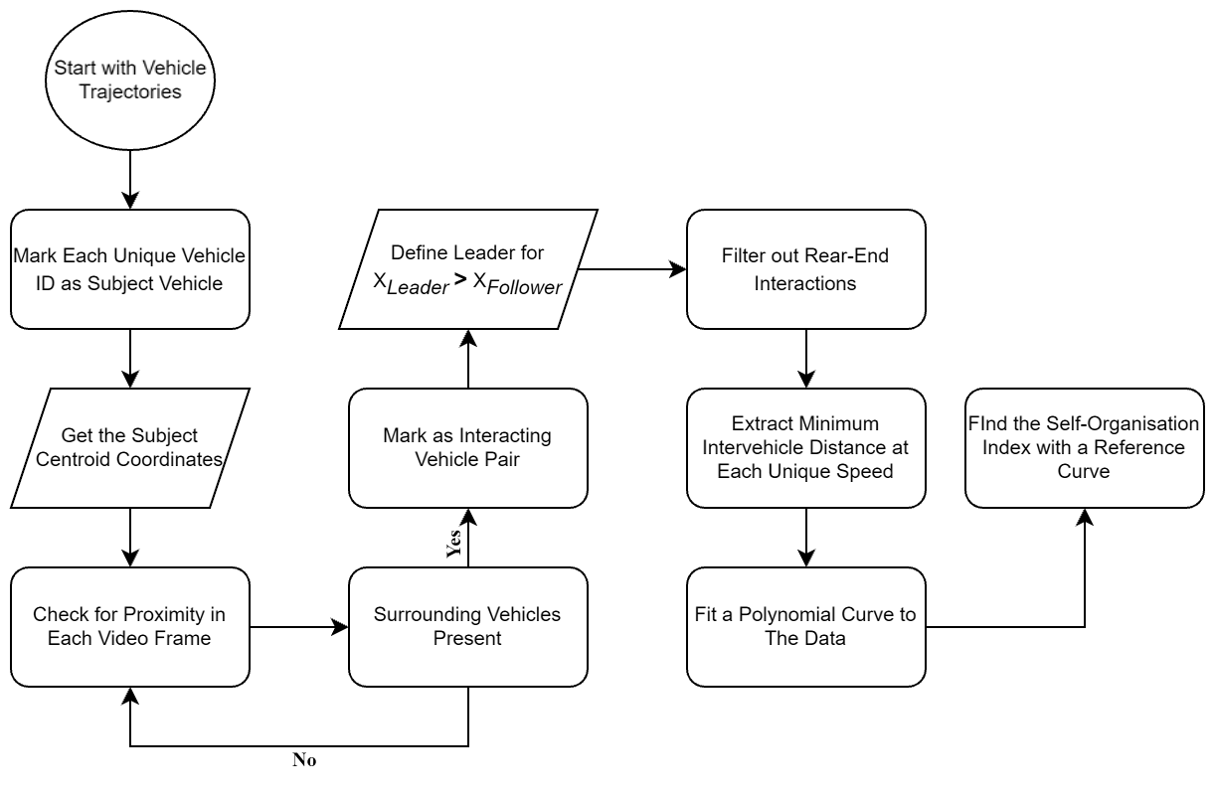
Methodology

Slide 8
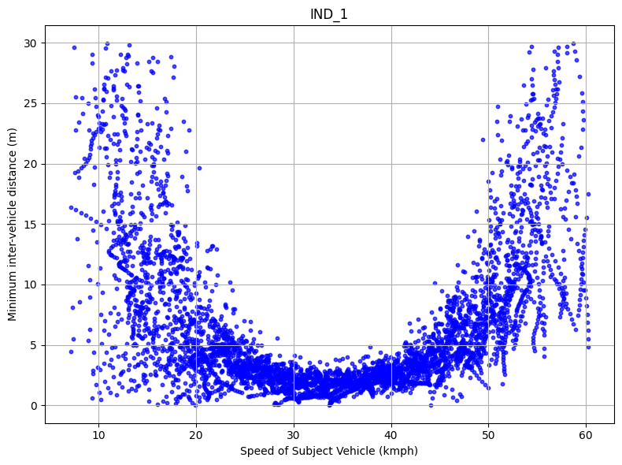
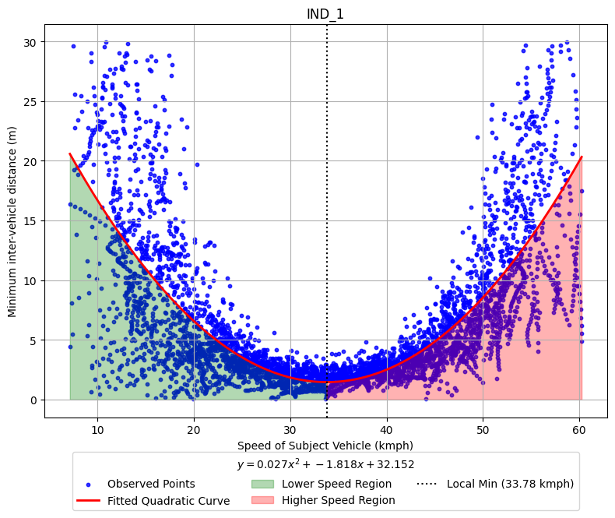
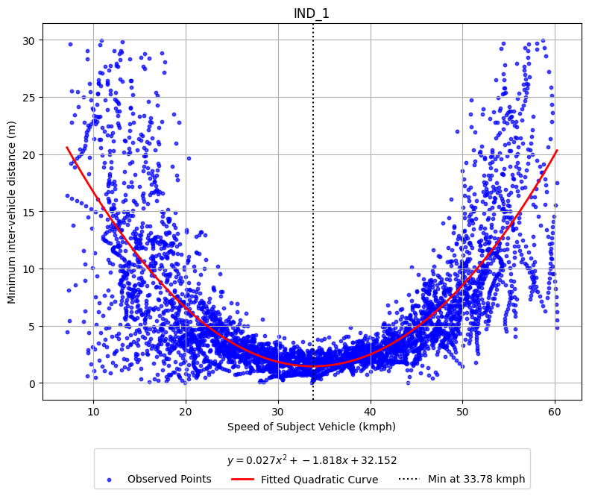
Notes:
plot_Surat.svg

Slide 9
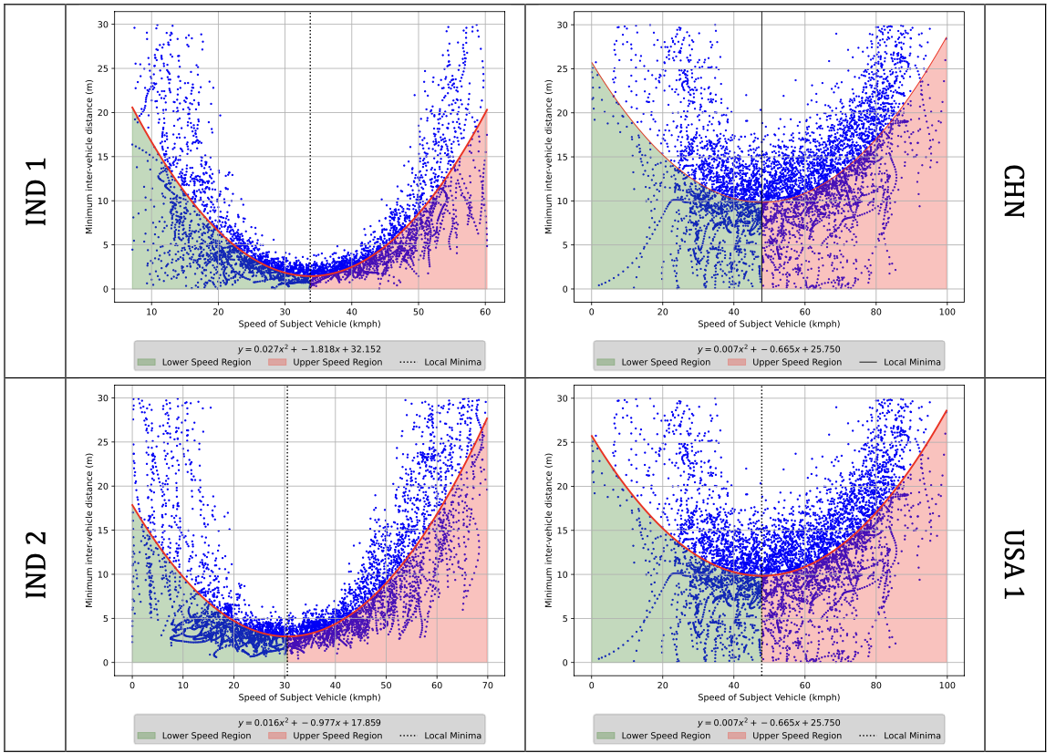
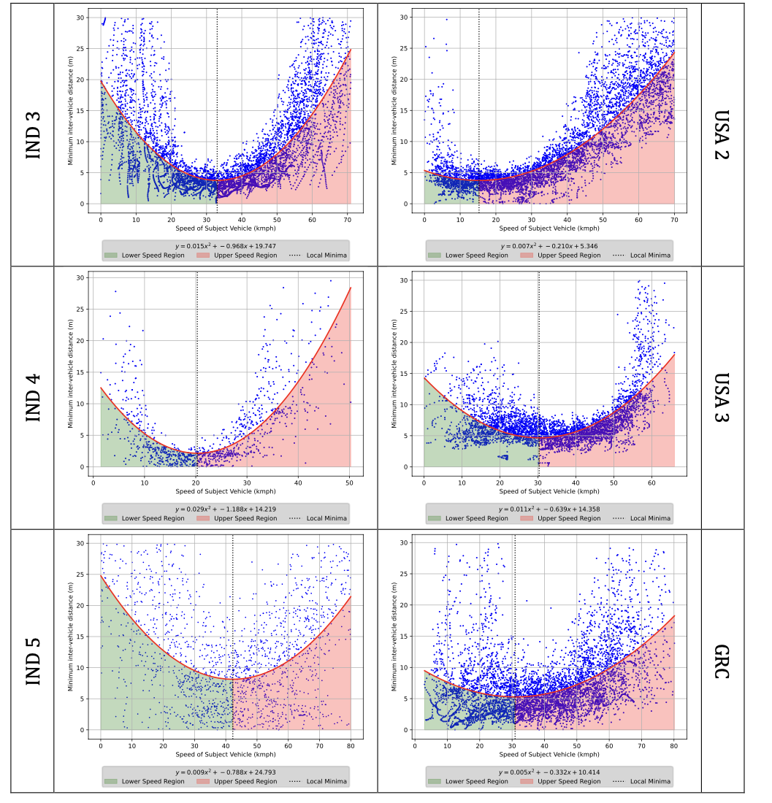
Notes:
plot_Surat.svg

Slide 10
Observations
In an uncongested traffic flow regime, drivers tend to get self-organised around an optimal speed range.
Similar patterns are observed at multiple locations within and outside of India.
This behavioural pattern is aimed to be quantified through a proposed Self-Organising Road Traffic (SORT) Index.
The generalised index will capture the emergent patterns that lie within varied road traffic conditions

Slide 11
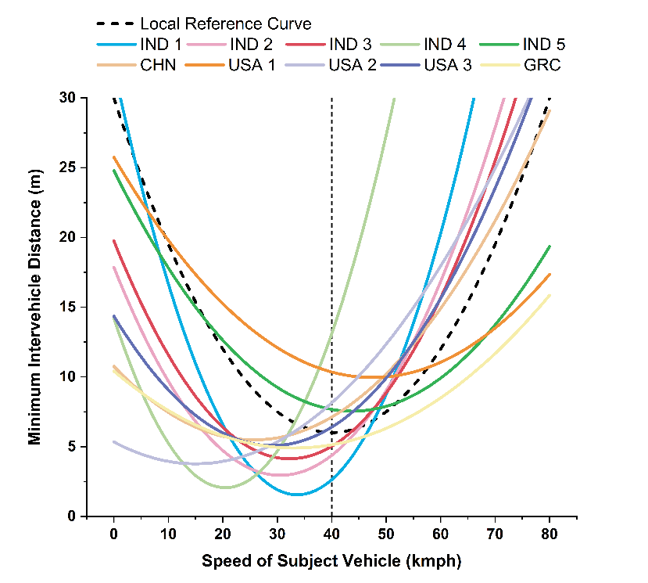
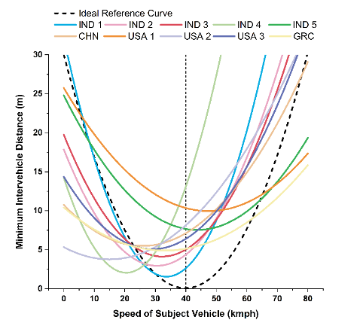
SORT-I Formulation
Deviation from Reference Curve
  Measures how closely traffic data aligns with an ideal or local reference curve, reflecting traffic flow accuracy.
Stability of Intervehicle Spacing
  Assesses consistency of spacing between vehicles using the coefficient of variation for traffic stability analysis.
Traffic Organisation Classification
  Categorizes sites into near-ideal, deviated, and no self-organisation based on normalized SORT-I scores.
Notes:
---
This slide references information from the following file: https://d.docs.live.net/7D1A824BA6CA3DA7/Microsoft%20Copilot%20Chat%20Files/Full_Paper_UMI.pdf
The Self-Organising Road Traffic Index (SORT-I) combines two components: deviation from a reference curve and stability of intervehicle spacing. The deviation term measures how closely observed data aligns with an ideal or local reference curve, while the stability term uses the coefficient of variation to assess consistency. The index is calculated using weighted terms (α and β), both set to 0.5 in this study. Global min-max scaling is applied to normalize scores across all sites, mapping the best case to 0 and the worst to 1. This ensures comparability and fairness in classification. Sites are categorized into near-ideal, deviated, and no self-organisation based on their normalized SORT-I scores. The methodology provides a robust framework for evaluating traffic organisation across diverse environments.

Slide 12
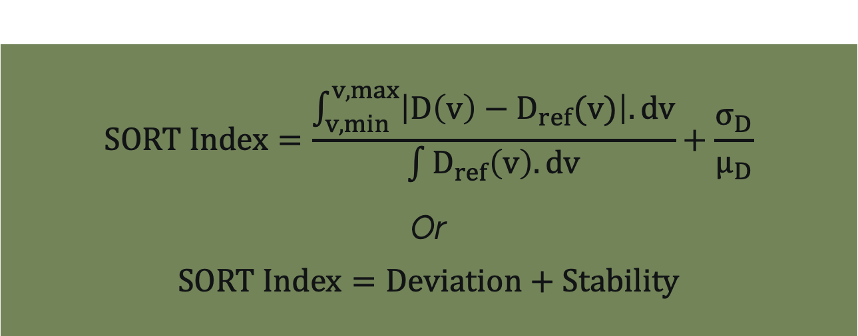
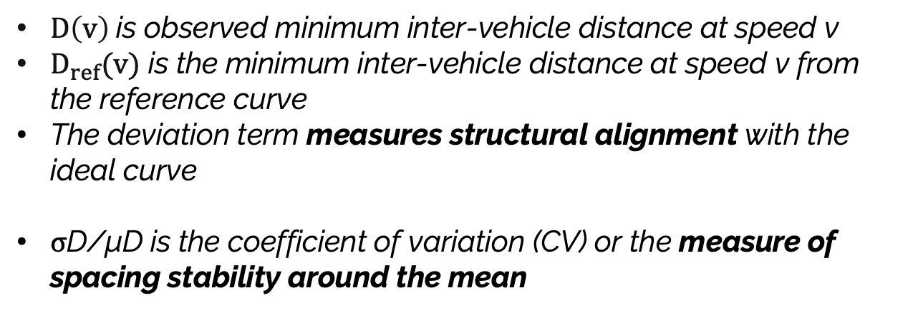
SORT-I Formulation
$$SORT Index=\frac{\int_{v,min}^{v, max}{\left|D\left(v\right)−D_{ref}(v)\right|.dv}}{\int{D_{ref}\left(v\right).dv}}+\frac{σ_{D}}{μ_{D}}$$
Or
$$SORT Index=Deviation+Stability$$
$D\left(v\right)$is observed minimum inter-vehicle distance at speed v
$D_{ref}(v)$ is the minimum inter-vehicle distance at speed v from the reference curve
The deviation term measures structural alignment with the ideal curve
σD/μD is the coefficient of variation (CV) or the measure of spacing stability around the mean

Slide 13
Results, Discussion and Conclusion
Notes:
---
This slide references information from the following file: https://d.docs.live.net/7D1A824BA6CA3DA7/Microsoft%20Copilot%20Chat%20Files/Full_Paper_UMI.pdf
Classification and Trends, Implications and Sensitivity

Slide 14
Results
Location Code | SORT-I (Ideal) | Class | SORT-I (Local) | Class
IND 1 | 1.00 | No SO | 0.92 | No SO
IND 2 | 0.54 | Deviated SO | 0.44 | Deviated SO
IND 3 | 0.20 | Near-ideal | 0.38 | Deviated SO
IND 4 | 0.99 | No SO | 1.00 | No SO
IND 5 | 0.12 | Near-ideal | 0.00 | Near-ideal
CHN | 0.55 | Deviated SO | 0.39 | Deviated SO
USA 1 | 0.00 | Near-ideal | 0.04 | Near-ideal
USA 2 | 0.86 | No SO | 0.37 | Deviated SO
USA 3 | 0.21 | Near-ideal | 0.35 | Deviated SO
GRC | 0.41 | Deviated SO | 0.37 | Deviated SO
Notes:
---
This slide references information from the following file: https://d.docs.live.net/7D1A824BA6CA3DA7/Microsoft%20Copilot%20Chat%20Files/Full_Paper_UMI.pdf
The normalized SORT-I values reveal distinct patterns of self-organisation across sites. IND1 and IND4 consistently fall into the 'No self-organisation' category, indicating high deviation and variability. USA1 consistently ranks as 'Near-ideal', reflecting low deviation and stable spacing. Other sites show sensitivity to the choice of reference curve. For example, IND3 and USA3 are classified as 'Near-ideal' under the Ideal reference but shift to 'Deviated' under the Local reference. This sensitivity highlights the importance of benchmark selection, especially for borderline cases. The classification confirms that SORT-I can reliably identify robust patterns and differentiate between ordered and disordered traffic regimes.

Slide 15
Conclusion
SORT-I Index Overview
  SORT-I combines structural deviation and spacing stability to measure traffic self-organisation effectively
Validation and Results
  Testing at ten sites shows SORT-I identifies robust traffic patterns and highlights borderline sensitivities
Practical Applications
  SORT-I aims to support traffic analysis, planning, management and understanding the driver behaviour along with bridging theory and real-world use
Future Directions
  Expanding datasets
  Exploring additional traffic metrics
Notes:
---
This slide references information from the following file: https://d.docs.live.net/7D1A824BA6CA3DA7/Microsoft%20Copilot%20Chat%20Files/Full_Paper_UMI.pdf
The SORT-I index provides a novel and practical measure of traffic self-organisation, combining structural deviation and spacing stability. It applies global scaling to enable comparisons across diverse traffic environments. Results from ten sites demonstrate its ability to identify robust patterns and highlight sensitivity in borderline cases. The study achieves its objectives by formulating the index, applying it across datasets, and validating its classification approach. Future research should expand the dataset pool, refine weighting strategies, and explore supplementary metrics. SORT-I has the potential to become a valuable tool for traffic analysis, planning, and management, bridging the gap between theory and real-world application.

Slide 16
References
Ashby, W.R., 1968. Principles of the Self-Organizing System, in: Systems Research for Behavioral Science. Routledge.
Barmpounakis, E., Geroliminis, N., 2020. On the new era of urban traffic monitoring with massive drone data: The pNEUMA large-scale field experiment. Transp. Res. Part C Emerg. Technol. doi:10.1016/j.trc.2019.11.023
Cools, S.-B., Gershenson, C., D’Hooghe, B., 2008. Self-organizing traffic lights: A realistic simulation. pp. 41–50.
Gartner, N., 2001. Traffic flow theory: A state-of-the-art report. URL= http//www. cta. ornl. gov/cta/research/trb/tft. html.
Gershenson, C., Rosenblueth, D.A., 2012. Self-organizing traffic lights at multiple-street intersections. Complexity 17 4 , 23–39. doi:10.1002/cplx.20392
Gloudemans, D., Wang, Y., Ji, J., Zachár, G., Barbour, W., Hall, E., Cebelak, M., Smith, L., Work, D.B., 2023. I-24 MOTION: An instrument for freeway traffic science. Transp. Res. Part C Emerg. Technol. doi:10.1016/j.trc.2023.104311
Huang, D., Huang, W., 2006. Biham–Middleton–Levine model with four-directional traffic. Phys. A Stat. Mech. its Appl. 370 2 , 747–755. doi:10.1016/j.physa.2006.02.026
Jiang, B., Zhao, S., Yin, J., 2008. Self-organized natural roads for predicting traffic flow: a sensitivity study. J. Stat. Mech. Theory Exp. 2008 07 , P07008. doi:10.1088/1742-5468/2008/07/P07008
Kanagaraj, V., Asaithambi, G., Toledo, T., Lee, T.C., 2015. Trajectory data and flow characteristics of mixed traffic. Transp. Res. Rec. 2491 1 , 1–11. doi:10.3141/2491-01
Kerner, B.S., 2004. Three-phase traffic theory and highway capacity. Phys. A Stat. Mech. its Appl. 333 1–4 , 379–440. doi:10.1016/j.physa.2003.10.017
Laval, J.A., 2023. Self-organized criticality of traffic flow: Implications for congestion management technologies. Transp. Res. Part C Emerg. Technol. 149, 104056. doi:https://doi.org/10.1016/j.trc.2023.104056
Nagel, K., Schreckenberg, M., 1992. A cellular automaton model for freeway traffic. J. Phys. I 2 12 , 2221–2229. doi:10.1051/jp1:1992277
Nicolis, G., 1977. Self-organization in nonequilibrium systems : from dissipative structures to order through fluctuations. New York : Wiley.
Raju, N., Arkatkar, S., Easa, S., Joshi, G., 2021. Developing extended trajectory database for heterogeneous traffic like NGSIM database. Transp. Lett. March . doi:10.1080/19427867.2021.1908490
Schweisguth, F., Corson, F., 2019. Self-organization in pattern formation, Developmental Cell. Elsevier. doi:10.1016/j.devcel.2019.05.019
Tadić, B., Melnik, R., 2024. Fundamental interactions in self-organised critical dynamics on higher order networks. Eur. Phys. J. B 97 6 , 68. doi:10.1140/epjb/s10051-024-00705-4
U.S. Department of Transportation, 2016. Next Generation Simulation (NGSIM) Vehicle Trajectories and Supporting Data | Department of Transportation - Data Portal. 2017.
Wang, Q., Zhu, S., Zhu, L., 2023. Effects of Adaptive Random Deceleration on Traffic Flow. J. Appl. Math. Phys. 11 3 , 618–628. doi:10.4236/jamp.2023.113039
Wang, Y., Li, Z., Liu, P., Xu, C., Chen, K., 2024. Surrogate safety measures for traffic oscillations based on empirical vehicle trajectories prior to crashes. Transp. Res. Part C Emerg. Technol. doi:10.1016/j.trc.2024.104543
Zang, J., Jiao, P., Liu, S., Zhang, X., Song, G., Yu, L., 2023. Identifying Traffic Congestion Patterns of Urban Road Network Based on Traffic Performance Index. Sustainability 15 2 , 948. doi:10.3390/su15020948
Zubillaga, D., Cruz, G., Aguilar, L.D., Zapotécatl, J., Fernández, N., Aguilar, J., Rosenblueth, D.A., Gershenson, C., 2014. Measuring the Complexity of Self-Organizing Traffic Lights. Entropy 16 5 , 2384–2407. doi:10.3390/e16052384
Notes:
---
This slide references information from the following file: https://d.docs.live.net/7D1A824BA6CA3DA7/Microsoft%20Copilot%20Chat%20Files/Full_Paper_UMI.pdf
The references include foundational works on self-organisation, traffic modeling, and empirical studies. Key sources are Ashby (1968), Kerner (2004), Nagel and Schreckenberg (1992), and recent studies by Laval (2023), Gloudemans et al. (2023), and Wang et al. (2024). These works provide the theoretical and empirical basis for the development and validation of the SORT-I index.

