Slide 1

Advanced Computational Approaches For Cost-effective Urban Bus Service Planning
18th Urban Mobility India Conference cum Exhibition, 2025
Paper ID: 8459
Authors
Aditi Gupta (Department of Architecture and Regional Planning, IIT Kharagpur)
Debapratim Pandit (Department of Architecture and Regional Planning, IIT Kharagpur)
Sneha Sahni (Department of Architecture and Regional Planning, IIT Kharagpur)
Krati Sharma (IIT Kharagpur)

Slide 2


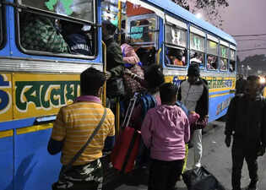





Problem Context
Issues
Overcrowding during peak hours, which leads to longer waits, discomfort.
A densely populated metro city with over 14 million residents
Underutilization in off-peak periods leads to wasted resources.
Buses are the backbone for low/middle-income mobility
Fig: Overcrowding in bus
Source: Times of India
High operating costs due to rising fuel and crew expenses.
Need
Move beyond fixed or time-block schedules toward full-day, data-driven frequency optimization that captures real operational dynamics.
Integrate real-time datasets (ETM, AVL, OD surveys) to develop cost-efficient, demand-responsive service plans.
Static scheduling fails to respond to fluctuating demand.
Title: Advanced Computational Approaches For Cost-effective Urban Bus Service Planning
Authors: Aditi Gupta, Debapratim Pandit, Sneha Sahni, Krati Sharma

Slide 3

Research gap and Motivation
Research Gaps
Need for Efficient Metaheuristic Optimization
Full-day simulation increases computational complexity.
Evaluating thousands of frequency combinations for both directions is difficult.
Computational time and convergence efficiency become critical.
Selection of an efficient metaheuristic algorithm is critical for practical deployment.
Dynamic frequency optimization has been studied, but mostly time-block-based, not full-day.
These methods ignore inter-period dependencies and fleet limitations.
Real-world data integration (ETM, AVL, OD) is rarely implemented.
What this research brings?
Moves beyond the conventional period-wise planning | Captures the interdependencies between time periods and both travel directions | Shifts frequency planning from assumption-based to data-driven decision making. | Develops a detailed digital twin of the S21 corridor | Simultaneously minimizes User Costs and Operator Costs (fleet operation) | Achieves an equitable balance between service quality and operational efficiency | Balanced frequencies reduced peak overcrowding and off-peak idling.
Addresses the limitations of conventional, period-wise frequency planning by introducing a full-day optimization framework.
By integrating real-world ETM and AVL data with an efficient metaheuristic approach, it achieves a balanced, cost-effective service plan that improves both operational efficiency and passenger experience.
Title: Advanced Computational Approaches For Cost-effective Urban Bus Service Planning
Authors: Aditi Gupta, Debapratim Pandit, Sneha Sahni, Krati Sharma

Slide 4

Research Objective
Aim of Study
To develop and apply advanced computational techniques that integrate simulation and metaheuristic optimization for designing cost-effective, demand-responsive, and reliable urban bus services in Kolkata.
Objectives
Genetic Algorithm (GA)
Population-based search using selection, crossover, mutation.
Particle Swarm Optimization (PSO)
Particles share information to reach global optimum quickly.
Ant Colony Optimization (ACO)
Pheromone-guided exploration for path/frequency setting.
Simulated Annealing (SA)
Probabilistic search that escapes local optima via gradual cooling.
Minimize total system cost by balancing User-side costs and Operator-side costs.
Determine optimal hourly service frequencies that adapt to real-world demand patterns.
Benchmark four metaheuristic algorithms to identify the most efficient optimization approach
Compare algorithms on cost reduction, convergence speed, and stability to recommend the best framework.
Title: Advanced Computational Approaches For Cost-effective Urban Bus Service Planning
Authors: Aditi Gupta, Debapratim Pandit, Sneha Sahni, Krati Sharma
4

Slide 5

Literature Review
Author / Year | Study Focus / Objective | Key Insights / Findings | Data Type / Source | Limitations / Gaps Identified | Relevance / Gap Addressed in Present Study
Yuan et al. (2023) | Examined static vs. dynamic bus scheduling methods in developing cities. | Static timetables ignore demand variation leading to overcrowding and inefficiency. | Case data from multi-modal networks. | Lacked adaptive, demand-responsive approach. | Highlights the need for real-time, data-driven frequency planning.
Momen et al. (2025) | Applied metaheuristic optimization for robust, cost-efficient bus networks. | Metaheuristics handle nonlinear and constrained problems effectively. | Sparse energy and ridership data. | Limited comparison across algorithms. | Supports use of metaheuristics for cost minimization and service reliability.
Chakroborty (2003) | Used GA for optimizing urban transit network and headways. | GA reduced waiting time and operational cost significantly. | Simulated network data. | Focused on single algorithm, no real data validation. | Validates use of GA for frequency optimization using real datasets.
Buba & Lee (2019) | Applied PSO for urban transit network design and fleet allocation. | PSO converged faster with simpler implementation. | Real-world operational data. | Limited to homogeneous fleet systems. | Justifies inclusion of PSO for quick, near-optimal frequency solutions.
Title: Advanced Computational Approaches For Cost-effective Urban Bus Service Planning
Authors: Aditi Gupta, Debapratim Pandit, Sneha Sahni, Krati Sharma
5

Slide 6
Literature Review
Author / Year | Study Focus / Objective | Key Insights / Findings | Data Type / Source | Limitations / Gaps Identified | Relevance / Gap Addressed in Present Study
Sukhbaatar et al. (2023) | Developed ACO for time-dependent route planning. | ACO adapts well to passenger flow variations. | Synthetic data | Did not test across multiple corridors. | Demonstrates ACO’s suitability for handling time-based demand variation.
Correia et al. (2023) | Implemented Simulated Annealing for multimodal transport optimization. | SA escapes local optima, providing stable solutions over time. | Simulation-based experiments. | Computationally slower; lacks real-world validation. | Adds SA as a robustness benchmark in comparative analysis.
Cipriani et al. (2012) | Investigated procedures for large urban transit network design. | Few comparative benchmarks using consistent criteria. | Theoretical and synthetic datasets. | No multi-algorithm evaluation with real OD data. | Bridges this gap by benchmarking GA, PSO, ACO, and SA on real ETM + AVL data for Kolkata’s S21 corridor.
Existing studies demonstrate the potential of metaheuristic algorithms in transit optimization but lack real-world comparative evaluation.
This study bridges that gap by applying and benchmarking four algorithms on actual ETM, AVL, and survey data from Kolkata’s S21 corridor.
Title: Advanced Computational Approaches For Cost-effective Urban Bus Service Planning
Authors: Aditi Gupta, Debapratim Pandit, Sneha Sahni, Krati Sharma
6

Slide 7

Proposed Approach
Problem Definition & Objectives
Define frequency optimization problem for Kolkata bus corridor
Set objectives (minimize total system cost while meeting service constraints)
Literature Review
Developed a digital twin of a real bus corridor (S21, Kolkata) simulating full-day operations in both directions.
Uses OD-based passenger flow modeling and trip-level cost evaluation.
Integrated with metaheuristic optimization (GA, PSO, ACO, SA) to identify best-performing algorithm.
Minimize total system cost = User cost + Operator cost, subject to fleet constraints.
Data Collection & Input Processing
OD matrices, demand profiles, stop sequences, and operational constraints
Preprocess ETM data, GPS/AVL data, and survey data
Data Analysis & Performance Benchmarking
Performance Indicator
Gap Analysis
Cost model Formulation
Calculate User Costs (waiting time, in-vehicle time, overcrowding) and Operator Costs (vehicle-km, wages, fuel/maintenance)
Define total system cost function
Optimization process
Select Algorithm (GA / PSO / ACO / SA) and generate initial feasible solutions
Comparison of optimal frequencies and cost by different Algorithms
Simulation Model
Simulate passenger flows for each solution and estimate waiting time, travel time, lost passengers, and operational cost
Evaluation & Iteration
Results & Comparison
Title: Advanced Computational Approaches For Cost-effective Urban Bus Service Planning
Authors: Aditi Gupta, Debapratim Pandit, Sneha Sahni, Krati Sharma
7

Slide 8

Data Collection and Preprocessing
Data Source | Key Parameters | Purpose in Study
ETM (Electronic Ticketing Machine) | Boarding & alighting counts, route, trip time, fare data from CSTC portal. | Develop stop-level OD matrices & hourly demand profiles.
AVL (GPS / Automatic Vehicle Location) | Bus location logs with arrival/departure times, dwell time, travel time, delays, speeds. | Calibrate link travel time, dwell durations, and reliability in simulation.
Field Survey | Route attributes (coordinates, lane width, congestion zones), stop features (shelter type, waiting area), and onboard passenger counts. | Validate ETM and AVL data; adjust dwell time and crowding parameters.
Cleaning & Validation:
- Removed invalid or missing records; corrected outliers.
- High-quality, realistic operational data.
Time Segmentation:
Divided operating hours (6 AM–10 PM) into 16 hourly blocks.
Enables hourly frequency optimization.
Demand Categorization:
Grouped into peak and off-peak periods.
Supports dynamic service planning.
OD Matrix Formation
Converted ETM records to hourly OD matrices for both directions.
Inputs for trip-level simulation.
Feasibility Constraints
Applied limits for fleet size, capacity, and headways.
Ensures realistic and policy-compliant optimization.
Preprocessing
Title: Advanced Computational Approaches For Cost-effective Urban Bus Service Planning
Authors: Aditi Gupta, Debapratim Pandit, Sneha Sahni, Krati Sharma
8

Slide 9

Cost Modelling Framework
The cost function calculates overall costs associated with the full-day operations of the bus system based on bus frequency, boarding and alighting data, travel time, and passenger arrival rate using the following cost functions.
Overall cost is the sum of User cost and Operator cost.
Operator Cost | Definition | Unit
Fuel cost | The unit cost of fuel for buses | ₹90 / Litre
Fuel consumption (running) | The average fuel consumption rate of running vehicles | 5 Km / Litre
Fuel consumption (idle) | The average fuel consumption rate of an idle engine running vehicle | 2 Litre/ hour
Vehicle cost | On-road cost of vehicle unit | ₹50,00,000
Crew wage | Average hourly salary per crew | ₹200 / Hour
Operator Penalty cost | Opportunity cost on the operator for not being able to serve the passenger. | ₹10 /Passenger
Maintenance cost | Maintenance cost per kilometer run | ₹5 / Km
User Cost | Definition | Unit
Waiting time cost | Cost of the time spent by the passenger at the bus stop while waiting for the bus | ₹60 / Hour
In-Vehicle cost | Cost of time by the passenger while traveling in the bus | ₹30 / Hour
In-Vehicle cost (crowding level>1.5) | Cost of time by the passenger while traveling in the bus more than desired capacity ,i.e., 1.5 | ₹60 / Hour
Inconvenience cost | The additional cost incurred by a passenger for not being able to board the bus & choosing another mode. | As per waiting time
Title: Advanced Computational Approaches For Cost-effective Urban Bus Service Planning
Authors: Aditi Gupta, Debapratim Pandit, Sneha Sahni, Krati Sharma
9

Slide 10

Simulation–Optimization Framework
Initial Frequency setting
Frequency Range setting
Overall costing of Bus Operations
Optimization
Genetic Algorithm
Particle Swarm Optimization
Ant Colony Optimization
Simulated Annealing
Passenger Load Data
Crowding Level Range
Bus Capacity
Travel Time
Passenger Load Data
Crowding Level Range
Bus Capacity
Travel Time
Frequency set
Alighting rate
Distance & Fare
Passenger arrival per hour
Stop Characteristics
Travel Time
Unit cost of Waiting time
In vehicle time
Passenger lost due to overcrowding
Input data
Input data
Algorithms
Input data
Ride Check Method
Point Check Method
Initial Frequency
Process
Minimum Overall Cost
Optimized Frequency associated with minimum overall cost
Output
Output
Initial Frequency fulfilling passenger Demand
Output
Frequency Range for each hour for both direction
Output
Frequency Range for each hour for both direction
Title: Advanced Computational Approaches For Cost-effective Urban Bus Service Planning
Authors: Aditi Gupta, Debapratim Pandit, Sneha Sahni, Krati Sharma
10

Slide 11
Simulation–Optimization Framework
Constraints | Relevance
Maximum crowding level | upper limit on passenger load per bus to maintain comfort.
Maximum passenger waiting time | ensures acceptable waiting duration at stops.
Maximum passenger loss | restricts the number of passengers unable to board due to full capacity
Minimum crowding / minimum load factor | prevents underutilization of buses
Minimum passengers per trip | ensures each trip carries a reasonable passenger load for efficiency.
Maximum operating cost per passenger | caps expenditure relative to passenger volume.
Minimum cost recovery ratio | ensures sufficient revenue relative to total operating cost
Developed to replicate full-day bus operations on Route S21 (Bagbazar ↔ Garia, 22 km, 13 segments).
Simulates trip-by-trip movement in both UP and DN directions.
Calculates boarding, alighting, and bus occupancy at each stop using OD matrices.
Records lost passengers due to overcrowding and added to system cost.
Evaluates user costs (waiting, in-vehicle, unserved passengers) and operator costs (fuel, crew, maintenance, penalties).
Simulation dispatches buses hourly based on time-block frequencies.
Minimize total social cost (User + Operator) while improving reliability & equity.
A frequency range is predefined for each time block to allow algorithms to search and optimize within operational limits.
Title: Advanced Computational Approaches For Cost-effective Urban Bus Service Planning
Authors: Aditi Gupta, Debapratim Pandit, Sneha Sahni, Krati Sharma
11

Slide 12

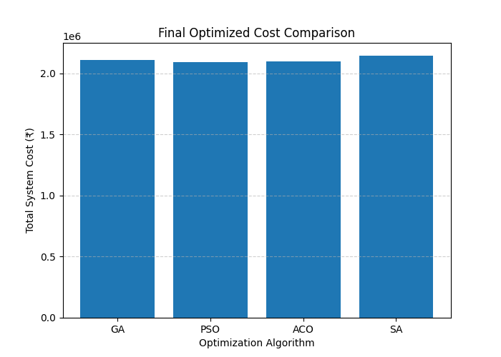
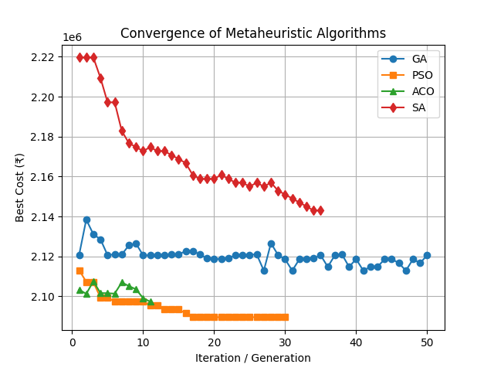
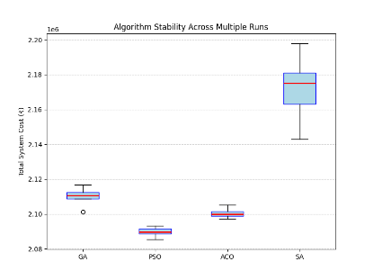
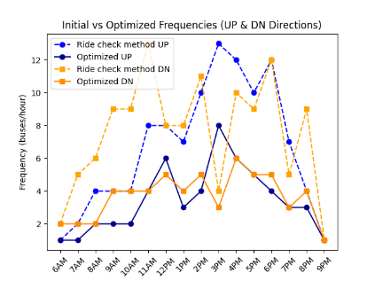
Results & Comparison
Algorithm | Optimized cost | Percentage reduction from initial cost | Remarks
Genetic Algorithm | Rs 2,110,848.89 | 12.59% | Stable, moderate convergence
Particle Swarm Optimization | Rs 2,089,531.79 | 13.47% | Best performer with lowest cost, fastest convergence
Simulated Annealing | Rs 2,143,004.95 | 11.26% | Near-optimal, stable results
Ant Colony Optimization | Rs 2,097,311.54 | 13.15% | Robust but slower and less consistent
Table: Comparison Matrix of different Algorithms
All algorithms achieved 11–13% system cost reduction in initial frequency of Rs 2,414,837.34, but PSO showed fastest and most stable convergence giving best overall performance.
Title: Advanced Computational Approaches For Cost-effective Urban Bus Service Planning
Authors: Aditi Gupta, Debapratim Pandit, Sneha Sahni, Krati Sharma
12

Slide 13
Results & Comparison
Criteria | GA | PSO | ACO | SA
Convergence Speed | Moderate | Fastest | Moderate | Slow
Stability / Variance | Good | Excellent | Good | Low
Cost Efficiency | High | Highest | High | Moderate
Computation Time | 1.145 sec | 1.755 sec | 1.519 sec | 1.094 sec
Performance
PSO delivered the lowest total cost (₹2.09M) with 13.47% savings.
GA and ACO produced nearly identical, stable results with moderate fluctuations.
SA was less consistent but useful for escaping local optima. It required more iterations and is effective as a refinement tool.
Transitioning from static to optimized frequency planning can cut total cost by ~13%.
Period | Frequency range UP |  | Frequency range DN |  | Ride check Method Frequency |  | GA |  | PSO |  | SA |  | ACO
 | Min | Max | Min | Max | Up | Dn | Up | Dn | Up | Dn | Up | Dn | Up | Dn
6AM | 1 | 1 | 1 | 2 | 1 | 2 | 1 | 2 | 1 | 2 | 1 | 1 | 1 | 1
7AM | 1 | 1 | 2 | 5 | 2 | 5 | 1 | 2 | 1 | 2 | 1 | 5 | 1 | 2
8AM | 2 | 4 | 2 | 5 | 4 | 6 | 2 | 2 | 2 | 2 | 2 | 2 | 2 | 2
9AM | 2 | 5 | 4 | 5 | 4 | 9 | 3 | 4 | 2 | 4 | 2 | 5 | 2 | 4
10AM | 2 | 4 | 4 | 6 | 4 | 9 | 3 | 4 | 2 | 4 | 3 | 5 | 2 | 6
11AM | 4 | 5 | 4 | 6 | 8 | 13 | 5 | 4 | 4 | 4 | 5 | 4 | 5 | 5
12PM | 6 | 9 | 3 | 5 | 8 | 8 | 6 | 3 | 6 | 5 | 9 | 3 | 6 | 4
1PM | 3 | 4 | 4 | 5 | 7 | 8 | 3 | 5 | 3 | 4 | 4 | 4 | 4 | 4
2PM | 4 | 6 | 5 | 7 | 10 | 11 | 5 | 5 | 4 | 5 | 5 | 6 | 4 | 5
3PM | 6 | 8 | 3 | 5 | 13 | 4 | 7 | 3 | 8 | 3 | 8 | 4 | 6 | 3
4PM | 6 | 8 | 6 | 8 | 12 | 10 | 7 | 7 | 6 | 6 | 6 | 7 | 6 | 6
5PM | 5 | 8 | 5 | 7 | 10 | 9 | 5 | 6 | 5 | 5 | 7 | 6 | 6 | 6
6PM | 4 | 9 | 5 | 8 | 12 | 12 | 5 | 7 | 4 | 5 | 5 | 8 | 4 | 5
7PM | 3 | 4 | 3 | 5 | 7 | 5 | 3 | 4 | 3 | 3 | 4 | 3 | 3 | 3
8PM | 3 | 4 | 4 | 6 | 4 | 9 | 3 | 5 | 3 | 4 | 4 | 5 | 3 | 4
9PM | 1 | 1 | 1 | 2 | 1 | 1 | 1 | 1 | 1 | 1 | 1 | 1 | 1 | 1
Output/ Result
Optimization corrected imbalanced frequencies which resulted in reduced passenger waiting times and improved service quality.
Increased frequencies in early morning (7 AM) and mid-day slots.
Reduced oversupply during peaks which makes better utilization of fleet.
More even distribution of services across time blocks.
Title: Advanced Computational Approaches For Cost-effective Urban Bus Service Planning
Authors: Aditi Gupta, Debapratim Pandit, Sneha Sahni, Krati Sharma
13

Slide 14

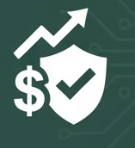
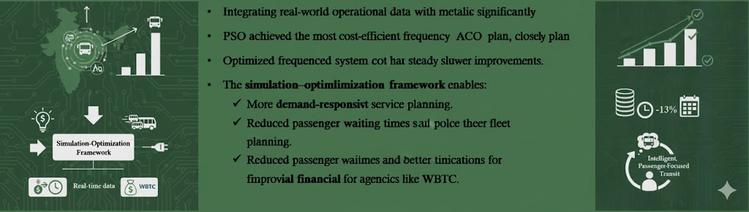
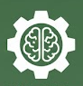
Conclusions & Future Scope
Integrating real-world operational data with metaheuristic optimization significantly improved Kolkata’s bus service performance.
PSO achieved the most cost-efficient frequency plan, followed closely by GA and ACO, while SA provided steady but slower improvements.
Optimized frequencies reduced total system cost by ~13%, enhanced service reliability, and improved equity across time blocks.
The simulation–optimization framework enables:
More demand-responsive and cost-efficient service planning.
Reduced passenger waiting times and better fleet utilization.
Improved financial sustainability for agencies like WBTC.
The approach is scalable and adaptable to other Indian cities, can integrate with real-time data systems for continuous service optimization.
Supports the transition toward intelligent, passenger-focused, and sustainable public transit systems.
Title: Advanced Computational Approaches For Cost-effective Urban Bus Service Planning
Authors: Aditi Gupta, Debapratim Pandit, Sneha Sahni, Krati Sharma
14

Slide 15
References
Ansari Esfeh, M., Saidi, S., Wirasinghe, S. C., & Kattan, L. (2022). Waiting time and headway modeling considering unreliability in transit service. Transportation Research Part A: Policy and Practice, 155, 219–233. https://doi.org/10.1016/j.tra.2021.11.015
Athira, I. C., Muneera, C. P., Krishnamurthy, K., & Anjaneyulu, M. V. L. R. (2016). Estimation of Value of Travel Time for Work Trips. Transportation Research Procedia, 17, 116–123. https://doi.org/10.1016/j.trpro.2016.11.067
Buba, A. T., & Lee, L. S. (2019). Hybrid Differential Evolution‐Particle Swarm Optimization Algorithm for Multiobjective Urban Transit Network Design Problem with Homogeneous Buses. Mathematical Problems in Engineering, 2019(1), 5963240. https://doi.org/10.1155/2019/5963240
Burnham, A., Gohlke, D., Rush, L., Stephens, T., Zhou, Y., Delucchi, M., Birky, A., Hunter, C., Lin, Z., Ou, S., Xie, F., Proctor, C., Wiryadinata, S., Liu, N., & Boloor, M. (2021). Comprehensive Total Cost of Ownership Quantification for Vehicles with Different Size Classes and Powertrains (No. ANL/ESD-21/4, 1780970, 167399; p. ANL/ESD-21/4, 1780970, 167399). https://doi.org/10.2172/1780970
Chakroborty, P. (2003). Genetic Algorithms for Optimal Urban Transit Network Design. Computer-Aided Civil and Infrastructure Engineering, 18(3), 184–200. https://doi.org/10.1111/1467-8667.00309
Cipriani, E., Gori, S., & Petrelli, M. (2012). Transit network design: A procedure and an application to a large urban area. Transportation Research Part C: Emerging Technologies, 20(1), 3–14. https://doi.org/10.1016/j.trc.2010.09.003
Correia, A. H. C., Worrall, D. E., & Bondesan, R. (2023). Neural Simulated Annealing.
Dominguez-Vergara, N., Dominguez-Perez, D. N., & Pantoja-Gallegos, J. L. (2022). Dependence of fuel economy on speed for two heavy duty vehicles. London Journal of Research in Science: Natural and Formal, 37–52.
Jara-Díaz, S., & Gschwender, A. (2003). Towards a general microeconomic model for the operation of public transport. Transport Reviews, 23(4), 453–469. https://doi.org/10.1080/0144164032000048922
Karlaftis, M. G., & McCarthy, P. (2002). Cost structures of public transit systems: A panel data analysis. Transportation Research Part E: Logistics and Transportation Review, 38(1), 1–18. https://doi.org/10.1016/S1366-5545(01)00006-0
Liu, R., & Sinha, S. (2007). Modelling urban bus service and passenger reliability. Proceedings of the Third International Symposium on Transportation Network Reliability. Proceedings of the Third International Symposium on Transportation Network Reliability, Leeds.
Mo, S., Bao, Z., Zheng, B., & Peng, Z. (2020). Bus Frequency Optimization: When Waiting Time Matters in User Satisfaction. https://doi.org/10.48550/ARXIV.2004.07812
Momen, S., Maknoon, Y., Van Arem, B., & Azadeh, S. S. (2025). Designing a robust and cost-efficient electrified bus network with sparse energy consumption data. Transportation Research Part C: Emerging Technologies, 171, 105020. https://doi.org/10.1016/j.trc.2025.105020
Sukhbaatar, U., Enkhtuya, D., & Galsandorj, A. (2023). An ant colony optimization technique to solve the line planning problem. Proceedings of the 14th Eastern Asia Society for Transportation Studies (EASTS) Conference.
Tirachini, A., Hensher, D. A., & Rose, J. M. (2013). Crowding in public transport systems: Effects on users, operation and implications for the estimation of demand. Transportation Research Part A: Policy and Practice, 53, 36–52. https://doi.org/10.1016/j.tra.2013.06.005
Wang, H., Guan, H., Qin, H., Zhao, P., & Liang, W. (2025). Assessing the impact of penalty strategies for cancellation behavior on the sustainability of demand-responsive transit service. Transportation Letters, 1–20. https://doi.org/10.1080/19427867.2025.2532274
Yuan, K., Cui, D., & Long, J. (2023). Bus frequency optimization in a large-scale multi-modal transportation system: Integrating 3D-MFD and dynamic traffic assignment. Digital Transportation and Safety, 2(4), 241–252. https://doi.org/10.48130/DTS-2023-0020
Title: Advanced Computational Approaches For Cost-effective Urban Bus Service Planning
Authors: Aditi Gupta, Debapratim Pandit, Sneha Sahni, Krati Sharma
15

Slide 16
Thank you

