Slide 1
Exploring Public Safety in Mobility-Oriented Dynamic Urban Spaces
Ayushi Tiwari¹ & Dr. Sneha²
¹Research scholar, ²Assistant Professor
^{1,2}Department of Architecture, Planning & Design, IIT (BHU)

Slide 2
Introduction
Table 1: Key Themes Framing the Study
Public Safety & Urban Mobility | Public safety is an essential yet underexplored component of urban mobility. It shapes how people move and interact within cities. | Beckmann (2004)
Urbanization Challenges | Rapid urbanization and weak infrastructure such as poor lighting, inadequate sidewalks and missing signage increase risks for pedestrians. | Yadav & Kumari (2024)
Dynamic Urban Spaces | Streets, transit corridors, intersections and pedestrian crossings are dynamic spaces involving constant movement and diverse user interactions. | Hidayati et al. (2020)
Technological Innovations | IoT-enabled crossings and Safe Commuting Systems (SCS) enhance safety through real-time monitoring and responsive management. | Chavez et al, (2019); Rabbani et al. (2025)

Slide 3
Spatial Design & Safety Perception in Dynamic Urban Spaces
Table 2: Literature Insights
Environmental Design & Perception | Public safety in cities depends on environmental design and the perception of fear, influenced by lighting, visibility and surveillance. | Blöbaum & Hunecke (2005); Lee (2022); Azevedo et al. (2021)
Dynamic Urban Spaces | Dynamic spaces such as streets, transit hubs and pedestrian corridors show high movement and temporal variation | El Husseiny & El Husseiny (2018); Lyu (2024)
Human-Infrastructure Interactions | Mobility environments evolve through human–infrastructure interactions. Indicators like accessibility, walkability and vitality reflect spatio-temporal complexity. | Lv et al. (2025)
Safety Perception Factors | Visible sightlines, good lighting and active pedestrian areas enhance safety perception, while poor maintenance increases risk. | Blöbaum & Hunecke (2005); Chavez et al. (2019)

Slide 4
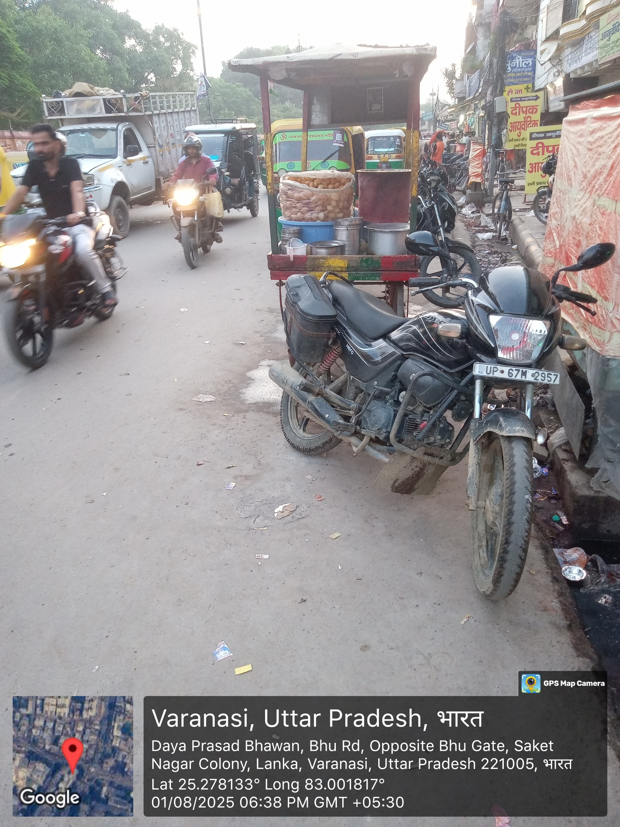
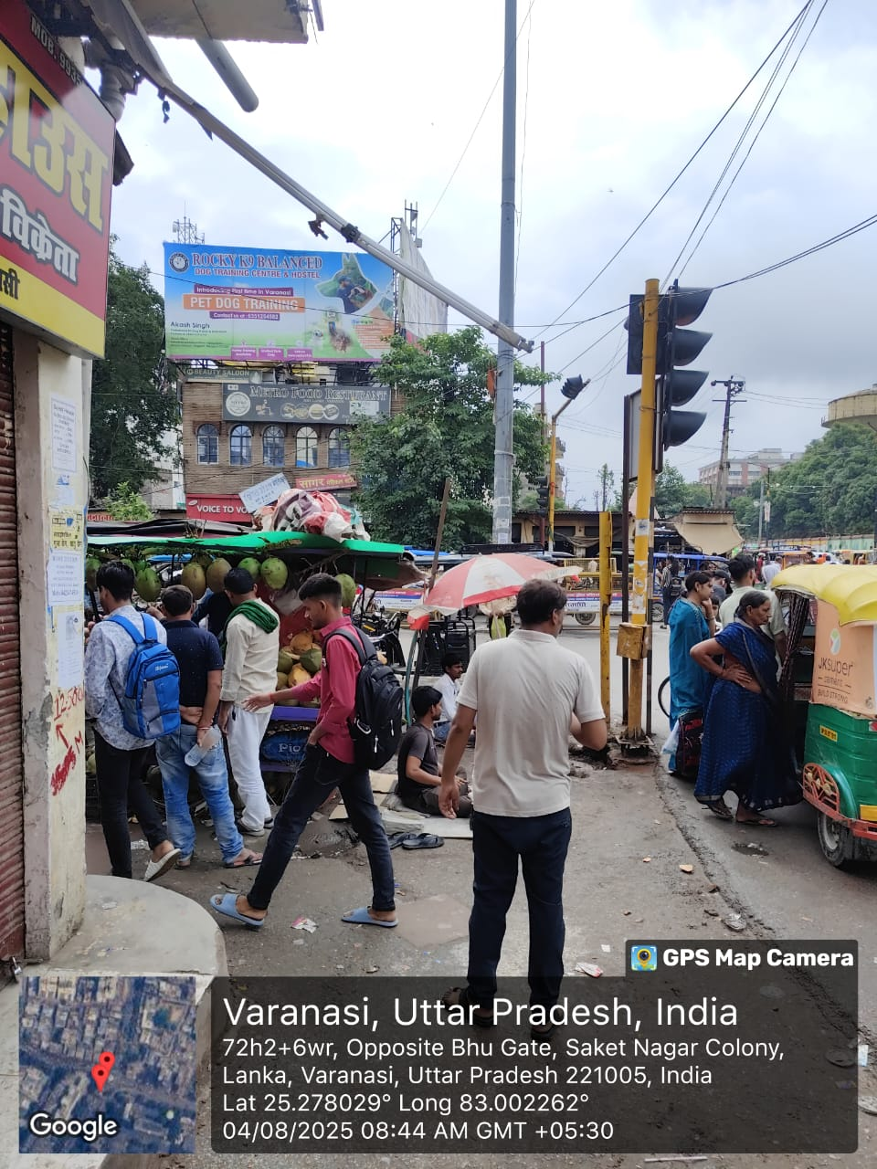
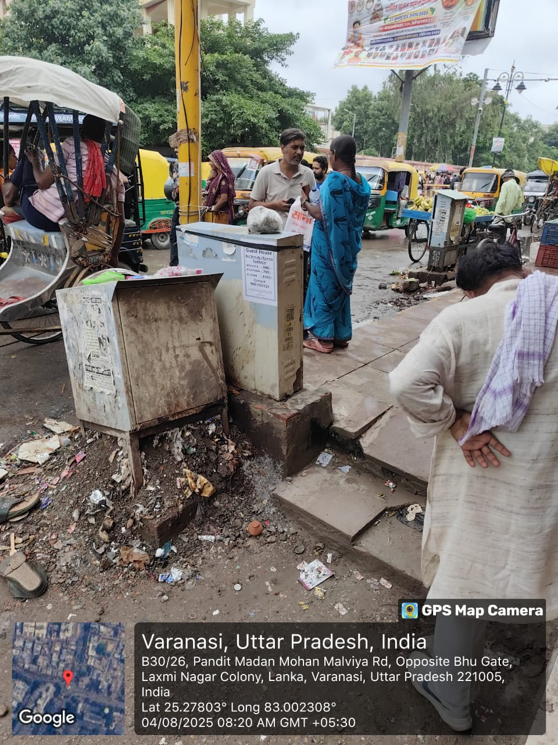
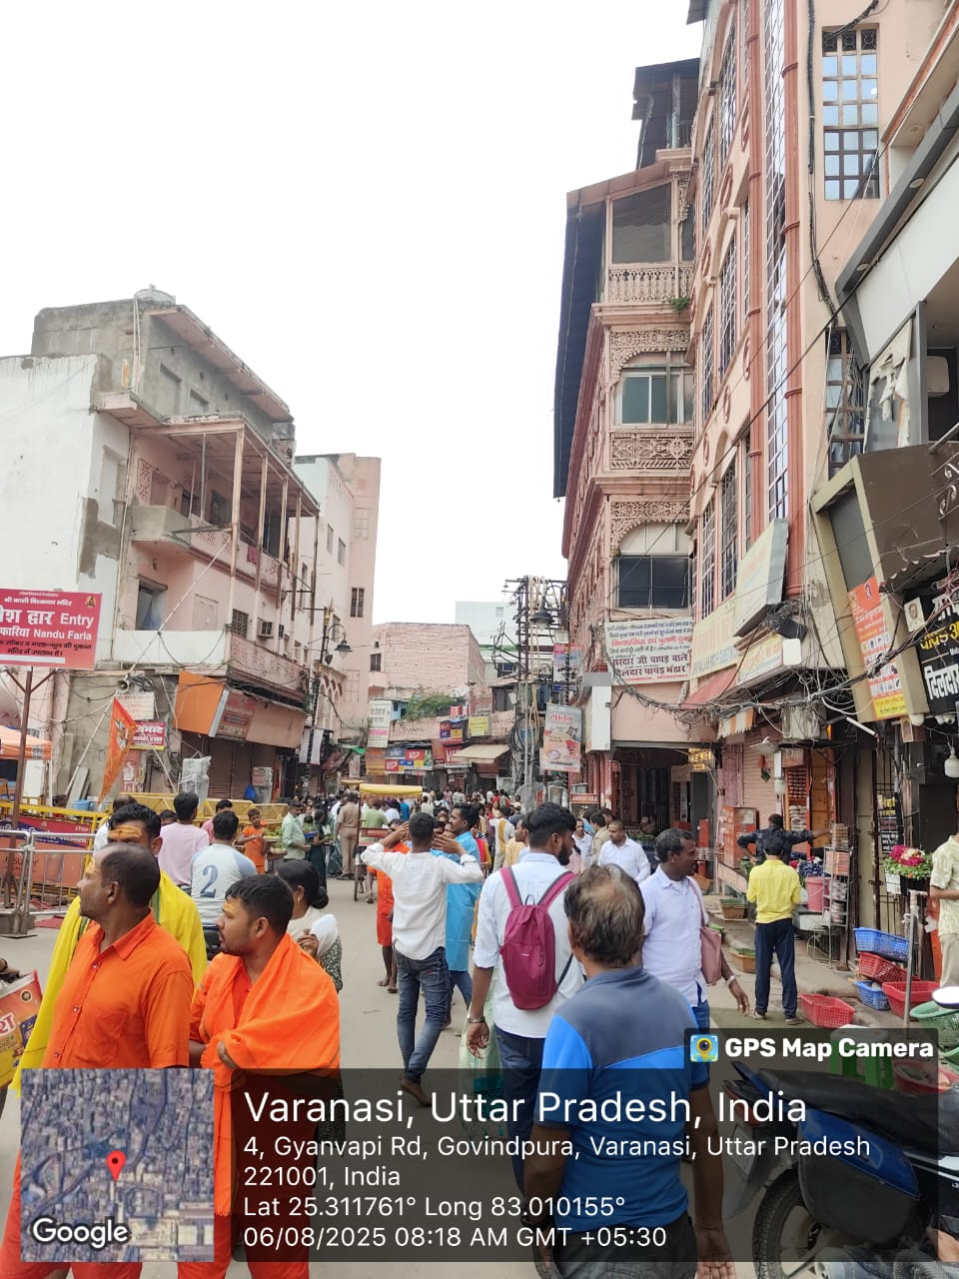
Aim of the Research
Aim:
To explore public safety in mobility-oriented dynamic urban spaces by integrating spatial design factors and user perceptions to understand how the built environment shapes safety experiences.
Fig. 1: Street views images depicting vehicular/ pedestrian flow, crowd dynamics and infrastructure challenges across different urban settings

Slide 5
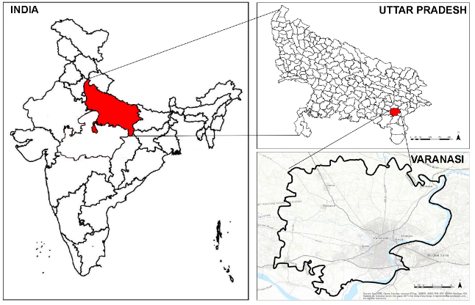
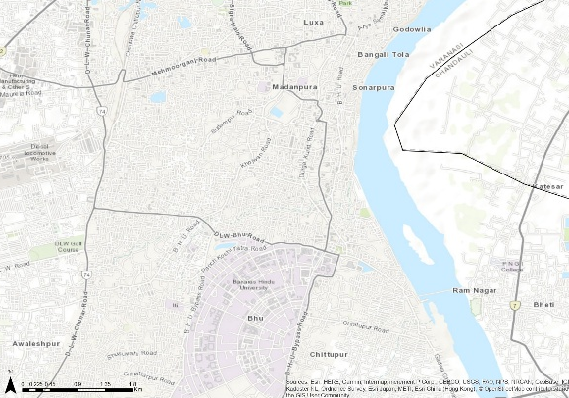
Study area & Context
The study was conducted in Varanasi, India a dense, culturally diverse and mobility-intensive city with dynamic urban environments.
Varanasi hosts religious, academic and commercial hubs including Lanka, Vishwanath Temple (BHU), Godowlia and Kashi Vishwanath Temple representing diverse mobility contexts (NIUA, 2021).
Religious precincts show high crowd density and strong surveillance, while academic zones face challenges of poor lighting and weak monitoring.
Fig. 2: Location map of Varanasi
Fig. 3: Survey areas located in Varanasi, India

Slide 6
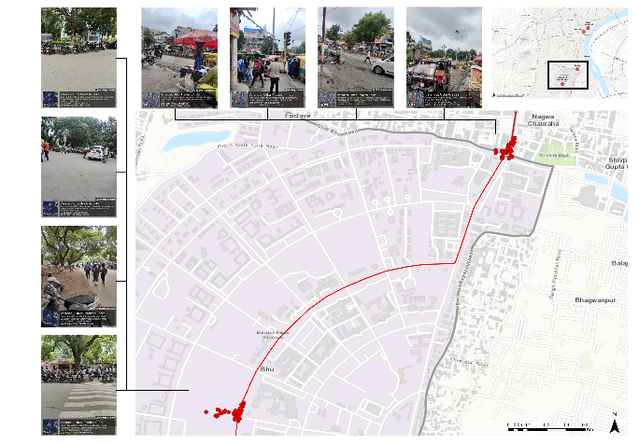
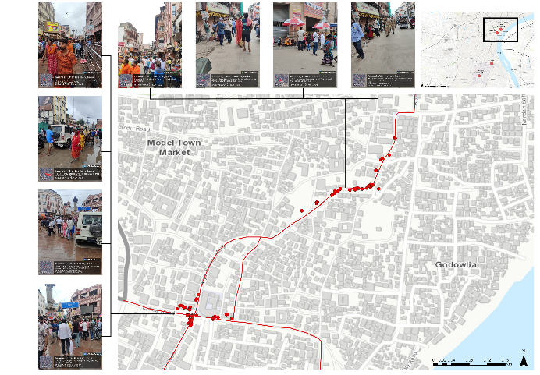
Study area & Context
Survey routes:
Route 1: Vishwanath Temple (BHU) → Lanka
Route 2: Godowlia → Shri Kashi Vishwanath Temple
These sites capture varied spatial forms, crowd dynamics and temporal patterns, offering a holistic context for assessing public safety in dynamic urban spaces.
Fig. 4: Survey routes and street views (Vishwanath Temple and Lanka)
Fig. 5: Survey routes and street views (Godowlia and Shri Kashi Vishwanath Temple)

Slide 7
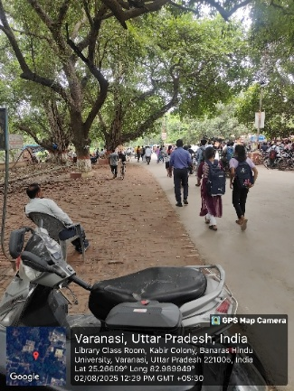
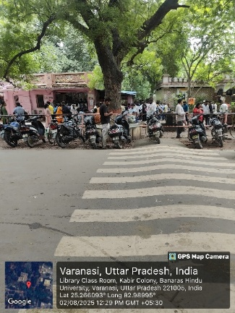
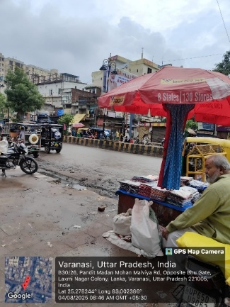
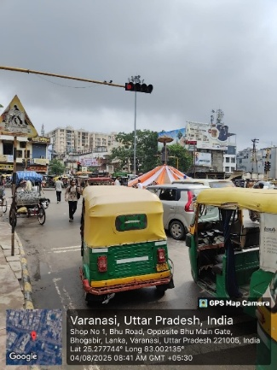
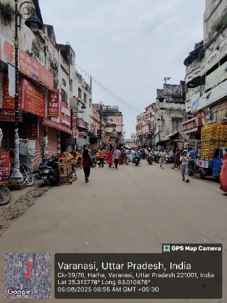
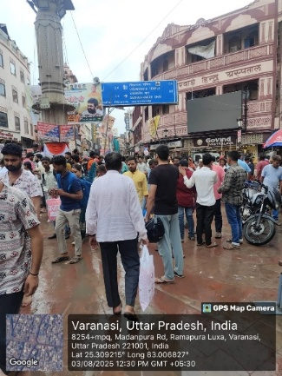
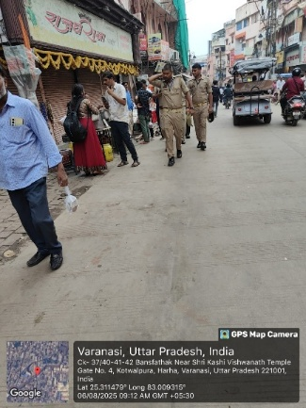
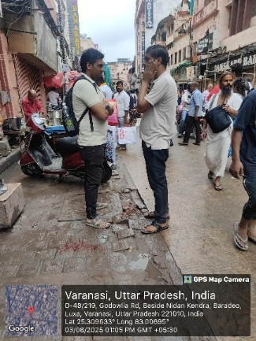
Study area & Context
Fig. 6: Street views images depicting pedestrian flows, crowd dynamics, parking conditions and infrastructure challenges across different urban settings

Slide 8
Methodology
Used a mixed-method approach combining spatial mapping, reconnaissance surveys, user perception surveys and statistical analysis to assess safety in dynamic urban spaces of Varanasi, India.
Research Design:
Comparative and exploratory; four purposively selected sites Lanka, Vishwanath Temple (BHU), Godowlia and Kashi Vishwanath Temple.
Data Collection:
GIS mapping and field observations at different times of day.
Structured questionnaire on lighting, surveillance, crowding, harassment, theft and emergencies.
Sampling & Analysis:
Purposive sampling of 174 respondents across diverse groups.
Applied descriptive statistics, chi-square test, correlation, factor analysis and SEM to link spatial and perceptual data.

Slide 9
Site-Wise Safety Insights
Table 3: Chi-square tabulation of location vs. safety perception
Location of survey | Do you feel safe
 | Yes | No | All
Lanka | 43 | 6 | 49
 | 42.8 | 6.2 | 49.00
 | 0.0299 | -0.0785
Vishwanath Temple (BHU) | 33 | 11 | 44
 | 38.44 | 5.56 | 44.0
 | -0.8769 | 2.3050
Godowlia | 37 | 3 | 40
 | 34.94 | 5.06 | 40.00
 | 0.3481 | -0.9149
Shri Kashi Vishwanath Temple | 39 | 2 | 41
 | 35.82 | 5.18 | 41.00
 | 0.5320 | -1.3984
All | 152 | 22 | 174
 | 152.00 | 22.00 | 174.00
Table 4: Key insights
Site | Key Findings
Lanka | Moderate safety perception
BHU Temple | Lower safety - poor lighting & surveillance
Godowlia | Moderate safety despite crowding
Kashi Vishwanath Temple | Highest safety - visible police & organized flow

Slide 10
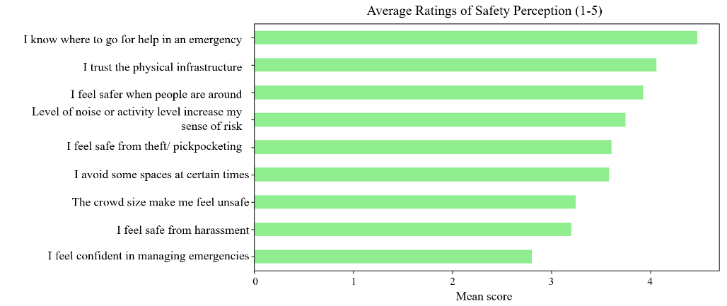
Key Indicators
Spatial Indicators:
Lighting, visibility, surveillance, signage, accessibility, crowding, dark zones.
Perception Indicators:
Safety from harassment/theft, trust in environment, comfort with crowding, emergency help.
Fig. 7: Survey ratings of safety perception

Slide 11
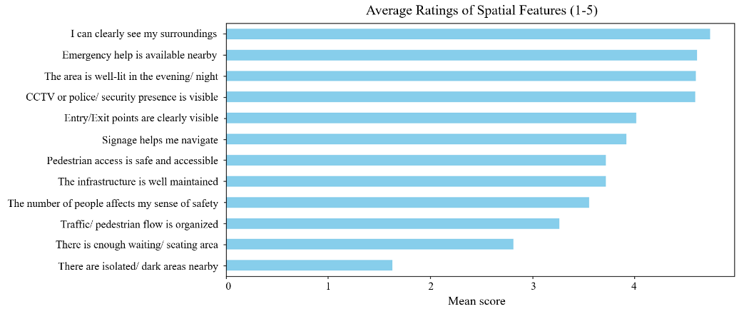
Key Indicators
High-rated: Good visibility, lighting, CCTV/police presence and emergency help boosted safety perception.
Low-rated: Fear of harassment, poor emergency confidence and dark isolated areas reduced safety.
Fig. 8: Survey ratings of spatial features

Slide 12
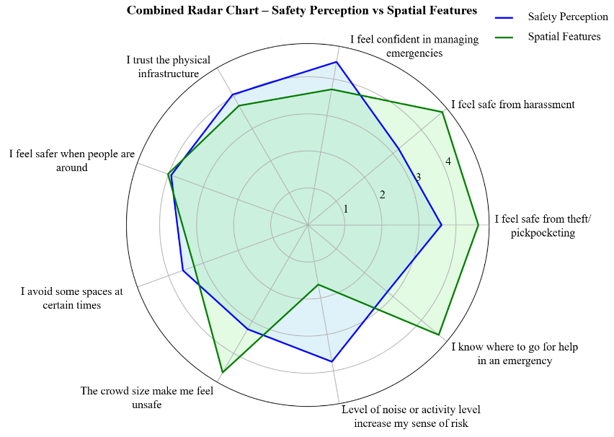
Perception & Spatial Ratings
High: Lighting (M≈4.5), visibility (M≈4.7), CCTV presence, emergency help.
Moderate: Pedestrian access, signage, maintenance.
Low: Safety from harassment, theft and crowd comfort.
Lighting, visibility and surveillance emerge as the most decisive safety factors.
Fig. 9: Radar chart of safety perceptions vs. spatial features

Slide 13
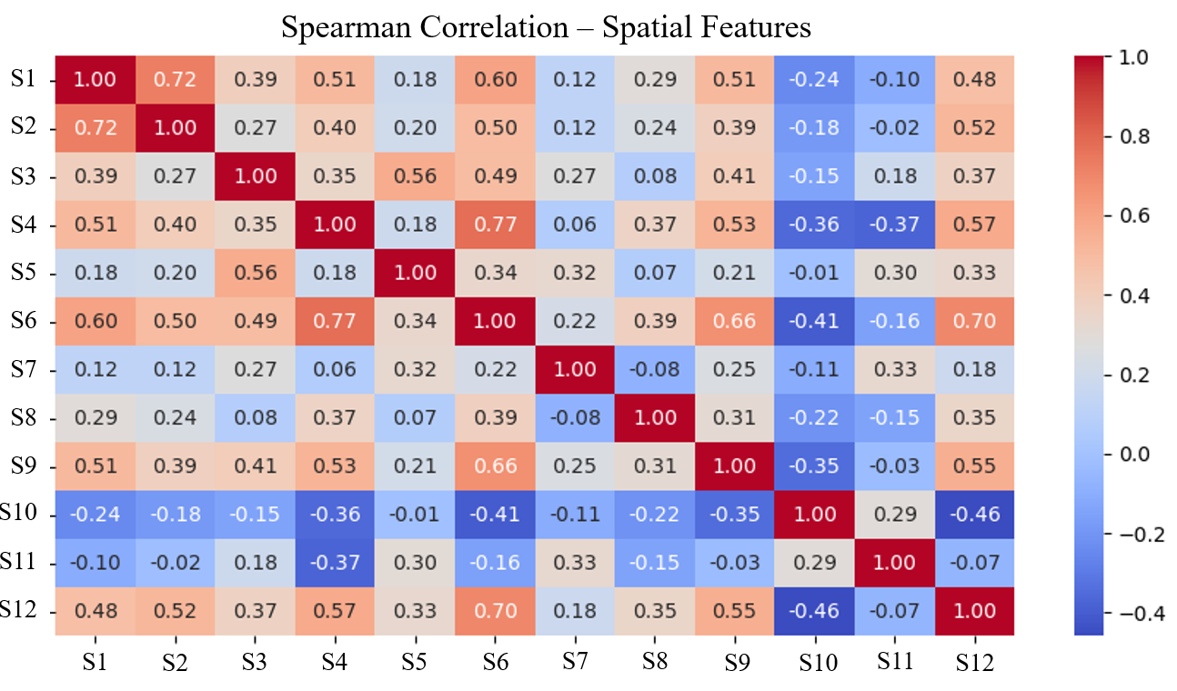
Spatial Features Correlation
Lighting, signage and access points strongly correlated (ρ = 0.60-0.77), forming a positive safety cluster.
Surveillance (CCTV, help points) moderately linked (ρ = 0.55), showing user trust in combined systems.
Dark or isolated areas showed negative correlation (ρ = -0.24 to -0.46), reducing overall safety perception.
Seating had minimal impact on perceived safety.
Legend: S1- The area is well-lit in the evening/ night
S2- I can clearly see my surroundings
S3- The infrastructure is well maintained
S4- Signage helps me navigate
S5- Pedestrian access is safe and accessible
S6- Entry/Exit points are clearly visible
S7- Traffic/ pedestrian flow is organized
S8- The number of people affects my sense of safety
S9- CCTV or police/ security presence is visible
S10- There are isolated/ dark areas nearby
S11- There is enough waiting/ seating area
S12- Emergency help is available nearby
Fig. 10: Correlation matrices of spatial features

Slide 14
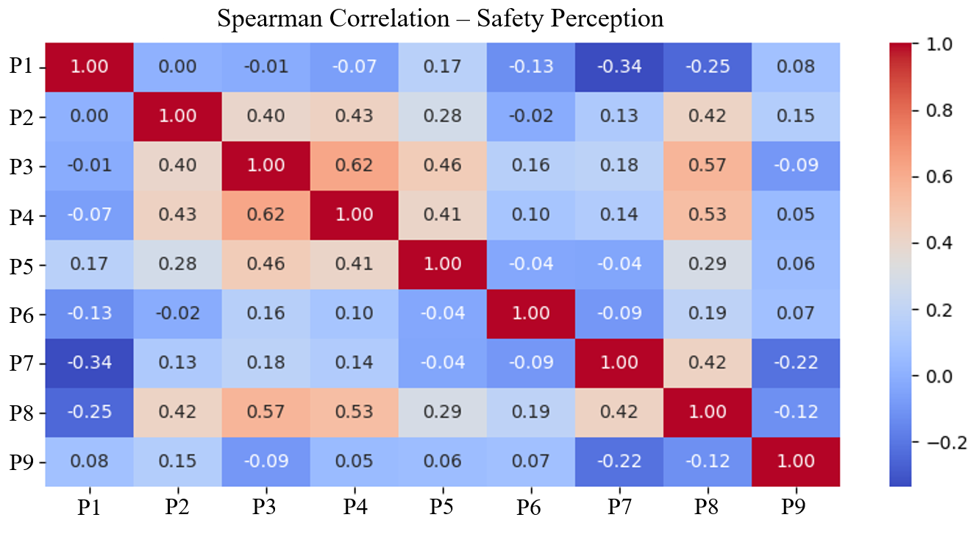
Safety Perceptions Correlation
Safety confidence linked to trust in infrastructure and access to help (ρ = 0.53-0.62).
Social presence improved harassment safety (ρ = 0.28-0.41).
Overcrowding and noise reduced theft safety and emergency confidence (ρ = -0.34, -0.22).
Safety is multi-dimensional, requiring design + social strategies for effective planning.
Legend:
P1- I feel safe from theft/ pickpocketing
P2- I feel safe from harassment
P3- I know where to go for help in an emergency
P4- I trust the physical infrastructure
P5- I feel safer when people are around
P6- I avoid some spaces at certain times
P7- The crowd size make me feel unsafe
P8- Level of noise or activity level increase my sense of risk
P9- I feel confident in managing emergencies
Fig. 11: Correlation matrices of safety perceptions

Slide 15
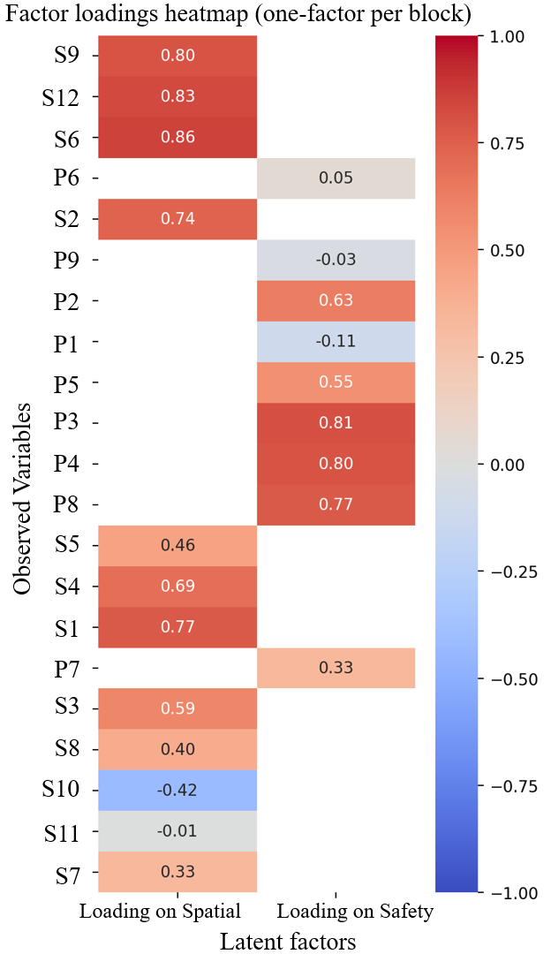
Factor Analysis
Key positive loadings:
Entry/exit clarity (0.86)
Emergency help (0.83)
CCTV presence (0.80)
Lighting (0.77)
Negative loadings:
Isolated/dark areas (-0.42)
Lack of seating (-0.01)
Legend:
P1- I feel safe from theft/ pickpocketing
P2- I feel safe from harassment
P3- I know where to go for help in an emergency
P4- I trust the physical infrastructure
P5- I feel safer when people are around
P6- I avoid some spaces at certain times
P7- The crowd size make me feel unsafe
P8- Level of noise or activity level increase my sense of risk
P9- I feel confident in managing emergencies
S1- The area is well-lit in the evening/ night
S2- I can clearly see my surroundings
S3- The infrastructure is well maintained
S4- Signage helps me navigate
S5- Pedestrian access is safe and accessible
S6- Entry/Exit points are clearly visible
S7- Traffic/ pedestrian flow is organized
S8- The number of people affects my sense of safety
S9- CCTV or police/ security presence is visible
S10- There are isolated/ dark areas nearby
S11- There is enough waiting/ seating area
S12- Emergency help is available nearby
Fig. 12: Factor loadings heatmap of spatial and safety perception variables

Slide 16
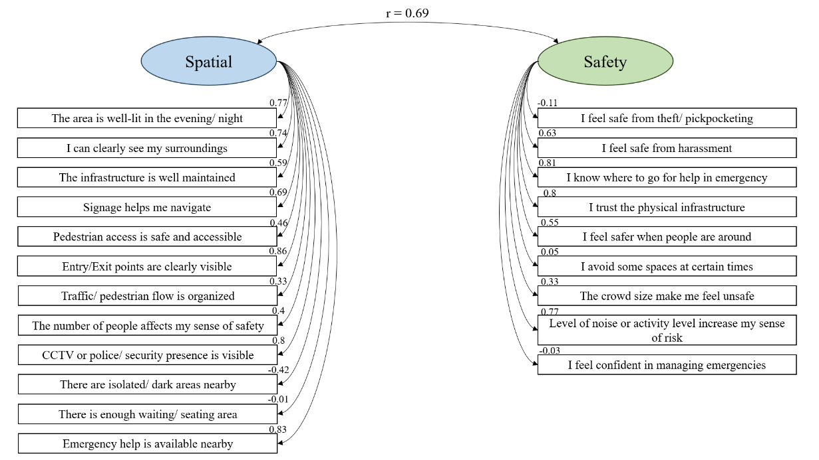
Structural Equation Model (SEM) Findings
Strong relationship (r = 0.69) between spatial design and perceived safety.
Lighting, visibility and emergency facilities are core predictors.
Social trust and presence of people reinforce safety feelings.
Fig. 13: Structural equation model (SEM) path diagram showing correlation between spatial and safety constructs

Slide 17
Discussion & Conclusion
Safety in dynamic urban spaces is multi-dimensional, shaped by both spatial design and social context.
Lighting, visibility and surveillance are the strongest enablers of user confidence.
Moderate activity improves safety (“eyes on the street”), but excessive crowding increases vulnerability.
Infrastructure alone is insufficient, safety must integrate social trust, crowd management and institutional measures.
Use data-driven, tech-based tools (GIS, IoT, AI) to monitor real-time risks and guide an Urban Safety Index.

Slide 18
References
Azevedo, V., Sani, A., Nunes, L. M., & Pauloa, D. (2021). Do you Feel Safe in the Urban Space? From Perceptions to Associated Variables. Anuario de Psicologia Juridica, 31(1), 75–84. https://doi.org/10.5093/APJ2021A12
Beckmann, J. (2004). Mobility and Safety. Theory, Culture & Society, 21(5), 81–100. https://doi.org/10.1177/0263276404046062
Blöbaum, A., & Hunecke, M. (2005). Perceived danger in urban public space: The impacts of physical features and personal factors. Environment and Behavior, 37(4), 465–486. https://doi.org/10.1177/0013916504269643
Chavez, C. V, Ruiz, E., Gomez Rodriguez, A., Rivas Pena, I., Larios, V. M., Villanueva-Rosales, N., Mondragon, O., & Cheu, R. L. (2019). Towards Improving Safety in Urban Mobility Using Crowdsourcing Incident Data Collection. http://landing.avisora.mx/
El Husseiny, A. M., & El Husseiny, A. A. (2018). Redefining Static and Dynamic Spaces Genius integration in Historic Cairo. Asian Journal of Behavioural Studies, 3(9), 161. https://doi.org/10.21834/ajbes.v3i9.71
Hidayati, I., Tan, W., & Yamu, C. (2020). How gender differences and perceptions of safety shape urban mobility in Southeast Asia. Transportation Research Part F: Traffic Psychology and Behaviour, 73, 155–173. https://doi.org/10.1016/j.trf.2020.06.014
Lee, S. (2022). The safety of public space: urban design guidelines for neighborhood park planning. Journal of Urbanism, 15(2), 222–240. https://doi.org/10.1080/17549175.2021.1887323

Slide 19
References
Lv, Y., Yang, J., Xu, J., Guan, X., & Zhang, J. (2025). High-dimensional urban dynamic patterns perception under the perspective of human activity semantics and spatiotemporal coupling. Sustainable Cities and Society, 121. https://doi.org/10.1016/j.scs.2025.106192
Lyu, C. (2024). Exploring the Influence of Dynamic Indicators in Urban Spaces on Residents’ Environmental Behavior: A Case Study in Shanghai Utilizing Mixed-Methods Approach and Artificial Neural Network (ANN) Modeling. Sustainability (Switzerland) , 16(8). https://doi.org/10.3390/su16083280
NIUA. (2021). Understanding Varanasi City from the lens of Disability Inclusion.
Rabbani, G. M., Islam, M. S., Rahman, N., Roy, T., Zihad, A. A., Naidu, A., & Jahan, S. (2025). Enhancing Pedestrian Safety and Urban Mobility through IoT-Based Smart Pedestrian Crossings. 2025 International Conference on Electrical, Computer and Communication Engineering, ECCE 2025. https://doi.org/10.1109/ECCE64574.2025.11013514
Yadav, A., & Kumari, R. (2024). Gender safety perspective in urban planning: The case of pedestrian mobility in Kanpur city. Cities, 147. https://doi.org/10.1016/j.cities.2024.104845

