Slide 1

Urban Mobility India Research Symposium 2025
Transport Energy Demand in a Medium-Sized Indian City: Insights from Jodhpur
UMI RS Paper ID: 3677
Authors
Pathan Mujahid Najekhan, Shahiq Ahmad Wani, Dr Ranju Mohan
Department of Civil and Infrastructure Engineering
Indian Institute of Technology (IIT) Jodhpur
Presenter: Shahiq Ahmad Wani

Slide 2
Presentation Outline
Introduction and Background
Research Gap & Objectives
Study Area Profile
Research Methodology
Analysis and Results
Implications
Conclusion
Transport Energy Demand in a Medium-Sized Indian City: Insights from Jodhpur

Slide 3
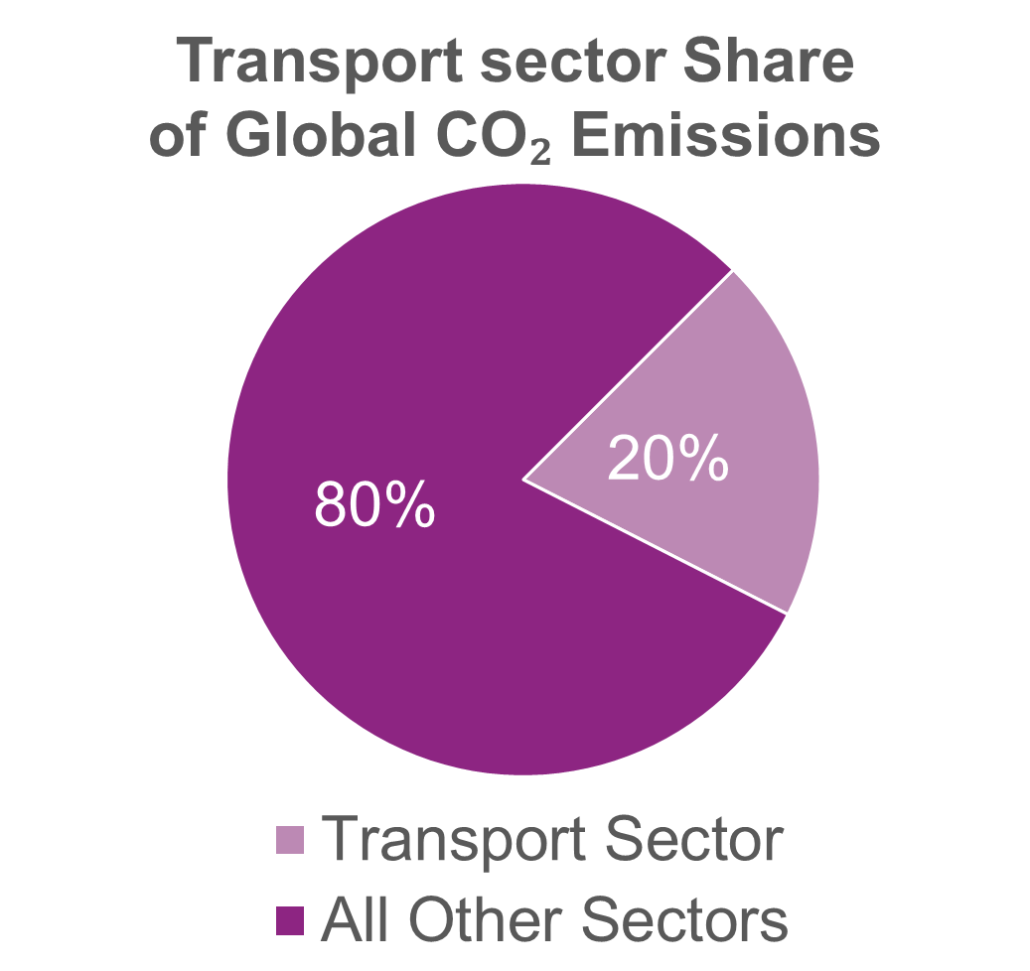
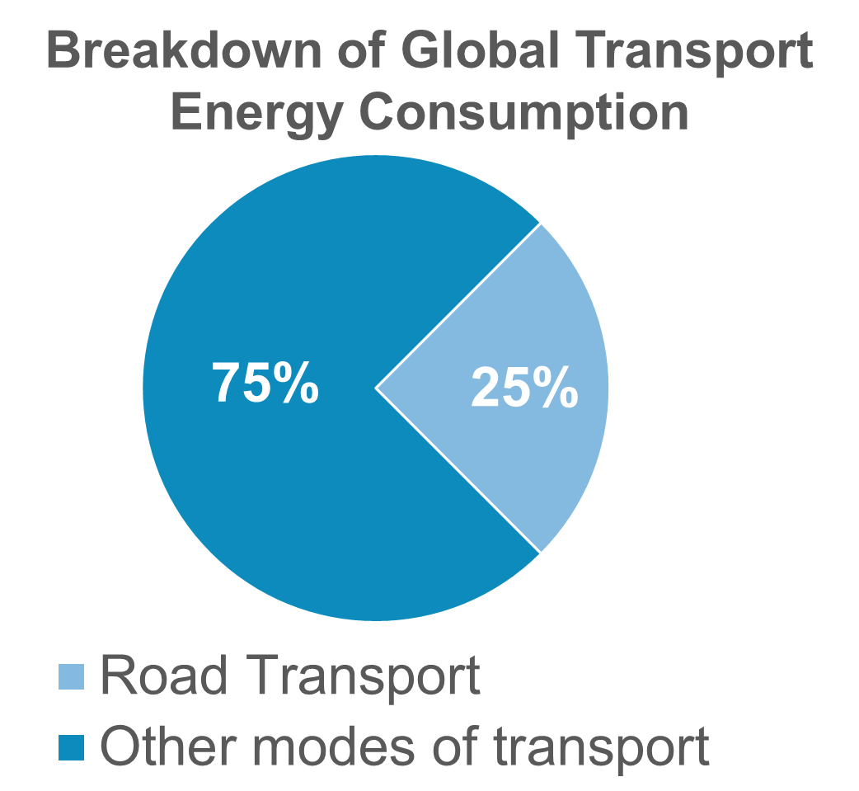
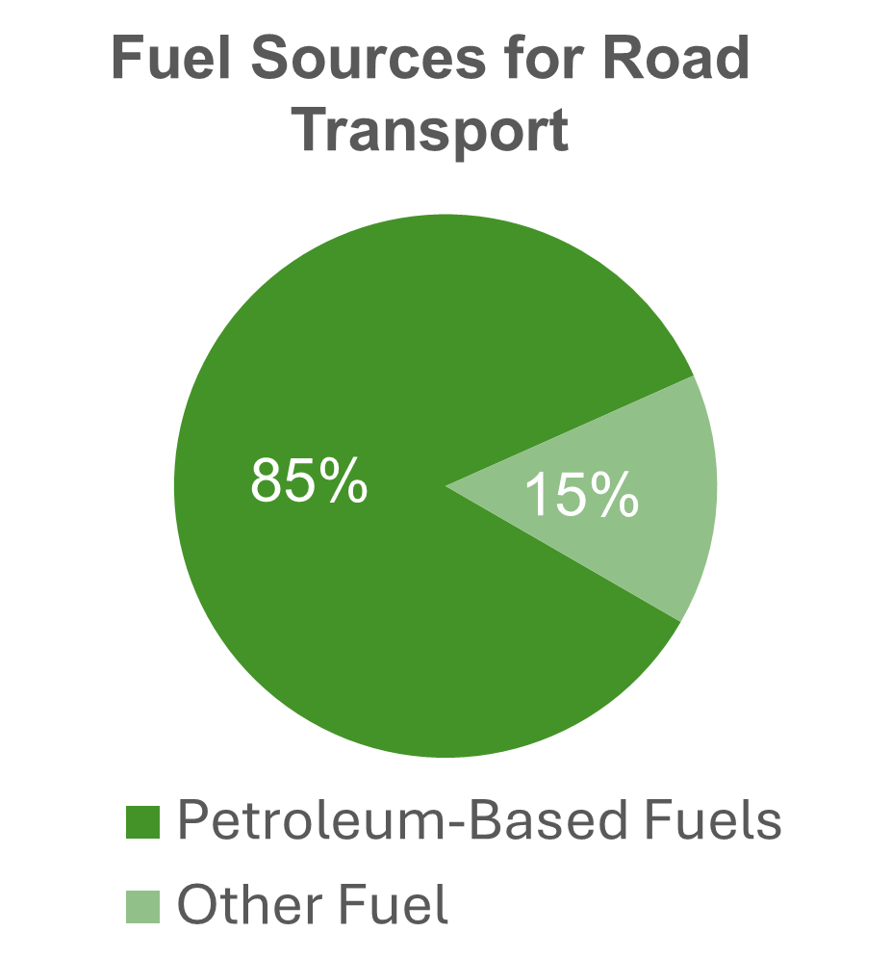
Introduction and Background
Sustainable urban transport given existing travel options and vehicle/fuel choices is a challenge
Transport sector accounts for ~19% of India’s final energy consumption, growing at 5-6% annually (see Fig.1).
Road transport dominates (>90%) in India and globally, with two-wheelers and cars as key contributors to fuel demand.
Urban Tier-2 cities are experiencing faster vehicle growth than metros but lack energy management frameworks.
Rising fuel consumption, congestion, and emissions pose new sustainability and policy challenges.
The study offers a descriptive analysis of Jodhpur, a representative medium-sized Indian city, presenting an integrated overview of its transport energy landscape through the intersection of vehicle characteristics and user behaviour.
Fig.1. Global transport energy and emission breakdown.
Source: IEA (2024) World Energy Outlook.
Transport Energy Demand in a Medium-Sized Indian City: Insights from Jodhpur

Slide 4
Research Gap and Objectives
Research Gaps
Objectives
Most transport energy research focuses on Indian megacities, critically neglecting medium-sized cities which house over half the urban population.
There is a significant lack of studies that integrate demand-side user behaviour with supply-side infrastructure data at the city level.
Policies from megacity models are often misaligned for medium-sized cities, which have unique fleets and distinct local challenges.
To profile Jodhpur's vehicle fleet, characterising its unique composition, technology, and operational usage intensity.
To describe and identify fuel choice, price sensitivity, and awareness of cleaner alternatives such as CNG and EVs.
To assess supply-side infrastructure and its challenges from the perspective of fuel station operators.
To identify the critical demand-supply mismatches that currently hinder a city-wide sustainable mobility transition.
Transport Energy Demand in a Medium-Sized Indian City: Insights from Jodhpur

Slide 5
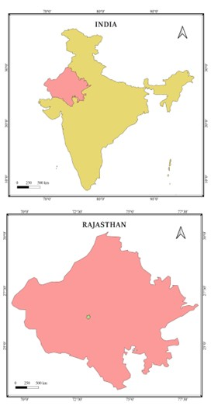
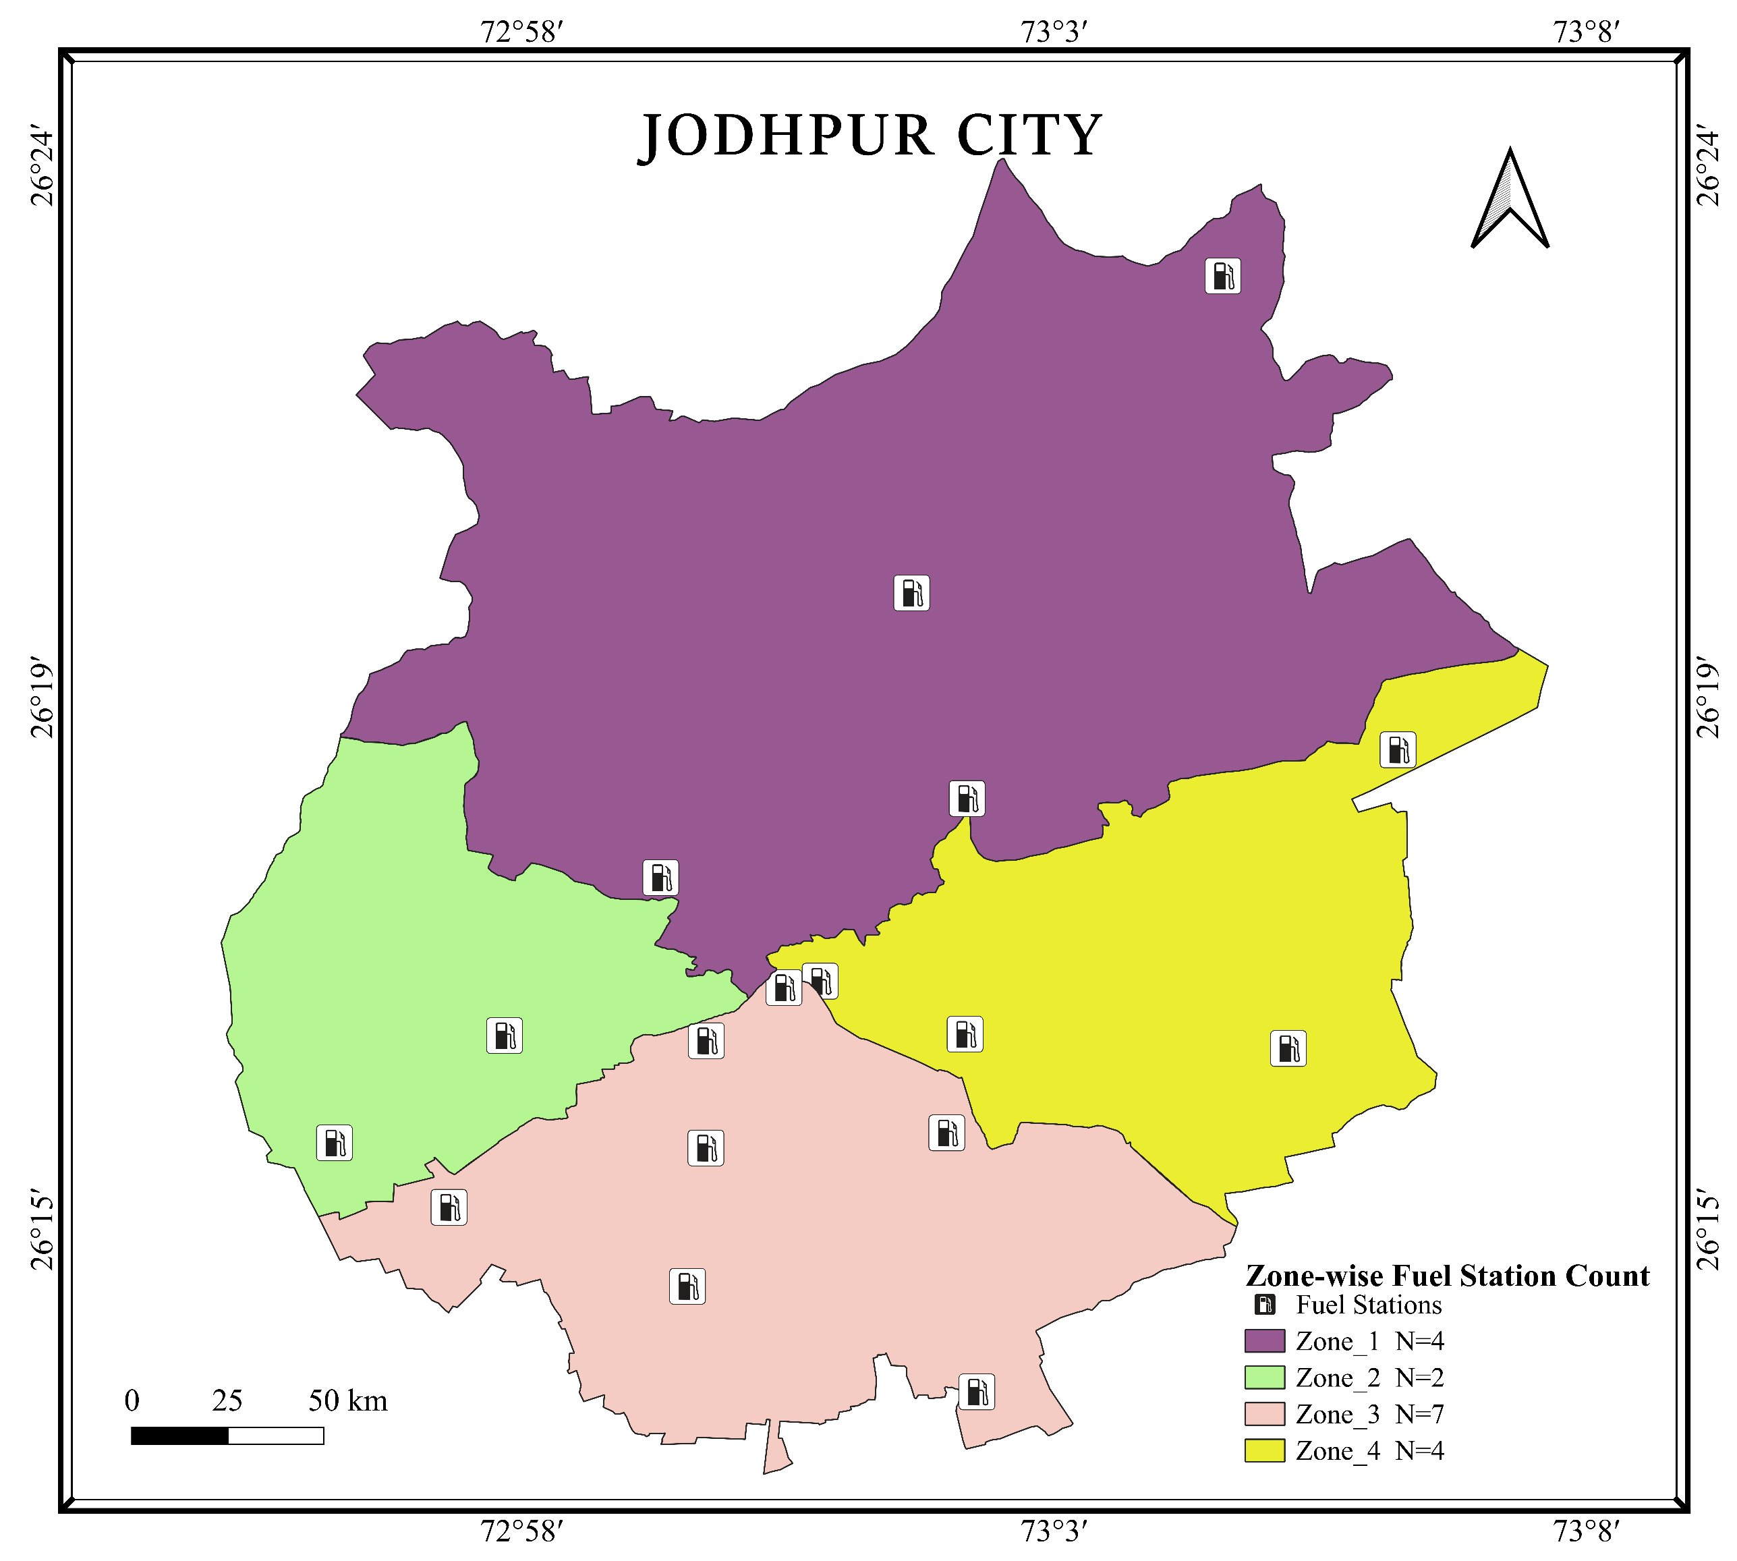
Study Area Profile - Jodhpur, Rajasthan
Jodhpur, Rajasthan's second-largest urban centre with ~1.3 million people, serves as a representative medium-sized city characterised by rapid urban sprawl and a two-wheeler-dominated fleet (>60%).
To ensure a representative sample, the city was stratified into four distinct population-density zones for the survey (see Fig.3), as clearly illustrated on the map.
Questionnaire surveys was conducted using stratified random sampling.
User Survey (n=250) – at Fuel stations, Residential areas, and key Road intersections.
Operator Survey (n=17) – From Fuel stations
RTO Registration data (2014-2024) – VAHAN SEWA portal, RTO Jodhpur.
Fig.3. Study area map showing stratified zones and surveyed fuel stations.
Transport Energy Demand in a Medium-Sized Indian City: Insights from Jodhpur

Slide 6
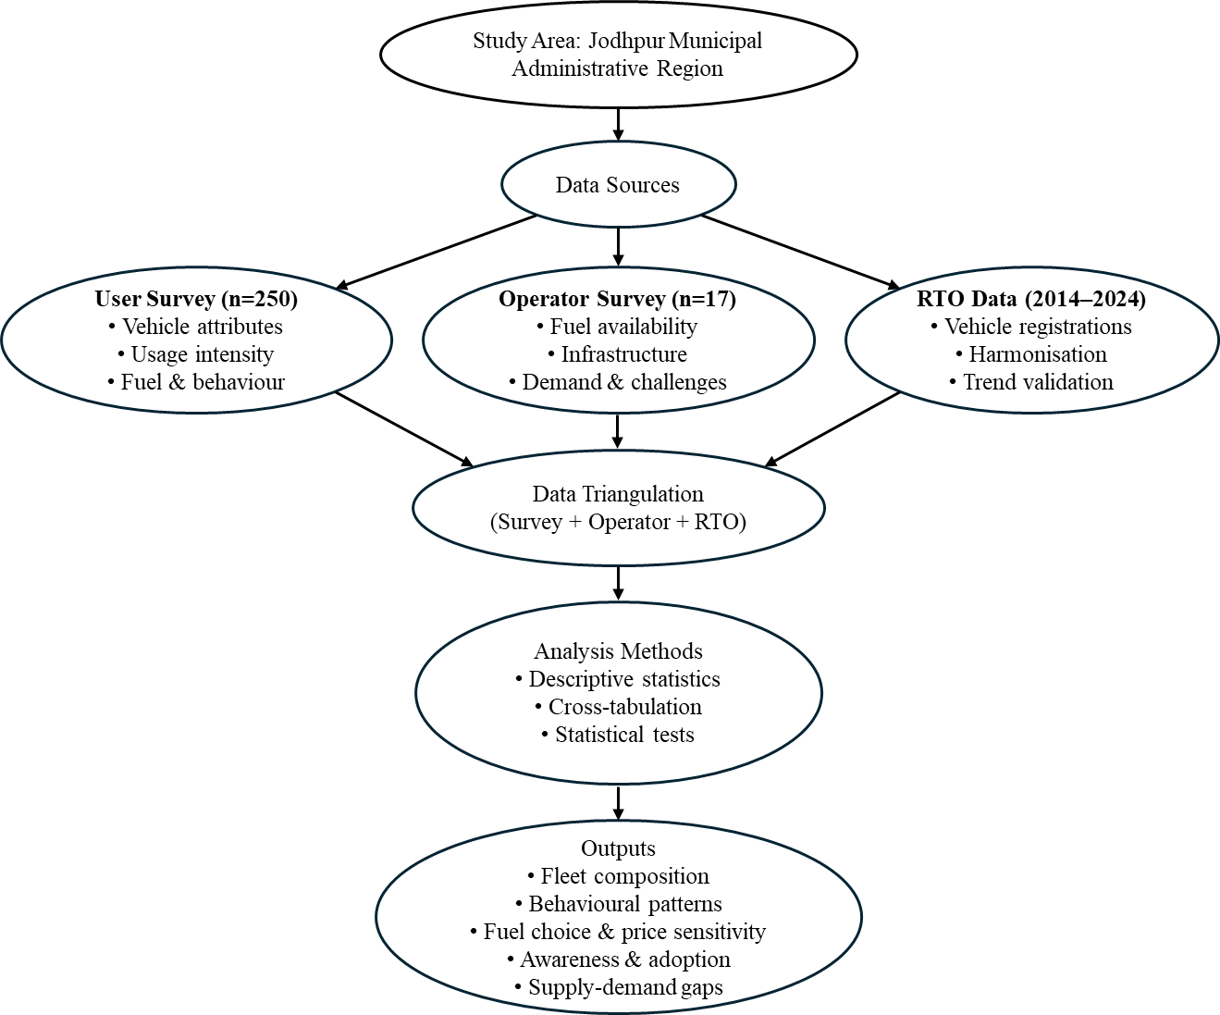
Research Methodology - Integrated Approach
This study uses Descriptive analysis methods such as cross-tabulation to identify key patterns and gaps.
Data triangulation enabled cross-verification of user and supply-side perspectives (see Fig.2).
City stratified into four population-density zones for representativeness.
Surveys distributed across residential, commercial, and arterial corridors.
250 user and 17 operator responses are spatially balanced.
Fig.2. Methodology Flow Chart
Transport Energy Demand in a Medium-Sized Indian City: Insights from Jodhpur

Slide 7
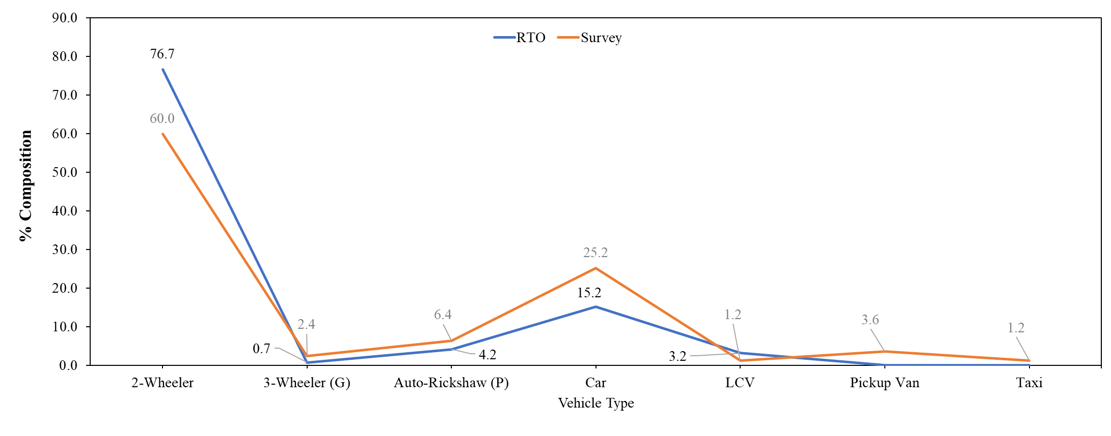
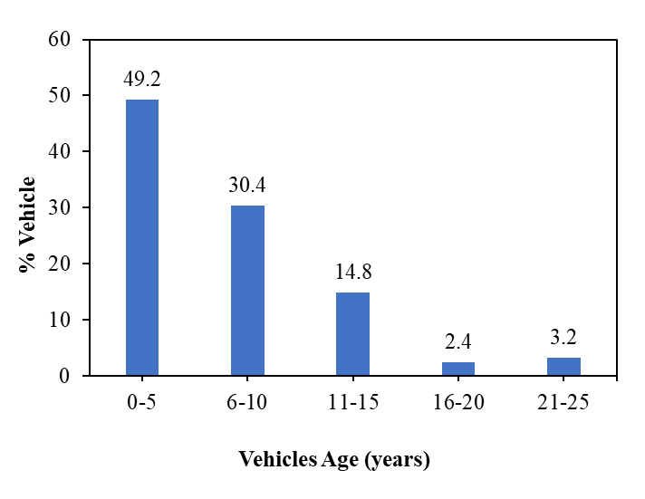
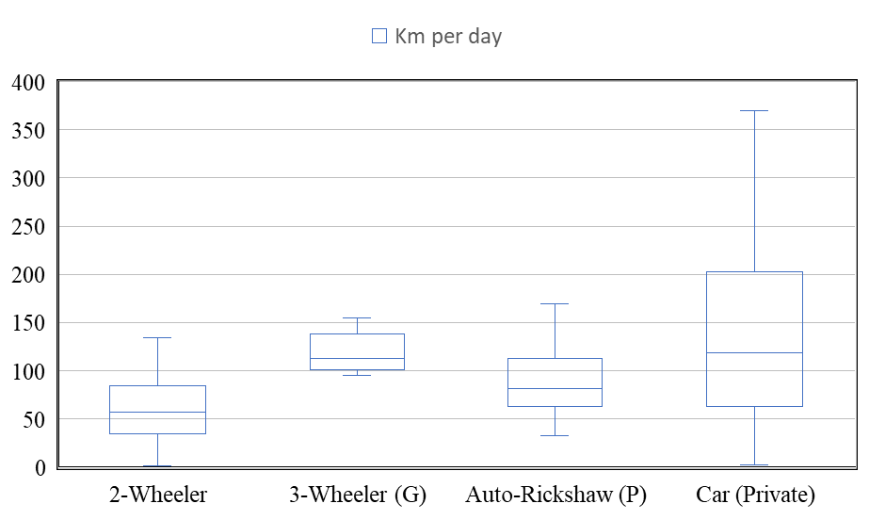
Analysis and Results: Fleet Composition & Usage
Two-wheelers dominate Jodhpur’s fleet (see Fig.4): > 60 % of registered vehicles, followed by cars (~ 25 %) and commercial modes.
Fleet Age (see Fig.5): 49.2 % are 0-5 years old Ownership Pattern: Two-wheelers prevalent among younger (18–25 yrs) and lower-income groups; car ownership rises with income and age.
Daily Usage (see Fig.5):
Commercial vehicles ≈ 150–180 km/day (highest energy intensity)
Cars ≈ 118 km/day (variable use)
Two-wheelers ≈ 56 km/day (steady urban use)
Fig.4. Fleet share comparison: Survey vs RTO.
Fig.5. Fleet profile of surveyed vehicles: Vehicle age distribution and Average daily usage intensity of vehicles by type
Transport Energy Demand in a Medium-Sized Indian City: Insights from Jodhpur

Slide 8
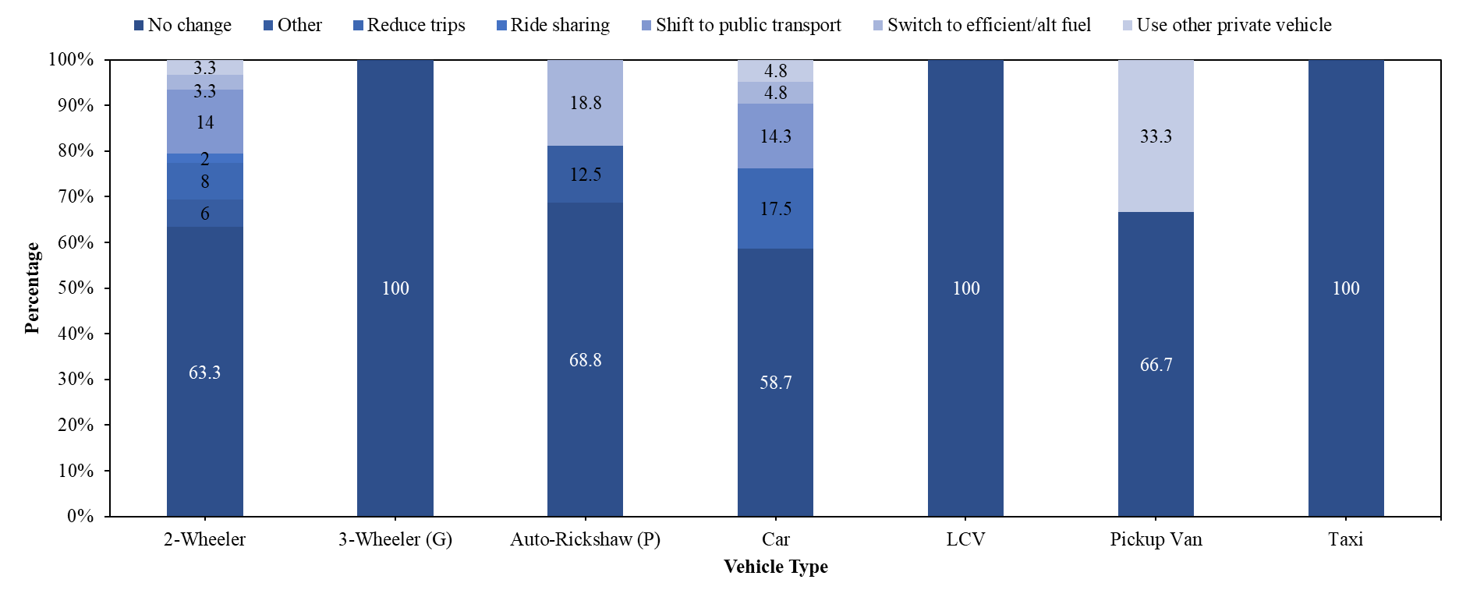
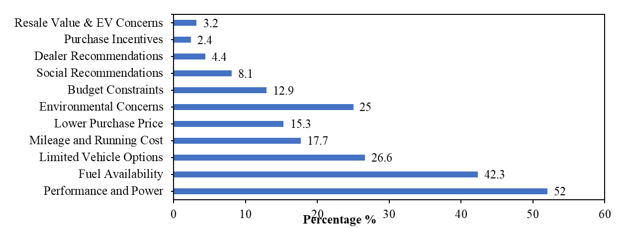
Analysis and Results: Fuel Mix, Behaviour, and Price Sensitivity
Jodhpur’s fleet is still petrol and diesel-based (see Table 1), with 90% of two-wheelers using petrol and diesel, leading cars (54 %) and LCVs (66.7 %).
Users favour performance (52 %) and fuel availability (42 %) over cost or environment (see Fig.6), showing strong behavioural lock-in.
About 63 % of two-wheeler users show no reaction to fuel-price hikes (see Fig. 7), indicating weak price sensitivity and the need for non-price interventions.
Table.1. Vehicle Type × Fuel Type (%)
Vehicle Type | CNG | Diesel | Electric | Hybrid (Petrol+CNG) | Petrol
2-Wheeler | 0 | 0 | 8 | 2 | 90
3-Wheeler (G) | 0 | 100 | 0 | 0 | 0
Autorickshaw (P) | 18.8 | 0 | 43.8 | 0 | 0
Car | 4.8 | 54 | 9.5 | 12.7 | 19
LCV | 33.3 | 66.7 | 0 | 0 | 0
Other | 0 | 100 | 0 | 0 | 0
Fig. 6. Stimuli for fuel choice.
Fig. 7. Vehicle type × Price sensitivity.
Transport Energy Demand in a Medium-Sized Indian City: Insights from Jodhpur

Slide 9
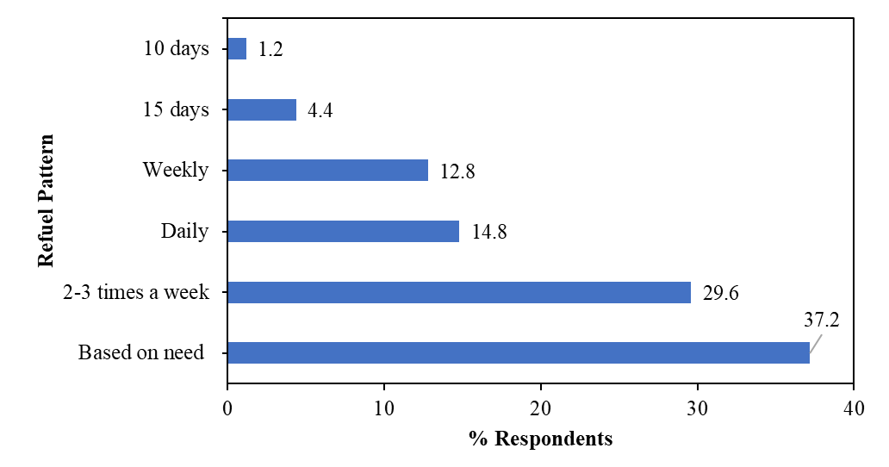
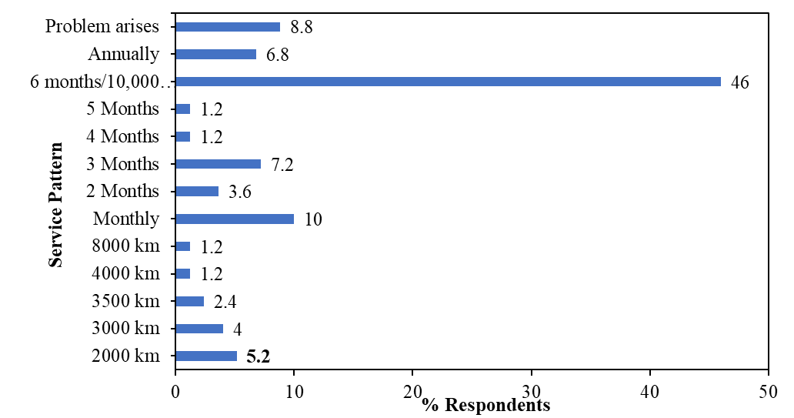
Analysis and Results: Servicing and Refuelling Behaviour
Servicing follows standard practice (see Fig. 8); 45 % of users service vehicles every 6 months or 10 000 km, mainly higher-income and commercial owners.
Refuelling habits are largely need-based (see Fig. 9), with 37 % of users refuelling only when fuel is low and 30 % doing so 2–3 times per week.
Such patterns affect fuel efficiency and emission levels, highlighting scope for behavioural interventions (e.g., digital reminders or maintenance incentives).
Fig. 8. Vehicle user Service practices
Fig. 9. Vehicle user Refuelling practices
Transport Energy Demand in a Medium-Sized Indian City: Insights from Jodhpur

Slide 10
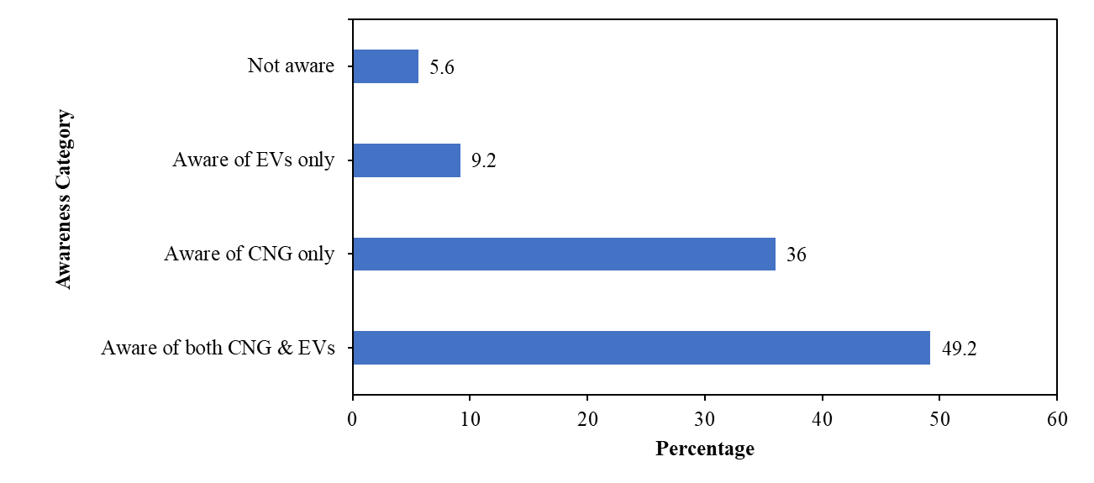
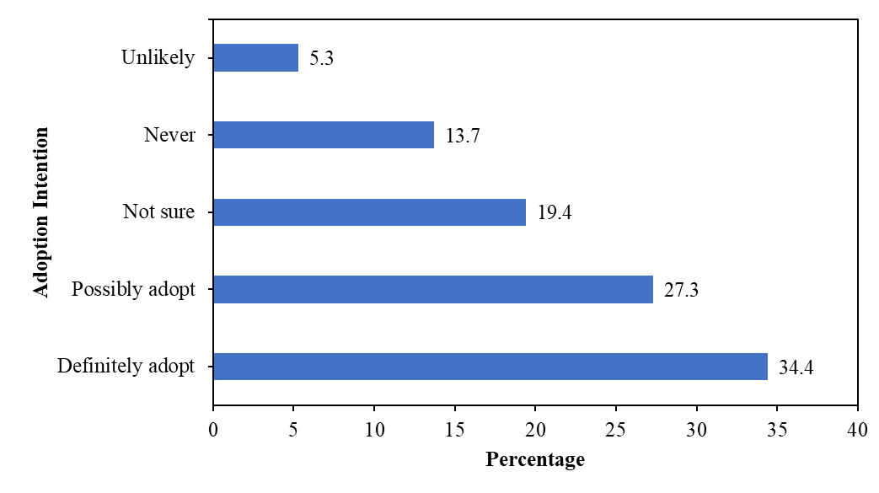
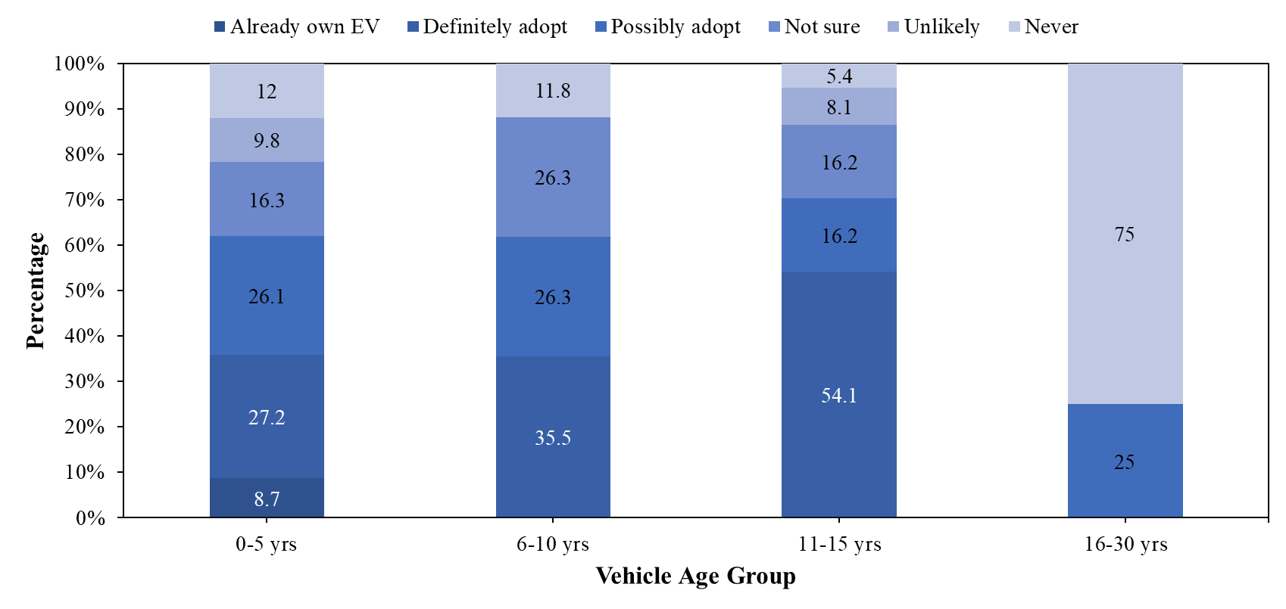
Analysis and Results: Awareness-Adoption Gap in Cleaner Fuel Alternatives
Although awareness of CNG and EVs is high ≈ 85 %, (see Fig. 10), only 34.4 % of users state they would “definitely adopt,” showing a strong awareness–action gap.
A significant 19 % remain unwilling or resistant, and another 19 % uncertain about switching (see Fig. 11), reflecting behavioural and infrastructural barriers.
Adoption intent is higher among younger and higher-income users, especially those owning newer vehicles (see Fig. 12), underscoring affordability and confidence as key enablers.
Fig.10. Awareness of CNG and EVs
Fig.11. Willingness to adopt cleaner alternatives.
Fig.12. Adoption intentions for alternative fuels by vehicle age group.
Transport Energy Demand in a Medium-Sized Indian City: Insights from Jodhpur

Slide 11
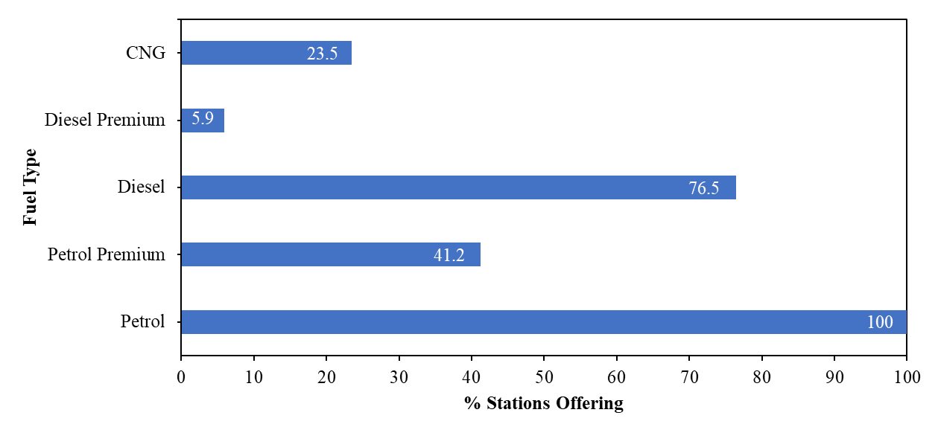
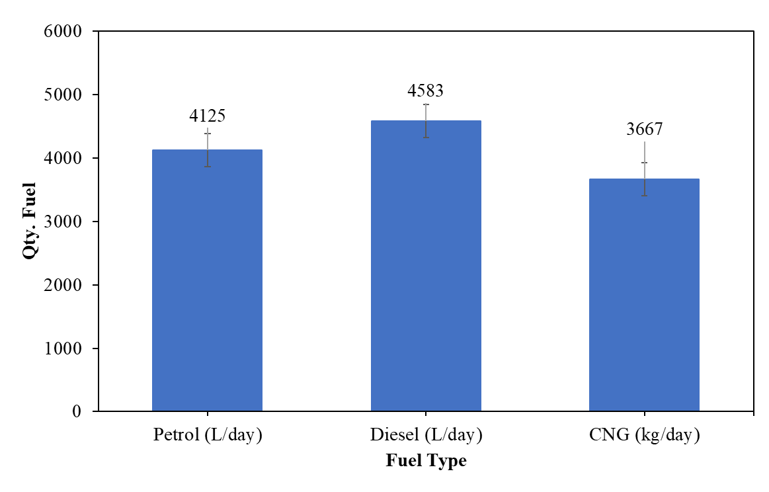
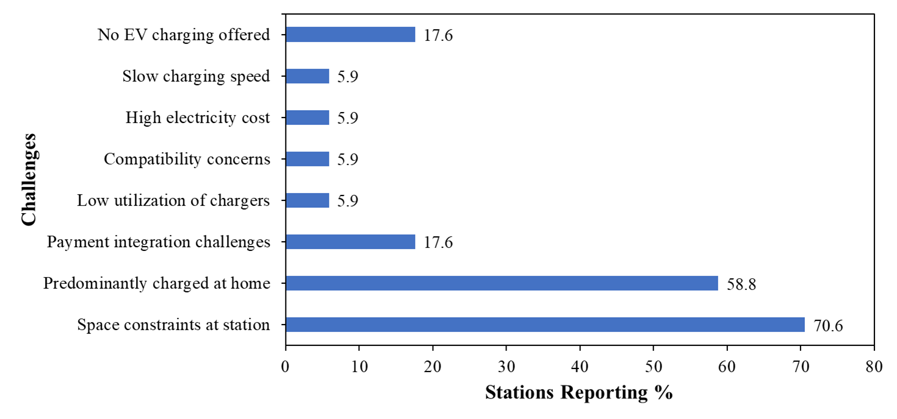
Analysis and Results: The Supply-Side Infrastructure Gap
The supply-side data reveals a major infrastructure gap for alternative fuels.
While Petrol (100%) and Diesel (76.5%) are universal , CNG is available at only 23.5% of surveyed stations (see Fig.13).
There is zero public EV charging at any station surveyed , with operators citing space constraints (71%) as the main barrier (see Fig.15).
Daily sales data confirms this dominance, with Diesel (4,583 L/day) and Petrol (4,125 L/day) as the top sellers (see Fig.14).
Fig.13. Fuel availability across surveyed stations
Fig.14. Average daily sales by fuel type
Fig.15. Challenges in providing EV charging.
Transport Energy Demand in a Medium-Sized Indian City: Insights from Jodhpur

Slide 12
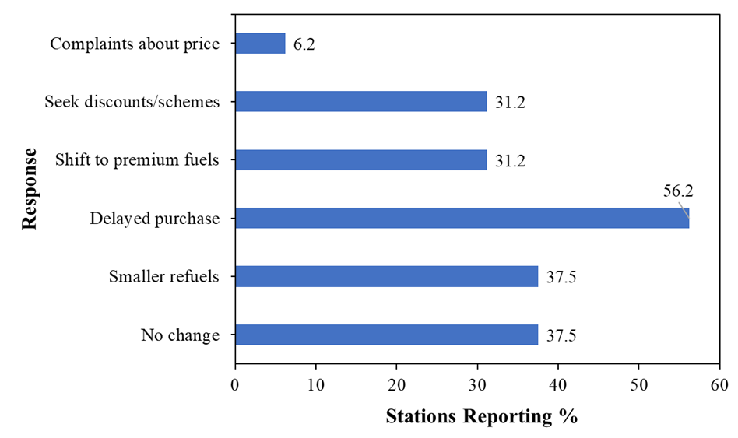
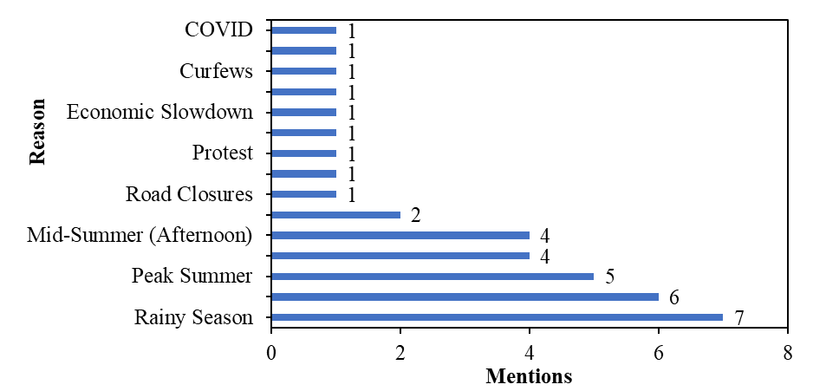
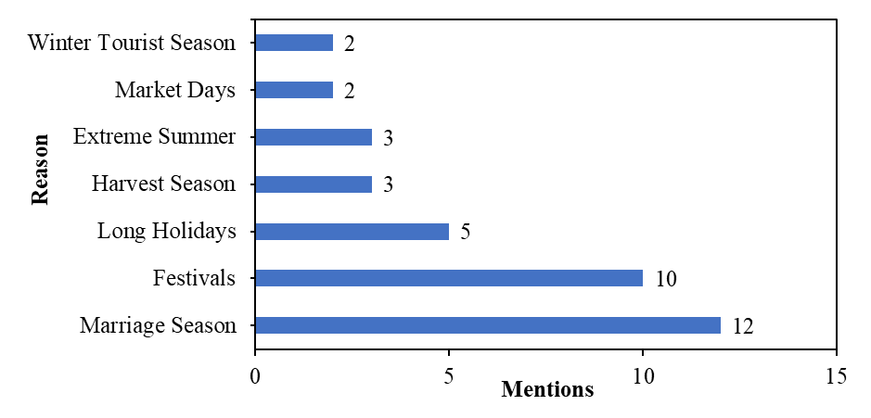
Analysis and Results: Operator Perspectives on Demand
Operators report that customer demand is highly responsive to external factors.
When fuel prices rise, the most common customer responses are delaying purchase (56.2%) or opting for smaller refuels (37.5%) (see Fig.16) .
Demand is also highly seasonal, with operators reporting significant sales peaks during marriage seasons and festivals (see Fig.17).
Conversely, demand drops significantly during the rainy season and peak summer (see Fig.18).
Fig.16. Customer responses to fuel price increases.
Fig.17. High demand reasons
Fig.18. Low demand reasons.
Transport Energy Demand in a Medium-Sized Indian City: Insights from Jodhpur

Slide 13
Policy Implications & Way Forward
Infrastructure & Supply-Side Actions
Fleet & Technology Actions
Behavioural & Demand-Side Actions
Incentivise the replacement of commercial fleets (LCVs, taxis), which have the highest daily usage intensity and thus offer the largest energy savings.
Develop programs for the two-wheeler segment (fleet renewal, maintenance) as it's the largest portion of the fleet.
Launch non-price interventions (awareness campaigns, maintenance incentives) targeting two-wheeler users, as they are the most price-insensitive group.
Empower municipal authorities to integrate transport and energy planning, using this study's framework to make data-driven decisions.
Expand the CNG network across all city zones to bridge the supply gap (only 23.5% of stations)
Prioritise public-private partnerships (PPPs) to roll out an EV charging network, overcoming operator barriers like space constraints.
Transport Energy Demand in a Medium-Sized Indian City: Insights from Jodhpur

Slide 14
Conclusion
Jodhpur’s transport energy demand is shaped by two-wheeler dominance, performance-driven fuel choices, and high usage intensity in commercial fleets.
A clear "Awareness-Adoption Gap" exists: High awareness of CNG/EVs (~85%) does not translate to high adoption (only ~34% definite).
A structural supply shortfall (only 23.5% of stations offer CNG; 0 surveyed stations offer public EV charging) is the key barrier to a clean fuel transition.
Future Works
Model the factors influencing the adoption of the Environmentally friendly fuels in medium and small sized cities
Incorporate GIS-based spatial analysis to map infrastructure gaps and identify priority zones for CNG/EV rollout.
Develop a granular and integrated framework to model the energy demand across the regions.
Transport Energy Demand in a Medium-Sized Indian City: Insights from Jodhpur

Slide 15
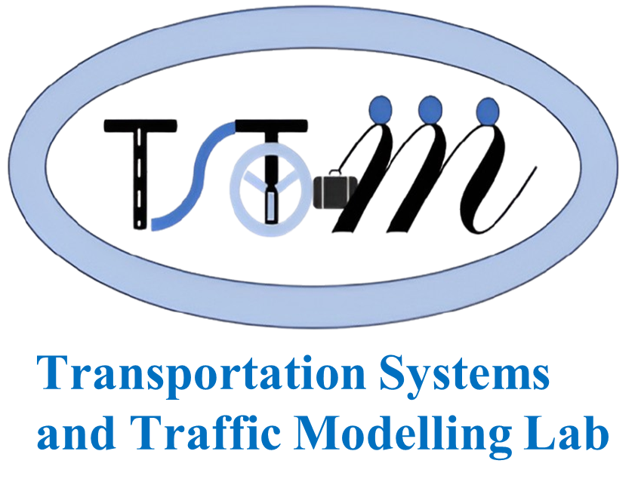

Thank You
Contacts:
Pathan Mujahid Najekhan, M-Tech. Scholar, Infrastructure and Energy specialisation, m24cin009@iitj.ac.in ;
Shahiq Ahmad Wani, PhD Scholar, wani.1@iitj.ac.in;
Dr Ranju Mohan, Associate Professor, ranju@iitj.ac.in,
TSTM Lab, E1 Berm,
Department of Civil and Infrastructure Engineering,
Indian Institute of Technology Jodhpur,
NH 62, Nagaur Road, Karwar 342030, Jodhpur District, Rajasthan, India.
Transport Energy Demand in a Medium-Sized Indian City: Insights from Jodhpur

