Slide 1

Understanding Pedestrian Priorities for Metro Access: A Dual-Method Analysis in Chandigarh
Abhishek
Research Scholar, Indian Institute of Technology Ropar

Slide 2
Contents
Introduction
Objectives
Methodology
Results
Implications

Slide 3

Introduction
Walking is the most sustainable and inclusive mode of urban mobility.
It serves as a critical first- and last-mile (FLM) link to enhance metro system accessibility.
In Indian cities, pedestrian planning often receives less attention compared to metro infrastructure development.
This study focuses on Chandigarh, a planned city, to identify which walking features people value most when accessing to proposed metro stations.
🚶
🚇
📊
Sustainability
Walkability
Metro
Analysis

Slide 4

Objectives
Identify key factors influencing how people choose walking routes to metro stations.
Analyze and rank these factors using two methods — RIDIT ( Relative to an Identified Distribution Integral Transformation) and Grey Relational Analysis (GRA).
Provide practical recommendations for improving pedestrian access to the proposed metro system in Chandigarh.

Slide 5
Methodology
Questionnaire Survey
Data Preparation
Ridit Analysis
Rank perceived importance of attributes.
Grey Relational Analysis (GRA)
Measure each attribute’s closeness to ideal walking conditions.
Comparison & Validation
Key Findings

Slide 6
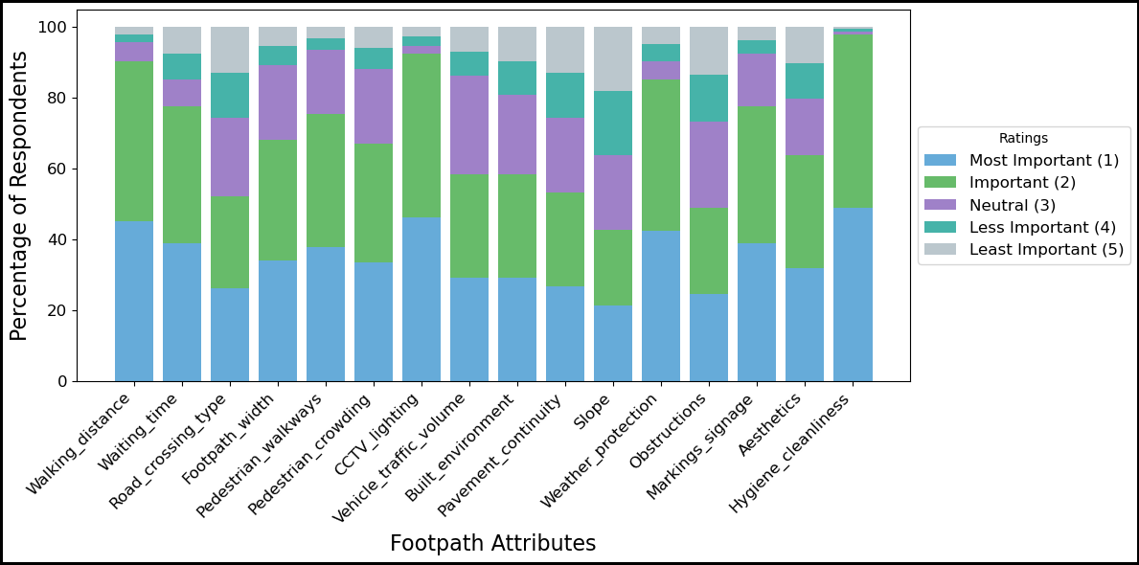
Results
The top 3 attributes:
Hygiene & Cleanliness
CCTV & Streetlights
Walking Distance
Fig. 1. Importance ratings of footpath attributes for Chandigarh metro access

Slide 7
Results - RIDIT Analysis
Converts ordinal responses (from the Likert scale) into probability-based scores (0–1).
Lower RIDIT (Relative to an Identified Distribution Integral Transformation) value → higher perceived importance of that attribute.
Highlights pedestrian’s priority perceptions among walking attributes.
Attributes | RIDIT Score | Rank
Walking distance | 0.3899 | 3
Waiting time | 0.4953 | 8
Road crossing type | 0.5912 | 13
Footpath width | 0.4790 | 7
Pedestrian walkways | 0.4428 | 5
Pedestrian crowding | 0.5326 | 9
CCTV and lighting | 0.3284 | 2
Vehicle traffic volume | 0.5630 | 11
Built environment | 0.5803 | 12
Pavement continuity | 0.6114 | 14
Slope | 0.6925 | 16
Weather protection | 0.4023 | 4
Obstruction | 0.6893 | 15
Markings and signage | 0.4546 | 6
Aesthetics | 0.5334 | 10
Hygiene and cleanliness | 0.2494 | 1

Slide 8
Results – Grey Relation analysis
Evaluates how closely each walking attribute aligns with an ideal pedestrian environment.
Attributes with higher Grey Relational Grades (GRG) indicate greater importance to pedestrians.
Attributes | GRA score | Rank
Walking distance | 0.8443 | 3
Waiting time | 0.7134 | 10
Road crossing type | 0.6432 | 13
Footpath width | 0.7953 | 5
Pedestrian walkways | 0.7638 | 7
Pedestrian crowding | 0.6642 | 12
CCTV and lighting | 0.9000 | 2
Vehicle traffic volume | 0.6391 | 14
Built environment | 0.7231 | 9
Pavement continuity | 0.6721 | 11
Slope | 0.5730 | 16
Weather protection | 0.8294 | 4
Obstruction | 0.6053 | 15
Markings and signage | 0.7836 | 6
Aesthetics | 0.7478 | 8
Hygiene and cleanliness | 0.9334 | 1

Slide 9
Conclusion
Study based on responses from 100 commuters in Chandigarh, focusing on walking accessibility for first- and last-mile (FLM) metro connectivity.
Used two complementary methods: RIDIT (subjective perception) and GRA (objective closeness) to rank key walking attributes.
Top influencing factors: Cleanliness & hygiene, Safety (CCTV & lighting), Walking distance, and Weather protection.
Less significant factors: Slope, obstacles, and pavement continuity.
Findings confirm that safety, comfort, and environmental quality are the core dimensions of a commuter-friendly walking environment.

Slide 10
Implications for Practice
Cleanliness & hygiene: Implement regular sweeping, anti-litter initiatives, and waste bins every 500 m.
Safety & security: Install CCTV and lighting (≥10 lux) at crossings; integrate surveillance into metro station design (per IRC:103-2012).
Comfort & Weather Protection: Develop shaded, tree-lined, and covered walkways to enhance pedestrian comfort and weather resilience.
Footpath design: Ensure wide, continuous, and obstacle-free sidewalks with clear pedestrian signage.
Walking distance: Optimize route length through underpasses or overpasses to provide safer, shorter connections to metro stations.

Slide 11
References
Gerike, R., de Nazelle, A., Wittwer, R., & Parkin, J. (2019). Special issue “walking and cycling for better transport, health and the environment”. Transportation research Part A: Policy and practice, 123, 1-6.
Herrmann-Lunecke, M. G., Mora, R., & Sagaris, L. (2020). Persistence of walking in Chile: lessons for urban sustainability. Transport reviews, 40(2), 135-159.
Erath, A., van Eggermond, M. A., Ordóñez, S. A., & Axhausen, K. W. (2017). Introducing the pedestrian accessibility tool: walkability analysis for a geographic information system. Transportation research record, 2661(1), 51-61.
Munoz-Raskin, R., 2010. Walking accessibility to bus rapid transit: Does it affect property values? The case of Bogot´a, Colombia. Transp. Policy 17, 72–84. https://doi.org/ 10.1016/j.tranpol.2009.11.002.
Neves, C.E.T., da Silva, A.R., de Arruda, F.S., 2021. Exploring the link between built environment and walking choice in S˜ao Paulo city, Brazil. J. Transp. Geogr. 93, 103064
Bivina, G.R., Gupta, A., Parida, M., 2020. Walk accessibility to metro stations: An analysis based on Meso- or Micro-scale Built Environment Factors. Sustain. Cities Soc. 55, 102047
Cervero, R., 2001. Walk-and-ride: factors influencing pedestrian access to transit. J. Public Transp. 3, 1–23.
Deng, H., Li, Y., 2016. How Actual Impedance and Overall Experience Shape the Walking Catchment Area of Rail Transit Station: A General Walking Efforts Framework, in: Transportation Research Board 95th Annual Meeting (No. 16-6436), Washington DC.
Jiao, J., Chen, Y., He, N., 2017. Plan pedestrian friendly environments around subway stations: lessons from Shanghai, China. J. Urban Des. 22, 796–811.

Slide 12
THANK YOU

