Slide 1
A Framework for Assessing the Multi-Modal Integration at the Interchange Hubs
18th Urban Mobility India Conference and Expo 2025
November 07-09, 2025
Presented by: Varsha Yadav
Research Scholar, CED, TEG, Indian Institute of Technology Roorkee
Co-Authors: Rajat Rastogi¹, Mukti Advani²
¹Professor, CED, TEG, Indian Institute of Technology Roorkee,
²Senior Principal Scientist, TPE, CSIR-Central Road Research Institute

Slide 2
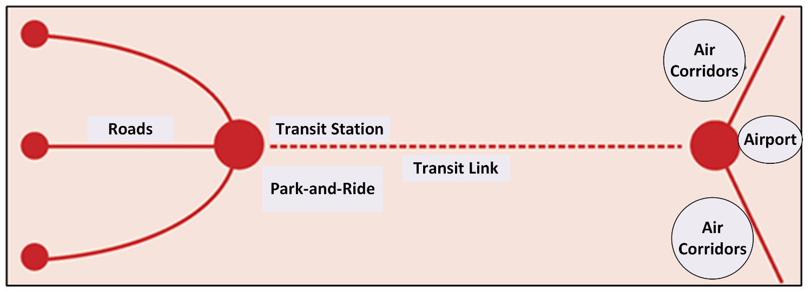
Multi-Modal Integration
Figure 1: Integrated network of transport system
Physical Integration –Distance proximity for seamless transfer between terminals
2. Network/ Operational Integration -Coordinated services and schedules for seamless connectivity
3. Fare Integration -Integrated single fare or a common card for all modes
4.Information Integration-
Integrated information of routes, fares, schedules, and services through web application
5.Institutional Integration- Single organizational framework controlling all modes

Slide 3
Motivation of the Study
Lack of institutional/operational/physical integration leads to:
  Physical integration and coordination issues among different modes
  Haphazard allocation of spaces to various modes causing entry and exit issues
  e.g. Charbagh Station, Lucknow, (https://www.hindustantimes.com/cities/)
  Time penalty to the passengers due to uncoordinated services, absence of proper information regarding location, schedules, service types, etc.
  Increase in discomfort and inconvenience due to absence of design and layout guidelines resulting in:
    Undue priority to non-sustainable modes
    Increase in conflicts (vehicle-vehicle and vehicle-passenger)
    Uncomfortable Inter-terminal movements
Non-availability of integrated single card/ticket (Fare integration)
  The time penalty at the interchanges is increasing
  Passengers are reporting continuous dissatisfaction with the public transport (Ola Mobility Institute, 2018)

Slide 4
Literature Review
Table 1 : Attributes and analysis methods used in the evaluation of interchange hubs
Author(s), year | Country | Factors/Attributes/ Indicators/Indices | Analysis Methods
Wang et al., 2009 | China | Transfer area facility per capita index, dynamic match degree index, hub parking area rate index, comfort degree of transfer index, and rational layout index | TOPSIS, and Entropy Method (assigning weight)
Yin et al., 2018 | China | 7 indexes -Transfer link, service facilities, information services, security emergency, environmental sanitation, operation management, public evaluation | Matter element analysis theory
Kopylova et al., 2018 | Russia | Transfer duration | Statistical Analysis
Conticell et al., 2021 | Europe | 52 factors under 9 categories (accessibility, quality of interchange environment, safety and security, efficiency, planning, service information, service coordination, policies, norms, and regulations, initiatives to change citizens behaviors) | Statistical Analysis
Note: TOPSIS= Technique for Order Preference by Similarity to Ideal Solution.

Slide 5
Literature Review (Conti….)
Table 1 : Attributes and analysis methods used for the evaluation of interchange hubs
Author(s), year | Country | Factors/Attributes/ Indicators/Indices | Analysis Methods
Nie et al., 2021 | China | 9 indexes under 3 criteria level (Facilities and equipment level, organization and management level, passenger satisfaction level) | AHP (for assigning weights)
Moodley & Venter, 2022 | South Africa | 8 attributes (Comfort and convenience, universal access, personal security, road traffic safety, provisions of information, integrated ticketing, provisions of amenities, and waiting times) | Statistical Analysis
Koottungal, 2022 | India | 25 indicators under 6 categories (operational, planning, build infrastructure, passenger information, passenger safety, and passenger comfort) | Statistical Analysis
Nie et al., 2023 | China | 14 factors under 4 indexes (hub distribution efficiency, passenger transfer efficiency, infrastructure construction, service level) | AHP (for assigning weights)
Note: AHP = Analytical Hierarchical Process

Slide 6
Research Gaps
Less studies are available on the performance evaluation of interchange hubs
Most of the studies used similar key factors in the evaluation framework
Evaluation mainly focused on the operational/functional/layout related aspects
Lacks overall evaluation framework related to multi-modal integration at the interchange hubs
Studies are case-sensitive, and lacks universal applicability
Benchmarking mechanism/framework for SWOT analysis is missing
There is a need of a practical tool for assessing and evaluating the multi-modal integration at interchange hubs in the light of Government of India initiatives
Aerocity set to become India’s key multimodal transport hub with rail, road, air Integration- Explained - Infrastructure News | The Financial Express

Slide 7
Overall Methodology
Literature Review
Identification of Key factors affecting multi-modality
Study Objectives
Quantification of Indicators
Identification of Study Locations
Data Collection
Inventory Survey
Passenger Survey
Expert Survey
Videographic Data Checklist
Satisfaction Score
Importance Weights of Key Factors and Domains
Multi-modality Equation
Multi-modality Score of an Interchange
Figure 2: Overall Methodology

Slide 8
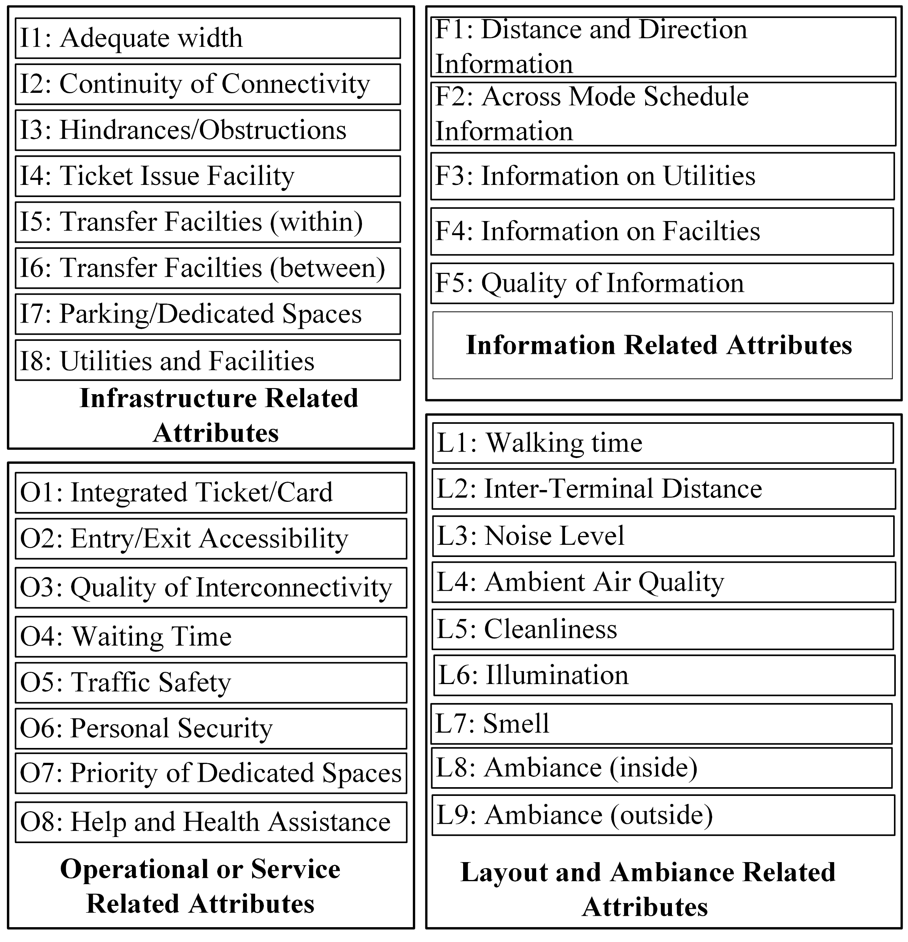
Selected Key factors (KFs)
KFs taken from literature review as well as considering feasibility and applicability for Indian conditions and possibility of adding new factor to the list
Figure 3: Set of selected key factors

Slide 9
Quantification of Key Factors (KFs)
Table 2 : Scoring system used in the literature
Author (s) | Scoring Method
(Moodley & Venter, 2022) | (0/1) - Absence/Full Presence (NO/YES) 0/0.5/1 - 3-point score Percentage of passengers who agreed on certain criteria
(Bryniarska & Zakowska, 2017) | 0 (fail to meet even one criteria) /1 (fulfilling all criteria)
(Sil et al., 2022) | Yes/No Five-point Scale (for passengers’ willingness/ perception) % Fulfilling a criteria
A 5-point scoring system (minimum 1 and maximum 5) is created for the indicators (30 Nos) selected in this study

Slide 10
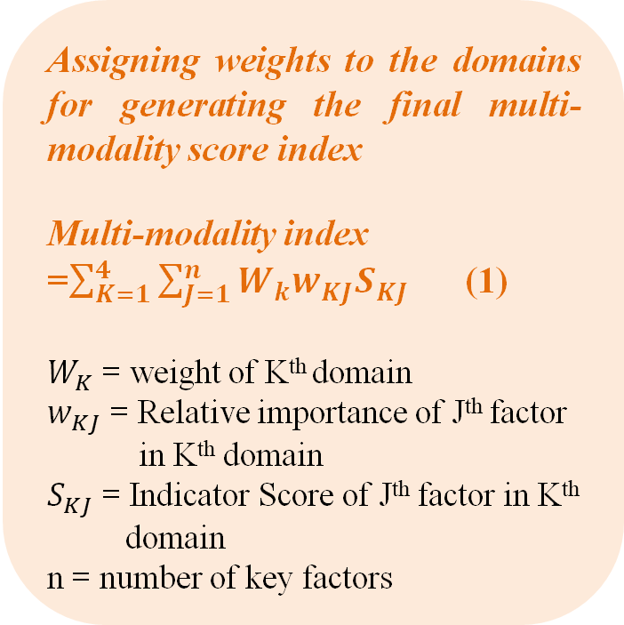
Method of Assigning Weights
Expert Survey -
3 Point scoring system: For assigning weights to KFs within domain
AHP - Analytical Hierarchical Process: For assigning weights to domains
Assigning weights to the key factors within respective domain
Score 1: The importance of KF is LOW, its absence will not have an impact on the overall performance in that domain.
Score 2: The importance of KF is MEDIUM, its absence will impact the overall performance in that domain.
Score 3: The importance of KF is HIGH, its absence will significantly impact the overall performance in that domain.
Assigning weights to the domains for generating the final multi-modality score index
Multi-modality index =$\sum_{K=1}^{4}{\sum_{J=1}^{n}{W_{k}w_{KJ}S_{KJ}}}$ (1)
$W_{K}$ = weight of K^{th} domain
$w_{KJ}$ = Relative importance of J^{th} factor in K^{th} domain
$S_{KJ}$ = Indicator Score of J^{th} factor in K^{th} domain
n = number of key factors

Slide 11
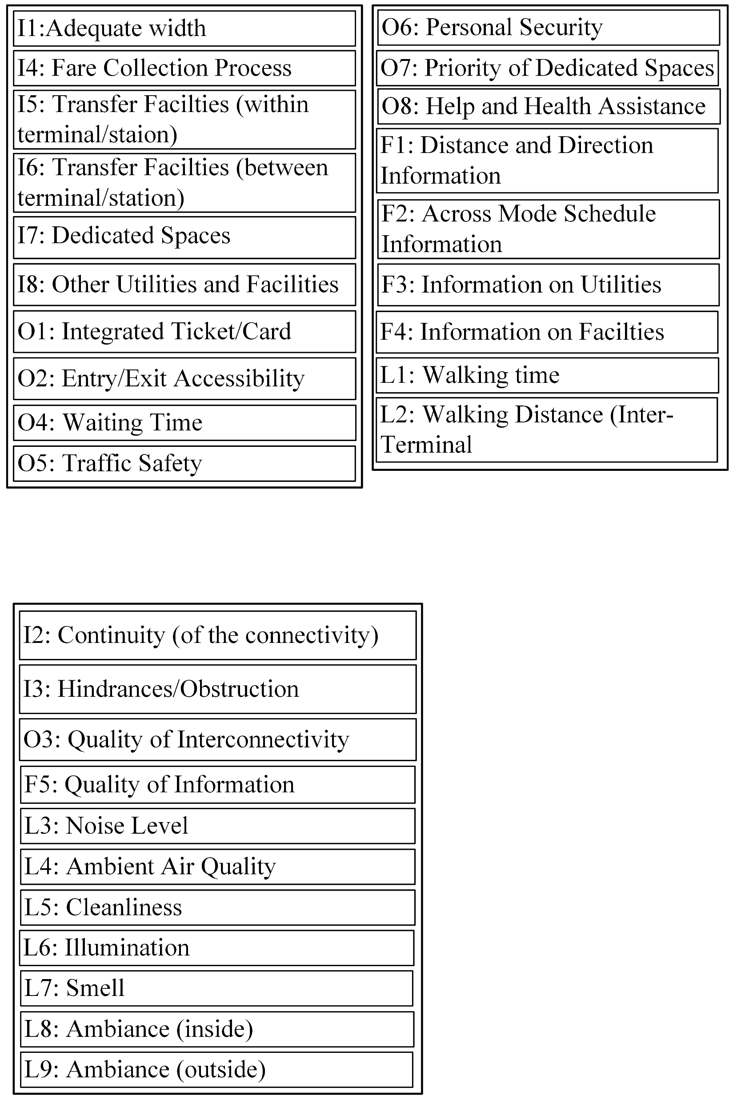
Data Collection Approaches
Inventory Survey
Passenger Survey
Expert Survey
To get the Key Factor Score
To get the importance weights of the key factor(s) and domains
Formulation of Multi-modality Equation
Figure 4: Data Collection Approaches
I = Infrastructure-related attributes, O = Operational/Service-related attributes
F = Informatics attributes, L= Layout and ambiance related attributes

Slide 12
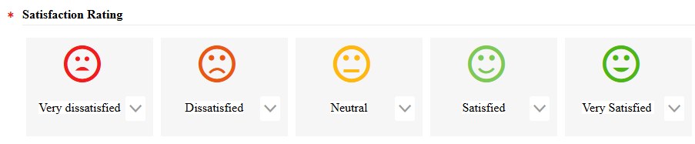
Passenger Survey
Structured Questionnaire for Satisfaction Ratings:
Likert Scale
1: Very Dissatisfied
2: Dissatisfied
3: Neutral
4: Satisfied
5: Very Satisfied
Figure 5: An illustration of visual aid for taking satisfaction ratings

Slide 13
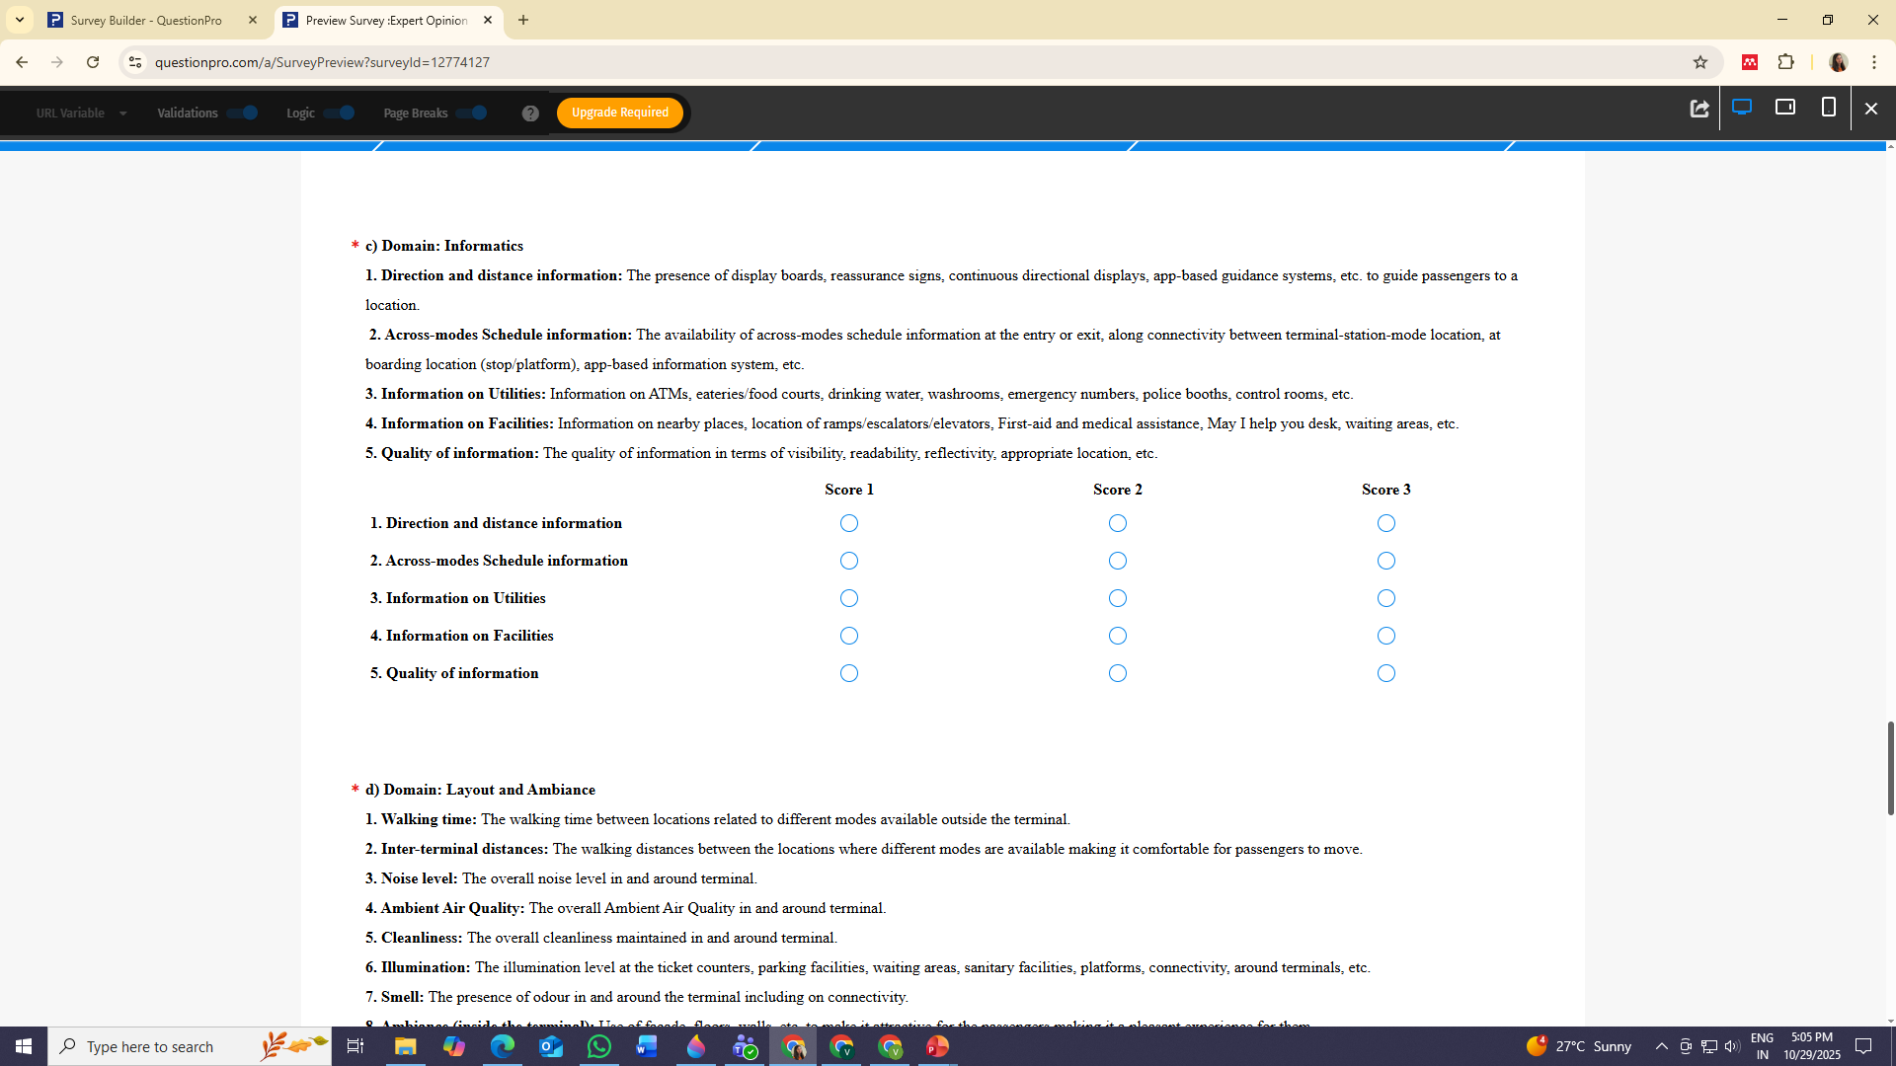
Expert Survey
Identification of Experts: Using Platforms like Google Scholar, Research Gate, LinkedIn, and Government and Educational Institutes websites
Criteria: Experts working in the domain of transportation planning or multi-modal integration area
Institutes Websites
Figure 6: An illustration to take key factors score within the domain

Slide 14
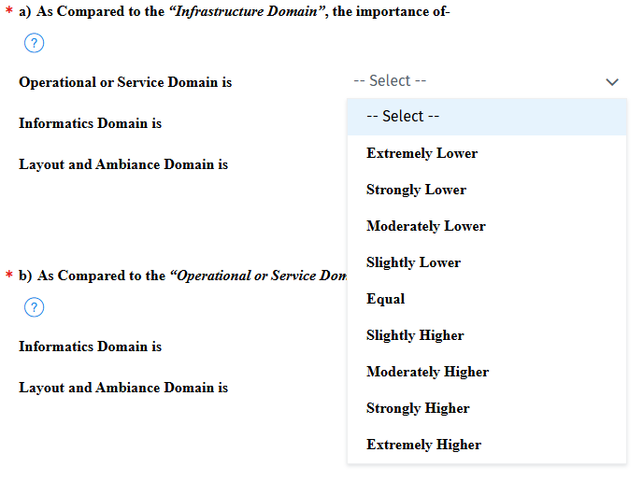
Expert Survey(Conti….)
Institutes Websites
Figure 7: An illustration of pairwise comparisons for the domains

Slide 15
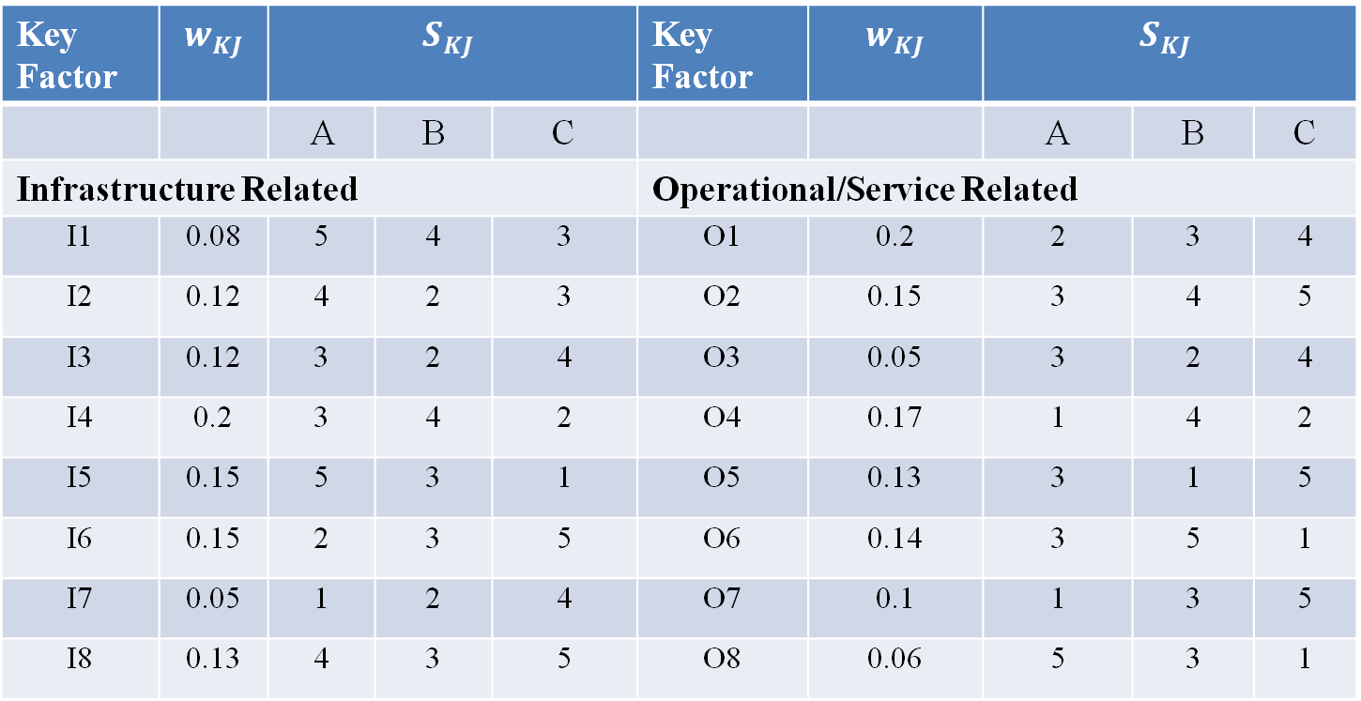
Application Example
Table 3 : Comparison analysis of multi-modality score of three hypothetical locations.
Key Factor | $$w_{KJ}$$ | $$S_{KJ}$$ |  |  | Key Factor | $$w_{KJ}$$ | $$S_{KJ}$$
 |  | A | B | C |  |  | A | B | C
Infrastructure Related |  |  |  |  | Operational/Service Related
I1 | 0.08 | 5 | 4 | 3 | O1 | 0.2 | 2 | 3 | 4
I2 | 0.12 | 4 | 2 | 3 | O2 | 0.15 | 3 | 4 | 5
I3 | 0.12 | 3 | 2 | 4 | O3 | 0.05 | 3 | 2 | 4
I4 | 0.2 | 3 | 4 | 2 | O4 | 0.17 | 1 | 4 | 2
I5 | 0.15 | 5 | 3 | 1 | O5 | 0.13 | 3 | 1 | 5
I6 | 0.15 | 2 | 3 | 5 | O6 | 0.14 | 3 | 5 | 1
I7 | 0.05 | 1 | 2 | 4 | O7 | 0.1 | 1 | 3 | 5
I8 | 0.13 | 4 | 3 | 5 | O8 | 0.06 | 5 | 3 | 1
Institutes Websites
I = Infrastructure related attributes, O = Operational/Service-related attributes, F = Informatics attributes, L= Layout and ambiance related attributes. A, B,C:- Three Hypothetical Locations

Slide 16
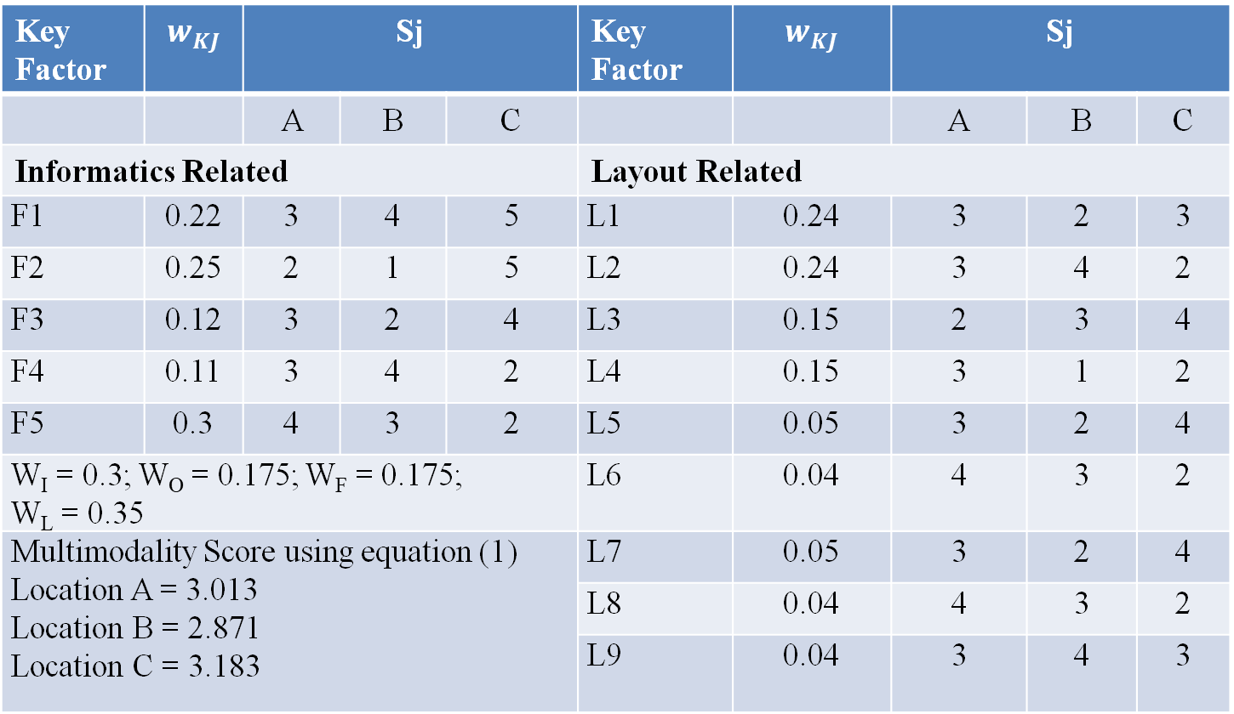
Application Example (Conti…)
Table 3 : Comparison analysis of multi-modality score of three hypothetical locations.
Key Factor | $$w_{KJ}$$ | Sj |  |  | Key Factor | $$w_{KJ}$$ | Sj
 |  | A | B | C |  |  | A | B | C
Informatics Related |  |  |  |  | Layout Related
F1 | 0.22 | 3 | 4 | 5 | L1 | 0.24 | 3 | 2 | 3
F2 | 0.25 | 2 | 1 | 5 | L2 | 0.24 | 3 | 4 | 2
F3 | 0.12 | 3 | 2 | 4 | L3 | 0.15 | 2 | 3 | 4
F4 | 0.11 | 3 | 4 | 2 | L4 | 0.15 | 3 | 1 | 2
F5 | 0.3 | 4 | 3 | 2 | L5 | 0.05 | 3 | 2 | 4
W_{I} = 0.3; W_{O} = 0.175; W_{F} = 0.175; W_{L} = 0.35 |  |  |  |  | L6 | 0.04 | 4 | 3 | 2
Multimodality Score using equation (1) Location A = 3.013 Location B = 2.871 Location C = 3.183 |  |  |  |  | L7 | 0.05 | 3 | 2 | 4
 |  |  |  |  | L8 | 0.04 | 4 | 3 | 2
 |  |  |  |  | L9 | 0.04 | 3 | 4 | 3
Institutes Websites

Slide 17
Conclusions
Proposed framework based on qualitative and quantitative indicis is expected to significantly improve the existing approaches related to multi-modal integration
Proposed framework considers:
  Inventory data (existing conditions),
  Passenger opinion (satisfaction rating) and
  Expert opinion (attributes weights)
  Aspects like infrastructure, operations and services, information availability, and layout-based accessibility
Proposed framework is therefore comprehensive and can be universally applied in any context, city or a country
Proposed framework can be used as a practical tool by practitioners, policy makers, authorities managing facilities or terminals, etc.
The proposed scoring system allows identification of attributes with deficient services which need improvement

Slide 18
References
Bryniarska, Z., & Zakowska, L. (2017). Multi-criteria evaluation of public transport interchanges. Transportation Research Procedia, 24, 25–32. https://doi.org/10.1016/j.trpro.2017.05.063
Conticelli, E., Gobbi, G., Rosas, P. I. S., & Tondelli, S. (2021). Assessing the performance of modal interchange for ensuring seamless and sustainable mobility in European cities. Sustainability (Switzerland), 13(2), 1–26. https://doi.org/10.3390/su13021001
Kopylova, T., Mikhailov, A., & Shesterov, E. (2018). A Level-of-Service concept regarding intermodal hubs of urban public passenger transport. Transportation Research Procedia, 36, 303–307. https://doi.org/10.1016/j.trpro.2018.12.087
Moodley, S., & Venter, C. (2022). Measuring the Service Quality at Multimodal Public Transport Interchanges: A Needs-Driven Approach. In Transportation Research Record (Vol. 2676, Issue 10, pp. 194–206). SAGE Publications Ltd. https://doi.org/10.1177/03611981221088782
Nie, T., Zheng, W., Han, J., & Wang, Q. (2023). Study on Evaluation Index and Its Application on Multimodal Passenger Transportation Hub Distribution System. In CICTP.
Nie, T., Zheng, W., & Li, Q. (2021). A Comprehensive Evaluation Method of Multimodal Passenger Transportation Hubs Based on AHP. ASCE.
Sil, A., Chaniotakis, E., Roy, U. K., & Antoniou, C. (2022). Exploring satisfaction for transfers at intermodal interchanges: A comparison of Germany and India. Journal of Public Transportation, 24. https://doi.org/10.1016/j.jpubtr.2022.100005
Wang, J., Shuai, B., & Wu, H. (2009). Evaluation of Urban Passenger Transportation Transfer Hub Based on Combinational Evaluation Model. International Conference on Transportation Engineering (ICTE 2009).
Yin, H., Zhu, Z., & Zhang, L. (2018). Evaluation of Multimodal Passenger Transportation Hub Service Quality Based on Matter Element Analysis Model. ASCE.

Slide 19
Thanks…….

