Slide 1

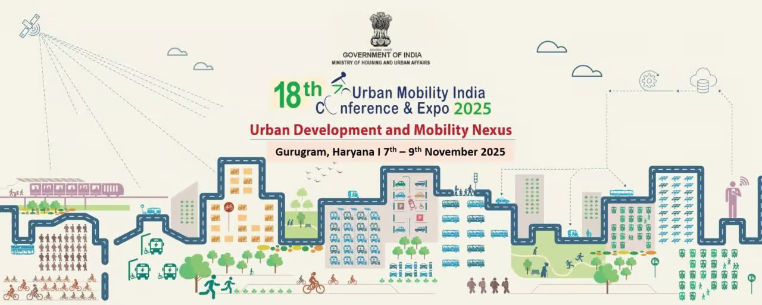


Paper Id: 0465
Analysing the Effect of Service Time in FASTag based Toll Tax Collection System in India
Sitansu Kumar Das, Ph.D. Scholar, NIT Rourkela
Dr. Prasanta Kumar Bhuyan, Associate Professor, NIT Rourkela
Mahabir Panda, Professor, NIT Rourkela
Date: November 09, 2025

Slide 2


Content
Introduction and Background
Literature Review
Research Methodology
Data Analysis and Result
Conclusion and Future Scope
References

Slide 3







Introduction and Background
Study Background
Research Objective
India's urban and infrastructural growth has increased travel demand on national and state highways
This study aims to address the research gap in understanding toll plaza operations in India by:
Public-Private Partnership (PPP) model is preferred for highway development
Analyzing service time variations under mixed-traffic conditions
Private concessionaires recover investments through toll collection
Examining different vehicle categories at selected toll plazas in Odisha
Operational efficiency of toll plazas is crucial for smooth traffic flow
Providing empirical insights into factors affecting service time
Proposing strategies to enhance the overall performance and reliability of India's electronic toll collection system
FASTag System
Government of India introduced FASTag as an RFID-based electronic toll collection (ETC) mechanism
The study focuses on understanding how different vehicle types impact toll plaza efficiency.
Over 90% of toll plazas in India now operate under FASTag
Despite modernization, operational challenges persist:
RFID reader malfunctions
Network delays
Poor lane discipline

Slide 4
Literature Review
Author(s) / Year | Study Focus / Method | Key Findings
Kepsutlu (1986) | Observed manual (cash) transaction duration at toll booths | Cash transactions take 8–30 s
Woo & Hoel (1991) | Examined impact of traffic demand on service rate | Collectors process faster under higher demand pressure
Kim (1993) | Applied queuing theory for lane requirement estimation | Service time modeled using exponential distribution
Lin & Su (1994) | Analyzed service time by vehicle type and payment mode | Shorter times with exact change/prepaid tickets
Kim (1995) | Decomposed service time into collection, transit, and preparation | Erlang distribution fits better than exponential
Parsula (1999) | Introduced mode-specific service time averages | Payment mode affects mean service time
Dijk et al. (1999) | Field study on cash transaction times | Cars/motorcycles: 7.5 s; Trucks: 13.1 s
Klodzinski & Al-Deek (2002); Gordon (2004) | Simulation of toll plaza operations | Service time = critical input parameter
Cho (2005) | Simulation of Hi-Pass lanes incorporating behavioral variables | Service times best represented by lognormal distribution
Aycin (2006) | Empirical estimation under mixed traffic | Cars: 10.5 s; Heavy vehicles: 19.6 s; Mixed: 11.5 s
Oliveira & Cybis (2006) | Studied influence of cash handling | More coins/bills increase service time; exact change speeds up
Korea Expressway Design Manual (2009) | Recommended model for toll design | Suggested exponential distribution
Lee et al. (2011) | Statistical fitting of observed data | Lognormal fits better than exponential
Navandar et al. (2018) | Developed service time models for Indian conditions | Cars: 2.64 s to Trailers: 58.76 s; Influenced by driver, operator, traffic

Slide 5















Research Methodology
Location & Time
Data Recording
Location: Dhenkikote Toll Plaza (DKTP), Keonjhar, Odisha
Vehicle movements timed to accuracy of two decimal places
Date: 14-16 November 2023
Time Slots: 9:00–11:00 AM and 4:00–6:00 PM
Software used: Avideux 2.6
Operational Lanes: Five toll booths (Lane 1 to Lane 5)
Data organized in spreadsheet format
Service time = Time of arrival - Time of transaction completion
Methodology
Video recordings of traffic through professional camera
Analysis conducted in laboratory setting on large-screen monitor
Analysis Approach
Focus on mixed-traffic conditions across different vehicle categories
Descriptive statistics to summarize service time patterns
Probability distribution functions to model service time variations
Service time defined as duration between vehicle arrival and boom barrier opening
ANOVA to assess lane-wise variation in service times
Focus on factors affecting service time across vehicle categories

Slide 6





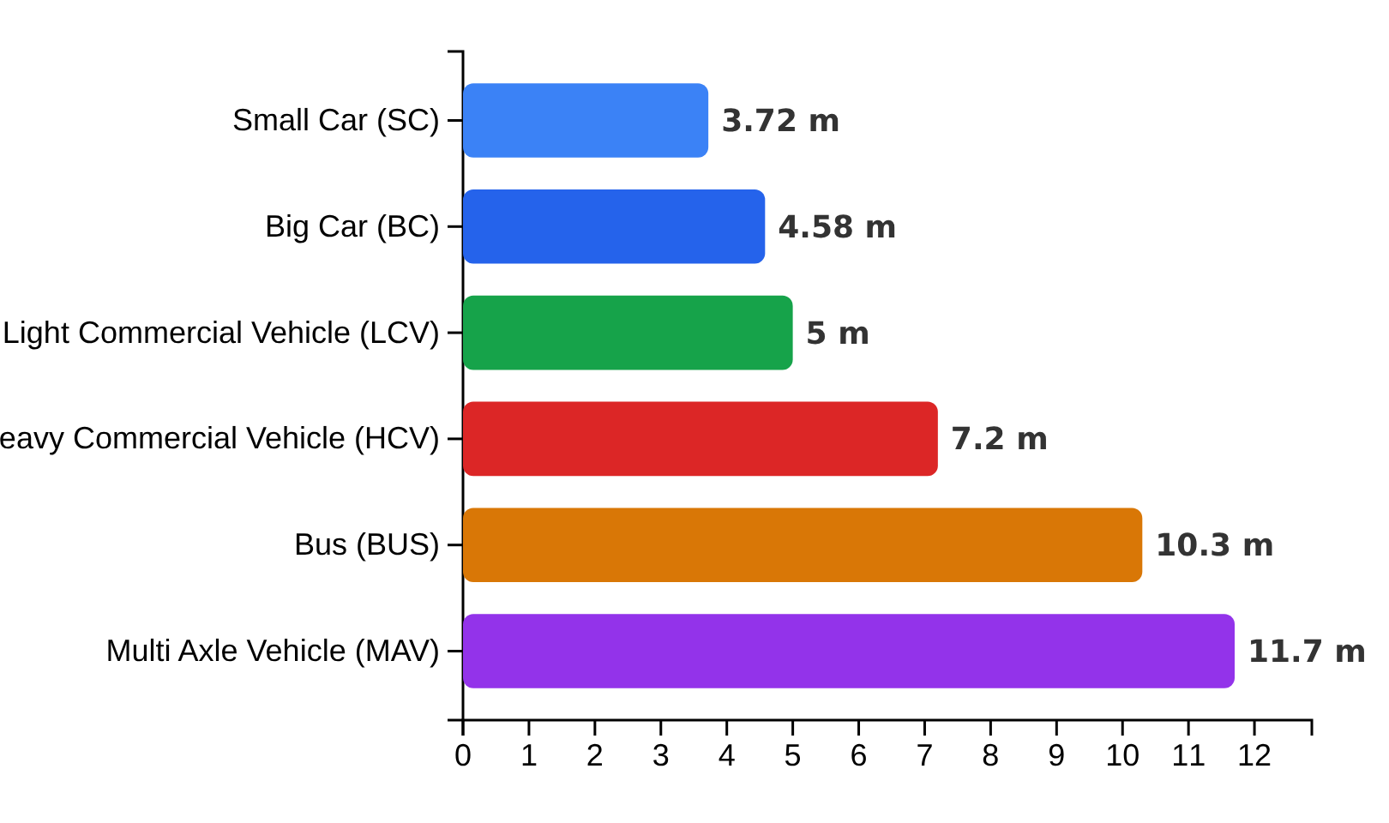











Vehicle Classification
Vehicles observed at the toll plaza were categorized into six distinct classes based on their average lengths, which is a key factor affecting service time.
Vehicle Categories & Average Lengths (Ref.: Navandar et al. (2018)
Visual Comparison of Vehicle Lengths
Vehicle Type
Average Length (m)
Small Car (SC)
3.72
Big Car (BC)
4.58
Light Commercial Vehicle (LCV)
5.00
Bus (BUS)
10.30
Heavy Commercial Vehicle (HCV)
7.20
Multi Axle Vehicle (MAV)
11.70
The average lengths of vehicle types significantly impact toll plaza operations, with larger vehicles generally requiring more time to process.

Slide 7



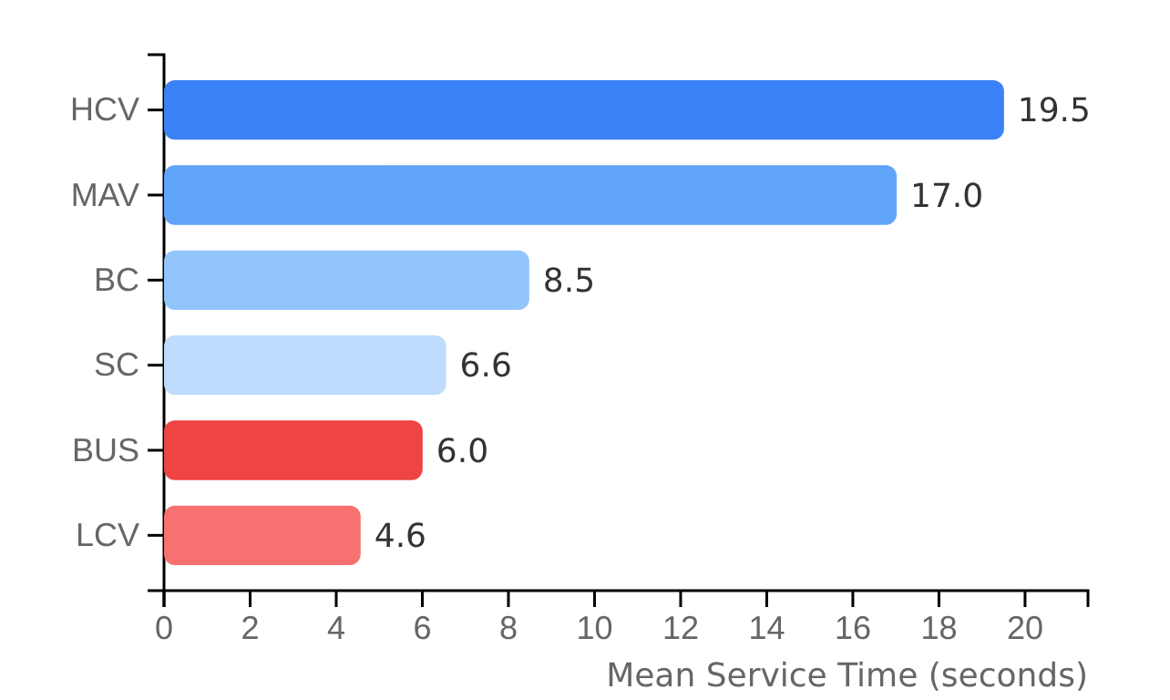





















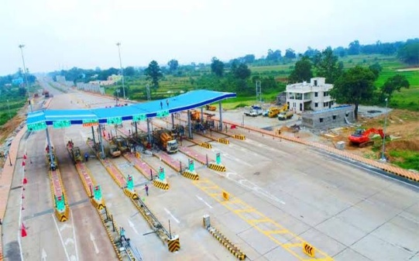
Descriptive Statistics of Service Time
Mean Service Time by Vehicle Type
Service Time Statistics by Vehicle Type
Vehicle Type
Mean (s)
Median (s)
SD (s)
Skewness
15th %
85th %
SC
6.553
3.34
8.178
2.453
1.84
11.352
BC
8.484
3.40
12.740
3.440
1.48
14.836
LCV
4.567
3.12
5.178
2.313
1.34
7.728
BUS
6.007
5.40
3.780
1.738
2.70
8.402
HCV
19.511
5.08
49.173
5.755
2.82
30.714
MAV
17.018
9.06
20.493
2.291
3.12
33.156
Key Observations
Heavy Commercial Vehicles (HCVs) have the highest mean service time (19.51 seconds)
Light Commercial Vehicles (LCVs) have the lowest mean service time (4.57 seconds)
Big Cars (BC) show the highest skewness (3.44), indicating occasional extreme delays
Multi-Axle Vehicles (MAVs) have service times comparable to HCVs but with slightly less variability
Passenger vehicles (SC, BC, BUS) generally process within 15 seconds for most cases
Fig.1 Dhenkikote Toll Plaza (DKTP) in Keonjhar, Odisha

Slide 8



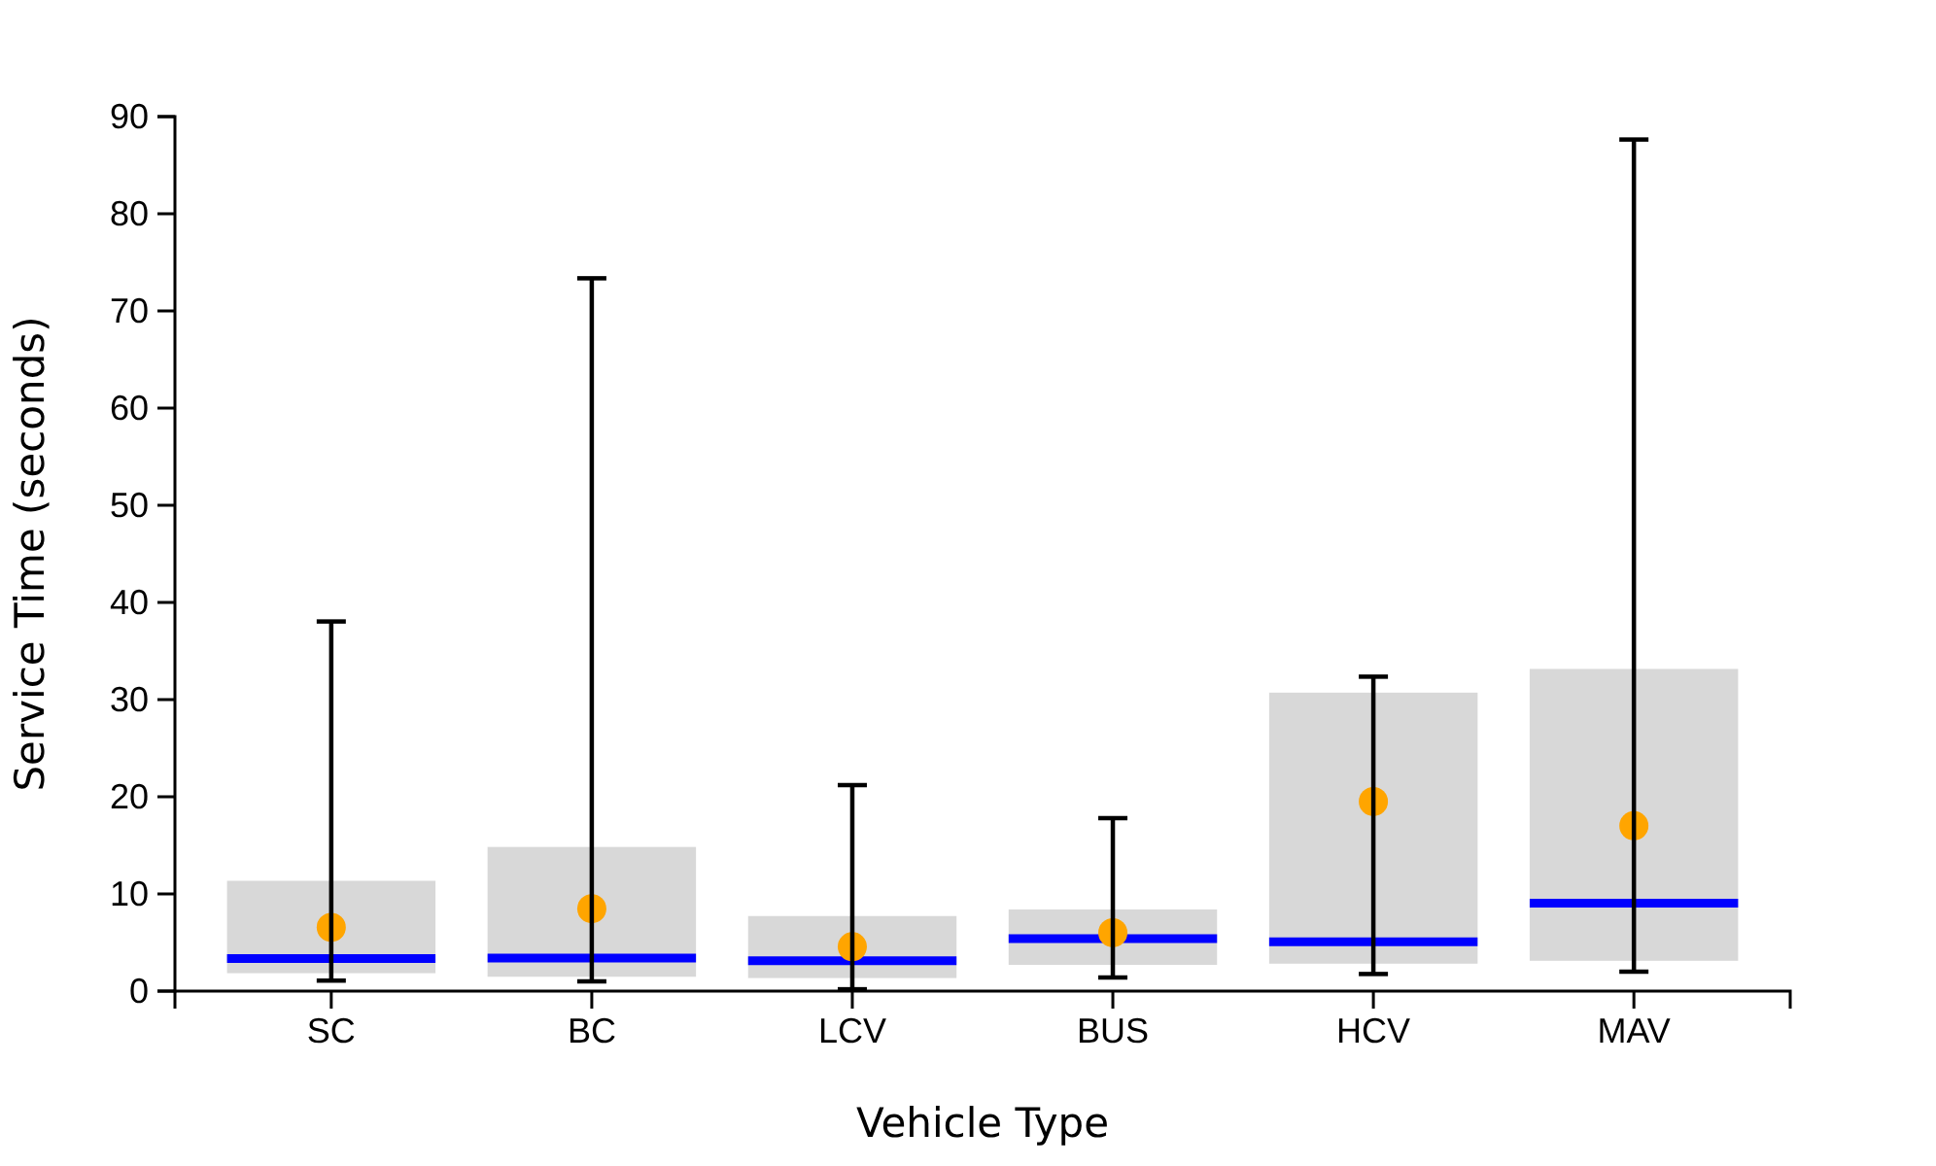





Service Time Distribution Analysis
Service Time Distribution by Vehicle Type
Key Insights
Passenger vehicles (SC, BC, LCV, BUS) are generally processed within 15 seconds
Heavy Commercial Vehicles (HCVs) and Multi-Axle Vehicles (MAVs) experience significantly longer service times
HCVs show the highest variability with a skewness of 5.755
MAVs have the highest mean service time at 17.018 seconds
Impact of Vehicle Type
The box plot clearly indicates that larger vehicles have disproportionately higher service times and greater variability, highlighting the need for specialized lane management for heavy vehicles.
Median
Mean
15th-85th Percentile

Slide 9





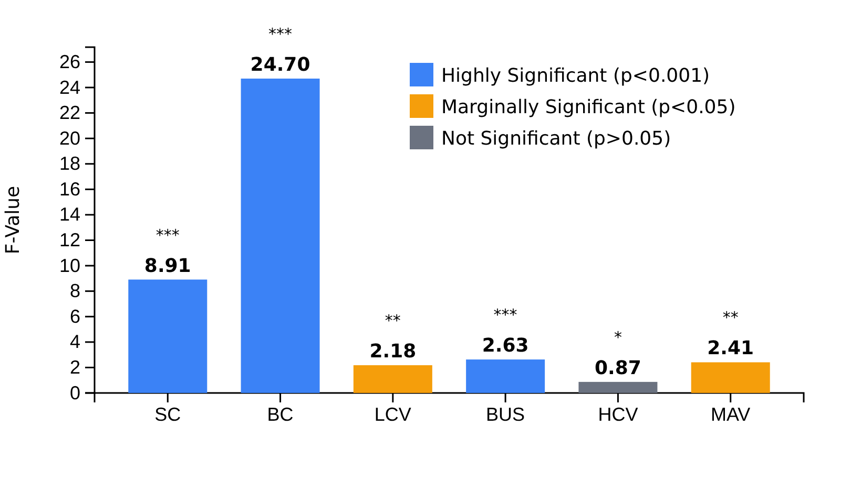




Lane-wise Variation Analysis (ANOVA)
ANOVA Analysis Overview
F-Values by Vehicle Type
A one-way analysis of variance (ANOVA) was conducted to assess whether mean service times differed significantly across the five operational toll lanes for each vehicle category.
The results indicate varying lane effects across vehicle types.
Key Findings
Passenger Vehicles (SC, BC)
Large and highly significant lane effects (p < 0.001)
Buses
Significant difference across lanes (p = 0.046)
Commercial Vehicles (LCV, MAV)
Interpretation
Marginal differences between lanes
These findings suggest that factors related to lane technology and payment methods, rather than the vehicle class itself, are primary contributors to service time variability at the plaza.
Heavy Commercial Vehicles (HCV)
No significant lane effects (p = 0.48)

Slide 10

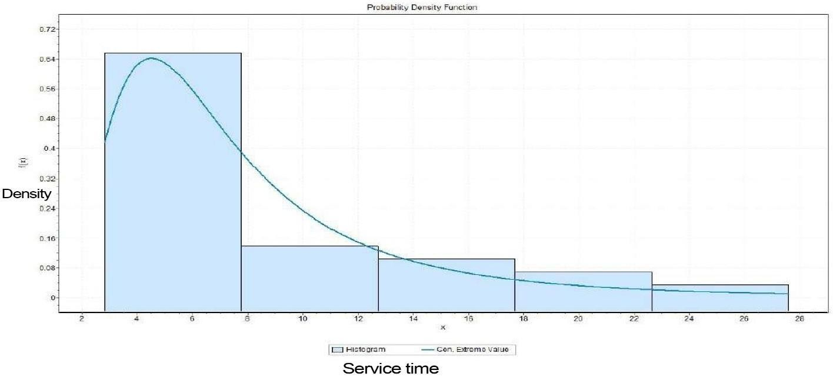


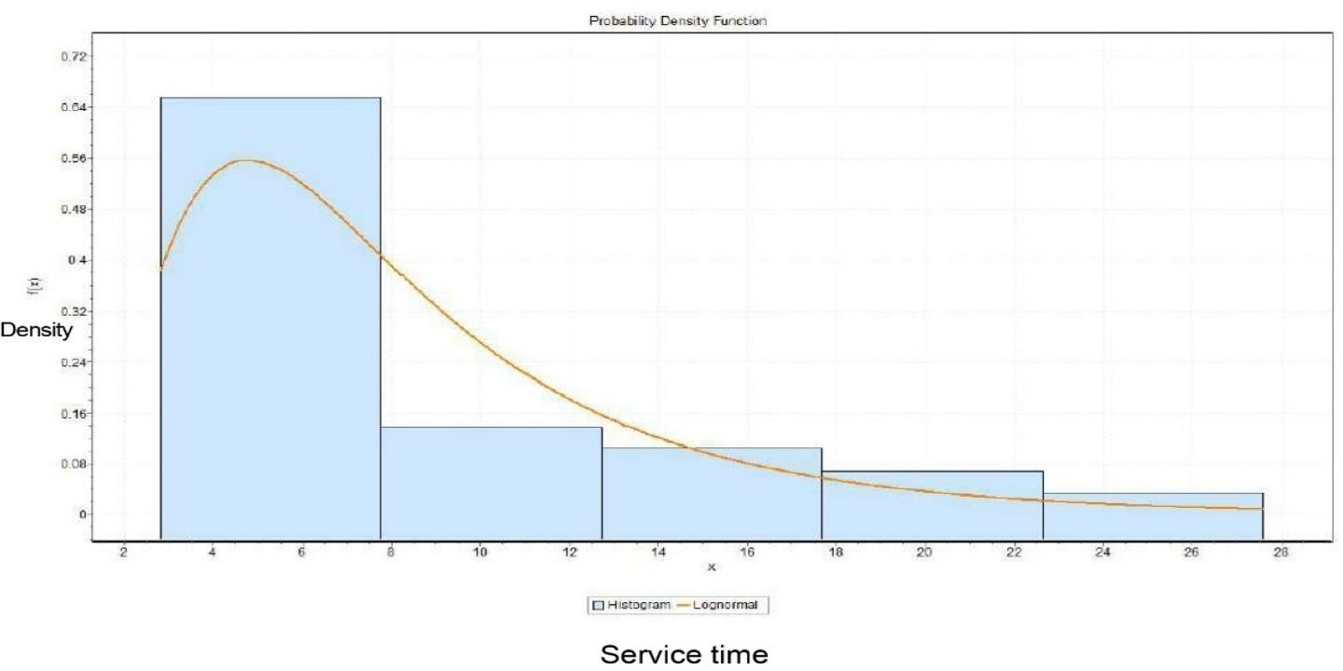






Best-Fit Distribution Models
Distribution Analysis Approach
Analysis of probability density functions (PDF) using Kolmogorov–Smirnov (KS) statistic
Fig. 2 Generalized Extreme Value Distribution
No single distribution universally explains service time across all lanes and vehicle types
Identified best-fit distributions for different vehicle categories
Key Insights
Fig. 3 Lognormal Distribution
Smaller vehicles (SC, BC, LCV): GEV distribution as common best fit
Larger vehicles (HCVs, MAVs): Lognormal and Inverse Gaussian distributions
Smaller Vehicles
Larger Vehicles
Log-Logistic and GIG distributions appear in specific lanes
SC, BC, LCV
HCV, MAV
GEV Distribution
Lognormal, Inverse Gaussian
Findings reflect operational conditions and driver behavior
Consistent statistical pattern
Higher variability

Slide 11












Key Findings
Vehicle Type Dependence
Heavy Vehicle Delays
Service time highly dependent on vehicle type
HCVs: 19.51 seconds (highest mean service time)
LCVs: 4.57 seconds (lowest mean service time)
MAVs: 17.02 seconds (second highest)
SC: 6.55 seconds and BUS: 6.01 seconds (relatively low)
Higher standard deviations indicating frequent irregular delays
Passenger vehicles processed within 15 seconds (85th percentile)
Primary contributors to toll plaza inefficiency
Extreme Service Times
Lane-Specific Variability
High skewness values (HCVs: 5.76, BC: 3.44)
Significant lane effects for passenger cars (SC, BC) and buses
Maximum delays up to 73.36 seconds for Big Cars
Maximum delays up to 87.64 seconds for MAVs
Marginal differences for LCVs and MAVs
Indicates occasional extreme service times
No significant difference for HCVs
Lane technology and payment methods are dominant sources of service-time variability
Heavy vehicles with longer and more variable service times could benefit from dedicated lanes with wider approaches and enhanced FASTag readers.

Slide 12
Concluding Remarks
The analysis confirms that service time varies significantly across vehicle categories, with passenger vehicles generally processed faster than heavy vehicles.
Heavy commercial and multi-axle vehicles exhibit prolonged and inconsistent service durations, largely contributing to toll plaza inefficiencies.
Statistical results further indicate that lane technology and payment methods are more influential than vehicle class in determining service time variability.
Distribution fitting revealed that the Generalized Extreme Value (GEV) model effectively represents smaller vehicle classes, while heavy vehicles align better with Lognormal or Inverse Gaussian distributions due to their higher variability.
Overall, the findings emphasize the heterogeneous and stochastic nature of toll operations and highlight the importance of customized lane management strategies to enhance toll plaza efficiency.

Slide 13










Implications and Future Research
Implications for Toll Plaza Optimization
Future Research Directions
Dedicated Lanes: Heavy vehicles (HCVs and MAVs) could benefit from dedicated lanes with wider approaches and enhanced FASTag readers
Hybrid Models: Developing hybrid or lane-specific service time models that integrate descriptive measures and probabilistic fits
Advanced Techniques: Exploring machine learning or simulation techniques to dynamically predict service times
Lane Prioritization: Passenger vehicles should be prioritized in high-throughput lanes for efficient processing
Driver Behavior: Considering driver behavior, traffic composition, and lane assignment strategies in models
Technology Enhancement: Improved FASTag readers and infrastructure can mitigate delays for all vehicle types
Validation: Validating findings with larger datasets across multiple toll plazas to generalize applicability
Adaptive Management: Implementing adaptive lane assignment and real-time monitoring systems could boost operational efficiency
Future research could support the design of adaptive toll lane management systems based on vehicle type and traffic conditions.
Heavy vehicles contribute disproportionately to toll plaza inefficiency due to longer and more variable service times.
This study provides empirical insights into factors affecting service time and proposes strategies to enhance the overall performance and reliability of India's electronic toll collection system.
Report Date: 2025-10-27
Page 10 of 10

Slide 14
References
Al-Deek, H., Klodzinski, J., & Radwan, A. (1998). Evaluation of vehicle emissions at an electronic toll collection plaza. Proceedings of the 77th Annual Meeting of the Transportation Research Board. Washington, DC.
Al-Deek, H., & Mohamed, A. A. (2000). Development of planning-level service time models for electronic toll collection systems. Transportation Research Record, 1710(1), 77–85.
Aycin, M. F. (2006). GENTOPS: A generic toll plaza simulation tool [Doctoral dissertation, University of Central Florida]. University of Central Florida Library.
Bureau of Transportation Statistics. (2018). Toll facility operations and queueing performance. U.S. Department of Transportation.
Cho, Y. J. (2005). Design and operation model for toll plaza based on driver behavior of lane selection: Focusing on applying the electronic toll collection system [Doctoral dissertation, Ajou University].
Dijk, N. M., Hermans, M. D., Teunisse, M. J. G., & Schuurman, H. (1999, December). Designing the Westerschelde tunnel toll plaza using a combination of queuing and simulation. In Proceedings of the Winter Simulation Conference (pp. 1272–1279). IEEE.
Gordon, R. L. (2004). Simulation-based evaluation of toll plaza operations [Master’s thesis, University of Central Florida]. University of Central Florida Library.
Kepsutlu, N. (1986). Queuing on the toll booths of Bosphorus Bridge [Master’s thesis, Yıldız University].
Kim, T. (1993). Application of queuing theory for estimating the required number of toll plaza lanes. Journal of Transportation Engineering, 119(1), 123–138. https://doi.org/10.1061/(ASCE)0733-947X(1993)119:1(123)
Kim, T. (1995). Service characteristics at toll plazas: Evaluating the Erlang distribution model. Transportation Research Record, 1482(1), 47–55.
Klodzinski, J., & Al-Deek, H. (2002). Modeling and evaluation of toll plaza operations. Journal of Transportation Engineering, 128(3), 245–252. https://doi.org/10.1061/(ASCE)0733-947X(2002)128:3(245)
Korea Expressway Corporation. (2009). Korea Expressway design manual.
Ma, X., Wang, Y., & Liu, C. (2019). Analysis of service time variability at electronic toll collection facilities. Journal of Advanced Transportation, 2019, 1–10.
Lee, S., Kim, H., & Park, J. (2011). Statistical modeling of toll plaza service times. KSCE Journal of Civil Engineering, 15(6), 1025–1033. https://doi.org/10.1007/s12205-011-1256-3
Lin, F. B., & Su, C. C. (1994). Analysis of service times for different payment methods at toll plazas. Transportation Research Record, 1457(1), 56–62.
Navandar, Y., Singh, S., & Arkatkar, S. S. (2018). Modeling service times at Indian toll plazas under heterogeneous traffic conditions. Transportation Research Procedia, 34, 125–132. https://doi.org/10.1016/j.trpro.2018.12.032
Nezamuddin, N., & Al-Deek, H. (2008). PARAMICS simulation of toll plaza operations. Journal of Transportation Systems Engineering and Information Technology, 8(4), 93–101. https://doi.org/10.1016/S1570-6672(09)60015-8
Oliveira, L. K., & Cybis, H. B. B. (2006). The influence of transaction characteristics on toll service times. Transportation Research Part A: Policy and Practice, 40(9), 689–702. https://doi.org/10.1016/j.tra.2005.11.002
Parsula, S. (1999). Payment method analysis in toll plazas [Master’s thesis, University of Central Florida]. University of Central Florida Library.
Woo, T. H., & Hoel, L. A. (1991). Effect of demand on toll service times. Transportation Research Record, 1320(1), 77–84.
Zarrillo, M. L., & Radwan, E. (2009). SHAKER: Simulation of highway and arterial knowledge for evaluating road toll systems. Simulation Modelling Practice and Theory, 17(3), 484–498. https://doi.org/10.1016/j.simpat.2008.10.012

Slide 15

Thank You

