Slide 1

Evaluating Urban Transport Network Design and Accessibility for Sustainable Development: A Case Study of Meghalaya
Coauthor:
Dr. Ravindra Kumar Dr. Punyabeet Sarangi
Presented by
Mr. Deepdev
PhD Scholar
Dept. of Civil Engineering
IIT(ISM) Dhanbad
Urban Mobility India (UMI) Conference-cum-Exhibition 2025
November 7-9, 2025, at the Hyatt Regency in Gurugram, Haryana, India

Slide 2
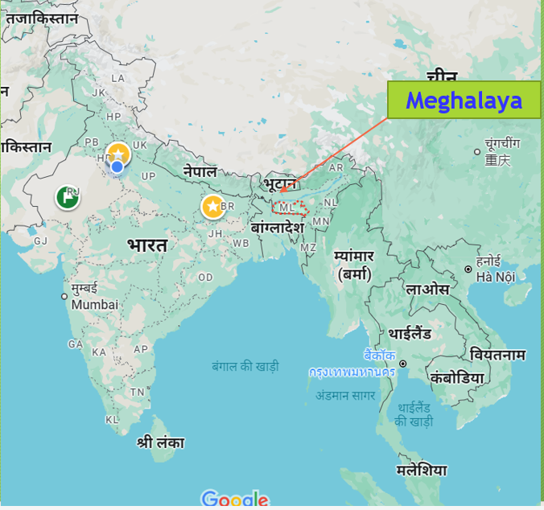
Introduction
Transportation infrastructure is vital for urban development and access to healthcare, education, markets, and jobs.
Connectivity shapes socioeconomic outcomes, especially in developing regions.
In India, major initiatives have improved mobility, yet hilly and ecologically fragile states like Meghalaya still face persistent challenges.
Steep terrain, scattered settlements, forests, and climatic risks hinder effective road-based development.

Slide 3
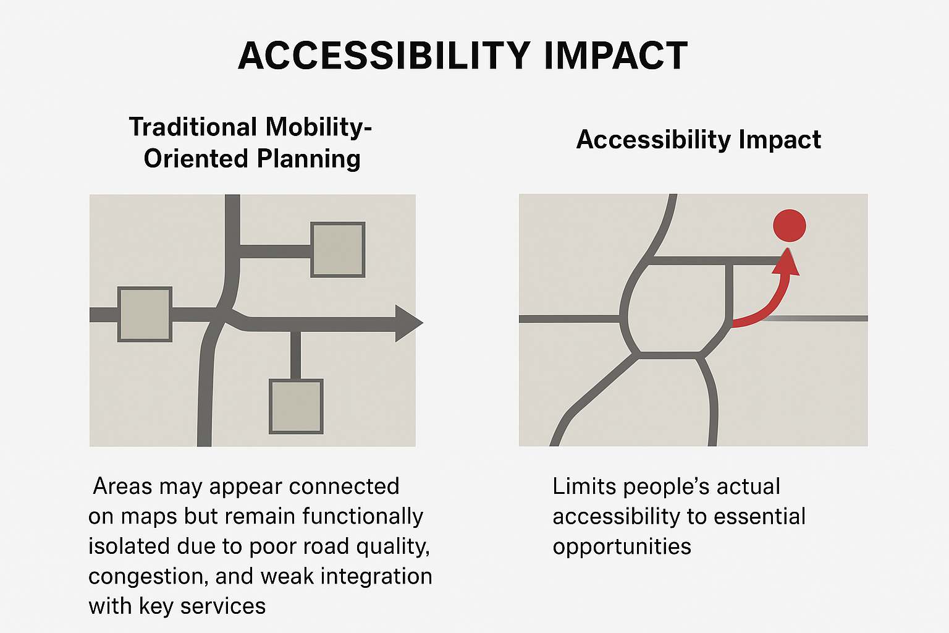
Problem Context
Traditional mobility-oriented planning emphasizes road expansion and vehicle flow.
Areas may appear connected on maps but remain functionally isolated due to poor road quality, congestion, and weak integration with key services.
This limits people’s actual accessibility to essential opportunities.

Slide 4
Gap
Accessibility-based planning remains underexplored in India’s hilly and ecologically sensitive regions.
Most studies focus on mobility metrics or large-scale programs, not local accessibility outcomes.
Lack of empirical, data-driven frameworks addressing terrain complexity, ecological fragility, and social equity.

Slide 5
Objectives
Assess accessibility to key services: health, education, markets
Identify zones with low accessibility
Prioritize roads using accessibility-based indicators
Develop replicable framework for hilly, data-scarce regions

Slide 6
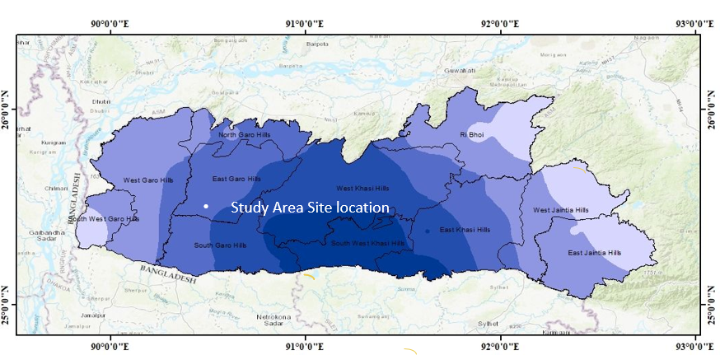
Study Area:
Study Area: Meghalaya
Hilly terrain, dispersed settlements, and ecological fragility
Strategic location in Northeast India
Map: districts, elevation, and road network

Slide 7
Data Sources
Census of India (Population, settlements)
PWD & PMGSY road inventories
OpenStreetMap, Google Earth, Survey of India
DEM (terrain/slope)
Validation through field survey & CRRI collaboration

Slide 8
Analytical Framework
Integrated GIS model combining spatial, functional & demographic dimensions
Data Sources: Roads, habitations, terrain (DEM), services (health, education, markets)
Steps:
Data compilation & preprocessing
Network integration & field validation
Accessibility modeling (buffer + cumulative opportunity + population-weighted indices)
Terrain-sensitive impedance adjustment (slope/elevation)
Prioritization & classification (very low → very high accessibility)
Validation with planners & policy feedback
Software: QGIS 3.38
Outcome: Spatially explicit accessibility surfaces for equitable road prioritization

Slide 9
Methods
Approach:
GIS-based integrated framework combining spatial, functional & demographic dimensions
Techniques Used:
Buffer Analysis: 1 km, 3 km, 5 km service zones
Cumulative Opportunity Index: Counts reachable essential services within defined travel-time thresholds (15, 30, 45 min)
Population-Weighted Accessibility: Adjusts reachability by population density (urban, peri-urban, rural)
Network Travel Time Modeling: Uses shortest-path algorithms incorporating slope & road hierarchy
Normalization & Classification: Five categories – Very Low → Very High Accessibility
Software & Tools:
QGIS 3.38 (Network Analyst, Raster Calculator)

Slide 10
Prioritization Criteria
Criterion | Description | Indicator / Metric
Accessibility Gain | Improvement in reach to essential services after intervention | % increase in reachable facilities / population
Population Served | Number of residents benefiting from improved connectivity | Population within buffer (1–5 km)
Service Reach | Access to hospitals, schools, markets, DHQs, tourist hubs | Weighted service accessibility index
Connectivity Integration | Linkage to NH, SH, MDR, VR hierarchy | Network integration score
Equity Weighting | Prioritization for low-access, high-need areas | Population-weighted accessibility index

Slide 11
Network Composition
Total Network Overview
Total Projects: 136
🟩 New Alignments: 54 roads → 204.03 km (39%)
🟦Resurfacing Works: 82 roads → 312.60 km(61%)
Total Length: 516.63 km
Coverage: 4 administrative blocks - Nongstoin, Rongram, Thadlaskein, and Mylliem
🔹 Functional Focus
New Roads: Extend last-mile accessibility for dispersed and semi-urban settlements
Resurfacing Roads: Improve all-weather reliability and reduce travel time
Integration with NH, SH, MDR, and VR networks

Slide 12
Network Composition
Block | New Roads (km) | Resurfacing Works (km) | Total (km)
Nongstoin | 30 roads – 118.72 km | 28 roads – 137.92 km | 256.64 km
Rongram | 22 roads – 68.00 km | 19 roads – 66.76 km | 134.76 km
Thadlaskein | 2 roads – 17.31 km | 17 roads – 79.92 km | 97.23 km
Mylliem | — | 18 roads – 29.00 km | 29.00 km
Total | 204.03 km | 312.60 km | 516.63 km

Slide 13
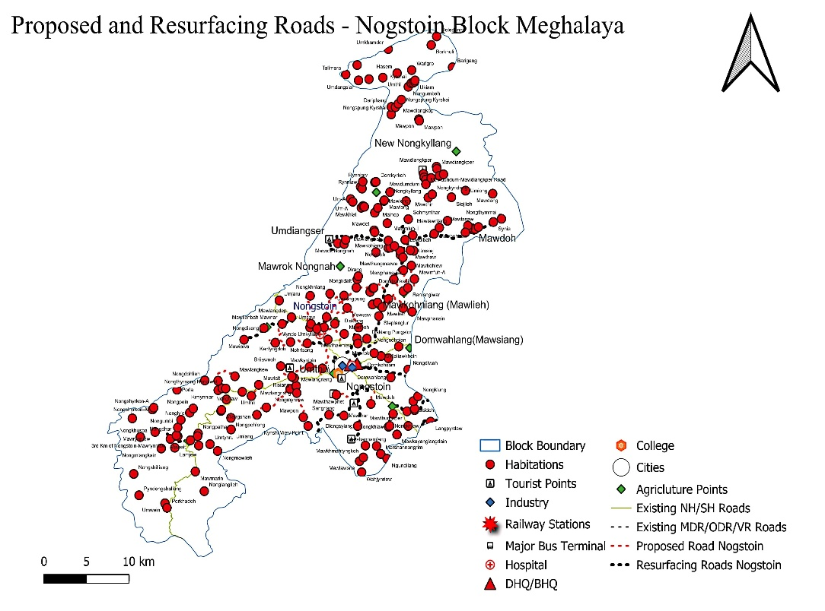
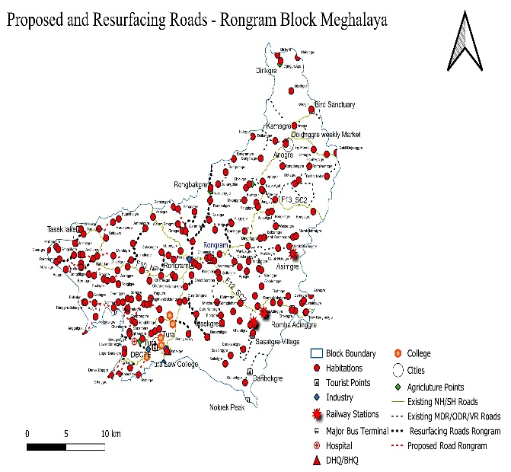
Network Composition

Slide 14
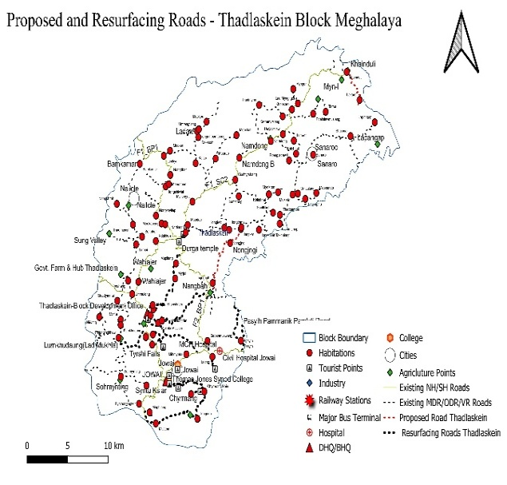
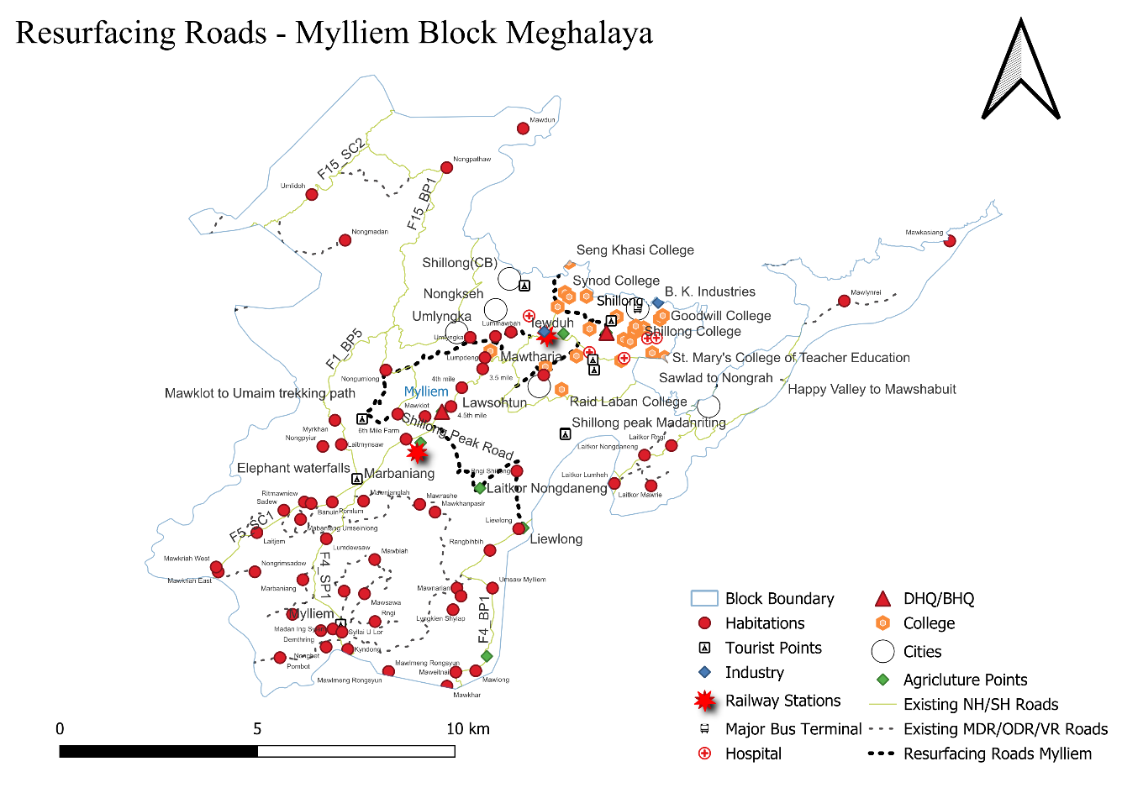
Network Composition

Slide 15
Accessibility Impact
Quantitative Improvements
Average travel time reduction: 20–30% across major corridors
Example:
  Shillong–Tura / Mariang–Iew Mawroh → ~50% reduction to health & market centers
Post-reclassification effects:
  Enhanced integration with NH, SH, MDR routes
  Improved access to hospitals, colleges, DHQs, bus terminals, markets, and tourist hubs
🔹 Spatial & Sectoral Impacts
Enhanced Connectivity & Spatial Equity:
Accessibility mapping shows major improvements in low-access zones—especially in Nongstoin and Rongram—linking peripheral habitations to core corridors and reducing rural–urban disparities.
Inclusive Economic & Social Growth:
Improved Road access to markets, tourist sites, industries, hospitals, and schools has strengthened livelihoods, regional trade, and public service delivery across Meghalaya.

Slide 16
Policy Implications
Integrate Accessibility Metrics in Planning.
Strengthen Last-Mile Connectivity.
Adopt Terrain-Sensitive Design.
Leverage GIS-Based Decision Tools.
Promote Multi-Modal and Sustainable Mobility.

Slide 17
Limitations & Future Work
Limited micro-level and person-based data restricted behavioural representation in accessibility modeling.
Analysis used a static accessibility model, excluding peak-hour or seasonal travel-time variations.
Topographical and environmental constraints (steep slopes, erosion zones, land acquisition) affected implementation feasibility.
Future work will develop dynamic models using real-time and climate-sensitive travel data for adaptive planning.
Incorporate behavioural and community inputs through GPS tracking and participatory mapping to reflect local mobility needs.
Expand to multimodal accessibility, integrating road, public transport, and non-motorized systems.
Create GIS-based decision dashboards and indices for equitable, data-driven infrastructure prioritization.

Slide 18
Conclusions
Accessibility-based planning provides a more effective framework than traditional mobility-centric approaches for transport development in hilly and ecologically fragile regions.
The study identified 136 projects (516.63 km) — combining new alignments and resurfacing works — which reduced average travel times by 20–30% and improved access to key services.
Integration of terrain-sensitive parameters (slope, elevation, ecological fragility) ensured more feasible and resilient network designs.
The GIS-based multi-criteria framework offers a replicable model for data-scarce and topographically complex regions in the Global South.
Accessibility-centered planning strengthens spatial equity, enhances regional integration, and advances sustainable development goals (SDG 9 & 11).
Future adaptation of this framework with dynamic, behavioural, and multimodal data can further improve inclusivity and resilience in transport systems.

Slide 19
Acknowledgements
Institutional Support:
Council of Scientific and Industrial Research – Central Road Research Institute (CSIR–CRRI)
Indian Institute of Technology (Indian School of Mines), Dhanbad (IIT–ISM Dhanbad)
Meghalaya Public Works Department (PWD)
Data & Field Validation:
Integrated Transport Network Development Programme (ITNDP, 2023)
Conference & Review:
Organizing Committee, 18th Urban Mobility India Conference & Exhibition 2025
Gratitude:
Appreciation to all reviewers, mentors, and collaborators for their valuable insights, guidance, and support in strengthening the methodology and policy relevance of this research.

Slide 20
Thank you

