Slide 1

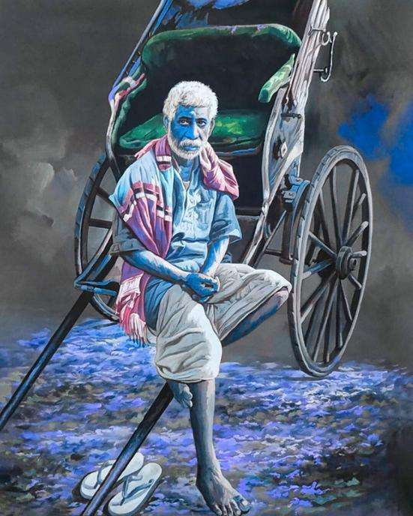
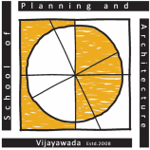



UMI-RS 2025
PAPER ID: 1157
8th November, 2025
On Socio-economic Status of Hand-pulled Rickshaw Pullers:
A study from Kolkata, India
Authors
Kheya Moni Das,
Angira Mondal
Prof. Dr. Laxman Singh Bisht
Prof. Dr. Geetam Tiwari
Shaunak Ghosh
Dept. of Planning
Dept. of Physical Planning
COE-SEA
TRIPC

Slide 2








Table of Contents
05. Conclusion
04. Results
03. Methodology
02. Literature Review
01. Introduction
PAPER ID: 1157 | Page 2

Slide 3
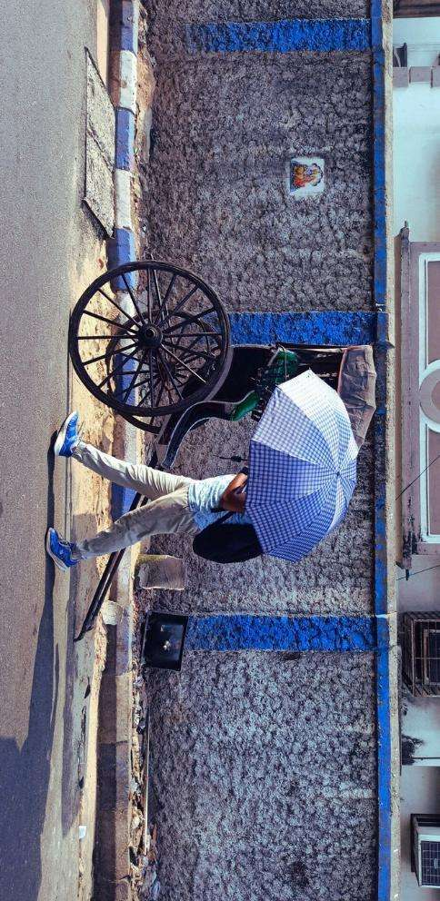
Aim
01. Introduction
Hand-pulled rickshaw (HPR) is one of the popular non-motorized transport (NMT) and intermediate public transport (IPT) modes in Kolkata, a city where this traditional, human-driven mode still operates.
HPRs continue to serve as an essential means of short-distance and first–last-mile connectivity, yet their pullers remain economically and socially marginalized despite their crucial role in urban mobility.
To assess the socio-economic characteristics of the hand-pulled rickshaw pullers in Kolkata city and understand their contribution to urban mobility
Objectives
To examine the socio-economic profile, living conditions, and health status of HPR pullers in Kolkata.
To understand the role of HPRs in providing first–last-mile connectivity and supporting sustainable urban mobility.
To provide recommendations for policy intervention, rehabilitation, and skill development of HPR pullers.
Photo: Primary Survey 2025
Page 3 | PAPER ID: 1157

Slide 4
02. Literature Review
Socioeconomic Characteristics of other NMT and IPTs drivers
Role of NMTs in Sustainable Public Transportation
Sustainable Urban Mobility Role: Despite decline, NMT modes remain vital for sustainable transport; studies stress the need for infrastructure investment, policy support, and integration with public transit to improve air quality and connectivity (Tiwari, 2002; Tiwari, 2015; Phun & Yai, 2016; Gadepalli et al., 2024; Tanwar & Agarwal, 2025).
Socio-Cultural and Livelihood Importance: In Kolkata, CR and HPR pullers persist as essential mobility providers and cultural symbols, highlighting inclusivity gaps in urban policy and last-mile connectivity (Hyrapiet & Greiner, 2012; Samanta & Roy, 2013; Ghosh & Schot, 2019).
Low Socio-Economic Status: CR and IPT workers face poverty, poor education, financial exclusion, and limited healthcare, worsened by neglect in planning and loss of income opportunities (Tiwari, 2002; Bisht & Ahmed, 2015; Rahman et al., 2004; Nandhi, 2011; Sarkar, 2021; Kumar et al., 2022).
Severe Health Risks: High exposure to pollutants and heavy physical workload cause respiratory and physiological impairments among CR pullers (Mukherjee et al., 2006; Pradhan et al., 2008).
PAPER ID: 1157 | Page 4

Slide 5






03. Methodology
A
B
C
D
Study area
Questionnaire Development
Sampling Strategy
Data Analysis
Page 5 | PAPER ID: 1157

Slide 6
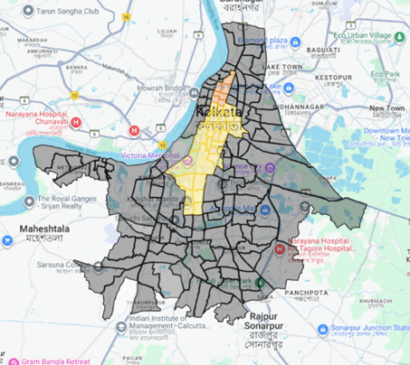
03. Methodology
a) Study Area
The selected study area is the city of Kolkata, in Eastern India, as shown in the map.
Kolkata remains the only major metropolis in India where the practice of manually pulling rickshaws persists as a visible, albeit dwindling, component of the urban transport ecosystem.
This co-existence creates a dynamic environment of complementarity, primarily serving short-distance, last-mile connectivity needs in densely populated areas often inaccessible to larger vehicles.
Map: Study area illustration
Source: Google May Maps 2025
PAPER ID: 1157 | Page 6

Slide 7
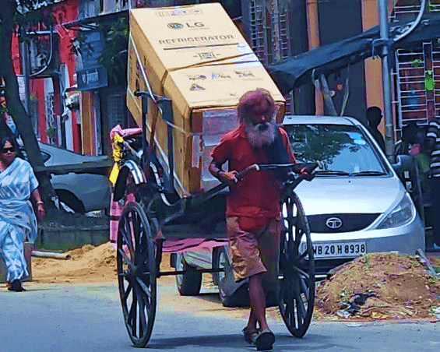
03. Methodology
Research Design: Used a cross-sectional quantitative survey to analyze HPR pullers’ socio-economic conditions and living realities in Kolkata.
Questionnaire Framework: Structured into four sections—trip details, safety, health, and socio-economics—using validated tools for comprehensive and ethical analysis.
b) Questionnaire Development
Photo: Primary Survey 2025
c) Sampling Strategy
Data Collection: Face-to-face surveys via Google Forms ensured clarity and inclusivity; a pilot test and All Bengal Rickshaw Union (ABRU) feedback refined the questionnaire.
Survey Execution: Conducted from 25 May–15 July 2025 with informed consent; 188 valid samples collected out of 384 targeted due to field constraints.
Page 7 | PAPER ID: 1157

Slide 8
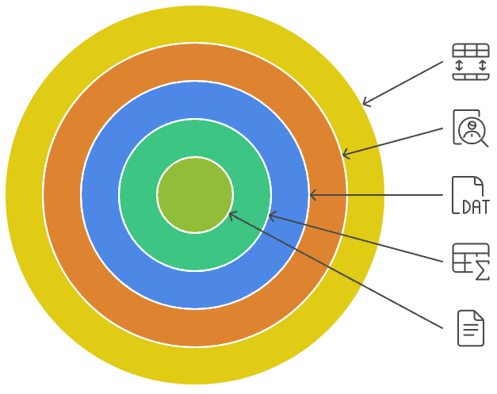
03. Methodology
d) Data Analysis
Data Handling: Survey responses were collected via Google Sheets and processed in Microsoft Excel.
Quality Check: Questionnaires were reviewed for completeness and consistency before analysis.
Data Coding: Raw data were coded using a predefined master code sheet for structured analysis.
Statistical Analysis: Descriptive statistics (percentages & averages) were computed for key socio-economic and occupational variables.
Policy Decisions: The analysis developed a detailed profile of HPR pullers to inform relevant socio-economic policy decisions.
Data Handling
Quality Check
Data Coding
Statistical Analysis
Policy Decisions
PAPER ID: 1157 | Page 8

Slide 9
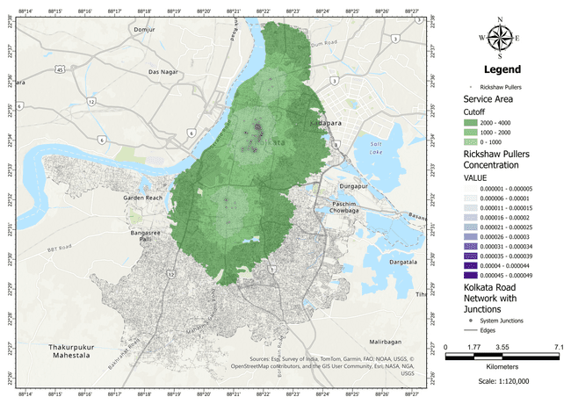
04. Results
This map shows the service provided by the HPR pullers to the citizens of Kolkata.
The majority of the HPR operation is in central Kolkata.
The average trip length is less than 3 km.
Most pullers complete, on average, nine daily trips of varying length. We found that longer work hours did not significantly increase trip frequency or daily income.
However, it may affect their health in the long term. Thus, they play a crucial role as a feeder mode of transport in the urban area.
In addition, they point out gaps in the existing public transportation system.
Map: Service area map of the HPR
Source: ArcGIS Pro
Page 9 | PAPER ID: 1157

Slide 10
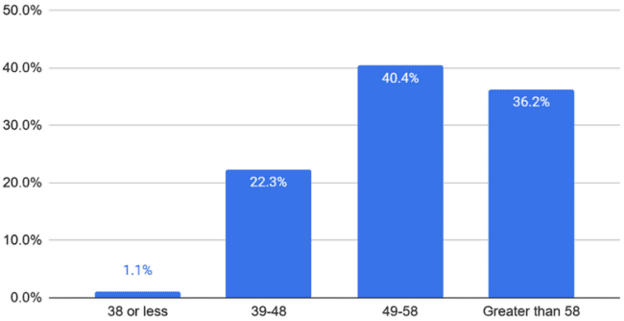
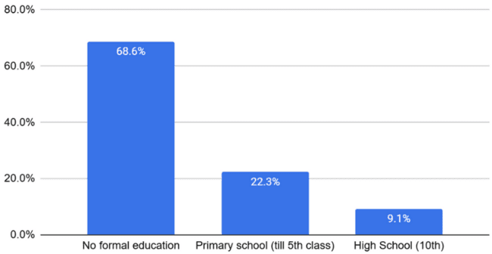
04. Results
Age of HPR Pullers:
Education Level:
The descriptive analysis outcomes of the demographic data reveal ageing, predominantly HPR puller informal and unorganized workforce witnessing disproportionate social marginalization.
Most of the pullers are 30 years or older. Approximately 36% of the pullers are more than 58 years old.
An alarming 68.6% of the pullers do not have formal education, with only 22.3% completed primary school.
Most of them can read and write, but they can sign their name only in their native language.
PAPER ID: 1157 | Page 10

Slide 11
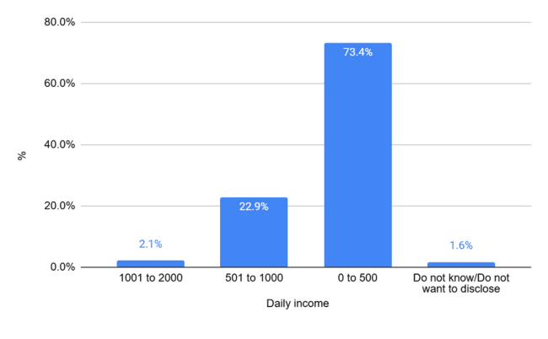
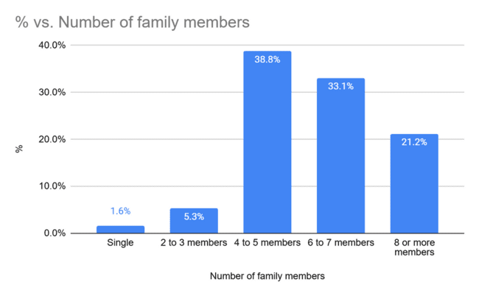
04. Results
Daily Income:
Number of family members:
73% of the pullers earn 500 or less than 500 Indian National Rupee (INR) daily.
This is less than the minimum wage for unskilled labour working in the Kolkata city (designated as area A), which is INR 783 per day, including variable dearness allowance (PIB, 2024)
93% of the puller family size is four or more members.
However, this could not ascertain how many family members depend on them.
Page 11 | PAPER ID: 1157

Slide 12
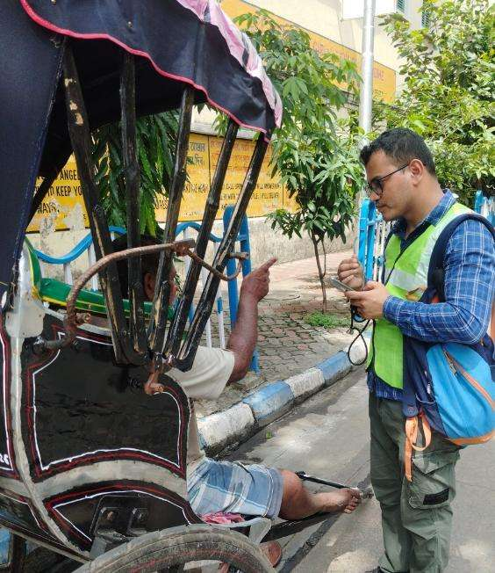
04. Results
Severe Economic Poverty: HPR pullers remain trapped in deep poverty with very low daily earnings (≤ INR 500 for 75%), below Kolkata’s minimum wage (PIB, 2024), and excluded from the Code on Wages, 2019 (Bagchi, 2017; Hyrapiet & Greiner, 2012; Samanta & Roy, 2013).
Exploitative Work Model: 98% rent rickshaws, losing part of income to owners, leading to chronic financial insecurity and exclusion from formal financial systems (Hyrapiet & Greiner, 2012; Maity et al., 2022; UN, 2015).
Limited Upward Mobility: Lack of credit, subsidies, and training prevents transition to e-rickshaws or better jobs; older workers resist change due to age and technology gaps (Sarkar, 2021; Samanta & Roy, 2013; Priye et al., 2021).
Poor Living & Health Conditions: Long work hours (5–9 hrs/day or more), homelessness, and kutcha housing reflect severe deprivation, worsening health and access to welfare (Pradhan et al., 2008; Bisht & Ahmed, 2015; Hemingway et al., 1997).
Policy Implication: Findings call for rehabilitation, financial inclusion, and skill-based transition programs to ensure safe, secure, and productive livelihoods aligned with SDG 8 (Samanta & Roy, 2013; UN, 2015).
Photo: Primary Survey 2025
PAPER ID: 1157 | Page 12

Slide 13



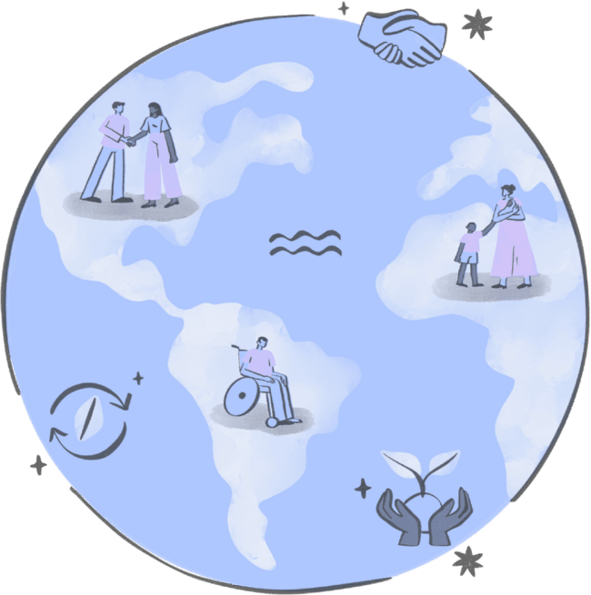
05. Conclusion
Sustainable Mobility Context
Social Inclusion Imperative
Policy Recommendations
Alignment with SDG 8
The study highlights the essential yet overlooked role of HPR pullers in Kolkata’s sustainable transport system, contributing to urban mobility despite facing severe poverty and health challenges (Tiwari et al., 2016).
As cities aim for “smart” and sustainable growth, policies must ensure that informal workers like HPR pullers are not excluded from the benefits of modernization and urban development.
Propose financial inclusion through low-interest loans, skill training for e-rickshaw transition, and integration into welfare schemes like Pradhan Mantri Shram Yogi Maandhan with access to free health checkups (CSC, 2019).
These measures promote decent work, economic growth, and worker dignity while addressing data limitations and encouraging future research for inclusive transport policy (UN, 2015; Boström et al., 1993; Goyder et al., 2002).
Page 13 | PAPER ID: 1157

Slide 14
References
Bagchi, S. (2017). Contextualizing Identity and Exclusion and the Unheard Voices of Kolkata’s Migrant Hand-rickshaw pullers. Contemporary Voice of Dalit, 9(2), 171–183.
Bagul, T. R., Patil, K., Kote, A., Balpgold, B. S., Kumare, R., & Kumar, R. (2018). Analysis of Autorickshaw as an Intermediate Paratransit system AISSMS College of Engineering Pune. 118(24), 1–10.
Bisht, L. S., & Ahmed, M. A. (2015). Socio Economic Characteristics of Autorickshaw Operators in Silchar. IOSR Journal of Mechanical and Civil Engineering, 48(July), 48–53. www.iosrjournals.org
Boström, G., Hallqvist, J., Haglund, bo J. a., Romelsjö, A., Svanström, L., & Diderichsen, F. (1993). Socioeconomic Differences in Smoking in an Urban Swedish Population: The bias introduced by non-participation in a mailed questionnaire. Scandinavian Journal of Public Health, 21(2), 77–82. https://doi.org/10.1177/140349489302100204
Cervero, R. (2000). Informal transport in the developing world. Un-habitat.
Cervero, R., & Golub, A. (2007). Informal transport: A global perspective. Transport Policy, 14(6), 445–457. https://doi.org/10.1016/j.tranpol.2007.04.011
Cochran, W. G. (1977). Sampling techniques (3rd ed.). John Wiley & Sons.
Cohen, L., Manion, L., & Morrison, K. (2017). Questionnaires. In Research methods in education (pp. 471–505). Routledge.
CSC. (2019). FAQ: PMSYM [PDF]. Common Service Centres (CSC). https://csc.gov.in/notification/FAQ%20PMSYM.PDF
DGE. (2024). Employment and Unemployment Scenario of India. https://dge.gov.in/dge/sites/default/files/2024 06/Employment_Situation_in_India_April2024.pdf
ESCAP. (2021). Sustainable Urban Transport in the Asia-Pacific Region for the 2030 Agenda: Recommendations towards safe, green, smart and inclusive urban transport.
Gadepalli, R., Bansal, P., Tiwari, G., & Bolia, N. (2024). A tactical planning framework to integrate paratransit with formal public transport systems. Transportation Research Part D: Transport and Environment, 136(September), 104438. https://doi.org/10.1016/j.trd.2024.104438
Gadepalli, R., Tiwari, G., & Bolia, N. (2020). Role of user’s socio-economic and travel characteristics in mode choice between city bus and informal transit services: Lessons from household surveys in Visakhapatnam, India. Journal of Transport Geography, 88(October 2017), 102307. https://doi.org/10.1016/j.jtrangeo.2018.08.017
Ghosh, B., & Schot, J. (2019). Towards a novel regime change framework: Studying mobility transitions in public transport regimes in an Indian megacity. Energy Research \& Social Science, 51, 82–95.
Goyder, J., Warriner, K., & Miller, S. (2002). Evaluating Socio-Economic Status (SES) Bias in Survey Nonresponse. Journal of Official Statistics, 18(1), 1–11.
Harding, S. E., Badami, M. G., Reynolds, C. C. O., & Kandlikar, M. (2016). Auto-rickshaws in Indian cities: Public perceptions and operational realities. Transport Policy, 52, 143–152. https://doi.org/10.1016/j.tranpol.2016.07.013
Harding, S., & Rojesh, S. (2014). Battery Rickshaws in New. 49(35), 43–47.
Hasan Khan, J., & Hassan, T. (2010). SOCIO-ECONOMIC PROFILE OF CYCLE RICKSHAW PULLERS: A CASE STUDY Introduction. European Scientific Journal January Edition, 8(1), 310–330.
Hemingway, H., Nicholson, A., Stafford, M., Roberts, R., & Marmot, M. (1997). The impact of socioeconomic status on health functioning as assessed by the SF-36 questionnaire: The Whitehall II study. American Journal of Public Health, 87(9), 1484–1490. https://doi.org/10.2105/AJPH.87.9.1484
PAPER ID: 1157 | Page 14

Slide 15
References
Hyrapiet, S., & Greiner, A. L. (2012). Calcutta’s Hand-Pulled Richshaws: Cultural Politics and Place Making in a Globalizing City. The Geographical Review, 102(4), 407–426. https://doi.org/https://doi.org/10.1111/j.1931 0846.2012.00167.x
ILO. (2024). India Employment Report 2024: Youth employment, education and skills. https://www.ilo.org/wcmsp5/groups/public/—asia/—ro-bangkok/—sro new_delhi/documents/publication/wcms_921154.pdf
Jaiswal, A., Manoj, M., & Tiwari, G. (2022). A review of studies on service quality of intermediate public transport. IATSS Research, 46(4), 537–546. https://doi.org/10.1016/j.iatssr.2022.09.002
Jaiswal, A., Manoj, M., & Tiwari, G. (2024). Exploring India’s Intermediate Public Transport: A Comprehensive Overview. Transportation in Developing Economies, 10(1), 1–14. https://doi.org/10.1007/s40890-024-00202-4
Jyotika, & Chandiramani, J. (2025). Towards Sustainable Urban Mobility—An Analysis of Electric Rickshaw Ecosystem of Delhi, India. Environment and Urbanization ASIA, 16(1), 159–176.
Kumar, A., Thomas, J., Wadhwa, S. S., Mishra, A., & Dasgupta, S. (2022). The last mile connectivity: Experience of passengers and drivers of E-rickshaws and cycle rickshaws in an Indian city. Case Studies on Transport Policy, 10(2), 948–953. https://doi.org/10.1016/j.cstp.2022.03.008
Maity, S., Sahu, T. N., & Biswas, D. (2022). Financial Inclusion Through Banking for the Poor: A Study on Cycle Rickshaw Pullers in West Bengal. Management and Labour Studies, 47(4), 431–447. https://doi.org/10.1177/0258042X221106633
Mohanty, B. K. (2021). Orienting India’s rural youth towards agriculture through multipurpose agricultural interpretation-cum-technical support centres. Man In India, 101(1–2), 77–90. Serials Publications. https://www.arfjournals.com/image/catalog/Journals%20Papers/MII/2021/No.1-2/05.pdf
Mukherjee, A. K., Chattopadhyay, B., Bhattacharya, S., Roy, S., Sen, S., Roychowdhury, A., & Sayed, H. (2006). Assessment of occupational exposure and pulmonary function of cycle rickshaw pullers engaged around high traffic areas of Kolkata metropolitan city in India. Epidemiology, 17(6), S517.
Nandhi, M. A. (2011). The Urban Poor and Their Money: A Study of Cycle Rickshaw Pullers in Delhi. In Institute for Financial Management and Research, Centre for Microfinance. http://www.centre-for-microfinance.org/wp content/uploads/attachments/csy/2257/Rickshaw Pullers Study.pdf
Oeschger, G., Carroll, P., & Caulfield, B. (2020). Micromobility and public transport integration: The current state of knowledge. Transportation Research Part D: Transport and Environment, 89(November). https://doi.org/10.1016/j.trd.2020.102628
Pascoe, S. J. S., Hargreaves, J. R., Langhaug, L. F., Hayes, R. J., & Cowan, F. M. (2013). “How Poor Are You?” - A Comparison of Four Questionnaire Delivery Modes for Assessing Socio-Economic Position in Rural Zimbabwe. PLoS ONE, 8(9). https://doi.org/10.1371/journal.pone.0074977
Phun, V. K., & Yai, T. (2016). State of the Art of Paratransit Literatures in Asian Developing Countries. Asian Transport Studies, 4(1), 57–77. https://doi.org/10.11175/eastsats.4.57
PIB. (2024). Central Government Increases Minimum Wages Rates for Worker. PIB.
Pradhan, C. K., Thakur, S., Mukherjee, A. K., & Roychowdhury, A. (2008). Energy expenditure of cycle rickshaw pullers in different places in India. Ergonomics, 51(9), 1407–1417.
Page 15 | PAPER ID: 1157

Slide 16
References
Priye, S., Manoj, M., & Ranjan, R. (2021). Understanding the socioeconomic characteristics of paratransit drivers and their perceptions toward electric three-wheeled rickshaws in Delhi, India. IATSS Research, 45(3), 357–370. https://doi.org/10.1016/j.iatssr.2021.03.002
Rahman, Md. M., Okura, I., & Nakamura, F. (2004). Effects of Rickshaws and Auto-Rickshaws on the Capacity of Urban Signalized Intersections. IATSS Research, 28(1), 26–33. https://doi.org/10.1016/s0386-1112(14)60089-3
Rajvanshi, A. K. (2002). Electric and improved cycle rickshaw as a sustainable transport system for India. Current Science, 83(6), 703–707.
Rana, M. S., Hossain, F., Shusmoy Roy, S., & Kumar Mitra, S. (2013). Exploring operational characteristics of battery operated auto-rickshaws in urban transportation system. American Journal of Engineering Research, 2(4), 1–11. www.ajer.us
Raveendran, G., & Vanek, J. (2020). Informal Workers in India: A Statistical Profile. In Statistical Brief (Issue 24). https://www.wiego.org/sites/default/files/publications/file/WIEGO_Statistical_Brief_N24_India.pdf
Ravi, R. (2016). No Space for Cycle Rickshaws. Economic and Political Weekly, 51(9), 49–51. https://www.jstor.org/stable/44004443
Ray, D. (2024). Handpulled Rickshaw: A heritage of Calcutta. Punthi Pustak.
Replogle, M. (1992). Bicycle and cycle rickshaws in Asian cities. In TRB (Issue 1372). http://fmats.project.kittelson.com/
Sahu, P. R., & Behera, D. K. (2025). Assessing the nature and determinant of informal employment in India. Discover Global Society, 3(86). https://doi.org/10.1007/s44282-025-00239-9
Saiyad, G., Minal, M., Kumar, R., & Rathwa, D. (2020). Trips Generated by Rickshaw Pullers and Trip Rate for Cycle Rickshaws: A Case Study of Delhi. Transportation Research Procedia, 48(2019), 2296–2312. https://doi.org/10.1016/j.trpro.2020.08.287
Samanta, G., & Roy, S. (2013). Mobility in the Margins. Transfers, 3(3), 62–78. https://doi.org/10.3167/trans.2013.030305
Santra, A. (2024). The rickety relic of hand-pulled rickshaws. The Statesman, 1. https://www.thestatesman.com/supplements/8thday/the-rickety-relic-of-hand-pulled-rickshaws-1503306346.html
Sarkar, S. (2021). Socio economic Status of Urban Pedal Rickshaw Pullers after the Introduction of E rickshaw. RESEARCH REVIEW International Journal of Multidisciplinary, 6(1), 127–135. https://doi.org/10.31305/rrijm.2021.v06.i01.026
Shandilya, N., Saini, V., & Ghorpade, A. R. (2019). Supporting SuStainable Mobility under SMart City MiSSion Title: E RICKSHAW DEPLOYMENT IN INDIAN CITIES-Handbook (Supporting Sustainable Mobility under Smart City Mission) Publisher: ICLEI-Local Governments for Sustainability, South Asia (ICLEI South Asia). http://southasia.iclei.org/
Sinha, S., Sadhukhan, S., Kumar, S., Bandhyopadhyaya, R., & Shrivastava, R. (2017). Users ’ assessment of Auto Rickshaw : A paratransit mode for mid-sized city in India. Proceedings of the Eastern Asia Society for Transportation Studies, Vol.11, 2017.
Sogbe, E., & Susilawati, S. (2024). Assessing shared auto-rickshaws adoption by intra-city commuters as part of the public transport system: The influence of negative encounters on passenger satisfaction. Transportation Research Part F: Traffic Psychology and Behaviour, 104(January), 15–30. https://doi.org/10.1016/j.trf.2024.05.009
PAPER ID: 1157 | Page 16

Slide 17
References
Sood, A. (2012). A future for informal services? the cycle rickshaw sector as case study. Economic and Political Weekly, 47(42), 95–102.
Steele, M. W. (2013). Rickshaws in South Asia. Transfers, 3(3), 56–61. https://doi.org/10.3167/trans.2013.030304
Su, M. M., Dong, H., Wang, S., & Wang, Y. (2025). Impacts of rural road development on community wellbeing – A case study of Ningxia Hui Autonomous Region, China. Case Studies on Transport Policy, 21(February), 101511. https://doi.org/10.1016/j.cstp.2025.101511
Taherdoost, H. (2017). How to calculate survey sample size: A primer (working paper). SSRN. https://papers.ssrn.com/sol3/papers.cfm?abstract_id=3224205.
Tanwar, R., & Agarwal, P. K. (2025). Multimodal integration in India: Opportunities, challenges, and strategies for sustainable urban mobility. Multimodal Transportation, 4(2), 100210. https://doi.org/10.1016/j.multra.2025.100210
Tiwari, G. (2002). Urban transport priorities: Meeting the challenge of socio-economic diversity in cities, a case study of Delhi, India. Cities, 19(2), 95–103. https://doi.org/10.1016/S0264-2751(02)00004-5
Tiwari, G. (2015). Role of Nonmotorized Transport and Sustainable Transport in Indian Cities. In S. Mahendra Dev & Sudhakar Yedla (Eds.), ities and Sustainability. (pp. 133–150). Springer, New Delhi. https://doi.org/https://doi.org/10.1007/978-81-322-2310-8_7
Tiwari, G., Jain, D., & Rao, K. R. (2016). Impact of public transport and non-motorized transport infrastructure on travel mode shares, energy, emissions and safety: Case of Indian cities. Transportation Research Part D: Transport and Environment, 44, 277–291.
UN. (2015). Goal 8: Decent work and economic growth - The Global Goals. Retrieved August 25, 2025, from https://globalgoals.org/goals/8-decent-work-and-economic-growth/
Verma, A., Sreenivasulu, S., & Dash, N. (2011). Achieving sustainable transportation system for Indian cities - Problems and issues. Current Science, 100(9), 1328–1339.
Page 17 | PAPER ID: 1157

Slide 18
Thank You.

