Slide 1
DELHI METRO RAIL CORP. LTD.
Revenue generation from Non-Fare Box mode in DMRC

Slide 2


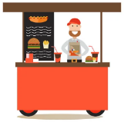
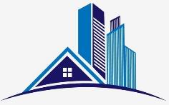
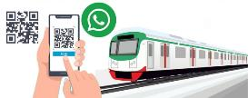

DMRC’s Revenue Sources apart from Fare Box Revenue
Non-Fare Revenue Streams
Media
Space
Telecom
Land & Property Development
Other Sources
Station advertising
Train advertising
Tunnel advertising
Pilar advertising
Station & Line Naming rights
Audio advertising including jingles
Mobile app advertising
Food & beverage
Retail
ATMs, Vending machines
Locker rooms
Shared offices
Temporary promo space incl. for film shoots, etc.
In-building solutions
Telecom towers
Small cells
Right-of-Way for optical fibre leasing
Monetization of land parcels and built-up spaces for development of malls, office spaces, MLCP, warehousing, hotels, residential, etc. across various land uses
Data centres at depot
Direct access to adjacent commercial establishments and residential societies.
Digital ticketing
Last mile tie-ups
Merchandising & brand licensing
Tickets for external trade fare & public events (IPL, Marathon)
Note “ “ stands for innovative NFBR source

Slide 3
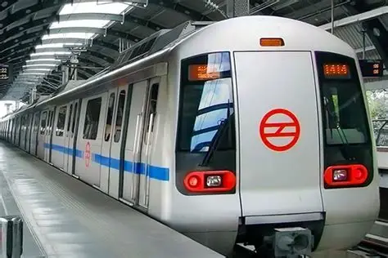
Comparison of Revenue ratios FY 2023-24 v/s FY 2024-25
Revenue Split
Share of NFBR Revenue
FY 2023 - 24
FY 2024 - 25
Fare Box
Non-Fare Box
Station Box
Real Estate
External Projects, Consultancy & other

Slide 4
Non-Fare Box Revenue from Commuters & Others
Rs. In Crore
Heads | 2020-21 | 2021-22 | 2022-23 | 2023-24 | 2024-25
NFBR from Commuters i.e. Advertisement, Co-branding, ATM’s, Shops, Parking etc. | 57.82 | 129.78 | 232.71 | 241.26 | 300.33
Telecom Business | 42.58 | 54.26 | 69.32 | 69.04 | 74.92
Rental Business | 230.06 | 309.00 | 389.64 | 416.85 | 473.97
External Projects Business (Net) | 174.91 | 183.29 | 110.08 | 108.56 | 144.56
Consultancy Business (Net) | 29.48 | 18.73 | 32.07 | 40.73 | 35.98
Total | 534.85 | 695.06 | 833.82 | 876.44 | 1,029.76

Slide 5
Types of Advertisement
Indoor Advertisement – within stations, includes digital screens, LED panels, staircases, platforms, kiosks, etc. (License: 9+6 years).
Outdoor Advertisement – covers station façades, piers, viaducts, and external areas (License: 3+2 years).
Train Advertisement & Wrapping – includes static/digital ads, exterior wraps (License: 9+6 years).
Audio Advertisement – limited duration audio ads in trains/stations (License: 9+6 years).
Digital Platforms – includes DMRC website, app, WhatsApp QR ticketing, smart lockers.
Promotional Events – short-term stalls, kiosks, events at stations.

Slide 6
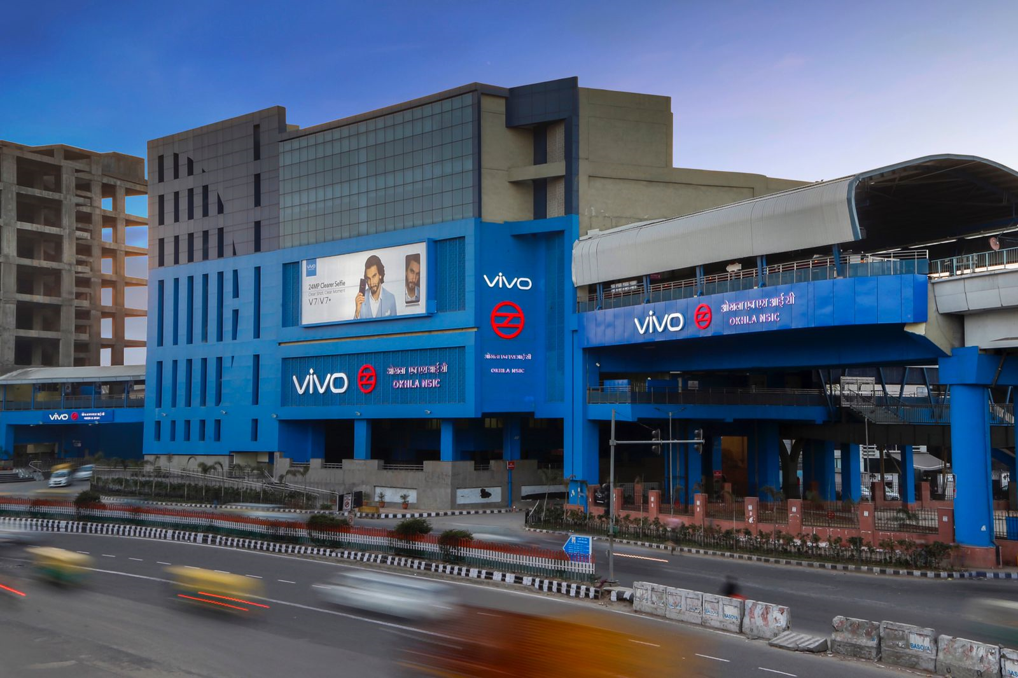
Station Co-branding
Station Co-Branding involves granting the right to prefix or suffix a brand name and logo (as approved by DMRC) with the name of a metro station. The rights also include the use of station colouring, interior/exterior themes.
Out of 226 metro stations (excluding 40 stations of RMGL, Aqua Line, AEL, and 23 stations located in historical, cantonment areas, or named after famous personalities), a total of 79 stations have already been allotted.
Avg. annual revenue per station is Rs. 75.82 Lakh.

Slide 7
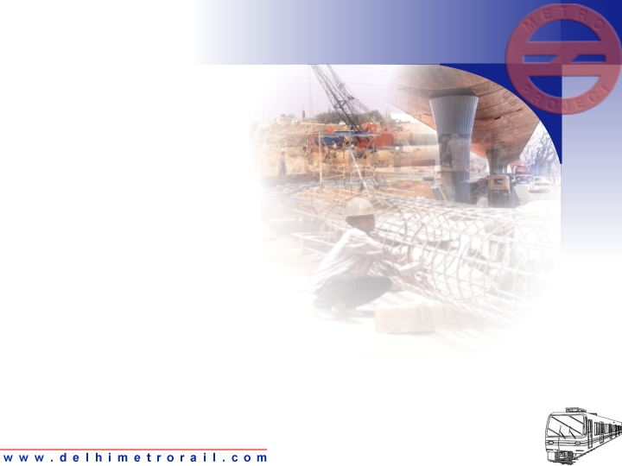
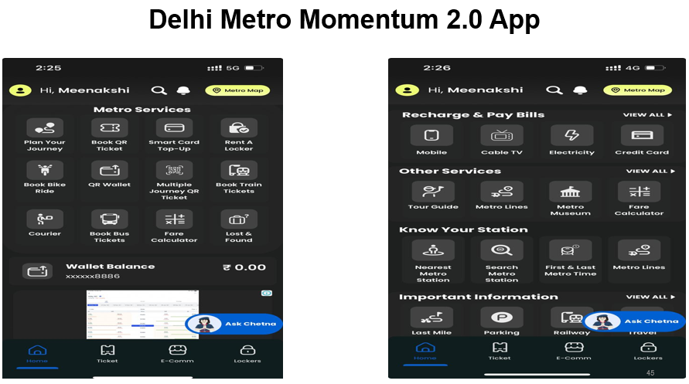
DMRC Momentum 2.0: Revenue Streams
The mobile-based App offers services such as Smart Locker Booking (Approx. 20,000 smart locker available in DMRC network),courier dispatch, e-commerce deliveries, utility bill payments, LMC and bus ticket bookings, event ticketing (e.g., ITPO, Surajkund Mela, World Book Fair), and in-app advertisements. It operates on a 65:35 revenue share model (65% licensee, 35% DMRC), generating approximately Rs. 35 lakh per annum for DMRC.

Slide 8
Telecom Business
DMRC has source of earning from Telecom business like licensing of space for installation of telecom towers, In-building solutions (CDMA/GSM), Small Cells Solutions, and Optical Fiber Leasing etc.
Earlier, the challenges were faced in leasing unused optical fibres due to non-availability of end to end patches and there were heavy capex for laying the optical fibres. Recently, DMRC has selected an agency through open tendering for Laying and Monetization of Optical Fibers on revenue sharing basis in whole DMRC network. The CAPEX is being borne by this selected agency.
The total expected revenue to DMRC is Rs 548.28 Crore in next 20 years.

Slide 9
New Initiatives
Promoted goodwill: Timely addressing the grievances of licensees, Amicable settlement of disputes through committees of appropriate level, avoidance of arbitrations.
Consolidation of Tenders – Integrated tender of advertisement for Phase-IV including 6 lines and 84 stations
Single packet invitation of tenders (Annual value up to 3.0 crores) - Early Finalization saves approx. 30 days.
Conversion to smart energy meters ensured timely electricity charge realization, clearance of pending dues, dispute resolution.
Introduction of Customer Payment Portal (CPP) enabled easy payments, real-time status tracking, and enhanced transparency, with about 80% of payments now received through the portal.
Audio Advertisement at Metros and Stay at POD Hotel.

Slide 10
Impediments/Challenges
Outdoor advertisement rights under OAP-2017 face delays and restrictions by MCD, including mandatory vendor registration and a 0.9 sqm size cap, limiting inventory and competitiveness. MCD demands 35% revenue share, double on digital screens, plus charges on station branding, impacting viability. Extending contract tenure from 3+2 to 5+3 years is proposed to boost investment, bids, and revenue for DMRC and MCD.
ATM rentals are declining as banks surrender spaces due to UPI-based transactions.

Slide 11
Way Forward
Premium offerings such as lounges, co-working zones.
Use of TOMS for PB - As DMRC is moving towards digital mode of Ticketing, TOMs which are obsolete may be used for commercial utilisation to add up PB revenue.
Licensing of spaces and advertisement rights for newly opened metro lines is being done in advance. Commuter amenity services are ensured to be operational at the station opening time with little loss of revenue.
Licensing of Merchandising Rights.

Slide 12


