Slide 1

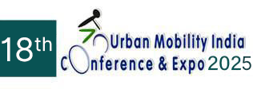
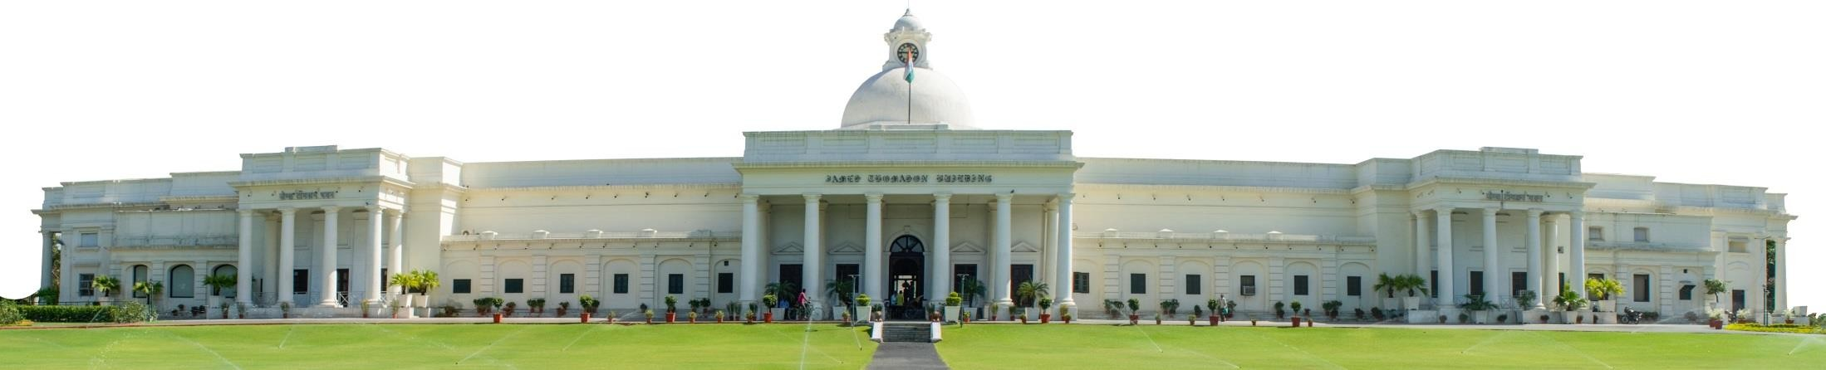
Intent vs Reality Conflict in Sustainable Transport Systems in India:
A Case Study of Public Transport in Ahmedabad City
INDIAN INSTITUTE OF TECHNOLOGY ROORKEE
Paper ID: 8894
Authors: Mohammad Shahid; Dr. Uttam Kumar Roy
Affiliation: Indian Institute of Technology Roorkee, Roorkee

Slide 2
Presentation outline
1. Introduction
2. Background
3. Research Gap
4. Research Methodology
5. Study Area Profile
6. Respondent Profile
7. Findings from Factor Analysis
8. Findings from SEM Analysis
9. Critical Factors resulted from Analysis
10. Conclusion
11. Recommendations
12. Limitations
13. References

Slide 3
Introduction
India is the most populous country in the world. In the last two decades, the number of registered vehicles in India has increased by 450% (Road Transport Year Book, 2019).
Indian cities have adopted various strategies, such as at present, 20 Cities in India have a metro of 810 km of operational lines and 980 km under construction, and almost 10 cities have a Bus Rapid Transit System, but still, cities are experiencing pressure, which is likely to increase.
In Indian cities, the BRTS has been announced to be dismantled due to the lack of public acceptance and worsened congestion scenarios, such as:
  The 6.6 km BRTS stretch in Jaipur (Misra, 2025),
  The Bhopal BRTS started dismantling in January 2024 (TNN, 2023),
  The Delhi BRTS was dismantled in 2016 (Kumavat et al., 2016), and
  Despite an increase in the bus fleet, ridership has declined by 48.5% since 2017-18 (Dixit, 2024).
  The Jaipur metro project has become economically unviable due to continuous low ridership (Parihar & Kumar, 2020), such that cities such as Bengaluru, Lucknow, Kanpur, and Ahmedabad, with significant investment in metro projects, have fallen short of achieving the desired ridership.
There is a requirement to underline the factors that affect the ridership of public transport in Indian cities.

Slide 4
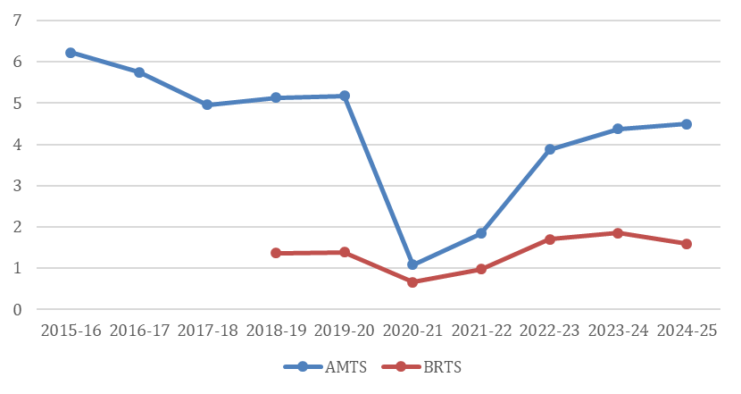
Background
As per the Transport Yearbook 2019-2020, as of March 2020, Ahmedabad ranked fifth among million-plus cities with 4.57 million registered motor vehicles, over 70% of which are two-wheelers.
Over the years, there has been a steep decline in the ridership of the buses:
  The AMTS ridership witnessed a 47% decline from 8.5 lakhs per day in 2008-09 (WRI, 2021) to 4.49 lakhs per day in 2024-25. (Ahmedabad Municipal Transport Service Depot, 2024)
  The BRTS has seen stagnant ridership growth since 2013, with a minimal increase of 3.60% that year, and there were no significant number increases after that.
  The BRTS network has not been extended, and ridership has plateaued at around 1.5 lakh passengers per day.
  Similarly, the metro has not met its ridership targets, achieving only up to 80,184 average daily ridership in FY 2023-24 (GMRCL, 2024), far below the 6.69 lakh projected for 2021 in its Phase-1 DPR (DMRC, 2015).

Slide 5
Research Gap
Instead of improving the existing transport system, the government has introduced new transport modes, such as BRTS started in 2009, then MRTS started in 2022, and now the government is aiming to introduce Light Rail Transit within the Ahmedabad Municipal Corporation area. (Ahmedabad Mirror, 2025).
Government-intended new initiatives without concern for the existing system raise the question: Why are commuters increasingly opting for private modes of transport over public options despite the city's substantial investment in public infrastructure?
The precise reasons, whether socio-economic, related to convenience, safety, or last-mile connectivity, remain unclear and require further investigation.
The study aims to assess the factors influencing public transport ridership decline in the city of Ahmedabad to bridge the gap between intent and reality.

Slide 6
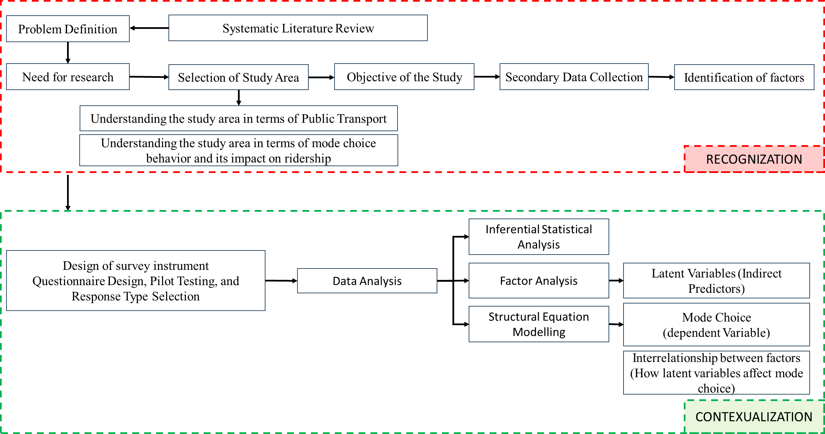
Research Methodology

Slide 7
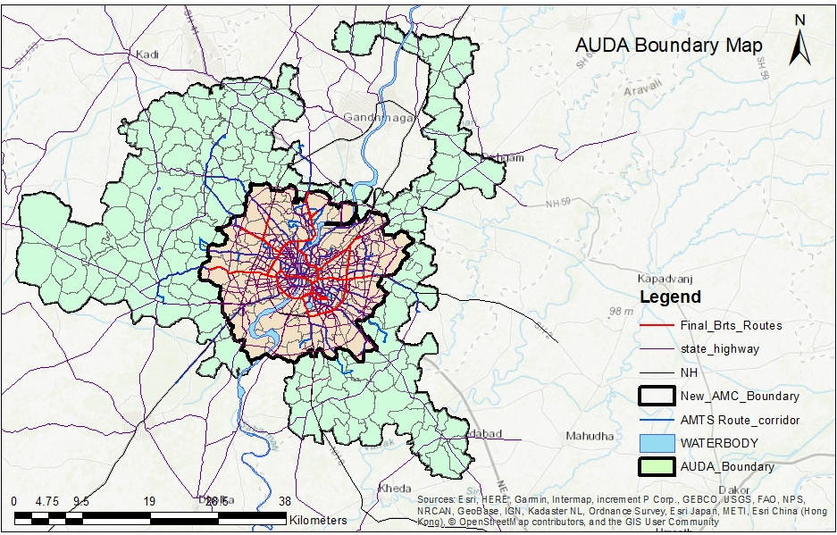
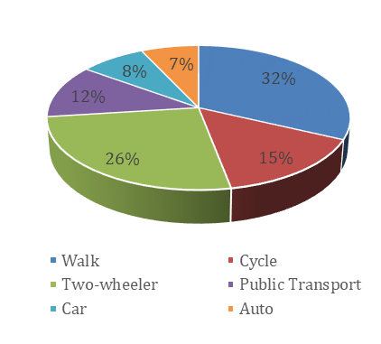
Study Area Profile
Ahmedabad, now the seventh-largest Metropolis in India and the largest in Gujarat, is spread over an area of 1866.47 sq. km, with a municipal area of 490 sq. km. (AUDA, 2021)
As per the census report, in 2011, the population of the AMC was 5.56 million, which was 4.5 million in 2001.
The study area selected is the AMC area because the public transport system is concentrated within the AMC boundary.
In Ahmedabad, the number of trips by walk accounts for 32% of the personal trips made daily. Two-wheeler has a share of 26% followed by public transport (12%) and car (8%) respectively. It is seen that two-wheelers are the predominant mode of transportation in Ahmedabad.

Slide 8
Respondent Profile
The minimum sample size of 196 was kept in mind (as per the Cochran formula), and accordingly, 218 responses were collected. Of these, 13 were found to be incomplete and were hence eliminated, and 205 responses were used for the analysis.
62% of the population belongs to the age group of 18-25 years, followed by 21% to the age group of 26-35 years, which corresponds directly to the percentage of respondents who are students 49.27% and private employees 29.27%
68% correspond to male commuters, while 32% of responses are that of female commuters.
Source: Author

Slide 9
Usage of Public Transport
Public transport was the most preferred mode of transport, i.e., 66.83%, then private vehicles, 20.97% such as two-wheelers (75%) and cars (10%).
Public transport has the highest usage (30.73%) among families earning ₹25,000–₹50,000 monthly.
The usage of private vehicles increases with income, as only 2.44% of users in the lowest-income group (<₹25,000) rely on private vehicles.
The lower-income groups rely more on auto-rickshaws and shared services (3.41%), while bicycle usage remains negligible across all groups.
Decrease in PT
Surge in Private Vehicles
Source: Author

Slide 10
Bus Users
Metro Users
The total number of bus users was 107 out of 205 responses, i.e., 52% of all the responses, including 43.93 % (47) BRTS users and 56.07% (60) AMTS users.
The total number of metro users was 47 out of 205 responses, i.e., 31% of all the responses.
The buses have been used to travel mostly for medium to long-range commutes; only 7.48% of users used buses for distances less than 5 km.
The average distance travelled by the bus users was approximately 11.19 km, which took an average time of 27.70 minutes to reach the destination.
The metro has been used to travel mostly medium to long-range commutes.
The average distance travelled by the metro users was 10.89 km = 11 km approximately, which took an average time of 22.86 minutes to reach the destination
Source: Author

Slide 11
Bus Users
Metro Users
To reach the bus stops, users had to travel an average distance of 0.6659 km (666m), which took an average time of 5.49 minutes to reach the station
To reach the metro station, users had to travel an average distance of 0.73 km (730m), which took an average time of 7.29 minutes to reach the station, as shown in the table.
Most of the users, 37 % (40 users), responded that they had to wait more than 15 minutes.
According to the responses, the average time they had to wait was 14.08 minutes.
Most of the users responded that they had to wait 5 to 10 minutes (89.36%) to get the metro at the station, while only 8.51% had to wait less than 5 minutes and 2.13% more than 15 minutes.
According to the responses, the average time they had to wait was 7.28 minutes. As per the GMRC, the average time for the next metro is 10 minutes.
Source: Author

Slide 12
Findings from Factor Analysis
To summarise satisfaction and group the attributes into relevant factors, an Exploratory Factor Analysis (EFA) using SPSS is done. The method used for analysis is “Principal Component Analysis (PCA)” with “Promax” as the rotation type.
Discriminant validity
Factors resulting from EFA
Discriminant validity here is evident as cross-loadings for the observed variables/attributes do not exist.
The results indicate that attributes loaded strongly exhibit a high loading (≥ 0.5) on a single factor and low loadings (≥ 0.4) on two attributes, indicating that the constructs are distinct and non-overlapping.
Factor | Attributes
Infrastructure & Multimodal Integration (F1) | Integration with other modes (buses, auto, etc.)
 | Availability of connecting Transit at the Interchange
 | Toilets and Drinking Water Facilities at stops/stations
 | Availability of parking facility at metro interchanges
 | Availability of footpaths & crosswalks
 | Signage and Directions
 | Passenger Information System (App/ announcements/screen)
Perceived Safety & Reliability (F2) | Safety in stations/stops
 | Safety in Public Transport (Buses/Metro)
 | Visual Communication through vulnerable language (information available in the regional language)
 | Overcrowding
 | Behavior of staff
 | Punctuality of Public Transport
 | Safety in crossing roads
User Inclusivity & Travel Experience (F3) | Ease in Payment
 | Ease of access to all age groups and gender
 | Comfort in Public Transport
 | Cleanliness in Public Transport (Buses/Metro)
The initial analysis yielded five factors with eigenvalues greater than 1, explaining 68.804 % of the total variance.
The attributes with differences between cross-loading less than 0.30 were removed, and the analysis was rerun.
The final factor structure consisted of 18 attributes reduced into 3 factors, explaining 59.073 % of the total variance
KMO and Bartlett's Test
Total Variance Explained
Reliability
The adequacy of the sample for EFA is tested.
The final factors were reduced into 3 factors, explaining 59.073 % of the total variance.
Here, the internal reliability of each factor is tested through Cronbach’s alpha test
> 0.6
Kaiser-Meyer-Olkin Measure of Sampling Adequacy. |  | 0.839
Bartlett's Test of Sphericity | Approx. Chi-Square | 1177.409
 | df | 153
 | Sig. | <.001
Component | Initial Eigen Values |  |  | Extraction Sums of Squared Loadings
 | Total | % of Variance | Cumulative % | Total | % of Variance | Cumulative %
1 | 6.846 | 38.034 | 38.034 | 6.846 | 38.034 | 38.034
2 | 2.425 | 13.470 | 51.503 | 2.425 | 13.470 | 51.503
3 | 1.362 | 7.569 | 59.073 | 1.362 | 7.569 | 59.073
S. No. | Factor | Cronbach’s Alpha | No. of Items
1 | Infrastructure & Multimodal Integration Attributes | 0.839 | 7
2 | Perceived Safety & Reliability | 0.713 | 7
3 | User Inclusivity & Travel Experience | 0.817 | 4
> 1
TVE
50%
Significant
> 0.7
Source: Author
Source: Author

Slide 13
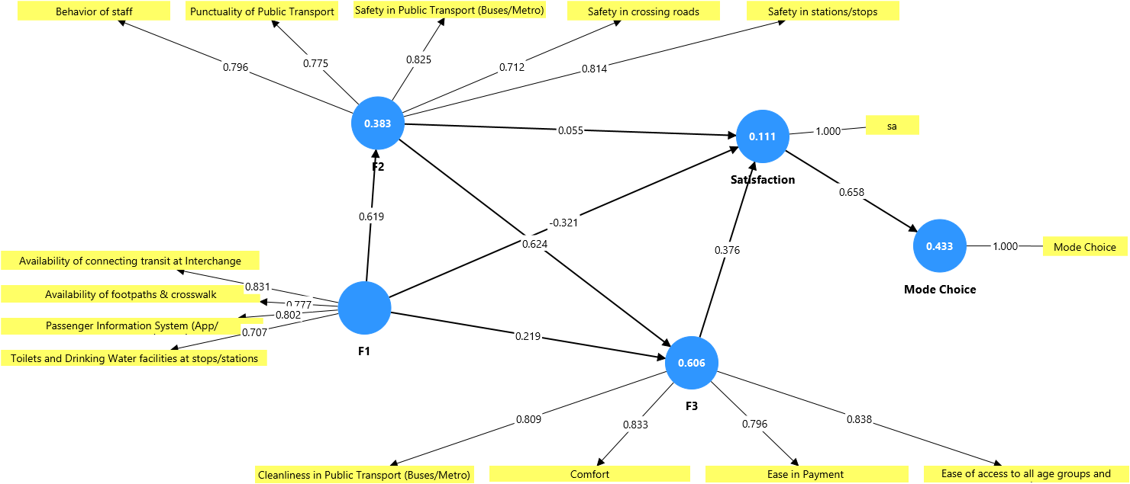
Structural Equation Modelling
Measurement Model
The type of SEM method used for the analysis is PLS-SEM, where the Partial Least Squares (PLS) method is used.
PLS-SEM estimates partial model structures by combining Principal Components Analysis with ordinary least squares regressions.
Loadings <0.7
Language Barrier
Signage & Directions
Overcrowding
Availability of parking facilities
Availability of Connecting transit at interchange
Integration with other Modes
VIF (>5.00)
5.706
5.875
Model with final attributes
Source: SmartPLS4.0.

Slide 14
Findings from SEM Analysis
Hypothesis Building
Validity Assessment of the Measurement Model
Reliability Assessment of the Measurement Model
Convergent Validity
Indicator Reliability
Hypothesis No. | Hypothesis Statements
H1a | F1 (Infrastructure & Multimodal Integration Attributes) has a positive influence on Satisfaction
H1b | F1 (Infrastructure & Multimodal Integration Attributes) positively influences F2 (Perceived Safety & Reliability)
H1c | F1 (Infrastructure & Multimodal Integration Attributes) positively influences F3 (User Inclusivity & Travel Experience)
H2a | F2 (Perceived Safety & Reliability) has a positive influence on Satisfaction.
H2b | F2 (Perceived Safety & Reliability) positive influences F3 (User Inclusivity & Travel Experience)
H3 | F3 (User Inclusivity & Travel Experience) has a positive influence on Satisfaction.
H4 | Satisfaction has a positive influence on Mode Choice
Discriminant Validity
Outer loadings represent the strength of the relationship between a latent variable and its indicators, with values above 0.70 generally considered acceptable.
All indicator loadings exceeded the 0.70 threshold, confirming the reliability of individual items.
Convergent validity refers to the extent to which multiple indicators of a construct are correlated.
It was tested using the Average Variance Extracted (AVE)
Discriminant validity determines the extent to which a construct is distinct from other constructs in the model.
It was assessed using the Heterotrait-Monotrait Ratio (HTMT), where values below 0.90 indicate satisfactory discriminant validity.
 | Average variance extracted (AVE)
F1 | 0.610
F2 | 0.617
F3 | 0.671
Internal Consistency Reliability
Paths | (HTMT)
F2 <-> F1 | 0.753
F3 <-> F1 | 0.736
F3 <-> F2 | 0.891
Mode Choice <-> F1 | 0.124
Mode Choice <-> F2 | 0.144
Mode Choice <-> F3 | 0.175
Satisfaction <-> F1 | 0.175
Satisfaction <-> F2 | 0.185
Satisfaction <-> F3 | 0.243
Satisfaction <-> Mode Choice | 0.658
Internal consistency reliability reflects the degree to which items within a construct are correlated.
 | Cronbach's alpha | Composite reliability (rho_c)
F1 | 0.787 | 0.862
F2 | 0.844 | 0.889
F3 | 0.837 | 0.891
> 0.50
> 0.7
Source: Author
Source: SmartPLS4.0.

Slide 15

Findings from SEM Analysis
Structural Model
Structural Model
After a valid measurement model is made, to examine the hypothesized relationships in the model, the structural model is assessed for the relationships between the latent constructs.
Convergent Validity
Coefficient of Determination (R²)
The structural model analysis tested several hypothesized relationships among the latent constructs to understand factors influencing mode choice in Ahmedabad.
The coefficient of determination (R²) provides insight into how well the independent variables explain the variance in the dependent constructs.
Paths | β (Original sample) | t- statistics | p-values | Significance
F1 -> F2 | 0.619 | 12.048 | 0.000 | Significant
F1 -> F3 | 0.219 | 2.750 | 0.006 | Significant
F1 -> Satisfaction | -0.321 | 3.713 | 0.000 | Significant
F2 -> F3 | 0.624 | 7.968 | 0.000 | Significant
F2 -> Satisfaction | 0.055 | 0.421 | 0.673 | Non-Significant
F3 -> Satisfaction | 0.376 | 3.152 | 0.002 | Significant
Satisfaction -> Mode Choice | 0.658 | 10.164 | 0.000 | Significant
Constructs | β (Original sample) | t-statistics | p-values
F2 | 0.383 | 6.056 | 0.000
F3 | 0.606 | 12.292 | 0.000
Mode Choice | 0.433 | 5.126 | 0.000
Satisfaction | 0.111 | 2.732 | 0.006
38.3% of its variance was explained by (F1)
F1 and F2 together explain over 60% of the variance in F3
over 43% of the variance in mode choice was attributable to perceived satisfaction
Structural model with p-values
11.1% of its variance is explained by F1, F2, and F3
Source: SmartPLS4.0.
Source: SmartPLS4.0.

Slide 16
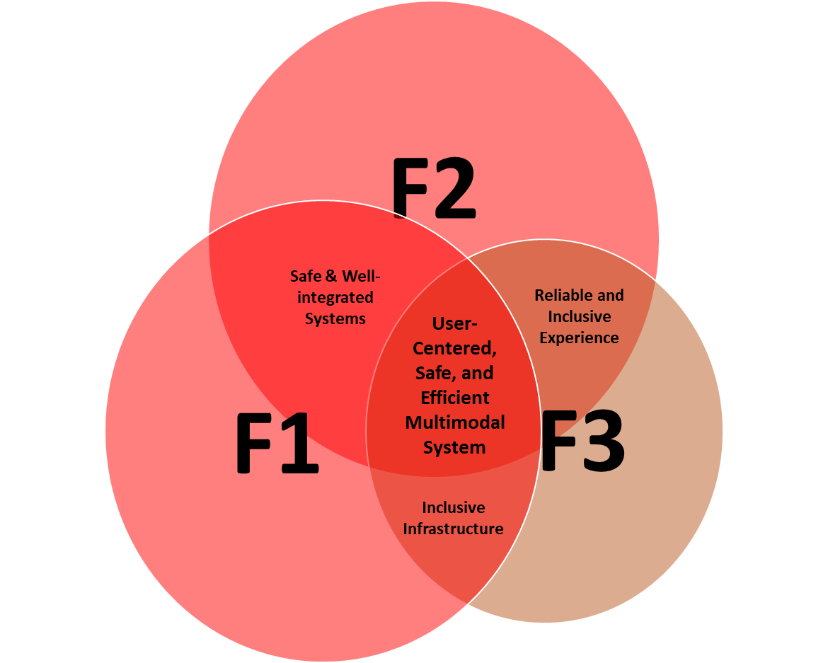
Critical Factors resulted from Analysis
The results demonstrate that infrastructure and multimodal connectivity form the foundation of a reliable and inclusive transport ecosystem, while user experience and comfort play a decisive role in shaping satisfaction and mode choice.
Safety in Stations and Stops
Safety in Crossing Roads
Punctuality of PT
Safety in Public Transport
Amenities and supporting infrastructure
Quality of comfort and convenience
Availability of connecting transit
Cleanliness
Walking infrastructure
staff behavior
PIS
ease of payment
Last-Mile connectivity
Source: Author

Slide 17
Conclusion
The research, grounded in commuter perceptions and expert opinions, reveals that despite significant investments in public transport infrastructure (such as BRTS, MRTS, and AMTS), there is a persistent underutilization of these services.
The analysis reveals that Ahmedabad's public transport network possesses significant untapped potential. Yet, merely introducing new infrastructure or transit modes will not suffice; attention must be given to optimizing and enhancing the performance of existing systems.
Pressing concerns observed during the analysis were the Infrastructure & Multimodal Integration and Safety & Reliability of public transport.
The study identified key influencing factors such as the frequency of public transport, longer time to reach the stop/station, poor last-mile connectivity, inadequate multimodal integration, comfort and safety concerns, service reliability, and a strong preference for private vehicles.

Slide 18
Recommendations
Institutional Framework
The focus should be on the existing transportation infrastructure improvement, upgrading AMTS and BRTS bus stops by ensuring weather-resistant seating, roofing, and universal design.
Many AMTS and BRTS stops are poorly maintained or incomplete; these should be prioritised for structural improvement. Enhancing pedestrian access is essential for ensuring seamless, safe, and comfortable first and last-mile connectivity to public transport.
A strategic approach based on five internationally recognized principles of multimodal integration should be adopted.
Existing Authorities
Unified Transport Operations Authority
Scheduling
Ticketing
Real-Time Info
MaaS Platform
Service Monitoring
Planning & Designing
Institutional Integration
Operation Integration
Physical Integration
Fare Integration
Information Integration
Unified Operations
Transformation Level
Ahmedabad Janmarg Limited – BRTS
Ahmedabad Municipal Transport Services – AMTS
Metro
BRTS
AMTS
Information
Level
Gujarat Metro Rail Corporation Limited – Metro
Ahmedabad Urban Development Authority
Ahmedabad Transport Authority
Source: Author

Slide 19
Limitations
References
The research is limited to the municipal area of Ahmedabad, focusing specifically on the city's public transport system and commuter behavior within this jurisdiction. Expanding the study to the broader metropolitan region may reveal additional variations in travel behavior.
Furthermore, as the research primarily examines public transport within the city, certain significant transport modes remain unexplored. A more localized, micro-level study could provide a deeper understanding of user preferences and refine the factors influencing public transport usage.
The study is constrained by the availability and accuracy of data, as well as other transport-related metrics, which may affect the comprehensiveness of the analysis.
Moreover, while the transit agency funding aspect falls outside the scope of this research, further studies could explore the relationship between the diﬀerent sources of funding and transit ridership.
The future research can also delve deeper into mode-specific analysis, examining each transport mode (e.g., AMTS, BRTS, and Metro) individually to assess their performance and user perceptions in greater detail, covering the Metropolitan area.
AMTS, BRTS, metro not enough: AMC eyes LRT. (2025, February 7). Ahmedabad Mirror. https://www.ahmedabadmirror.com/flying-taxis-next/81884911.html#goog_rewarded
AUDA. (2021). Urban Planning & Development Practices of Ahmedabad Urban Development Authority.
Census of India. (2011). District Census Handbook Ahmadabad. https://censusindia.gov.in/nada/index.php/catalog/405
CEPT. (2011). Integrated Mobility Plan 2031 Volume 2.
Dixit, K. (2024, March 3). More modern buses plying, but ridership dips in Delhi. Times of India. https://timesofindia.indiatimes.com/city/delhi/more-modern-buses-plying-but-ridership-dips-in-city-delhi-news/articleshow/108172204.cms
Heidari, I., Toloie Eshlaghy, A., & Hosseini, S. M. S. (2024). “Effect of improving sustainable transportation indicators on quality of life in Tehran.” Environmental Research, 263. https://doi.org/10.1016/j.envres.2024.120241
Kaushik, H. (2024, August 4). Ahmedabad woos traffic jams, boos AMTS, BRTS & metro Trending Stories. Times of India. https://timesofindia.indiat
Kumavat, C., Sonawane, H., Patel, T., Sakhalkar, X., & Pansare, A. (2016). Effective Learning From Delhi BRTS- A Case Study of Pune BRTS. IJRET: International Journal of Research in Engineering and Technology, 2321–7308. http://ijret.esatjournals.org
Misra, S. (2025, July 28). Rise and fall of India’s BRTS. ‘World-class’ solution that made problems worse. The Print. https://theprint.in/ground-reports/rise-and-fall-of-indias-brts-world-class-solution-that-made-problems-worse/2703724/
Parihar, M., & Kumar, A. (2020). An Economic Analysis Of Mass Rapid Transit System (MRTS) In India With Special Reference To Jaipur Metro Rail In Rajasthan. 2020 International Conference on Computation, Automation and Knowledge Management (ICCAKM) Amity University.
Pathak, S., & Upadhyay, R. K. (2023). Macro level performance study of Ahmadabad bus rapid transit system: Janmarg. Green Energy and Intelligent Transportation, 2(3). https://doi.org/10.1016/j.geits.2023.100093
Road Transport Year Book. (2019).
TNN. (2023, December 27). CM Mohan Das signals the end of the road for BRTS. Times of India. https://timesofindia.indiatimes.com/city/bhopal/cm-mohan-yadav-signals-end-of-the-road-for-bhopal-brts/articleshow/106305275.cms
WRI. (2021). AMTS Vision Plan: 2035.

Slide 20
Thank you
Mohammad Shahid
mohammad_s@ar.iitr.ac.in

