Slide 1


An empirical investigation of the influence of sociodemographic, travel information, satisfaction, and tech savviness on the safety perception of the first and last mile travel
Authors
Dilawaiz Aliª, Prasanta K. Sahuª, Avijit Maji^{b}, Bandhan Bandhu Majumdarª, Ishant Sharmaª, Arkopal Goswami^{c}
ªDepartment of Civil Engineering, BITS Pilani, Hyderabad Campus
^{b}Department of Civil Engineering, IIT Bombay
^{c}Department of Civil Engineering, IIT Kharagpur
Presenter: Dilawaiz Ali Paper ID: 5801

Slide 2
Introduction
First and last mile (FLM) is a crucial segment to improve accessibility for transit users
Despite high-quality main-mile services, FLM sections can deter transit ridership
Safety and security concerns during FLM travel
Essential to analyse commuters’ safety perception during FLM travel
Transportation negative externalities
(congestion, pollution)
Probable shift to private vehicles

Slide 3
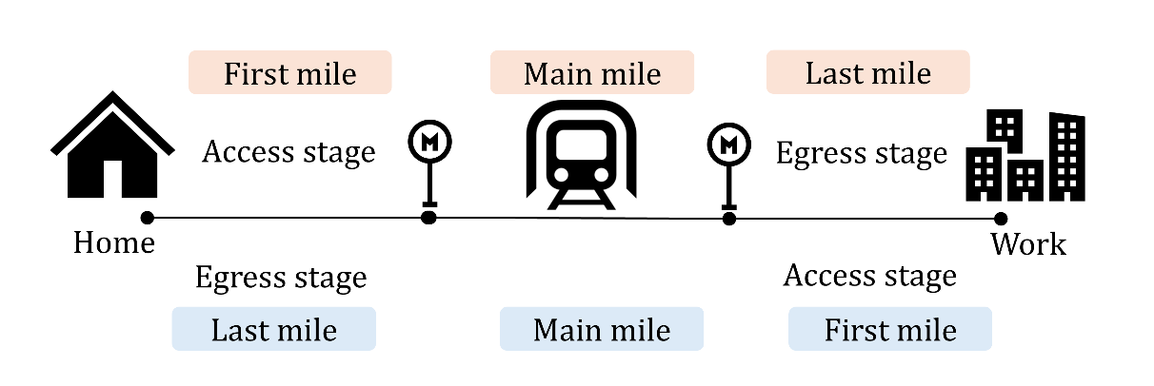
Introduction
Figure 1. First and last mile diagram

Slide 4
Objectives
To identify the factors influencing the safety perception of transit commuters during the first and last mile travel.
To investigate the role of psychological attributes on the safety perception of commuters.
To determine how the safety perception varies with first and last mile travel.

Slide 5
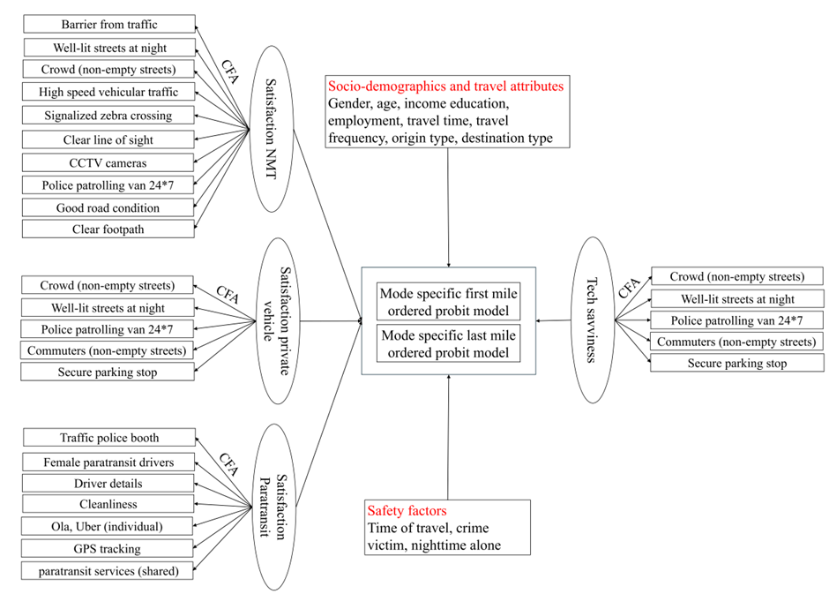
Methodology
Figure 2. Methodological framework

Slide 6
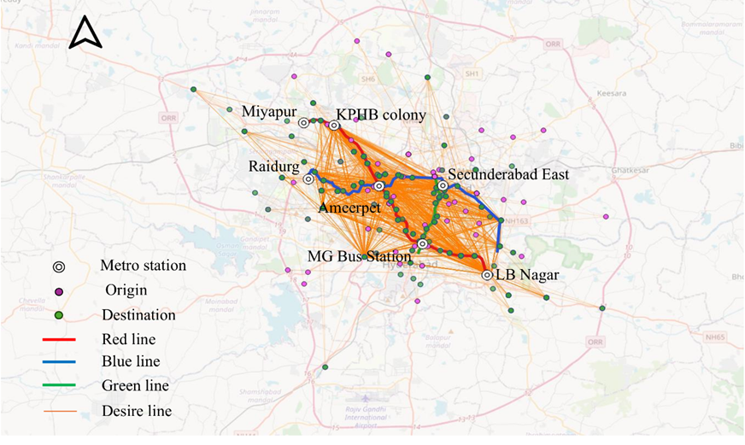
Data Collection
Sample size, n = 4514
Simple random sampling technique
Data collected at seven metro stations of Hyderabad.
Figure 3. Study area (Hyderabad)

Slide 7
Data description
Table 1. Sample Characteristics
Variables | Levels | Percentage (%)
Gender | Male | 70
 | Female | 30
Age (years) | 15-24 | 29
 | 25-44 | 49
 | 45-59 | 20
 | >60 | 2
Income (lakhs* per annum) | 0-2.5 | 38
 | 2.5-5 | 37
 | 5-10 | 23
 | >10 | 2
Employment | Self-employed | 16
 | Government | 5
 | Private | 53
 | Student | 25
 | Other | 1
Education | Grade 10 or below | 6
 | Intermediate | 13
 | Graduate | 66
 | Postgraduate and above | 15
Commuting trips’ frequency | Once a week or less | 15
 | 2 – 3 times a week | 30
 | 4 – 5 times a week | 24
 | 5 – 6 times a week | 23
 | More than 6 times a week | 8
Non-commuting trips’ frequency | Once a month or less | 60
 | Once in every 3 weeks | 14
 | Once in every 2 weeks | 18
 | Once in a week | 6
 | More than once a week | 2
The majority of respondents were males.
Most of the respondents (49%) were aged between 25 and 44 years.
The majority of respondents (38%) had an annual income of less than 2.5 lakhs and held a graduate degree.

Slide 8
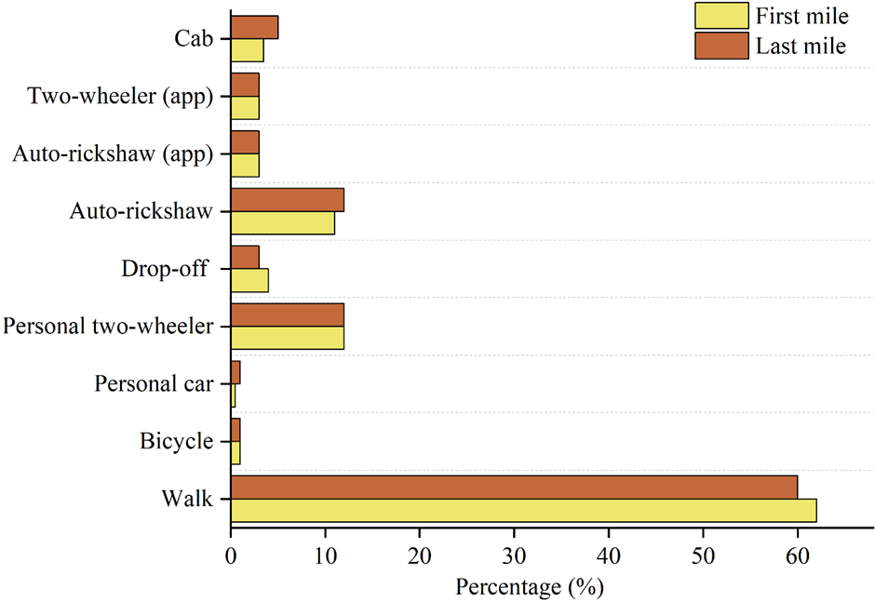
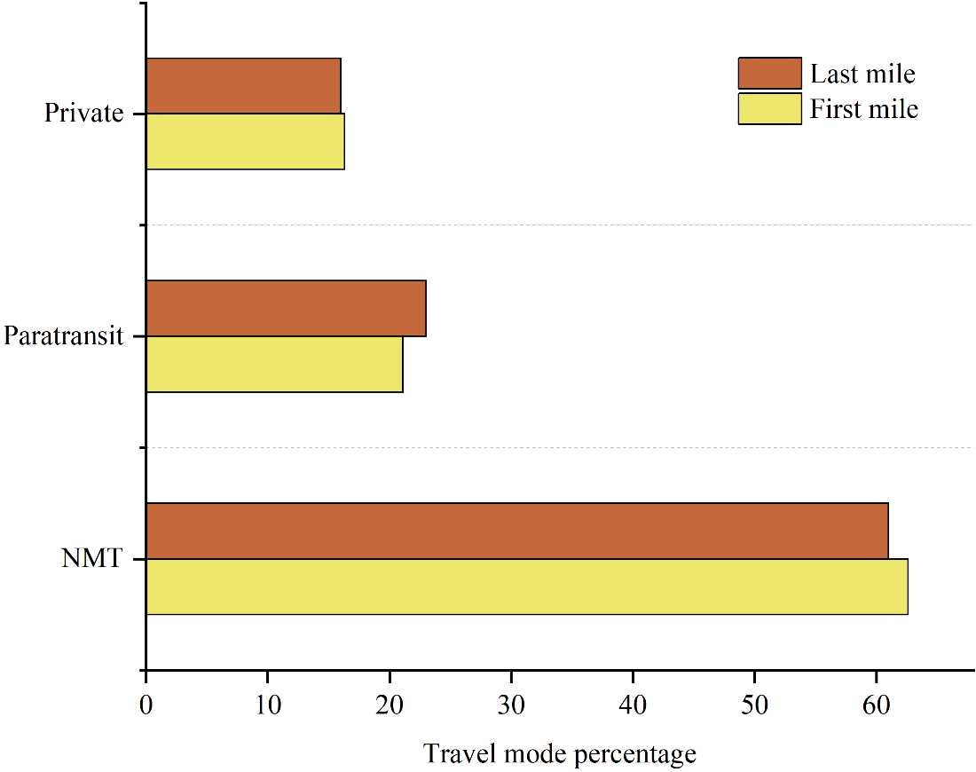
Data description
Figures 4 and 5. First and last mile travel modes

Slide 9
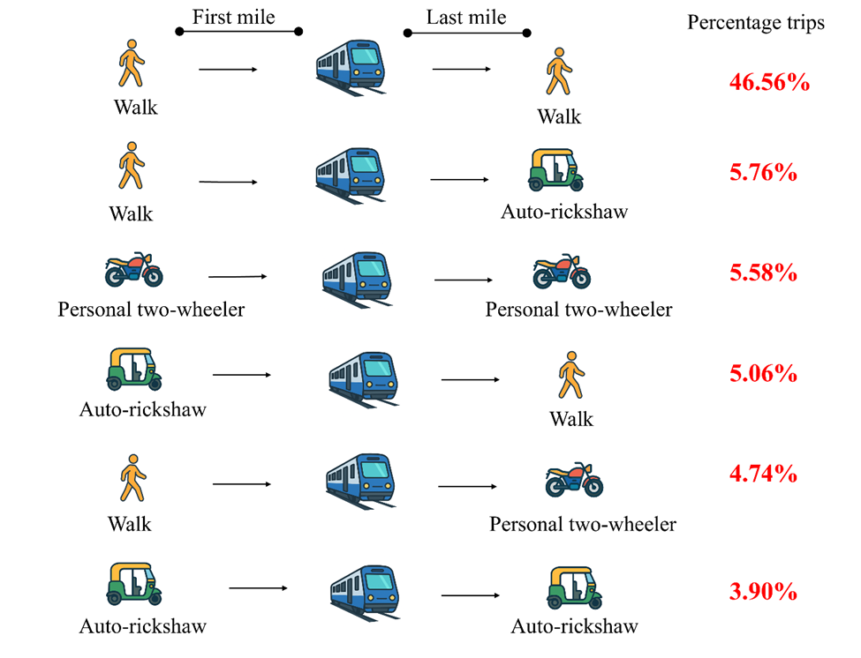
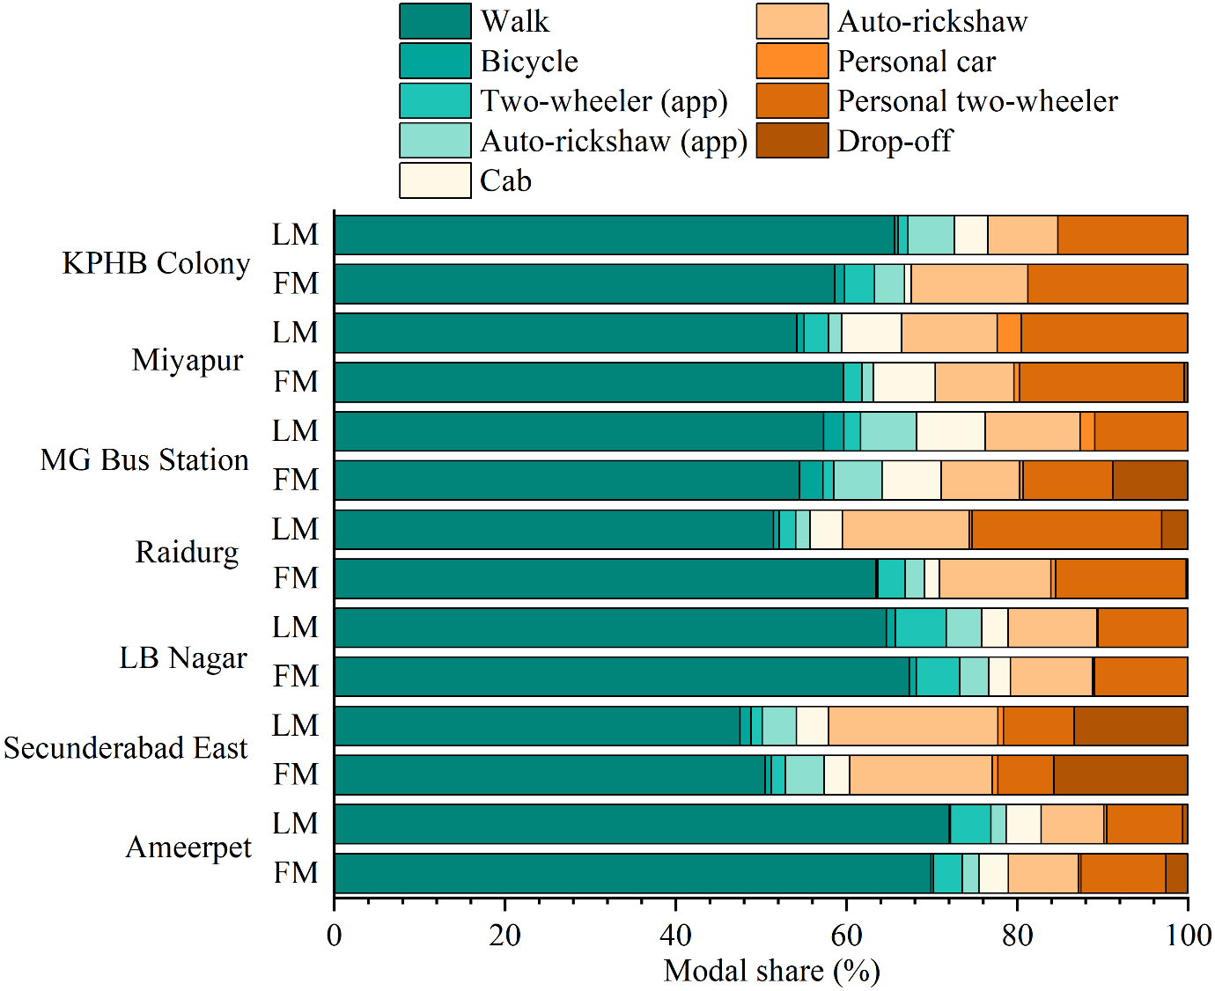
Data description
Figure 6. Common trip chain composition for metro users
Figure 7. Modal share at different metro stations

Slide 10
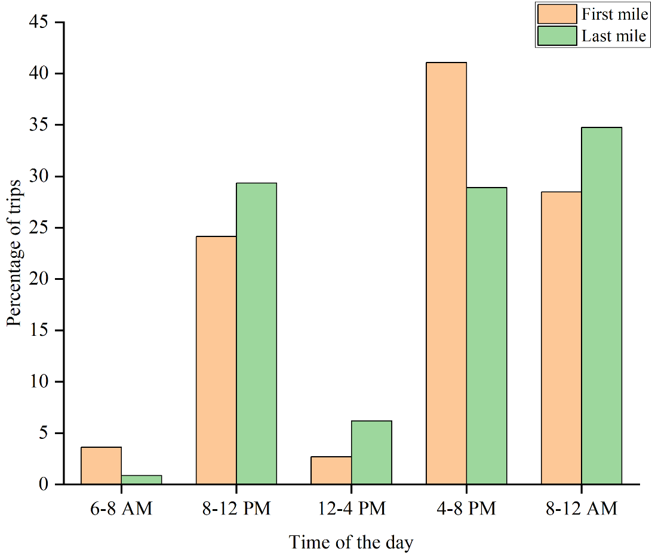
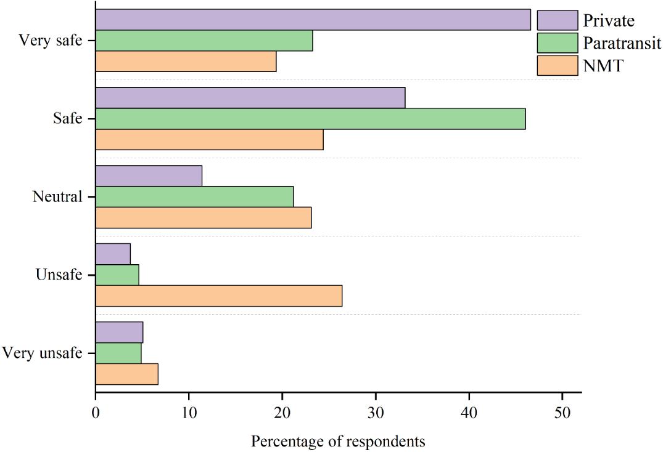
Data description
Figure 8. Percentage of trips at different times
Figure 9. Perception of safety travelling alone at nighttime

Slide 11
Results - CFA
Table 2. Confirmatory factor analysis results
Mode | Indicators | Latent variable | First mile |  | Last mile
 |  |  | Loadings | CR | Loadings | CR
NMT | Police patrolling van 24*7 | Satisfaction | 0.426 | 0.83 | 0.561 | 0.85
 | Signalized zebra crossing |  | 0.601 |  | 0.658
 | CCTV cameras |  | 0.573 |  | 0.649
 | Well-lit streets |  | 0.593 |  | 0.656
 | Crowd (non-empty streets) |  | 0.642 |  | 0.668
 | Clear footpath |  | 0.671 |  | 0.696
 | High-speed vehicular traffic |  | 0.703 |  | 0.678
 | Barrier from traffic |  | 0.678 |  | 0.707
 | Clear line of sight |  | 0.697 |  | 0.716
 | Navigation | Tech savviness | 0.854 | 0.75 | 0.831 | 0.76
 | UPI |  | 0.872 |  | 0.865
 | Online shopping |  | 0.913 |  | 0.907
 | Ticket booking |  | 0.912 |  | 0.900
 | Cab booking |  | 0.897 |  | 0.891
Paratransit | Shared services | Satisfaction | 0.643 | 0.77 | 0.580 | 0.77
 | GPS tracking |  | 0.636 |  | 0.579
 | Single services |  | 0.698 |  | 0.687
 | Driver details |  | 0.648 |  | 0.621
 | Cleanliness |  | 0.695 |  | 0.731
 | Female driver |  | 0.477 |  | 0.547
 | Traffic police booth |  | 0.574 |  | 0.669
 | Navigation | Tech savviness | 0.826 | 0.77 | 0.840 | 0.78
 | UPI |  | 0.816 |  | 0.830
 | Online shopping |  | 0.902 |  | 0.909
 | Ticket booking |  | 0.869 |  | 0.896
 | Cab booking |  | 0.873 |  | 0.887
Private | Secure parking | Satisfaction | 0.579 | 0.70 | 0.565 | 0.73
 | Crowd (non-empty streets) |  | 0.634 |  | 0.573
 | Police patrolling van 24*7 |  | 0.702 |  | 0.794
 | Good road condition |  | 0.673 |  | 0.643
 | Well-lit streets |  | 0.670 |  | 0.769
 | Navigation | Tech savviness | 0.746 | 0.77 | 0.853 | 0.81
 | UPI |  | 0.770 |  | 0.813
 | Online shopping |  | 0.842 |  | 0.866
 | Ticket booking |  | 0.795 |  | 0.819
 | Cab booking |  | 0.846 |  | 0.863

Slide 12
Results – Ordered Probit Models
Table 3. Model estimation results
Category | Variables | First mile |  |  | Last mile
 |  | Coefficients
 |  | NMT | Paratransit | Private | NMT | Paratransit | Private
Gender | Male (Reference)
 | Female |  |  | -0.346*** | -0.17*** | -0.919*** | -0.58***
Age | Older (Over 45 years old) Reference
 | 15 to 24 years | -0.102* |  |  |  | -1.1***
 | 25 to 44 years |  |  |  |  | -0.255***
Income | Income greater than 10 lakhs (Reference)
 | Less than 2.5 lakhs | -0.363*** | -0.221*** | -0.551*** | -0.22*** | -0.44*** | -0.711***
 | 2.5 to 5 lakhs | -0.282*** |  | -0.227** | -0.181*** | -0.315*** | -0.82***
 | 5 to10 lakhs |  | -0.187** |  |  |  | -0.603**
Highest education level | Lower education (Reference)
 | Higher education | -0.116** | -0.433*** | -0.236* | -0.129** | -0.302***
Employment | Unemployed (Reference)
 | Student
 | Employed | -0.219*** |  | -0.434***
Commuting trips frequency | Less than 4 times a week (Reference)
 | More than 4 times a week | -0.132*** |  |  |  |  | 0.205**
Non-commuting trip frequency | Less than 4 times a month (Reference)
 | More than 4 times a month |  |  |  | 0.099*
Time of the day | Early morning (6-8 AM) Reference
 | Morning (8-12 PM) |  |  | -0.194*
 | Afternoon (12-4 PM) |  |  | 0.43* | 0.195** | 0.376**
 | Evening (4-8 PM) |  |  |  |  | -0.147* | -0.354***
Origin type | Work (Reference)
 | Home |  |  | 0.291*** | na | na | na
Access time |  |  | -0.006** |  | na | na | na
Egress time |  | na | na | na | -0.007***
If observed crime while travelling | No (Reference)
 | Yes |  | -0.356* | -0.433* | -0.308***
Perception of safety while travelling alone at night |  | 0.137*** |  |  | 0.123*** |  | 0.14***
Latent variables | Satisfaction | 1.64*** | 1.27*** | 1.64*** | 1.32*** | 0.793*** | 1.13***
 | Tech savviness |  | 0.08* |  |  | 0.178*** | -
Threshold parameters | µ₁ | -3.62*** | -3.54*** | -4.55* | -3.5*** | -4.43*** | -3.97***
 | µ₂ | -2.41*** | -2.88*** | -3.52*** | -2.28*** | -3.56*** | -2.62***
 | µ₃ | -0.995*** | -1.59*** | -2.1*** | -0.979*** | -2.67*** | -1.73***
 | µ₄ | 1.18*** | 0.869*** | 0.63*** | 1.48*** | -1.29*** | 0.763**
McFadden pseudo-R-square |  | 0.16 | 0.16 | 0.2 | 0.16 | 0.18 | 0.14

Slide 13
Results - Ordered Probit Models
Table 3. Model estimation results
Category | Variables | First mile |  |  | Last mile
 |  | Coefficients
 |  | NMT | Paratransit | Private | NMT | Paratransit | Private
Gender | Male (Reference)
 | Female |  |  | -0.346*** | -0.17*** | -0.919*** | -0.58***
Age | Older (Over 45 years old) Reference
 | 15 to 24 years | -0.102* |  |  |  | -1.1***
 | 25 to 44 years |  |  |  |  | -0.255***
Income | Income greater than 10 lakhs (Reference)
 | Less than 2.5 lakhs | -0.363*** | -0.221*** | -0.551*** | -0.22*** | -0.44*** | -0.711***
 | 2.5 to 5 lakhs | -0.282*** |  | -0.227** | -0.181*** | -0.315*** | -0.82***
 | 5 to10 lakhs |  | -0.187** |  |  |  | -0.603**
Highest education level | Lower education (Reference)
 | Higher education | -0.116** | -0.433*** | -0.236* | -0.129** | -0.302***
Employment | Unemployed (Reference)
 | Student
 | Employed | -0.219*** |  | -0.434***
Commuting trips frequency | Less than 4 times a week (Reference)
 | More than 4 times a week | -0.132*** |  |  |  |  | 0.205**
Non-commuting trip frequency | Less than 4 times a month (Reference)
 | More than 4 times a month |  |  |  | 0.099*
Time of the day | Early morning (6-8 AM) Reference
 | Morning (8-12 PM) |  |  | -0.194*
 | Afternoon (12-4 PM) |  |  | 0.43* | 0.195** | 0.376**
 | Evening (4-8 PM) |  |  |  |  | -0.147* | -0.354***
Origin type | Work (Reference)
 | Home |  |  | 0.291*** | na | na | na
Access time |  |  | -0.006** |  | na | na | na
Egress time |  | na | na | na | -0.007***
If observed crime while travelling | No (Reference)
 | Yes |  | -0.356* | -0.433* | -0.308***
Perception of safety while travelling alone at night |  | 0.137*** |  |  | 0.123*** |  | 0.14***
Latent variables | Satisfaction | 1.64*** | 1.27*** | 1.64*** | 1.32*** | 0.793*** | 1.13***
 | Tech savviness |  | 0.08* |  |  | 0.178*** | -
Threshold parameters | µ₁ | -3.62*** | -3.54*** | -4.55* | -3.5*** | -4.43*** | -3.97***
 | µ₂ | -2.41*** | -2.88*** | -3.52*** | -2.28*** | -3.56*** | -2.62***
 | µ₃ | -0.995*** | -1.59*** | -2.1*** | -0.979*** | -2.67*** | -1.73***
 | µ₄ | 1.18*** | 0.869*** | 0.63*** | 1.48*** | -1.29*** | 0.763**
McFadden pseudo-R-square |  | 0.16 | 0.16 | 0.2 | 0.16 | 0.18 | 0.14

Slide 14
Results - Ordered Probit Models
Table 3. Model estimation results
Category | Variables | First mile |  |  | Last mile
 |  | Coefficients
 |  | NMT | Paratransit | Private | NMT | Paratransit | Private
Gender | Male (Reference)
 | Female |  |  | -0.346*** | -0.17*** | -0.919*** | -0.58***
Age | Older (Over 45 years old) Reference
 | 15 to 24 years | -0.102* |  |  |  | -1.1***
 | 25 to 44 years |  |  |  |  | -0.255***
Income | Income greater than 10 lakhs (Reference)
 | Less than 2.5 lakhs | -0.363*** | -0.221*** | -0.551*** | -0.22*** | -0.44*** | -0.711***
 | 2.5 to 5 lakhs | -0.282*** |  | -0.227** | -0.181*** | -0.315*** | -0.82***
 | 5 to10 lakhs |  | -0.187** |  |  |  | -0.603**
Highest education level | Lower education (Reference)
 | Higher education | -0.116** | -0.433*** | -0.236* | -0.129** | -0.302***
Employment | Unemployed (Reference)
 | Student
 | Employed | -0.219*** |  | -0.434***
Commuting trips frequency | Less than 4 times a week (Reference)
 | More than 4 times a week | -0.132*** |  |  |  |  | 0.205**
Non-commuting trip frequency | Less than 4 times a month (Reference)
 | More than 4 times a month |  |  |  | 0.099*
Time of the day | Early morning (6-8 AM) Reference
 | Morning (8-12 PM) |  |  | -0.194*
 | Afternoon (12-4 PM) |  |  | 0.43* | 0.195** | 0.376**
 | Evening (4-8 PM) |  |  |  |  | -0.147* | -0.354***
Origin type | Work (Reference)
 | Home |  |  | 0.291*** | na | na | na
Access time |  |  | -0.006** |  | na | na | na
Egress time |  | na | na | na | -0.007***
If observed crime while travelling | No (Reference)
 | Yes |  | -0.356* | -0.433* | -0.308***
Perception of safety while travelling alone at night |  | 0.137*** |  |  | 0.123*** |  | 0.14***
Latent variables | Satisfaction | 1.64*** | 1.27*** | 1.64*** | 1.32*** | 0.793*** | 1.13***
 | Tech savviness |  | 0.08* |  |  | 0.178*** | -
Threshold parameters | µ₁ | -3.62*** | -3.54*** | -4.55* | -3.5*** | -4.43*** | -3.97***
 | µ₂ | -2.41*** | -2.88*** | -3.52*** | -2.28*** | -3.56*** | -2.62***
 | µ₃ | -0.995*** | -1.59*** | -2.1*** | -0.979*** | -2.67*** | -1.73***
 | µ₄ | 1.18*** | 0.869*** | 0.63*** | 1.48*** | -1.29*** | 0.763**
McFadden pseudo-R-square |  | 0.16 | 0.16 | 0.2 | 0.16 | 0.18 | 0.14

Slide 15
Results - Ordered Probit Models
Table 3. Model estimation results
Category | Variables | First mile |  |  | Last mile
 |  | Coefficients
 |  | NMT | Paratransit | Private | NMT | Paratransit | Private
Gender | Male (Reference)
 | Female |  |  | -0.346*** | -0.17*** | -0.919*** | -0.58***
Age | Older (Over 45 years old) Reference
 | 15 to 24 years | -0.102* |  |  |  | -1.1***
 | 25 to 44 years |  |  |  |  | -0.255***
Income | Income greater than 10 lakhs (Reference)
 | Less than 2.5 lakhs | -0.363*** | -0.221*** | -0.551*** | -0.22*** | -0.44*** | -0.711***
 | 2.5 to 5 lakhs | -0.282*** |  | -0.227** | -0.181*** | -0.315*** | -0.82***
 | 5 to10 lakhs |  | -0.187** |  |  |  | -0.603**
Highest education level | Lower education (Reference)
 | Higher education | -0.116** | -0.433*** | -0.236* | -0.129** | -0.302***
Employment | Unemployed (Reference)
 | Student
 | Employed | -0.219*** |  | -0.434***
Commuting trips frequency | Less than 4 times a week (Reference)
 | More than 4 times a week | -0.132*** |  |  |  |  | 0.205**
Non-commuting trip frequency | Less than 4 times a month (Reference)
 | More than 4 times a month |  |  |  | 0.099*
Time of the day | Early morning (6-8 AM) Reference
 | Morning (8-12 PM) |  |  | -0.194*
 | Afternoon (12-4 PM) |  |  | 0.43* | 0.195** | 0.376**
 | Evening (4-8 PM) |  |  |  |  | -0.147* | -0.354***
Origin type | Work (Reference)
 | Home |  |  | 0.291*** | na | na | na
Access time |  |  | -0.006** |  | na | na | na
Egress time |  | na | na | na | -0.007***
If observed crime while travelling | No (Reference)
 | Yes |  | -0.356* | -0.433* | -0.308***
Perception of safety while travelling alone at night |  | 0.137*** |  |  | 0.123*** |  | 0.14***
Latent variables | Satisfaction | 1.64*** | 1.27*** | 1.64*** | 1.32*** | 0.793*** | 1.13***
 | Tech savviness |  | 0.08* |  |  | 0.178*** | -
Threshold parameters | µ₁ | -3.62*** | -3.54*** | -4.55* | -3.5*** | -4.43*** | -3.97***
 | µ₂ | -2.41*** | -2.88*** | -3.52*** | -2.28*** | -3.56*** | -2.62***
 | µ₃ | -0.995*** | -1.59*** | -2.1*** | -0.979*** | -2.67*** | -1.73***
 | µ₄ | 1.18*** | 0.869*** | 0.63*** | 1.48*** | -1.29*** | 0.763**
McFadden pseudo-R-square |  | 0.16 | 0.16 | 0.2 | 0.16 | 0.18 | 0.14

Slide 16
Results - Ordered Probit Models
Table 3. Model estimation results
Category | Variables | First mile |  |  | Last mile
 |  | Coefficients
 |  | NMT | Paratransit | Private | NMT | Paratransit |  | Private
Gender | Male (Reference)
 | Female |  |  | -0.346*** | -0.17*** | -0.919*** |  | -0.58***
Age | Older (Over 45 years old) Reference
 | 15 to 24 years | -0.102* |  |  |  | -1.1***
 | 25 to 44 years |  |  |  |  | -0.255***
Income | Income greater than 10 lakhs (Reference)
 | Less than 2.5 lakhs | -0.363*** | -0.221*** | -0.551*** | -0.22*** | -0.44*** |  | -0.711***
 | 2.5 to 5 lakhs | -0.282*** |  | -0.227** | -0.181*** | -0.315*** |  | -0.82***
 | 5 to10 lakhs |  | -0.187** |  |  |  |  | -0.603**
Highest education level | Lower education (Reference)
 | Higher education | -0.116** | -0.433*** | -0.236* | -0.129** | -0.302***
Employment | Unemployed (Reference)
 | Student
 | Employed | -0.219*** |  | -0.434***
Commuting trips frequency | Less than 4 times a week (Reference)
 | More than 4 times a week | -0.132*** |  |  |  |  |  | 0.205**
Non-commuting trip frequency | Less than 4 times a month (Reference)
 | More than 4 times a month |  |  |  | 0.099*
Time of the day | Early morning (6-8 AM) Reference
 | Morning (8-12 PM) |  |  | -0.194*
 | Afternoon (12-4 PM) |  |  | 0.43* | 0.195** | 0.376**
 | Evening (4-8 PM) |  |  |  |  | -0.147* |  | -0.354***
Origin type | Work (Reference)
 | Home |  |  | 0.291*** | na | na |  | na
Access time |  |  | -0.006** |  | na | na |  | na
Egress time |  | na | na | na | -0.007***
If observed crime while travelling | No (Reference)
 | Yes |  | -0.356* | -0.433* | -0.308***
Perception of safety while travelling alone at night |  | 0.137*** |  |  | 0.123*** |  |  | 0.14***
Latent variables | Satisfaction | 1.64*** | 1.27*** | 1.64*** | 1.32*** | 0.793*** | 0.793*** | 1.13***
 | Tech savviness |  | 0.08* |  |  | 0.178*** | 0.178*** | -
Threshold parameters | µ₁ | -3.62*** | -3.54*** | -4.55* | -3.5*** | -4.43*** | -4.43*** | -3.97***
 | µ₂ | -2.41*** | -2.88*** | -3.52*** | -2.28*** | -3.56*** | -3.56*** | -2.62***
 | µ₃ | -0.995*** | -1.59*** | -2.1*** | -0.979*** | -2.67*** | -2.67*** | -1.73***
 | µ₄ | 1.18*** | 0.869*** | 0.63*** | 1.48*** | -1.29*** | -1.29*** | 0.763**
McFadden pseudo-R-square |  | 0.16 | 0.16 | 0.2 | 0.16 | 0.18 | 0.18 | 0.14

Slide 17
Results - Ordered Probit Models
Table 3. Model estimation results
Category | Variables | First mile |  |  | Last mile
 |  | Coefficients
 |  | NMT | Paratransit | Private | NMT | Paratransit |  | Private
Gender | Male (Reference)
 | Female |  |  | -0.346*** | -0.17*** | -0.919*** |  | -0.58***
Age | Older (Over 45 years old) Reference
 | 15 to 24 years | -0.102* |  |  |  | -1.1***
 | 25 to 44 years |  |  |  |  | -0.255***
Income | Income greater than 10 lakhs (Reference)
 | Less than 2.5 lakhs | -0.363*** | -0.221*** | -0.551*** | -0.22*** | -0.44*** |  | -0.711***
 | 2.5 to 5 lakhs | -0.282*** |  | -0.227** | -0.181*** | -0.315*** |  | -0.82***
 | 5 to10 lakhs |  | -0.187** |  |  |  |  | -0.603**
Highest education level | Lower education (Reference)
 | Higher education | -0.116** | -0.433*** | -0.236* | -0.129** | -0.302***
Employment | Unemployed (Reference)
 | Student
 | Employed | -0.219*** |  | -0.434***
Commuting trips frequency | Less than 4 times a week (Reference)
 | More than 4 times a week | -0.132*** |  |  |  |  |  | 0.205**
Non-commuting trip frequency | Less than 4 times a month (Reference)
 | More than 4 times a month |  |  |  | 0.099*
Time of the day | Early morning (6-8 AM) Reference
 | Morning (8-12 PM) |  |  | -0.194*
 | Afternoon (12-4 PM) |  |  | 0.43* | 0.195** | 0.376**
 | Evening (4-8 PM) |  |  |  |  | -0.147* |  | -0.354***
Origin type | Work (Reference)
 | Home |  |  | 0.291*** | na | na |  | na
Access time |  |  | -0.006** |  | na | na |  | na
Egress time |  | na | na | na | -0.007***
If observed crime while travelling | No (Reference)
 | Yes |  | -0.356* | -0.433* | -0.308***
Perception of safety while travelling alone at night |  | 0.137*** |  |  | 0.123*** |  |  | 0.14***
Latent variables | Satisfaction | 1.64*** | 1.27*** | 1.64*** | 1.32*** | 0.793*** | 0.793*** | 1.13***
 | Tech savviness |  | 0.08* |  |  | 0.178*** | 0.178*** | -
Threshold parameters | µ₁ | -3.62*** | -3.54*** | -4.55* | -3.5*** | -4.43*** | -4.43*** | -3.97***
 | µ₂ | -2.41*** | -2.88*** | -3.52*** | -2.28*** | -3.56*** | -3.56*** | -2.62***
 | µ₃ | -0.995*** | -1.59*** | -2.1*** | -0.979*** | -2.67*** | -2.67*** | -1.73***
 | µ₄ | 1.18*** | 0.869*** | 0.63*** | 1.48*** | -1.29*** | -1.29*** | 0.763**
McFadden pseudo-R-square |  | 0.16 | 0.16 | 0.2 | 0.16 | 0.18 | 0.18 | 0.14

Slide 18
Results - Ordered Probit Models
Table 3. Model estimation results
Category | Variables | First mile |  |  | Last mile
 |  | Coefficients
 |  | NMT | Paratransit | Private | NMT | Paratransit |  | Private
Gender | Male (Reference)
 | Female |  |  | -0.346*** | -0.17*** | -0.919*** |  | -0.58***
Age | Older (Over 45 years old) Reference
 | 15 to 24 years | -0.102* |  |  |  | -1.1***
 | 25 to 44 years |  |  |  |  | -0.255***
Income | Income greater than 10 lakhs (Reference)
 | Less than 2.5 lakhs | -0.363*** | -0.221*** | -0.551*** | -0.22*** | -0.44*** |  | -0.711***
 | 2.5 to 5 lakhs | -0.282*** |  | -0.227** | -0.181*** | -0.315*** |  | -0.82***
 | 5 to10 lakhs |  | -0.187** |  |  |  |  | -0.603**
Highest education level | Lower education (Reference)
 | Higher education | -0.116** | -0.433*** | -0.236* | -0.129** | -0.302***
Employment | Unemployed (Reference)
 | Student
 | Employed | -0.219*** |  | -0.434***
Commuting trips frequency | Less than 4 times a week (Reference)
 | More than 4 times a week | -0.132*** |  |  |  |  |  | 0.205**
Non-commuting trip frequency | Less than 4 times a month (Reference)
 | More than 4 times a month |  |  |  | 0.099*
Time of the day | Early morning (6-8 AM) Reference
 | Morning (8-12 PM) |  |  | -0.194*
 | Afternoon (12-4 PM) |  |  | 0.43* | 0.195** | 0.376**
 | Evening (4-8 PM) |  |  |  |  | -0.147* |  | -0.354***
Origin type | Work (Reference)
 | Home |  |  | 0.291*** | na | na |  | na
Access time |  |  | -0.006** |  | na | na |  | na
Egress time |  | na | na | na | -0.007***
If observed crime while travelling | No (Reference)
 | Yes |  | -0.356* | -0.433* | -0.308***
Perception of safety while travelling alone at night |  | 0.137*** |  |  | 0.123*** |  |  | 0.14***
Latent variables | Satisfaction | 1.64*** | 1.27*** | 1.64*** | 1.32*** | 0.793*** | 0.793*** | 1.13***
 | Tech savviness |  | 0.08* |  |  | 0.178*** | 0.178*** | -
Threshold parameters | µ₁ | -3.62*** | -3.54*** | -4.55* | -3.5*** | -4.43*** | -4.43*** | -3.97***
 | µ₂ | -2.41*** | -2.88*** | -3.52*** | -2.28*** | -3.56*** | -3.56*** | -2.62***
 | µ₃ | -0.995*** | -1.59*** | -2.1*** | -0.979*** | -2.67*** | -2.67*** | -1.73***
 | µ₄ | 1.18*** | 0.869*** | 0.63*** | 1.48*** | -1.29*** | -1.29*** | 0.763**
McFadden pseudo-R-square |  | 0.16 | 0.16 | 0.2 | 0.16 | 0.18 | 0.18 | 0.14

Slide 19
Conclusions
Females perceive the first and last mile as less safe than males, highlighting the existence of gender inequality that can affect the mobility of female travellers.
Notable temporal pattern in safety and security perception across FLM segments, with peak-hour travel associated with lower safety.
Respondents with a prior experience of criminal activity are found to have a negative perception of safety.
As the satisfaction with the safety and security facilities, built environment factors, and service-related factors increases for a particular mode, more likely commuters feel safe during FLM travel.
Respondents who are technologically proficient are more likely to feel safe in paratransit services like ride-hailing autos and two-wheelers during first and last mile travel.

Slide 20
Policy Implications
Formation of gender sensitive policies
Dedicated transit safety cell
Infrastructure-related policies
Promoting collaborations with private mobility providers

Slide 21
Thank you

