Slide 1
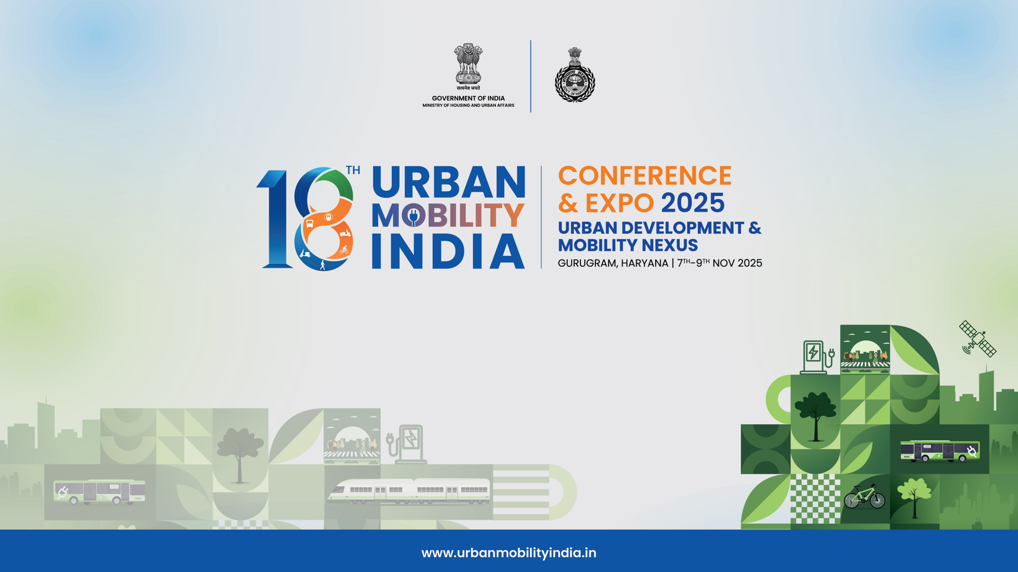
Evolving Low Emission Zones in Indian Cities

Slide 2
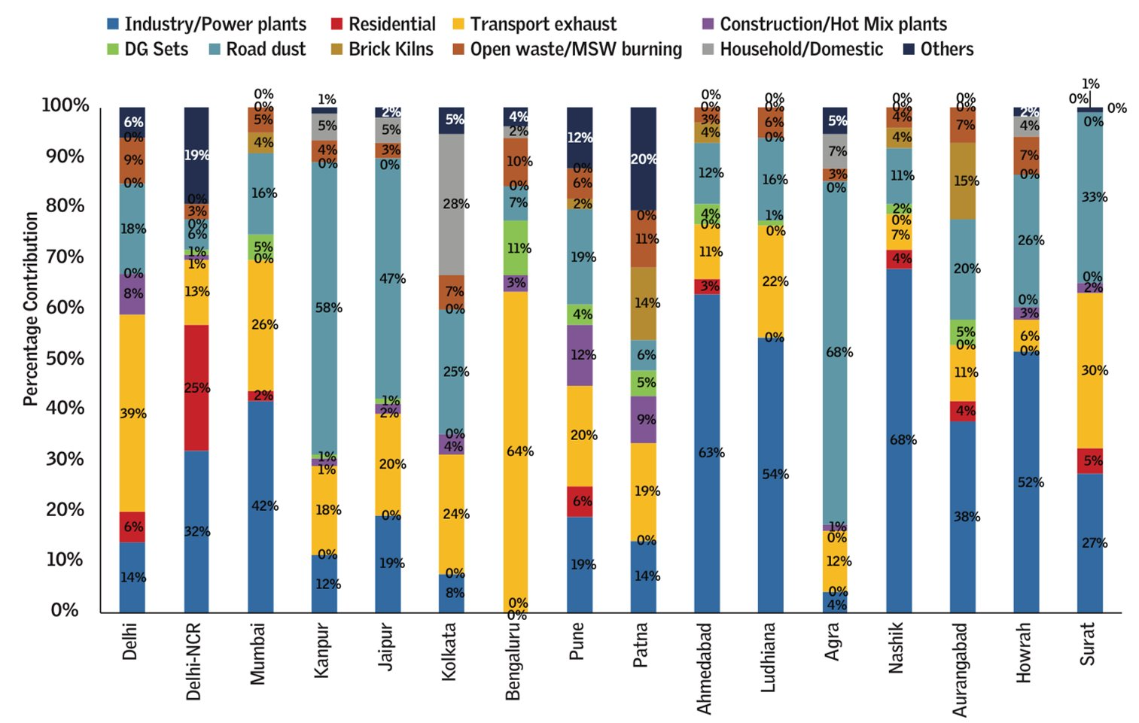
Road transport accounts for around 20-30% of urban air pollution (PM 2.5 emissions)
Title Data Source: Transitioning India's Road Transport Sector, Realising Climate & Air Quality Benefits Report by the International Energy Agency & NITI Aayog, 2023
Graph Source: National Clean Air Programme, an Agenda for Reform, CSE, 2024
PM 2.5 emissions contribution from different sources, based on data from various emission inventories

Slide 3
3 Mantras to reduce vehicular pollution
Improve
Shift
Restrict
Improve vehicle engine technology
Shift to Public transport, walking and cycling
Discourage the use of high polluting vehicles

Slide 4


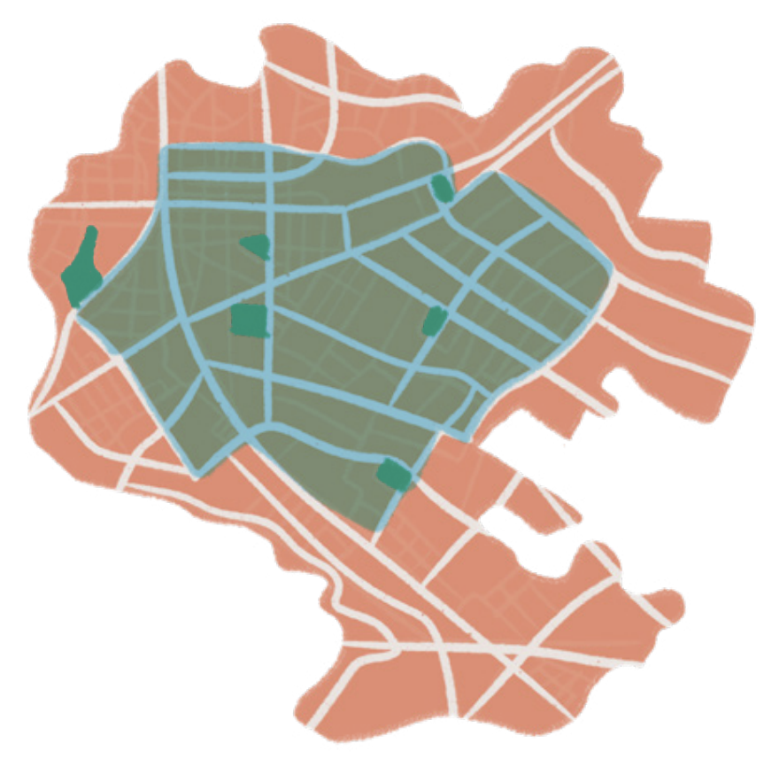

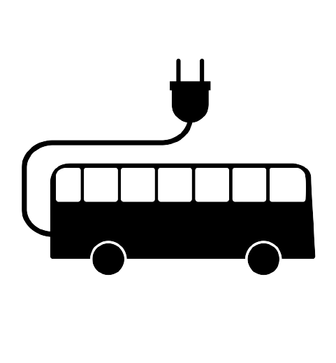
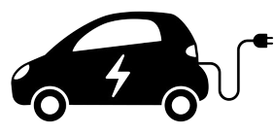
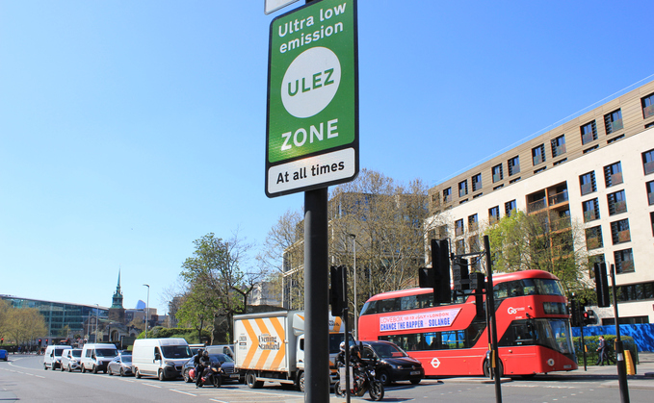
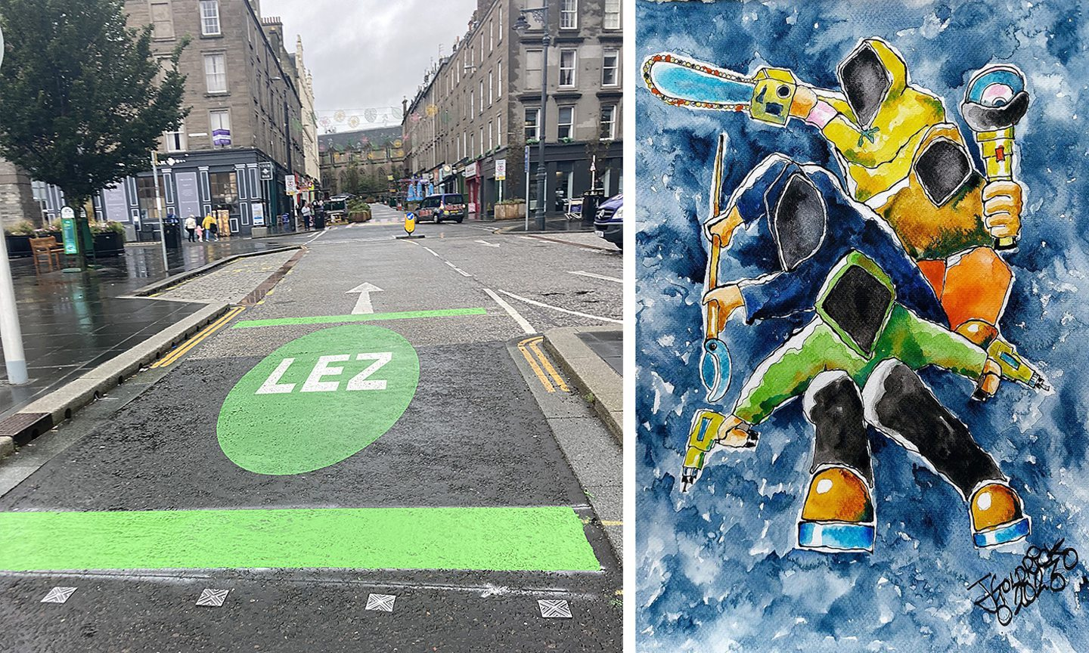


Low Emission Zones (LEZ) discourage the use of high polluting vehicles
LEZ can be part area of the city, or the entire city or the metropolitan area
High polluting vehicles are discouraged through:
Ban
(Brussels, Seoul)
Pricing
(London)
LEZ are demarcated through signages & markings
Image Source (LHS): Business Green
Image Source (RHS) : Article by Joanna Bremner on the courier.co.uk

Slide 5
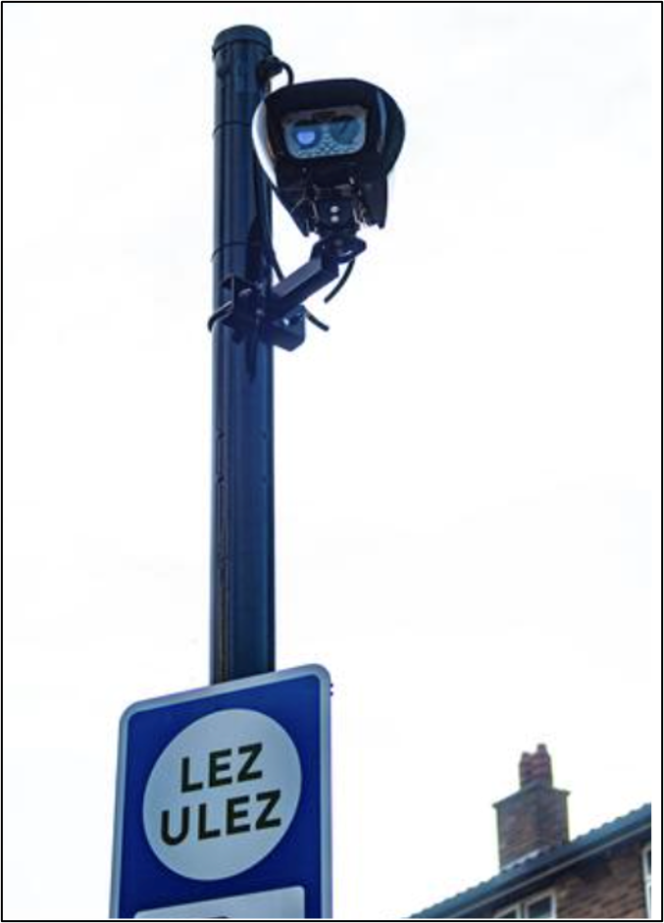
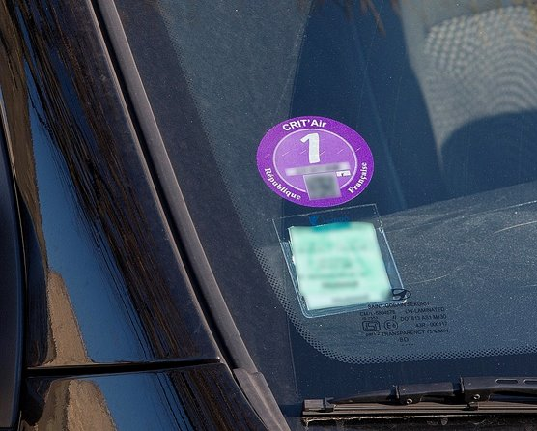
Non-compliant vehicles in LEZs are enforced by cameras or sticker system
ANPR cameras in London
Sticker system in Paris
Image Source: alamy.com​
Image Source: https://www.france.fr​

Slide 6

Global cities have implemented LEZs incrementally
LEZ area have expanded gradually
High-polluting engines and vehicle types are targeted first
2024
2030
2024
2030
2035
2035
Different rules for different zones are also planned

Slide 7
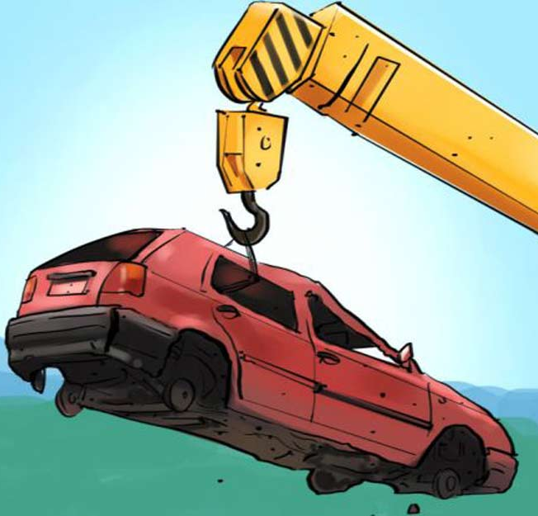
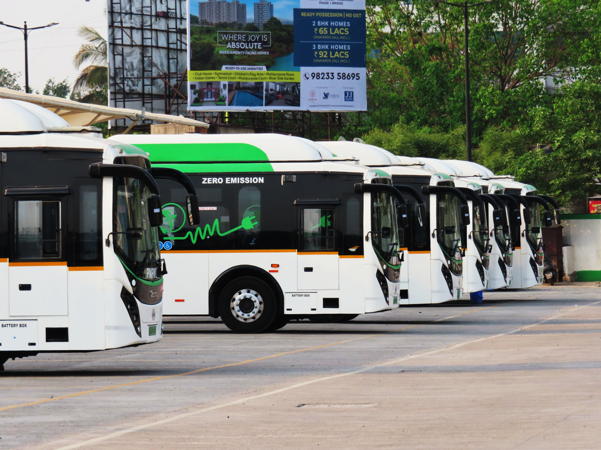
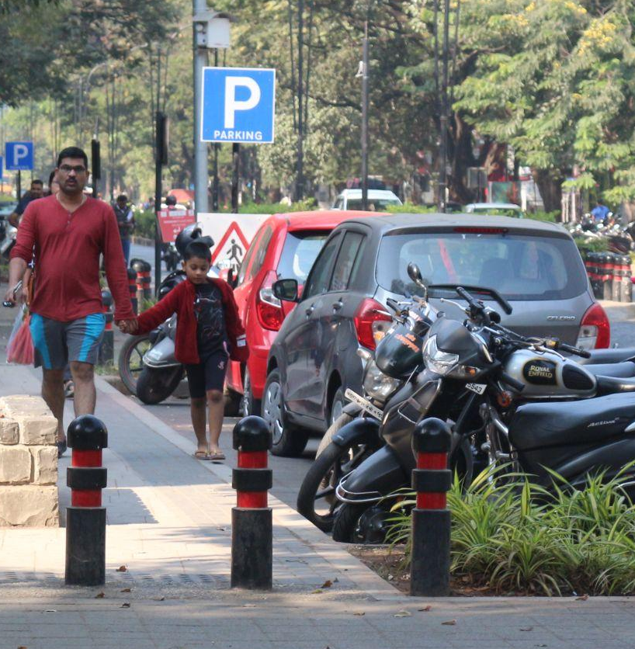
Global cities have considered other interventions along with restriction measures
Mitigation measures such as fiscal incentives that reduce the burden on those affected
Complementary interventions such as public transport that provide cleaner alternatives
Travel Demand Management measures such as parking & congestion pricing, license plate lotteries to manage traffic congestion

Slide 8
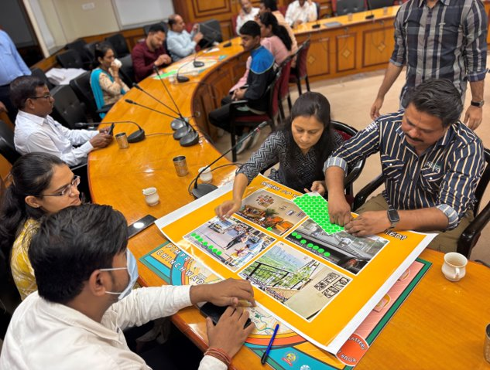
LEZ charge could bring behaviour shift
Of the total 2000 car and 2-wheeler users in Pune and Pimpri-Chinchwad, 95% would not use their non-compliant vehicles, if LEZ charge was around Rs. 100 and Rs. 50 per day respectively.
Around 60% users would shift to a compliant ICE vehicle or Electric vehicle.
Around 20% users would also use public transport, walk, and cycle.
Data Source: As per the survey conducted by
ITDP India in 2025
Focused group discussion conducted with residents in Pimpri Chinchwad on LEZ

Slide 9
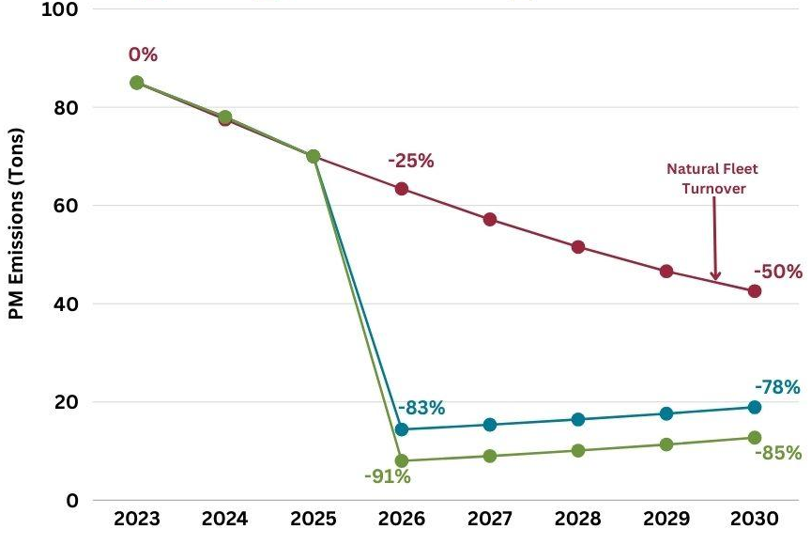
LEZs are a way to fast-track the reduction in vehicular pollution
Business as usual scenario: There are no restrictions; there is a natural fleet turn-over, BS-6 vehicles proportion increase year-after-year
LEZ scenario 1: BS-4 and below vehicles are restricted & those affected shift to BS-6 vehicles
LEZ scenario 2: BS-4 and below vehicles are restricted & those affected shift to electric vehicles
96% of vehicles in London’s LEZ are cleaner, compared to 39% in 2017
LEZ helped to reduce PM2.5 road side concentrations by 40% in Central London between 2017 and 2023, and roadside NO₂ concentrations have reduced by 62%
Data Source: London wide Ultra Low Emission Zone 6 month Report 2024
Estimates in PM reductions from vehicles after implementing LEZ in Pimpri Chinchwad
Data Source: ITDP India & ICCT study on LEZ in Pimpri Chinchwad, 2023

Slide 10
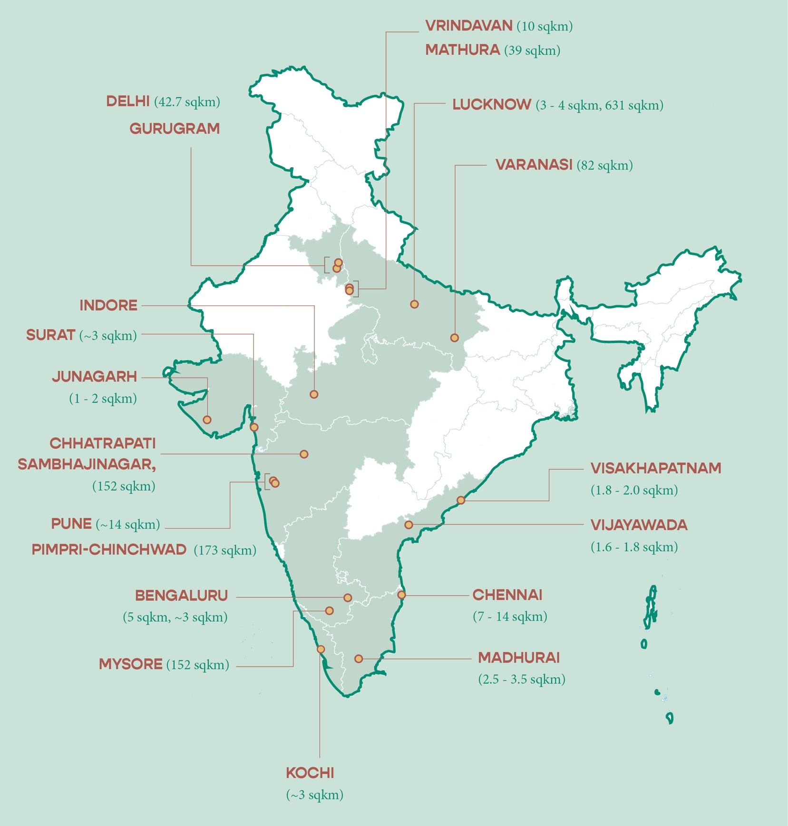
Around 20 Indian cities are exploring LEZs
MADURAI

Slide 11






Various aspects need to be figured out
Legal aspects
Air pollution & vehicle emissions monitoring
Data & technology for enforcement
₹
Funding & financing
Building support
Institutional structure

