Slide 1
Rethinking Urban Transport: The Assessment of Public Transport Accessibility and Equality in Tier-2 Indian City
Nisha Jangid, PhD Scholar, IIM Jammu
Bijoy Rakshit, Assistant Professor, IIM Jammu

Slide 2
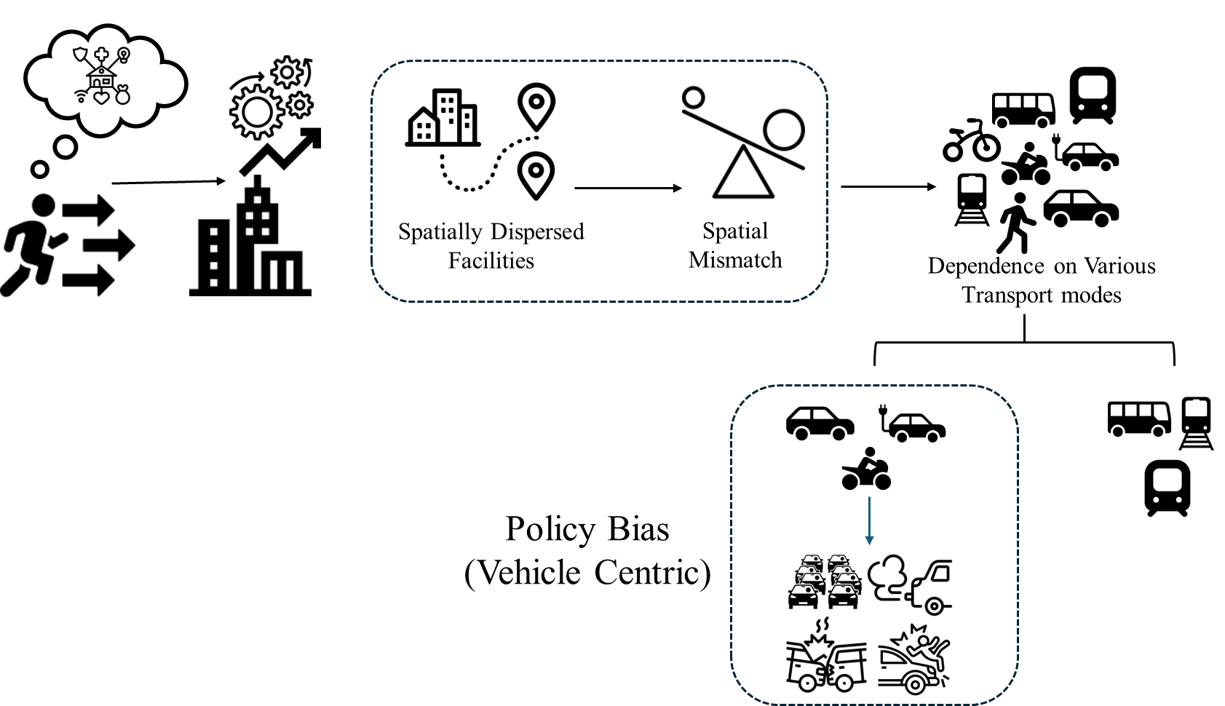
Background
Source: Authors

Slide 3
Introduction
Based on Sen’s Capability Approach (1999)- resources alone don’t ensure well-being
Equity depends on the ability to convert resources into real opportunities
Left-behind groups face spatial, economic, and social barriers (Abreu et al., 2024)
Developing countries remain mobility-focused, prioritizing speed and capacity
Infrastructure expansion ≠ Livability unless everyone can access key destinations (Vickerman, 2024)
Mobility | Accessibility
Ease of movement (speed, distance, time) | Ease of reaching desired destinations
A means to an end | The end goal itself
Focuses on infrastructure and flow | Integrates transport and land use
Prioritizes movement | Prioritizes opportunity access
Global Shift Toward Accessibility:
Europe: 15-minute city and compact city planning (Cavallaro & Dianin, 2020)
USA, Australia, Canada: Accessibility integrated into transport policy (Handy, 2020; Mann & Levinson, 2024; Hensher et al., 2025)

Slide 4
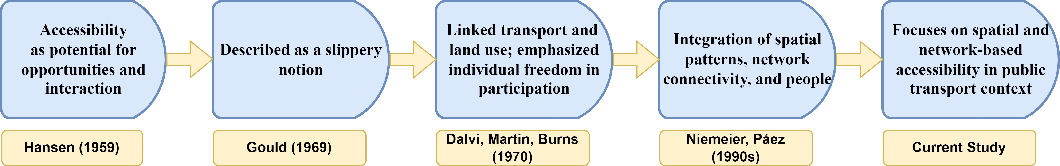
Literature Review
Accessibility Measures
Infrastructure-based: focuses on route and network efficiency (Albuquerque-Oliveira, 2023; Luo, 2019)
Geographic / Location-based: opportunity dispersion and travel impedance using cumulative and gravity models (Hansen, 1959; Klar, 2023; Kapatsila, 2023)
Person-based: Individual perception and utility-based approach (Ben-Akiva & Lerman,1979; Guzman, 2023)

Slide 5
Prior Literature based on Indian Cities
Accessibility studies in India are largely limited to metro cities such as Mumbai and Delhi
Sharma & Patil (2022, 2021) assessed public transport accessibility in Mumbai for education and healthcare services using location-based indicators
Marwal & Silva (2024) examined accessibility and its relationship with the built environment in Delhi
Adhvaryu et al (2019, 2021) evaluated accessibility in Tier II cities like Surat, Ahmedabad, Lucknow, and Hubli-Dharwad using the PTAL approach
These studies focus on stop proximity and service frequency, adopting a static, origin-based framework
Most ignore destination attractiveness, travel impedance, and first–last mile connectivity
Accessibility research for Tier II cities remains limited, despite their growing urban and economic importance

Slide 6
Objective and Contribution
To assess the public transport accessibility of the bus network in Jaipur and the spatial equality
This study contributes in the following ways:
Integrates First and Last Mile (FLM) walking time into both cumulative and gravity-based measures
Considers multiple time thresholds to capture variation and explain co-accessibility
Employs a data-driven decay factor using the Kneedle algorithm for different destinations
Assesses accessibility for 4919 non-work destinations, including healthcare, education, and recreation
Uses the Palma ratio to evaluate spatial equity in accessibility distribution

Slide 7
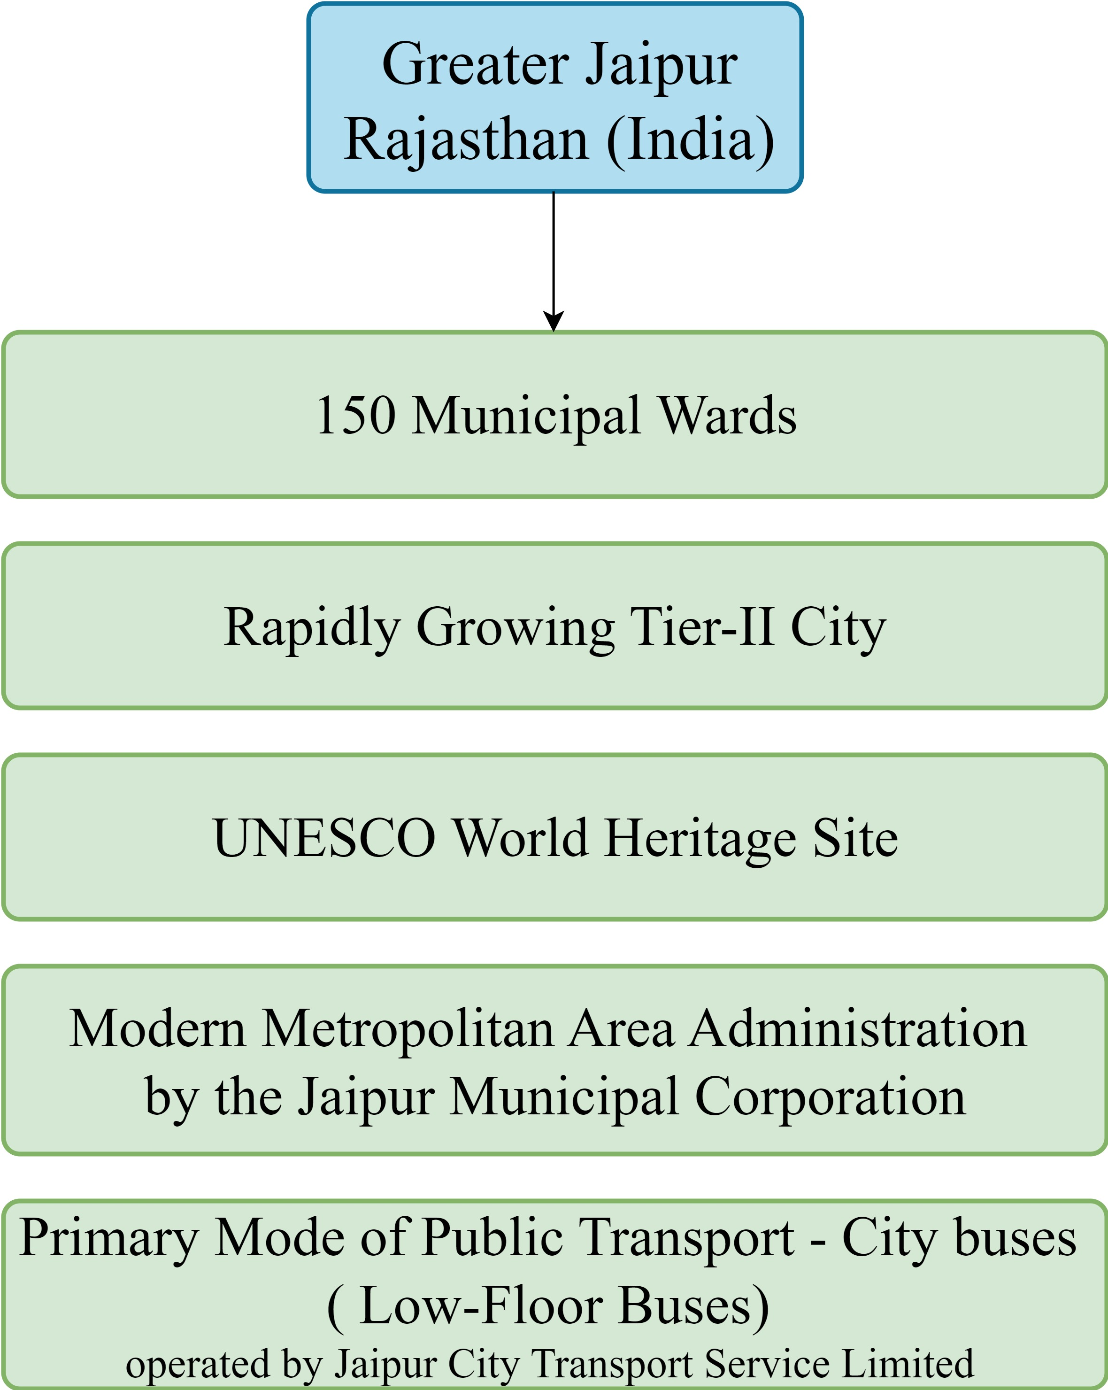
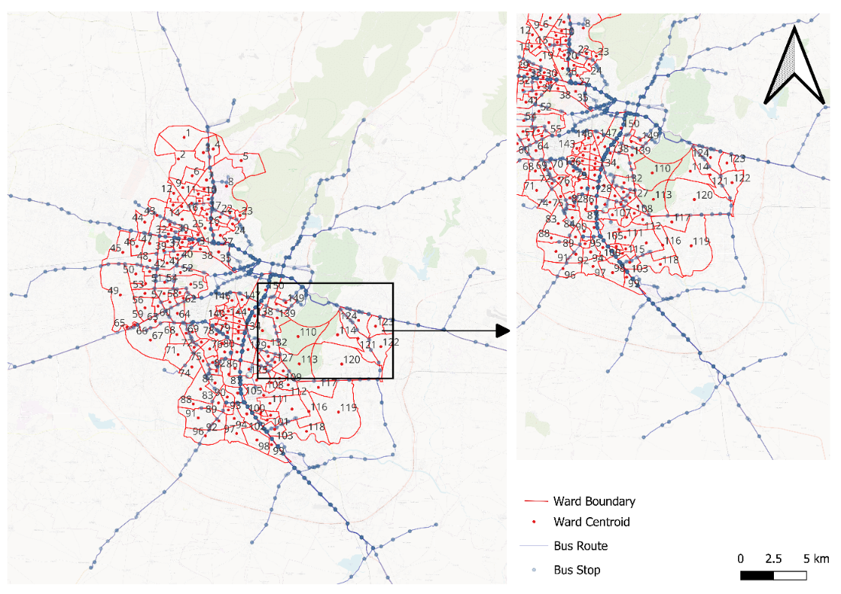
Study Area
Source: Authors

Slide 8
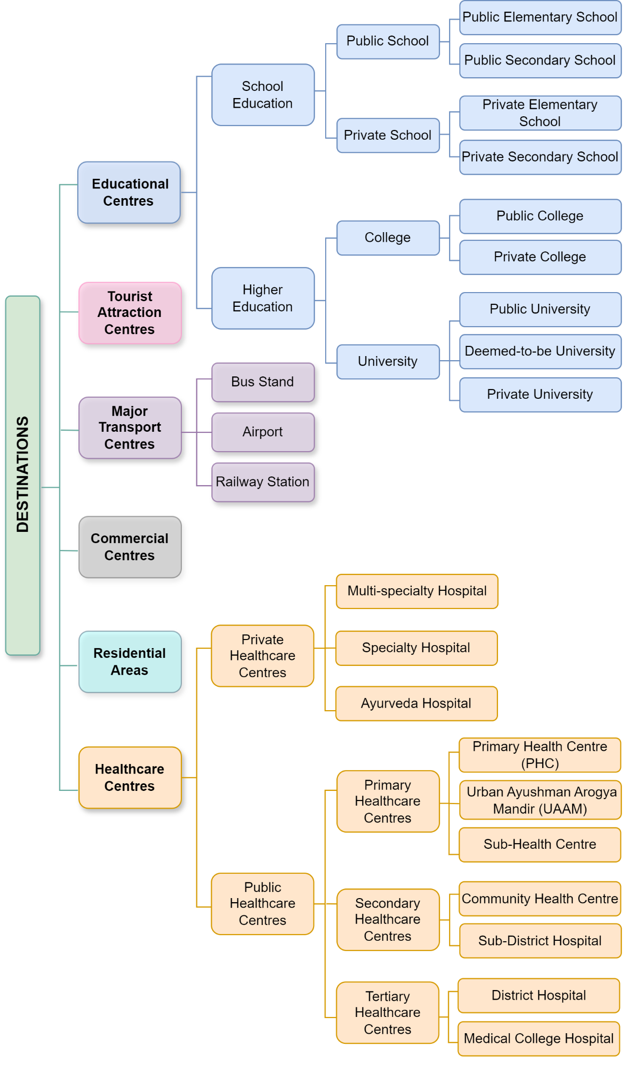
Origin and Destinations
Specifics | Purpose / Relevance
Origin | Centroid of municipal wards of Jaipur
Education & Healthcare | Key for spatial equity and quality of life (Sharma & Patil, 2022)
Tourism Sites | Jaipur as a UNESCO Heritage city; improved public transport supports sustainable tourism and reduces emissions (Kim et al., 2024)
Commercial Centres | Malls and markets represent daily needs, employment, and recreation (Li et al., 2020)
Major Transport Centres | Airports, bus stands, and railway stations capture inter-city and regional connectivity (Kim et al., 2024)
Residential Areas | Reflect social interaction and community life, adding a social dimension to accessibility (Li & Farber, 2013; Hofstede, 1980)
Source: Authors

Slide 9
Data Preparation
Integrated multi-source datasets- Used Google Maps API for real-time travel time extraction( Reference time: 13 Feb 2025, 12:00 PM (weekday))
Destination | Specifics | N | Data Sources
Major Transport Centers | Airport, Bus Stands, Railway Stations | 24 | Google Maps, Railyatri website, RSRTC official website
Commercial Centres | Shopping malls, Complexes | 40 | Google Maps, OpenStreetMaps
Tourist Attraction Centers | Forts, Museums, Zoo, Temples, Parks, etc. | 59 | Google Maps
Educational Centers | Schools, Colleges, Universities | 3529 | Shala Darpan official website, Department of College Education official website
Healthcare Centers | Public Healthcare Centers, Private Healthcare Centers | 434 | Empanelled Hospital RUHS, Ministry of welfare and health
Residential Areas | Localities, colonies, and societies | 833 | High traffic websites, magicbricks.com, housing.com

Slide 10
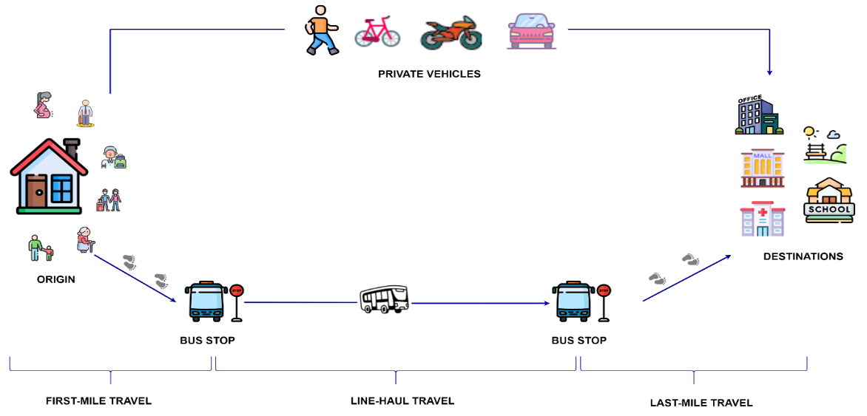
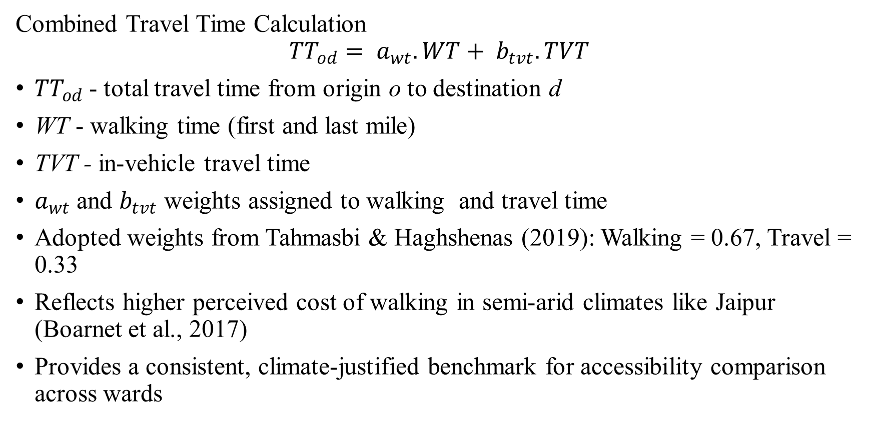
Accessibility Measure Framework
Combined Travel Time Calculation
$${TT}_{od}= a_{wt}.WT+ b_{tvt}.TVT$$
${TT}_{od}$- total travel time from origin o to destination d
WT - walking time (first and last mile)
TVT - in-vehicle travel time
$a_{wt}$ and $b_{tvt}$ weights assigned to walking and travel time
Adopted weights from Tahmasbi & Haghshenas (2019): Walking = 0.67, Travel = 0.33
Reflects higher perceived cost of walking in semi-arid climates like Jaipur (Boarnet et al., 2017)
Provides a consistent, climate-justified benchmark for accessibility comparison across wards

Slide 11
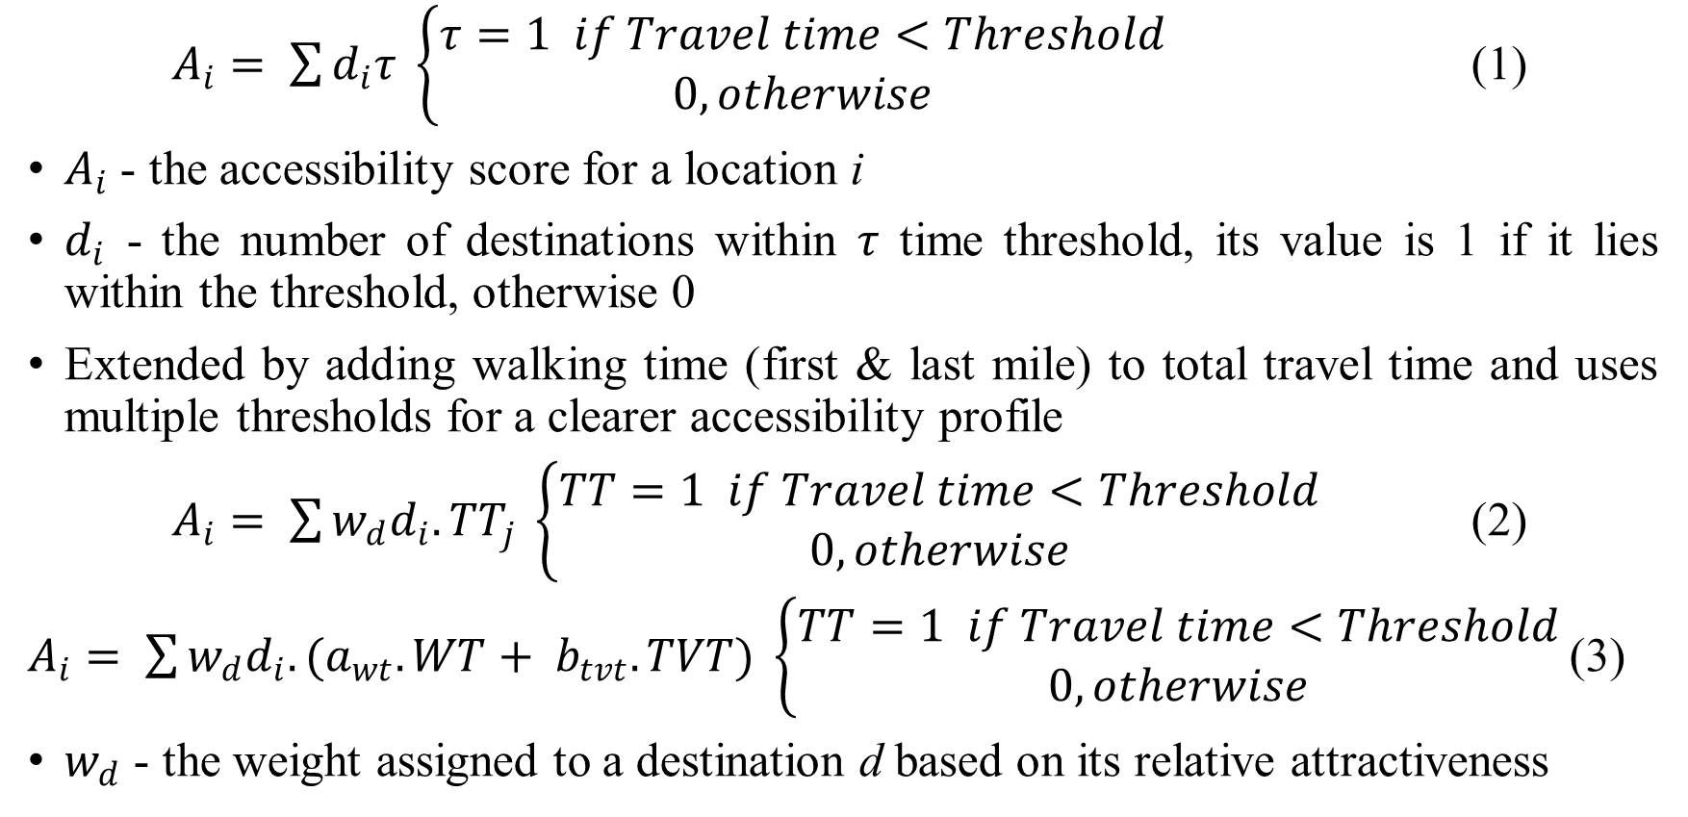
Cumulative Opportunity Measure (COM)
$A_{i}= \sum{d_{i}τ \left\{\begin{aligned}τ=1 if Travel time<Threshold \\ 0, otherwise \end{aligned}\right.}$ (1)
$A_{i}$ - the accessibility score for a location i
$d_{i}$ - the number of destinations within $τ$ time threshold, its value is 1 if it lies within the threshold, otherwise 0
Extended by adding walking time (first & last mile) to total travel time and uses multiple thresholds for a clearer accessibility profile
$A_{i}= \sum{{w_{d}d}_{i}{.TT}_{j} \left\{\begin{aligned}TT=1 if Travel time<Threshold \\ 0, otherwise \end{aligned}\right.}$ (2)
$A_{i}= \sum{{w_{d}d}_{i}.{(a}_{wt}.WT+ b_{tvt}.TVT) \left\{\begin{aligned}TT=1 if Travel time<Threshold \\ 0, otherwise \end{aligned}\right.}$(3)
$w_{d}$ - the weight assigned to a destination d based on its relative attractiveness

Slide 12
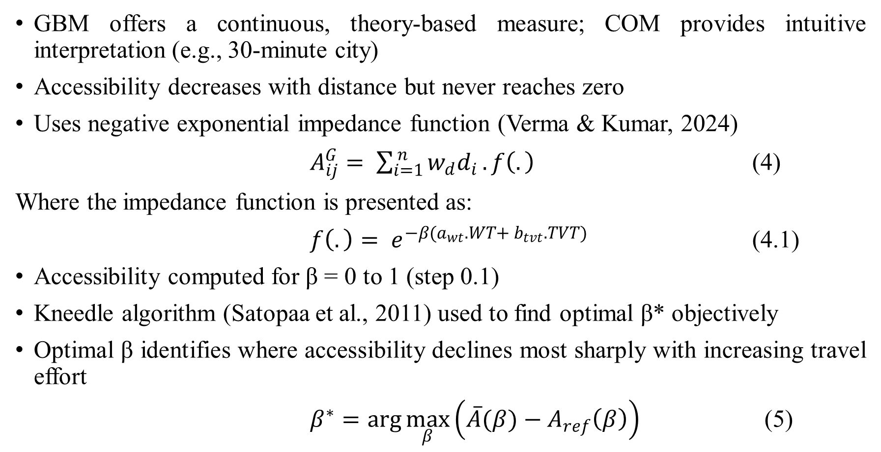
Gravity-Based Measure (GBM)
GBM offers a continuous, theory-based measure; COM provides intuitive interpretation (e.g., 30-minute city)
Accessibility decreases with distance but never reaches zero
Uses negative exponential impedance function (Verma & Kumar, 2024)
$A_{ij}^{G}= \sum_{i=1}^{ n}{{w_{d}d}_{i}}.f\left(.\right)$ (4)
Where the impedance function is presented as:
$f\left(.\right)= e^{−β{(a}_{wt}.WT+ b_{tvt}.TVT)}$ (4.1)
Accessibility computed for β = 0 to 1 (step 0.1)
Kneedle algorithm (Satopaa et al., 2011) used to find optimal β* objectively
Optimal β identifies where accessibility declines most sharply with increasing travel effort
$β^{∗}=\arg{\max_{β}\left(\overline{A}(β)−A_{ref}\left(β\right)\right)}$ (5)

Slide 13
Attraction value for destinations
Category | Subtypes | Weight Basis
Transport | Airport (1), Bus (0.25–0.10), Rail (0.455–0.036) | Network coverage & train frequency
Education | School (0.887), Higher Ed (0.113) | Student enrolment (UDSIE, AISHE 2021–22)
Healthcare | Public (0.445), Private (0.555) | Hierarchy & capacity (beds, staff)
Residential | Localities & societies (1) | Equal weight
Commercial | Malls (rating ≤ 4.9 → 0.4 to 0.1) | Google Maps rating
Tourism | Forts, Museums, Parks | (0.3Rᵗ + 0.7Rᵛ) from Maps

Slide 14
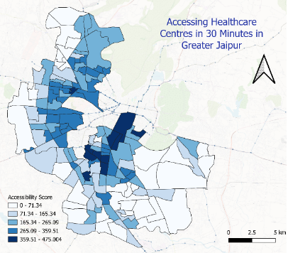
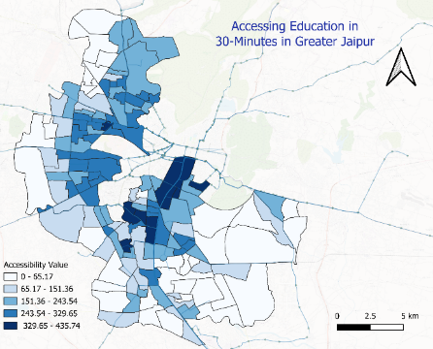
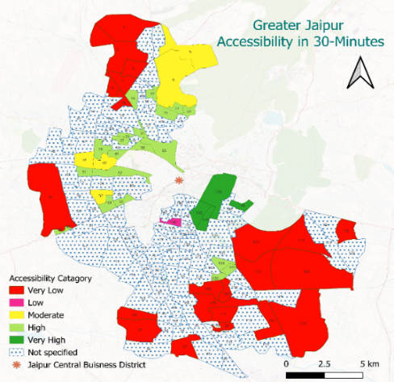
Implementation and Result
(Accessibility measure using Cumulative Opportunity)
Accessibility assessed for 15–75 min thresholds; 30-minute chosen as most balanced measure (Moreno, 2021)
Lower skewness and higher variation at 30-min → most meaningful for planning
High-accessibility wards (e.g., 34, 77, 79, 138, 142, 149, 150) cluster near central zones
Peripheral wards show low accessibility, revealing strong spatial inequity
High co-accessibility observed for health & education centers; peripheral wards lag behind

Slide 15
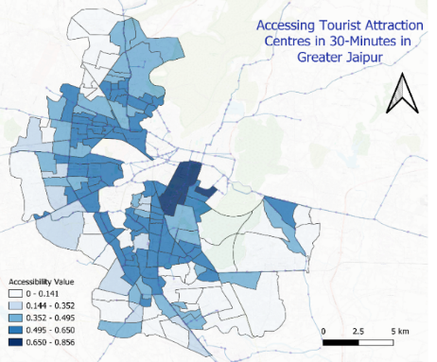
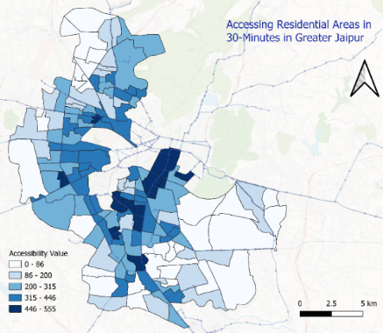
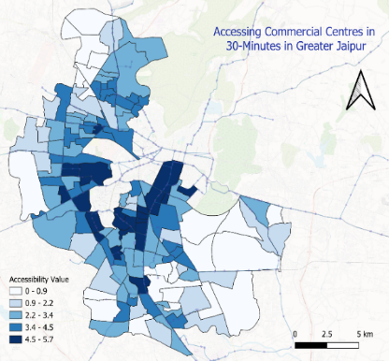
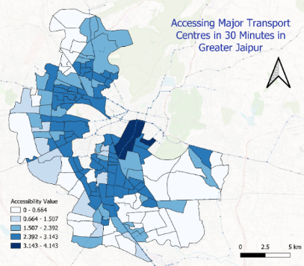
Destination Type | Very High Accessibility | Very Low Accessibility | Insight
Residential | 13 wards (8.7%) | 29 wards (19.3%) | Core–periphery divide
Transport | 4 wards (2.6%) | 33 wards (22%) | Weak connectivity to outer zones
Education | 11 wards (7.3%) | 34 wards (22.6%) | High overlap with healthcare
Healthcare | 11 wards (7.3%) | 34 wards (22.6%) | Similar to education pattern
Commercial | 24 wards (16%) | 22 wards (14.7%) | More evenly spread
Tourism | 4 wards (2.6%) | 33 wards (22%) | Concentrated around heritage core
Fig. 2(a-f). Cumulative Opportunity-based accessibility measure for a 30-minute threshold

Slide 16
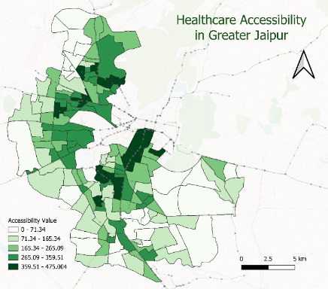

Implementation and Result
(Accessibility measure using Gravity-based Measure)
Provides a continuous and nuanced measure of accessibility
Combines in-vehicle and out-of-vehicle (walking) travel time in the impedance term
Accessibility calculated for β = 0 to 1 (step 0.01)
Kneedle algorithm used to identify optimal β for each destination type
Detects maximum curvature in decay curve (point where accessibility gain levels off)
Ensures data-driven calibration in the absence of behavioral travel data
ANOVA test confirms significant variation across β values
Generates destination-wise spatial accessibility maps for 150 wards

Slide 17
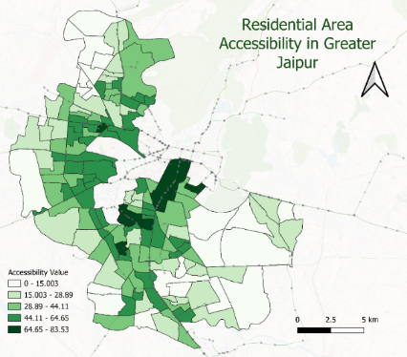
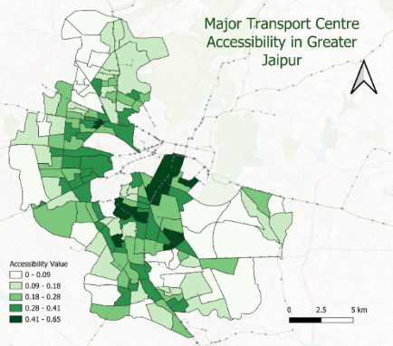
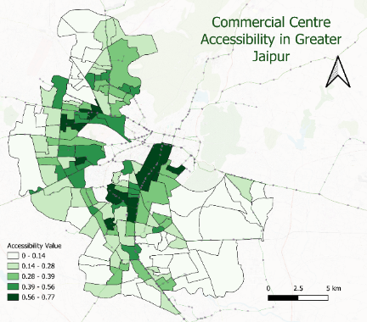
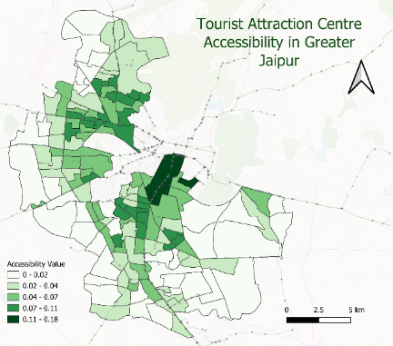
Destination Type | Very High Accessibility | Very Low Accessibility | Key Insight
Education | 19 wards (12.6%) | 25 wards (16.6%) | Highest co-accessibility with healthcare
Healthcare | 19 wards (12.6%) | 25 wards (16.6%) | Similar pattern; spatial overlap
Transport | 13 wards (8.7%) | 25 wards (16.7%) | Linked with tourist centres
Commercial | 16 wards (10.7%) | 39 wards (26%) | More dispersed; mixed-use benefit
Residential | 10 wards (6.7%) | 21 wards (14%) | Peripheral disadvantage
Tourism | 4 wards (2.6%) | 38 wards (25.3%) | Concentrated near heritage core

Slide 18
Measuring spatial equality using the Palma ratio
Inequality in accessibility affects vulnerable and marginalised groups most
Palma Ratio (Cobham et al., 2016; Palma, 2011) used to assess disparity across wards
Compares the top 10% and the bottom 40% of wards by accessibility level

Slide 19
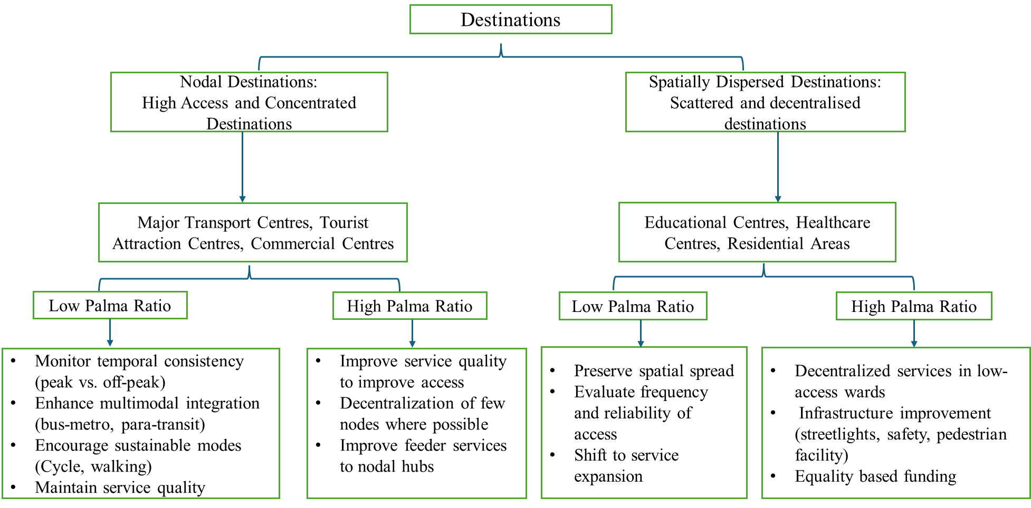
Policy Implication

Slide 20
References
Abreu, M., Comim, F., & Jones, C. (2024). A capability-approach perspective on regional development. Regional Studies, 58(11), 2208–2220.
Vickerman, R. (2024). The transport problem: The need for consistent policies on pricing and investment. Transport Policy, 149, 49–58.
Handy, S. (2020). Is accessibility an idea whose time has finally come? Transportation Research Part D, 83, 102319.
Boisjoly, G., & El-Geneidy, A. M. (2017). How to get there? A critical assessment of accessibility objectives and indicators in metropolitan transportation plans. Transport Policy, 55, 38–50.
Levine, J. (2020). A century of evolution of the accessibility concept. Transportation Research Part D, 83, 102309.
Cavallaro, F., & Dianin, A. (2020). Efficiency of public transport for cross-border commuting: An accessibility-based analysis in Central Europe. Journal of Transport Geography, 89, 102876.
Mann, I., & Levinson, D. M. (2024). Access-based cost-benefit analysis. Journal of Transport Geography, 119, 103952.
Hensher, D. A., Ho, C. Q., & Wei, E. (2025). Development, practical challenges, and application of a state-wide transport model system in Australia. Transportation Planning and Technology, 48(1), 1–42.Indian Context Studies (Empirical References)
Sharma, G., & Patil, G. R. (2024). Urban spatial structure and equity for urban services through the lens of accessibility. Transport Policy, 146, 72–90.
Sharma, G., & Patil, G. R. (2021). Public transit accessibility approach to understand equity for public healthcare services: A case study of Greater Mumbai. Journal of Transport Geography, 94, 103123.
Sharma, G., & Patil, G. R. (2022). Spatial and social inequities for educational services accessibility: A case study for schools in Greater Mumbai. Cities, 122, 103543.
Adhvaryu, B., & Kumar, S. (2021). Public transport accessibility mapping and its policy applications: A case study of Lucknow, India. Case Studies on Transport Policy, 9(4), 1503–1517.
Adhvaryu, B., Chopde, A., & Dashora, L. (2019). Mapping public transport accessibility levels (PTAL) in India and its applications: A case study of Surat. Case Studies on Transport Policy, 7(2), 293–300.
Adhvaryu, B., & Mudhol, S. S. (2022). Visualising public transport accessibility to inform urban planning policy in Hubli-Dharwad, India. GeoJournal, 87(Suppl 4), 485–509.
Marwal, A., & Silva, E. A. (2024). Analysing inequity in accessibility to services with neighbourhood location and socio-economic characteristics in Delhi. Geographical Analysis, 56(4), 651–677.Methodological References (Models & Measures)
Hansen, W. G. (1959). How accessibility shapes land use. Journal of the American Institute of Planners, 25(2), 73–76.
Satopaa, V. A., Albrecht, J. R., Irwin, D., & Raghavan, B. (2011). Finding a “Kneedle” in a Haystack: Detecting Knee Points in System Behavior. ICDCSW, Minneapolis, MN, 166–171.
Cobham, A., Schlögl, L., & Sumner, A. (2016). Inequality and the tails: the Palma proposition and ratio. Global Policy, 7(1), 25–36.

