Slide 1
18th Urban Mobility India Conference cum Exhibition 2025 Automation Protocol for Urban Transit Operation Using Machine Learning: A Short-Term Demand Forecasting
Paper ID: 5998
Sneha Sahni
Department of Architecture and Regional Planning, IIT Kharagpur
Debapratim Pandit
Department of Architecture and Regional Planning, IIT Kharagpur
Krati Sharma
IIT Kharagpur
Aditi Gupta
Department of Architecture and Regional Planning, IIT Kharagpur
Jayesh Dubey
IIT Kharagpur

Slide 2
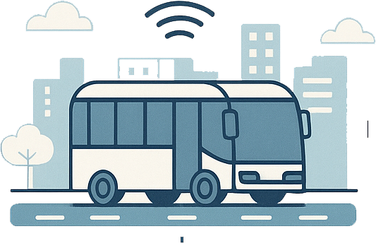


Problem
Data is the new oil, but underutilised data is wasted potential
The bus transit has the same potential in the form of ETM and AVL data
Current transit system
No standardized data handling
Automation limited to data collection
Not capture the Dynamic demand
Mismatch: Static supply and dynamic demand
Disconnected, noisy data stream
Operational inefficiency
Existing automation ends at data acquisition, So there is an absence of integrated frameworks for data organization and processing to support decision-making according to dynamic demand
18th Urban Mobility India Conference cum Exhibition 2025
1

Slide 3





Research Approach
Integrated automation frameworks for data collection, organization, and processing, with a continuous predictive and adaptive system
Short-Term Demand Prediction
Long-Term Demand Prediction
Leveraging the advancement in machine learning
Daily accumulation of data and daily processing
While developing a robust model for short-term demand prediction, the approach focuses on enhancing overall demand forecasting capability through a transitional framework that bridges the short-term (operational) and long-term (strategic) prediction horizons.
Scalable
Automatically utilizing variables that have at least 90% data points present in the dataset
Continuous learning, operationally deployable
Considered an increase of 5 %(Gradual decrease over years ) in hourly Passenger arrivals on stop as ETM does not record Passenger lost
Data Adaptive
Automatic execution of training module after regular interval as more data is available
18th Urban Mobility India Conference cum Exhibition 2025
2

Slide 4
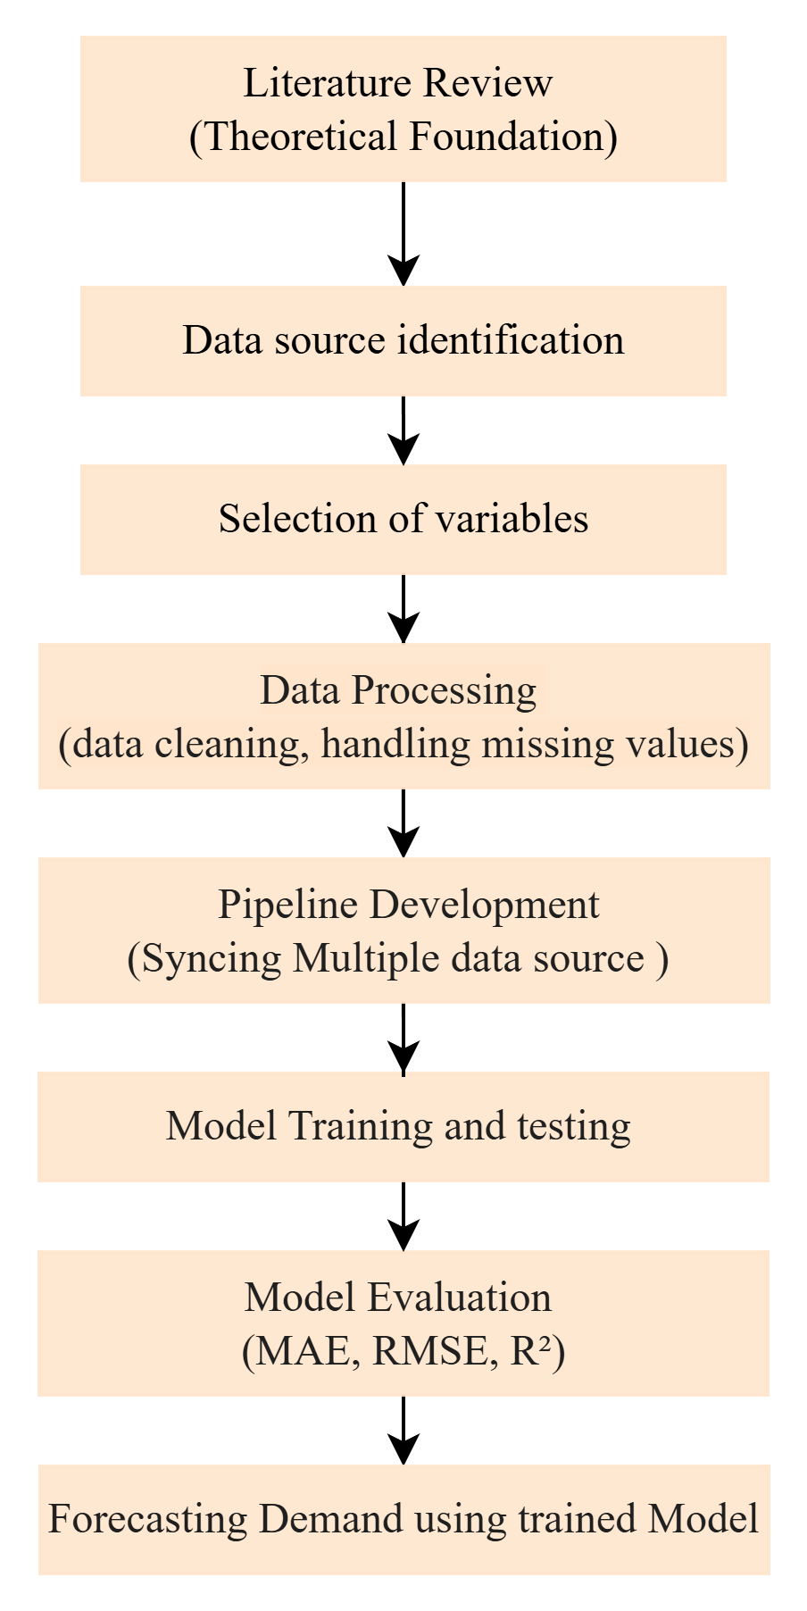
Methodology
Limitation
Sequential methodological stages ensure robustness and continuity
Reliance on synthesized data due to limited real-world dataset access. So, the seven-day data set is synthesized to form six months of data on hourly passenger arrival using random noise, peak hour effect introduction addition, which ensures realistic variability and non-deterministic passenger flow patterns.
Data Description
Electronic Ticketing Machine (ETM) – Hourly passenger boarding counts at each stop.
Automatic Vehicle Location (AVL) – Bus trajectories, stop arrivals, and schedule adherence.
Land Use & Stop Characteristics – Spatial data (residential, commercial, recreational, public use).
Weather API – Hourly temperature, humidity, and precipitation data.
Calendar & Event API – Public holidays, city events, and special conditions.
18th Urban Mobility India Conference cum Exhibition 2025
3

Slide 5
Variable selection
Variable selection is important to identify and engineer variables that capture temporal, spatial, and contextual dynamics influencing hourly passenger demand at bus stops.
Basic Variables
Interaction variable
 | Basic Variables | Input | Data type
1. | Timestamp | hourly | Datetime
2. | Passenger count | Hourly passengers arriving at each stop during all service hours | Numerical Variable
3. | Day of the week | Monday to Sunday | Categorical Variable
4. | Hour | 6 to 21 hours | Categorical Variable
5. | Month | January to December | Categorical Variable
6. | Temperature | Degree Celsius | Numerical Variable
7. | Precipitation | Millimeter | Numerical Variable
8. | Holiday | Yes or No | Categorical Variable
9. | Event | Yes or No | Categorical Variable
Spatial variables are static for a stop across hours, but
The travel pattern depicts that an area with high residential land use will generate more trips during peak hours
To capture the weights of static spatial variables across hourly temporal change in passenger count, Interaction variables are required
Interaction variable =Spatial variable x dummy temporal variable
Residential Land Use × Peak Hour (0/1)
Recreational Land Use × Weekend (0/1)
Peak Hour × Temperature
Centrality Score × Peak Hour
Land Use × Passenger Count
Facility Type × Time Window (0/1)
18th Urban Mobility India Conference cum Exhibition 2025
4

Slide 6
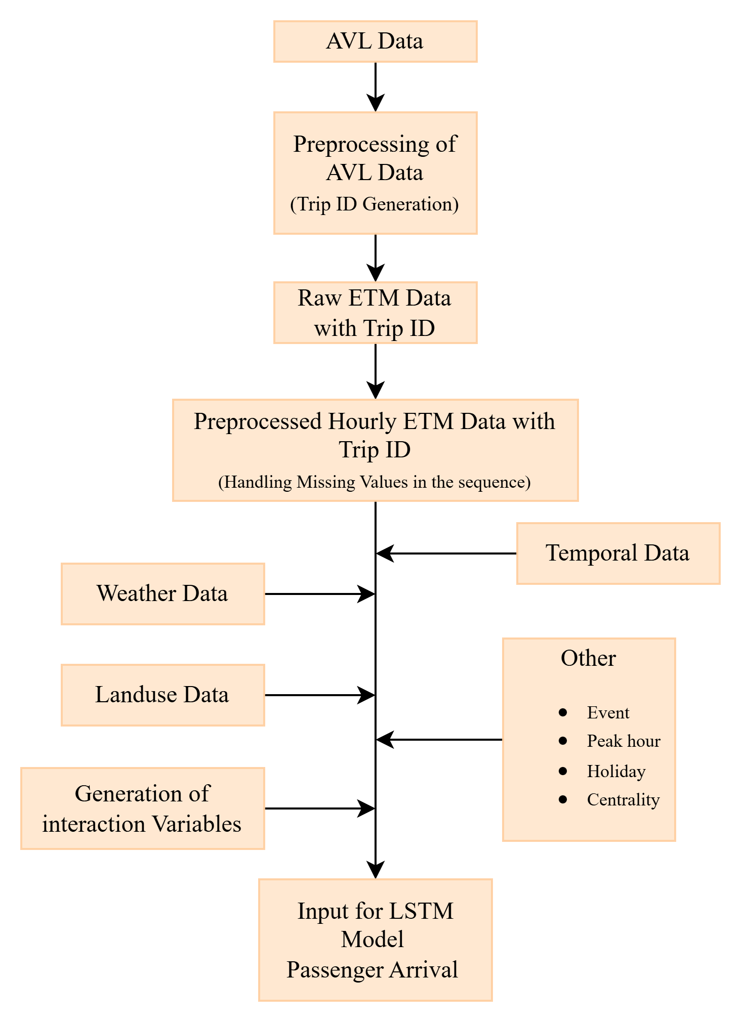
Automated Data Pipeline
Convert raw ETM, AVL, and multisource datasets into structured, cleaned, and feature-engineered, high-quality inputs through a fully automated data pipeline that feeds the LSTM model for short-term passenger demand forecasting.
Data Collection & Integration
ETM and AVL datasets merged using unique Trip IDs..
Ensures accurate temporal alignment of passenger activity and bus movement.
Preprocessing, Cleaning, and Structuring
Sequential hourly data grouped by stop over six months
Handle missing values, normalize passenger counts, and fill missing hours with zeros.
Ensure consistent hourly time steps for each stop, integrating the passenger lost factor.
Feature Engineering
Generate temporal features (hour, day, month, holiday, event).
Capture weather data through Hourly time step and coordinates of stops from API
create interaction variables (e.g., Residential × Peak Hour, Temperature × Peak Hour).
.
Automation
Automated SQL queries are triggered daily to fetch new ETM, AVL, and API data. Leads to automation of data collection for demand prediction
Updated data automatically ingested into the LSTM model for next-day prediction
Structured data grouped by stop name and hourly timestamps to serve as input to the model
End-to-end automated data ingestion system will lead transform this to a long term demand data set
18th Urban Mobility India Conference cum Exhibition 2025
5

Slide 7
Model Framework
A Multivariate Stacked Long Short-Term Memory (LSTM) neural network designed for automation and integration with an SQL-based data pipeline for short-term passenger demand prediction.
Training module
Many-to-one architecture
Initially, trained on 6 months of data
Retrained at regular intervals to capture changing patterns after more data is available
Data Split
70% training
15% validation
15% testing
Sequence Length
7 days (112 time steps)
Predict the next hour
Forecasting module
Many-to-one architecture was iterated 16 times to capture demand for all service hours. Transforming the single-step model into a multi-step predictor
Forecasts are scheduled automatically via a daily time-based trigger
Normalization
Min–Max Scaler
Label Encoding
Categorical variables
18th Urban Mobility India Conference cum Exhibition 2025
6

Slide 8
Hyperparameter tuning
Random Search (12 iterations) on the validation set is used for hyperparameter tuning
Parameter | Possible Values | Best Value
LSTM Layer 1 Units | [32,64,128] | 64
LSTM Layer 2 Units | [16,32,64] | 16
Dense Units | [8,16,32] | 32
Dropout Rate | [0.1–0.4] | 0.1
Batch Size | [8,16,32] | 8
Optimizer | [adam, rmsprop, nadam] | nadam
ReLU activation function
Loss Function: Mean Squared Error (MSE)
Trained for 100 epochs
Early stopping if validation loss doesn’t improve for 8 epochs prevents the model from overfitting
18th Urban Mobility India Conference cum Exhibition 2025
7

Slide 9
Results
The model demonstrated a strong predictive performance, suitable for short-term operational planning
Evaluation metrics result on the testing set for each stop
 | Stop Name | MAE | RMSE | R² | Accuracy within (%)+5 Passenger | Normalized Accuracy (%)
1 | Stop 1 | 4.12 | 5.45 | 0.79 | 74.21 | 92.37
2 | Stop 2 | 4.92 | 6.58 | 0.82 | 78.10 | 93.44
3 | Stop 3 | 3.83 | 4.86 | 0.80 | 78.35 | 91.30
Overall performance across the stop
Average MAE: 4.29
Average RMSE: 5.63
Average R²: 0.80
Average Accuracy: 76.8%
Normalized Accuracy: 92.37%
It can proactively regulate service supply based on demand. Supports fleet optimization, overcrowding control.
18th Urban Mobility India Conference cum Exhibition 2025
8

Slide 10
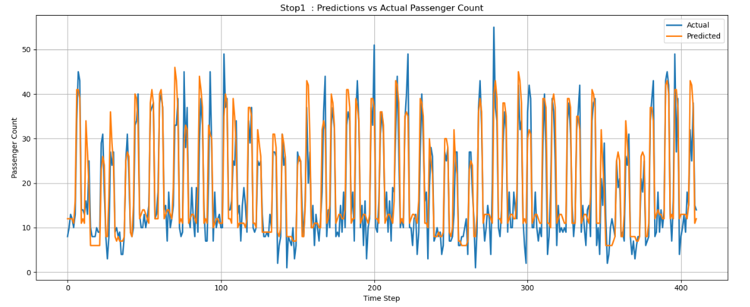
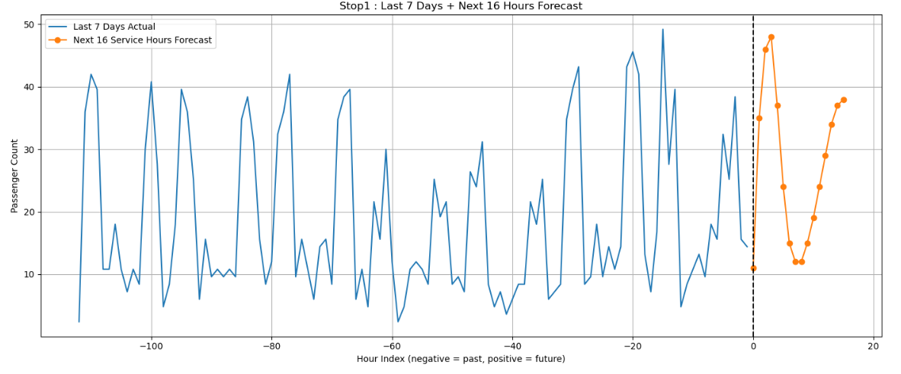
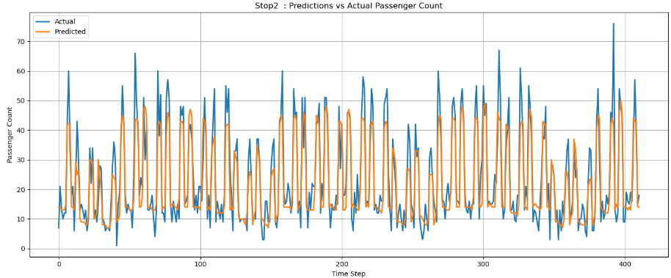
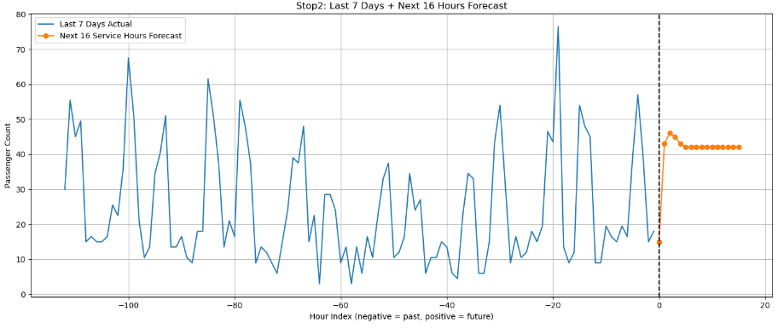
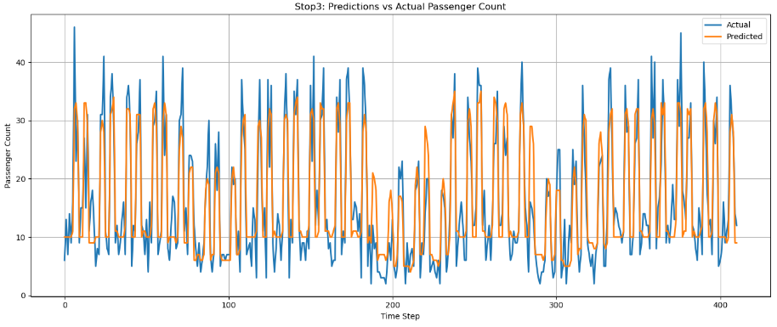
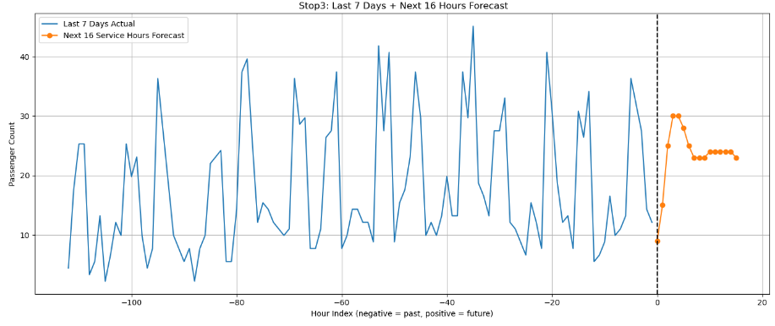
Model Performance on Test Set and forecasted results
Stop1
Stop2
Stop3
18th Urban Mobility India Conference cum Exhibition 2025
9

Slide 11
Conclusion
Future scope
The automated, multivariate LSTM framework successfully demonstrated the prediction protocol for short-term passenger demand by integrating temporal, spatial, and contextual data.
.
Apply the proposed protocol to real-world large-scale datasets for improved generalization
Extend model to network-level demand forecasting across multiple routes/corridors.
Incorporate service design parameters, such as vehicle load factors and the availability of alternative modes of transportation.
The proposed protocol will enable the system to bridge the gap between short-term and long-term demand.
Dynamically adjust services, aligning supply with fluctuating demand .Protocol is scalable, reusable, and city-adaptable.
Enables improved service reliability, frequency optimization, capable to support infrastructure and resource allocation descision .
18th Urban Mobility India Conference cum Exhibition 2025
10

Slide 12
Reference
Boateng, A., Anum Adams, C., & Kofi Akowuah, E. (2023). Estimating Passenger Demand Using Machine Learning Models: A Systematic Review. E3S Web of Conferences, 418, 03002. https://doi.org/10.1051/e3sconf/202341803002
Da Silva, D. G., Geller, M. T. B., Moura, M. S. D. S., & Meneses, A. A. D. M. (2022). Performance evaluation of LSTM neural networks for consumption prediction. E-Prime - Advances in Electrical Engineering, Electronics and Energy, 2, 100030. https://doi.org/10.1016/j.prime.2022.100030
Halyal, S., Mulangi, R. H., & Harsha, M. M. (2022). Forecasting public transit passenger demand: With neural networks using APC data. Case Studies on Transport Policy, 10(2), 965–975. https://doi.org/10.1016/j.cstp.2022.03.011
Li, L., Dai, S., & Cao, Z. (2019). Deep Long Short-term Memory (LSTM) Network with Sliding-window Approach in Urban Thermal Analysis. 2019 IEEE/CIC International Conference on Communications Workshops in China (ICCC Workshops), 222–227. https://doi.org/10.1109/ICCChinaW.2019.8849965
Liyanage, S., Abduljabbar, R., Dia, H., & Tsai, P.-W. (2022). AI-based neural network models for bus passenger demand forecasting using smart card data. Journal of Urban Management, 11(3), 365–380. https://doi.org/10.1016/j.jum.2022.05.002
Mekouar, S. (2025). Enhanced LSTM model with integrated attention mechanism and data augmentation for projecting COVID-19 trends in Africa. Scientific African, 28, e02617. https://doi.org/10.1016/j.sciaf.2025.e02617
Toque, F., Khouadjia, M., Come, E., Trepanier, M., & Oukhellou, L. (2017). Short & long-term forecasting of multimodal transport passenger flows with machine learning methods. 2017 IEEE 20th International Conference on Intelligent Transportation Systems (ITSC), 560–566. https://doi.org/10.1109/ITSC.2017.8317939
Zhang, J., & Zhang, J. (2024). Enhancing Intelligent Mobility: LSTM Neural Networks for Short-Term Passenger Flow Prediction in Rail Transit: Proceedings of the 1st International Conference on Data Science and Engineering, 410–415. https://doi.org/10.5220/0012797600004547
18th Urban Mobility India Conference cum Exhibition 2025
11

Slide 13
THANK YOU

