Slide 1



Comparison of Pedestrians’ Safety at Signalized and Unsignalized Intersections Using Block Maxima Approach
18th Urban Mobility India Conference cum Exhibition 2025
Paper ID: 4057
Authors: Mr. Harendra Pratap Singh¹; Mr. Vishwapriya Sahran²; Prof. Ashish Verma³
¹Research Scholar, Department of Civil Engineering, Indian Institute of Science, Bengaluru
²Mtech Student, Department of Civil Engineering, Indian Institute of Science, Bengaluru
³Professor, Department of Civil Engineering, Indian Institute of Science, Bengaluru

Slide 2
Table of Content
Introduction
Methodology for ATTC
Lateral Clearance
Block Maxima Approach
Data Collection and Extraction
Result and Analysis
Conclusion

Slide 3
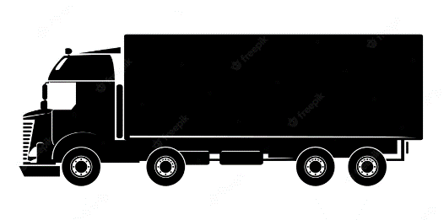

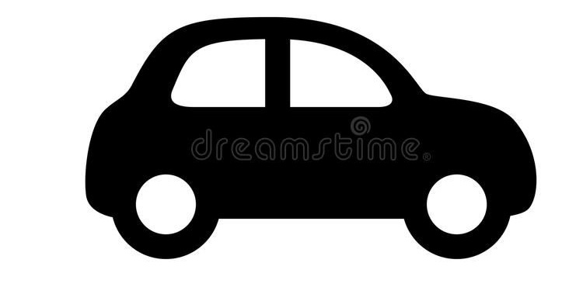

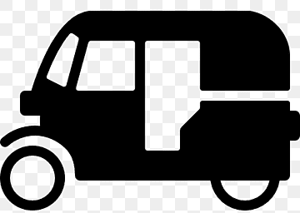
Introduction
Road users are at the highest risk in the traffic stream.
Unprotected by outside shield/Traffic participants without outer protective cells are comes in the category of Vulnerable road users.
Pedestrians are mainly struck by motorized vehicles and have a 25% share of fatalities in India.
Road crashes not only claim lives and inflict injuries but also create an economic burden to society due to the loss of productivity.
Insufficient road infrastructure, like footpath-biased shared space, as well as the lack of training of the road users, still account for a large number and kinds of accident causes.

Slide 4
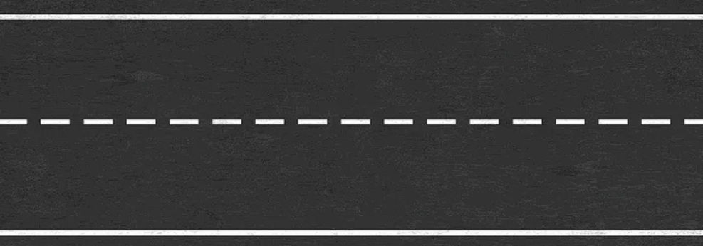
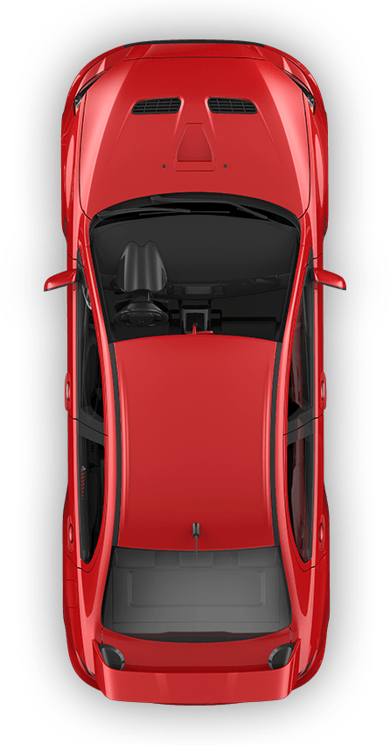




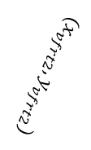
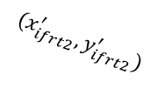
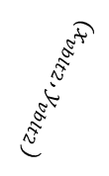







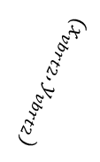


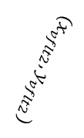





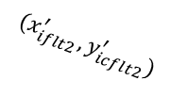

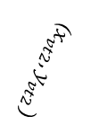


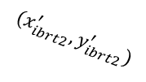


Methodology
Step 1
Angular Time To Collision
$$x_{ifrt1},y_{ifrt1})$$
$${(x}_{{vt}_{′}},y_{{vt}_{1}})$$
$${(x}_{iflt1},y_{iflt1})$$
$${(x}_{{vt}_{2}},y_{{vt}_{2}})$$
$${(x}_{vflt1},y_{vflt1})$$
$${(x}_{vfrt1},y_{vfrt1})$$
$$\text{Point} \text{of} \text{Collison}$$
b_{v}
($x_{it},y_{it})$
$$θ_{vt}$$
l_{v}
($x_{vt1},y_{vt1})$
l_{i}
$${(x}_{vblt1},y_{vblt1})$$
$${(x}_{vbrt1},y_{vbrt1})$$
$${\text{δ}}_{min}$$
$${(x}_{iblt1},y_{iblt1})$$
b_{i}
$$x_{ibrt1},y_{ibrt1})$$
$$D_{min}$$
Step 2
$${(x}_{it_{2}},y_{it_{2}})$$
$${(x}_{vflt2},y_{vflt2})$$
$${(x}_{iflt2}^{′},y_{icflt2}^{′})$$
$${(x}_{ifrt2}^{′},y_{ifrt2}^{′})$$
$$θ_{it_{12}}$$
$${(x}_{vfrt2},y_{vfrt2})$$
l
($x_{vt2},y_{vt2})$
l
($x_{it2},y_{it2})$
$${(x}_{vblt2},y_{vblt2})$$
$${(x}_{vbrt2},y_{vbrt2})$$
$${(x}_{it_{1}},y_{it_{1}})$$
v = Pedestrian
i= Conflicting Vehicle
$${(x}_{iblt2}^{′},y_{iblt2}^{′})$$
b
$${(x}_{ibrt2}^{′},y_{ibrt2}^{′})$$

Slide 5
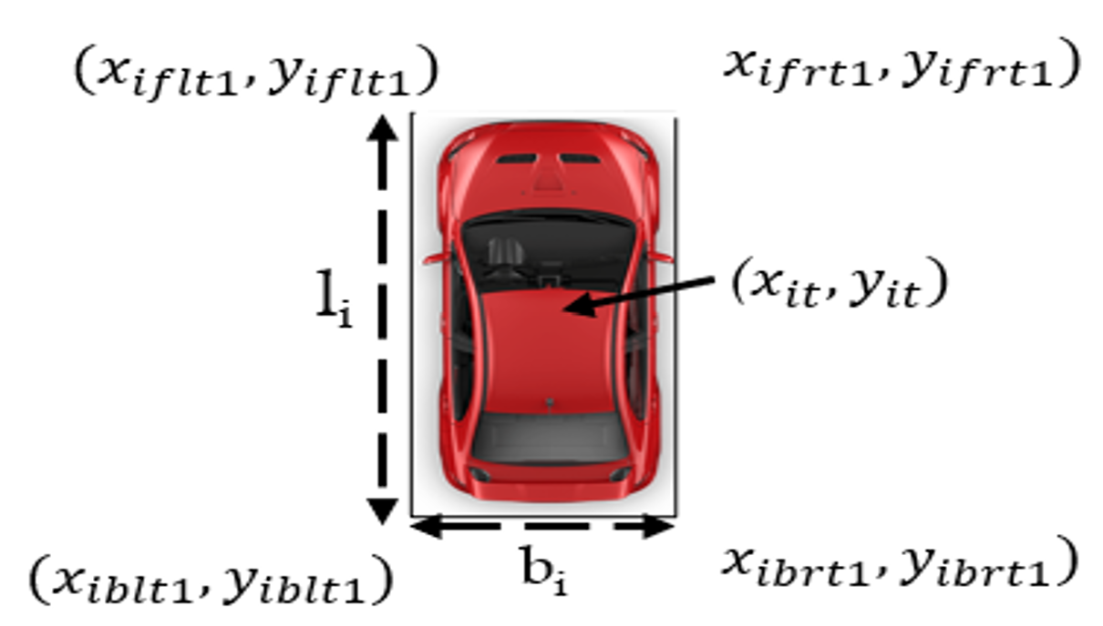
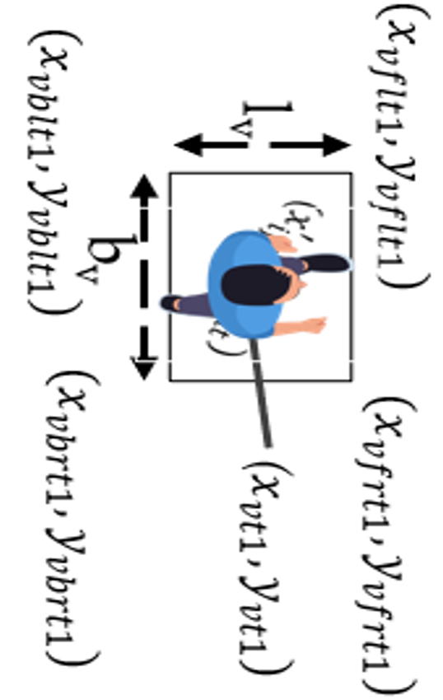
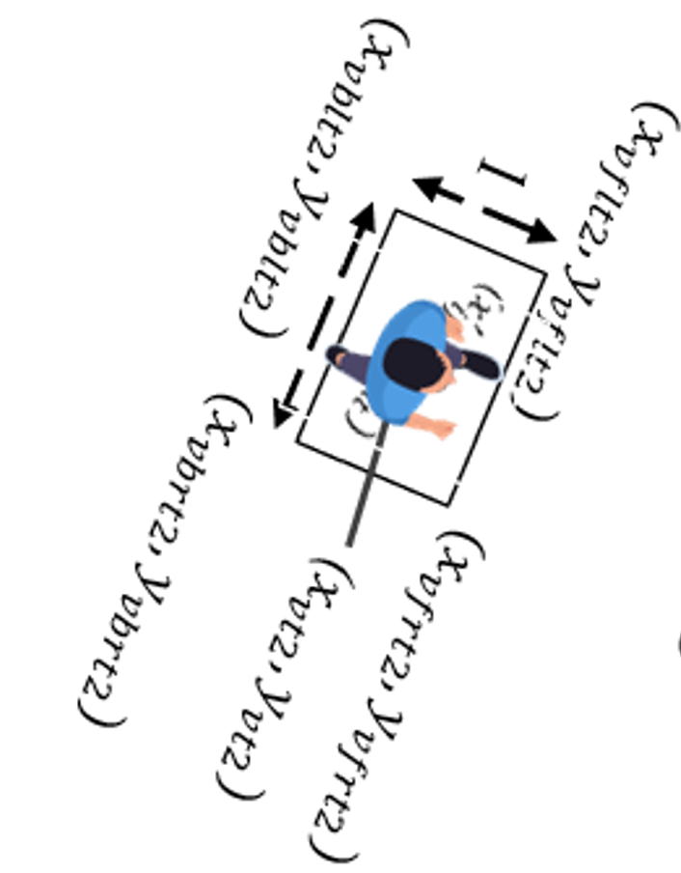
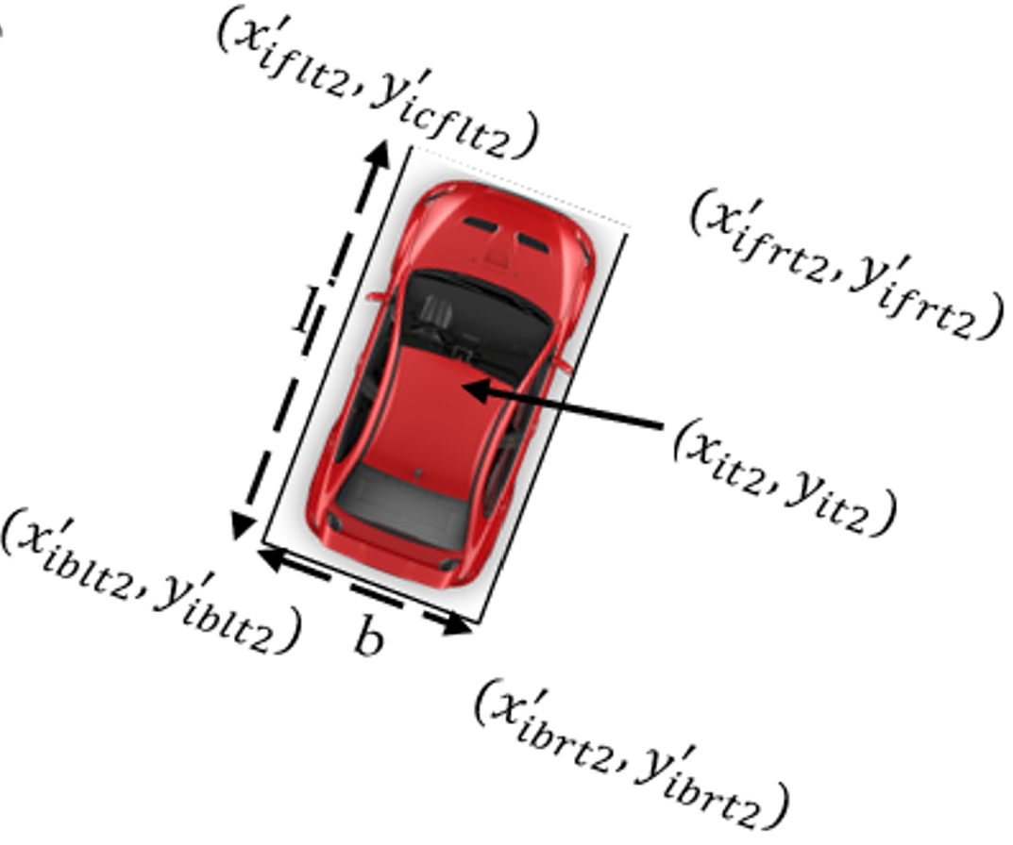
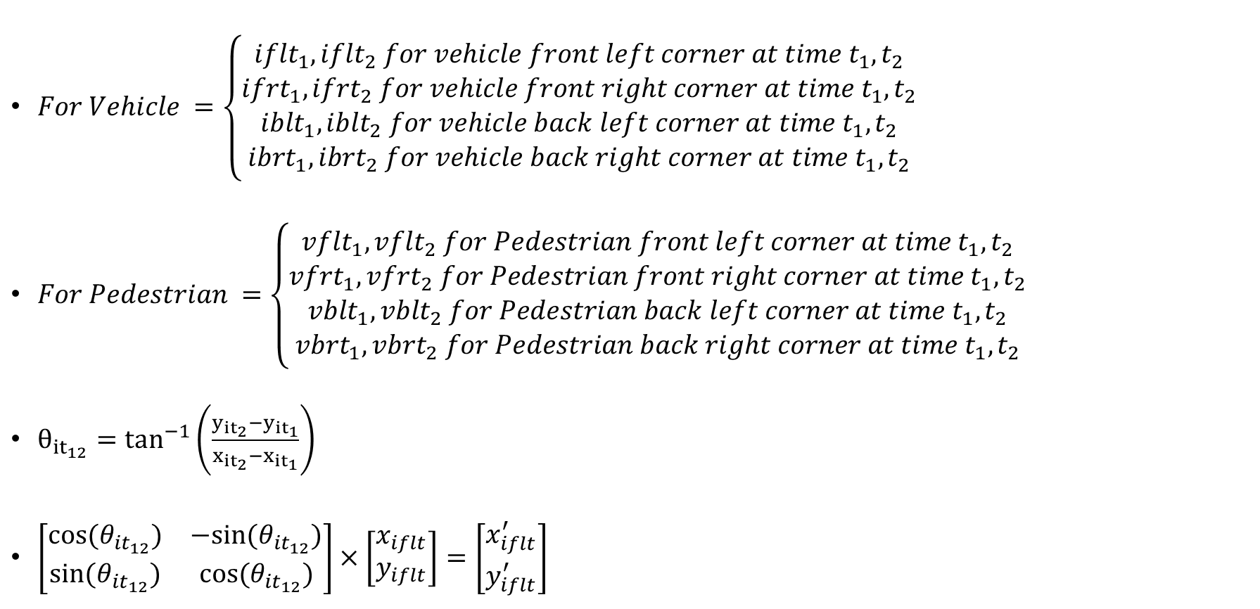
Road Users Dimensions
$For Vehicle =\left\{\begin{aligned}{iflt}_{1}, {iflt}_{2} for vehicle front left corner at time t_{1},t_{2} \\ {ifrt}_{1}, {ifrt}_{2} for vehicle front right corner at time t_{1},t_{2} \\ {iblt}_{1}, {iblt}_{2} for vehicle back left corner at time t_{1}, t_{2} \\ {ibrt}_{1},{ibrt}_{2} for vehicle back right corner at time t_{1}, t_{2}\end{aligned}\right.$
$For Pedestrian =\left\{\begin{aligned}{vflt}_{1}, {vflt}_{2} for Pedestrian front left corner at time t_{1},t_{2} \\ {vfrt}_{1}, {vfrt}_{2} for Pedestrian front right corner at time t_{1},t_{2} \\ {vblt}_{1}, {vblt}_{2} for Pedestrian back left corner at time t_{1}, t_{2} \\ {vbrt}_{1},{vbrt}_{2} for Pedestrian back right corner at time t_{1}, t_{2}\end{aligned}\right.$
$θ_{{it}_{12}}=\tan^{−1}\left(\frac{y_{{it}_{2}}−y_{{it}_{1}}}{x_{{it}_{2}}−x_{{it}_{1}}}\right)$
$\left[\begin{matrix}cos(θ_{{it}_{12}}) & −sin(θ_{{it}_{12}}) \\ sin(θ_{{it}_{12}}) & cos(θ_{{it}_{12}})\end{matrix}\right]×\left[\begin{matrix}x_{iflt} \\ y_{iflt}\end{matrix}\right]=\left[\begin{matrix}x_{iflt}^{′} \\ y_{iflt}^{′}\end{matrix}\right]$

Slide 6
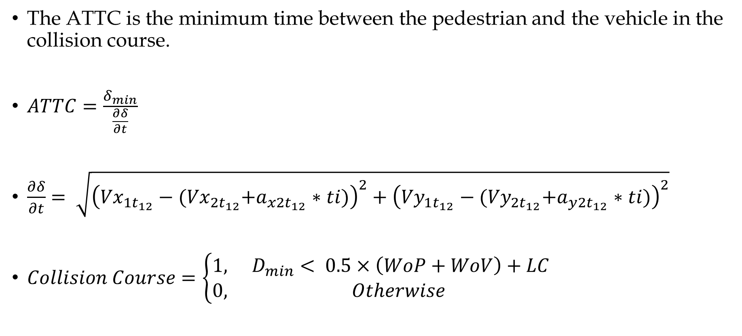
ATTC Formulation
The ATTC is the minimum time between the pedestrian and the vehicle in the collision course.
$ATTC=\frac{δ_{min}}{\frac{∂δ}{∂t}}$
$\frac{∂δ}{∂t}= \sqrt{{\left({Vx}_{1t_{12}}−{(Vx}_{2t_{12}}+a_{x{2t}_{12}}∗ti)\right)}^{2}+{\left({Vy}_{1t_{12}}−{(Vy}_{2t_{12}}+a_{y{2t}_{12}}∗ti)\right)}^{2}}$
$Collision Course=\left\{\begin{matrix}1, & D_{min}< 0.5×\left(WoP+WoV\right)+LC \\ 0, & Otherwise\end{matrix}\right.$

Slide 7
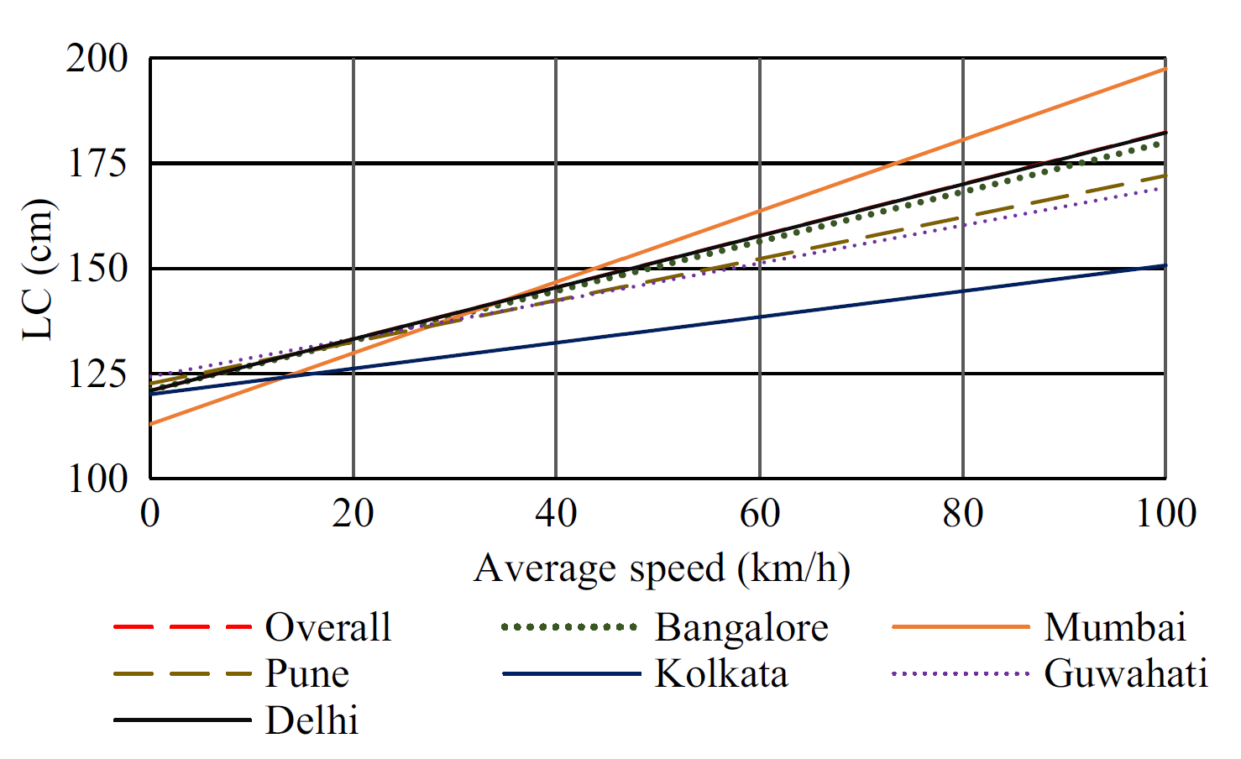
Lateral Clearance
Source: Anuj et al., 2017

Slide 8
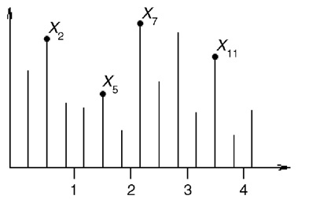
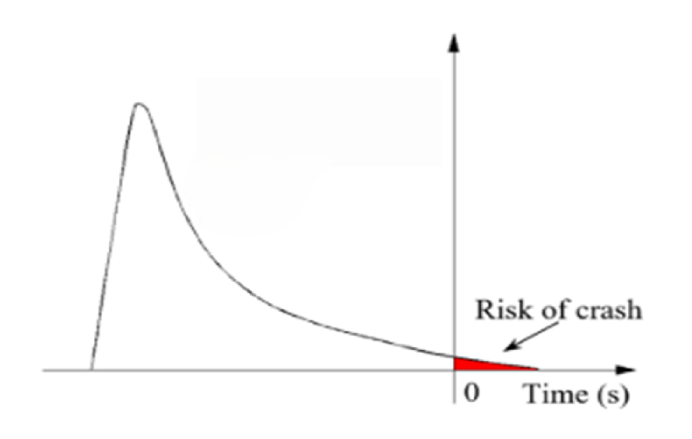
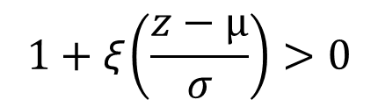
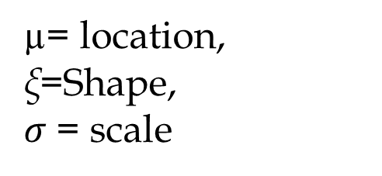
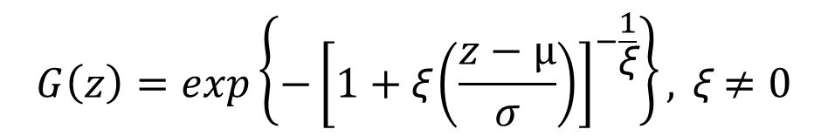
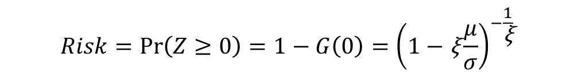
Block Maxima Approach
$$G\left(z\right)=exp\left\{−{\left[1+\text{ξ}\left(\frac{z−µ}{σ}\right)\right]}^{−\frac{1}{\text{ξ}}}\right\}, \text{ξ}≠0$$
$$1+\text{ξ}\left(\frac{z−µ}{σ}\right)>0$$
µ= location, $\text{ξ}\text{=}$Shape,
$σ$ = scale
GEV distribution of block maxima of inverted TTC
BM approach using Generalised Extreme Value Distribution
$$Risk=\operatorname{Pr}\left(Z≥0\right)=1−G\left(0\right)={\left(1−\text{ξ}\frac{μ}{σ}\right)}^{−\frac{1}{\text{ξ}}}$$

Slide 9
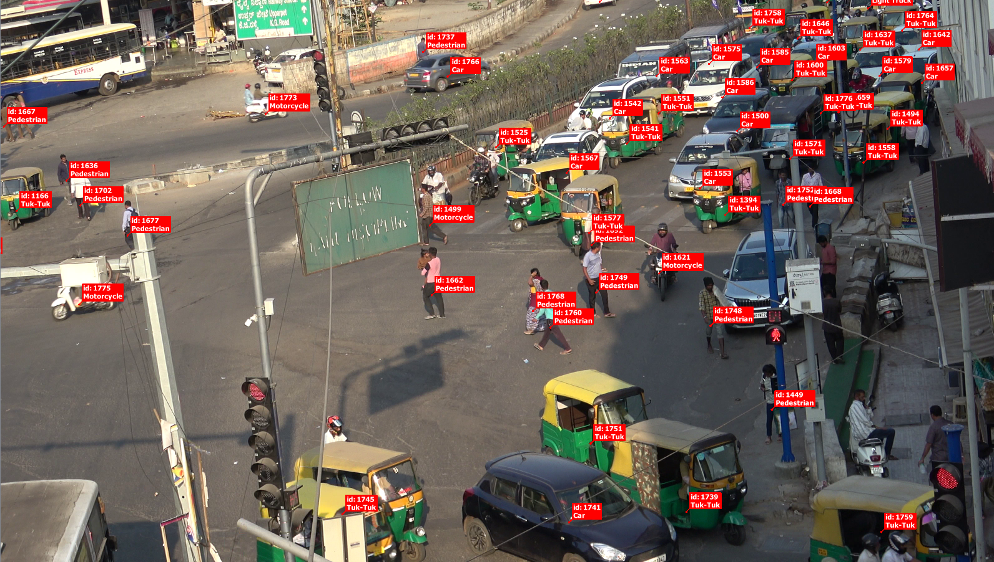
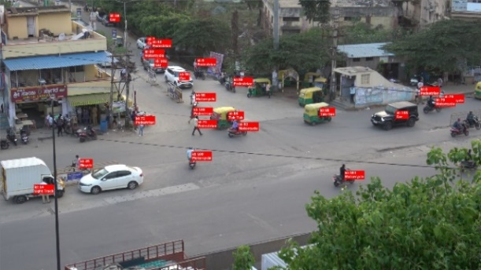
Data Collection and Extraction
Trajectories recorded at 0.16-second intervals, providing X and Y coordinates at each time stamp
Majestic Signalized Intersection
Bommasandra Unsignalized Intersection
Type of Road User | Frequency (%) at Signalized Intersection | Frequency (%) at Unsignalized Intersection
Pedestrian | 1069 (20.73) | 724 (12.51)
2-Wheeler | 3011 (58.38) | 3584 (61.93)
Car | 1040 (20.16) | 963 (16.64)
3-Wheeler | 18 (0.35) | 284 (4.91)
LCV | 14 (0.27) | 203 (3.51)
Others | 6 (0.12) | 29 (0.50)
Total | 5,158 | 5,787

Slide 10
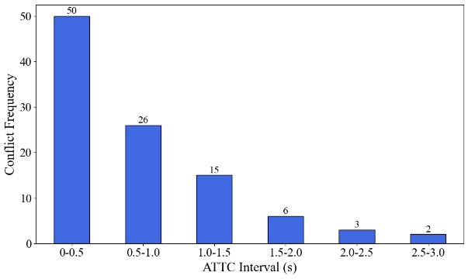
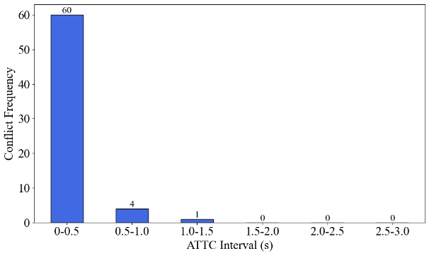
Conflict Analysis
Majestic Signalized Intersection
Bommasandra Unsignalized Intersection

Slide 11
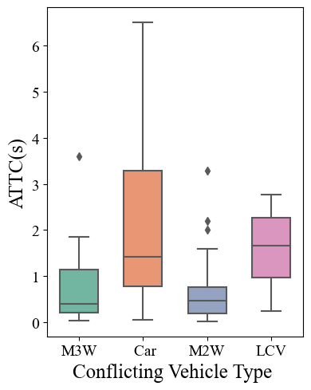
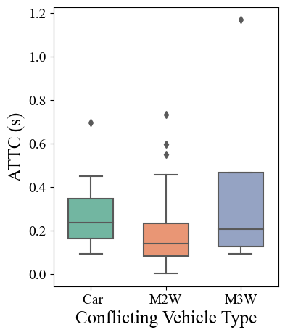
ATTC of Major Conflicting Vehicles
Majestic Signalized Intersection
Bommasandra Unsignalized Intersection

Slide 12
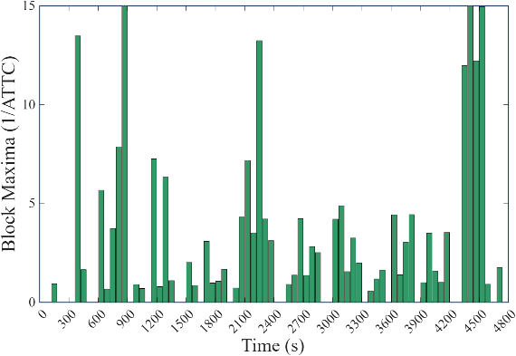
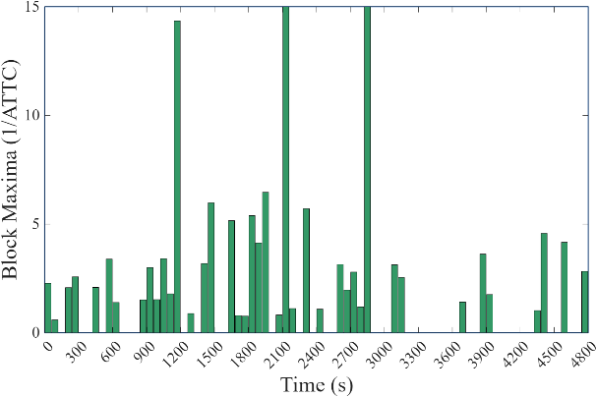
Block Maximas
The GEV distribution is fitted to the block maxima, with ATTC values transformed into inverted ATTC so that high-risk interactions are represented as extremes.
Majestic Signalized Intersection
Bommasandra Unsignalized Intersection

Slide 13
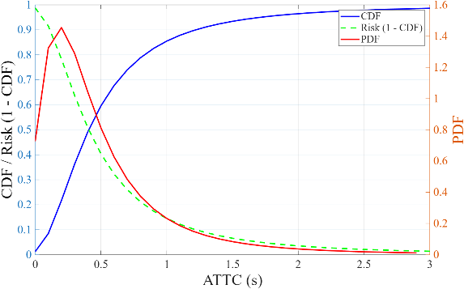
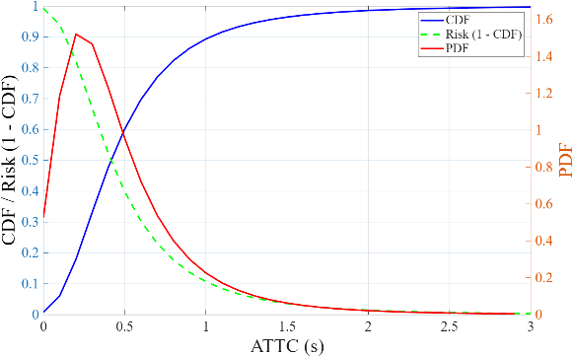
PDF, CDF, and Risk estimation
Majestic Signalized Intersection
Bommasandra Unsignalized Intersection
Risk = 0.1033 at 1.2 sec
Risk = 0.0671 at 1.2 sec

Slide 14
PDF, CDF, and Risk Statistics
Signalized Intersection
Unsignalized Intersection
Shape (ξ) = 0.3605, scale (σ) = 0.2642, and location (μ) = 0.3037
The Kolmogorov-Smirnov (KS) statistic = 0.1034, the Anderson-Darling (A²) = 0.8506, and the Cramer-Von Mises (W²) statistic = 0.1350, indicating an overall acceptable fit.
Shape (ξ) = 0.2181, scale (σ) = 0.2423, and location (μ) = 0.3238
The Kolmogorov-Smirnov (KS) statistic = 0.0682, the Anderson-Darling (A²) = 0.2194, and the Cramer-Von Mises (W²) statistic = 0.0308, indicating an overall acceptable fit

Slide 15
Conclusion
Introducing a novel surrogate safety indicator characterized by a rotation angle, termed ATTC.
This enhanced formulation enables more accurate conflict analysis, particularly in non-lane-based, mixed-traffic conditions.
Unsignalized intersection is more critical than signalized intersection, particularly within the 0-0.5 second ATTC range, However, the overall number of conflicts is greater at the signalized intersection.
Insufficient crossing time and when signals change, drivers often accelerate rapidly at the start of green or attempt to clear the yellow, leading to conflicts with late-crossing pedestrians.
Need for context-specific interventions that prioritize pedestrian safety, including traffic calming measures, clearly delineated crosswalks, pedestrian refuge islands, and signal timing adjustments to ensure adequate crossing opportunities.

Slide 16
Thank you
Email: harendras@iisc.ac.in

