Slide 1



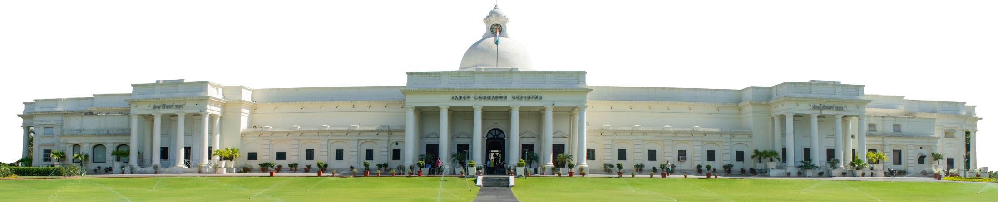
Paper ID 3113
Investigating Parents’ Priorities for Improvement of Child Walkability
to School: Insights from Roorkee City
Saurabh Choudhary, Manan Monga and Shubhajit Sadhukhan
Department of Architecture and Planning, IIT Roorkee
Research Symposium on Integrated Land Use Transport Planning
8 November 2025
Gurugram, Haryana

Slide 2

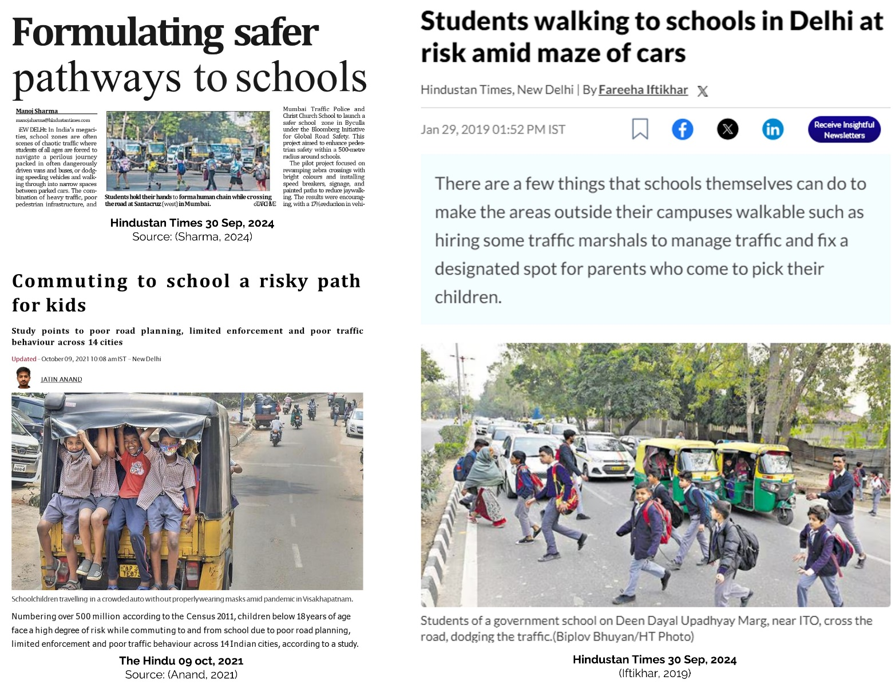
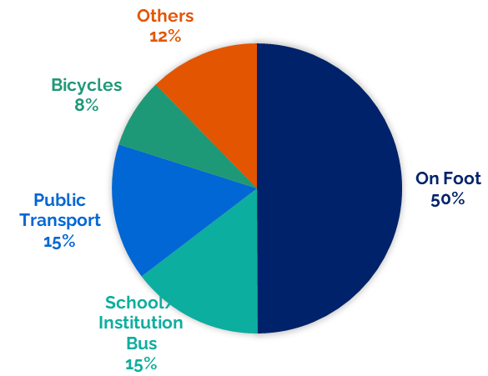
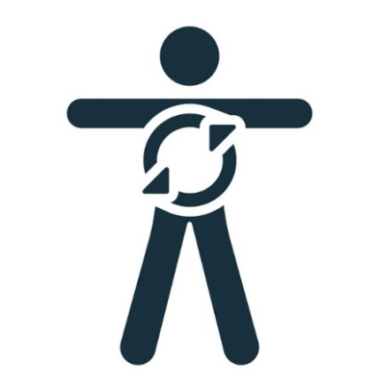

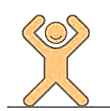
Introduction
Safe, accessible and sustainable mobility for all.
Promote walking and create pedestrian friendly environment
Half of adolescents in India do not meet the WHOs recommendations of daily physical activity.
(Source: (Bhawra et al., 2023).
Student Distribution by Mode of Transport to Institution
(Source: (Ministry of Statistics & Program Implementation, 2017)
Benefits of Walking
Physical Benefits
Mental Benefits
Independence & Self-reliance

Slide 3


Introduction
GOI Initiatives
Aim of the Study
To investigate parents’ perceptions for identifying the priority attributes for improvement towards child
walkability to school
State Level Initiatives
Objectives
Cities like Delhi, Chennai, Pune, Bengaluru, and Mumbai have undertaken multiple pilot projects establishing ‘Safe School Zones’ (Sharma, 2024).
Identification of attributes influencing child walkability to school in existing studies
Collecting parents’ perception on the identified attributes in the study area
Identifying the priority attributes for improving child walkability to school in the study area
Capturing Parents’ Perception
Parents are the key decision makers for their children during school years, their perception largely influences their children’s school commuting choices (Nikitas et al., 2019)

Slide 4
Identification of attributes
Keywords Used: (Child OR Student*) AND (School OR Education) AND (Walk* OR Pedestrian) AND (Factors OR Covariates OR Determinants OR Attributes OR Predictors OR Motivators OR Barriers OR Deterrents)
Attribute | Sources
Sidewalk | (J. R. Panter et al., 2010), (Wong et al., 2011)
Pedestrian Crossing | (Mammen et al., 2012), (Oluyomi et al., 2014)
Traffic Light | (Hume et al., 2009) (Lu et al., 2014)
Sign Boards | (Indian Roads Congress, 2023)
Less Vehicular Traffic | (Kerr et al., 2006), (J. R. Panter et al., 2010)
Vehicular Speed Limit | (Rothman et al., 2018), (Aranda-Balboa et al., 2020)
Safety from Strangers | (Hume et al., 2009), (Mammen et al., 2012)
Crossing Guard | (Rothman et al., 2018), (Van Dyck et al., 2010)
Safety From Street Animals | (Oluyomi et al., 2014)
Shaded Areas | (Binns et al., 2009), (Aranda-Balboa et al., 2020)
Greenery Along School Routes | (Larsen et al., 2009), (Wong et al., 2011)
Distance to school | (McDonald, 2008), (Wong et al., 2011)
Data Source:
Web of Science
Inclusion and Exclusion Criteria
Filter: Language (English)
Attributes affecting child walking to school
Total Papers: 61
Total Papers: 341
Total Papers: 1487
Abstract Screening
Title Screening
Attribute | Sources
Child Physical Activities | (Leslie et al., 2010), (Robertson-Wilson et al., 2008)
Walking Companion | (Wilson et al., 2018) , (Lin et al., 2017)
Child’s Ability to Cross Busy Roads | (Timperio et al., 2004), (Helbich et al., 2016)
Weight of School Bag | (Forman et al., 2008), (Lu et al., 2014)
Child’s Preference for Walking | (Aranda-Balboa et al., 2020), (Forman et al., 2008)

Slide 5
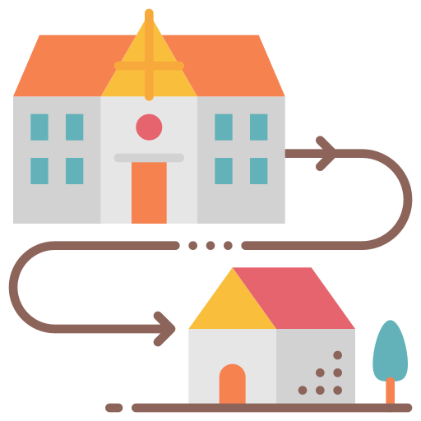
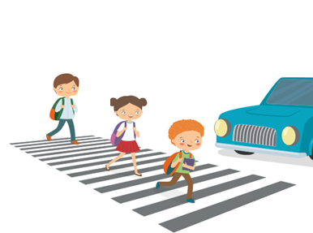




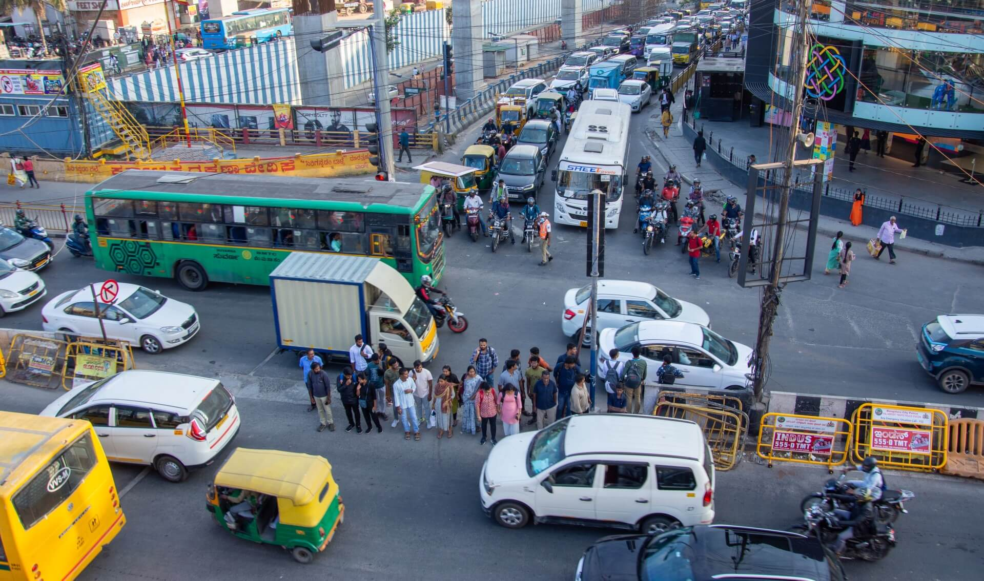
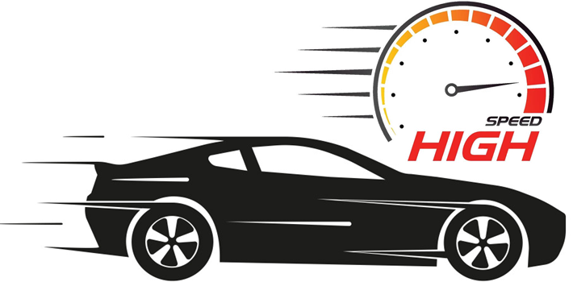
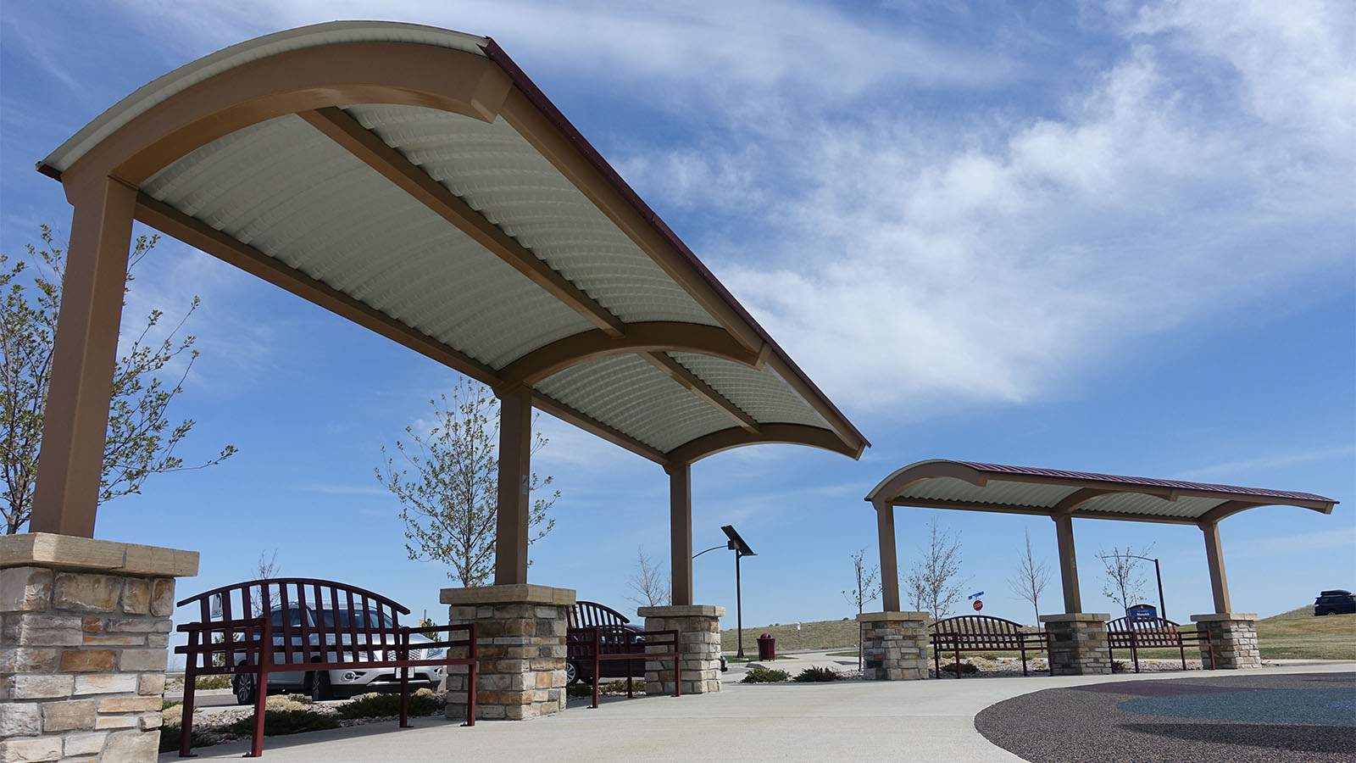
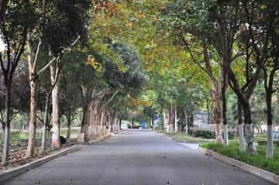
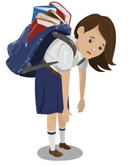
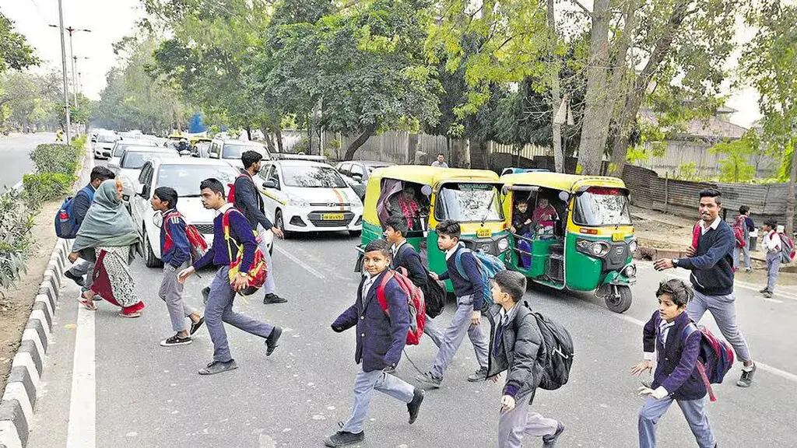

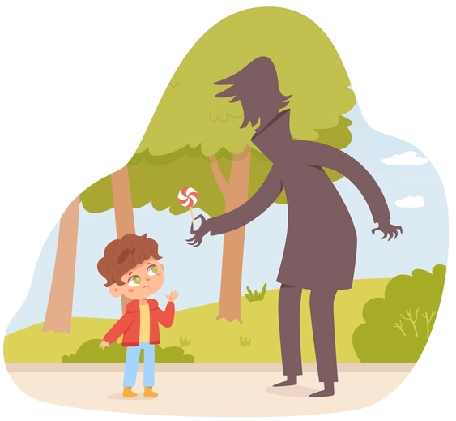
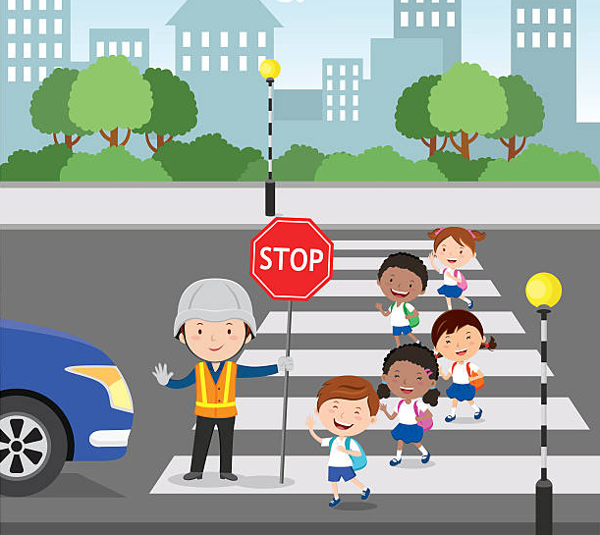
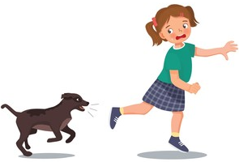


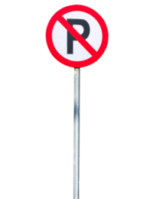
Identification of attributes
Traffic and Road Safety
Infrastructure
Environmental factors
Child specific factors
Infrastructure
Traffic and Road Safety
Child Physical Activities
Vehicular Speed Limit
Distance to school
Walking Companion
Less Vehicular Traffic
Traffic Light
Sidewalk
Pedestrian Crossing
Attributes
Environmental factors
Shaded areas
Greenery Along School Routes
Child specific factors
Weight of school bag
Child’s Ability to Cross Busy Roads
Child’s Preference for Walking
Crossing Guard
Safety From Street Animals
Safety from Strangers
(School Zone)
(Stop)
(No Parking)

Slide 6
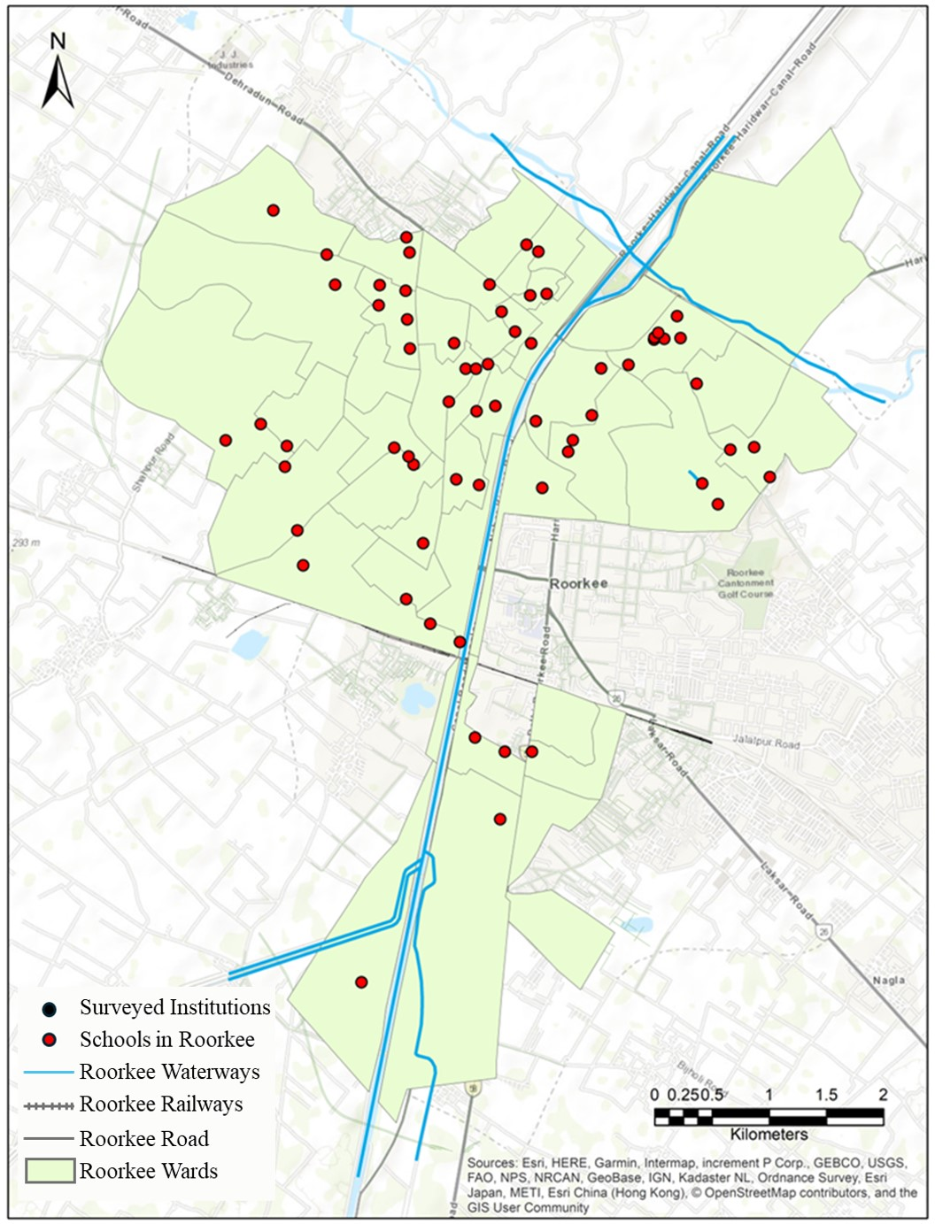
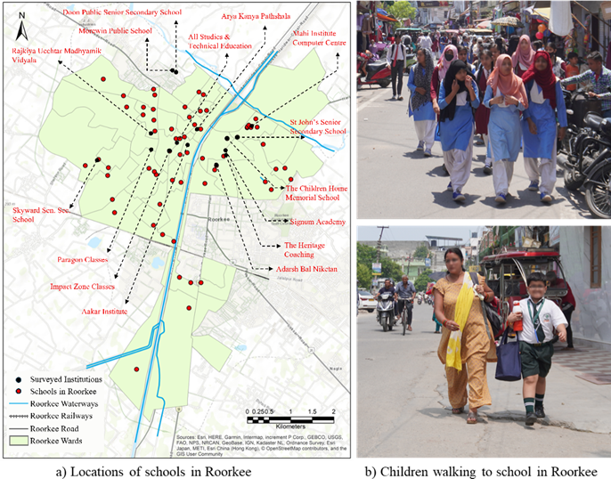
Study Area
Locations of Institutions in Roorkee
Roorkee
Roorkee, Haridwar district, Uttarakhand.
Population: 1,18,200 (2011 Census).
Geography: Linear city layout along the Ganga Canal.
Urban Area: 8.11 sq km under Roorkee Nagar Nigam.
Children Walking to School (Location: Roorkee)

Slide 7
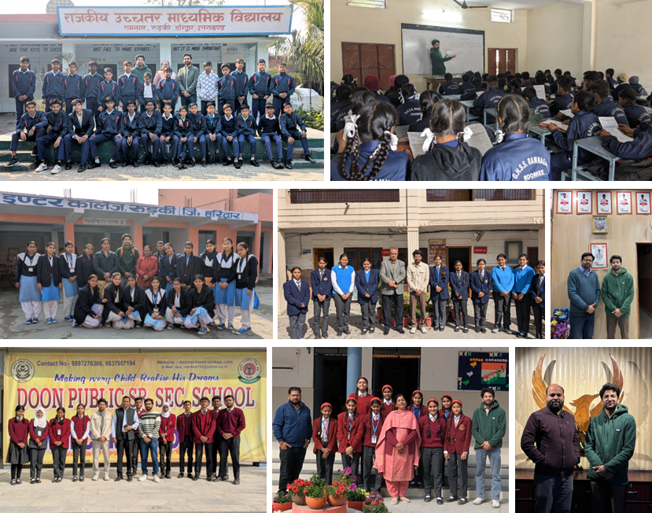
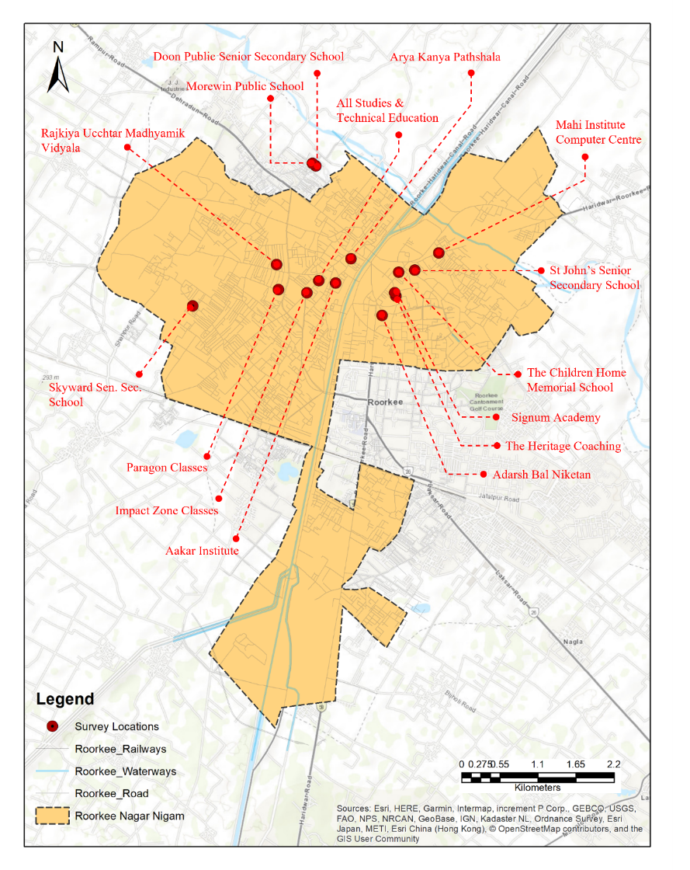
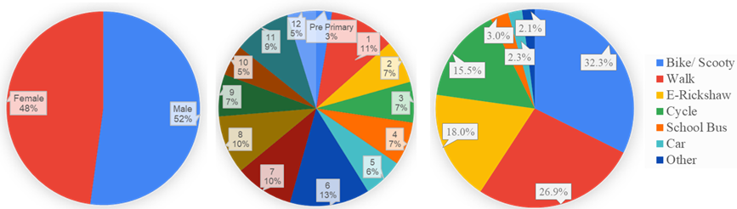
Data Collection
878 completely filled responses from parents of school going children.
Perception on a 5 Point Likert scale where 1 represented least importance or satisfaction and 5 represented maximum importance or satisfaction
Locations of Educational Facilities
Schools and Coachings approached for survey
Children’s Gender
Children’s Class
Children’s Mode to School

Slide 8
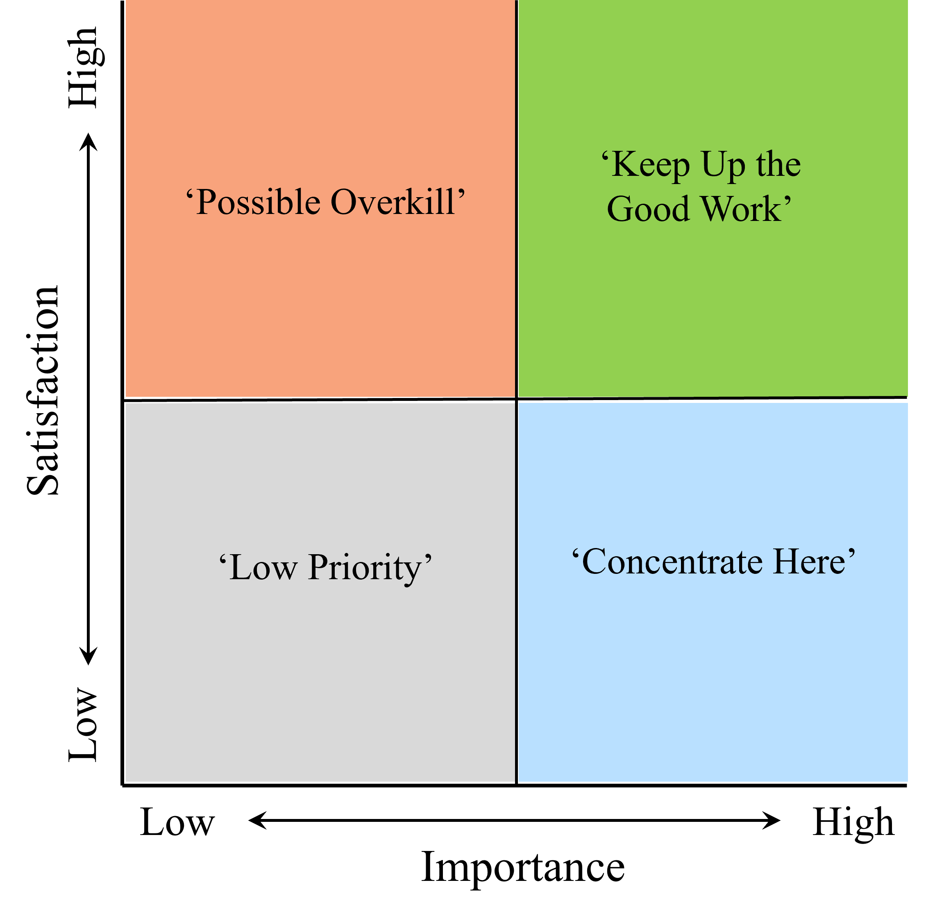
Conventional ISA
Importance Satisfation Analysis: Factors are divided into 4 quadrants in a 2D graph
“Keep Up the Good Work”: Highly important and satisfying factors. No urgent action needed, but continuous monitoring is required.
“Concentrate Here”: Highly important but low satisfaction factors. Immediate improvements are needed to boost satisfaction.
“Low Priority”: Low importance and low satisfaction factors. These are not a priority for improvement.
“Possible Overkill”: High satisfaction but low importance factors. Resources here can be redirected to more critical areas.

Slide 9
Revised ISA
Assumptions in Conventional ISA
ISA assumes a linear relation between attribute performance and overall satisfaction. Studies have proven that this relation can be asymmetrical (Matzler et al., 2004).
Independence between the importance and satisfaction of attributes. Ryan & Huyton (2002) found that there is an association between the importance and satisfaction level of the attributes.
Limitations in Conventional ISA
Placement of dividers in forming quadrants depends on judgment (Bacon, 2003).
An attribute falls close to the line separating two quadrants, it becomes difficult to justify which management scheme is the most suitable for it (Ban et al., 2022).

Slide 10
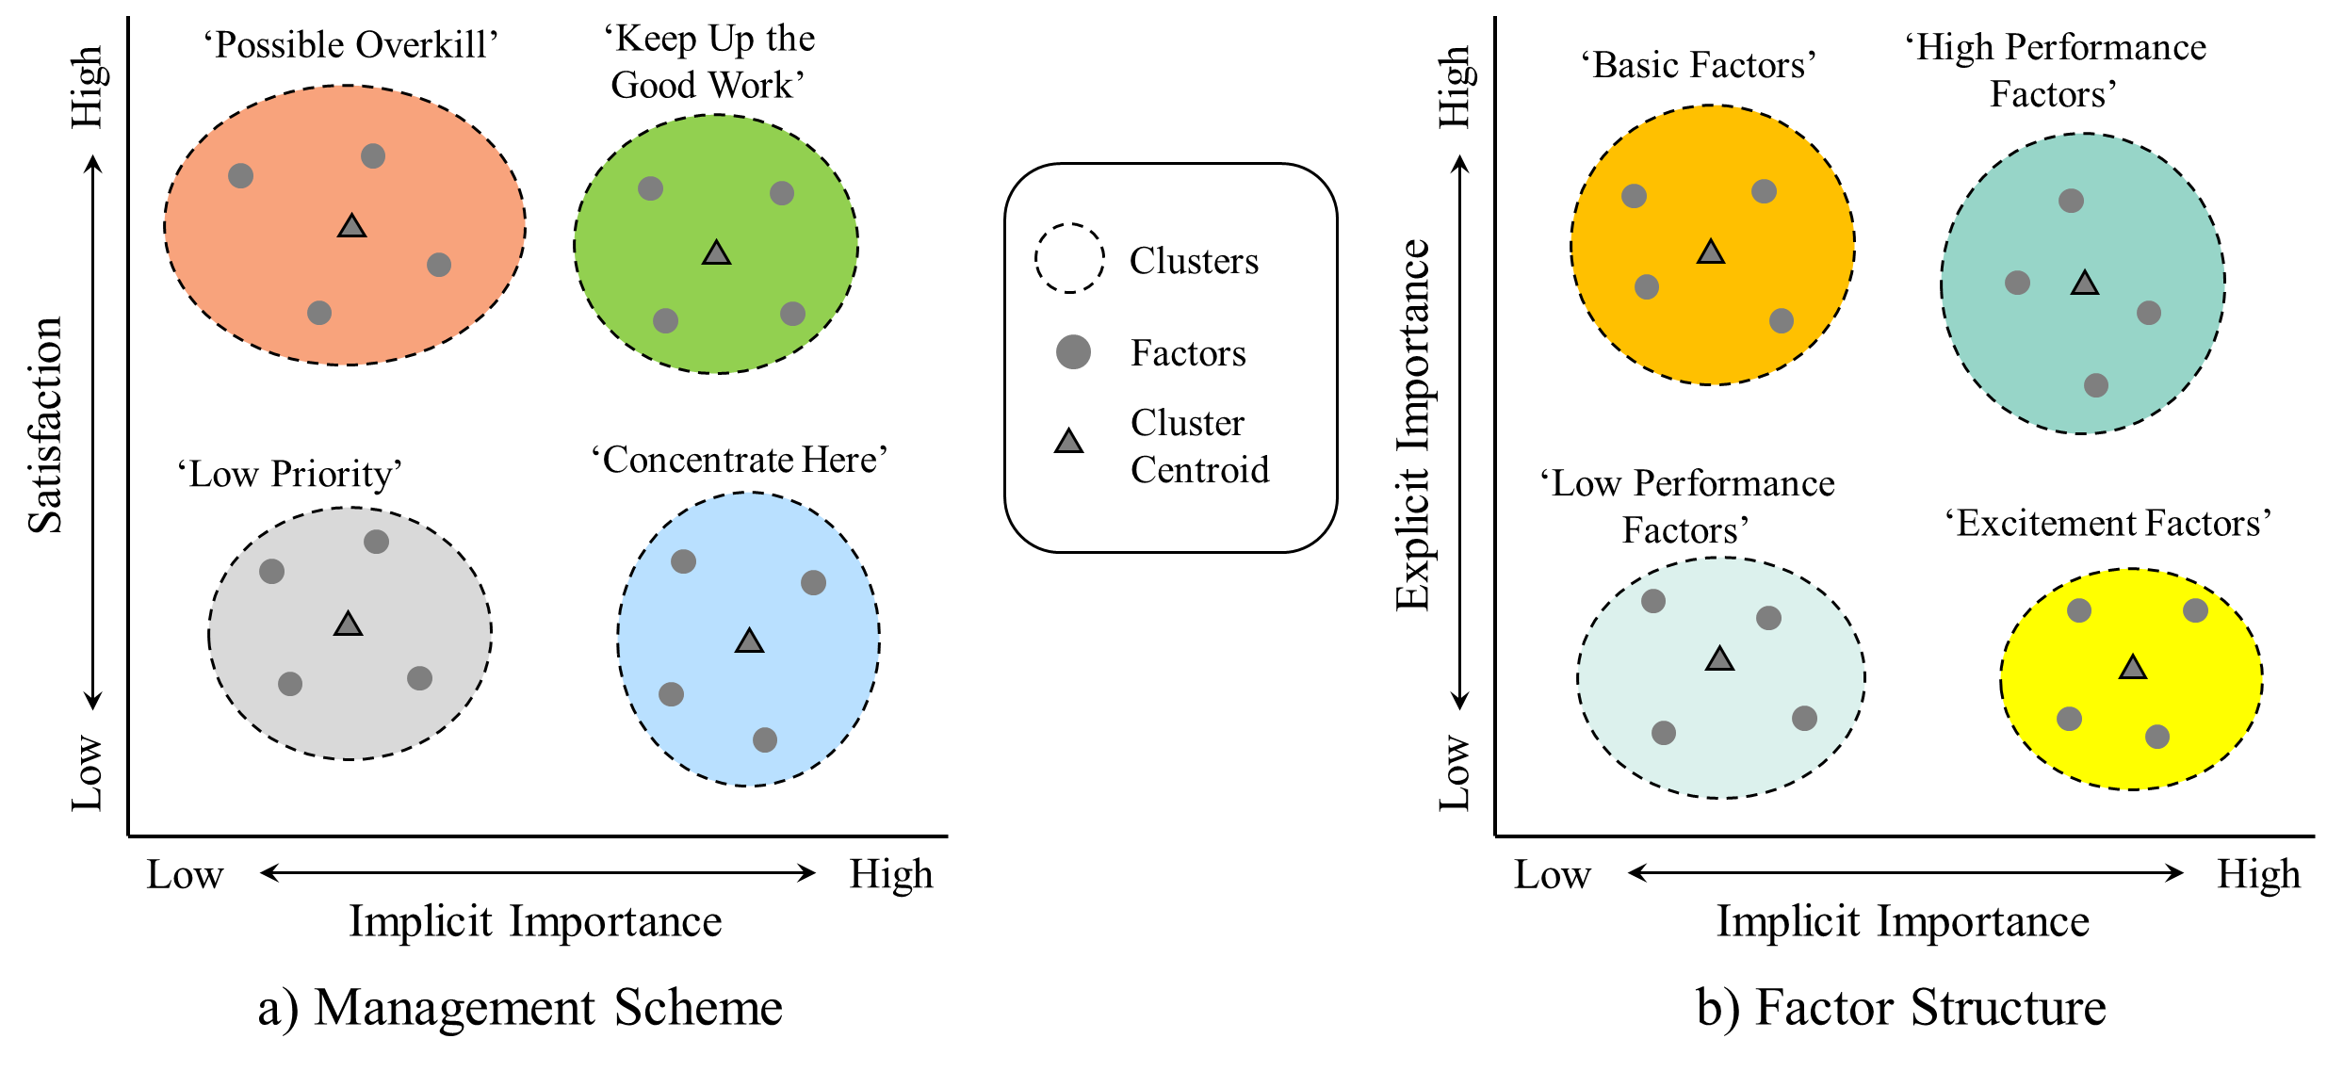
Revised ISA & K-means clustering

Slide 11
Revised ISA & K-means clustering
Basic Factors: Must-have elements; their absence causes dissatisfaction, but their presence doesn't enhance satisfaction.
Excitement Factors: Unexpected features that delight users; their presence boosts satisfaction, but absence doesn’t cause dissatisfaction.
Performance Factors: Directly impact satisfaction; more satisfaction with these leads to higher overall satisfaction, and vice versa.
Performance Factors are split into Low Performance and High Performance factors based on their contribution to overall satisfaction.

Slide 12
Priority-wise Criteria
Phase | Criteria (Combination of Clusters)
Priority 1 | Concentrate Here (C.H.) + Basic Factor (B.F.); Concentrate Here (C.H.) + High Performance Factor (H.P.F.); Keep Up the Good Work (K.U.G.W.) + Basic Factor (B.F.)
Priority 2 | Concentrate Here (C.H.) + Excitement Factor (E.F.); Keep Up the Good Work (K.U.G.W.) + High Performance Factor (H.P.F.); Keep Up the Good Work (K.U.G.W.) + Excitement Factor (E.F.); Low Priority (L.P.) + Basic Factor (B.F.); Low Priority (L.P.) + High Performance Factor (H.P.F.)
Priority 3 | Concentrate Here (C.H.) + Low Performance Factor (L.P.F.); Keep Up the Good Work (K.U.G.W.) + Low Performance Factor (L.P.F.); Low Priority (L.P.) + Excitement Factor (E.F.); Possible Overkill (P.O.) + Basic Factor (B.F.)
Priority 4 | Low Priority (L.P.) + Low Performance Factor (L.P.F.); Possible Overkill (P.O.) + High Performance Factor (H.P.F.); Possible Overkill (P.O.) + Excitement Factor (E.F.); Possible Overkill (P.O.) + Low Performance Factor (L.P.F.)

Slide 13
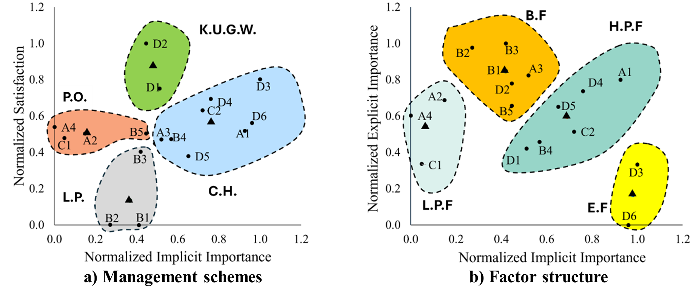
Parent’s Perception
Attribute
A1 | Sidewalk
A2 | Pedestrian Crossing
A3 | Traffic Light
A4 | Sign Boards
B1 | Less Vehicular Traffic
B2 | Vehicular Speed Limit
B3 | Safety from Strangers
B4 | Crossing Guard
B5 | Safety From Street Animals
C1 | Shaded Areas
C2 | Greenery Along School Routes
D1 | Distance to school
D2 | Child Physical Activities
D3 | Walking Companion
D4 | Child’s Ability to Cross Busy Roads
D5 | Weight of School Bag
D6 | Child’s Preference for Walking

Slide 14
Major Findings
Phase-wise Resource Allocation and Improvement Criteria
Phase | Factors
Phase 1 (CH+BF, CH+HPF, KUGW+BF) | Sidewalk (A1), Traffic Light (A3), Crossing Guard (B4), Greenery Along School Routes (C2), Child Physical Activities (D2), Child’s Ability to Cross Busy Roads (D4), Weight of School Bag (D5)
Phase 2 (CH+EF, KUGW+HPF, KUGW+EF, LP+BF, LP+HPF) | Less Vehicular Traffic (B1), Vehicular Speed Limit (B2), Safety from Strangers (B3), Distance to School (D1), Walking Companion (D3), Child’s Preference for Walking (D6)
Phase 3 (CH+LPF, KUGW+LPF, LP+EF, PO+BF) | Safety From Street Animals (B5)
Phase 4 (LP+LPF, PO+HPF, PO+EF, PO+LPF) | Pedestrian Crossing (A2), Sign Boards (A4), Shaded Areas (C1)

Slide 15
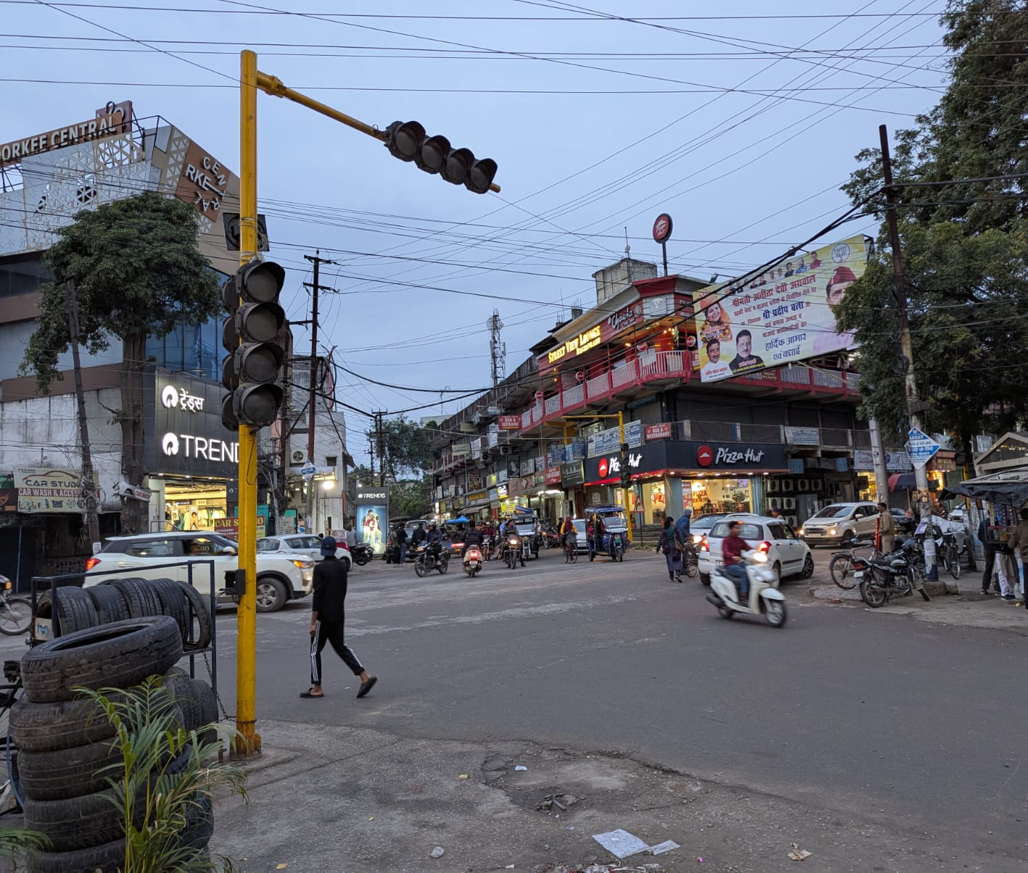
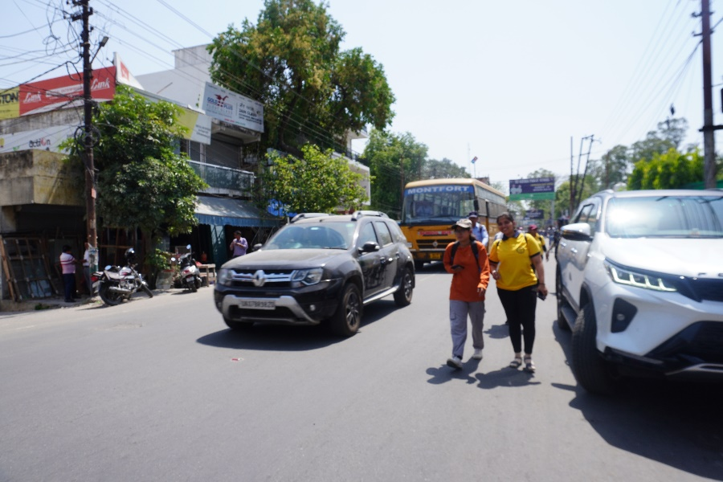
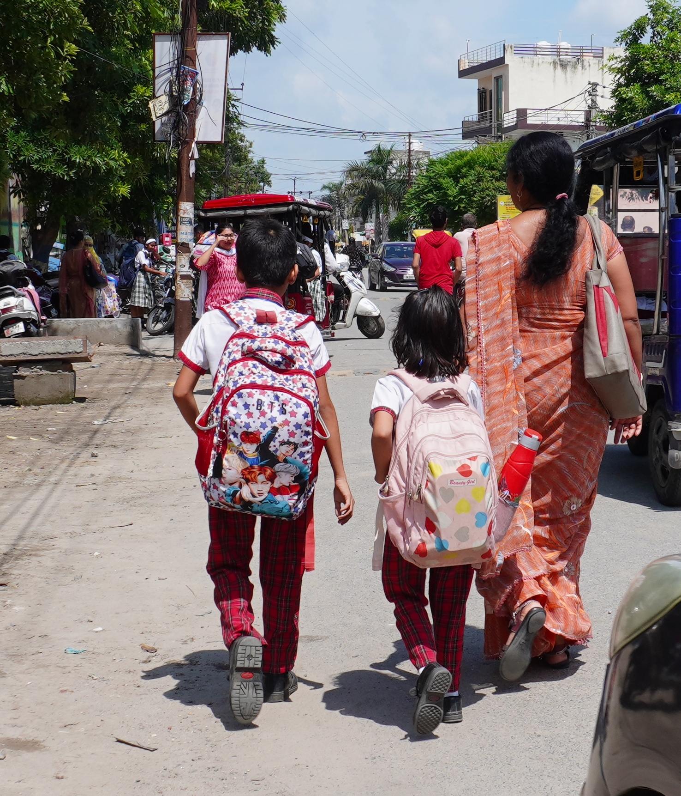
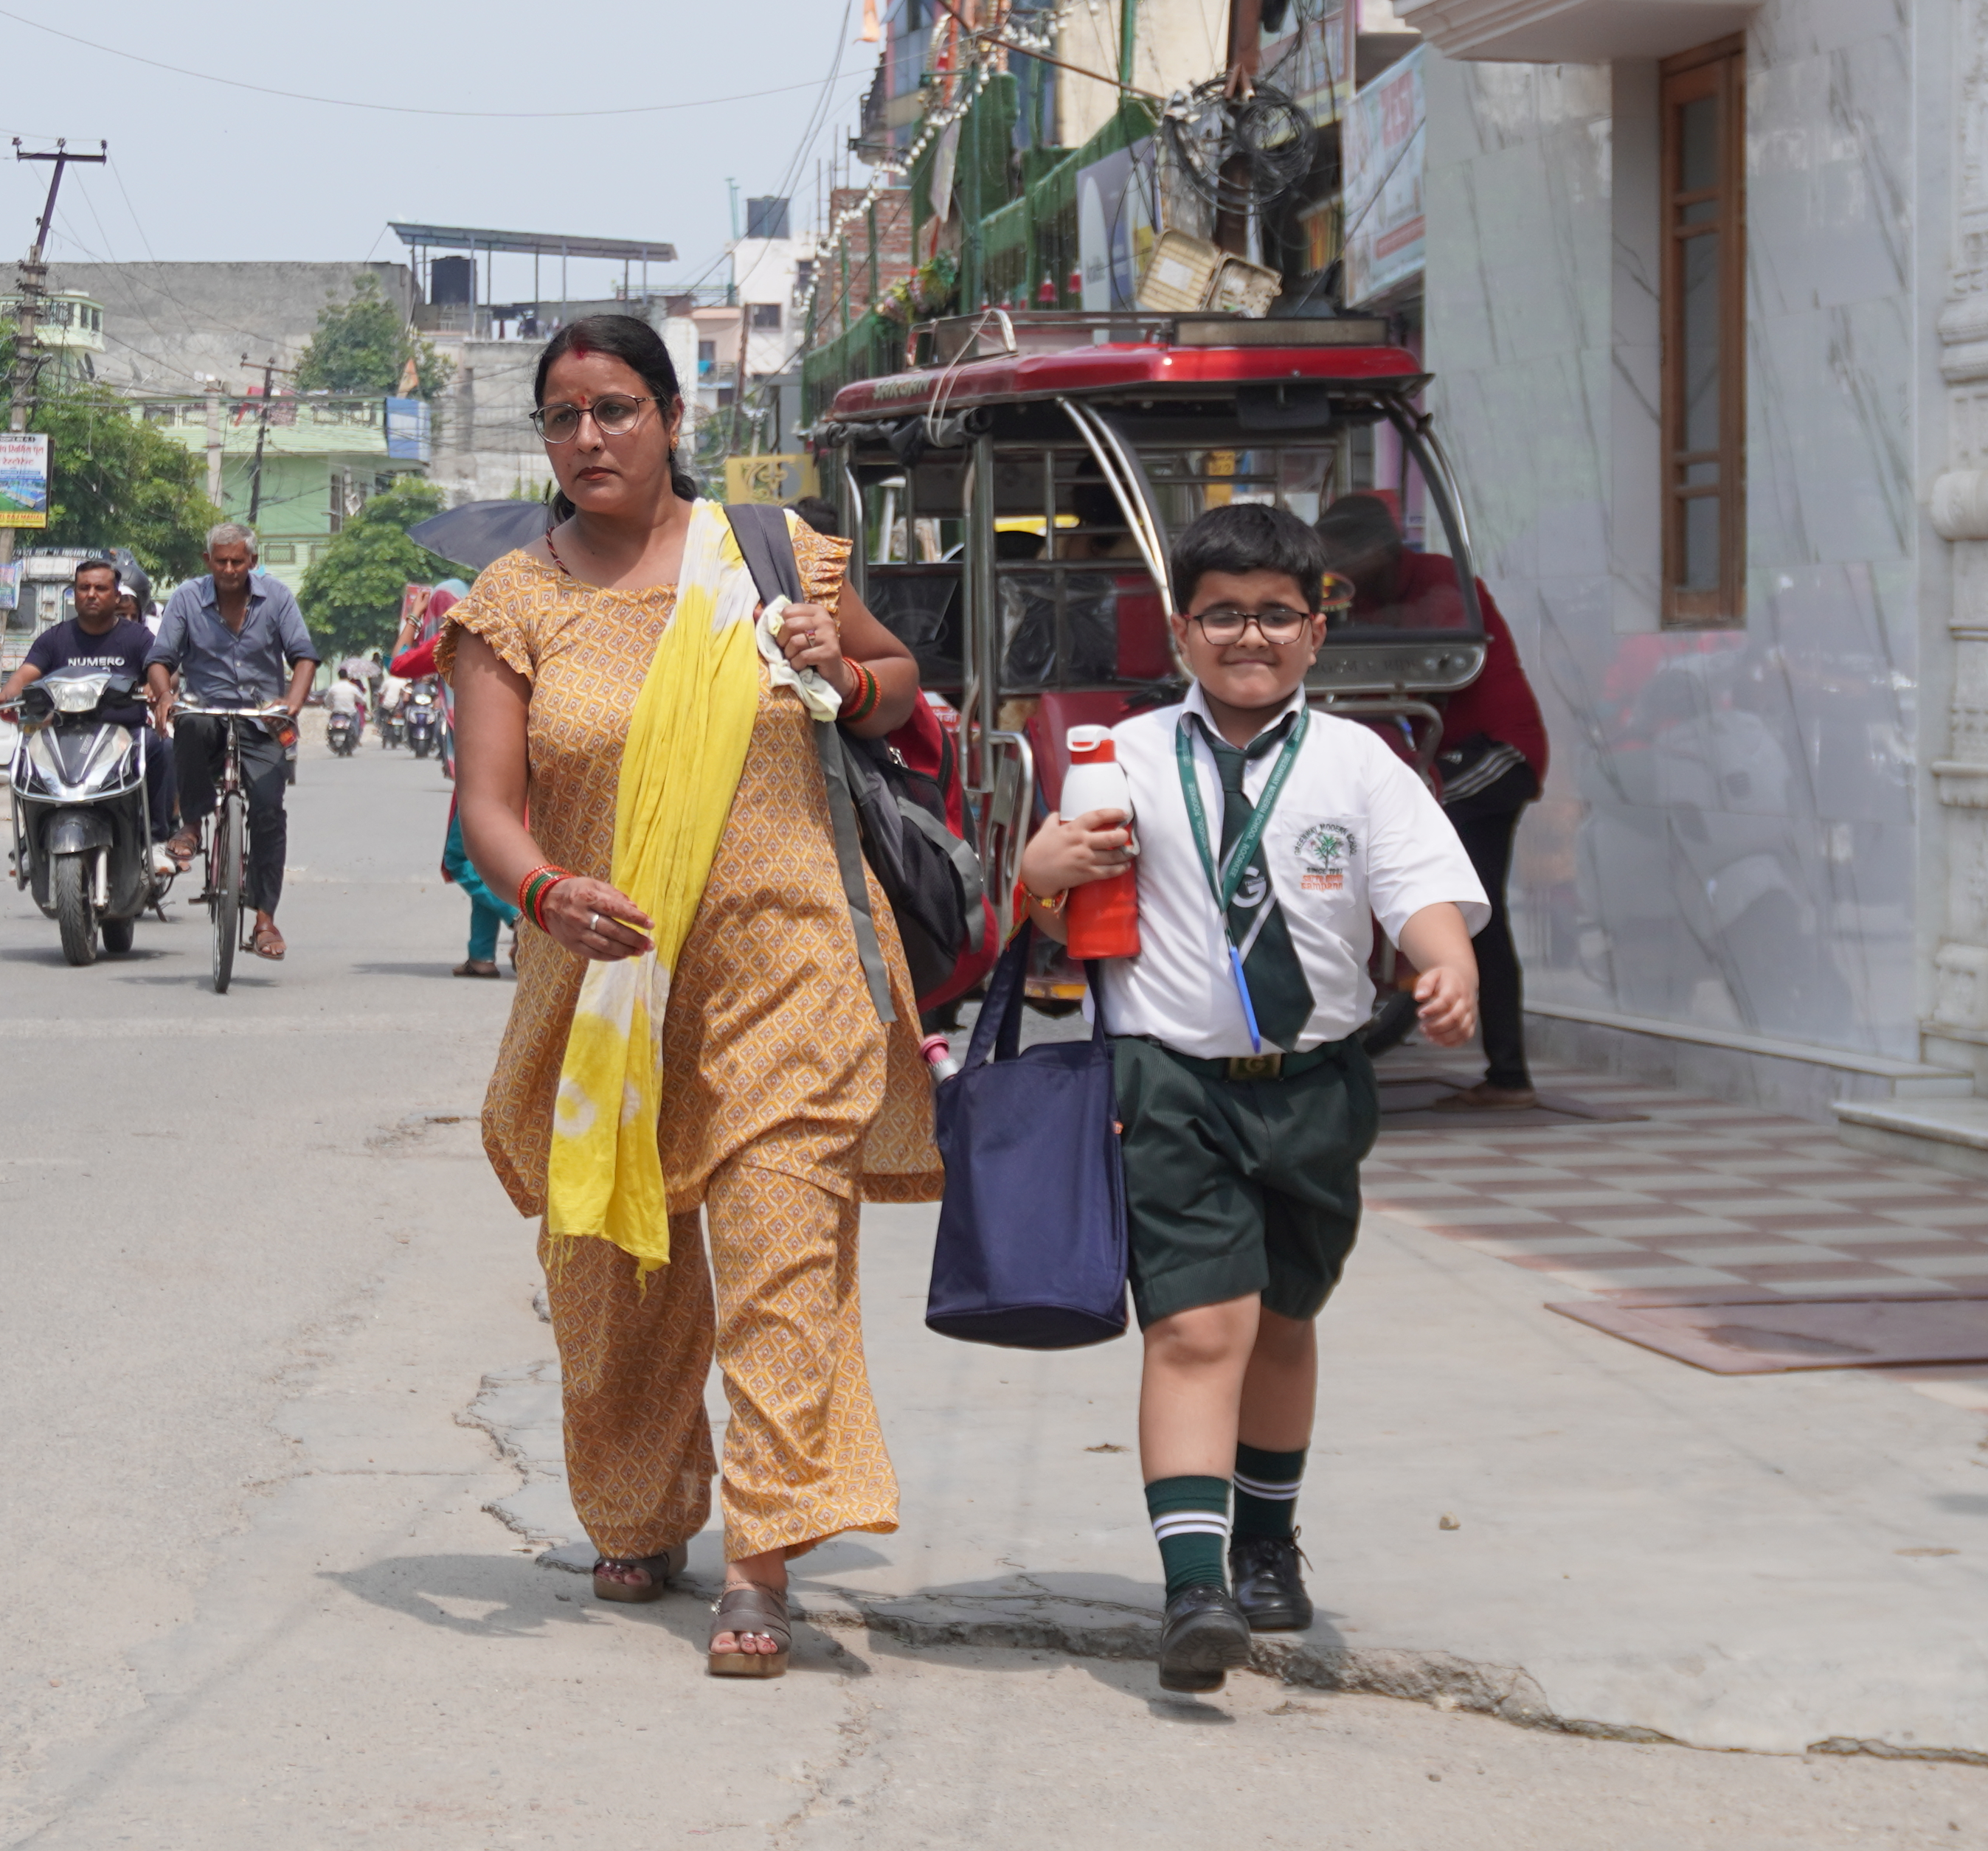
Major Findings
Traffic lights not working
The first priority is to address the lack of sidewalks, absent on 68% of roads (UKMRC, 2019), along with poor condition and absence of traffic lights
Parents’ concerns over their children’s physical activity need to be addressed to meet health thresholds.
Heavy weight of the school bag is highlighted as a major concern, resulting in parental chauffeuring and concern over children’s independent mobility to school.
Absence of Sidewalk
Absence of Sidewalk
Parents’ safety concern from high traffic, vehicular speed and unknown danger prevents adds to restriction over independent mobility.
Walking companion and child’s own preference for walking reflects upon the child’s natural willingness and motivation to walk to school.
Children and Parent Carrying Heavy School Bag

Slide 16
Implementation Challenges
Congested roads and heavy motorized traffic conditions create difficulties in implementing the suggestions on the ground.
Scarcity of land, makes expanding roads and integrating wider, safer sidewalks a complex issue in the city.
Securing adequate funding from different initiatives and programs becomes difficult.
Lack of sufficient human resources in public service and even their limited willingness to take up the work add more challenges.
Conflict over overlapping jurisdiction among different agencies results in delayed implementation.

Slide 17
Interventions at different levels
School level initiatives should focus on providing road safety knowledge and maintaining the physical activity of students through courses.
Ensuring crossing guard presence, either police or school staff, at major intersections will ensure children’s safety.
Policies on regulating school bag weight can ensure children’s willingness to walk to school.
Policymakers must ensure supportive policies and funding. Exploration of different financing options including government schemes, public-private partnerships (PPPs), corporate social responsibility (CSR) initiatives, and collaboration with national and international agencies.
Coordination among different stakeholders is critical in ensuring safe walking routes for children in the city.

Slide 18
References
Bhawra, J., Khadilkar, A., Krishnaveni, G. V., Kumaran, K., & Katapally, T. R. (2023). The 2022 India Report Card on physical activity for children and adolescents. Journal of Exercise Science & Fitness, 21(1), 74–82. https://doi.org/10.1016/j.jesf.2022.10.013
Anand, J. (2021, October 9). Commuting to school a risky path for kids. The Hindu. https://www.thehindu.com/news/national/other-states/commuting-to-school-a-risky-path-for-kids/article36907040.ece
Indian Roads Congress. (2023). IRC:SP:32-2023 Guidelines for Safer Commute to Schools.
UKMRC. (2019). Comprehensive Mobility Plan For Dehradun - Rishikesh - Haridwar Metropolitan Area. https://www.ukmrc.org/pdfs/CMP 25July/CMP Final July.pdf
Aranda-Balboa, M. J., Huertas-Delgado, F. J., Herrador-Colmenero, M., Cardon, G., & Chillón, P. (2020). Parental barriers to active transport to school: a systematic review. International Journal of Public Health, 65(1), 87–98. https://doi.org/10.1007/s00038-019-01313-1
Bacon, D. R. (2003). A comparison of approaches to importance-performance analysis. International Journal of Market Research, 45(1), 55–71. https://doi.org/10.1177/147078530304500101
Ban, O. I., Droj, L., Tușe, D. A., & Botezat, E. (2022). Operationalization of importance-performance analysis with nine categories and tested for green practices and financial evaluation. Technological and Economic Development of Economy, 28(6), 1711–1738. https://doi.org/10.3846/TEDE.2022.17653
Bhawra, J., Khadilkar, A., Krishnaveni, G. V., Kumaran, K., & Katapally, T. R. (2023). The 2022 India Report Card on physical activity for children and adolescents. Journal of Exercise Science & Fitness, 21(1), 74–82. https://doi.org/10.1016/j.jesf.2022.10.013
Binns, H. J., Forman, J. A., Karr, C. J., Osterhoudt, K., Paulson, J. A., Roberts, J. R., Sandel, M. T., Seltzer, J. M., Wright, R. O., Kim, J. J., Blackburn, E., Anderson, M., Savage, S., Rogan, W. J., Jackson, R. J., Tester, J. M., & Spire, P. (2009). The built environment: Designing communities to promote physical activity in children. Pediatrics, 123(6), 1591–1598. https://doi.org/10.1542/peds.2009-0750
Forman, H., Kerr, J., Norman, G. J., Saelens, B. E., Durant, N. H., Harris, S. K., & Sallis, J. F. (2008). Reliability and validity of destination-specific barriers to walking and cycling for youth. Preventive Medicine, 46(4), 311–316. https://doi.org/10.1016/j.ypmed.2007.12.006
Helbich, M., Emmichoven, M. J. Z. van, Dijst, M. J., Kwan, M. P., Pierik, F. H., & Vries, S. I. d. (2016). Natural and built environmental exposures on children’s active school travel: A Dutch global positioning system-based cross-sectional study. Health and Place, 39, 101–109. https://doi.org/10.1016/j.healthplace.2016.03.003
Hume, C., Timperio, A., Salmon, J., Carver, A., Giles-Corti, B., & Crawford, D. (2009). Walking and Cycling to School: Predictors of Increases Among Children and Adolescents. American Journal of Preventive Medicine, 36(3), 195–200. https://doi.org/10.1016/J.AMEPRE.2008.10.011
Kerr, J., Rosenberg, D., Sallis, J. F., Saelens, B. E., Frank, L. D., & Conway, T. L. (2006). Active commuting to school: Associations with environment and parental concerns. Medicine and Science in Sports and Exercise, 38(4), 787–794. https://doi.org/10.1249/01.MSS.0000210208.63565.73
Larsen, K., Gilliland, J., Hess, P., Tucker, P., Irwin, J., & He, M. (2009). The influence of the physical environment and sociodemographic characteristics on children’s mode of travel to and from school. American Journal of Public Health, 99(3), 520–526. https://doi.org/10.2105/AJPH.2008.135319
Leslie, E., Kremer, P., Toumbourou, J. W., & Williams, J. W. (2010). Gender differences in personal, social and environmental influences on active travel to and from school for Australian adolescents. Journal of Science and Medicine in Sport, 13(6), 597–601. https://doi.org/10.1016/j.jsams.2010.04.004
Lin, E. Y., Witten, K., Smith, M., Carroll, P., Asiasiga, L., Badland, H., & Parker, K. (2017). Social and built-environment factors related to children’s independent mobility: The importance of neighbourhood cohesion and connectedness. Health and Place, 46(November 2016), 107–113. https://doi.org/10.1016/j.healthplace.2017.05.002
Lu, W., McKyer, E. L. J., Lee, C., Goodson, P., Ory, M. G., & Wang, S. (2014). Perceived barriers to children’s active commuting to school: A systematic review of empirical, methodological and theoretical evidence. International Journal of Behavioral Nutrition and Physical Activity, 11(1), 1–20. https://doi.org/10.1186/s12966-014-0140-x

Slide 19
References
Mammen, G., Faulkner, G., Buliung, R., & Lay, J. (2012). Understanding the drive to escort: A cross-sectional analysis examining parental attitudes towards children’s school travel and independent mobility. BMC Public Health, 12(1), 1–12. https://doi.org/10.1186/1471-2458-12-862/FIGURES/1
Matzler, K., Bailom, F., Hinterhuber, H. H., Renzl, B., & Pichler, J. (2004). The asymmetric relationship between attribute-level performance and overall customer satisfaction: a reconsideration of the importance–performance analysis. Industrial Marketing Management, 33(4), 271–277. https://doi.org/10.1016/S0019-8501(03)00055-5
McDonald, N. C. (2008). Children’s mode choice for the school trip: The role of distance and school location in walking to school. Transportation, 35(1), 23–35. https://doi.org/10.1007/s11116-007-9135-7
Nikitas, A., Wang, J. Y. T., & Knamiller, C. (2019). Exploring parental perceptions about school travel and walking school buses: A thematic analysis approach. Transportation Research Part A: Policy and Practice, 124, 468–487. https://doi.org/10.1016/j.tra.2019.04.011
Oluyomi, A. O., Lee, C., Nehme, E., Dowdy, D., Ory, M. G., & Hoelscher, D. M. (2014). Parental safety concerns and active school commute: Correlates across multiple domains in the home-to-school journey. International Journal of Behavioral Nutrition and Physical Activity, 11(1), 1–14. https://doi.org/10.1186/1479-5868-11-32
Panter, J. R., Jones, A. P., Van Sluijs, E. M. F., & Griffin, S. J. (2010). Attitudes, social support and environmental perceptions as predictors of active commuting behaviour in school children. Journal of Epidemiology and Community Health, 64(1), 41–48. https://doi.org/10.1136/jech.2009.086918
Robertson-Wilson, J. E., Leatherdale, S. T., & Wong, S. L. (2008). Social-Ecological Correlates of Active Commuting to School Among High School Students. Journal of Adolescent Health, 42(5), 486–495. https://doi.org/10.1016/j.jadohealth.2007.10.006
Rothman, L., Macpherson, A. K., Ross, T., & Buliung, R. N. (2018). The decline in active school transportation (AST): A systematic review of the factors related to AST and changes in school transport over time in North America. Preventive Medicine, 111(October 2017), 314–322. https://doi.org/10.1016/j.ypmed.2017.11.018
Ryan, C., & Huyton, J. (2002). Tourists and Aboriginal people. Annals of Tourism Research, 29(3), 631–647. https://doi.org/10.1016/S0160-7383(01)00073-1
Sharma, M. (2024). Creating safer pathways to schools | Latest News Delhi - Hindustan Times. Hindustan Times. https://www.hindustantimes.com/cities/delhi-news/creating-safer-pathways-to-schools-101727634723053.html
Timperio, A., Crawford, D., Telford, A., & Salmon, J. (2004). Perceptions about the local neighborhood and walking and cycling among children. Preventive Medicine, 38(1), 39–47. https://doi.org/10.1016/J.YPMED.2003.09.026
Van Dyck, D., De Bourdeaudhuij, I., Cardon, G., & Deforche, B. (2010). Criterion distances and correlates of active transportation to school in Belgian older adolescents. International Journal of Behavioral Nutrition and Physical Activity, 7(1), 1–9. https://doi.org/10.1186/1479-5868-7-87/TABLES/3
Wilson, K., Clark, A. F., & Gilliland, J. A. (2018). Understanding child and parent perceptions of barriers influencing children’s active school travel. BMC Public Health, 18(1), 1–14. https://doi.org/doi.org/10.1186/s12889-018-5874-y
Wong, B., Faulkner, G., & Buliung, R. (2011). GIS measured environmental correlates of active school transport : A systematic Review of 14 studies. International Journal of Behavioral Nutrition and Physical Activity, 8(39). https://doi.org/10.1186/1479-5868-8-39

Slide 20
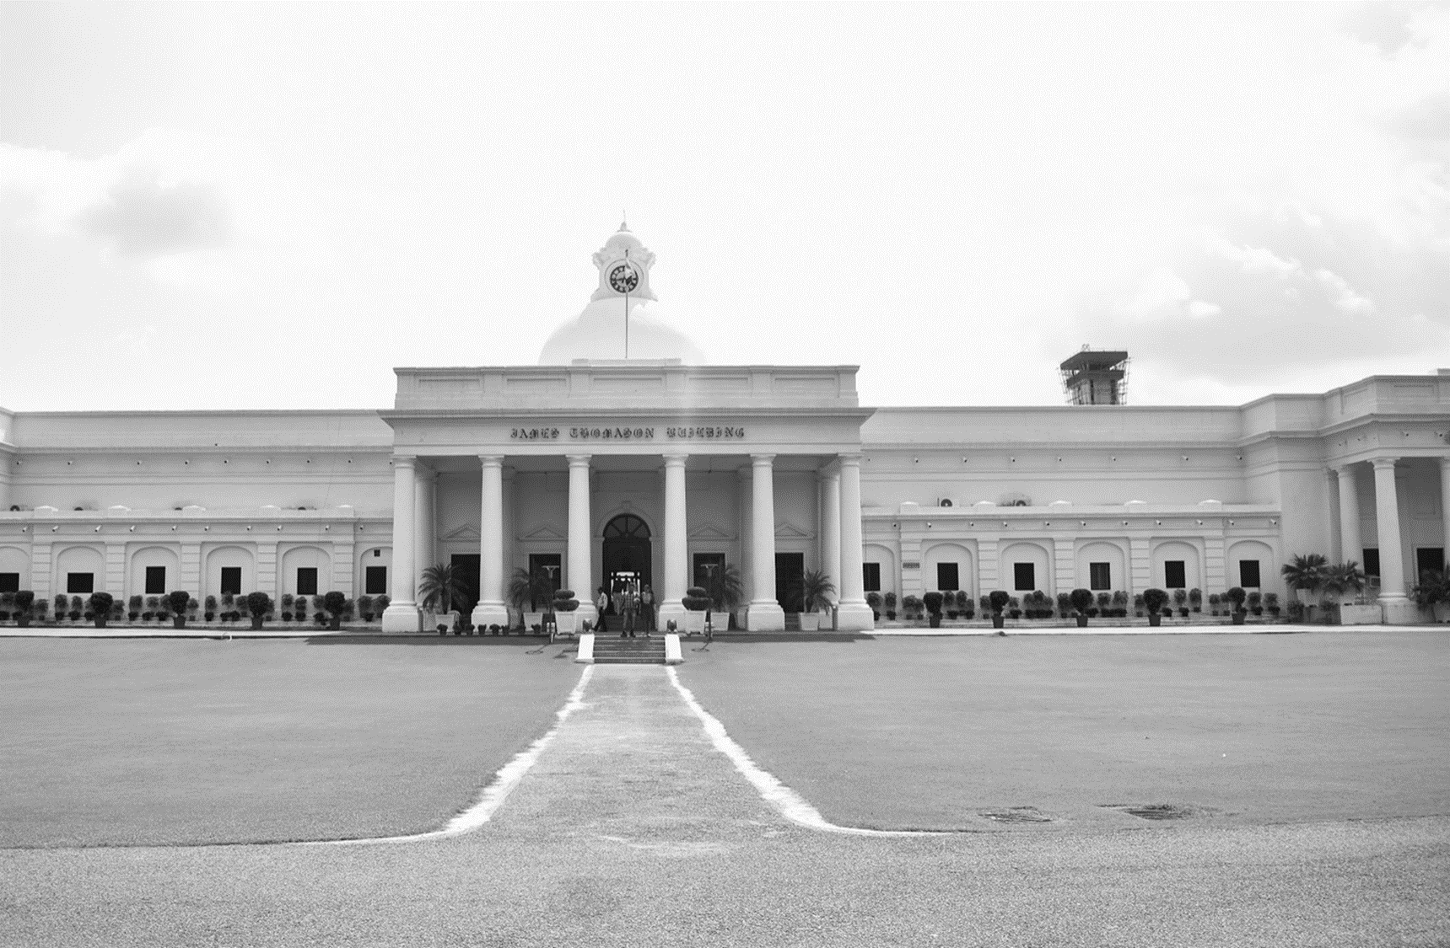



Thank You
Presenting Author:
Saurabh Choudhary
Master of Urban and Rural Planning
Infrastructure Planning Lab
Department of Architecture and Planning
Indian Institute of Technology Roorkee
saurabh_c@ar.iitr.ac.in

