Slide 1
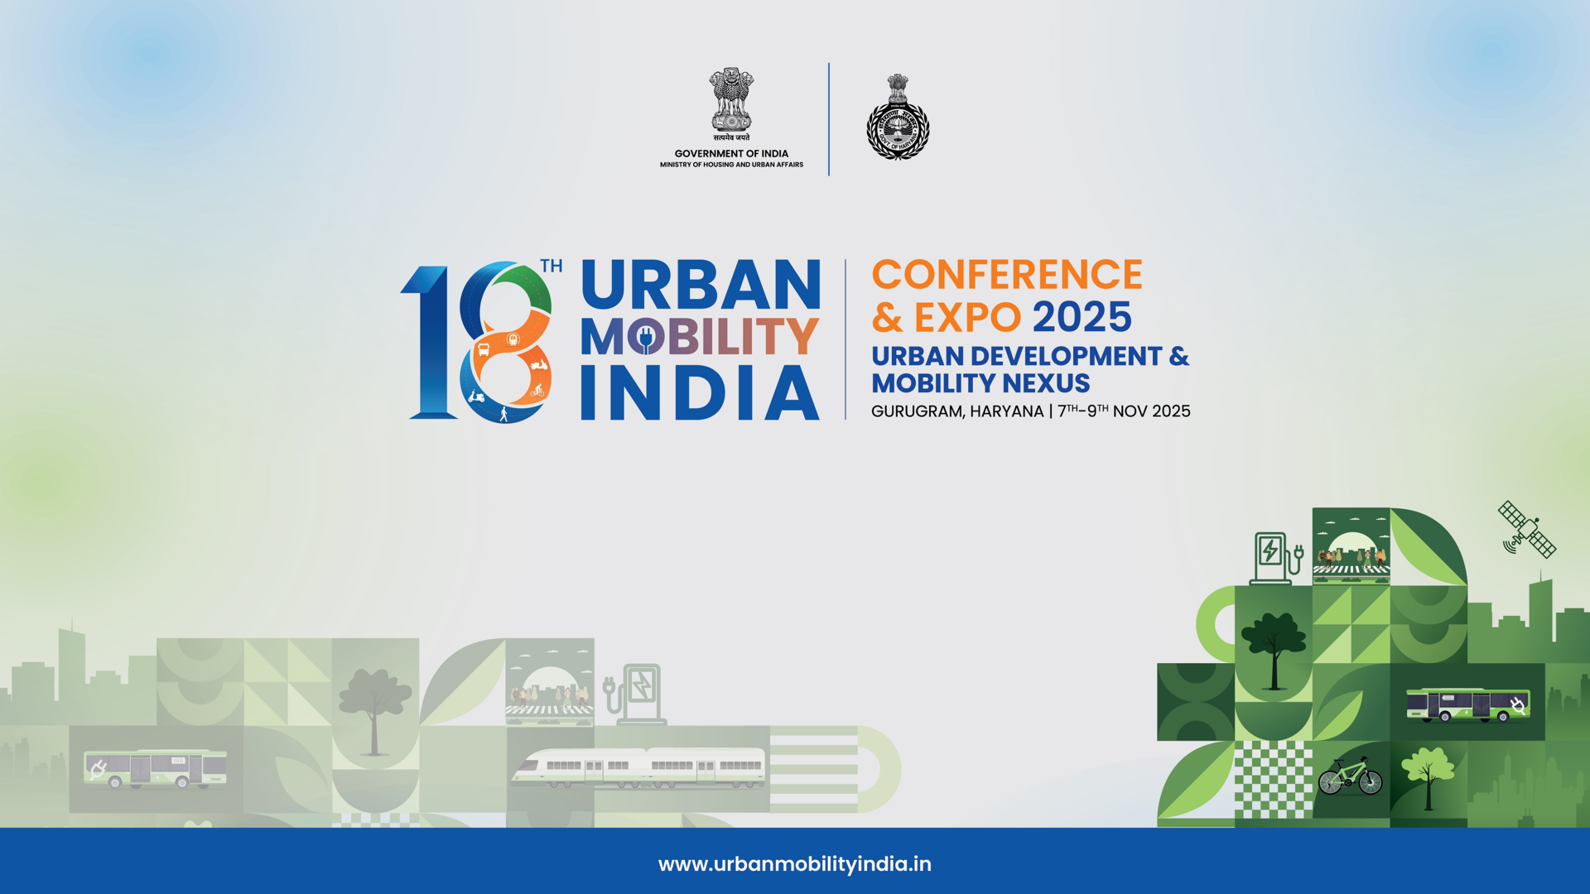

Slide 2
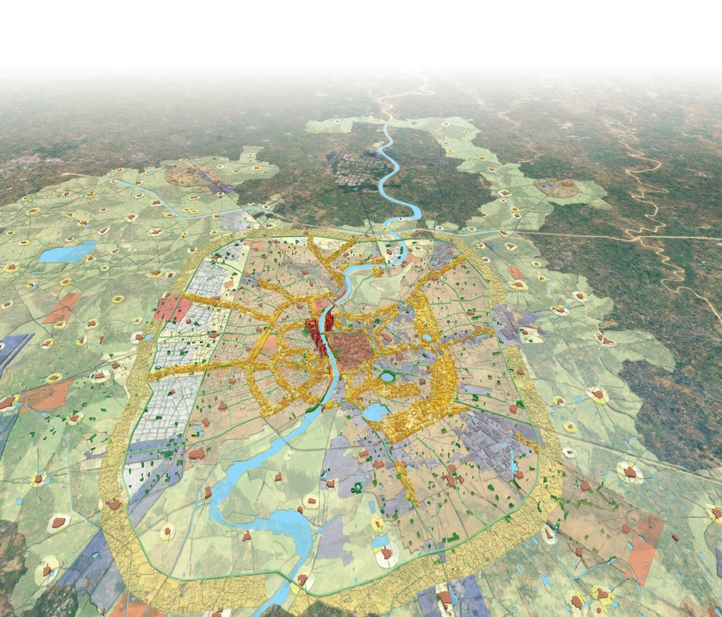
Planning TODs for Non-Farebox Revenue
Jignesh Mehta
Senior Adjunct Associate Professor & Program Chair, MUP, CEPT University
Member, High Level Committee, Govt of Gujarat
Director, HuE Design & Planning Studio

Slide 3
Contents
Development Patterns around Metro Stations
TOD & Non-Farebox Revenue in Indian Cities

Slide 4
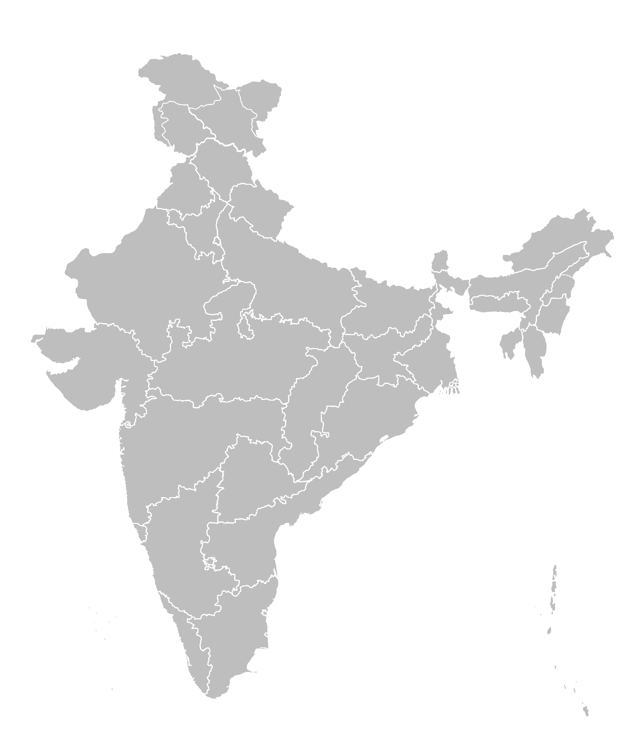
Cities included in this study and sampling strategy
These cities are classified into 3 categories based on the following parameters
# |  | City | State
Category 1
1 | City Population- >20 million Network Length- >100km Ridership/day- >10 Lakhs | Delhi NCR | Delhi NCR
Category 2
2 | City Population- 5-20 million Network Length- 30-100 km Ridership/day- 1.5-10 Lakhs | Mumbai | Maharashtra
3 |  | Hyderabad | Telangana
4 |  | Bangalore | Karnataka
5 |  | Chennai | Tamil Nadu
Category 3
6 | City Population- <5 million Network Length- <30 km Ridership/day- <1.5 Lakhs | Kochi | Kerala
7 |  | Jaipur | Rajasthan
8 |  | Lucknow | Uttar Pradesh
9 |  | Nagpur | Maharashtra
JAIPUR
DELHI
LUCKNOW
NAGPUR
MUMBAI
HYDERABAD
BANGALORE
CHENNAI
KOCHI

Slide 5
Development around Stations are the most crucial for both 1. Increased Ridership 2. Increased Revenue Generation
Based on study with IUT, GoG

Slide 6
Land Utilisation and Development Patterns in station areas based on On-ground Survey & GIS Analysis*
1 Land Utilization
2 Development Intensity
Built up – (Existing & Change from 10 years back (possibly due to Metro))
Gross FAR Consumed
3 Steet Network (Street Network Density, Block Size)
4 Walkability (Sidewalk Coverage)
*Based on study by HuE Design & Planning with IUT

Slide 7
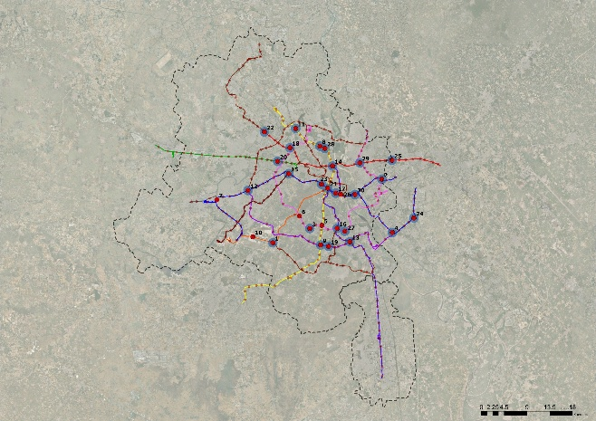
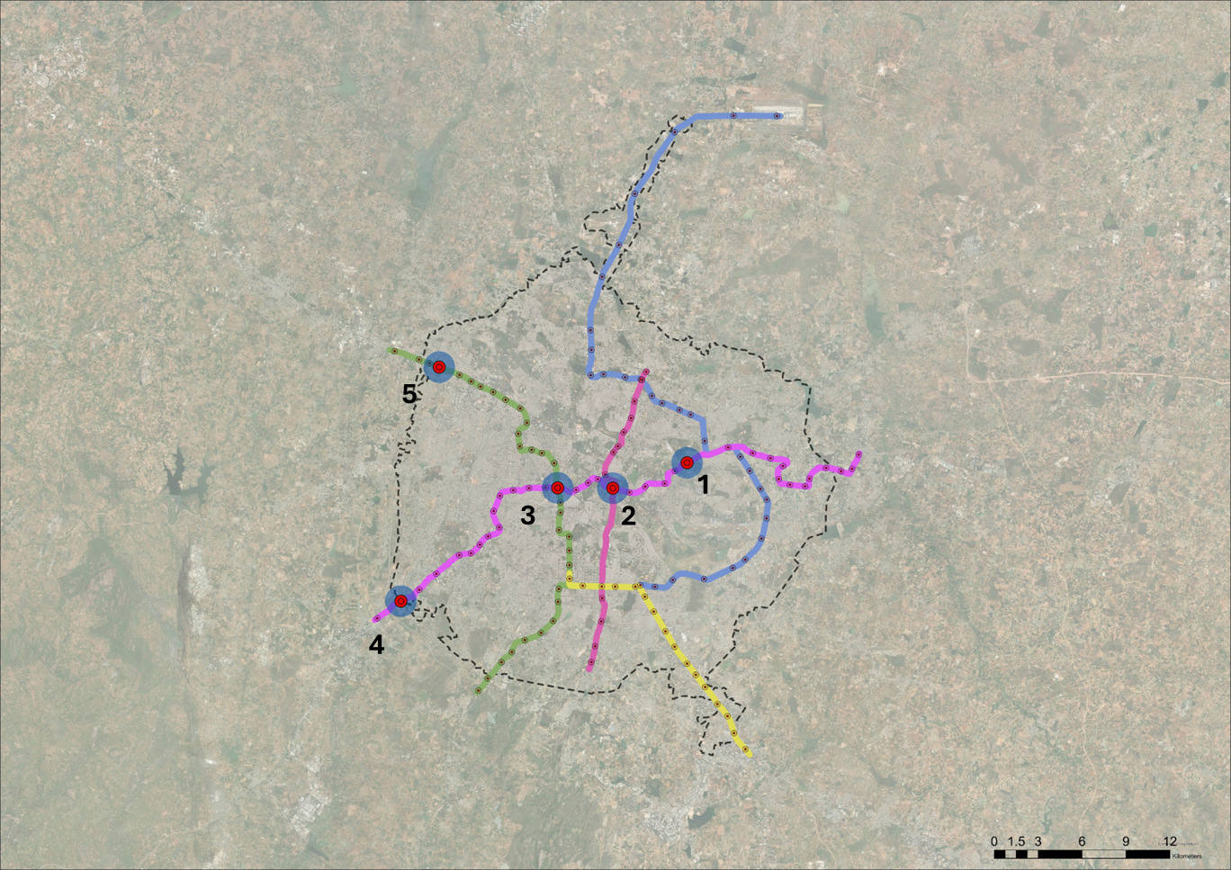
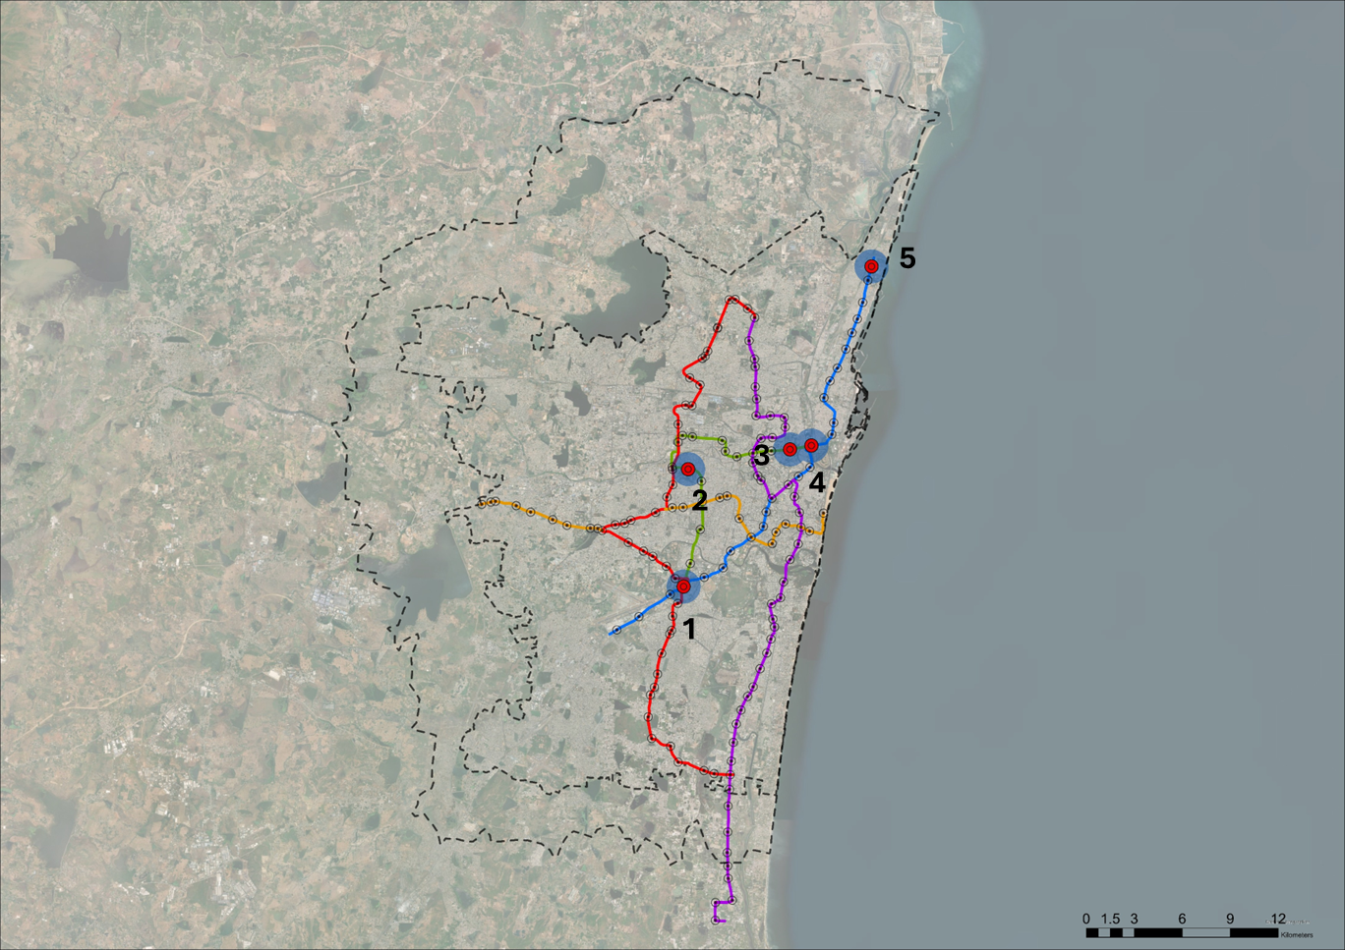
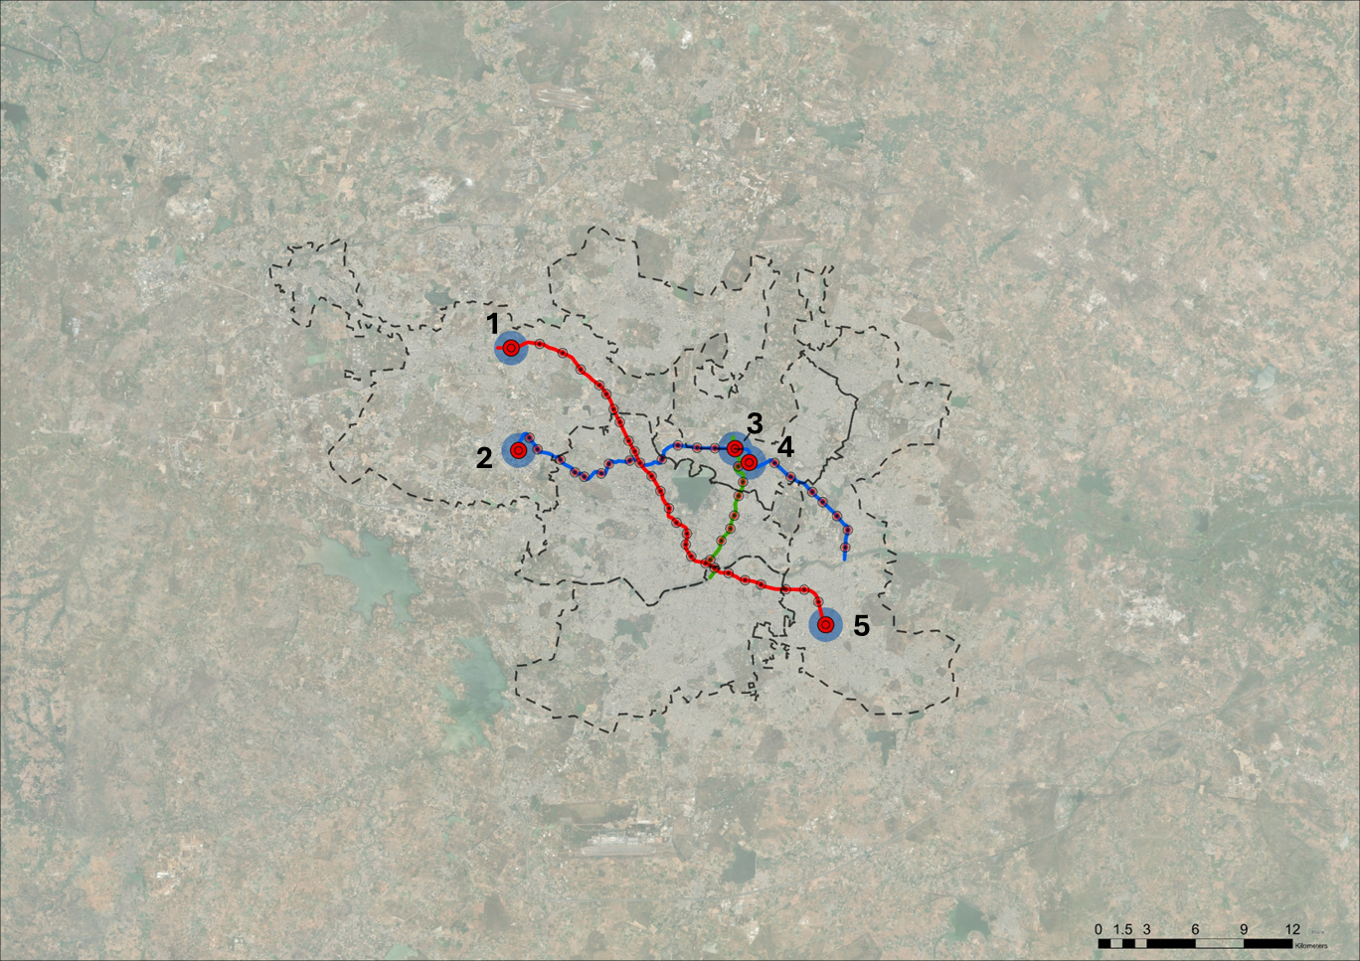
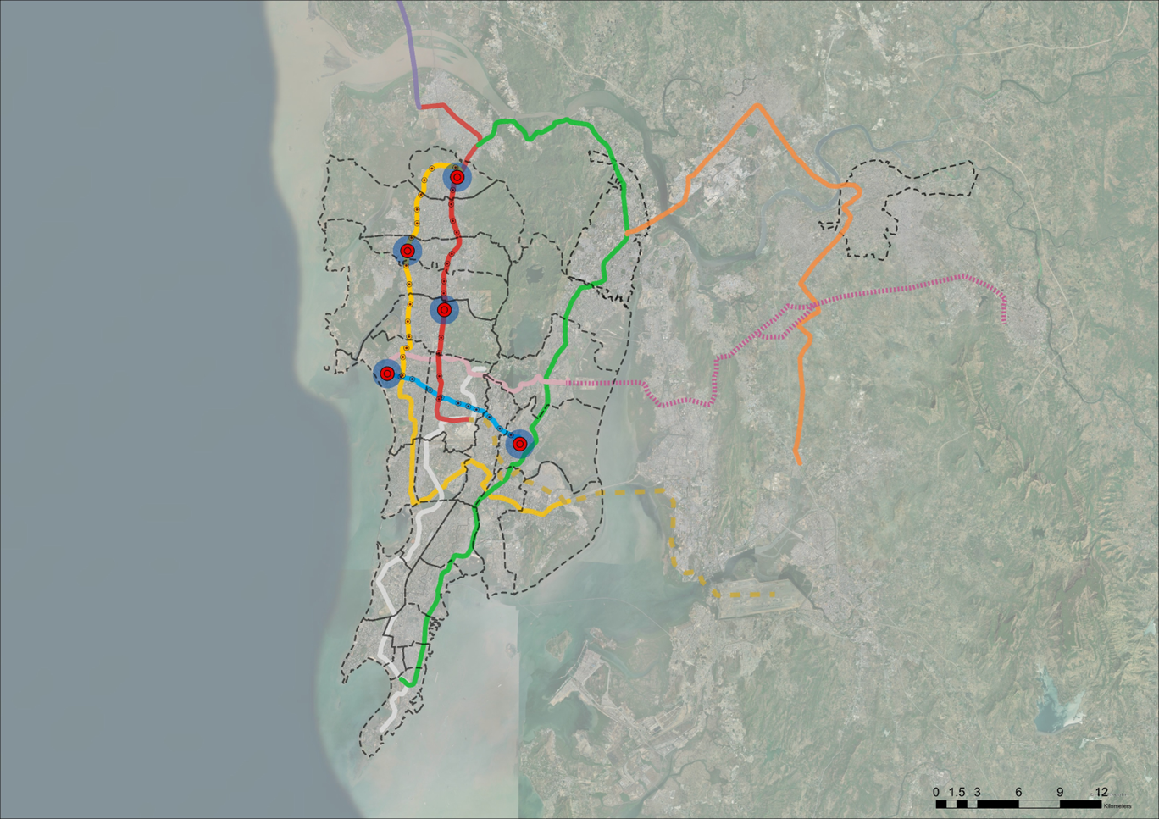
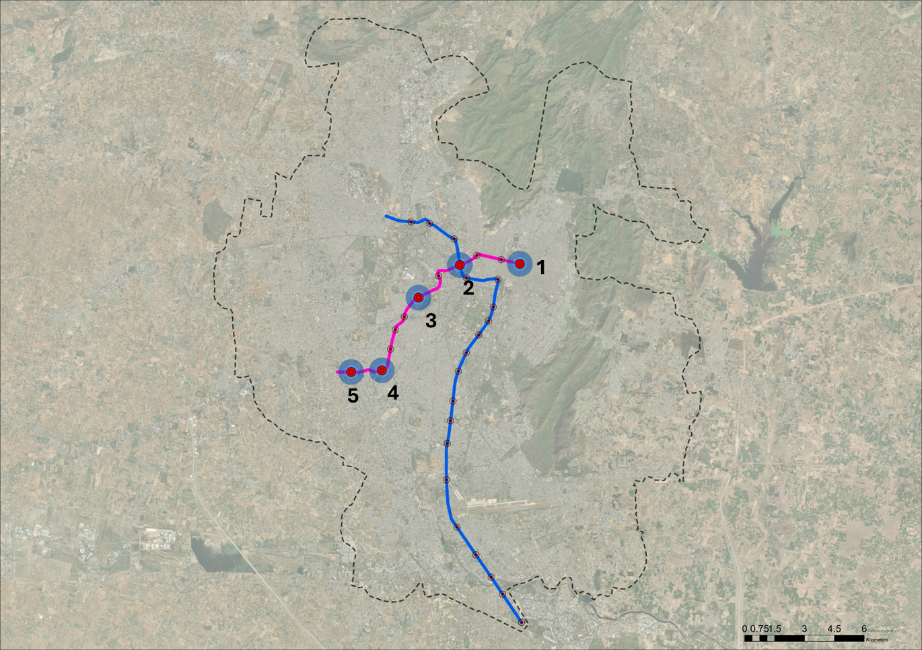
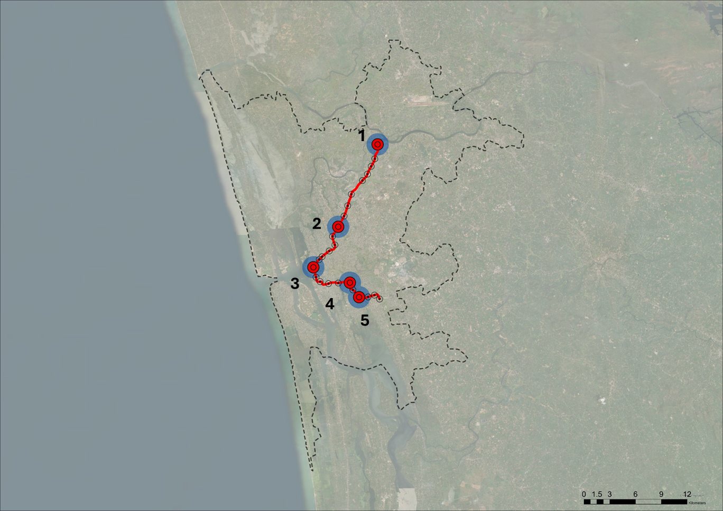
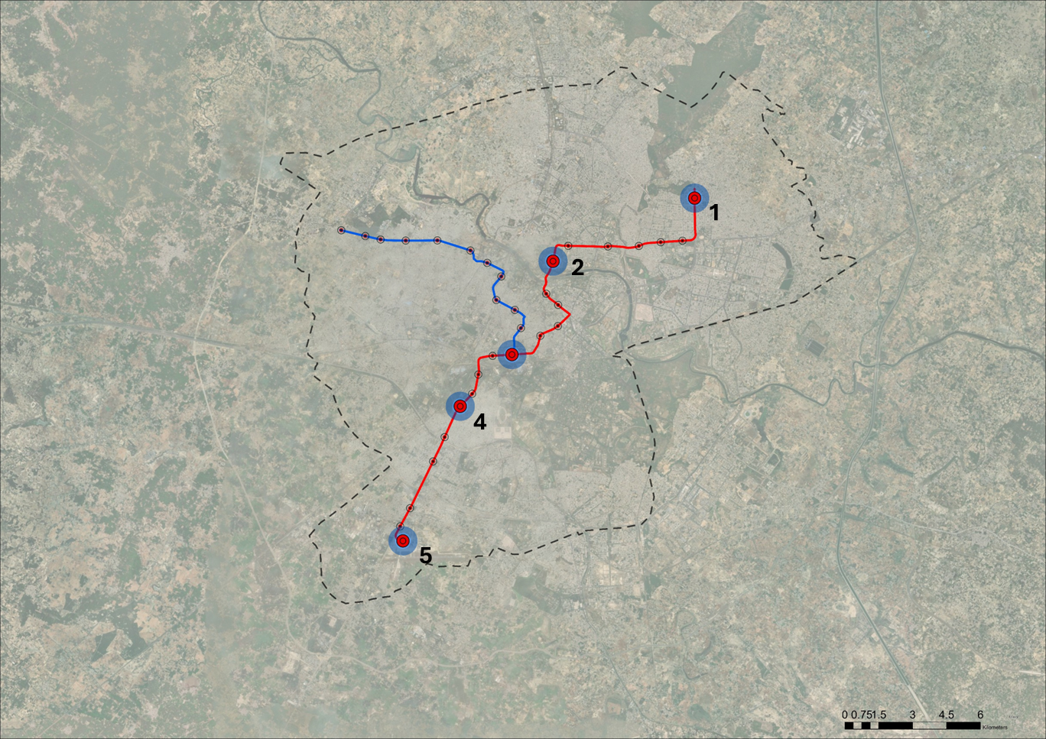
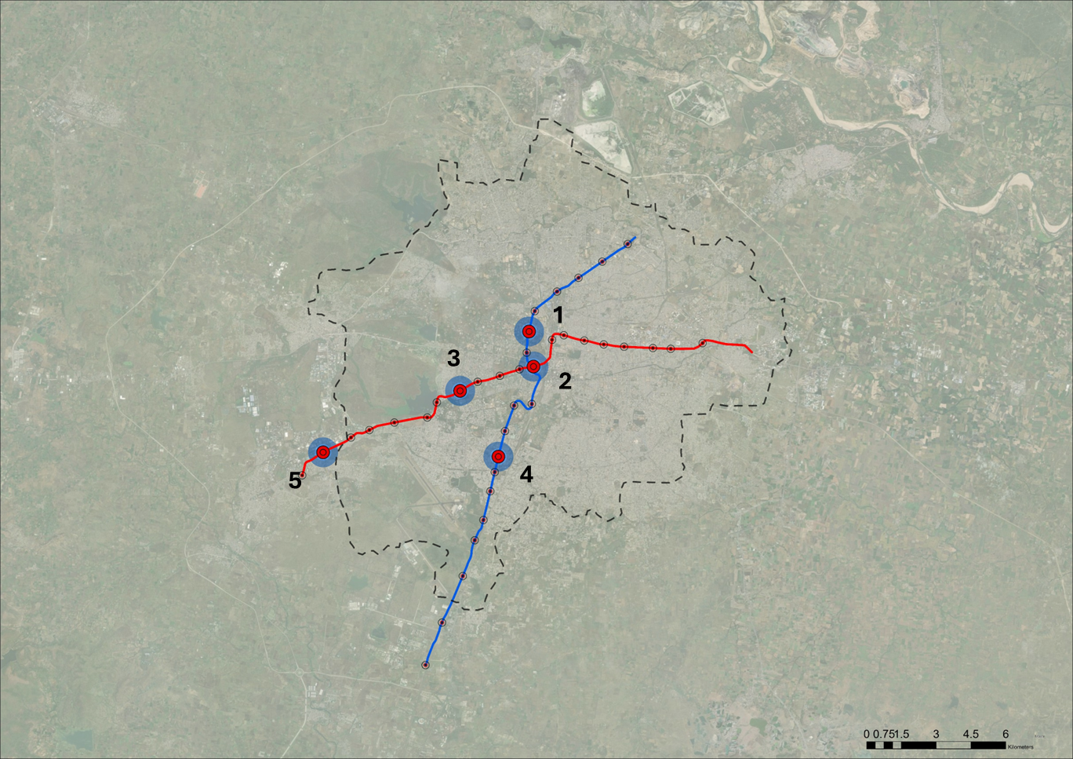

Delhi
Bangalore
Chennai
City | Operational Year | Operational length (as per Inception Report)
Delhi | 2002 | 412 km
Bangalore | 2011 | 56 km
Chennai | 2015 | 54.6 km
Hyderabad | 2017 | 151 km
Mumbai | 2014 | 46.5 km
Jaipur | 2015 | 38.3 km
Kochi | 2017 | 27.7 km
Lucknow | 2017 | 33.9 km
Nagpur | 2019 | 43.8 km
Hyderabad
Mumbai
Jaipur
Kochi
Lucknow
Nagpur
N

Slide 8
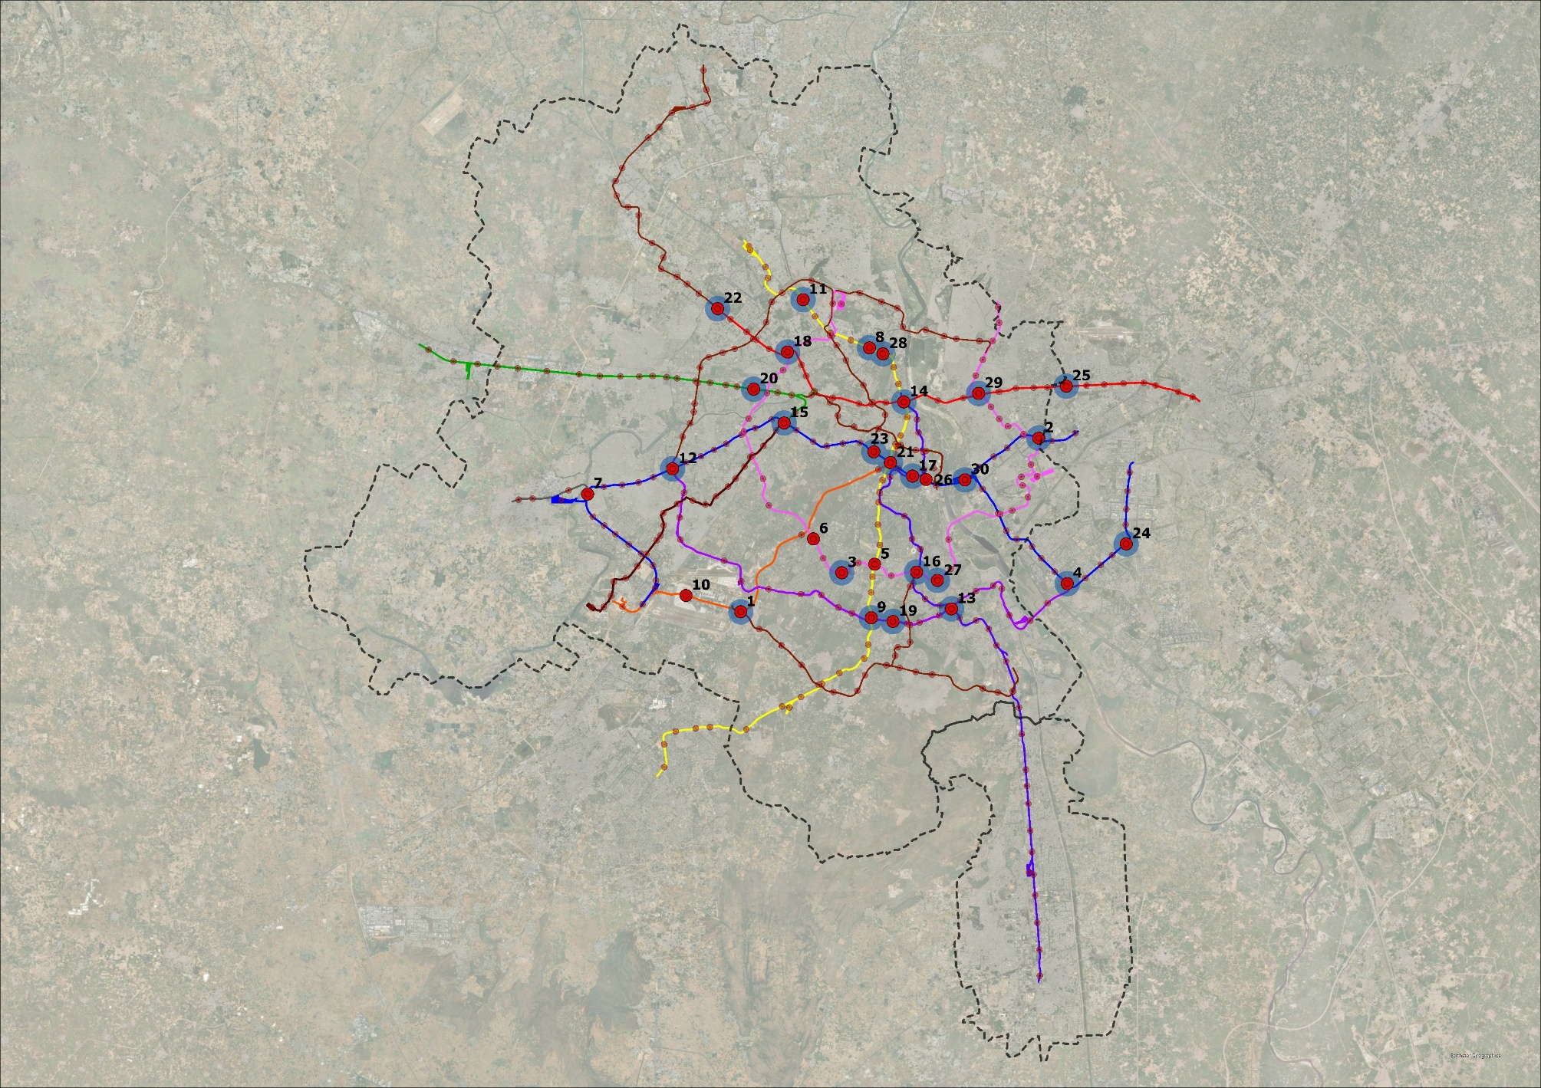
Landuse and Development Analysis (Delhi)
Delhi
Metro Stations For Assessment
Aerocity
Anand Vihar
Bhikaji Cama Palace
Botanical Garden
Delhi Haat
Durgabhai Deshmukh South Campus
Dwarka
Gtb Nagar
Hauz Khas
Jahangirpura
Janakipur West
Kalkaji Mandir
Kashmere Gate
Kirti Nagar
Lajpat Nagar
Mandi House
Nataji Subhash Palace
Panchsheel Park
Punjabi Bagh West
Rajiv Chowk
Rithala
Rk Ashram Marg
Sector 52 Noida
Shaheed Sthal New Bus Adda
Supreme Court
Terminal 1 Igi Aiport
Vinobapuri
Vishwavidhyalaya
Welcome
Yamuna Bank
CITY BOUNDARY
SELECTED METRO STATIONS
METRO STATIONS

Slide 9
Landuse and Development Analysis (Delhi)
Delhi
Metro Stations For Assessment
Aerocity
Anand Vihar
Bhikaji Cama Palace
Botanical Garden
Delhi Haat
Durgabhai Deshmukh South Campus
Dwarka
Gtb Nagar
Hauz Khas
Jahangirpura
Janakipur West
Kalkaji Mandir
Kashmere Gate
Kirti Nagar
Lajpat Nagar
Mandi House
Nataji Subhash Palace
Panchsheel Park
Punjabi Bagh West
Rajiv Chowk
Rithala
Rk Ashram Marg
Sector 52 Noida
Shaheed Sthal New Bus Adda
Supreme Court
Terminal 1 Igi Aiport
Vinobapuri
Vishwavidhyalaya
Welcome
Yamuna Bank
CITY BOUNDARY
SELECTED METRO STATIONS
METRO STATIONS

Slide 10
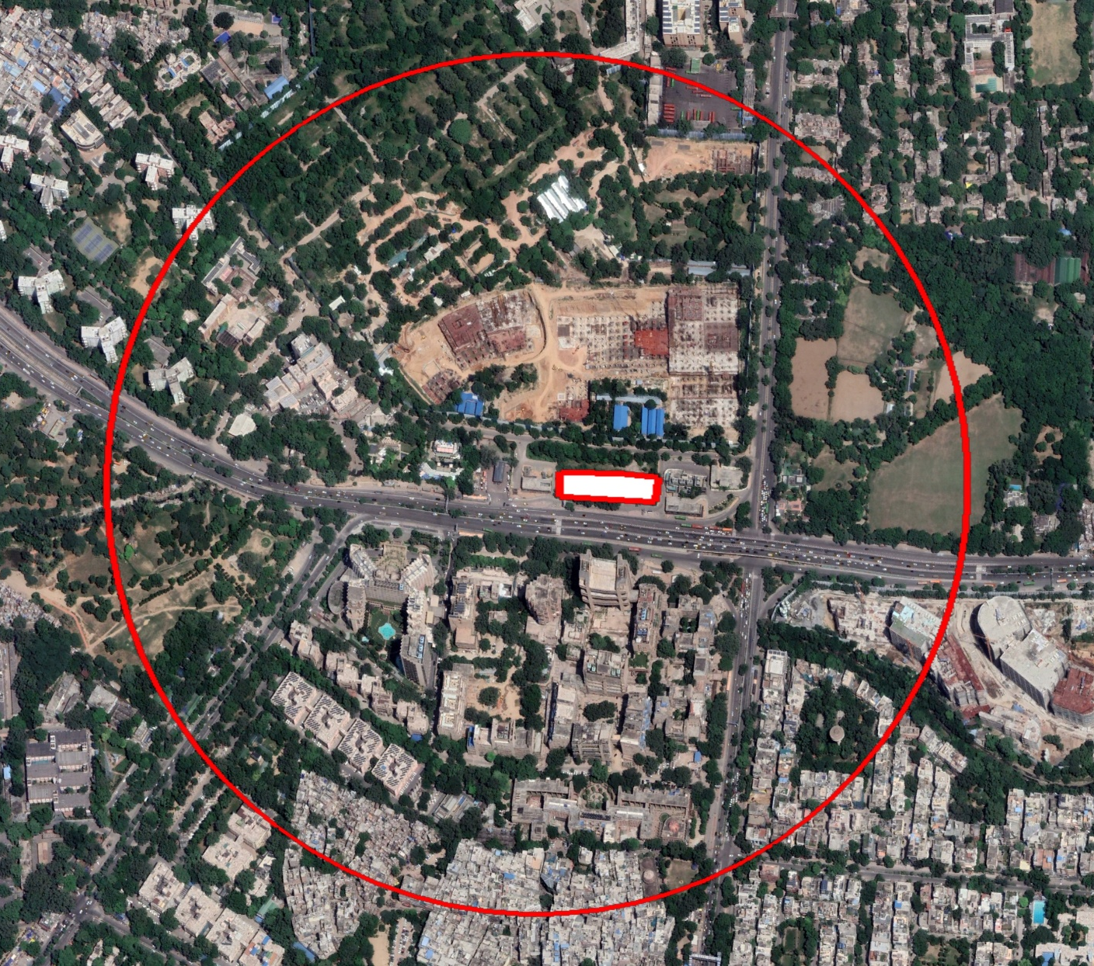
Landuse utilization maps (2023) around Metro stations (DELHI)
Bhikaji Cama Place Metro Station

Slide 11
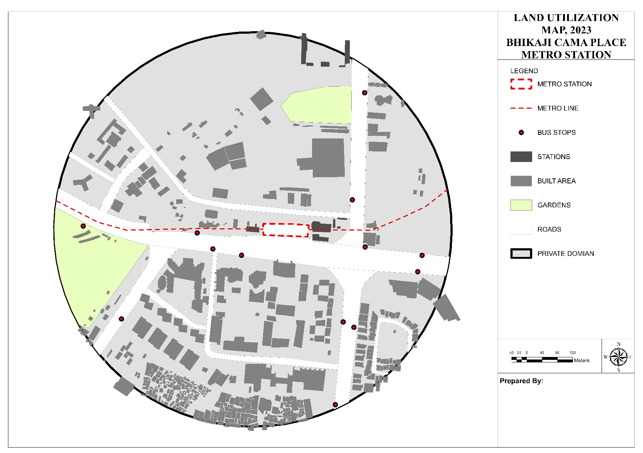
Landuse utilization maps (2023) around Metro stations (DELHI)
Bhikaji Cama Place Metro Station
METRO STATION
BUS STOPS
METRO LINE
BUILDING FOOTPRINTS
STATIONS
PUBLIC STREETS
PRIVATE OPEN SPACE
Observations:
Highest amount land (60%) in Private Open Space
Only 18.6% land under buildings
Only 16% land in public streets

Slide 12

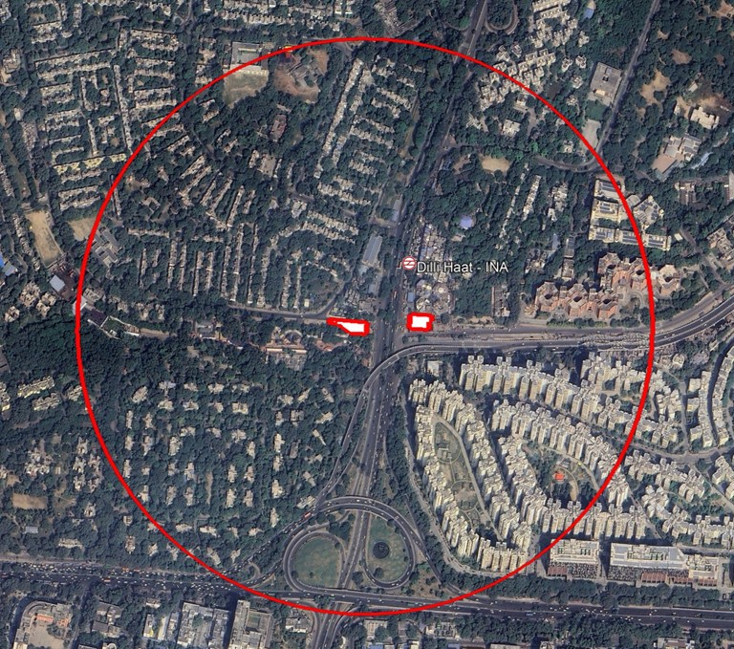
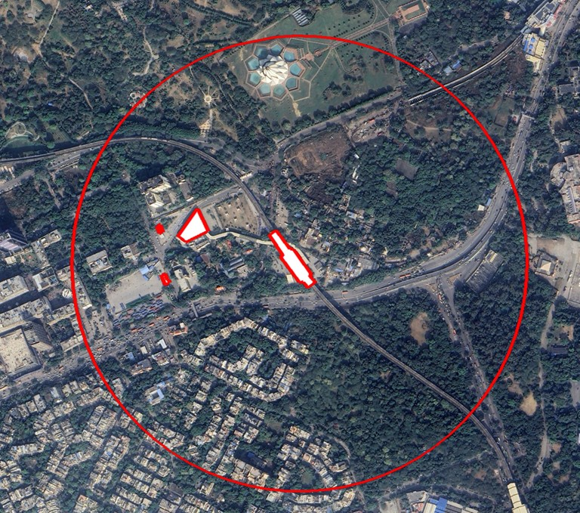
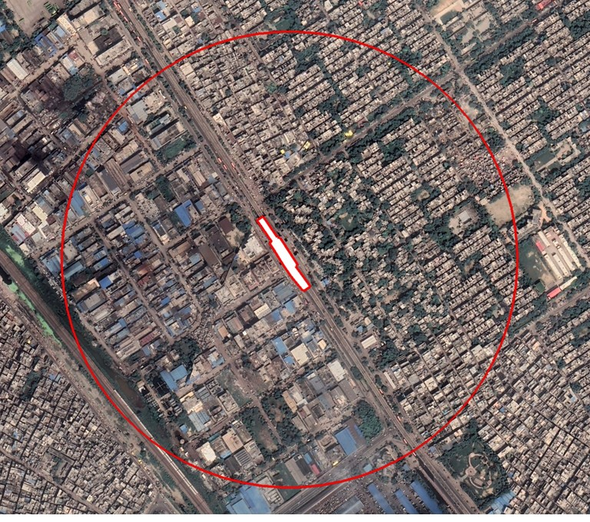
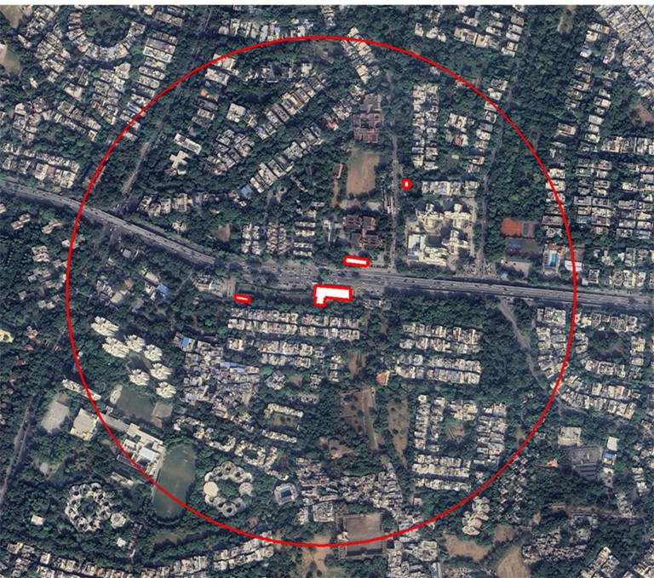
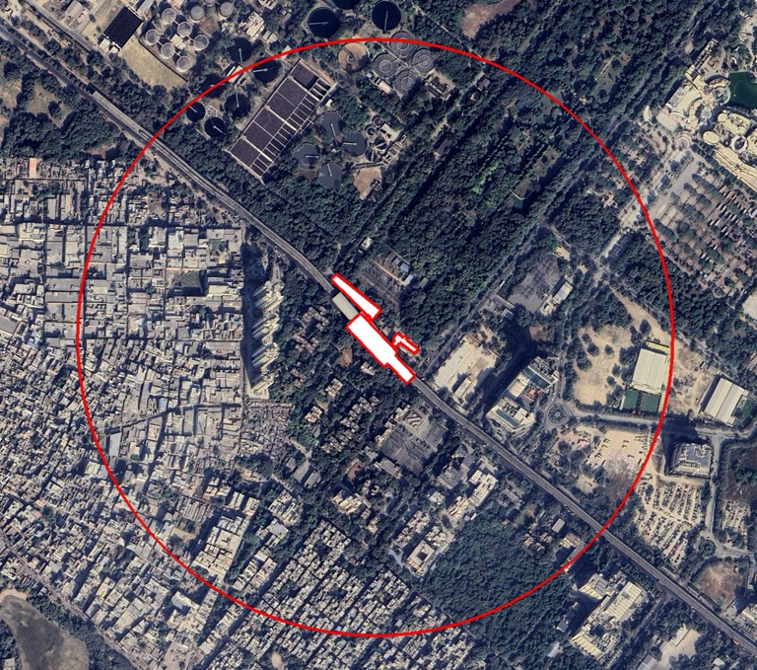
Satellite imagery for selected station areas in Delhi
Bhikaji cama palace
Delhi Haat INA
Kalkaji Mandir
Jahangirpuri
Hauz Khas
Rithala

Slide 13
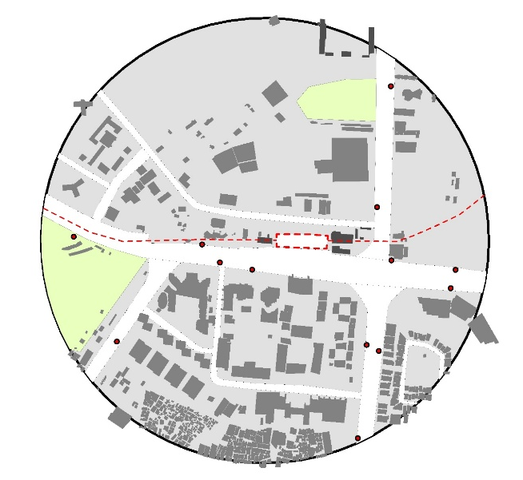
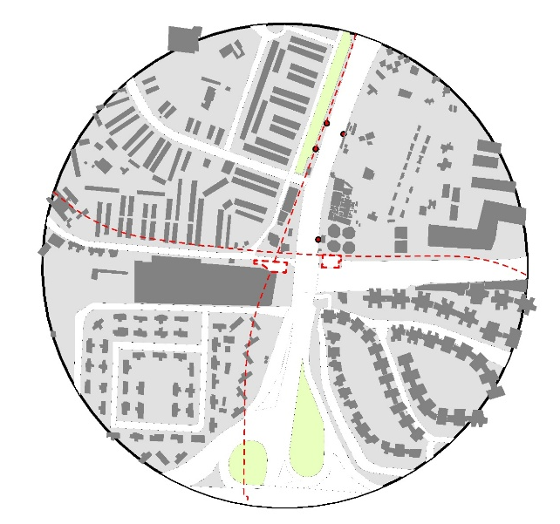
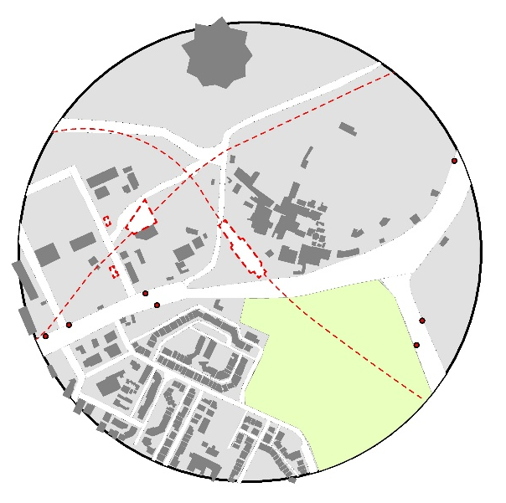
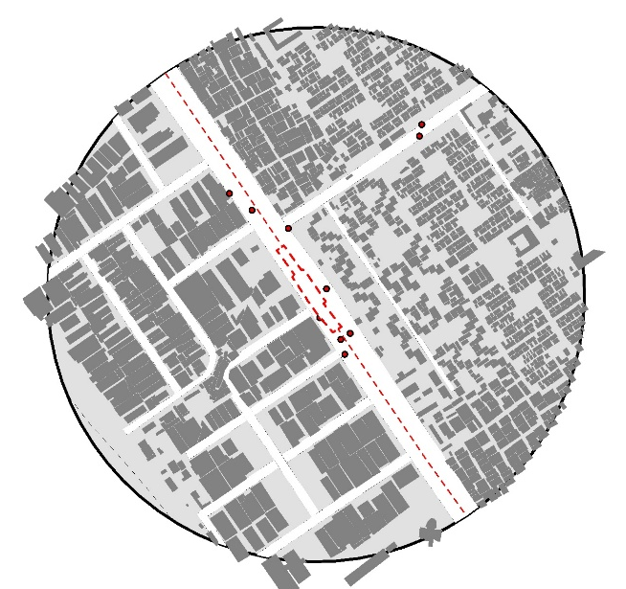
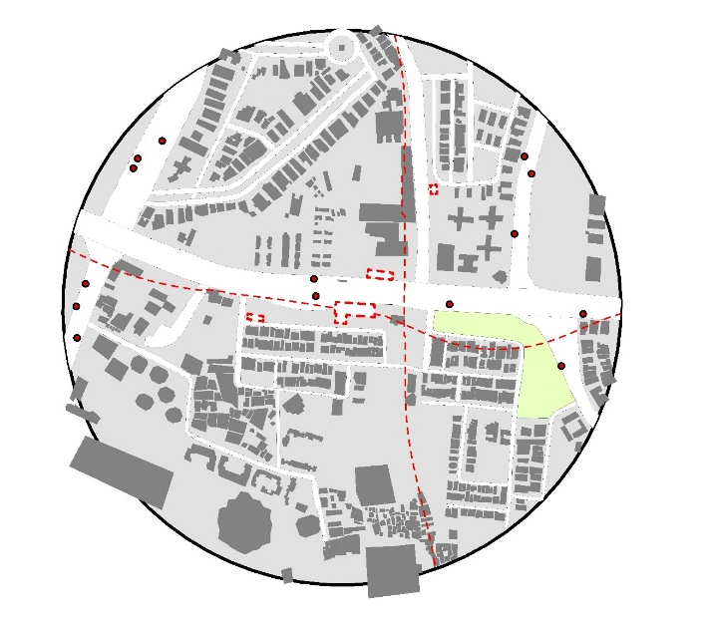
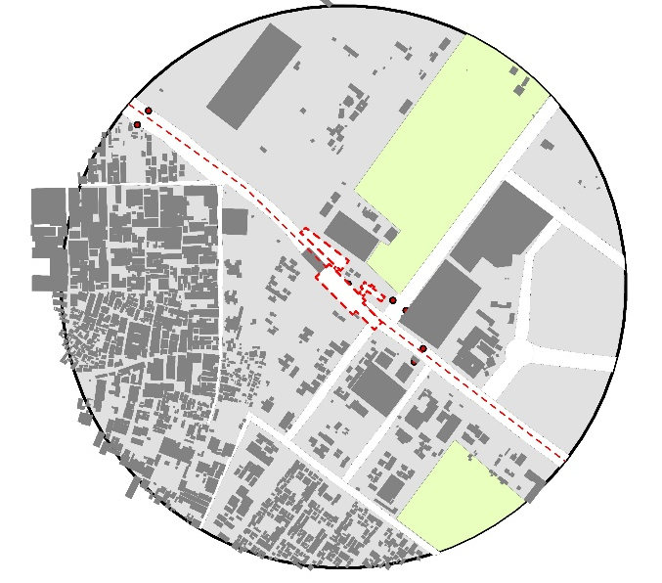
Land Utilisation in selected station areas in Delhi
The land utilisation in 30 selected station areas of Delhi has been assessed, the figures below, illustrate six of them.
Bhikaji Cama Place
Delhi Haat INA
Kalkaji Mandir
Jahangirpuri
Hauz Khas
Rithala

Slide 14
Landuse and Development Analysis (Delhi)

Slide 15
Landuse and Development Analysis (Delhi)
Observations:
Highest amount land (56%) in Private Open Space (which is often cut-up in small slivers as setbacks, and remains underutilized under temporary structures, parking, or storage of unused vehicles & equipmens).
Only 23% land under buildings
Only 16% land in public streets
Only 5% land under Public Green Spaces

Slide 16
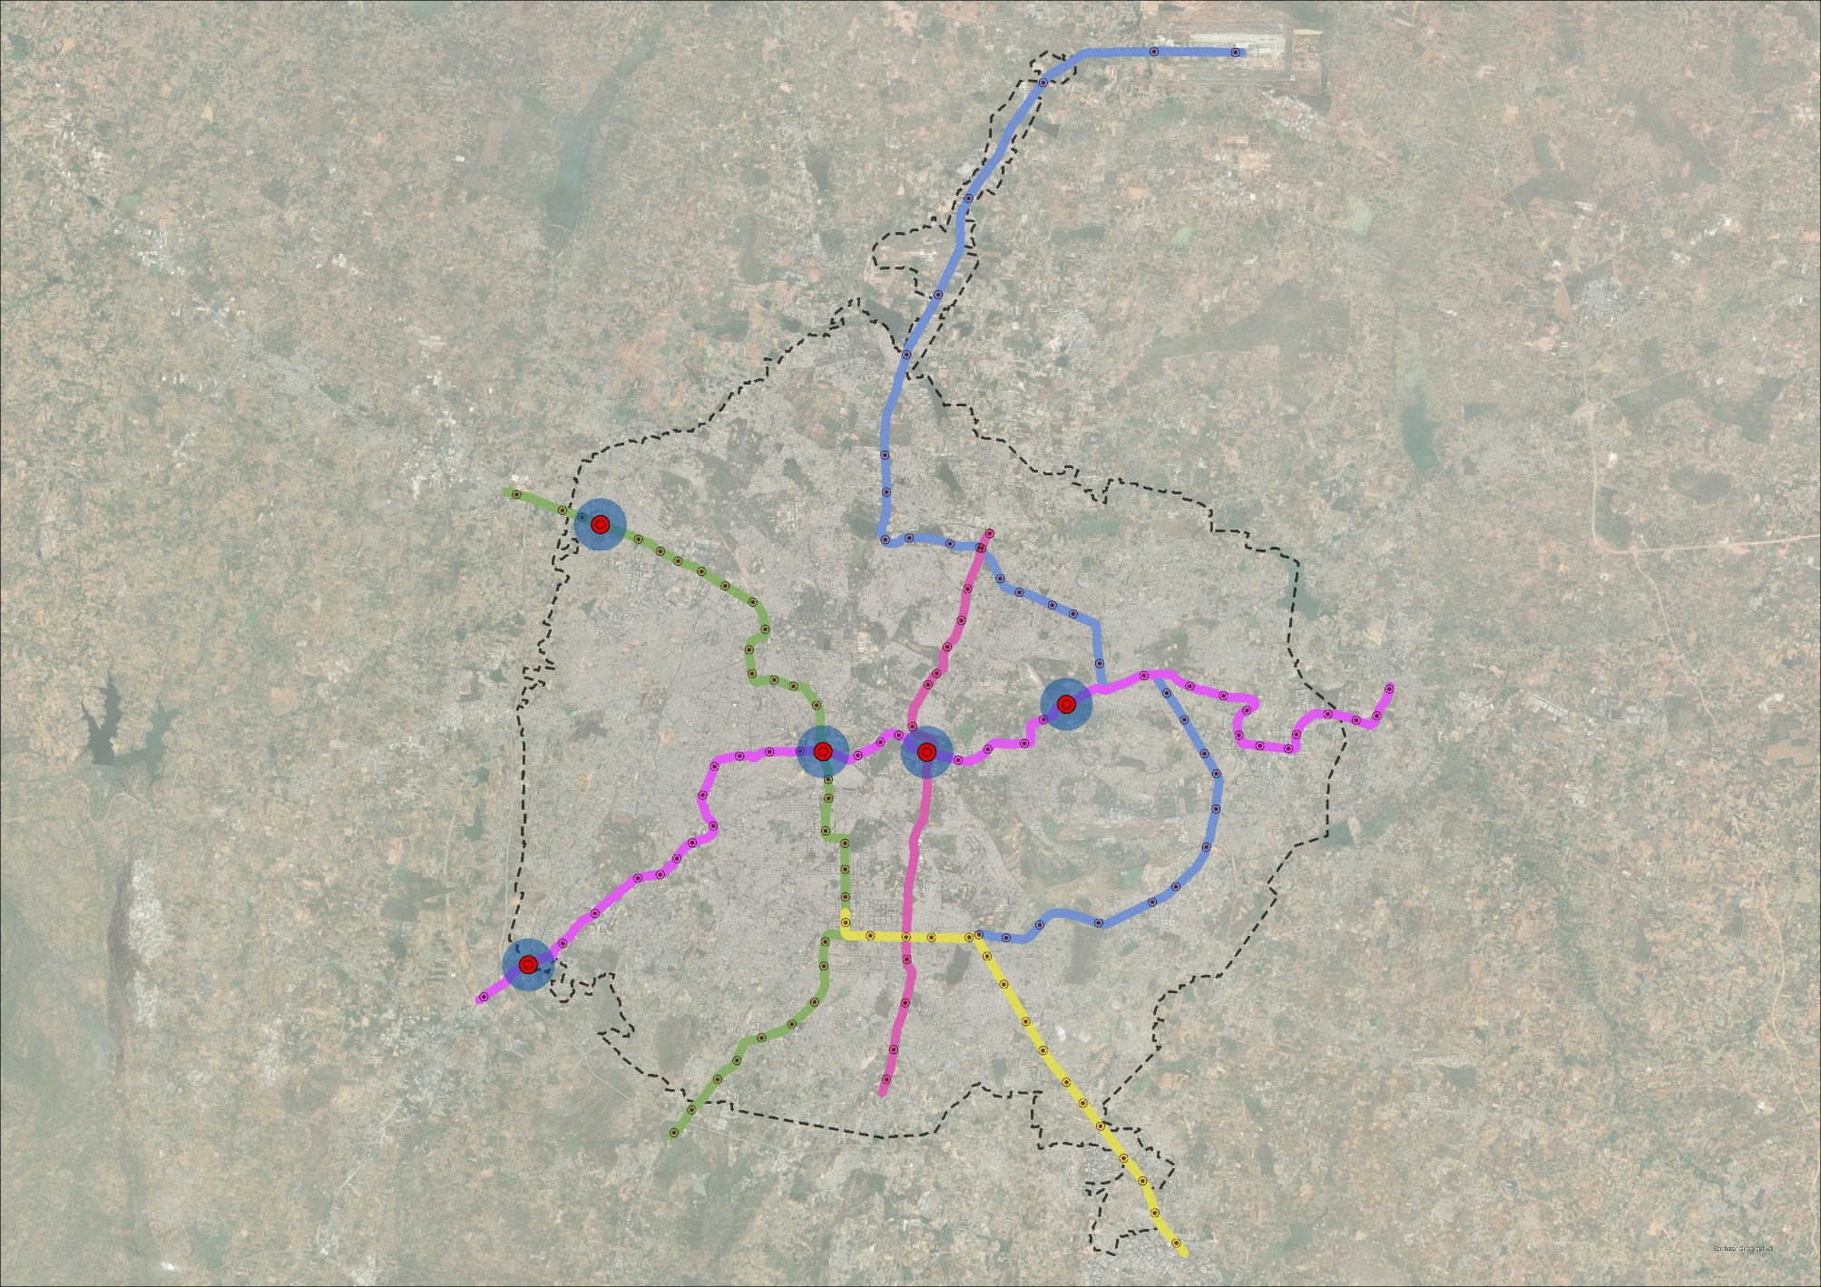
Landuse and Development Analysis (Bangalore)
Bangalore
Metro Stations For Assessment
Baiyappanahalli
MG Road
Kempegowda Majestic
Kengeri
Nagasandra
5
1
3
2
4
CITY BOUNDARY
SELECTED METRO STATIONS
METRO STATIONS

Slide 17
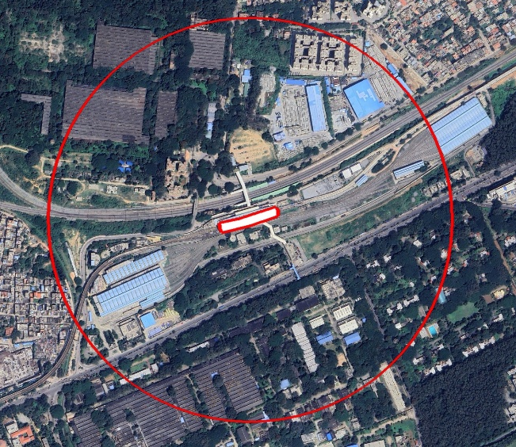
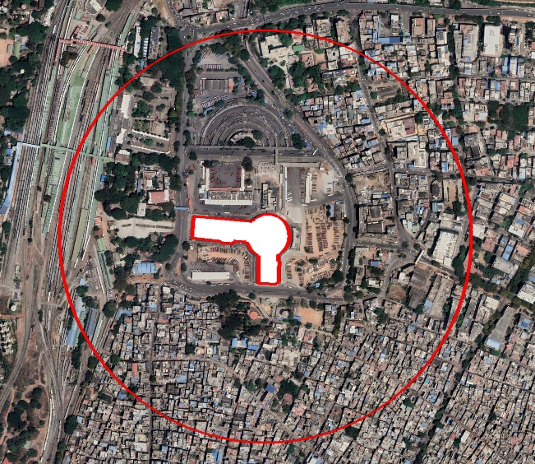
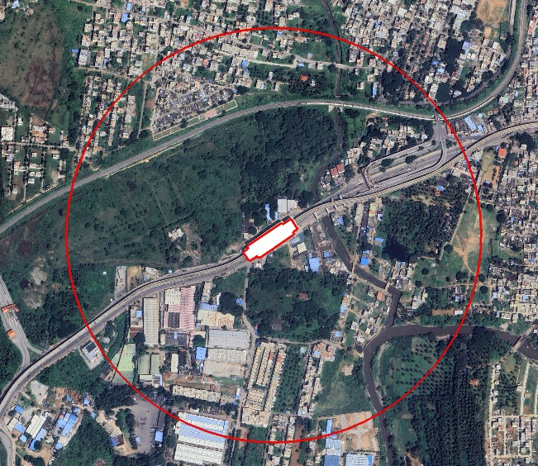
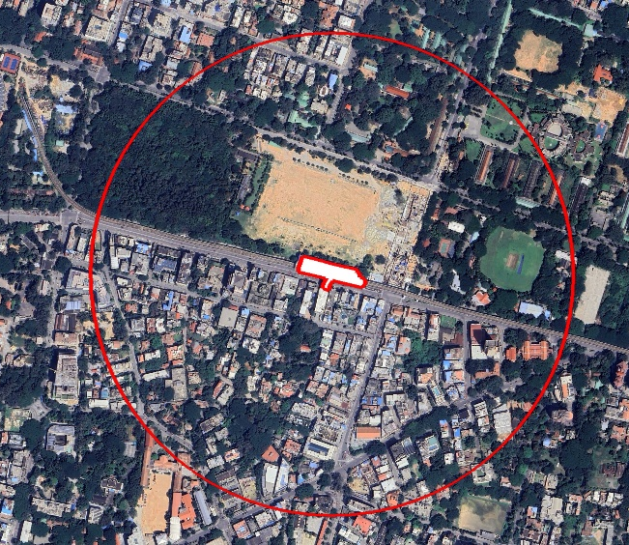
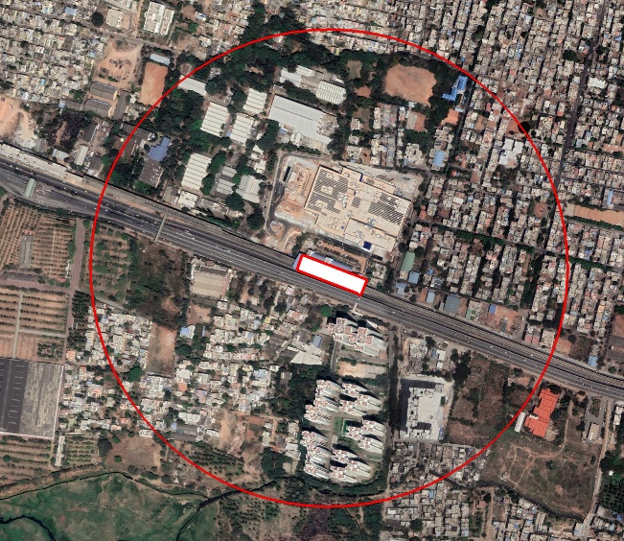
Satellite imagery for selected station areas in Bangalore
Baiyapanahalli
Kempogowda Magestic
Kengeri
MG Road
Nagasandra

Slide 18
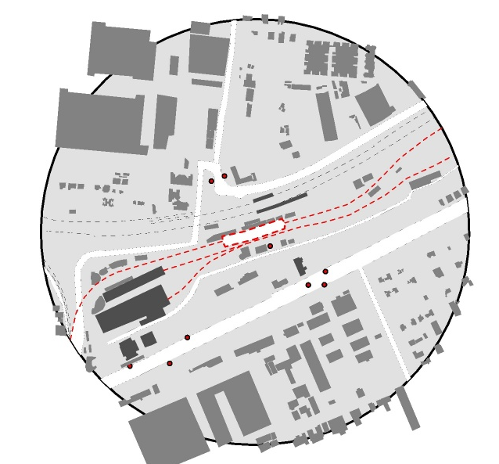
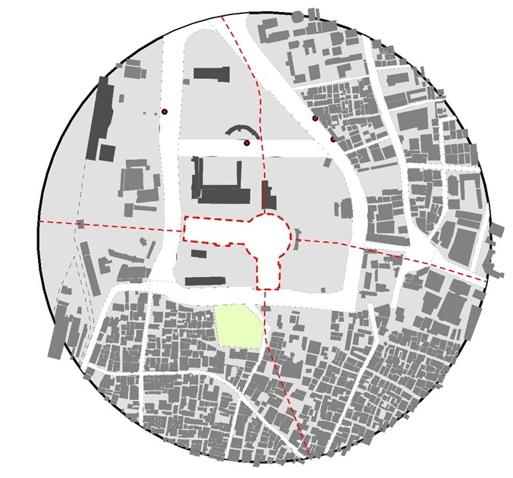
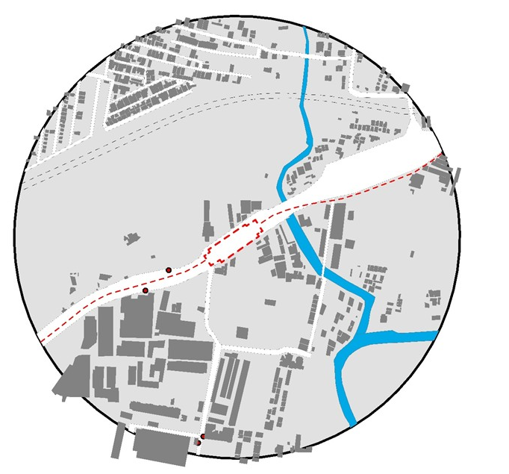
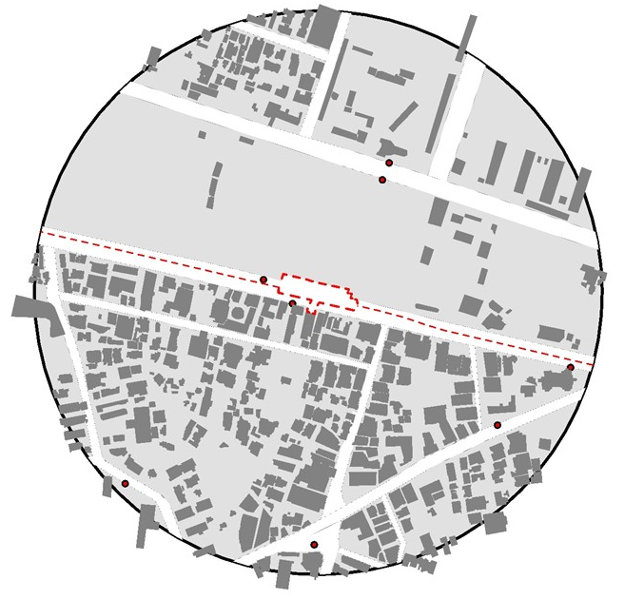
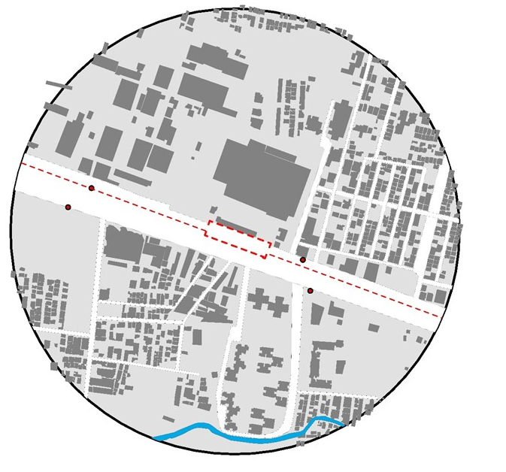
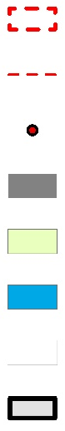
Land Utilisation in selected station areas in Bangalore
Baiyapanahalli
Kempogowda Magestic
Kengeri
METRO STATION
METRO LINE
BUS STOPS
BUILDING FOOTPRINTS
PUBLIC OPEN SPACE
WATERBODY
PUBLIC STREETS
MG Road
Nagasandra
PRIVATE OPEN SPACE

Slide 19
Landuse and Development Analysis (Bangalore)
Observations:
Highest amount land (60%) in Private Open Space (which is often cut-up in small slivers as setbacks, and remains underutilized under temporary structures, parking, or storage of unused vehicles & equipmens).
Only 27% land under buildings
Only 13% land in public streets
Less than 1% land under Public Green Spaces

Slide 20
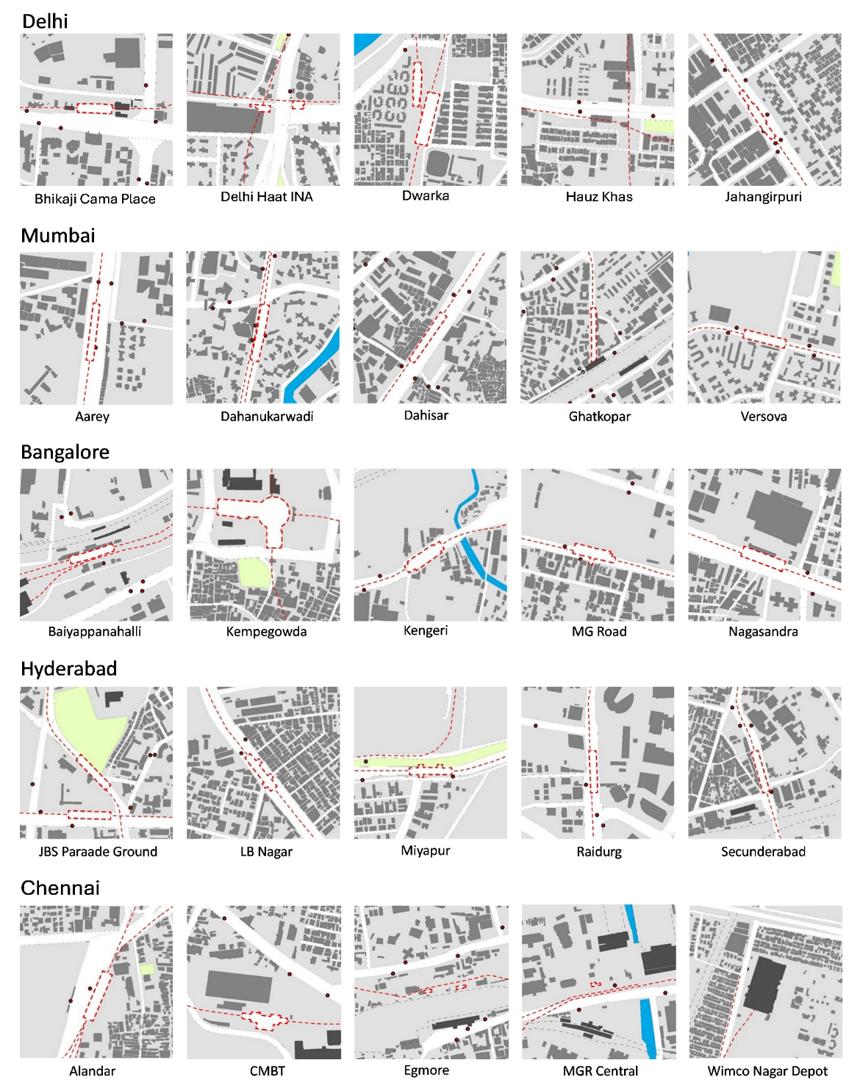
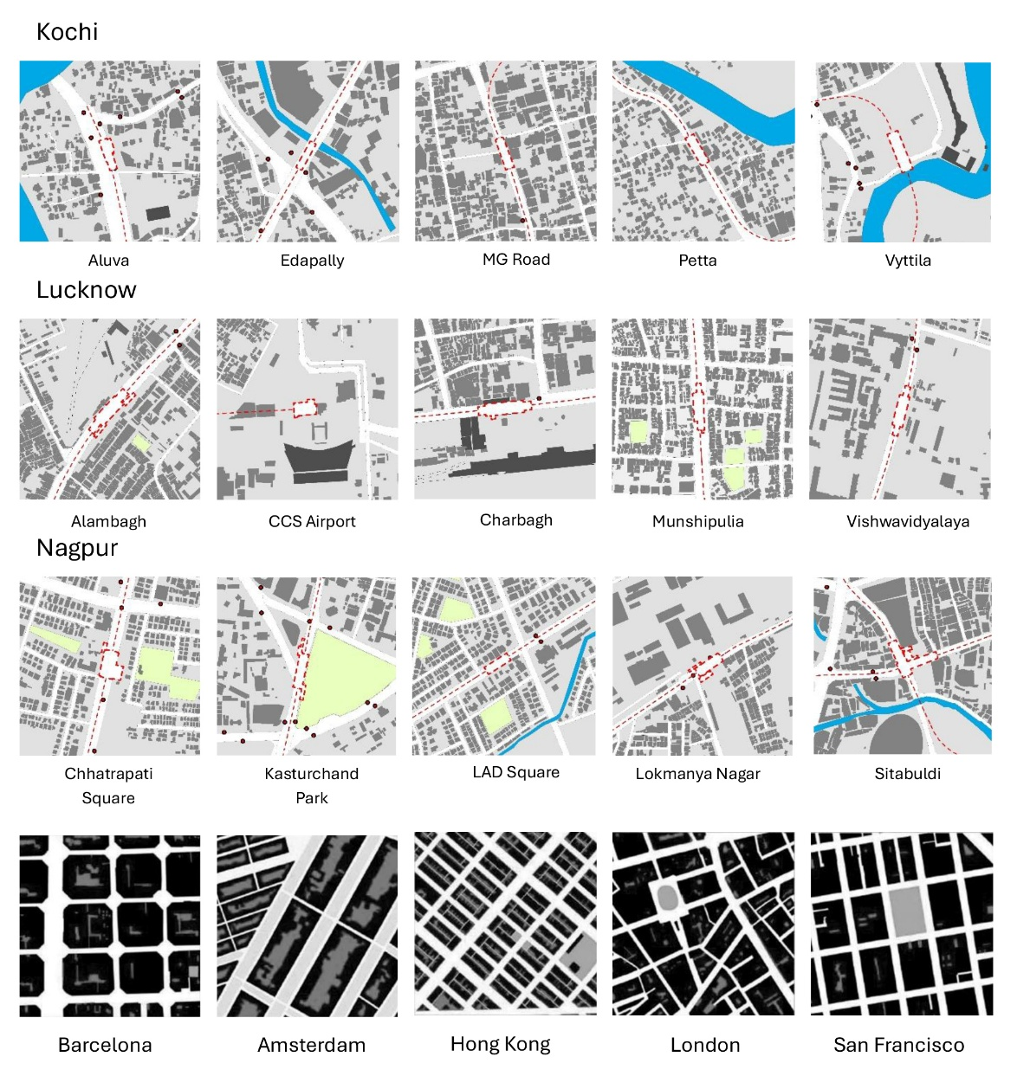
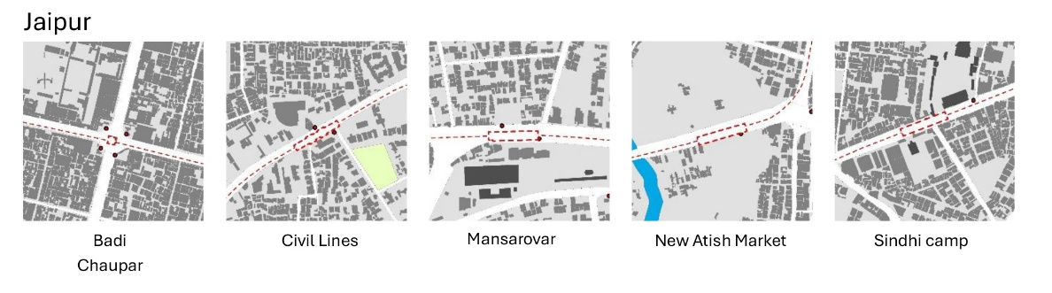
Comparative assessment of Land Utilization in the 9 Indian cities and Global Case studies
Kochi

Slide 21
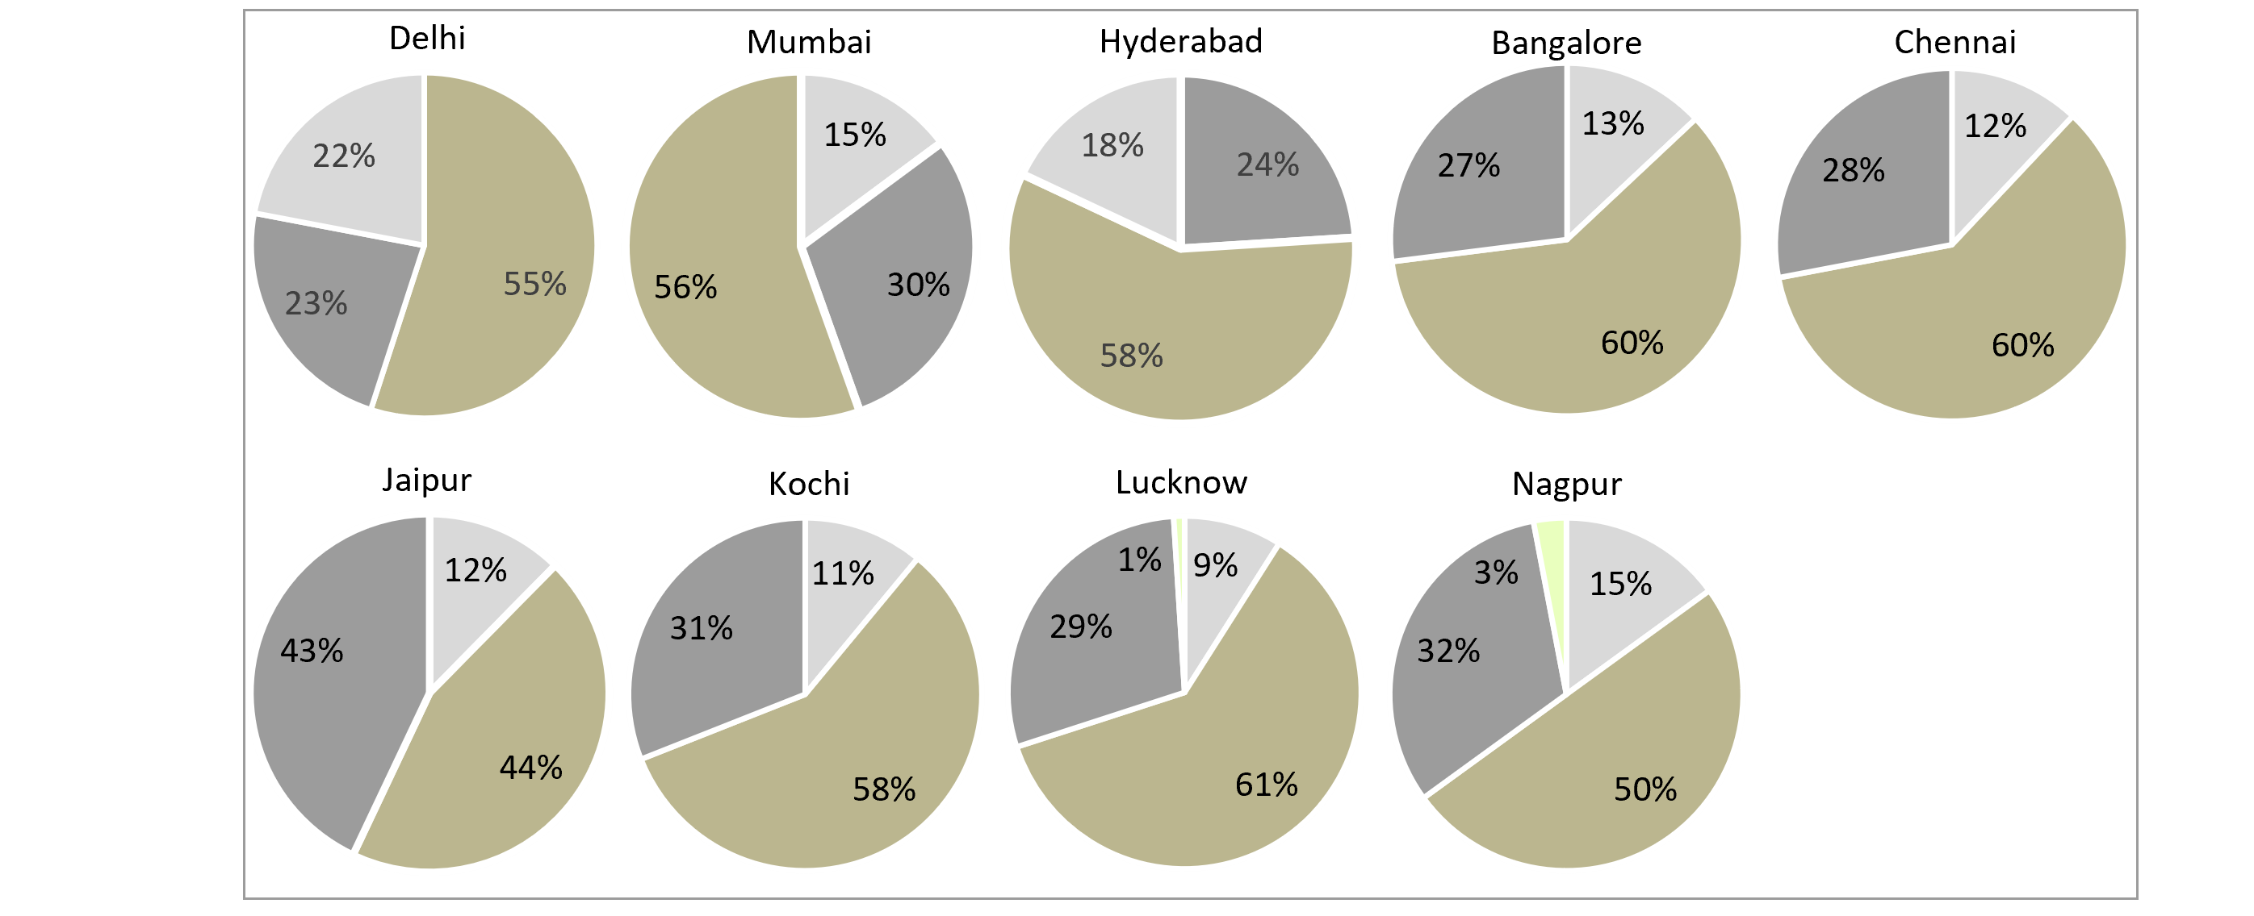
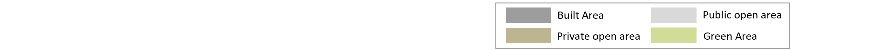
Comparative assessment of Land Utilization around station areas in selected Indian cities
Land Utilization for Indian study Cities
Observations:
In the station areas studied in the 9 cities, on average
Only 14% land in public domain (streets & green spaces)
Only 30% land under buildings
Highest amount land (56%) in Private Open Space which is often cut-up in small slivers as setbacks, and remains underutilized under temporary structures, parking, or storage of unused vehicles & equipments.
The stations in Lucknow has the highest amount land (61%) under private open spaces, and lowest proportion of land (9%) under Streets & Public Open Spaces
Delhi has lowest proportion of land under built area at 23%, whereas Jaipur has highest proportion of land under built area at 43%

Slide 22
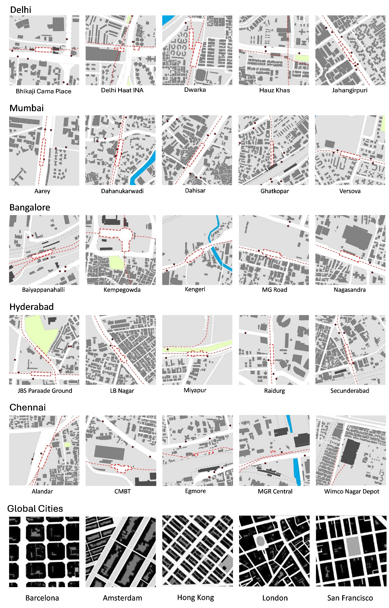
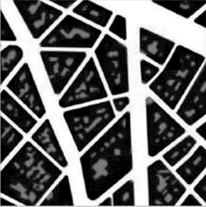
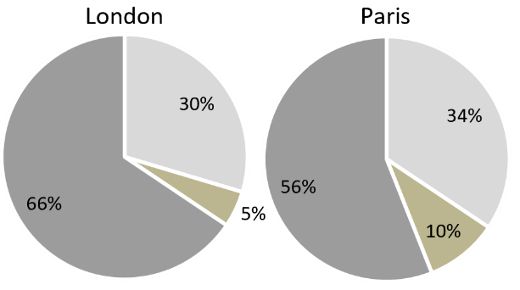
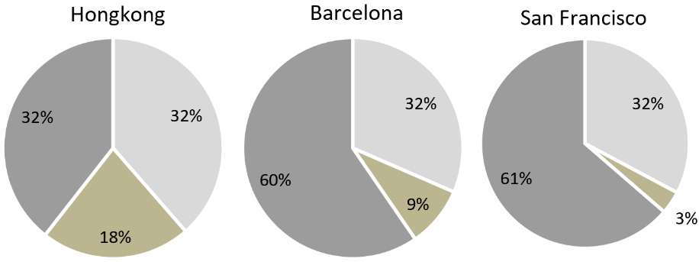
Land Utilization – Comparison with Global Cities
Paris
Findings-
In all global cities, the highest portion of land is under Built Area (54% average) whereas On average, only 11% of land is utilised under private open spaces.

Slide 23
Comparative assessment of Land Utilization in the 9 Indian cities and Global Case studies
Kochi

Slide 24

Comparative assessment of Land Utilization in Indian and Global Cities
Land Utilization for Indian study Cities
Land Utilization for selected Global Cities

Slide 25
Comparative assessment of Land Utilization in Indian and Global Cities
Land Utilization for Indian study Cities for the stations studied
Observations
Land under Streets & Public Opens Spaces:
Indian cities have very low amount of land (only 14%) in Streets & Public Open Spaces,
whereas the global cities have 35% of land in streets & public open spaces
Land under Buildings
Indian cities have only about 30% of land under built up areas, leaving almost 56% land under utilized in private open spaces
Compared to this, the global cities have 54% land under built up areas, allowing more people to live, work, shop and use the floor space in close proximity to public transport.
Land under Private Open Spaces
Indian cities have high amount of land (56%) in private open space (ranging from 50% to 61%) which is often cut-up in small slivers as setbacks, not accessible to public, and remains vacant or under utilized.
Compared to this, the global cities have only 11% of land in private open space, allowing more land under streets & buildings
Observations: Global cities demonstrate more efficient land utilization allowing more land under Buildings and more land under Streets and Public Open Spaces, while minimizing the land under private open spaces
Land Utilization for selected Global Cities

Slide 26
Development intensity around the selected station areas of the cities
Built up – (Existing & Change from 10 years back (possibly due to Metro)
Gross FAR Consumed
Delhi
Bangalore
Chennai
Mumbai
Hyderabad
Jaipur
Kochi
Lucknow
Nagpur

Slide 27
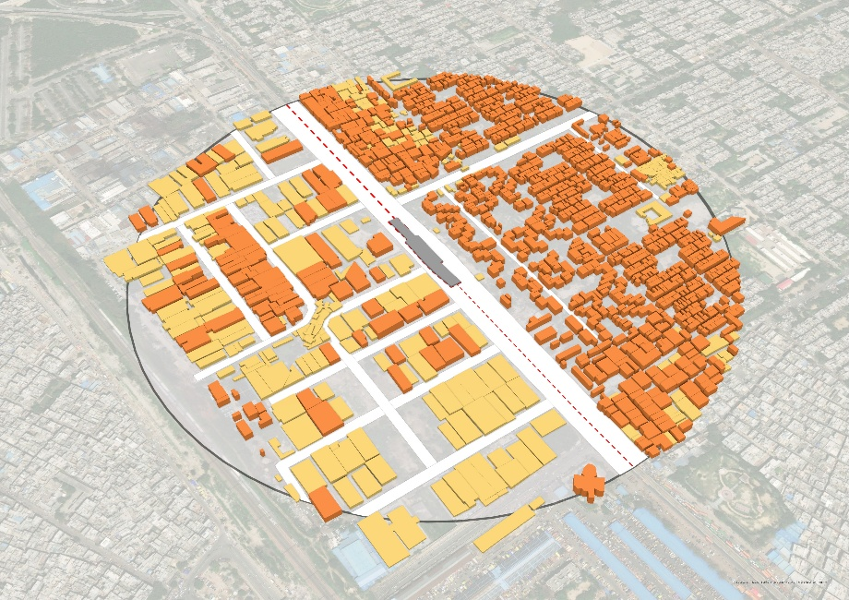
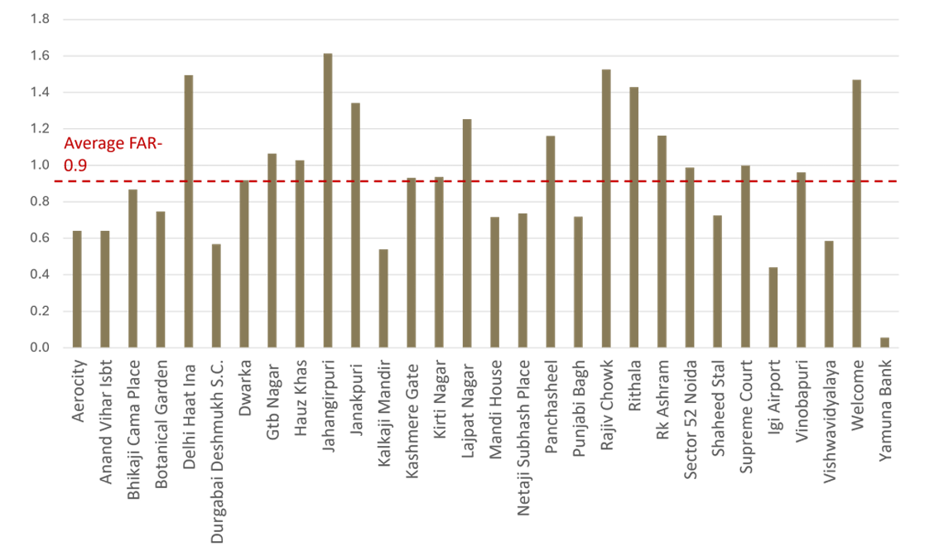
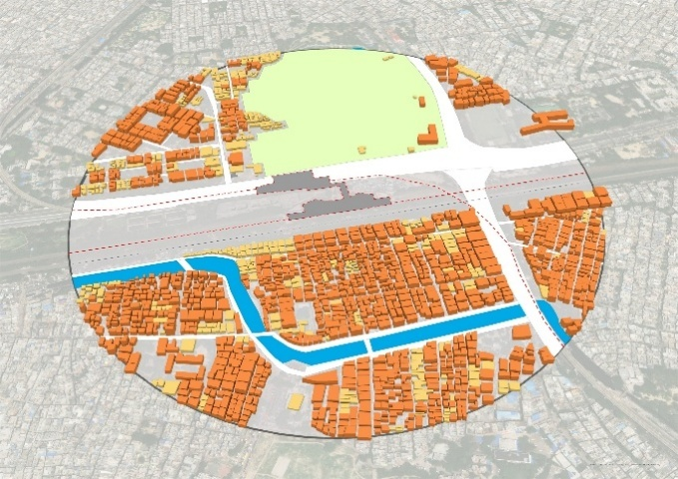
Built-up in station areas of Delhi
1.6
0.1
Jahangirpuri Metro Station Area
Observations:
The selected metro station areas in Delhi have an average Floor Area Ratio (FAR) of only 0.9.
Jahangirpuri station area has the highest FAR at 1.6 whereas Yamuna Bank station area records the lowest FAR at 0.1.
Metro Station
G – G+1
G+2 – G+5
G+6 – G+12
G+13 and Above
Welcome Metro Station Area

Slide 28
Change in the built-up of station areas in Delhi
Built-up in station areas
Delhi
Station | 2013 | 2023 | Change
Aerocity | 354318 | 408532 | 54214
Anand Vihar ISBT | 374280 | 392603 | 18323
Bhikaji Cama Place | 669130 | 569507 | -99623
Botanical Garen | 293318 | 476315 | 182997
Delhi Haat INA | 345977 | 891193 | 545216
Durgabai Deshmukh South Campus | 367955 | 373565 | 5610
Dwarka | 511304 | 545772 | 34468
GTB Nagar | 640766 | 652662 | 11896
Hauz Khas | 604845 | 629551 | 24706
Jahangirpuri | 1068819 | 1065556 | -3263
Janakpuri West | 756268 | 805431 | 49163
Kalkaji Mandir | 268917 | 295057 | 26140
Kashmere Gate | 489278 | 475017 | -14261
Kirti Nagar | 667876 | 627856 | -40020
Lajpat Nagar | 766435 | 760089 | -6346
Mandi House | 451287 | 468305 | 17018
Netaji Subash Place | 398021 | 477107 | 79086
Panchsheel Park | 625891 | 622767 | -3124
Punjabi Bagh West | 413548 | 431368 | 17820
Rajiv Chowk | 767044 | 802410 | 35366
Rithala | 1248876 | 1860515 | 611639
RK Ashram Marg | 755884 | 757234 | 1350
Sector 52 Noida | 313212 | 465297 | 152085
Shaheed Stal New Bus Adda | 445395 | 466641 | 21246
Supreme Court | 397502 | 651749 | 254247
Terminal 1 IGI Airport | 262580 | 301045 | 38465
Vinobapuri | 655895 | 588263 | -67632
Vishwavidhyala | 357895 | 392061 | 34166
Welcome | 668522 | 689745 | 21223
Yamuna Bank | 61143 | 42128 | -19015
Total | 16004194 | 17987364 | +1983170
Average increase in built up – 14%
Findings:
There is an average increase of 14% in the built up around station areas of Delhi since 2013
Delhi Haat station area shows the highest increase (158%) in the builtup area.
Botanical Garden, Rithala, RK Ashram & Supreme Court station areas also show almost 50% increase, or more, in the builtup area

Slide 29


Built Up in station areas of Bangalore
1.2
Average FAR - 0.9
0.4
Kempegowda Majestic Metro Station
Findings:
The selected metro station areas in Bangalore have an average Floor Area Ratio (FAR) of only 0.9.
Kempegowda Majestic station area has the highest FAR at 1.2 whereas Kengeri station area has the lowest FAR at 0.4.
Metro Station
G – G+1
G+2 – G+5
G+6 – G+12
G+13 and Above
Kengeri Metro Station

Slide 30

Comparative Analysis of Built up area (Built FAR) across the 9 cities
Findings:
There is an average Built FAR in the stations in 9 Indian cities is only 1.1
Mumbai has the highest Built FAR of 1.7, whereas Lucknow has the lowest built FAR of 0.7 among the 9 cities.
Given the high population densities in Indian cities, the low FAR suggest a substantial underutilization of development potential in the metro corridors

Slide 31
Comparative Analysis of Built up FAR across the study cities & global cities
Average Built FAR in Indian study cities*
Average built FAR in Global case study cities*
As per the report
Global Cities
Average Built FAR: 3.34
Indian Cities
Average Built FAR: 1.1
INDIAN CITIES (STUDY CITIES)
GLOBAL CASE STUIDES
Findings:
The average built FAR of Global cities is 3.34 which is significantly higher than the average built FAR in Indian cities at 1.1.
Analysis of 5 cities from data analysis report submitted on 10.03.25
*in the study areas for TOD

Slide 32
Comparative Analysis of Built up FAR across the study cities & global cities
Average Built FAR in Indian study cities
Average built FAR in Global case study cities
Global Cities
Average Built FAR: 3.34
Indian Cities
Average Built FAR: 1.1
INDIAN CITIES (STUDY CITIES)
GLOBAL CASE STUIDES
Findings:
the average Built FAR in Indian cities is only 1.1.,
Whereas average built FAR of Global cities is 3.34

Slide 33
Change in the built-up area of station areas in the 9 Cities
City | 2013/14 (in sq. m) | 2023 (in sq. m) | Variation (in sq. m) | Average increase in built up
Delhi | 16004194 | 17987364 | 1983170 | 14%
Bangalore | 2056205 | 2380534 | 324329 | 22.8%
Chennai | 2739237 | 3016112 | 276875 | 12.6%
Hyderabad | 2917630 | 3252050 | 334420 | 25%
Mumbai | 4855643 | 5561159 | 705516 | 14.6%
Jaipur | 4467477 | 4623842 | 156365 | 5.2%
Kochi | 3260060 | 3434069 | 174009 | 7.8%
Lucknow | 2400565 | 2556873 | 156308 | 12.6%
Nagpur | 3370900 | 3464279 | 93379 | 3.2%
 |  |  | 4267300
Findings:
Overall, Hyderabad and Bangalore show the highest change in the Builtup FAR
Whereas, Nagpur, Jaipur and Kochi show very little change in Builtup FAR

Slide 34
Contents
Development Patterns around Metro Stations
TOD & Non-Farebox Revenue in Indian Cities

Slide 35
1. Non-farebox revenue types
Development Based Tools
Additional Cess on Stamp Duty (1%)
Transit Oriented Development (TOD)
Purchasable FAR
TDR
Property Taxes
Lease & Rent Based Tools
Property Business (PB) Spaces within Metro Stations
Property Development (PD) on Stand Alone Plots
Hiring Metro premises & Metro train for Group Tours, Pre-Wedding Photo Shoot, Shooting of films documentary, TV commercials and Birthday Party.
Advertisement Based Tools
Co-Branding Rights of Metro Stations
Train Wrapping Advertisement
Indoor Advertisement inside Metro Station
Advertisement on exterior space of Metro station

Slide 36
FAR as a tool for Non Fare-box Revenue Generation
How are our cities doing? - Some examples
Nagpur Metro:
The standard permissible FAR is 2.5, but it can be increased up to 4.0 under the TOD policy, subject to the payment of a premium. The premium
Kochi
The standard permissible FAR for entire city is 3.0. Plus additional FAR of 1.0 can be purchased anywhere.
This results in over-supply of FAR compared to the demand in the entire city.
Very low demand for Purchasable FAR in the entire city, including Metro TODs
is it does not - it is about differential FSI & demand
Ahmedabad :
Base FAR – 1.8, Purchasable FAR – 2.2, Total FAR 4
Purchasable FAR is charged at 40% of Jantri Rates (Circle Rates), which is significant revenue generation
Such revenue gets useed in improving the urban infra. But no direct Revenue Sharing with Metro or BRTS.
Chennai & Guwahati:
TODs are proposed on wider Roads without transit (ie Ring Roads) which will really make the cities NON-TODs
Delhi:
TODs being developed by DDA in limited areas, resulting in limited non-farebox rev for Metro. Needs to expand

Slide 37


Nagpur Metro
Additional Cess on Stamp Duty
1% Additional Cess on Stamp Duty
The surcharge can be levied in cities, where Vital Urban Transportation projects are implemented.
Accordingly, the recovery of 1% Additional Surcharge on Stamp Duty was started from October 2016.
On behalf of Maha-Metro, Government of Maharashtra collected an amount of Rs. 539.17 Crores till June 2025, towards 1% increase in Stamp Duty, which will be disbursed to Maha-Metro during operational phase.

Slide 38


Nagpur Metro
TOD Policy
Jurisdiction of TOD - 500 Mts on either side of the Nagpur Metro Rail
Up to 4 FSI is allowed subject to Plot area and width of road.
premium for availing additional FSI as per TOD
30% of ASR value for minimum Tenement density of 200 Tenements per Hectare
40% of ASR Value for Tenement density is less than 200 Tenements per Hectare.
The Premium so collected to be distributed equally among Maha Metro and Planning Authorities (NIT/NMC/MADC).
Maha-Metro receives 50% share of premium & has collected Rs. 200.04 Crores till Sept 2025 ,

Slide 39



Kochi Metro - TOD
Master Plan for KMC Area - 2040
The standard permissible FAR for entire city is 3.0.
Additional FAR of 1.0 can be purchased anywhere.
This results in over-supply of FAR compared to the demand in the most areas of the city.
Very low demand for Purchasable FAR in the entire city, including Metro TODs
No additional amount of FAR would be effective to bring more development in TOD; Unless there is a difference between the TOD and Non-TOD FAR
It is about differential FSI & development demand

Slide 40

Ahmedabad TOZ
Base FAR - 1.8
Purchasable FAR – 2.2 & 3.6
Total Permissible FAR – 4.0 & 5.4
Significant redevelopment taking place due to increased FAR
Premium FAR charged at 40% of the Jantri Rates

Slide 41


Ahmedabad TOZ
Base FAR - 1.8
Purchasable FAR – 2.2 & 3.6
Total Permissible FAR – 4.0 & 5.4
Significant redevelopment taking place due to increased FAR
Premium FAR charged at 40% of the Jantri Rates

Slide 42



Delhi TOD
The TODs being developed by DDA as per TOD Policies
Development on limited land – primarily DDA land
Hence the revenue generation potential on limited land area, in spite of having a very high demand city
Restrictive planning and regulations lead to under-utilization of land and development potential

Slide 43
FAR as a tool for Non Fare-box Revenue Generation
How are our cities doing? - Some examples
Nagpur Metro:
The standard permissible FAR is 2.5, but it can be increased up to 4.0 under the TOD policy, subject to the payment of a premium. The premium
Kochi
The standard permissible FAR for entire city is 3.0. Plus additional FAR of 1.0 can be purchased anywhere.
This results in over-supply of FAR compared to the demand in the entire city.
Very low demand for Purchasable FAR in the entire city, including Metro TODs
is it does not - it is about differential FSI & demand
Ahmedabad :
Base FAR – 1.8, Purchasable FAR – 2.2, Total FAR 4
Purchasable FAR is charged at 40% of Jantri Rates (Circle Rates), which is significant revenue generation
Such revenue gets useed in improving the urban infra. But no direct Revenue Sharing with Metro or BRTS.
Chennai & Guwahati:
TODs are proposed on wider Roads without transit (ie Ring Roads) which will really make the cities NON-TODs
Delhi:
TODs being developed by DDA in limited areas, resulting in limited non-farebox rev for Metro. Needs to expand

Slide 44

Key Take-Aways
It is not just about increased FAR but about differential FAR.
It is about Development Demand vs FAR Supply
In low demand & high supply cities
The FAR should be made chargeable in the non TOD areas (potential suggestion for Kochi)
In High demand cities
the new development due to Metro should be charged and revenue can be shared with Metro (eg Nagpur)
TDR can be a great mechanism to generate revenue – by selling the TDR from Rail Property – by receiving the TDR into TOD and using a part of the premium for Metro revenue

Slide 45



Ahmedabad CBD & TOD LAPs - Recent developments
Source: srfdcl.co.in

Slide 46
Thank you

