Slide 1

Route Choice Behaviour of Electric Vehicle Users: The Role of Route Characteristics and Battery Swapping Attitudes
Authors:
Athira Anil: PhD student at IIT Madras
Poonam Rajaram Adsule: PhD student at IIT Delhi
Gongalla Vamsi Krishna: PhD student at IIT Delhi
Dr. Manoj M: Associate Professor, IIT Delhi
Rahul T.M: Associate Professor, IIT Ropar

Slide 2
INTRODUCTION
The growing adoption of Electric Vehicles (Evs) is a key step toward sustainable urban mobility and reduction of fossil fuel dependency
EV users face unique route choice challenges influenced by vehicle range limitations and availability of charging infrastructure
Understanding how route characteristics and attitudes toward battery swapping influences EV users route choice is critical
This study investigates the behavioural patterns of EV users in selecting routes, considering both route attributes and psychological factors related to battery swapping

Slide 3
LITERATURE REVIEW
Ashkrof et al. (2020) and Yang et al. (2016) demonstrated that charging needs significantly influence EV route choice, particularly under range and availability constraints
They integrate charging infrastructure into route choice, but do not fully consider network congestion and the distance between charging stations
The battery swapping attitudes are not included in most of the studies
Planning ability, which has been well examined in the field of psychology, has not been taken into account in previous research, which has concentrated on the impact of risk attitude and range anxiety on EV drivers' travel behavior. This planning ability is considered in attitudinal factors in this paper
Existing models underplay the strategic complexity EV drivers face on long trips, including charging stop planning, detour distances, and infrastructure availability across corridors

Slide 4
LITERATURE REVIEW
Existing route choice models rarely account for the unique travel behaviour of electric vehicles, especially the influence of battery swapping.
This paper develops a route choice modelling framework specifically for electric vehicles.
It introduces the battery swapping characteristic as a critical factor influencing route choice decisions, which has not been sufficiently explored in prior literature.
By integrating battery swapping through attitudinal statements into the route choice model, the study provides new insights for planning EV infrastructure and improving sustainable transportation systems.

Slide 5
OBJECTIVES
To identify the most selected routes of electric car drivers that minimize inconvenience of travel
To analyse how various route characteristics affect route choice behaviour of EV users
To examine the influence of EV users attitudes toward battery swapping on their route selection decisions
To integrate route characteristics and battery swapping attitudes to develop a model for predicting EV route choice behaviour

Slide 6
METHODOLOGY
Literature Review
Objective Formulation
Define Study Area
Conduct Stated Preference Survey (EV car users)
Data Collection
Factor Analysis (Attitudinal Factors)
Model Development
Validate and Analyse Model Results
Conclusions

Slide 7
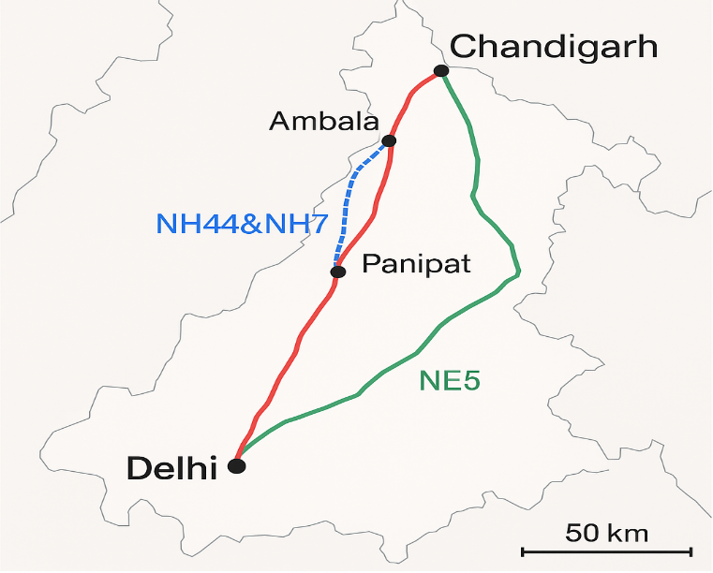
STUDY AREA
The study focuses on the intercity travel corridor between Delhi and Chandigarh, two major urban centers in northern India
This route spans approximately 250–270 kilometers, depending on the selected path, and is served by multiple highways, including NH-44, NH-7, and the Ambala-Chandigarh Expressway
Fig 1: Study area

Slide 8
SURVEY DESIGN
A SP survey was designed to collect data on traveler preferences when choosing among three predefined route alternatives between Delhi and Chandigarh
A respondent was asked to select one alternative from the three alternatives
The scenarios included the three alternatives with their attributes, i.e., travel time, total cost (including tolls and running cost), traffic congestion level, availability of amenities, exit point accessibility, and charging station spacing
These SP scenarios were extracted using a D efficient design to efficiently represent the combinations of route attributes
The survey comprised three main parts: stated preferences, attitudinal variables, and traveler socio-demographic characteristics
Further respondents were asked to respond to 7 attitudinal statements related to battery swapping measured on a 5-point Likert scale (Strongly Disagree to Strongly Agree)

Slide 9
ATTRIBUTES AND LEVELS
Table1: Attributes and levels of survey design
ATTRIBUTES | LEVELS
Travel time | 4.5hr, 5hr
Total cost | Rs.550, Rs.660, Rs.770
Spacing between charging stations | 15km, 20km, 25km
Traffic congestion on routes | Low, Medium, High
Amenities on routes | Rest area only, Rest area with charging station, Rest area with charging station but not working
Exit point to other routes | 1, 2, 3

Slide 10
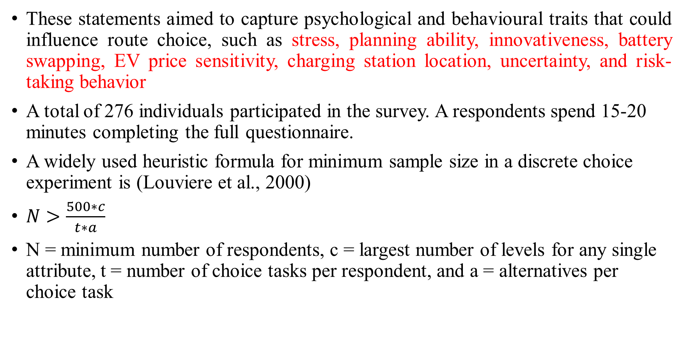
SURVEY DESIGN
These statements aimed to capture psychological and behavioural traits that could influence route choice, such as stress, planning ability, innovativeness, battery swapping, EV price sensitivity, charging station location, uncertainty, and risk-taking behavior
A total of 276 individuals participated in the survey. A respondents spend 15-20 minutes completing the full questionnaire.
A widely used heuristic formula for minimum sample size in a discrete choice experiment is (Louviere et al., 2000)
$N>\frac{500∗c}{t∗a}$
N = minimum number of respondents, c = largest number of levels for any single attribute, t = number of choice tasks per respondent, and a = alternatives per choice task

Slide 11
FACTOR ANALYSIS
The goal of this analysis was to reduce the dimensionality of the 26 attitudinal statements (labeled A to Z)
To identify a smaller set of latent factors that capture key behavioral tendencies influencing route choice, which later used in the MNL utility function as interaction terms
The main factors considered in attitudinal statements are stress, planning ability, innovativeness, battery swapping EV price sensitivity, charging station location, uncertainty and risk-taking behavior
The latent variables were extracted from the 7 attitudinal variables using factor analysis
MNL model is developed to find the travel behaviour of people using electric car

Slide 12
RESULTS
Table 2: Attitudinal Statements
ID | Statement | Strongly agree | Agree | Neutral | Disagree | Strongly disagree
BSS1 | I plan to use BST in the future | 40.94 | 41.30 | 11.59 | 4.71 | 1.45
BSS2 | The cost of battery swapping is not a problem for me | 25.36 | 38.41 | 22.46 | 8.33 | 5.43
BSS3 | I prefer on-street BSS | 36.96 | 29.71 | 20.29 | 8.33 | 4.71
BSS4 | I can save my time by opting for BST | 32.97 | 33.33 | 21.38 | 7.61 | 4.71
BSS5 | I choose routes with more BSS | 26.45 | 34.06 | 28.99 | 6.88 | 3.62
BSS6 | I think battery swapping would make EVs more practical for long-distance travel | 24.64 | 30.07 | 29.35 | 11.23 | 4.71
BSS7 | I think that EV battery swapping is expensive | 12.68 | 18.12 | 26.45 | 29.35 | 13.41

Slide 13
Table 3: Model estimates
 | NH44 |  | NH44&NH7 |  | NE5
 | Estimate | t-ratio | Estimate | t-ratio | Estimate | t-ratio
Alternative specific constant | -4.51 | -1.01 | -1.79 | -0.43 | - | -
Travel Cost | -0.67 | -1.80 | -0.79 | -1.99 | -0.69 | -2.83
Charging Station Spacing | 0.23 | 1.69 | -0.36 | -1.98 | -1.32 | -2.65
Exit Points | -0.02 | -1.84 | -0.12 | -1.88 | 0.02 | 1.79
Willingness to Use BST | -0.04 | -1.67 | 0.05 | 1.68 | - | -
Perceived Affordability | - | - | - | - | 0.07 | 1.83
Model Fit Indices
Initial Log Likelihood |  |  | -1212.87
Final Log Likelihood |  |  | -1196.18
AIC |  |  | 2420.36
BIC |  |  | 2490.45
Rho-square |  |  | 0.014
Estimated Parameters |  |  | 14
Number of individuals/Observations |  |  | 276/1104

Slide 14
POLICY INTERVENTIONS
Route-specific charging infrastructure planning: Develop denser charging networks and battery swapping stations along expressways such as NE5, where longer distances amplify range anxiety.
Cost Management Policies: Introduce EV-specific discounts on high-toll routes to mitigate the negative impact of travel cost and encourage wider EV utilization for intercity trips
BST integration and standardization: Promote battery swapping compatibility standards and incentives for private operators to expand BST corridors.
User-Centric Technology Promotion: Campaigns and incentives to improve user awareness and acceptance of BST can shift attitudes positively, encouraging EV drivers to utilize routes equipped with such facilities, thereby optimizing travel efficiency and infrastructure utilization.

Slide 15
CONCLUSION
This study explains electric vehicle (EV) drivers’ route choices from three alternative routes(NH44, NH44 & NH7, NE5) between Delhi and Chandigarh
The MNL model results reveal that the travel cost reduces the preference of route choice across all three routes
Charging station spacing strongly influences the NE5 route, reflecting range anxiety
Positive attitudes toward battery swapping (BST) increase the likelihood of choosing NE5
The Perceived Affordability and Advantage of BST factor was positively associated with the choice of NE5
Route choice is shaped by both infrastructure factors, such as cost and charging station spacing, and travelers’ attitudes toward new technology

Slide 16
CONCLUSION
Route1- NH44: shows sensitivity to travel cost (estimate = –0.67, t = –1.80) had a negative and moderately significant effect, indicating that higher running expenses reduce the likelihood of choosing this route.
The charging station spacing variable (estimate = 0.23, t = 1.69) is positive, suggesting that respondents perceive NH44 as relatively better equipped with charging points and associate it with convenience and reliability.
The exit points coefficient (estimate = –0.02, t = –1.84) implies that excessive access points may create perceptions of slower or more congested flow, slightly reducing its attractiveness.
The Willingness to Use BST factor (estimate = –0.04, t = –1.67) was negative but weak, meaning that drivers inclined toward battery swapping are less likely to prefer this route, possibly because NH44 is dominated by conventional charging infrastructure rather than BST facilities.
Overall, NH44 serves as a baseline route, favoured for its established facilities and familiarity but less appealing to technology-adopting EV users seeking faster charging options.

Slide 17
CONCLUSION
Route 2 - NH44 & NH7 (Combined Corridor): Travel cost again negatively impacts preference with a higher magnitude (-0.79, t = -1.99), showing even greater sensitivity than NH44 alone.
Charging station spacing (estimate = –0.36, t = –1.98) also shows a negative effect, implying that respondents perceive charging infrastructure along this corridor are less reliable.
Unlike NH44, Willingness to Use BST factor exhibits a positive influence (estimate = 0.05, t = 1.68), suggesting that drivers open to adopting BST are more likely to choose this mixed corridor.
The exit point variable (estimate = –0.12, t = –1.88) continues to show a weak negative effect, likely due to higher perceived detour frequency or interruptions.

Slide 18
CONCLUSION
Route 3- NE5 (National Expressway 5): The results reveal a distinctly different behavioural pattern.
The travel cost coefficient (estimate = –0.69, t = –2.83) is highly significant, confirming strong price sensitivity, particularly because NE5 typically involves higher toll rates.
The charging station spacing (estimate = –1.32, t = –2.65) shows a strong negative relationship with route preference, meaning that as the distance between charging stations increases, EV users become much less likely to select NE5. This emphasizes range anxiety as a dominant barrier in expressway travel.
The exit points variable (estimate = 0.02, t = 1.79) is positive, suggesting that greater accessibility through multiple exits improves perceived flexibility for recharging.
The Perceived Affordability of BST factor (estimate = 0.07, t = 1.83) is positive and significant, indicating that EV users who consider battery swapping economical and convenient are substantially more inclined to choose NE5.

Slide 19
CONCLUSION
The pseudo-R² value (0.014) appears low, this is consistent with stated preference (SP) route choice studies, where choice variability is high and respondents face hypothetical trade-offs
The improvement in model fit was validated through a Likelihood Ratio (LR) test, comparing the estimated model (LL₁ = –1196.18) against the null model (LL₀ =1212.87)
The computed LR statistic (33.38) exceeds the critical χ² value (29.14 at 14 df, p < 0.01), confirming that the inclusion of route attributes and attitudinal factors provides a statistically significant improvement in explanatory power over a random-choice model
The model reveals that route choice is a complex interplay of alternative-specific factors such as cost and infrastructure, as well as latent psychological factors like attitudes towards new technology
The significant impact of the BST attitude factor on NE5 choice underscores the potential for battery swapping infrastructure to shape the route preferences of EV drivers

Slide 20
REFERENCES
Agrawal, S. K., Boyles, S. D., Jiang, N., Shahabi, M., & Unnikrishnan, A. (2015). Network route choice model for battery electric vehicle drivers with different risk attitudes. Transportation Research Record, 2498(1), 75–83. https://doi.org/10.3141/2498-09
Alizadeh, H., Farooq, B., Morency, C., & Saunier, N. (2019). Frequent versus occasional drivers: A hybrid route choice model. Transportation Research Part F: Traffic Psychology and Behaviour, 64, 171–183. https://doi.org/10.1016/j.trf.2019.04.009
Ashkrof, P., Homem de Almeida Correia, G., & van Arem, B. (2020). Analysis of the effect of charging needs on battery electric vehicle drivers’ route choice behaviour: A case study in the Netherlands. Transportation Research Part D: Transport and Environment, 78, 102212. https://doi.org/10.1016/j.trd.2019.102212
Cui, D., Wang, Z., Liu, P., Wang, S., Dorrell, D. G., Li, X., & Zhan, W. (2023). Operation optimization approaches of electric vehicle battery swapping and charging station: A literature review. Energy, 263, 126073. https://doi.org/10.1016/j.energy.2022.126073
Deng, J., Gao, L., Chen, X., & Yuan, Q. (2024). Taking the same route every day? An empirical investigation of commuting route stability using personal electric vehicle trajectory data. Transportation, 51(4), 1547–1573. https://doi.org/10.1007/s11116-023-10416-y
Frejinger, E., Bierlaire, M., & Ben-Akiva, M. (2009). Sampling of alternatives for route choice modeling. Transportation Research Part B: Methodological, 43(10), 984–994. https://doi.org/10.1016/j.trb.2009.03.001

Slide 21
REFERENCES
Hu, X., Yang, Z., Sun, J., Zhang, Y., & Shang, H. (2023). Optimal pricing strategy for electric vehicle battery swapping: Pay-per-swap or subscription? Transportation Research Part E: Logistics and Transportation Review, 171, 103060. https://doi.org/10.1016/j.tre.2023.103060
Jensen, A. F., Rasmussen, T. K., & Prato, C. G. (2020). A route choice model for capturing driver preferences when driving electric and conventional vehicles. Sustainability, 12(3), 1057. https://doi.org/10.3390/su12031057
Langbroek, J. H. M., Franklin, J. P., & Susilo, Y. O. (2018). How would you change your travel patterns if you used an electric vehicle? A stated adaptation approach. Travel Behaviour and Society, 13, 144–154. https://doi.org/10.1016/j.tbs.2018.07.001
Lee, H., & Kim, J. (2024). Pricing strategies of a battery swapping service for electric vehicles. Transportation Research Part D: Transport and Environment, 129, 103805. https://doi.org/10.1016/j.trd.2023.103805
Li, H., Yu, L., Chen, Y., Tu, H., & Zhang, J. (2023). Uncertainty of available range in explaining the charging choice behavior of BEV users. Transportation Research Part A: Policy and Practice, 170, 103615. https://doi.org/10.1016/j.tra.2023.103615
Li, Y., Li, F., Li, Q., & Zhang, P. (2025). Battery swapping station location routing problem: A cooperative business model. Computers & Industrial Engineering, 200, 108788. https://doi.org/10.1016/j.cie.2025.108788

