Slide 1
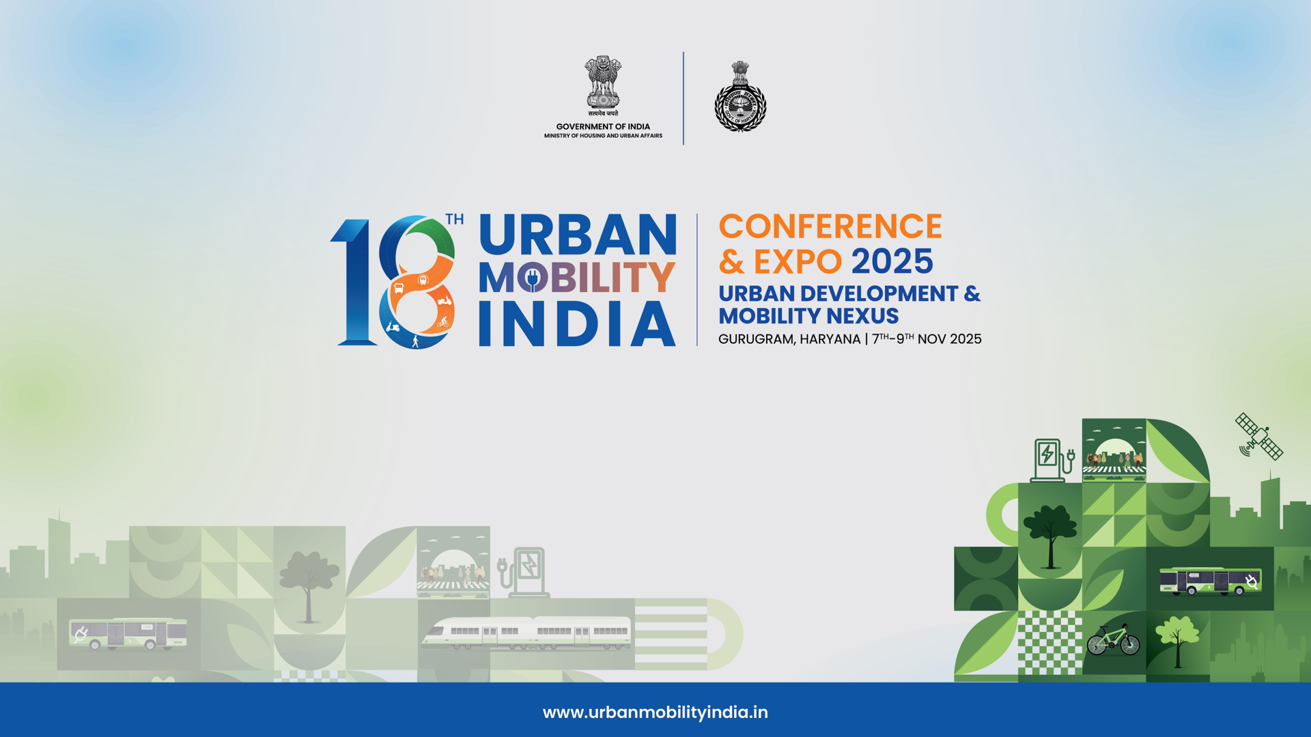
Strategy for Non-Fare Box
Nireesh .C
General Manager – P & BD
Vijayvaradhan
Jnt. General Manager – Mktg.

Slide 2
Non-Fare Box – Business Perspective
Existing Line of Business
01
New business - To be Explored
02

Slide 3
Existing Line of Business
Advertising
Real Estate
Telecom & IT
Others
Inside & outside Stations
Commercial & Retail Spaces
OFC
Film Shooting
In Trains
Leaky Cables
Property Development
Parking
AVM and ATM
Small Cells
In UniPole
Events
IBS, BTS
Semi Naming Rights
Land Licensing

Slide 4
Non-Fare Box Challenges
NFB activities not conceived during DPR stage
Lack of adequate funding for Property Development and related Utilities
Lack of expertise to industry specific Projects like Hotels / IT Parks / ITeS / Co-working space ( Basic facilities and current trends)
Exemption of property Tax / License fee from local bodies
Lack of standard policy guidelines – TOD / VCF
Telecom & Infra – Change in concepts – Revenue model to basic Service Model - change in Technology / Operators unwillingness to provide connectivity (Telecom Infra- Network connectivity & BTS) in UG metro stations
Adopting Risk free model – Land

Slide 5
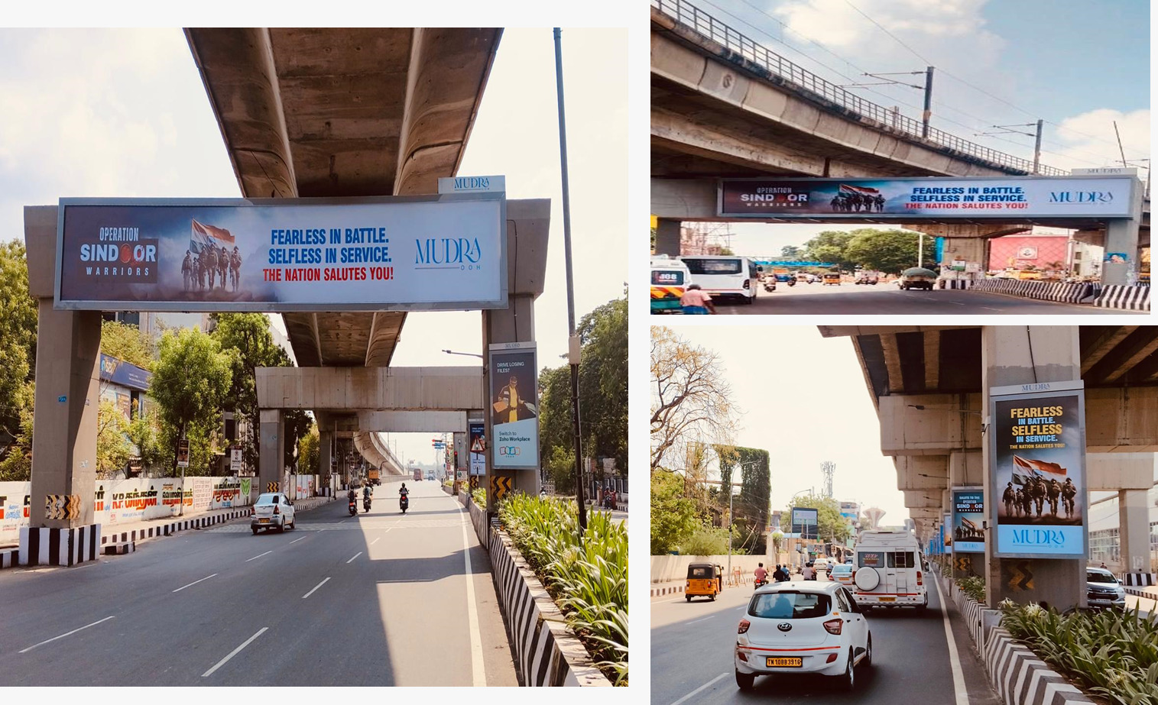
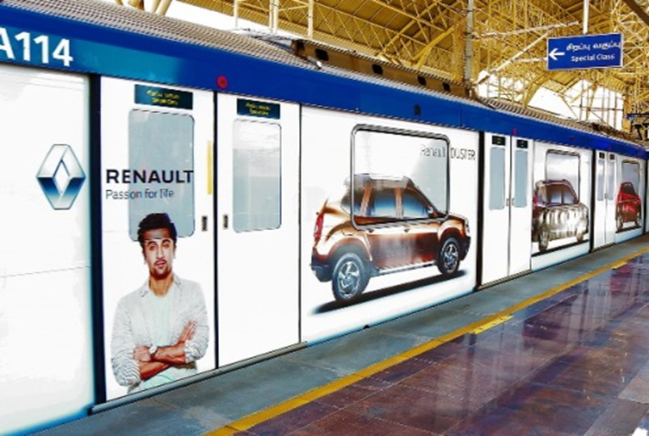
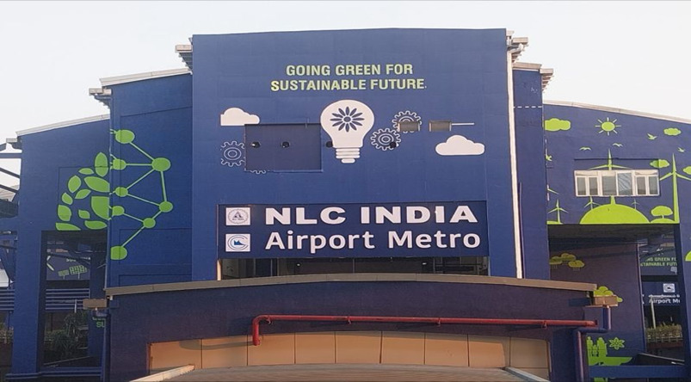
Advertising - Strategy
Pricing
-Determination of Market price
- Determination of Premium & Non Segment
Scope of Work
- Exclusivity / Non- Exclusive
- Identification of locations
- Type of Medium – LED / Digital
- Demarcation of area
- Demarcation of panel board Sizes
- Provision for Additional areas / New medium
- Utility Provisions
Tenure
- New locations – Short term
- High Investments – Long Term
Allotment :
- Forward Bidding

Slide 6
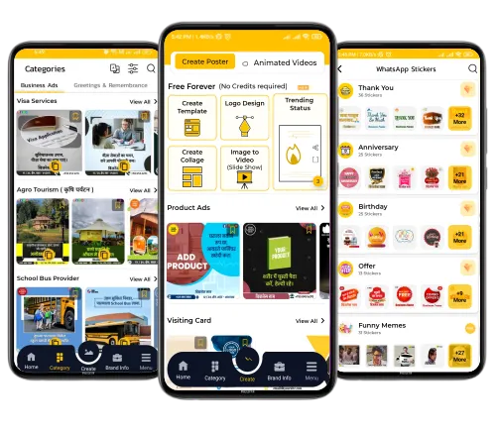
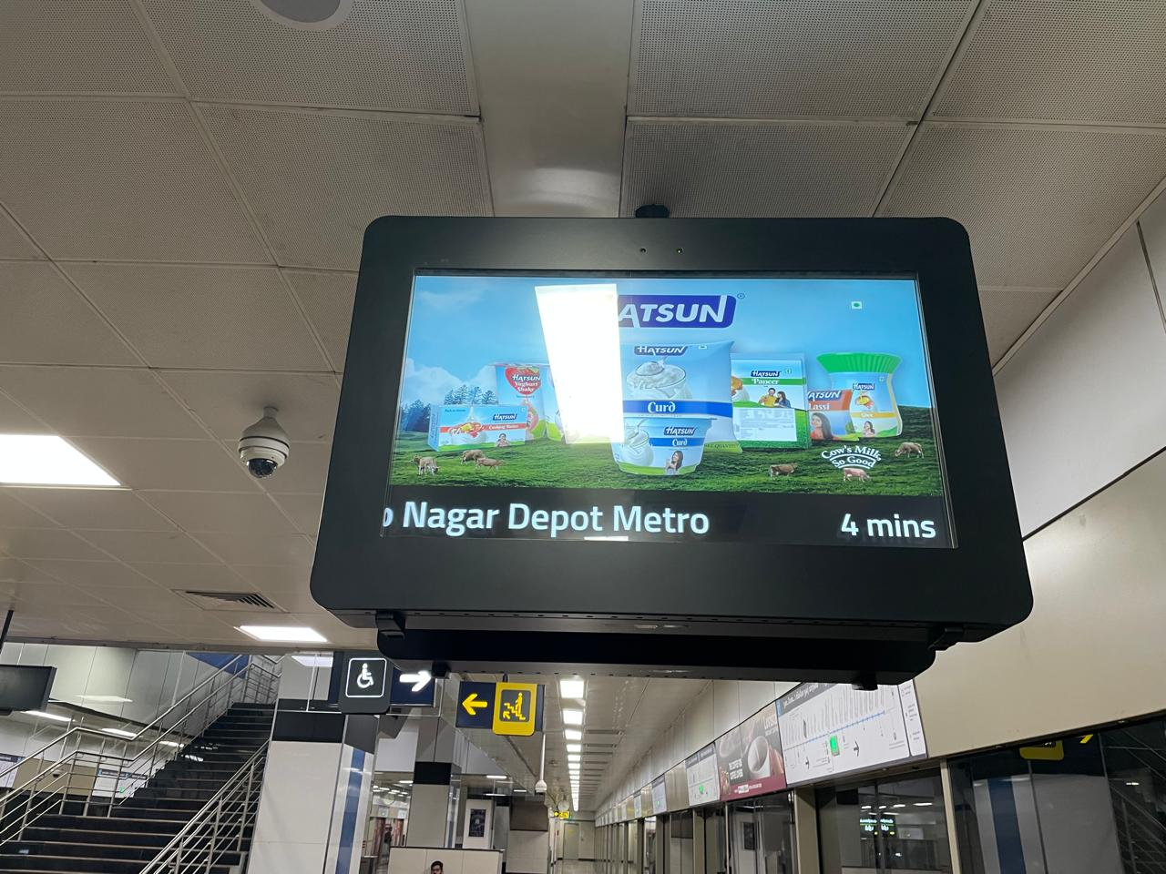
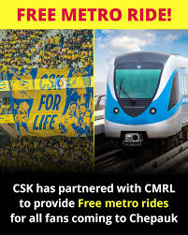
New Line of Business
New Initiatives
Innovative concepts – Centre of excellence, Buit-to Suit
Advertisement in Metro Application & Web Site : Digital advertisement space on journey-planning application or websites/ social media
Event sponsorships: Partner with brands for sports events / IPL match/ Marathon / Music events and etc
Advertisement in Station TV Display (PIDS)

Slide 7

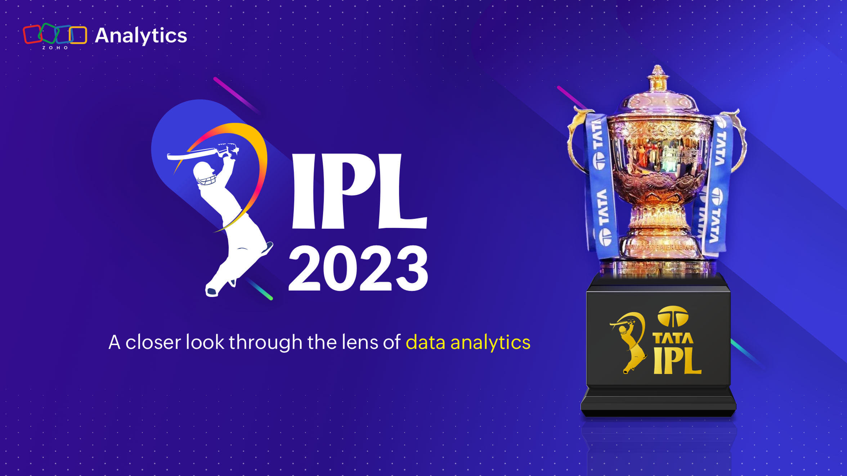
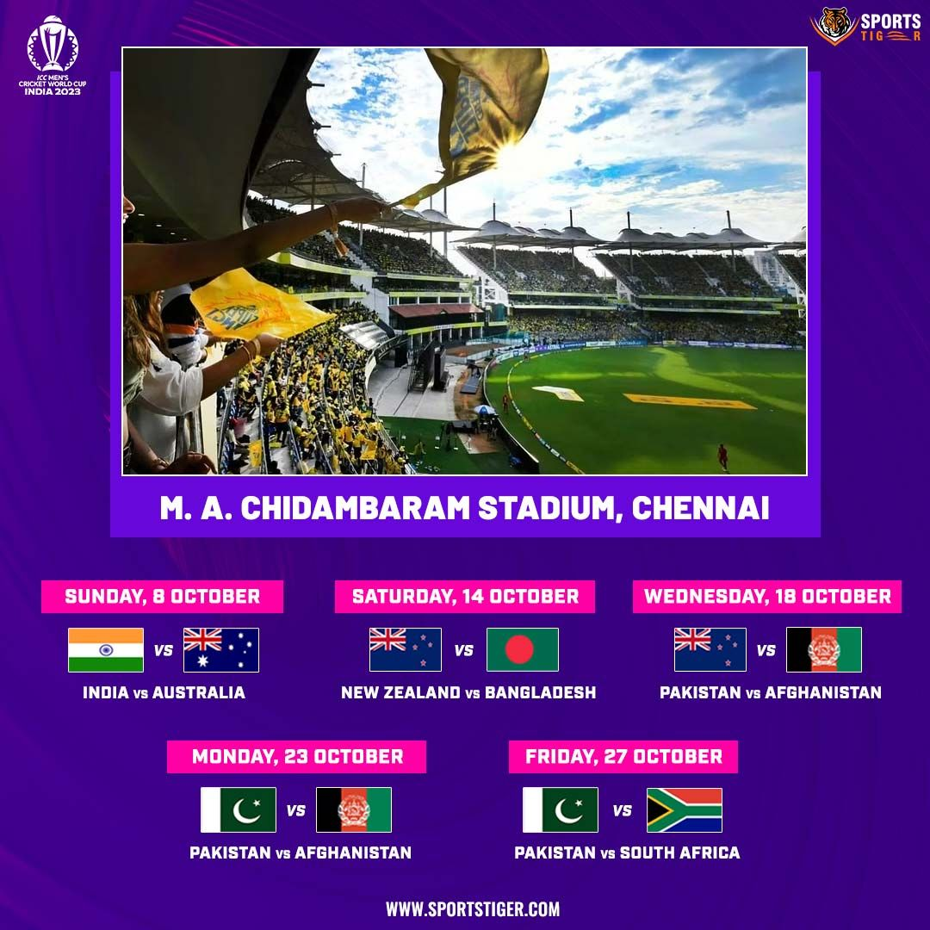
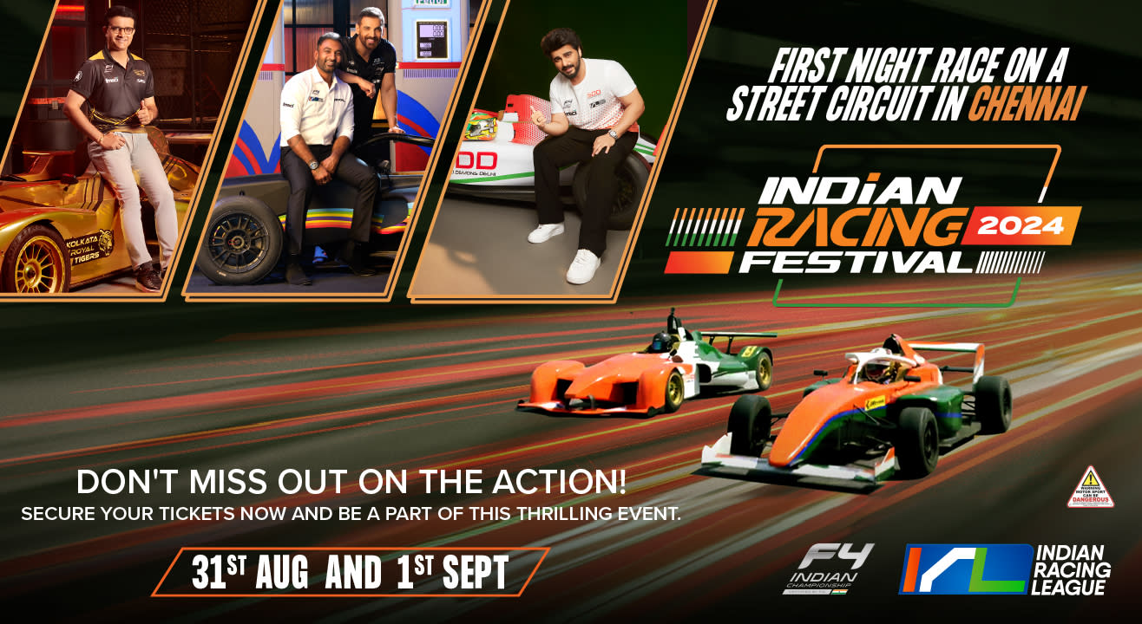
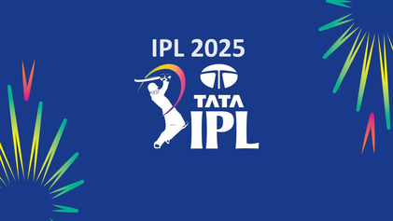
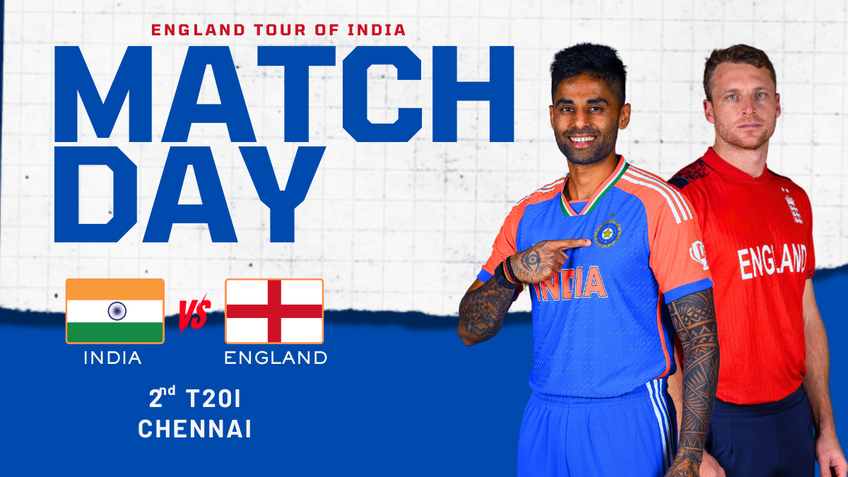
Event Ticket Integration with CMRL
CMRL has collaborated with major event Authorities like Chennai Super Kings (IPL), Indian Foot Ball Federation, TNCA, to integrate event ticketing with its Automated Fare Collection (AFC) system. This initiative enables increasing the CMRL Non-fare revenue as well as increasing metro ridership. As a result of this integration, 32 events have Integrated with over 2.59 lakh metro rides being availed through the initiative and ₹1.45 crores in revenue generated from event organizers.
Major Integrated Sports Events
IPL 2023 – 7 Matches
ICC World Cup- 2023- 5 Matches
Indian Racing Festival – Chennai Circuit
India Vs England T20 Cricket
IPL 2025- 4 Matches
Foot Ball -Brazil legends Vs Indian Legends

Slide 8
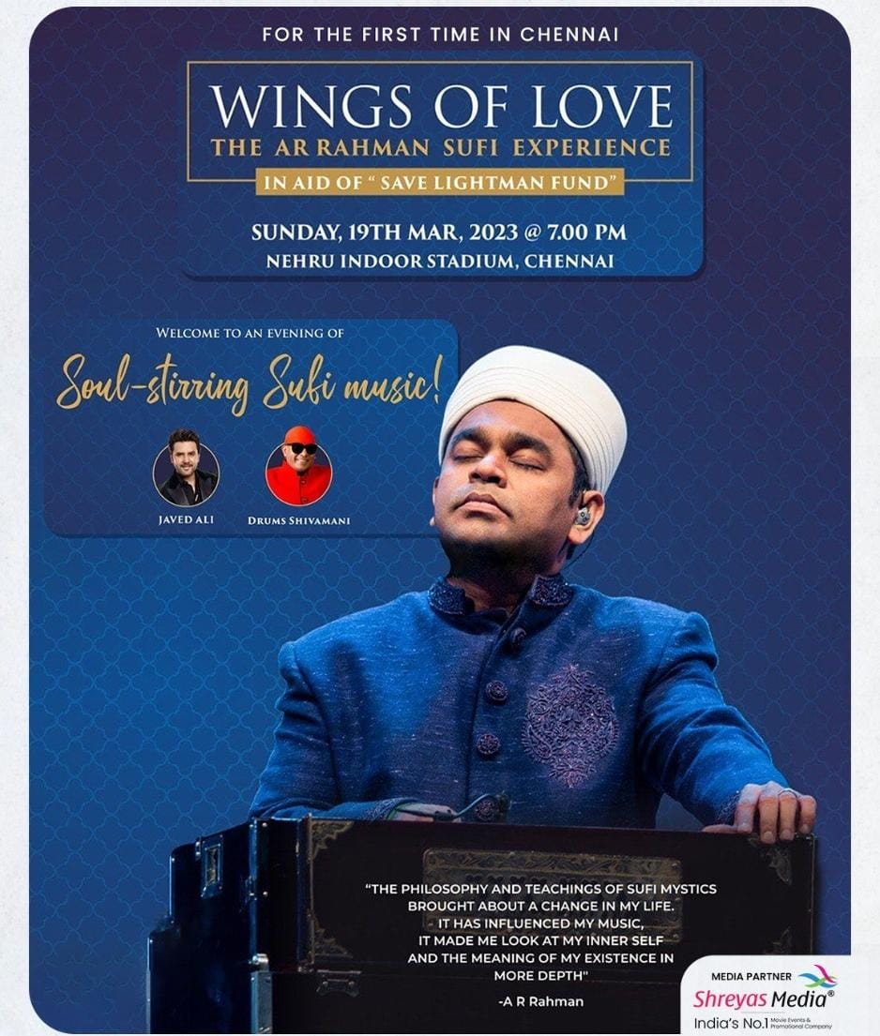
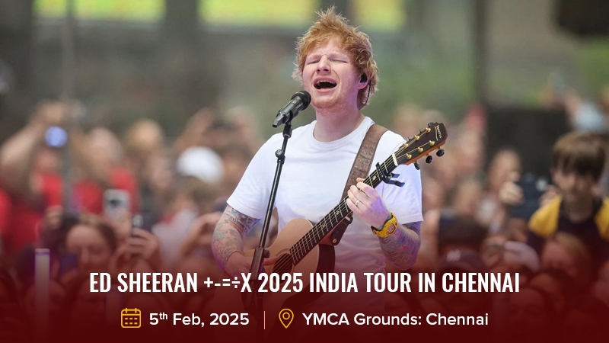
Event Ticket Integration with CMRL
Major Music concert
AR Rahman Live Music Concert
ED Sheeran Live Music Concert
Ilayaraja Live Music concert
Vijay Antony Live Music concerts
Santhosh Narayanan Live Music Concert
Harris Jeyaraj Live Music Concerts
Hip Hop Aadhi Live Music Concert
Sheraya Ghoshal Live Music Show
Kyn Fusion Show

Slide 9
Real Estate – Strategy
Planning of PD Space - DPR
Forward Bidding
Price Determination
Basic Utility provisions
Conceptualization of PD space

Slide 10
  Planning – DPR Stage
  - Potential space
  - Area to be developed
  - Market Demand
  - Feasibility
  - Designing – Visibility, Entry Exit, utility llift, Loading & unloading bay
  Utility Provisions
  - Required Power Load
  - AC
  - Drain facilities
  - Utility lift
  - Water

Slide 11
Conceptualisation of PD Space
- Innovative space – Centre of Excellence / R & D - Urban Square, Kathipara
- Existing Demand – Hotel / Co-working space / Co-living – BNR, Ekatuthangal
- AVM spaces - Vending machines, ATM, Digital Lockers
Price Determination
  - Market Price
  - Licensing type – end User / Sub – letting
  - Forward Bidding
Implementation of Single Window Clearance System
  - All statutory approvals
  - Faster Execution of work

Slide 12
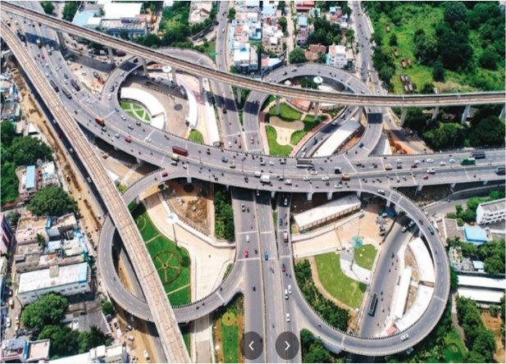
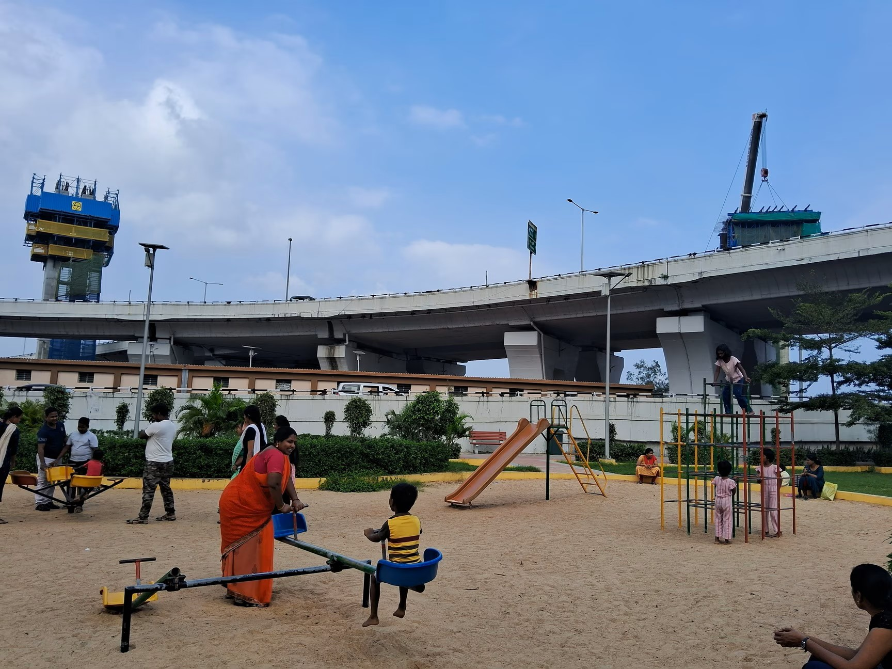
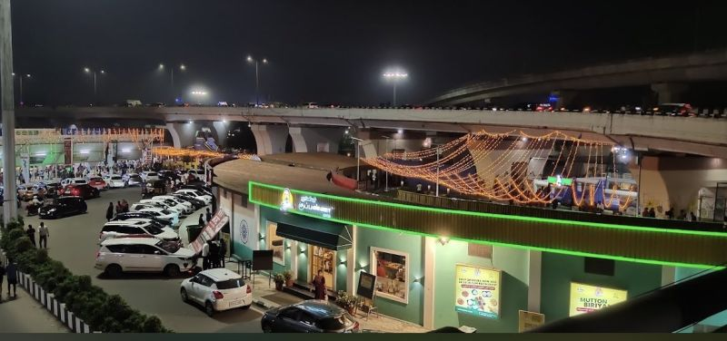
Property Development – MMI Urban Square
Transit hub for Commuters for City Bus (MTC Bus) & Alandur Metro Station.
KATHIPARA INTERCHANGE DEVELOPMENT CHENNAI
Commercial Development, Landscaping, Passenger Amenities , Parking facility , & Children's play area.

Slide 13
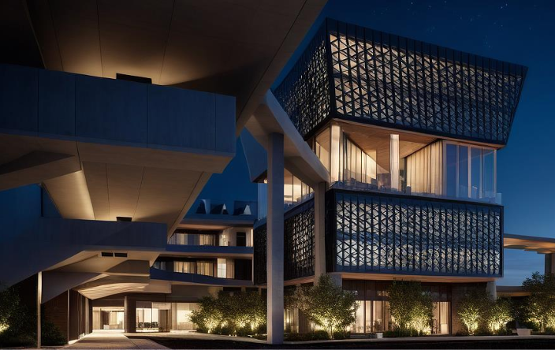
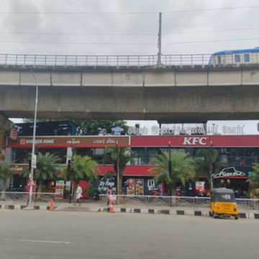
Integrated Property Development
Upcoming – Phase 2
Under Via Duct

Slide 14
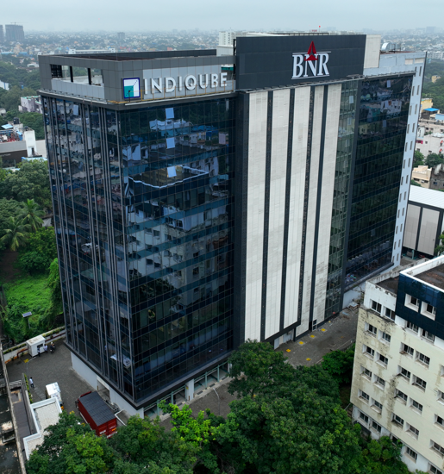
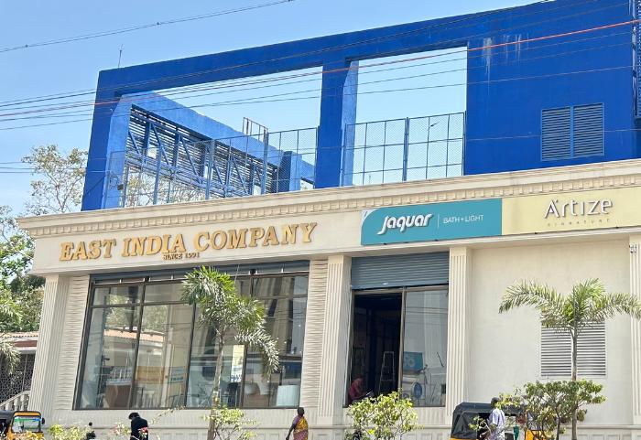
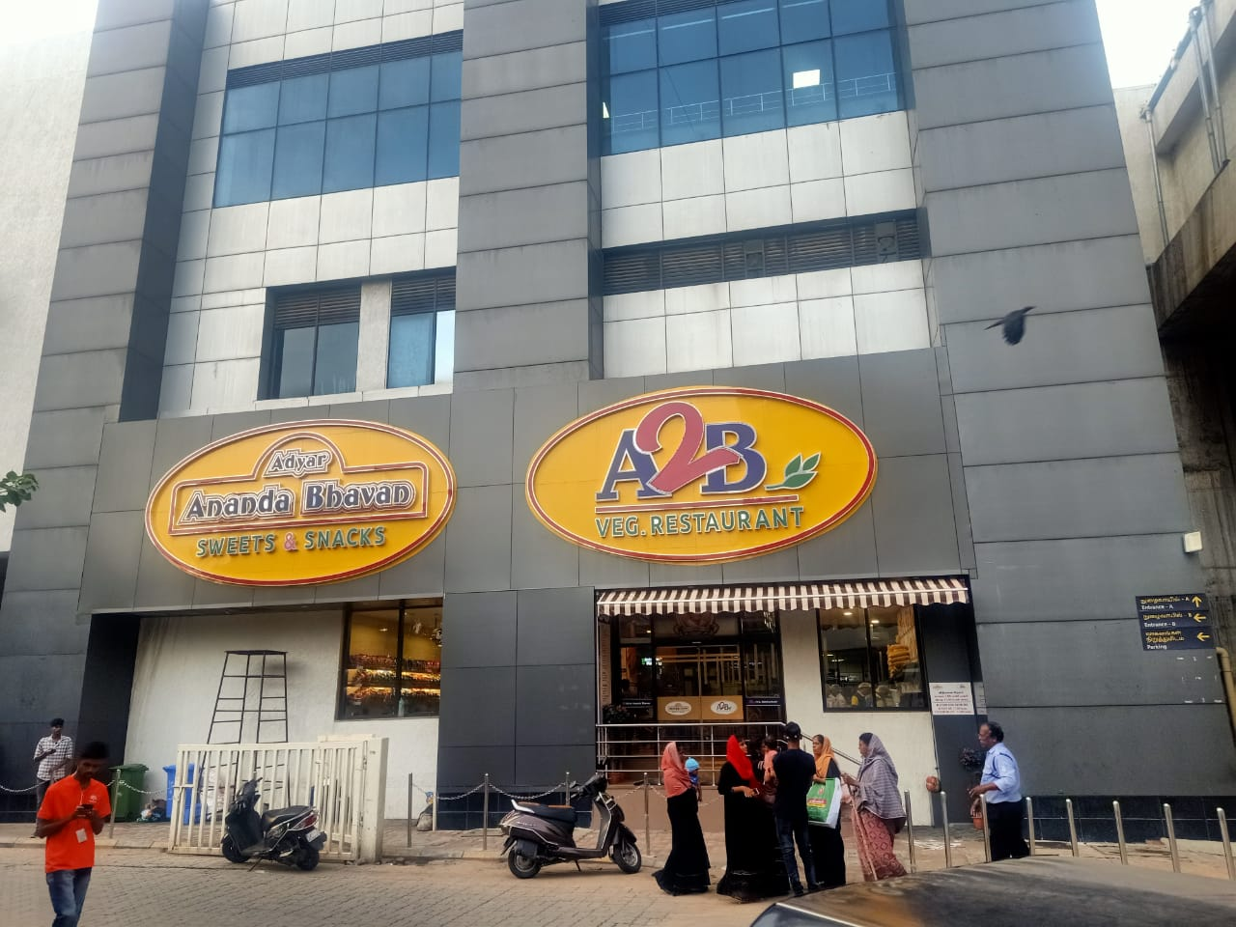
Independent Property development
  Property development in Ancillary building

Slide 15
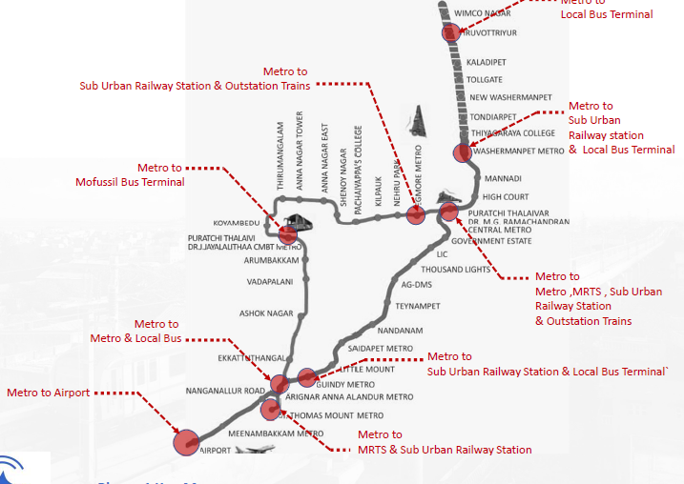
Real Estate -Property Development
Transit-Oriented Development (TOD)
Transit-Oriented Development (TOD) Policy Farmwork
  Lease or sell land around transit hubs for mixed-use developments.
  TOD Alignments with a radius of 500-800m from metro line
  Additional FSI for Metro owned Projects
  Enable Multi Model integration wherein PD developments
  Partner with private developers under joint ventures or PPP.

Slide 16
Real Estate Development
  Implementation of SPV for Property Development
  M/s.Chennai Metro Asset Management Limited (CMAML)
  Joint venture between Chennai Metro Rail Limited (CMRL) and Tamil Nadu Industrial Development Corporation (TIDCO). The company's primary activity is real estate development, including projects like the Multimodal Facility Complex.

Slide 17
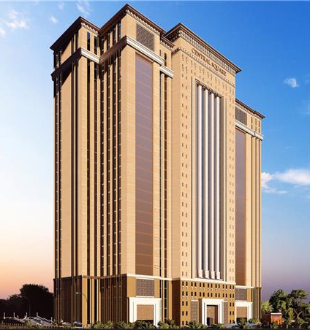
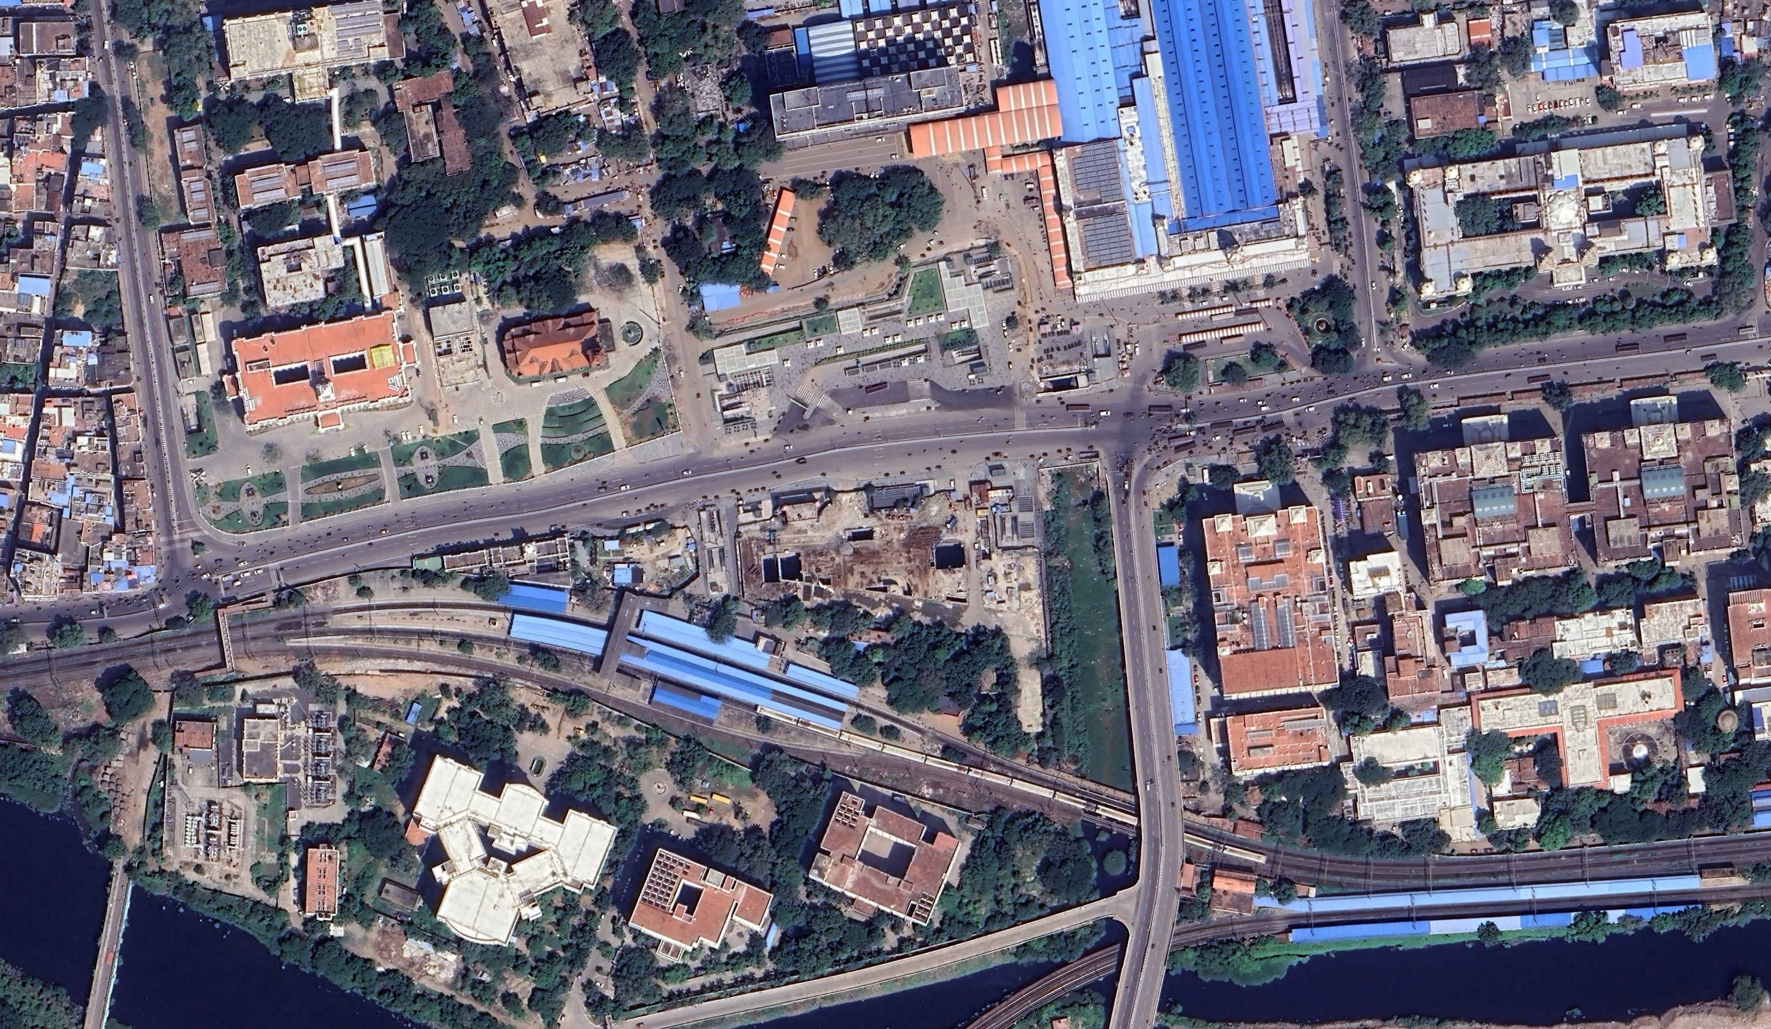

TOD & MMI - Concept
Chennai Central Tower serves as a key multi-modal transport hub, facilitating seamless movement between major transportation points such as Chennai Central Railway Station, Suburban Central Railway Terminal, Park Town Railway Station, MRTS, CMDA-headquarters and Government hospital
Chennai Central Tower
SUBURBAN STATION
CHENNAI CENTRAL STATION
SOUTHERN RAILWAYS HQ
Raja Muthiah Road
Subject Property
RAJIV GANDHI HOSPITAL
PARK STATION
Pallavan Salai
PARK TOWN STATION
  Arterial Roads
  Landmark nodes around the site
  Subject Site

Slide 18
Value Capturing Finance
Value Capture financing
  Implement land value capture mechanisms
  Maharashtra have implemented specific VCF mechanisms : 1% surcharge on stamp duty, to fund urban transport projects.
  Standard guidlines to be set across State for revenue generation

Slide 19
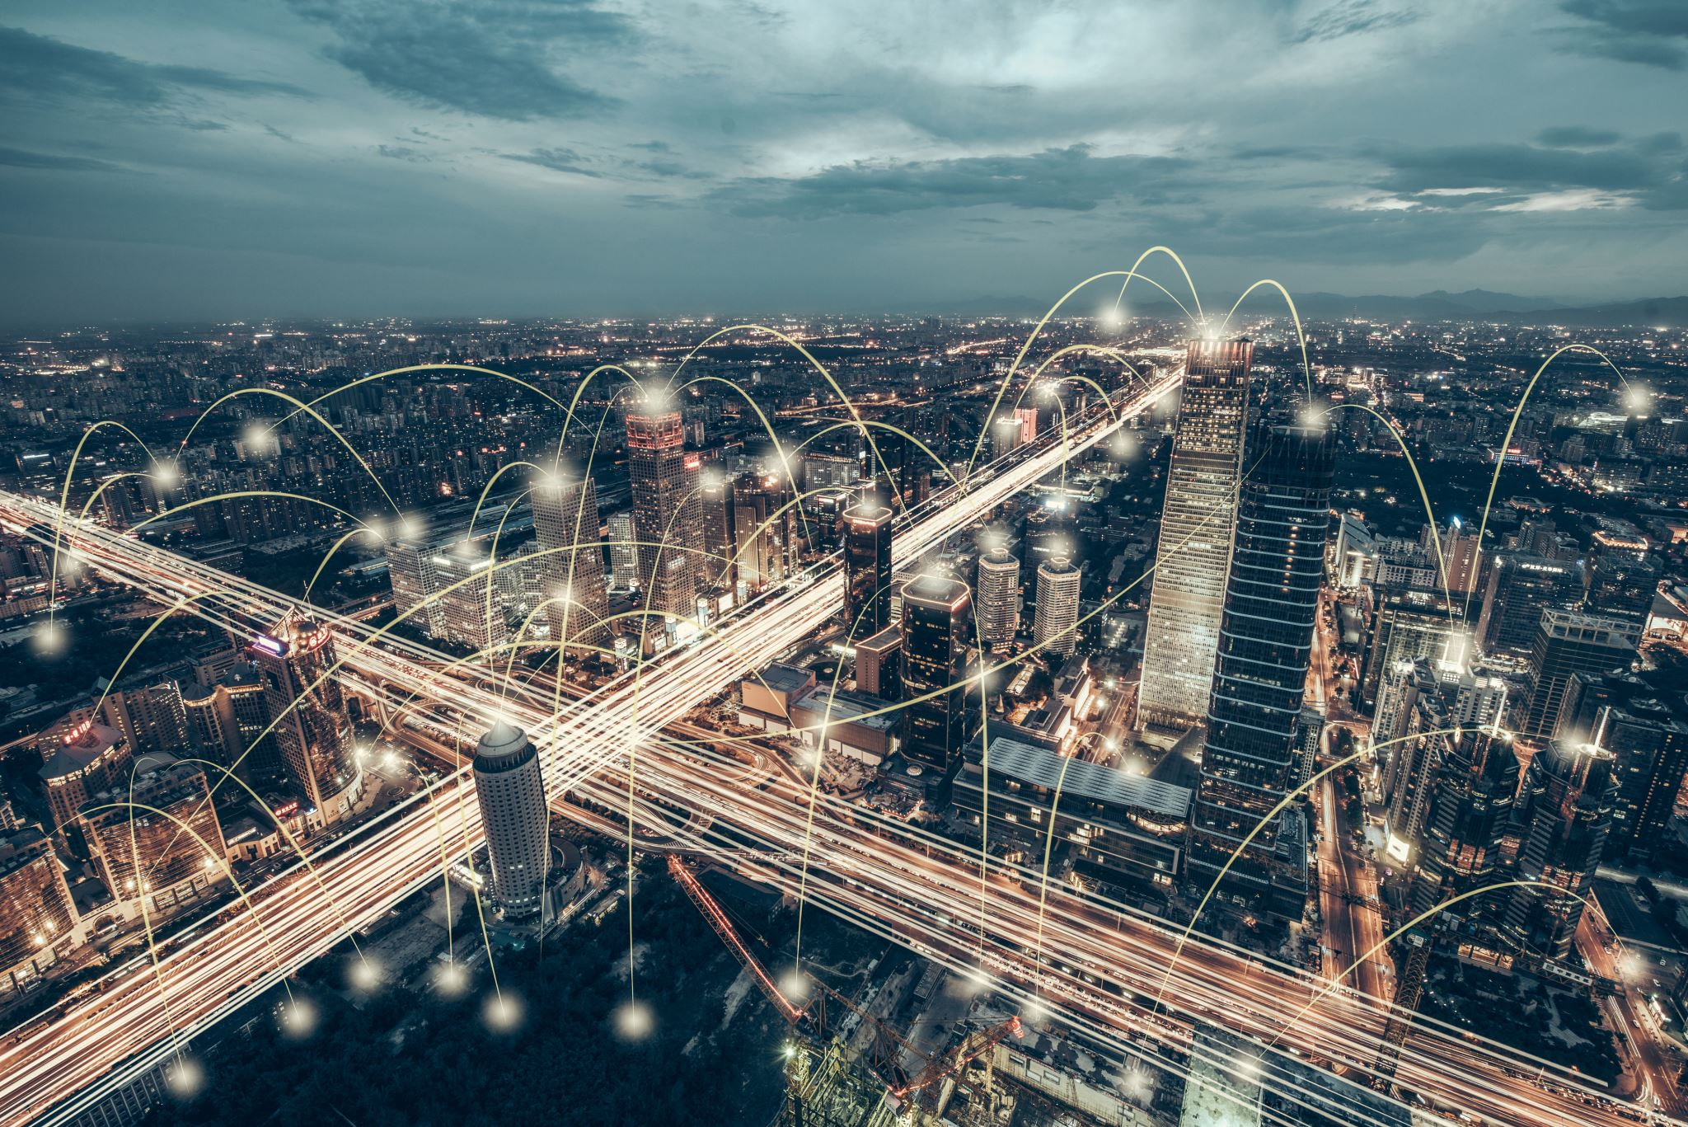

Telecom & IT Infra
Space to be provided to Infrastructure Service Providers – OFC cables,
Regular Monitoring system
Technology upgradation
CHALLENGES:
Change in Technology / Networking
Pricing – Elevated and Under ground
Long term Tenure

Slide 20

Take Aways
Non- Farebox
Facilitate New Business Concept
Integrated Development
Co-exist & compliment
Farebox
Compliment

Slide 21
Thank You

