Slide 1
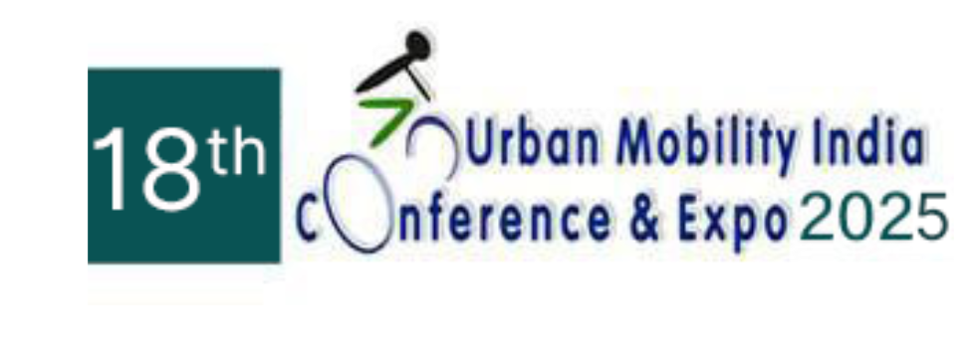
Factors Influencing Bicycle Preference in Nagpur, India: Insights for Sustainable Urban Transport
by
Poonam Rajaram Adsule (Research scholar, IIT Delhi)
Dr. B. R. Kadali (Assistant Professor, NIT Warangal)

Slide 2
Content
Introduction
Past studies
Methodology
Result
Policy implications
Conclusion

Slide 3
INTRODUCTION
The rapid growth of motorized vehicles in India has intensified urban challenges, including traffic congestion, road accidents, air pollution, and noise pollution.
Transport emission in India - 1.7 percent per year from 1990 to 2022
The transport emissions should decrease by 3 per cent per year to achieve the Net Zero emission by 2050 target (IEA, 2025). -
An effective solution is adopting sustainable transport modes like bicycles
A bicycle is an affordable, accessible, and environmentally friendly mode of transportation.
It also offers health benefits such as a reduction in chronic diseases (Advani and Tiwari, 2006).

Slide 4
INTRODUCTION
Previous studies have shown that bicycling preferences are influenced by environmental, infrastructural, and socio-demographic factors.
Despite its potential, the modal share of cycling has declined due to inadequate infrastructure, safety concerns, theft, social status issues, and the lack of supportive regulations.
This decline has been particularly evident in developing countries such as India (The Energy and Resources Institute, 2025; WRI India, 2025), especially in cities like Nagpur, where the bicycle share is 6.4 percent. → Highest among Indian megacities
Therefore, this study aims to examine the determinants affecting bicycling preferences in Nagpur, India.

Slide 5
Past studies
Past studies have shown that bicycling is influenced by socio-demographic characteristics, bicycling infrastructure, and the attitudes of bicyclists.
A study by Advani and Tiwari (2006) highlighted the importance of safe routes and parking near transit to integrate bicycles with buses.
A study by Branion-Calles et al. (2019) confirmed that infrastructure improves perceived safety.
Cabral et al. (2018) emphasized the importance of perceived safety in decisions to cycle, while the study further identified traffic stress tolerance, perceived behavioural control, education, and intention as significant predictors of utility cycling and active travel behaviour.
Overall, safety perceptions, demographics, and health suggest that traffic calming and facilities encourage cycling (Sallis et al., 2013).

Slide 6
Past studies
Overall, previous studies have shown that bicycling preferences are influenced by environmental, infrastructural, and socio-demographic factors. Despite its potential, the modal share of cycling has declined due to inadequate infrastructure,
The present study's contributions are twofold - first, the study considered the weather effect on bicycling preferences; Second, this study considered the level of bicycling preferences rather than considering the generic bicycling preferences.

Slide 7
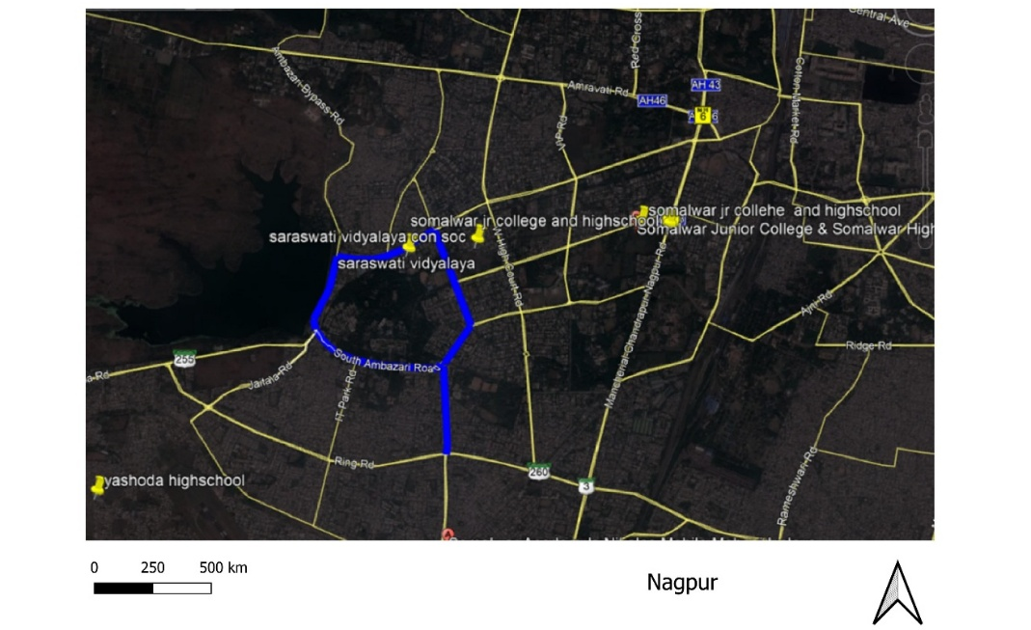
Methodology
Nagpur city has the highest bicycle share compared to other cities (Gupta and Puntambekar, 2016).
The data was collected along the corridor where bicyclists were observed near college schools and local workplaces, as shown in Figure 1.
Offline survey conducted from October 2019 to January 2020
After an in-depth examination, 623 responses (out of 1123) were coded and analyzed.
Figure 1: Selected corridor in Nagpur

Slide 8
Methodology
The questionnaire included attitudinal variables related to motivation, barriers, social norms, preference level to bicycling, and bicyclist socio-demographic characteristics. - 5-point Likert scale.
Collected data, analysed using factor analysis, followed by an ordered logit model.
Factor analysis is a multivariate statistical technique used to simplify and structure large datasets by identifying underlying relationships among variables.
In this study, the dependent variable is the preference level for using a bicycle, with five levels: never, rarely, uncertain, often, and always. Hence, the ordered logit model is a suitable method to analyse the user preference level for bicycling. The study

Slide 9
Result
Variables | Estimate | t-ratio
Infrastructure facility | 0.309 | 1.261*
Motivation | -2.407 | -6.247
Environmental barrier | 1.120 | 10.547
Personal norm | -0.175 | -1.171*
Parking facility | -2.613 | -7.411
Trip purpose
work | 1.355 | 2.885
school | 1.031 | 2.813
Recreation | 1.034 | 2.356
Distance | 0.240 | 2.944
Gender | -0.292 | -2.459
Occupation | 0.875 | 1.977
Preference level for bicycling
Tau_1 | 3.058 | 3.504
Tau_2 | 5.166 | 5.812
Tau_3 | 6.343 | 7.031
Tau_4 | 8.669 | 9.306
Model fit
Log-likelihood (Initial) | -1137.860
Log-likelihood (Final) | -687.370
Adj. Rho-squared | 0.168
Estimated parameter | 15
Number of responses | 623
Table 3 presents the estimation results of the ordered logit model examining individuals’ preference for bicycling.
The dependent variable was measured on a five-point Likert scale ranging from never to always.
Latent constructs extracted from factor analysis (infrastructure facility, motivation, environmental barrier, personal norm, and parking facility), along with observed variables (trip purpose, distance, gender, occupation), were included as independent variables.
The four threshold parameters (Tau_1 to Tau_4) separating the preference levels are all highly significant, confirming that the ordered logit structure is suitable for modeling the five-point Likert outcome.

Slide 10
Planning implications
The study observed that motivation, environmental barriers, parking facilities, and socio-demographic characteristics influence the level of bicycling preference. Hence, separate infrastructure facilities, such as clean and well-maintained bicycling lanes, can help bicyclists travel seamlessly. Additionally, secure and safe parking facilities at public and workplace locations can help alleviate the fear of having a stolen bicycle. A total of 16 km of separate bicycle paths exists in Nagpur; however, they are not well-maintained.
Regular maintenance from government authorities can increase the bicycle share in the city. Providing a dedicated lane for bicycling at city centres, city attractions, and nearby schools can motivate bicyclists to engage in regular cycling.
A gender-sensitive intervention and campaigns targeting different trip purposes can broaden the appeal of bicycling across population groups. The study analysis is based on their responses to attitudinal statements. Therefore, the addition of their real-time travel history can enhance the model outcome

Slide 11
Conclusion
The present study aims to understand the factors influencing the preference level of bicycling in Nagpur, India. The attitudinal responses from the bicyclist were analysed using the order probit model. Using 623 responses from bicyclists, an exploratory factor analysis was employed to get latent factors. The key findings of the studies are as follows,
Less motivated bicyclists indicated a lower likelihood of preferring regular bicycling.
Adverse environmental conditions like scorching summer, heavy rain, and low visibility at night, always keep bicyclists away from regular bicycling.
An insecure parking facility discourages users from preferring bicycling regularly.
Women are less likely to prefer cycling on a regular basis than men.
Bicyclists prefer bicycling mostly for commuting compared to non-commuting trips.
Overall, the study found that motivation, environmental barriers, and parking facilities were the primary determinants of bicycling preference levels.

Slide 12
Study limitations and future scope
Since the study was conducted in 2019, the pandemic and post-pandemic analysis are not covered in the study. Additionally, the study's outcome is limited to Nagpur city; however, it is applicable to similar cities.
Future research could address these limitations by incorporating longitudinal data, combining attitudinal and revealed-preference approaches, and conducting comparative studies across multiple cities.
Overall, the study's outcomes can help policymakers make bicycles a viable, attractive, and sustainable mode of transport for a wider range of people.

Slide 13
References
Advani, M., and Tiwari, G. 2006. Bicycle – As a Feeder Mode for Bus Service. VELO MONDIAL, Conference 2006 held at Cape Town, South Africa. URL -http://tripp.iitd.ernet.in/publications/paper/planning/mukti_VELO06 paper.pdf Accessed – 29.08.2025
Cabral, L., Laura, Kim, A. M., Parkins. J. R., 2018. Bicycle Ridership and Intention in a Northern , Low-Cycling City. Travel Behaviour and Society. 13,165 - 173. https://doi.org/10.1016/j.tbs.2018.08.005
IEA, 2025. Tracking Transport. URL - https://www.iea.org/energy-system/transport. Accessed – 23.08.2025
The Energy and Resource Institute, 2025. Pedaling towards a greener India: Report on promoting cycling in the country. URL - https://www.teriin.org/eventdocs/files/Cycling_Report_LR.pdf. Accessed on - 23.08.2025
WRI INDIA (2025). Public bicycle sharing in India: Lessons learned from implementation in three cities. URL - https://wriindia.org/sites/default/files/FINAL_Public%20Bicycle%20Sharing%20India_WP_3July.pdf. Accessed 23.08.2025
Branion-Calles, M., Nelson, T., Fuller, D., Gauvin, L., Winters, M. 2019. Associations between Individual Characteristics, Availability of Bicycle Infrastructure, and City-Wide Safety Perceptions of Bicycling: A Cross-Sectional Survey of Bicyclists in 6 Canadian and U.S. Cities. Transportation Research Part A: Policy and Practice. 123, 229-239. https://doi.org/10.1016/j.tra.2018.10.024

Slide 14
THANK YOU

