Slide 1

Research Symposium
18th Urban Mobility India Conference and Expo, 2025
Evolving Urban Freight Management Strategies for a
Wholesale Textile Market –
A Case of Gandhi Nagar Textile Market, Delhi
Smith Sarthak Mohanty* Sanjay Gupta**
* Post Graduate Student
**Professor and Head of Department
Department of Transport Planning, School of Planning and Architecture,
New Delhi, India

Slide 2






INTRODUCTION
IMPORTANCE OF URBAN FREIGHT IN INDIA
Indian Logistics
growing at
13%
Indian Logistics cost
as the part of GDP
14%
Employment to
People
20 Million
Modal Split of Freight Movement in India
Road Rail Water Pipeline Air
72%
16%
5%
2%
2%
Urban Freight Transport (UFT) is essential for meeting needs of the city firms and residents. (NITI Aayog, 2021)
Demand for UFT increases with increase in population and economic growth.
Addition of 125 million population and growth logistics by 11 lakh cr. by 2025.
Higher focus on PT and Private Vehicles but low focus on freight, thus need for freight & logistics management.
RESEARCH CONTEXT / NEED OF THE STUDY
OBSOLETE INFRASTRUCTURE
Poor loading/unloading zones
Narrow internal/access roads
Absence of Logistic facilities
Limited parking facilities
Lack of freight docking facilities
INEFFICIENCIES IN PRODUCTIVITY
High Logistics Cost
High Delivery Time
Congestion due to frequent trips of heavy vehicles
Unregulated Movements
LOGISTIC COST
Inventory Cost (34%)
Transportation Cost (62%)
Administrative Cost (4%)
ENABLE TARGATED INTERVENTIONS
Off-Peak Deliveries
Freight Consolidation Centers
Low Emission Zones
Optimization of Delivery Routes
Supply Chain Management

Slide 3
METHODOLOGY
AIM OF THE RESEARCH
Stage – 1
Background Study
Research Context and Need of the Study
Setting Research Rationale:
Aim, Objectives, Methodology, Scope and Limitations.
To develop Urban Freight Management Strategies for improving productivity of Gandhi Nagar Wholesale Textile Market, Delhi.
OBJECTIVES
Stage – 2
Literature Review
Concept of Collaborative Delivery and UCC
Research Papers & Global Case Studies
Identifying Stakeholders and Analytical Model
To assess the importance of Urban Freight Management Strategies around Wholesale Market area and review best practices.
Stage – 3
Selection of Study Area and Study Zone
Selection of Study Area
Selection of Study Zone/Site within the
Study Area
To assess the physical, operational and traffic movement patten of the case market area and identify issues and challenges.
Stage – 4
Data Collection
Secondary Data Collection:
Mapping of Market and Existing Logistic Facilities
Primary Data Collection:
Reconnaissance Survey, Establishment Survey, Transport Op., Truck Op.
To develop Alternate Freight Management Strategies in the case market area and identify appropriate strategies/measures
Stage – 5
Data Analysis
Assessment of Physical, Operational and Road & Traffic Characteristics
Analytical Tool:
MCDA: RII and AHP
To assess the impact of selected strategies/measure for the case market area and propose operational plan for its implementation.
Stage – 6
Scenario Development & Impact Assessment
Development of Alternate Freight Management Strategies
Assessment of the Impact of Alternate Strategies on the Market Operation
SCOPE AND LIMITATIONS
Scope: To study the freight operations and planning with focus on one commodity (Textile) and one wholesale market (Gandhi Nagar Market).
Limitations: Extent of study area is limited to NCT and Time constraints.
Stage – 7
Conclusion & Proposals
Propose an Operational Plan for implementation of best alternate strategy and Recommendations

Slide 4
LITERATURE REVIEW
STRATEGIES
CONCEPT
PARAMETERS FOR EFFECTIVENESS
BENEFITS AND IMAPCT
NIGHT-TIME DELIVERIES
Night-time deliveries can alleviate truck traffic during peak hours, easing crowded roads.
Narrow roads
High congestion at peak hours
Limited parking space for delivery vehicles
Shorter delivery time and greater delivery efficiency
Lower risk of delay in deliveries.
URBAN CONSOLIDATION CENTERS
Urban consolidation centers (UCCs) are city warehouses that consolidate shipments for efficient final-mile deliveries.
Many shipments come from areas far away from the city.
Underloading of trucks is a key issue with the city’s logistics
Share of rated loading capacity (when vehicle is loaded)
Timely deliveries, reduction in sorting and packaging time.
URBAN LOGISTICS SPACES AND HOTELS
Establishing urban logistics spaces and hotels in the city’s core minimizes this distance, to inefficient final-mile deliveries.
Existing logistics centers are far away from the urban core, and the cost of delivery is extremely high
Urban logistics spaces (ULSs) in city centers store goods for efficient final-mile delivery, benefiting both logistics and hotels.
LOGISTICS DEVELOPMENT AND LOGISTICS PARKS
Logistics development and logistics parks include warehousing infrastructure, transportation infrastructure, and customer services.
Land is owned by the city and is designated for industrial use
There is a potential for intermodal logistics delivery,
Infrastructure enabling multimodal freight transfer (Railside or portside)
Mechanized material handling and specialized storage solutions
MODAL SHIFT PLANNING
Modal shift planning is required to efficiently integrate alternative modes of transport.
This measure is most effective when the majority of the freight is and the existing rail or waterway infra is underutilized.
Modal shift planning builds the capacity of existing railways or waterways to shift freight movement from roads
ELECTRIFICATION OF
URBAN FREIGHT
EVs have lower operational costs and zero tailpipe emissions, which can help improve the air quality.
This measure is most effective in areas with high air pollution and poor health due to air quality.
India’s freight vehicles rely primarily on diesel. With increasing import prices, high dependence on diesel is both environmentally and economically concerning.

Slide 5







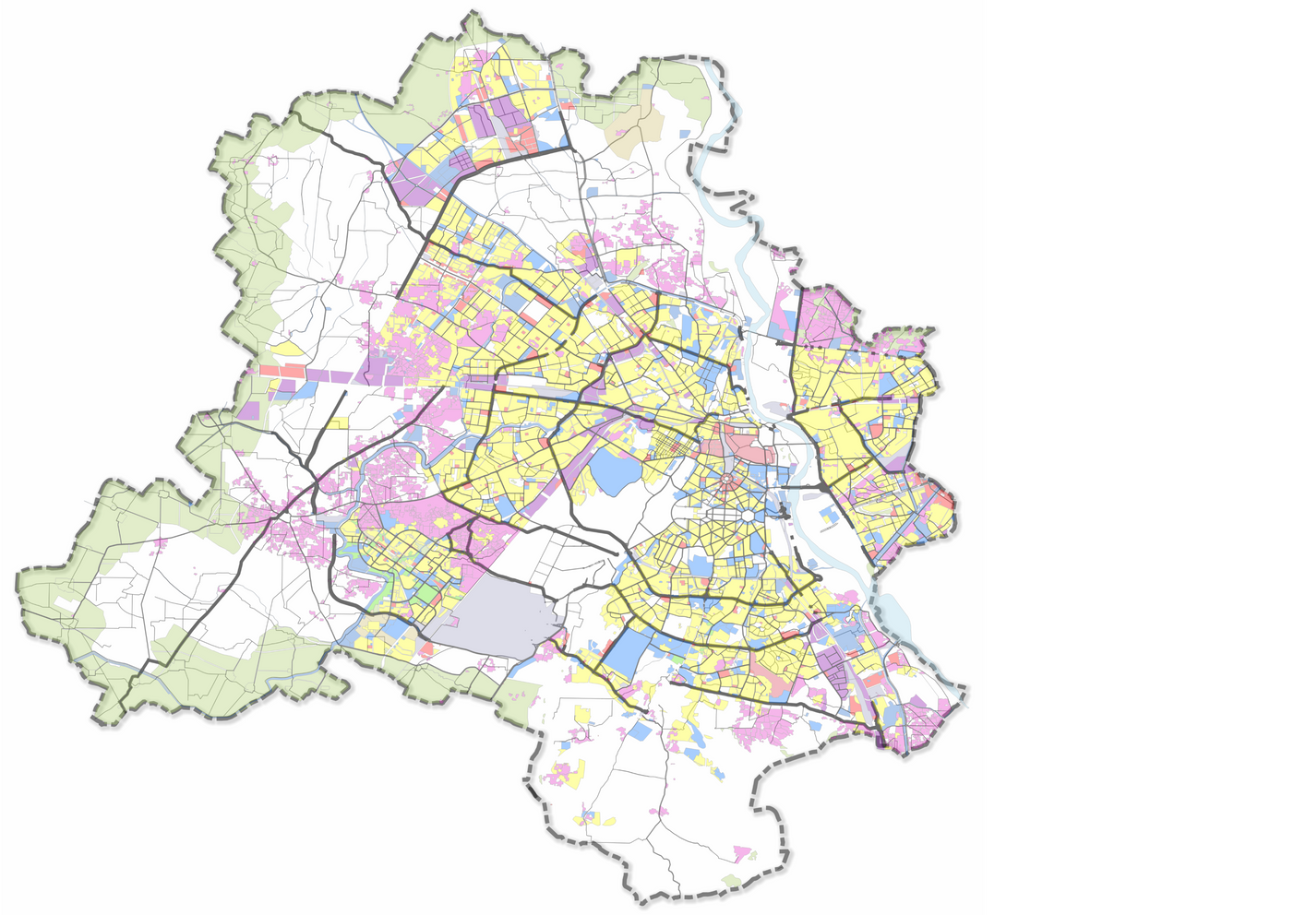





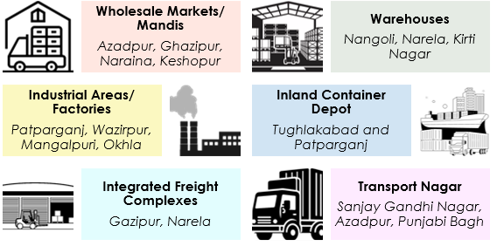
CITY PROFILE
PHYSICAL PROFILE
91 % Male
80 % Female
WFPR
33.28%
Capital of the country
One of the Metropolitan cities
Ring and Radial Pattern development
Envisioned as poly-nodal with hierarchy of commercial centres
Sex Ratio
866 Female per 1000 male
1483 Sqm (NCT)
18 Planning
Zones
Employment
Primary Secondary Tertiary
FREIGHT PROFILE OF DELHI
1%
13%
86%
2.46 Lakh Goods Vehicle
6 Lakh tons daily regional movement
3.72%
Employment
5,98,922
GDP (per capita)
1.6 lakh ton daily intra city goods movement
15-20% goods vehicle share on peak hour
ROAD NETWORK
MAJOR FREIGHT GENETRATORS OF DELHI
32663 Km
Road network Length
17.49 Km per km square
Road density
21%
City area coverage
21Million
Registered vehicles
0.3 Million
Goods Vehicle
1.2%
Goods Vehicle AGR
Map: Road Network of Delhi

Slide 6
SURVEY DESGIN AND DATABASE
PRIMARY SURVEY
TYPE OF SURVEY | STAKEHOLDER | DURATION & TIME | METHOD | SAMPLE COLLECTED | STATUS | EXPECTED OUTCOMES
Reconnaissance Survey | Whole Market | Morning | Observation | - | Completed | No. Of Establishment, Market Profiling, Mapping Establishments Types of Establishments and Layout
Establishment Survey | The type of establishments include wholesale, retail, small business and industries. | Peak hours of good inflow/outflow | Stratified Random Sampling | 178 (4.5% of total) | Completed | Market profiling, Total trips, Goods movement, location of facilities, employment, time taken, Transportation, and supply chain,
Traffic Volume count | Focal Points surrounding the market place (entry/exit of market places) | Peak hours of good inflow/outflow | - | 3 Hours Peak Operational Time | Completed | Types of goods vehicles on selected roads or routes, or crossing specified cordons by time of the day Type of Vehicles, Vehicular flow
Transport Operator / Freight Forwarder Survey | The truck owners and fleet operators' offices. | Market Operational Hours | Stratified Random Sampling | 26 (40% of total) | Completed | Trip Characteristics (haulage, waiting time, dwell time, frequency, cost per trip), Commodities, Fleet.
Freight Vehicle Driver Survey | Freight Vehicle Drivers | Market Operational Hours | Random Sampling | 74 | Completed | Driver's trip pattern, including loading/unloading details, commodities, trip length, and frequency..
SECONDARY DATA
Delhi Freight Study Report, 2020 (SPA Studies)
Tom-Tom Traffic Index Report, 2025
Master Plan Delhi, 2021 and Zonal Plan
CRRI MEGALOG Final Report, 2018
Urban Consolidation Center Final Report, 2016
Freight Management Strategies
Economic Survey of Delhi, 2024-25

Slide 7
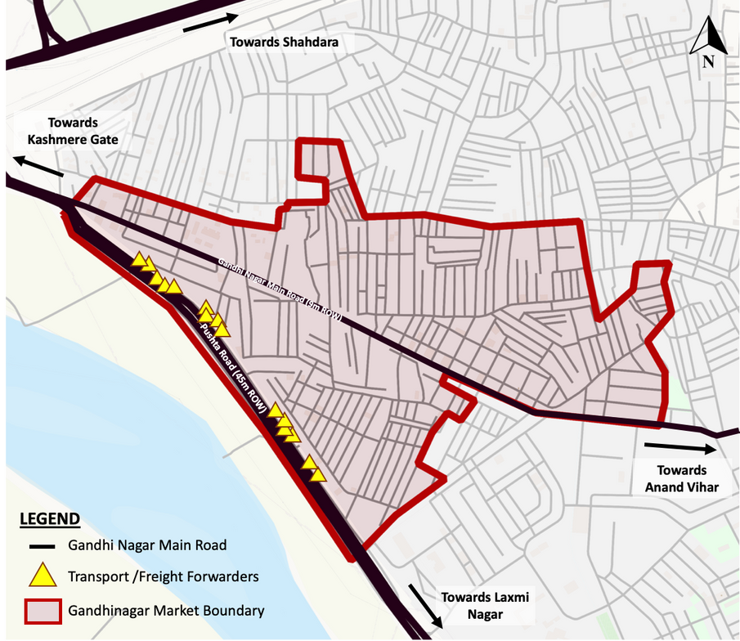
PHYSICAL CHARACTERISTICS OF GANDHI NAGAR MARKET
PROFILE OF THE MARKET
DISTRIBUTION OF SHOPS IN THE MARKET
ATTRIBUTES | UNITS
Area (Ha) | 70 Ha
No. of Establishments | 4000
Establishment Density | 59 estt/ha
No. of Transporters | 65
Annual Tonnage Inflow (lakh) | 8.35 lakhs
Growth Rate | 6%
Daily tonnage handled (tonnes) | 2290 tonnes
Tonnage per Unit Area | 33 tonnes/ha
TYPE | UNITS | SHARE
Wholesale Units | 3650 | 91.25%
Retail Units | 350 | 8.75%
TOTAL | 4000 | 100%
TYPE | UNITS | SHARE
Readymade Wholesale | 3450 | 95%
Fabric Wholesale | 150 – 200 | 5%
TOTAL | 3650 | 100%
Source: Primary Survey and Association of Wholesale Readymade Garments
Source: Primary Survey and Association of Wholesale Readymade Garments
Map: Gandhinagar Market, Delhi
The retail units all comprise of readymade garments.
There are about 700 – 750 manufacturing units in Ajit Nagar including small scale manufacturing and household industries involved with stitching, dye, embroidery, and other activities.
The wholesale shops size can be categorized into 4 types in terms of dimension:
4 x 6m ; 6 x 6 m ; 6 x 10 m ; and 8 x 10m.
The main abutting roads connecting to the market are:
Pushta Road (45m ROW)and Ansari Road (30m ROW) connecting the Grand Trunk Road (45M ROW), and Gandhinagar Market Road (9m ROW, local road) providing access to the identified area.

Slide 8
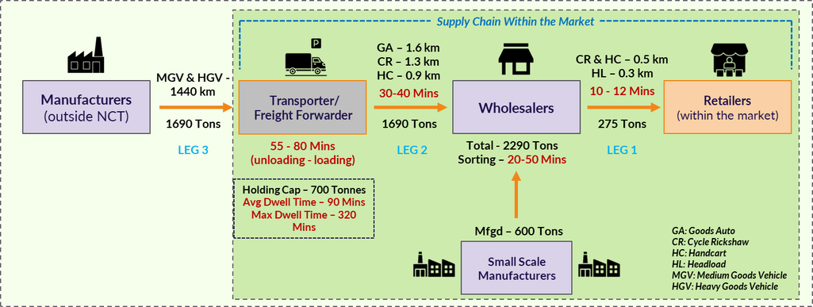
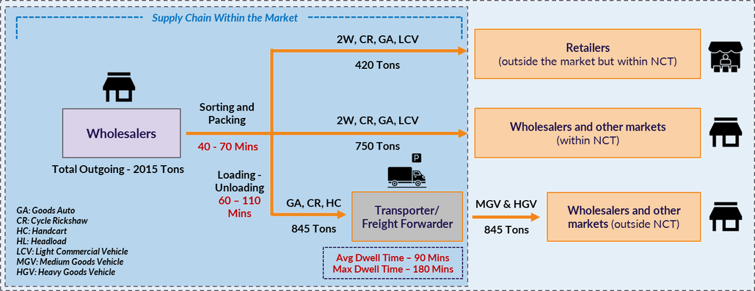
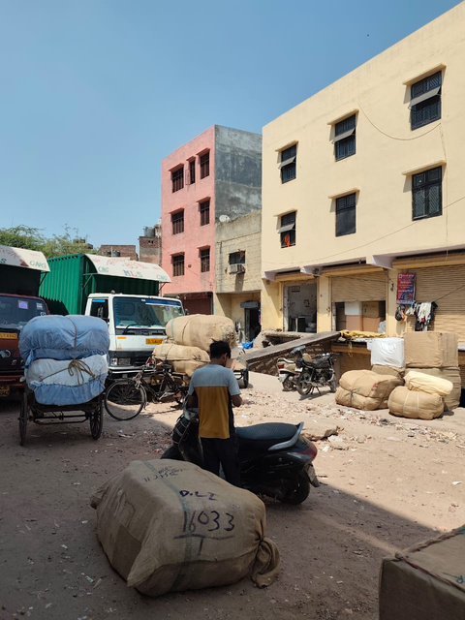
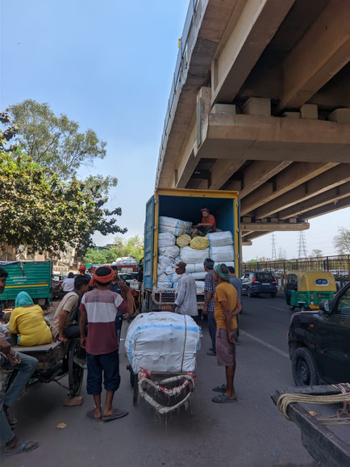
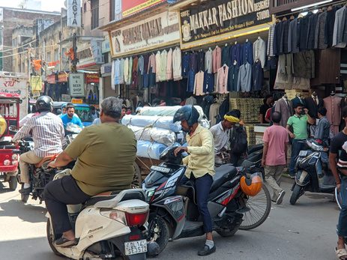
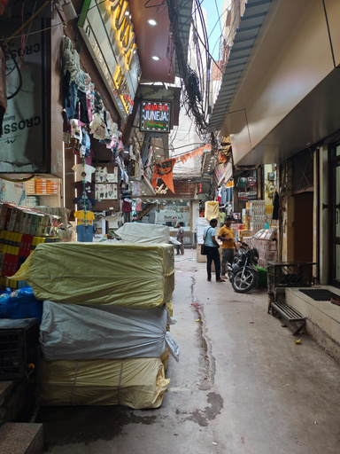
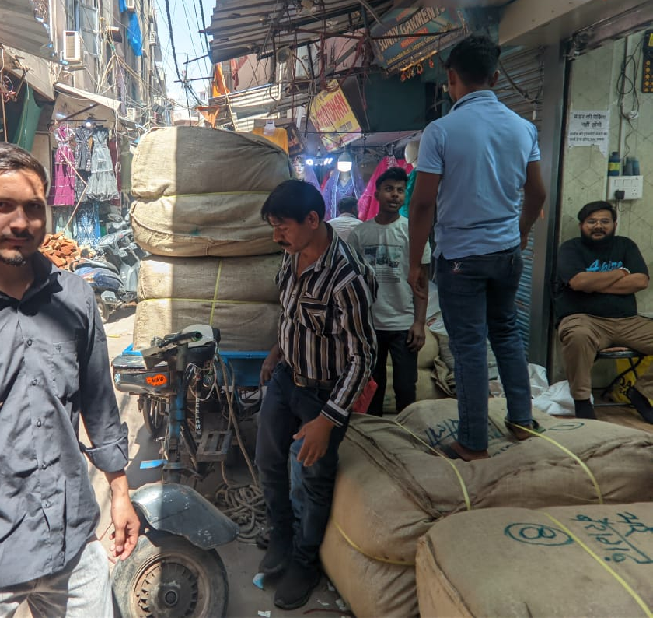
SUPPLY CHAIN OF GANDHI NAGAR MARKET
INCOMING SUPPLY CHAIN
OUTGOING SUPPLY CHAIN
Total incoming tonnage = 2290 tonnes
The total turnabout time from parking to retailer shop for inflow of commodity is 115 – 180 mins. This indicates productivity loss due to excess time taken in loading and sorting time taken.
Overall Incoming Supply Chain
Total outgoing tonnage = 2015 tonnes
The total turnabout time for outflow of commodity is 100 – 180 mins. Maximum time taken in Sorting & Packing as well load-unloading of commodity, affecting the productivity of the market.
Overall Outgoing Supply Chain
Supply Chain within Market
Supply Chain within Market
Transporters
Unloading near Main Rd
Wholesalers
Sorting of Goods
To Retailers

Slide 9
OPERATIONAL CHARACTERISTICS OF GANDHI NAGAR MARKET
The operational characteristics of the three legs of supply chain in terms of Average Lead Distance, Average Travel Time, Freight Cost (INR/tonne-km) and Percentage share of NMT to Motorized mode is given:
TONNAGE HANDLED BY THE TIME OF THE DAY
Supply Chain | Tonnage Handled | Mode Used | Avg. Lead Distance (km) | Avg. Travel Time (min) | Cost (INR/ton-km) | Motorized- Non-Motorized Share
LEG 3 From Manufacturer to Transporter | 1690 tonnes | MGV | 1054 | 1.5 – 2 days | 37 | 100% Motorized
LEG 3 From Manufacturer to Transporter | 1690 tonnes | HGV | 1894 | 2 - 3 days | 45 | 100% Motorized
LEG 2 From Transporter to Wholesaler | 1690 tonnes + 600 tonnes | Handcart | 0.9 | 42 | 128 | 74% NMT 26% Motorized
LEG 2 From Transporter to Wholesaler | 1690 tonnes + 600 tonnes | Cycle Rickshaw | 1.3 | 35 | 90 | 74% NMT 26% Motorized
LEG 2 From Transporter to Wholesaler | 1690 tonnes + 600 tonnes | Goods Auto | 1.6 | 15 | 40 | 74% NMT 26% Motorized
LEG 1 From Wholesaler to Retailer (within the market) | 275 tonnes | Cycle Rickshaw | 2.9 | 70 | 87 | 92% NMT 8% Motorized
LEG 1 From Wholesaler to Retailer (within the market) | 275 tonnes | 2W | 4.2 | 35 | 32 | 92% NMT 8% Motorized
LEG 1 From Wholesaler to Retailer (within the market) | 275 tonnes | Goods Auto | 12.7 | 105 | 35 | 92% NMT 8% Motorized
LEG 1 From Wholesaler to Retailer (within the market) | 275 tonnes | LCV | 15.4 | 120 | 28 | 92% NMT 8% Motorized
LEG 1 From Wholesaler to Retailer (within the market) | 275 tonnes | MGV | 21 | 145 | 17 | 92% NMT 8% Motorized
The total tonnage handled in Gandhi Nagar Market is 2290 tonnes through out the day, involving both inflow and outflow of goods.
Peak hour of freight movement is 02:00 to 03:00 pm.
During the market operational hours (10:00 to 18:00), the morning shift deals with incoming goods and the afternoon shift mostly deals with outgoing goods.
Thus, the market is always congested due to the unrestricted two-way movement of goods which leads to delay in outgoing consignments and need for more inventory holding.

Slide 10
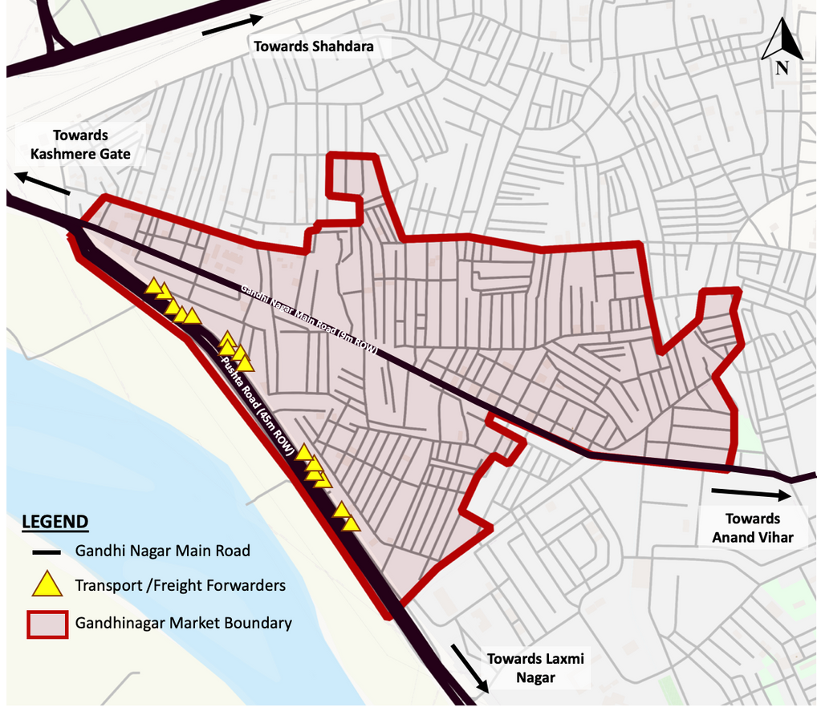
TRAFFIC CHARACTERISTICS OF GANDHI NAGAR MARKET
Source: Primary Survey
Freight movement is dominated by NMT modes within the market, contributing to about 79% of total mode share.
LEVEL OF SERVICE
Road | Capacity (PCU/hr) | Peak Hour Volume | Peak Hour PCU | V/C | LOS
Pushta Road | 5400 (4-Lane D) | 3747 | 4266 | 0.79 | LOS D
Gandhi Nagar Rd | 2400 (2-Lane U) | 1552 | 2712 | 1.13 | LOS F
Source: Primary Survey
Map: Gandhinagar Market, Delhi

Slide 11
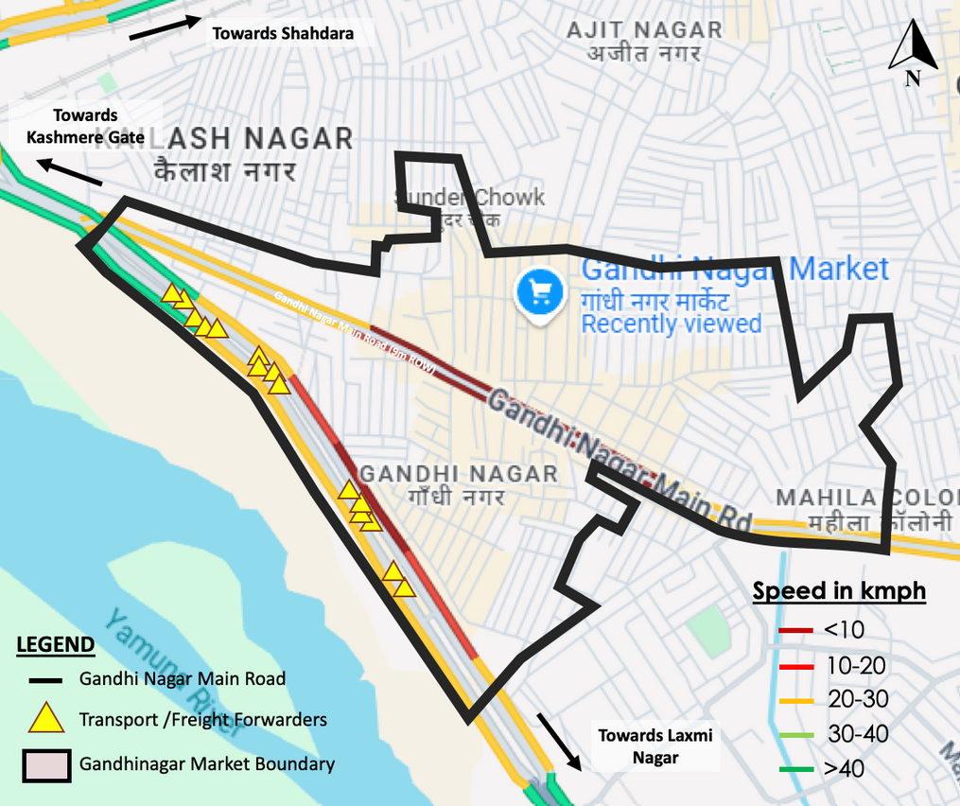
RELATIONSHIP BETWEEN NETWORK SPEED AND FREIGHT MOVEMENT
SPEED ON GANDHI NAGAR MARKET ROAD (9M ROW)
Source: Primary Survey
TONNAGE HANDLED BY THE TIME OF THE DAY
Source: Primary Survey
The network speed graph shows the slowest speed between 2 to 3 pm and the tonnage handled by the day graph shows the maximum tonnage moved in and out during the same time.
Thus, tonnage movement is inversely proportional to network speed.
Map: Network Speed of Gandhinagar Market during peak hour

Slide 12
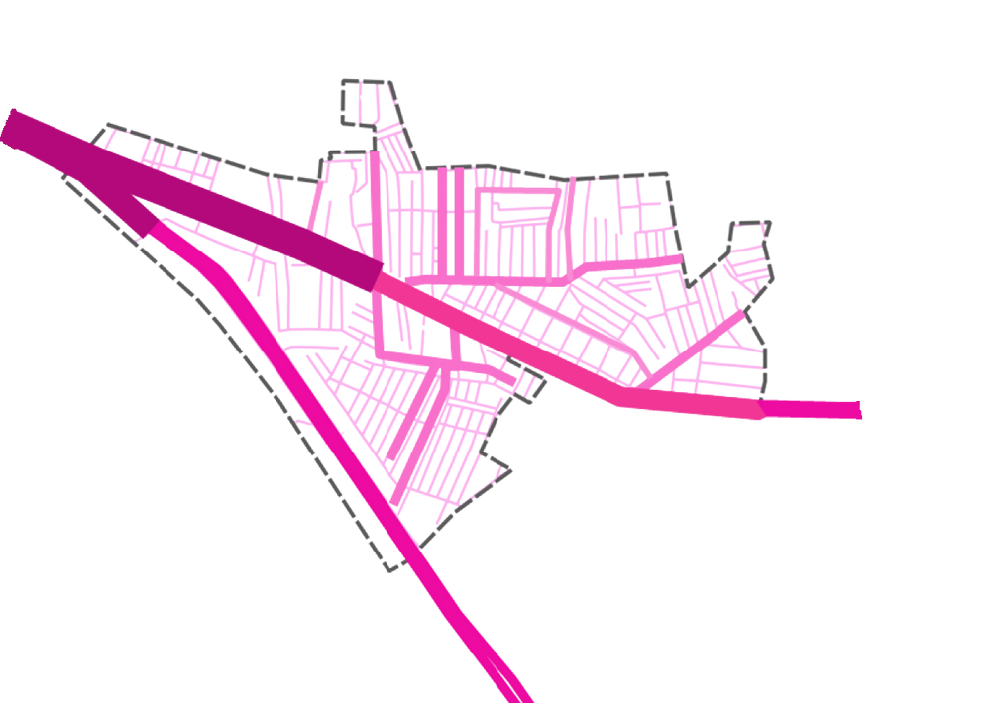

TRAFFIC ASSIGNMENT FOR BASE SCENARIO & ISSUES
ASSIGNED TRIPS (PCU) WITHIN THE MARKET
ISSUES
CONGESTION OF THE MARKET DUE TO IDLE PARKING
Encroachment due to idle parking of freight vehicles.
Unregulated two-way movement at the same time.
Congestion of Market and Productivity loss.
CONGESTION OF THE MARKET TO SORTING OF GOODS ON ROAD
Encroachment of the streets due to sorting and packaging of on streets.
Reduction of effective carriageway and smooth movement
Increase in congestion & total turn about time of inflow and outflow.
TIME LOSS IN UTILIZATION OF NMT MODES
Utilization of NMT for movement of goods within the market.
Manual loading and unloading of goods.
Increasing total turnabout time and productivity loss.
ABSENCE OF DEDICATED PARKING FACILITY
Volume (PCU)
Gandhi Nagar Market
Boundary
Time loss in searching for parking space.
0 – 750
750 – 1500
1500 – 2250
2250 - 3000
Absence of dedicated parking space and parking bays.
Increase in total turnabout time of inflow and outflow.
Congestion of main access road
KEY STAKEHOLDER ISSUES
Map: Traffic Assignment for existing scenario (within study area).
WHOLESALERS/RETAILERS | FREIGHT VEHCLE DRIVERS | FREIGHT FORWARDERS/TRANSPORTERS
Absence of inventory holding space | Haphazard movement during peak hours | Lack of Storage / Inventory Holding Space
Inefficient ROW of internal access roads | Inefficient ROW of internal access roads | Lack of dedicated parking
Road | Observed Traffic Volume (in PCU/hr) | Modelled Traffic Volume (in PCU/hr) | GEH Value
Gandhi Nagar Market Road | 2712 | 2598 | 2.21
Encroachment of the streets due to sorting and packaging of on streets.
GEH value of the ratio of Observed value and Modelled value is 2.21 which is within acceptable fit, which proves the model is acceptable.

Slide 13
RANKING OF ISSUES USING RII
The Relative Importance Index (RII) is a statistical measure used to rank the importance or priority of different factors based on survey responses. It helps in comparing the relative significance of multiple variables.
Where W - Weight assigned to each response.
k - Highest weight in the scale.
N - Total number of respondents.
RII = [∑(Wi∗x)] / (k∗n)
ISSUES | TOTAL RESPONSE | SKEWNESS AND KURTOSIS TEST | SKEWNESS AND KURTOSIS TEST | SKEWNESS AND KURTOSIS TEST | SKEWNESS AND KURTOSIS TEST | SKEWNESS AND KURTOSIS TEST | SKEWNESS AND KURTOSIS TEST | RELATIVE IMPORTANCE INDEX | RELATIVE IMPORTANCE INDEX | RELATIVE IMPORTANCE INDEX
ISSUES | TOTAL RESPONSE | Min | Max | Mean | Std. Deviation | Skewness | Kurtosis | W | RII | Ranking
Congestion due to unregulated two-way freight movement | 155 | 1 | 5 | 3.58 | 1.253 | -0.386 | -1.033 | 555 | 0.716 | 1
Time loss in sorting of goods at wholesale shops. | 155 | 1 | 5 | 3.50 | 1.240 | -0.355 | -0.936 | 542 | 0.699 | 2
Congestion due to encroachment of streets | 155 | 1 | 5 | 3.39 | 1.266 | -0.102 | -1.236 | 525 | 0.677 | 3
Absence of dedicated Parking facility. | 155 | 1 | 5 | 3.26 | 1.395 | -0.225 | -1.246 | 505 | 0.651 | 4
Utilization of NMT increasing the total turnabout time. | 155 | 1 | 5 | 2.98 | 1.407 | 0.021 | -1.232 | 479 | 0.618 | 5
Time loss due to manual loading-unloading of Goods | 155 | 1 | 5 | 2.93 | 1.437 | 0.139 | -1.385 | 462 | 0.596 | 6
Inefficient row of internal access roads (>6m ROW). | 155 | 1 | 5 | 3.09 | 1.397 | -0.105 | -1.248 | 454 | 0.585 | 7
SKEWNESS AND KURTOSIS TEST
Higher RII (closer to 1) = Factor is more important.
Lower RII (closer to 0) = Factor is less important.
The top three ranked issues from stakeholder opinion have majorly been focused through strategies, and the rest are intervened through recommendations.
Skewness: Data is appx. symmetric as it lies between -0.5 to 0.5.
Kurtosis: Indicates that data is close to normal distribution as it lies between -2 to 2. There is no extreme peak-ness or flatness in the dataset.

Slide 14
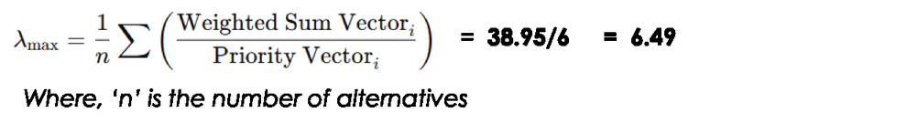
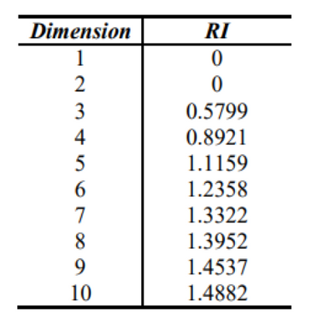


APPLICATION OF AHP FOR PRIORITIZING STRATEGIES
STEP-BY-STEP PROCESS OF AHP
CONSISTENCY CHECK
Defining the Issues
CALCULATION OF LAMBDA-MAX:
Development of Alternate Freight Management Strategies
= 38.95/6 = 6.49
Where, ‘n’ is the number of alternatives
RANDOM CONSISTENCY INDEX OR RANDOM INDICES
Pair wise comparison of indicators by stakeholders in a matrix
CALCULATION OF CONSISTENCY INDEX (CI):
Calculation of Normalized Values and Criteria Weights/
Priority Vector
= 0.098
Computation of Weighted Normalized Matrix
Where, ‘n’ is the number of alternatives
Checking Consistency Ratio
CALCULATION OF CONSISTENCY RATIO:
Ranking and Selection of Strategy(s) based Weightage
= 0.098/1.235
=
0.079
RANKING OF ALTERNATE FREIGHT MANAGEMENT STRATEGIES
STRATEGIES | Weighted Sum Vector (a) | Criteria Weights (b) | a/b | Final Weightages | Ranking
Zone-wise Staggering | 1.94 | 0.29 | 6.69 | 29% | 1
Urban Consolidation Centers - UCC | 1.88 | 0.26 | 6.47 | 26% | 2
Inclusion of Cargo Bikes and E-vehicles | 1.27 | 0.2 | 6.33 | 20% | 3
Parking Strategies with unloading bays | 0.81 | 0.13 | 6.25 | 13% | 4
Delivery Optimization via access time res. | 0.46 | 0.08 | 5.79 | 8% | 5
Logistic Spaces via mixed-use activities | 0.21 | 0.04 | 5.17 | 4% | 6

Slide 15
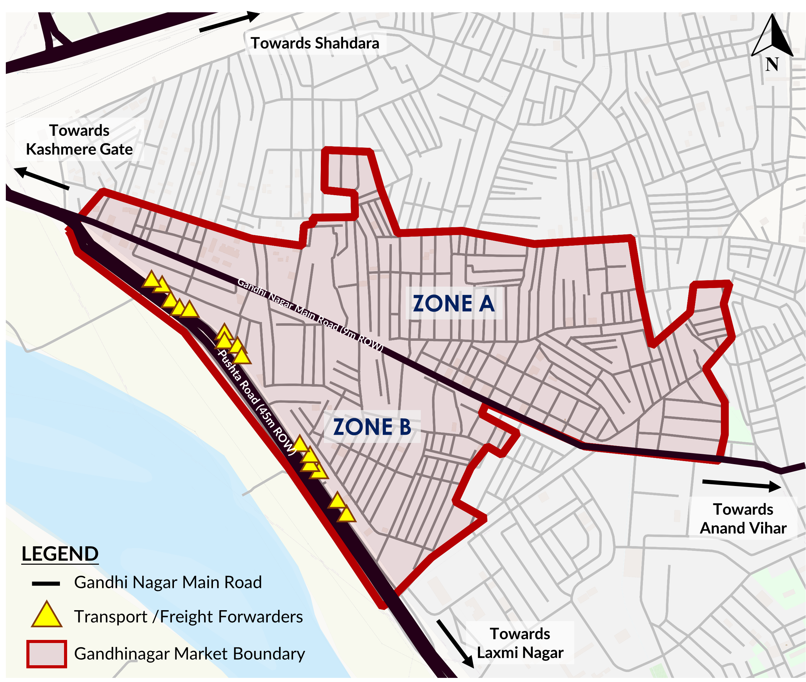
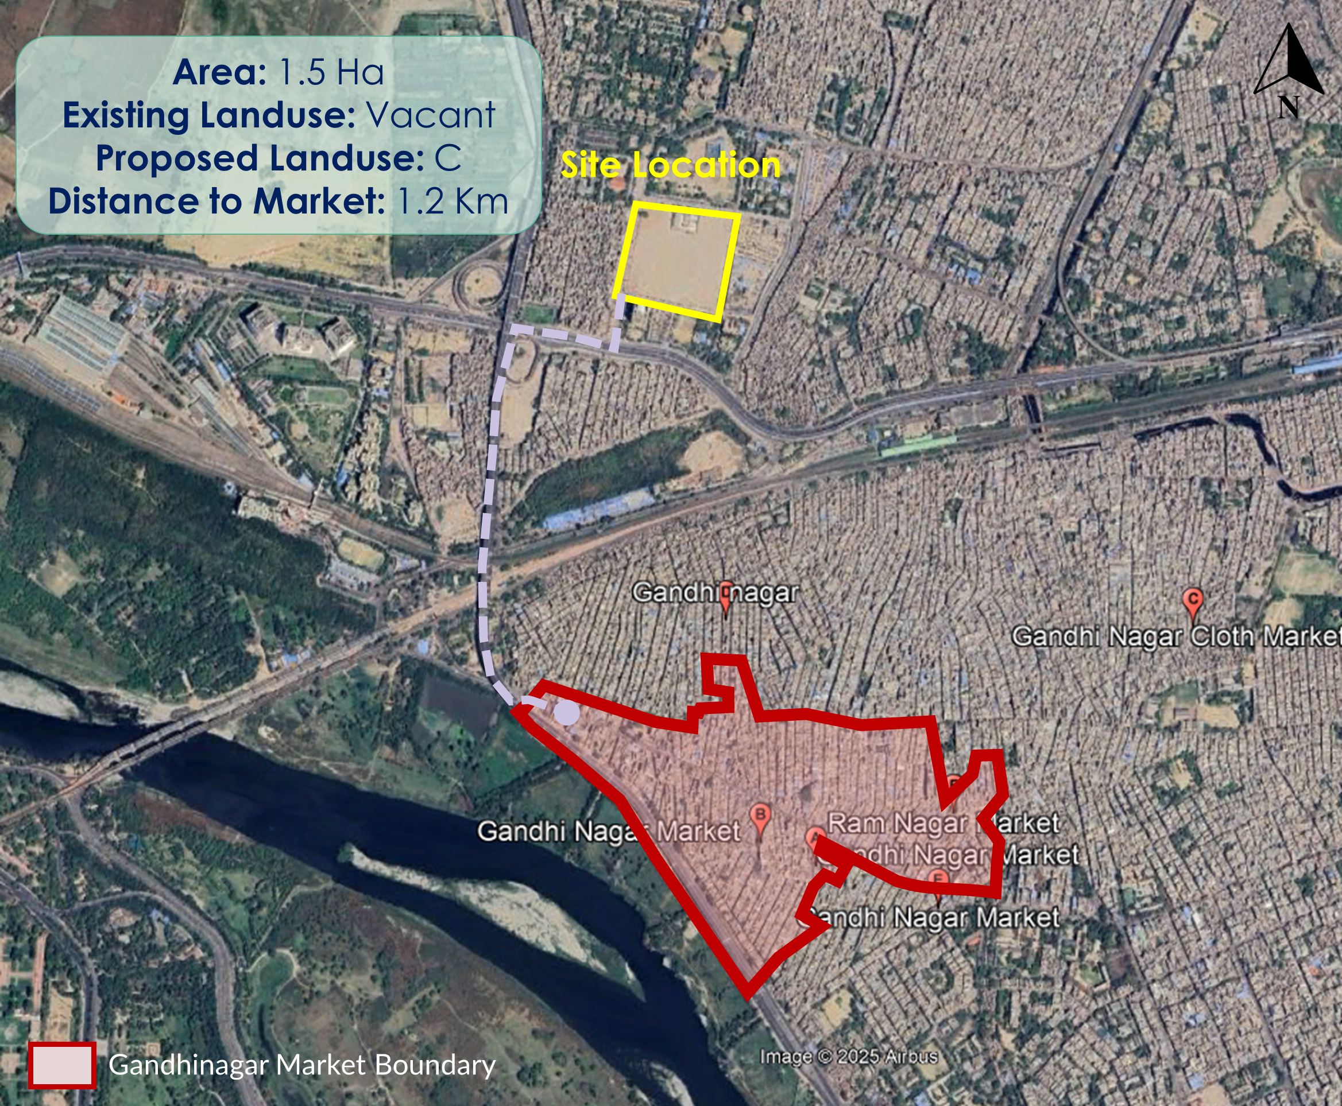
DESCRIPTION OF ALTERNATE STRATEGIES
STRATEGY 1 - ZONE WISE STAGGERING
STRATEGY 2 – URBAN CONSOLIDATION CENTERS
Map: Zone Wise Staggering
Map: Urban Consolidation Center
Staggering of markets is a strategy of closure of main wholesale markets by zones on different days of the week so as to reduce tonnage movement and its implications to a specific extend. The major objective is to reduce congestion due to freight movement in the core market,
Urban Consolidation centre (UCC) or Freight Consolidation Centers (FCC) is a logistics facility situated in relatively close proximity to the geographic area that it serves (be that a city centre, an entire town or a specific site such as a shopping centre), from which consolidated deliveries are carried out within that area.

Slide 16
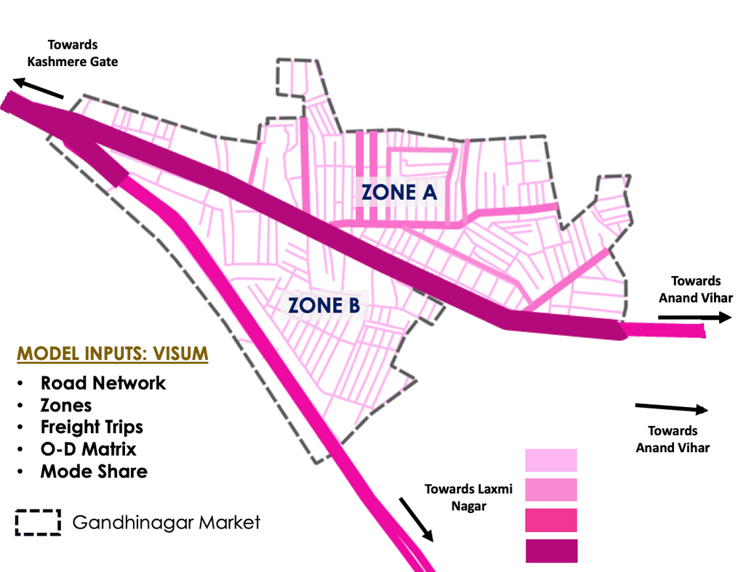
EVALUATION OF STRATEGY 1: ZONE-WISE STAGGERING
ASSIGNED TRIPS (PCUS) FOR STRATEGY 1
LEVEL OF SERVICE FOR GANDHI NAGAR ROAD
The assignment of trips (PCU) is shown when Zone A is open.
 | Freight Trips | Pass. Trips | Total Trips | Peak Hour Trips | PCU for Peak Hour | V/C | LOS
BAU | 11764 (79%) | 3127 (21%) | 14891 | 1552 | 2712 | 1.13 | LOS F
S1 | 5292 | 1112 | 6404 | 672 | 1344 | 0.56 | LOS C
With the implementation of Strategy 1, the LOS level of Gandhi Nagar Market Road improves from LOS F to LOS C.
COMPARISON OF SPEED
 | Peak Hour Trips | LOS | Avg. Speed as per IRC | Calculated Avg Speed (kmph) | % Change in Speed wrt BAU
BAU | 1552 | LOS F | 33% of FFS | 10.4 kmph | -
S1 | 672 | LOS C | 50% of FFS | 15 kmph | + 44.2%
*FFS – Free flow speed. Source: IRC 106-1990 and IRC 86-2018
With the implementation of Strategy 2, the network speed on Gandhi Nagar Market Road improves by almost 44% w.r.t. base scenario.
Map: Traffic Assignment for Strategy 1

Slide 17
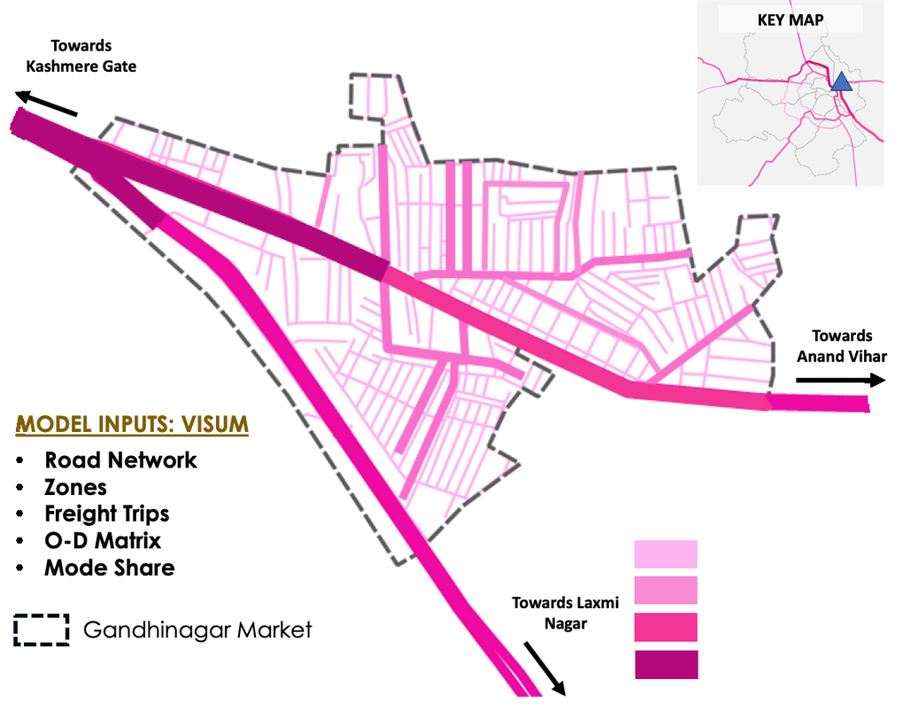
EVALUATION OF STRATEGY 2: URBAN CONSOLIDATION CENTRES (UCC)
ASSIGNED TRIPS (PCUS) FOR STRATEGY 2
LEVEL OF SERVICE FOR GANDHI NAGAR ROAD
 | Freight Trips | Pass. Trips | Total Trips | Peak Hour Trips | PCU for Peak Hour | V/C | LOS
BAU | 11764 (79%) | 3127 (21%) | 14891 | 1552 | 2712 | 1.13 | LOS F
S2 | 1280 | 3127 | 4407 | 485 | 875 | 0.37 | LOS B
With the implementation of Strategy 2, the LOS level of Gandhi Nagar Market Road improves from LOS F to LOS B.
COMPARISON OF SPEED
 | Peak Hour Trips | LOS | Avg. Speed as per IRC | Calculated Avg Speed (kmph) | % Change in Speed wrt BAU
BAU | 1552 | LOS F | 33% of FFS | 10.4 kmph | -
S2 | 485 | LOS B | 70% of FFS | 21 kmph | + 50.4%
*FFS – Free flow speed. Source: IRC 106-1990 and IRC 86-2018
With the implementation of Strategy 2, the network speed on Gandhi Nagar Market Road improves by almost 50% w.r.t. base scenario.
Map: Traffic Assignment for Strategy 2

Slide 18
COMPARISON OF IDENTIFIED STRATEGIES
COMPARISON BASED ON LEVEL OF SERVICE
Strategies | Freight Trips | Pass. Trips | Total Trips | Peak Hour Trips | PCU for Peak Hour | V/C | LOS
BAU | 11764 | 3127 | 14891 | 1552 | 2712 | 1.13 | LOS F
S1 | 5292 | 1112 | 6404 | 672 | 1344 | 0.56 | LOS C
S2 | 1280 | 3127 | 4407 | 485 | 875 | 0.36 | LOS B
Implementation of Strategy 2 (Urban Consolidation Center) shows LOS B on the network of the study area while Strategy 1 shows LOS C. Thus, planning for Urban Consolidation Centers is the most preferred strategy.
COMPARISON BASED ON KPIS
Strategies | Peak Hour Trips | % Change in Trips | PCU for Peak Hour | % Reduction in PCU | Daily Vehicle-Kms Travelled (freight only) | % Reduction in VKT | Avg Delivery Time per Trip (in mins) | % Reduction in Delivery Time
BAU | 1552 | - | 2712 | - | 21175.2 | - | 9.8 | -
S1 | 672 | - 39.1% | 1344 | - 31.6% | 9525.6 | -42.7% | 7.8 | - 20.1%
S2 | 485 | - 68.75% | 825 | - 69.58% | 5120 | - 75.82% | 6.95 | - 29.4%
Evaluation based on key performance indicators – Peak hour trips, PCU per hour, Vehicle-kms travelled and Average delivery time shows significant reduction with implementation of Urban Consolidation Centers.

Slide 19
CONSLUSION AND WAY FORWARD
PRODUCTIVITY INDEX
Peak hour trips,
PCU per hour,
Vehicle-kms travelled, and
Average delivery time
Weightage and summation to calculate PI
PRODUCTIVITY INDEX (WITH STRATEGY 1)
PRODUCTIVITY INDEX (WITH STRATEGY 2)
Normalization of KPIs w.r.t. to BAU
0.33
0.59
CONCLUSION
Literature review suggests various freight management strategies, and that each strategy focuses on addressing specific issues.
Evaluation and selection of Freight Management Strategies should be based on the area meant to be served.
Impact analysis based on Key Performance Indicators, impact on network and stakeholder consultation gives a sense of issues on ground that should be addressed.
Literature review revealed the tonnage handled per unit area and successful driving factors for planning of UCC.
Urban Consolidation Centers are most likely to be successful in Specific and clearly defined geographical areas where there are delivery-sorting-related problems and in town centers, wholesale market areas that are suffering from delivery traffic congestion.
UCC results in improving the overall productivity of the market significant reducing Trips, VKT, Delivery Time and Emissions.
RECOMMENDATIONS
Partner with local planning authorities to integrate UCC usage into zoning bylaws, issue delivery permits only via UCC, and enforce time-windowed access for last-mile deliveries from UCC.
Role of a Planner / Decision maker is to identify Alternate Freight Managements Strategies and evaluate Key Performance Indicators frequently in terms of delivery time reduction, VKT (Vehicle Kilometers Travelled), CO₂ reduction, and fleet utilization, and shared publicly to build trust and stakeholder confidence.
This research emphasizes the need of strategic freight management and planning in urban wholesale hubs, seeking to provide replicable model for other wholesale markets where similar challenges exist.

Slide 20
REFERENCES
Allen, J., Browne, M., & Cherrett, T. (2012). Investigating relationships between road freight transport, facility location, logistics management, and urban form. Journal of Transport Geography
Allen, J. et al. (2012). The Role of Urban Consolidation Centres in Sustainable Freight Transport. Transport Reviews
Browne, M., Allen, J., & Leonardi, J. (2012). Evaluating the use of an urban consolidation center and electric vehicles in central London. IATSS Research, 35(1), 1-6.
Browne, M., Woodburn, A., & Allen, J. (2005). Urban freight consolidation centres: Case studies in the UK and EU. Transportation Research Record, 1929(1), 31-38.
Cherrett, T., Allen, J., McLeod, F., Maynard, S., Hickford, A., & Browne, M. (2012). Understanding urban freight activity – Key issues for freight planning. Journal of Transport Geography, 24, 22-32.
Cui, J., Dodson, J., and Hall, P. V. (2015). Planning for Urban Freight Transport: An Overview. Transport Reviews, 35(5), 583-598.
Dablanc, L. (2007). Goods transport in large European cities: Difficult to organize, difficult to modernize. Transportation Research Part A: Policy and Practice, 41(3), 280-285.
International Council on Clean Transportation (ICCT). (2020). Electric freight vehicles in Shenzhen: A case study of rapid scale-up.
Gonzalez-Feliu, Jesus., (2019). Logistics and transport modeling in urban goods movement.
Muñuzuri, J., Larrañeta, J., Onieva, L., & Cortés, P. (2012). City logistics in Spain: Why it might never work. Cities, 29(2), 133-141. [11]. Haarstad, H., Rosales, R., and Shrestha, S. (2023). Freight logistics and the city. Urban Studies, 61(1), 3-19
Muñuzuri, J., Larrañeta, J., Onieva, L., & Cortés, P. (2012). City logistics in Spain: Why it might never work. Cities, 29(2), 133-141.
World Bank. (2020). Freight transport in India: Challenges and opportunities.
NITI Aayog and RMI India (2021). Fast Tracking Freight in India: A Roadmap for Clean and Cost-Effective Goods Transport Report.
THANK YOU

