Slide 1



Property, Planning and Profit: The Interplay of Land Assembly, Floor Area Ratio, and Markets in India’s Transit-Oriented Development
18th Urban Mobility India Conference and Expo 2025
Bala Eswari Macha, Debapratim Pandit
IIT Kharagpur
City Future Lab
Department of Architecture and Regional Planning

Slide 2
Introduction – Global Paradigm
TOD has emerged as a leading paradigm in contemporary urban planning.
Its core principle of promoting compact, mixed-use, and pedestrian-friendly development around transit stations
TOD as a global paradigm:
Hong Kong’s Rail+Property - transit agencies sustained metro expansion by capturing land value through property development rights (ADB 2022; Cervero and Murakami 2009; Tang et al. 2004).
Tokyo’s private sector-driven model - rail operators integrate real estate, retail, and ridership markets (Calimente 2012; Chorus and Bertolini 2016).
Paris Grand Paris Express - state-led approach that embeds density and mixed-use zoning within strong regulatory frameworks (Salat and Olliver 2017).
Portland’s planning-regulation-driven TOD - urban growth boundaries to guide development along light rail corridors (Thorne-Lyman et al. 2011).
Effective TOD implementation depends on the dynamic interactions among property regimes, regulatory tools, and market behaviour.

Slide 3
TOD in India
Metro Rail Policy, 2017 and National TOD Policy, 2017
National Value Capture Financing Policy Framework, 2017
Uniform FAR norms based on adjacent road width are applied city-wide, without considering station-specific characteristics and infrastructure capacities (Li et al. 2019).
Outdated Building Bye-Laws and Development Control Regulations, often 15 years older, are misaligned with TOD principles (Macha and Pandit 2024; Ramulu, Sankar, and Aman 2021).
Delays in land assembly and acquisition, including compensation disputes (Gandhi and Phatak 2016) under the Land Acquisition Act, 2013 (GoI 2013).
Limited adoption of LVC, despite the National Framework (MoUD 2017c), due to the absence of an integrated framework for implementation and involvement of multiple stakeholders.
Institutional fragmentation across transit agencies, development authorities, and municipal bodies (e.g., lessons from Delhi's Airport Express underperformance; Li and Love 2019)
Market volatility and community resistance contribute to land price escalation, spatial inequalities, and gentrification risks (Chava, Newman, and Tiwari 2019).

Slide 4
Key Dimensions in TOD Research
Regulatory and Institutional Dimensions
FAR regulations
Market and Financial Dimensions
LVC - Premium FAR, betterment levies, TDR, and impact fees
Behavioural and Social Dimensions
Travel behaviour
Integration with master and zonal plans
Building bye-laws
Land pooling schemes
Redevelopment frameworks
Real estate markets
Developer incentives
Financing structures
Transit-property nexus
Socio-economic stratification
Accessibility
Community responses
Affordability
Displacement risks

Slide 5
Global shifts in TOD research
Financial sustainability
Increasing emphasis on economic aspects like the role of land, finance and revenue capture in determining overall feasibility of TOD
Social consequences
Concerns such as gentrification and affordability in TOD areas is being observed due to land value uplift
Shifting from overall Density, Diversity, and Design considerations to Statutory instruments like FAR policies, integration with small-scale plans, and land pooling mechanisms
Regulatory focus
Systems orientation
TOD is being recognised as a system of interdependent factors, where changes in one factor may lead to an effect on the other through a feedback-driven approach

Slide 6
System Dynamics as analytical method
System Dynamics, pioneered by J.W.Forrester in 1958, provides a feedback-driven approach for understanding complex problems and testing alternative scenarios through simulation.
The approach recognizes that system behaviour emerges from interacting feedback loops, including both reinforcing (positive) and balancing (negative) mechanisms, which often generate nonlinear and counterintuitive outcomes (Forrester 1958, 1969)
Region / City | Focus | SD Application | Author
Sao Paulo, Brazil | Sustainable mobility policies | CLD, Stock-Flow Diagram (SFD), scenario simulation | (Fontoura et al. 2019, 2023)
Al Ghanim district, Qatar | Systematic TOD analysis | Factors identification, CLD, SFD (partially), spatial analysis | AlKhereibi et al. 2022
Surabaya, Indonesia | Carbon emission reduction through TOD implementation | Factors identification and CLD development | Riski et al. 2021
Europe (unspecified) | Urban growth and decline | Factors identification and CLD development | Diemer and Nedelciu 2020
Guangzhou, China | Impact of urban rail transit on metropolitan regions | SFD, scenario simulation | Yang, Zhang, and Ni 2014
Chennai, India | Land use–transport interaction and policy testing | Spatial Analysis, SFD, scenario simulation | Vijayalakshmi and Umadevi 2014
India | Property, planning and profit in TOD implementation | Factors identification and CLD development | Current Study

Slide 7
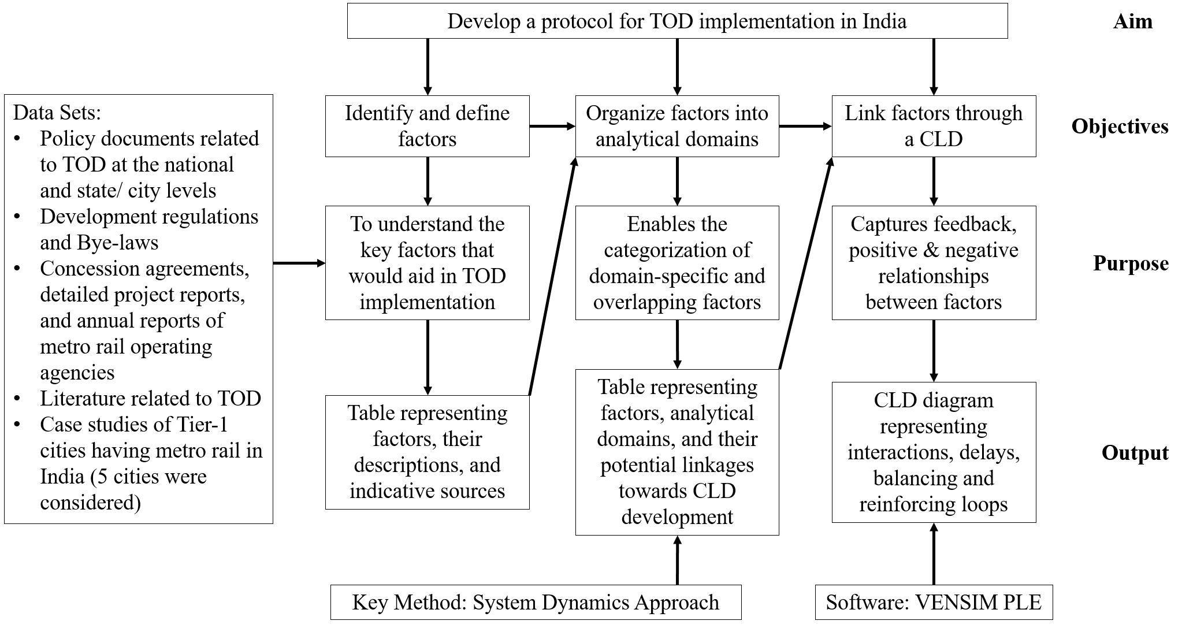
Protocol structure (methodology)

Slide 8
Identification of factors
Insights from case studies of five metro cities
Delhi: Persistent land - related liabilities, arbitration delays, and limited real estate returns constrain the potential of value capture, even when the TOD regulations (2021) and draft MPD 2041 expand zoning and FAR incentives are notified
Mumbai: The complexity of coordinating TOD under fragmented institutional arrangements, outdated land records, and overlapping compensation mechanisms is evident. However, the recent amendment to Mumbai’s DCPR 2034, which includes TOD-specific provisions, illustrates gradual progress
Bangalore: Streamlined land acquisition through dedicated institutional arrangements, showing early signs of financial consolidation, though operational losses persist and real estate uptake remains modest
Hyderabad: State-driven land allocation and a PPP-led metro model that relies on the commercial development near station areas through malls, but without a dedicated TOD framework, its value capture remains underdeveloped
Chennai: Fiscal risks of growing acquisition and arbitration costs, with premium FAR provisions emerging as a policy response to attract private investment alongside

Slide 9
Identification of factors
No. | Factor | Definition / Description | Data Sources | Dimension | Related factors
1 | Land assembly | Acquisition/Pooling of land parcels required for development | Land related Acts, DPRs State/City’s TOD Policies | A | 2,8
2 | Land holdout | Degree of cooperation by land owners | Case studies, court cases, newspapers | A | 1,3,17
3 | Land price | Prevailing market value | Market study reports | A + C | 2,4,7,8,10
4 | Market demand for development | Demand for residential, office, retail in the influence zone | Real estate reports, stakeholders opinions, filed study | C | 3,5,9,16,20,21
5 | Developers’ willingness | Readiness of private developers to build | PPP contracts, stakeholder surveys | C | 4,6,7,8
6 | Mixed-use zoning | Permissible mixed use zones | Master Plans, TOD regulations | B | 9
7 | FAR allocation | Permissible floor area in TOD zones | DCRs, Building-bye laws | B + C | 3,5
8 | Redevelopment | Transforming low-density/old buildings through TOD projects | Redevelopment project cases, age and height of properties | A + C | 1,3,5,6,9,15, 16,18,19
9 | Ridership | No.of people using metro | Metro rail websites | B + C | 4,5,8,14,15
10 | LVC | Tools to capture the land value uplift | Case studies, annual reports | C + B | 3,11
11 | Governments financing capacity | Fiscal strength of government to support infrastructure | Budgets, PPP policies, metro rail policy | C + B | 10,13
12 | Cost of infrastructure | Capital, O&M cost of physical and social infrastructure | DPRs, CAG reports, statement of rates | C | 13

Slide 10
Identification of factors
No. | Factor | Definition / Description | Data Sources | Dimension | Related factors
13 | Infrastructure provision | Utilities, stations and social infrastructure | DPRs, URDPFI, CPHEEO | B + C | 11,13,14,19
14 | First/Last mile connectivity | Accessibility between metro and metro connected neighbourhood | Insights from filed surveys | B | 9,13,19,21
15 | Parking provision | Regulated supply of parking spaces | Building-bye laws, policies | B | 8,9,19
16 | Affordable housing | Percentage of affordable in TOD projects | National/ State TOD Policy | A + B | 4,8,17
17 | Social equity concerns | Risks of exclusion/gentrification | Case studies and filed insights | A + B | 16,20
18 | Environmental limits | Natural, ecological limits for development | EIA, Master Plans, DPRs | B | 8
19 | Quality of life | Perceived improvement in liveability | Surveys, TOD guidelines | Outcome | 9,13,14,15,20
20 | Positive perception of TOD | Overall public attitude towards TOD | Surveys, media discourse | Outcome | 4,17,19
21 | Occupancy rate | Occupied newly built units w.r.t. new developments | Surveys, real estate reports | A + C | 4,14
Note for Dimensions column: A – Property, B – Planning, C – Profit
Note for Related factors column: The numbers indicate the corresponding No. of the factor

Slide 11
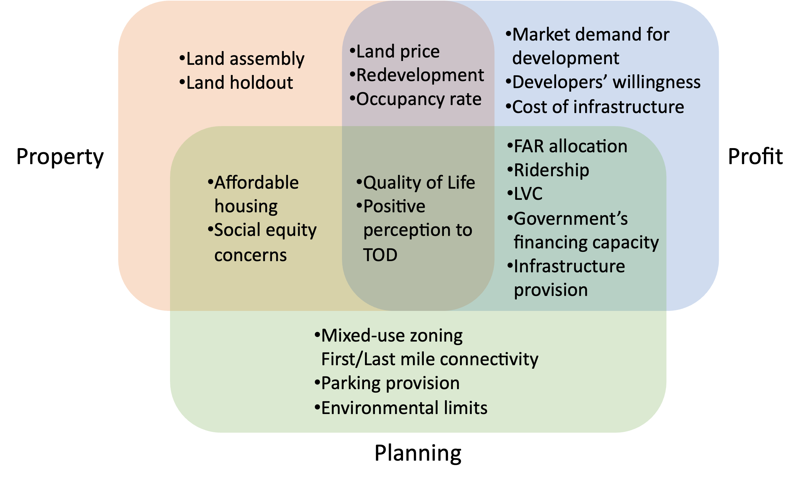
Categorization of factors

Slide 12
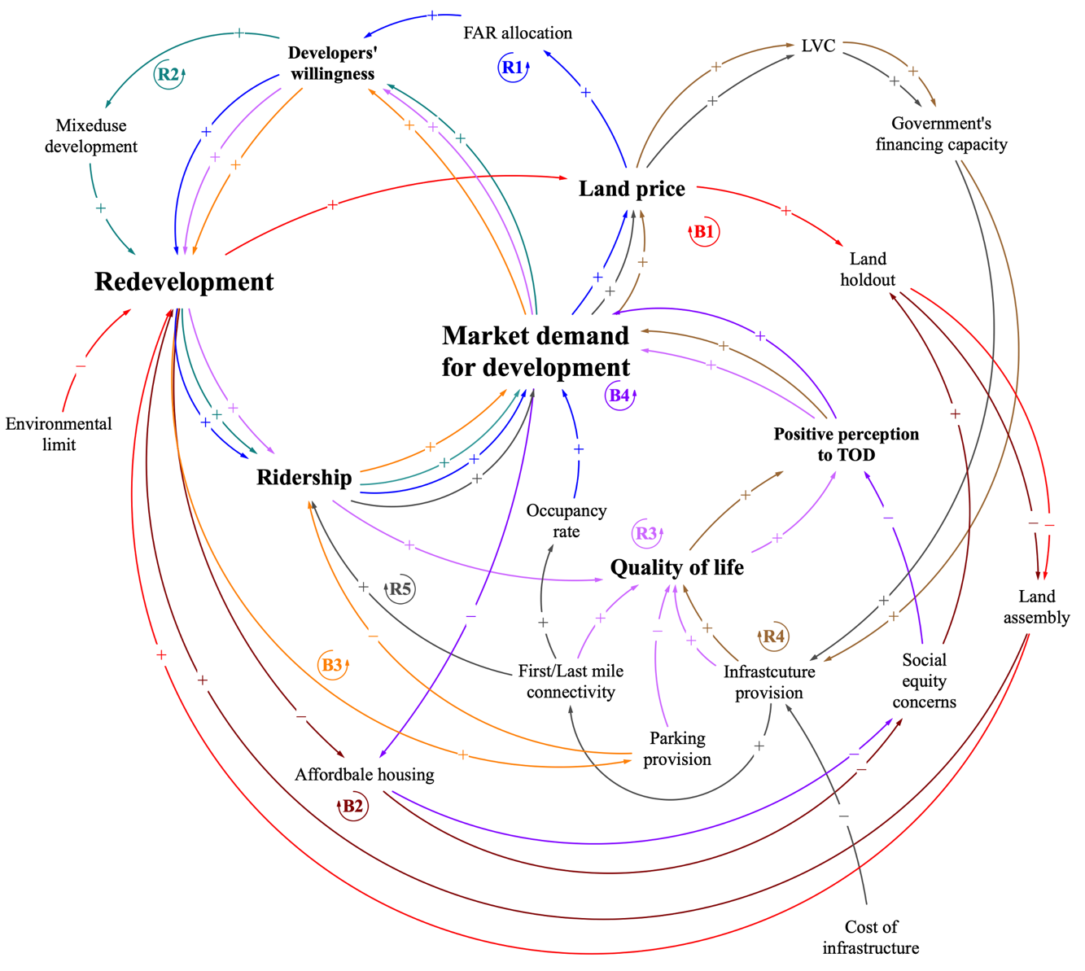
Causal Loops and Feedbacks
R1: FAR allocation → (+) Developers’ willingness → (+) Redevelopment → (+) Ridership and (+) Occupancy rate → (+) Market demand for development → (+) Land price → (+) FAR allocation.
R2: Mixed use development → (+) Redevelopment → (+) Ridership → (+) Market demand for development → (+) Developers’ willingness → (+) Mixed use development.
R3: First/Last mile connectivity (+), Infrastructure provision (+), and Parking provision (–) → Quality of life → (+) Positive perception to TOD → (+) Market demand for development → (+) Developers’ willingness → (+) Redevelopment → (+) Ridership → (+) Quality of life.

Slide 13
Causal Loops and Feedbacks
R4: Infrastructure provision → (+) Quality of life → (+) Positive perception to TOD → (+) Market demand for development → (+) Land price → (+) LVC → (+) Government’s financing capacity → (+) Infrastructure provision.
R5: Ridership → (+) Market demand for development → (+) Land price → (+) LVC → (+) Government’s financing capacity → (+) Infrastructure provision → (+) First/Last mile connectivity → (+) Ridership and (+) Occupancy rate.

Slide 14
Causal Loops and Feedbacks
B1: Land price → (+) Land holdout → (–) Land assembly → (+) Redevelopment → (+) Land price.
B2: Affordable housing → (–) Social equity concerns → (–) Land assembly → (+) Redevelopment → (–) Affordable housing.
B3: Parking provision → (–) Ridership → (+) Market demand for development → (+) Developers’ willingness → (+) Redevelopment → (+) Parking provision.
B4: Market demand for development → (–) Affordable housing → (–) Social equity concerns → (–) Positive perception to TOD → (+) Market demand for development

Slide 15
Applicability and Operationalization
Policymakers
A way to align regulatory levers (such as FAR allocation, value-capture instruments, and land readjustment) with market dynamics and social objectives
Metro agencies
Need to integrate transport planning with land-use decisions, ensuring that infrastructure investments are synchronized with redevelopment incentives and inclusionary housing provisions.
ULBs and Planners
To identify leverage points, such as mixed-use zoning, last-mile connectivity, and affordable housing, that can strengthen the reinforcing loops while mitigating social and market constraints
Next step in overall SD methodology – Development of the Stock-Flow Diagram (SFD)
CLD establishes a qualitative basis by capturing the linkages between factors; the SFD formalizes these dynamics by specifying the accumulations (stocks) and the rates of change (flows) within the system over a given time period.

Slide 16
Conclusion
This study addressed the disconnect between TOD policy intent and on-ground implementation in Indian cities by developing an SD-based protocol for analysing and guiding TOD processes.
21 key factors influencing TOD implementation were identified and organized within the Property–Planning–Profit (3P) framework
Methodologically, the paper contributes a replicable SD protocol tailored for TOD contexts in developing economies
Reinforcing loops, such as those between FAR allocation, redevelopment activity, and ridership, illustrate the potential for virtuous growth cycles. Balancing loops related to land assembly, affordability, and social equity reveals critical constraints
This study is qualitative and exploratory, relying on secondary data and feedback structures
Future research can operationalize the framework quantitatively by developing an SFD with measurable variables, equations, and time dimensions.

Slide 17
Selected References
ADB. 2022. Realizing India’s Potential for Transit-Oriented Development and Land Value Capture - A Qualitative and Quantitative Approach. https://dx.doi.org/10.22617/SPR220271-2.
BMRCL. 2024. Annual Report - BMRCL - FY 2023-24.
Cervero, Robert, and Kara Kockelman. 1997. “Travel Demand and the 3Ds: Density, Diversity, and Design.” Transportation Research Part D: Transport and Environment 2(3):199–219. doi:10.1016/S1361-9209(97)00009-6.
CMRL. 2025. “Chennai Metro Rail Limited - Website.” https://chennaimetrorail.org/.
Delhi Development Authority. 2024. Draft Master Plan for Delhi - 2041.
Dittmar, Hank, and Gloria Ohland. 2004. The New Transit Town: Best Practices in Transit-Oriented Development.
DMRCL. 2024. Delhi Metro - Annual Report 2023-24.
Fontoura, Wlisses Bonelá, Gisele de Lorena Diniz Chaves, and Glaydston Mattos Ribeiro. 2019. “The Brazilian Urban Mobility Policy: The Impact in São Paulo Transport System Using System Dynamics.” Transport Policy 73(September 2018):51–61. doi:10.1016/j.tranpol.2018.09.014.
Forrester, J. W. 1969. Urban Dynamics.
Forrester, Jay Wright. 1958. “Industrial Dynamics: A Major Breakthrough for Decision Makers.” Harward Business Reviews. https://www.bibsonomy.org/bibtex/26fda6c4d27707bbb65958a826b71ccd0/krevelen.
GoI. 2013. The Right to Fair Compensation and Transparancy in Land Acquisition, Rehabilitation and Resettlement Act. India.
Government of Karnataka. 2022. TOD Policy for Bengaluru. India.
Government of Maharashtra. 2024. Regulation 33(23) Transit Oriented Development (TOD) - Development Control and Promotion Regulations (DCPR) 2034 - Mumbai.
HMDA. 2010. Revised Zoning and Development Promotion Regulations - 2010.
Li, Xinjian, and Peter E. D. Love. 2019. “Employing Land Value Capture in Urban Rail Transit Public Private Partnerships: Retrospective Analysis of Delhi’s Airport Metro Express.” Research in Transportation Business and Management 32(January):100431. doi:10.1016/j.rtbm.2020.100431.
L&THMRL. 2024. Hyderabad Metro Annual Report - FY 2023-24.
Macha, Bala Eswari, and Debapratim Pandit. 2024. Urban Mobility Research in India. Vol. 551. edited by M. Manoj and D. Roy. Lecture Notes in Civil Engineering. Singapore: Springer Nature Singapore.
Mathur, Shishir. 2019. “An Evaluative Framework for Examining the Use of Land Value Capture to Fund Public Transportation Projects.” Land Use Policy 86(May):357–64. doi:10.1016/j.landusepol.2019.05.021.
MMRDA. 2022. Mumbai Metro - Annual Report 2021-22.
MMRDA - Metro PIU. 2025. “Mumbai Metropolitan Region Development Authority Website.” https://mmrda.maharashtra.gov.in/division/metro-piu/overview.
Mohanty, Prasanna K. 2022. LAND ECONOMICS AND POLICY IN DEVELOPING COUNTRIES.
MoHUA; Delhi division. 2021. TOD Policy - Delhi.
MoUD. 2017a. Metro Rail Policy.
MoUD. 2017b. National TOD Policy.
MoUD. 2017c. Value Capture Finance Policy Framework. https://mohua.gov.in/upload/whatsnew/59c0bb2d8f11bVCF_Policy_Book_FINAL.pdf.
Sinha, Meenakshi. 2021. “Harnessing Land Value Capture: Perspectives from India’s Urban Rail Corridors.” Land Use Policy 108(May). doi:10.1016/j.landusepol.2021.105526.
Suzuki, Hiroyuki, Jin Murakami, Yu-Hung Hong, and Beth Tamayose. 2015. Financing Transit-Oriented Development with Land Values - Adapting Land Value Capture in Developing Countries

Slide 18
THANK YOU
By linking property market dynamics, planning mechanisms and profit incentives, the proposed SD framework builds a conceptual basis for sustainable, inclusive, and financially viable TOD strategies.

