Slide 1


Perceived Truck Level of Service for Sub-urban Roads: Insights from Indian Truck Drivers using BRNN (Paper ID: 9945)
Authors-
Sujeet Sahoo(Presenting author) Ph.D. scholar NIT Rourkela
Prasanta kumar Bhuyan Associate professor NIT Rourkela

Slide 2
Motivations Why Study Truck Level of Service (LOS) in Indian Cities?
Urban freight movement is vital for city economies but faces severe operational challenges in India.
Trucks share road space with heterogeneous traffic—cars, two-wheelers, buses, and non-motorized vehicles.
Existing LOS frameworks are car-oriented and overlook the unique performance and perception of truck drivers.
Poor truck mobility affects logistics efficiency, delivery reliability, and contributes to urban congestion.
There is a need for a human-centered evaluation of service quality, reflecting truck drivers’ on-road experience.

Slide 3
Research Gap Limitations of Existing LOS Studies
Conventional LOS models use speed, delay, or V/C ratios, focusing mainly on passenger vehicles.
Truck performance is influenced by road width, maneuvering space, and surrounding traffic composition—often ignored in standard methods.
Few studies integrate driver perception with measurable roadway and traffic characteristics.
There is a lack of quantitative frameworks linking physical infrastructure and driver experience in Indian urban contexts.
Need for robust modeling capable of handling nonlinear relationships between infrastructure variables and perceived service quality.

Slide 4
Objectives of the Study
To develop a Perception-Based Truck Level of Service (Truck-PLOS) model for urban freight corridors.
To analyze key influencing variables such as effective road width, available shoulder width, pavement condition index, percentage of truck traffic, speed ratio, presence of lighting and reflectors, obstruction due to transit stops, V/C ratio, and speed variability among modes.
To model the relationship between these variables and drivers perceived LOS using a Bayesian Regularized Neural Network (BRNN).
To validate the model’s performance (Training R² = 0.9192, Testing R² = 0.8666).
To recommend policy measures for improving truck mobility and infrastructure design in sub-urban freight corridors.

Slide 5
Study Framework
Data Collection
Variable Selection
Driver Survey
Driver Survey
TLOS BRNN Modelling
Validation

Slide 6
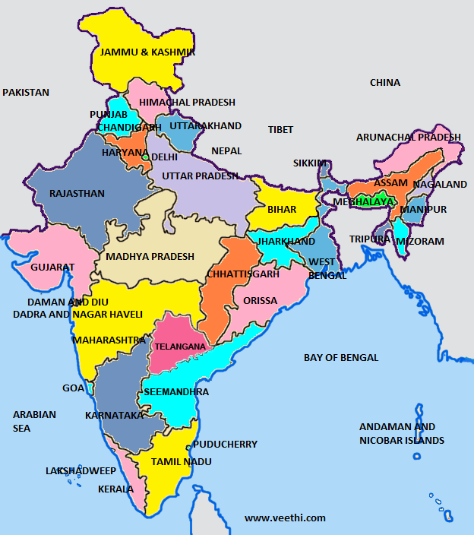
Study Area
City consideration:
Functional importance
Heterogeneous traffic representation
Geographical spread
Site consideration:
Sub-urban location: Mostly outskirts of major cities
Width: minimum 4 lane road
Side friction: Zero to low local street or collector street interference
PURULIA
BHUBANESWAR
HYDERABAD
KOZHIKODE
THIRUVANANTHAPURAM
Fig. 1: Map of India showing the cities where data was collected

Slide 7
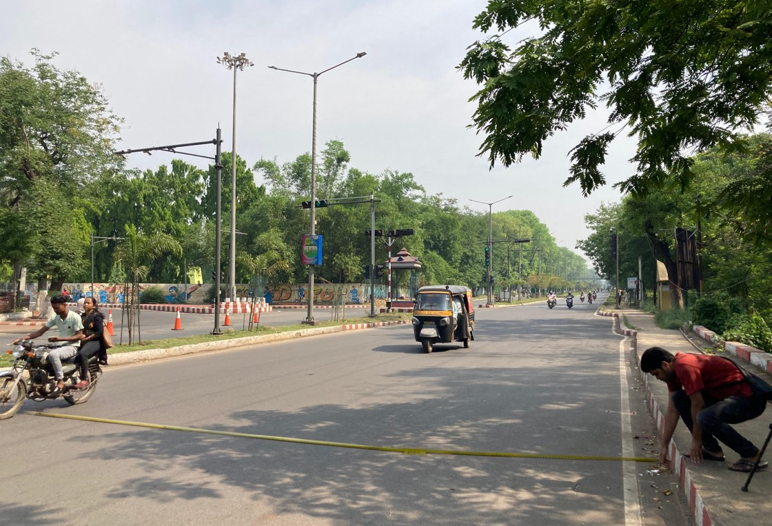
Data Collection
A. Field Data Collection
Data gathered from selected urban freight corridors with significant truck traffic.
Physical & operational variables recorded on-site:
Effective road width and available shoulder width (m)
Pavement Condition Index (PCI)
Presence of streetlights and roadside reflectors
Obstruction due to transit stops
Classified traffic volume to compute V/C ratio and percentage of truck traffic
GPS-based spot speed data to calculate speed ratio and standard deviation of speeds across modes
B. Driver Perception Survey
Structured questionnaire administered to 3015 truck drivers operating on these corridors.
Drivers rated service quality (1–7 scale) covering travel time, comfort, safety, congestion, and road environment.
Responses used to derive a Truck LOS (TLOS) score for each corridor segment.

Slide 8
Variables Considered
The study considered a combination of geometric, pavement, traffic, and environmental variables that influence truck drivers’ perception of service quality.
These measurable parameters were collected from field surveys and integrated with driver perception data for model development.
Category | Variable | Description
Geometric | Effective Road Width, Adequate Shoulder Width | Measured in meters Binary (0/1)
Pavement | Pavement Condition Index | 0–3 scale
Traffic | V/C Ratio, % Truck Traffic, Speed Ratio, Standard Deviation Ratio | Collected via count & videographic survey

Slide 9
Correlation Analysis
Parameters | p-value | rho
Effective Road Width | 0.003 | 0.331
Available Shoulder Width | <0.001 | 0.429
Pavement Condition Index | 0.001 | 0.399
Percentage of Truck Traffic | 0.001 | 0.381
Free flow Speed Ratio (SR) of Truck modes with total traffic | 0.003 | 0.321
V/C ratio | 0.012 | -0.264
Speed standard deviation ratio (SDR) of truck mode to all modes | <0.001 | -0.497
Composite TLOS score derived using weighted mean of perception responses.
Partial spearman correlation analysis was used filtering out the statistically significant parameters which influence the TLOS score.
A total of 31 parameters were tested for correlation.
The level of significance was 0.005 used as threshold for filtering out parameters.

Slide 10
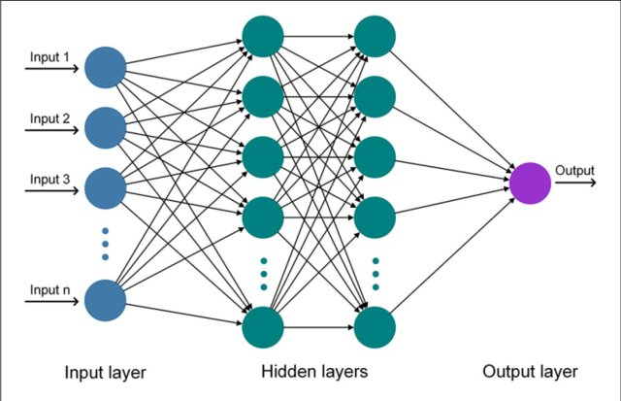
BRNN Modeling Overview
Overcomes overfitting common in conventional neural networks.
Provides automatic regularization through Bayesian inference.
Delivers stable and generalizable results even with limited data samples.
Balances model complexity and predictive accuracy efficiently.

Slide 11
Training BRNN
Training Objective: To optimize the neural network parameters ensuring the best prediction accuracy for Truck Perception Level of Service (PLOS).
Data Split:
Training set: 70% of data
Testing set: 30% of data
Inputs normalized to [0–1] range before training.
Training Algorithm:
Levenberg–Marquardt backpropagation with Bayesian regularization to control overfitting.
Regularization parameters auto-adjusted to minimize Mean Square Error (MSE).
Activation Functions Tested: 1️⃣ Log-sigmoid (logsig) – smooth, bounded output (0–1). 2️⃣ Tan-sigmoid (tansig) – symmetric output (–1 to 1), faster convergence. 3️⃣ Purelin – linear output function for regression-style prediction.
Activation function | Optimized number of hidden layers | Optimized R² training
Purelin | 5 | 0.69
Tan-sigmoid | 3 | 0.91
Log-sigmoid | 4 | 0.88

Slide 12
Model Training and Testing
The training and testing of the optimized BRNN TLOS model shows that training R² of 0.91 and a testing R² of 0.87, indicating high reliability in capturing the nonlinear relationships between physical infrastructure conditions and drivers perceived LOS.
Tan sigmoid activation function shows the best fit properties for TLOS predictions.

Slide 13


Weight bias of the Optimized BRNN TLOS model
Estimates | Parameters | Hidden Layer-1 | Hidden Layer-2 | Hidden Layer-3
Weights
W_{ik} | Effective Road width | -0.512 | -0.012 | -0.131
 | Available shoulder width | -0.147 | 0.09 | 0.141
 | Pavement condition index | -0.341 | 0.241 | 0.384
 | Percentage of truck | -0.412 | 0.129 | 0.281
 | SR | -0.666 | 0.160 | 0.619
 | Presence of streetlight | 0.008 | 0.0645 | 0.381
 | V/C ratio | 1.075 | -0.534 | -0.617
 | SDR | -0.074 | -0.545 | -0.638
 | Hidden-layer weight (w_{lk}) | -1.634 | -0.058 | -0.759
Bias (b)
b_{hk} | Hidden layer | 0.623 | -0.027 | -.0341
b₀ | TLOS_{pred} | -0.162
$$B_{i}=w_{lk}×\frac{\left.{\left(e\right.}^{A_{i}}−e^{{−A}_{i}}\right)}{\left(e^{A_{i}}+e^{{−A}_{i}}\right)}$$
$$TruckLOS= b_{0}+\sum_{i=1}^{k}{B_{i}}$$

Slide 14
TLOS class
Truck-LOS class | Description | Category
A | Excellent Service | >5.51
B | Very Good Service | 4.80-5.51
C | Good Service | 3.61-4.80
D | Fair Service | 2.01-3.61
E | Poor Service | 1.32-2.01
F | Very Poor Service | <1.35
Objective: To classify the continuous predicted TLOS values (from BRNN model) into six distinct LOS categories (A–F) representing perceived service quality.
Clustering Method:
K-Means algorithm applied on predicted PLOS (TLOS) scores.
Number of clusters (k) = 6, corresponding to LOS A–F.
Euclidean distance used as the similarity measure.
Iterations continued until centroid stabilization (Δcentroid < 10⁻³)
Cluster Output:.
Each data point assigned to nearest centroid → LOS Class (A–F).
Cluster centroids represent average TLOS score of each LOS class.
Provides data-driven threshold values between LOS categories rather than arbitrary cut-offs.

Slide 15
Conclusions
Traditional operational indicators alone are insufficient to capture the performance of sub-urban roads with high truck volumes.
Developed a Truck Level of Service (Truck-LOS) framework based on truck drivers’ perception under heterogeneous traffic conditions.
Integrated geometric, operational, environmental, and perceptual variables to ensure both measurable and experience-based relevance.
Used partial Spearman correlation to select variables strongly associated with perceived service quality.
The Bayesian Regularized Neural Network (BRNN) effectively modeled nonlinear and conditional interactions between variables.
Achieved high predictive accuracy (Training R² = 0.9192, Testing R² = 0.8666).
K-Means clustering classified continuous Truck-LOS predictions into A–F categories for practical interpretation.
The perception-driven, AI-enabled framework provides an evidence-based approach to evaluate and compare sub-urban freight corridors.
Represents a step toward human-centered, perception-based transport planning for India’s sub-urban logistics corridors.

Slide 16

Policy recommendations
Incorporate Truck-LOS as a supplementary performance indicator in urban freight and sub-urban road design guidelines.
Prioritize infrastructure upgrades in parameters with strong perceptual influence:
Shoulder rehabilitation and road width enhancement
Use Truck-LOS outcomes to identify sub-urban areas traffic evaluation and allocate funds for freight corridor improvement.
Encourage data-driven and perception-based decision-making in transport policy formulation.
Integrate driver feedback mechanisms into periodic road performance assessments.
Promote AI-based analytical tools (like BRNN and clustering) for real-time freight corridor monitoring.
Align infrastructure development with driver comfort and safety to improve freight mobility and supply-chain efficiency.
Contribute to sustainable and competitive logistics systems supporting India’s economic growth.

Slide 17
References
Afroz, F., & Singh, E. B. (2023). Congestion modelling and level of service assessment of urban roads in mixed traffic conditions. International Journal of Innovative Research in Computer Science & Technology, 11(1), 17-20.
Ahmed, A., Khan, F., Rizvi, S. F. A., Outay, F., Ahmed, M. F., & Adnan, M. (2025). Level of Service Criteria for Urban Arterials with Heterogeneous and Undisciplined Traffic Streams. Sustainability, 17(11), 5126.
Ali, K. S., & Abid, N. M. (2021, February). The importance of google maps for traffic in calculating the level of service for the road and traffic delay. In IOP Conference Series: Materials Science and Engineering (Vol. 1076, No. 1, p. 012015). IOP Publishing.
Bhattarai, A., & Bastola, P. N. (2022). Effects of roadside friction on traffic flow parameters and level of service of urban arterials: A case study of Pokhara Metropolitan City. Case Stud Transport Policy, 10(1), 204-12.
Fattah, M. A., Morshed, S. R., & Kafy, A. A. (2022). Insights into the socio-economic impacts of traffic congestion in the port and industrial areas of Chittagong city, Bangladesh. Transportation Engineering, 9, 100122.
Flores, A., Suarez, R., & Sanchez, A. (2024). Assessment of methods to estimate the level of service on third-class roads. In Emerging Cutting-Edge Developments in Intelligent Traffic and Transportation Systems (pp. 243-252). IOS Press.
Guerrieri, M. (2024). A practical method for assessing sustainable traffic levels of roundabouts in urban areas using the macroscopic fundamental diagram. Sustainable Futures, 7, 100157.
Marazi, N. F., Majumdar, B. B., Sahu, P. K., Panda, S., & Koramati, S. (2023). Traffic congestion Assessment Tool for Urban roads based on traffic and geometric characteristics: A case of Hyderabad, India. Journal of transportation engineering, Part A: Systems, 149(11), 04023106.
Paul, S., Kumar, V.C., Chandrashekar, R., Nagpal, A., Khan, I., Raed, I., Raed., Rawya, Sharma, N. (2024). Capacity of Heterogeneous Traffic in Urban Areas: A Level of Service Estimation. E3S Web of Conf. 529 03012
Sahoo, S., Sudha, C., & Kumar Bhuyan, P. (2025). Generalized Additive Models to assess Truck Driver's Perceived LOS of Signalized Intersections. Transportation Research Procedia, 82, 2232-2244.
Zhao, J., Xu, H., Zhang, Y., Tian, Y., & Liu, H. (2021). Traffic volume detection using infrastructure-based LiDAR under different levels of service conditions. Journal of Transportation Engineering, Part A: Systems, 147(11), 04021080.

