Slide 1


Assessing True Cost of Passenger Modes in Urban Areas
A Case of Ahmedabad
Saumya and Prof. Shalini Sinha
Centre of Excellence in Urban Transport (CoE-UT), CRDF, CEPT University, Ahmedabad

Slide 2
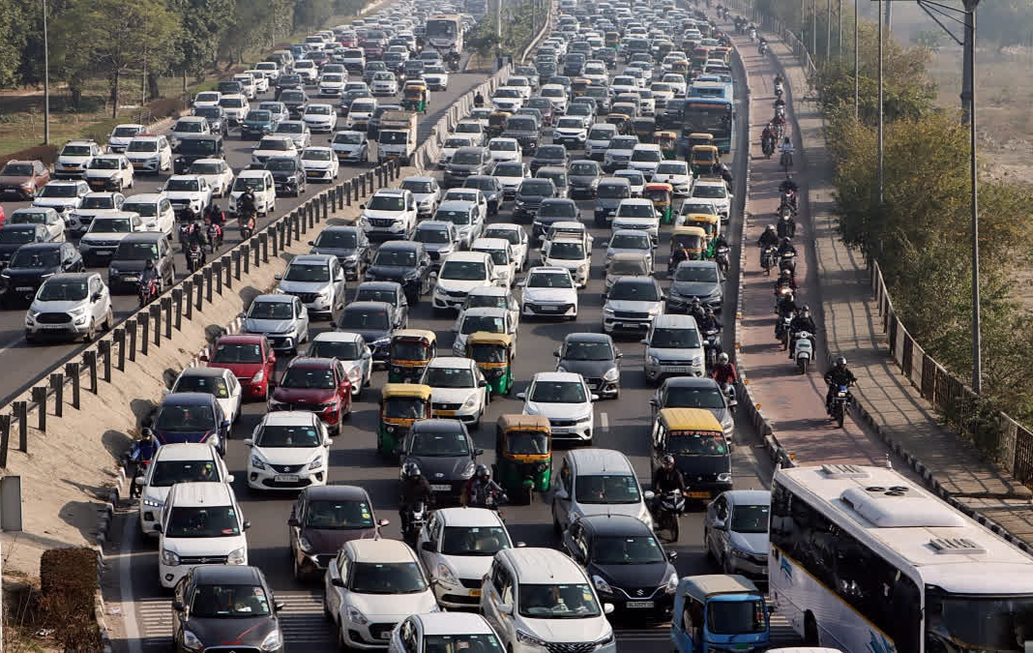
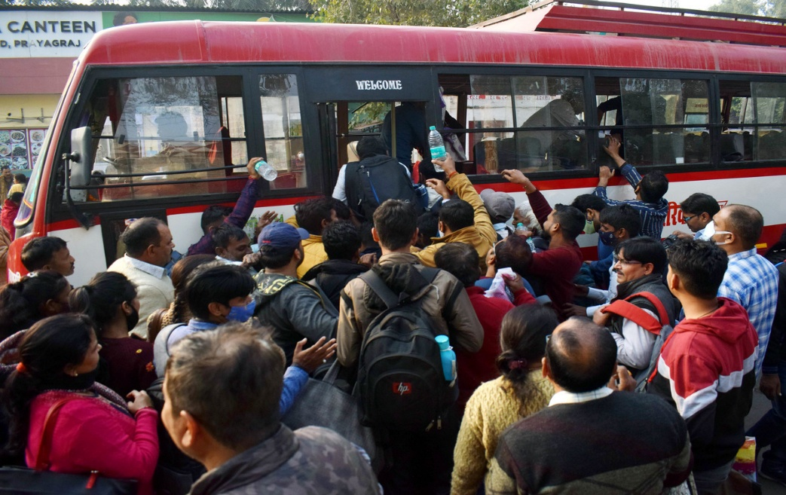
Research Need
National Urban Transport Policy, 2006 recommends equitable allocation of space and resources in urban mobility.
Policy responses have largely focused on road expansion, which have only deepened congestion, emissions, and safety risks.
Average sustainable mode share has declined by 10% over 8 years.
Vehicle registrations growing at 12.4% rate annually.
Investments in Public Transport are heavily scrutinized!
Limited investment makes public transport inefficient, undermining social inclusion and equitable mobility.
Are investments made in urban mobility truly equitable?
System-wide cost assessment is essential to guide public investment in urban transport.
Source: NUTP, 2006, NIUA Baseline Report Transport, Delhi, 2020; The Urban Commute, CSE, 2018

Slide 3
Research Question
How can the 'true cost' of transport be defined, and what system-wide methodological framework can be developed to estimate and compare these costs across different passenger modes of transport.
Objectives
To comprehend the various components of transport cost and to develop a common methodology for evaluating the true cost of various passenger modes of transport.
To analyze the budgetary expenditures by public agencies for urban transport and evaluate how these costs are allocated across different passenger transport modes.
To determine the true cost of private and public passenger transport modes taking a case of Ahmedabad city.

Slide 4
Defining “Cost”
Cost is the monetary value of goods and services purchased by producers and consumers. This can involve money, time, land, or the loss of an opportunity to enjoy a benefit. The cost components of transport can be classified into categories:
Internal costs, which are directly borne by the users are not considered.
Costs | Infrastructure supply cost | Vehicle ownership cost | Vehicle operation cost | Transport Externalities
Particular | Infrastructure construction and maintenance cost and opportunity cost. | Categorized as an internal fixed cost, this refers to the one-time expenditure incurred for vehicle ownership. | Categorized as variable cost and often referred to as “out of pocket cost”. | It refers to the additional economic, social, and environmental expenses that arise due to transportation activities
Cost Elements | Road Facilities (Construction, operation and maintenance) PT service provision On-Street Parking Off-Street Parking Land Value Traffic services Depots Terminals | Vehicle Cost Insurance Cost Road Tax | Fuel Cost Vehicle Maintenance cost Vehicle Repair Cost | Accidents Pollution Congestion Noise Water Pollution Waste
Public Transport | Cost incurred by public agencies or municipal corporation | Cost incurred by public agencies | Cost incurred by public agencies | Cost incurred by society.
Private Transport |  | Internalized cost | Internalized cost
Costs | Infrastructure supply cost | Vehicle ownership cost | Vehicle operation cost | Transport Externalities
Particular | Infrastructure construction and maintenance cost and opportunity cost. | Categorized as an internal fixed cost, this refers to the one-time expenditure incurred for vehicle ownership. | Categorized as variable cost and often referred to as “out of pocket cost”. | It refers to the additional economic, social, and environmental expenses that arise due to transportation activities
Cost Elements | Road Facilities (Construction, operation and maintenance) PT service provision On-Street Parking Off-Street Parking Land Value Traffic services Depots Terminals | Vehicle Cost Insurance Cost Road Tax | Fuel Cost Vehicle Maintenance cost Vehicle Repair Cost | Accidents Pollution Congestion Noise Water Pollution Waste
Public Transport | Cost incurred by public agencies or municipal corporation | Cost incurred by public agencies | Cost incurred by public agencies | Cost incurred by society.
Private Transport |  | Internalized cost | Internalized cost
Source: Adapted from, The price of transport – overview of social cost of transport, 2019, CE-Delft

Slide 5
Analytical Framework
Approach & Methodology
Initial Year: 2010
Base Year : 2024
Cost to Agency
Cost to Society
Financial Outlay by the public Agency
Annual Budget Report
Year on year cost are calculated and converted to constant price, and the lifecycle cost are annualized according to the life of the particular investment.
GHG emissions
WTW emission Year on year cost are calculated and brought to constant price of 2024.
Accident Cost
Year on year accidents are taken from MoRTH and accident cost are calculated and brought to constant price of 2024.
Cost Allocation
Cost Allocation
Cost Allocation
Dynamic Space Time Usage
Cost of commuting
Allocated between passenger modes according to the PCU hours.
Static Space Time Usage
Cost of parking
Allocated between car and 2w according to the ECS hours.
According to fuel and Norm specification
Emissions are a function of vehicle kilometer.
Accidents per mode
Accidents are allocated to different modes with respect to vehicle kilometer.
Cost of PT Operation
Calculated by Net CPKM
Cost Estimation
Accident cost is estimated based on the metro appraisal guideline, 2017.

Slide 6
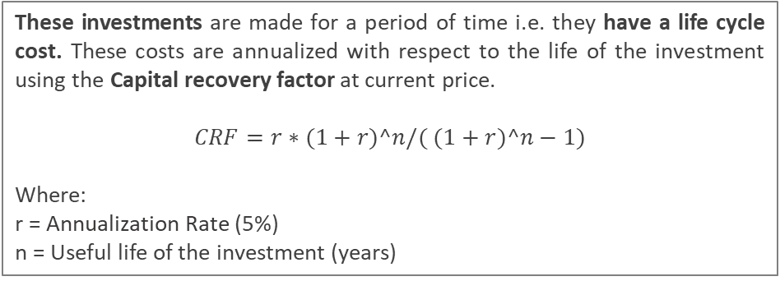
Methodology – Cost for Public Agency
Annual Budget Cost
Initial Year: 2010
Base Year : 2024
Infrastructure Expansion Cost
Periodic Maintenance Cost
Regular Maintenance Cost
Operational Cost
New lane addition cost
Construction of new roads
Road Resurfacing cost
Road Cleaning cost
Traffic control system maintenance cost
Street light maintenance
Establishment cost
Electricity Cost
These investments are made for a period of time i.e. they have a life cycle cost. These costs are annualized with respect to the life of the investment using the Capital recovery factor at current price.
$$CRF=r∗(1+r)^n/( (1+r)^n−1)$$
Where:
r = Annualization Rate (5%)
n = Useful life of the investment (years)
These represent recurring annual costs borne by the agency.
As the costs are mentioned in their respective years, it is to be escalated to the constant year of 2024. This is done by applying escalation factor. The year-on-year escalation factor is arrived by taking the average of the WPI index for the all products from Ministry of Economic affairs.
Data Source: AMTS and BRTS, Financial Report, AMC – Budget Report (2012 - 2024)

Slide 7
Methodology – Cost Allocation (Cost to Public Agency)
The budgetary expenditure on road infrastructure incurred by municipal corporation is allocated across transport modes based on their respective usage; it has been apportioned according to the relative space each mode occupies on the road over a given period.
Space Time Traffic Usage
Initial Year: 2010
Base Year : 2024
Dynamic Space Time Usage
Static Space Time Usage
On Road Cost
On-street parking by 2-w and 4-w.
Number of vehicles of roads:
Passenger trips by mode /
Occupancy Ratio of the mode
Buses: 90% Fleet Utilization
Relative space used by each mode:
Vehicular trips * Respective PCU values
Time Spent on the Road:
Average travel distance / average travel speed
Per bus operational hours – 12 hours
On street Parking in ECS:
AMC Provided Parking
+
Encroached Parking
On street Parking Utilization:
Assumption: 60% utilization of total on street parking space.
Relative space used by each mode :
Total Parking space distributed according to the proportion of vehicles trips.
Space Time Usage = Relative Space * Time Spent on Roads
Space Time Usage = Relative Space * Time Spent on Roads
Data Source: AMTS and BRTS, Financial Report, AMC – Budget Report (2012 - 2024), SUMP – 2022, IMP – 2012, VAHAAN Dashboard

Slide 8
Methodology – Cost to Society - Emissions
Emissions
Well to Wheel (WTW) Emissions
Initial Year: 2010
Base Year : 2024
Well To Tank Emissions
Tank to Wheel Emission
These are the indirect emissions associated with the production, processing, and delivery of the fuel before it reaches the vehicle's fuel tank.
These are the direct emissions that occur from the vehicle during operation, i.e., when fuel is combusted in the engine.
Fuel Consumption
VKT
Emission Factor
VKT
Emission Factor
The treatment cost of various pollutants is taken from Appraisal Guidelines for Metro Rail Project Proposals, 2017, but the costs are in 2017 prices, so the costs are escalated to 2024 prices using escalation factor, attained from Ministry of Economic affairs.
Annual Treatment Cost = [Volume of pollutant] x [Treatment cost / ton]
Source: Adapted from Metro Appraisal Guideline, 2017.

Slide 9
Research Framework
Literature Review
Identification of transport cost component and developing methodology for evaluating true cost.
Transport Cost Component assessment
Methodological Assessment
Methodology Adopted
For internal and external cost variability by mode and degree of internalization
For cost estimation and allocation to different modes
System wide Assessment Framework
Analyzing the expenditures by public agencies for urban transport
Defining True Cost
Cost Assessment
Only external cost components are considered.
Secondary data collection; AMC budget report, AMTS and AJL finance etc.
True Cost Assessment
Determining the true cost for different transportation mode
Daily cost allocation assessment to different modes
Cost per pax km assessment
For assessing the cost efficiency of different modes
For internal and external cost variability by mode and degree of internalization

Slide 10
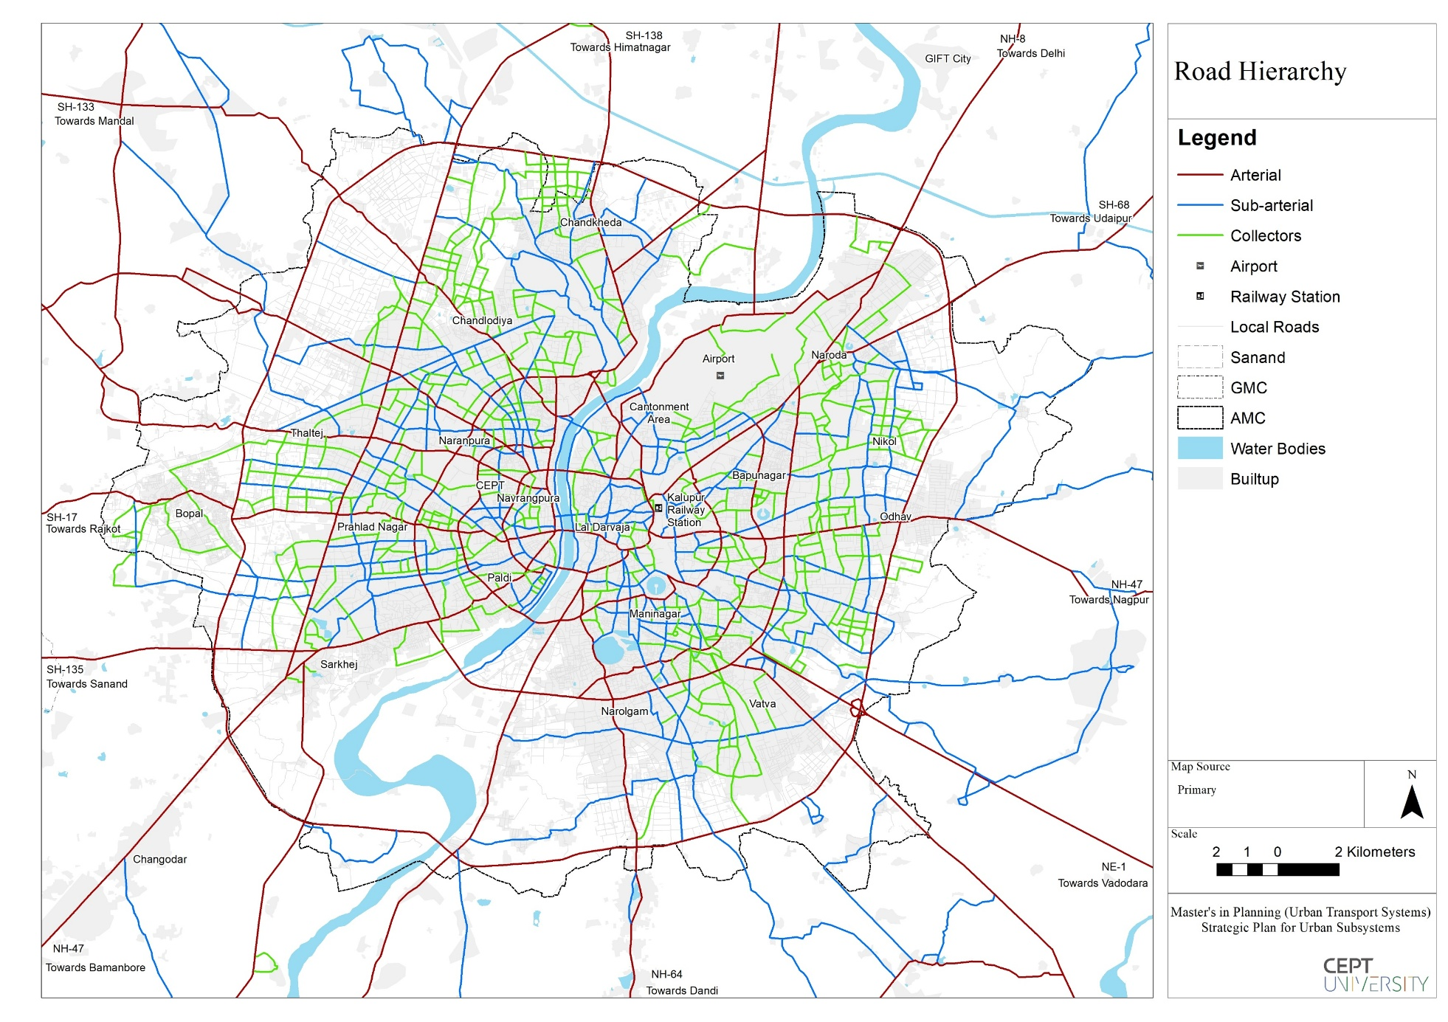
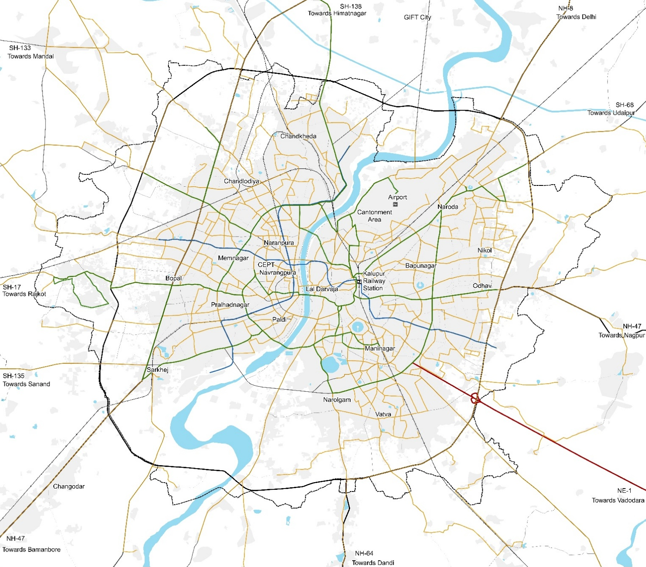
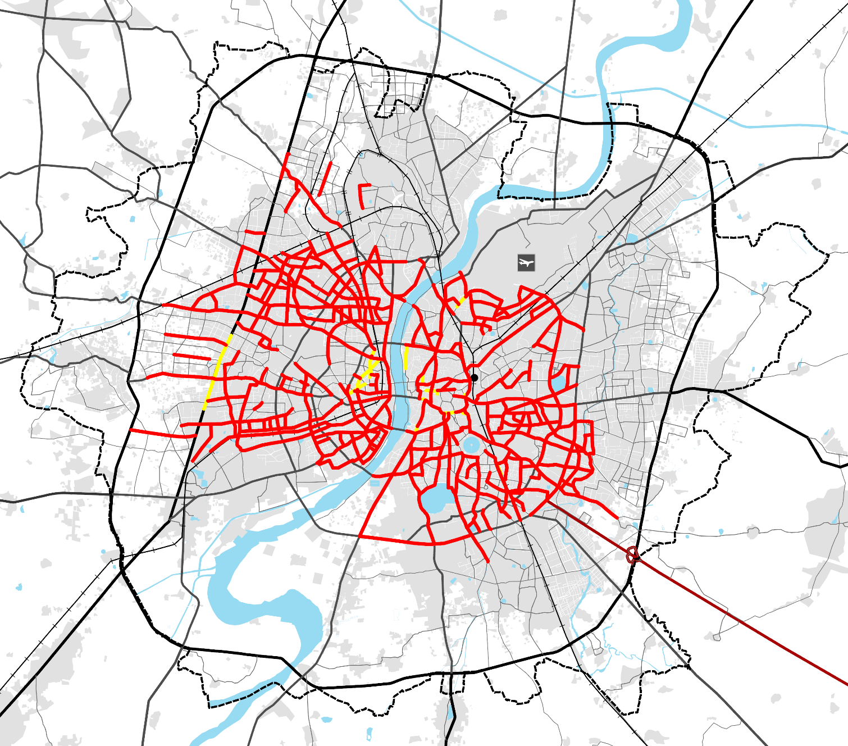


Ahmedabad’s City Profile
489 Sq.km
AMC Area 2024
7.95 M
AMC Population 2024
Road Network
4 Ring Roads
17 Radial Roads
LoS 1
3,218 km of road network within AMC boundary
Public Transport
897 km
AMTS Network
144 km
BRTS Network
40.3 km
Metro Network
0.15 buses per 1,000 population
Despite the presence of multiple transport modes, LoS for PT remains at Level 3, indicating that current investments in public transport are inadequate.
Mode Share
Mode​ | Car | 2-w | 3-w | PT | Others
Mode Share (2022) | 11% | 60% | 18% | 8% | 3%
Mode Share (2012) | 7% | 48% | 11% | 22% | 12%
On Street Parking
Out of the Total Road Network of Ahmedabad (3,218 Km) 35% is under the Major Roads (1,110 Km). From which 29.3% (326 Km, Equivalent to 64,285 ECS) is encroached parking.
Source: MUTS Studio Spring 24’, CEPT University, SUMP- 2022, IMP - 2012

Slide 11
Financial Outlay to Urban Mobility
Operational and regular maintenance expenses are funded through AMC’s revenue account (from taxes and utility charges), while capital works like new road construction and periodic maintenance are financed via the capital account, supported by government grants.
Budget Cost Components
Operational Cost | Regular Maintenance Cost | Periodic Maintenance Cost | Infrastructure Expansion Cost
Establishment Cost (for road cleaning) Electricity Cost (associated with the operation of traffic signals etc.). Fuel cost for vehicle operation. Financial support to AMTS/AJL | Road Cleaning Cost Maintenance Cost of traffic signals and other equipment. Repair cost of street lights and other equipment. | Road Resurfacing cost | Capacity enhancement cost (New lane addition cost and cost of new roads) Installation of new equipment like street lights, traffic signals, traffic control blocks etc.
Annual Financial Outlay
Cost (in Cr.)
Particulars | 2020 -2021 | 2021 -2022 | 2022 -2023 | 2023 -2024
Urban Mobility Outlay | 1,542 | 1,389 | 1,837 | 2,483
AMC Budget | 7,827 | 9,482 | 10,454 | 11,420
% Allocation towards Urban Mobility | 20% | 15% | 18% | 22%
Source: AMC – Budget Report (2010 - 2024)

Slide 12
Financial Outlay to Urban Mobility
Annual Budget Outlay (at Constant Price) (A)
Capital & periodic maintenance costs are life cycle costs and are annualized using a 5% capital recovery rate. All costs are adjusted to reflect constant prices.
Outlay on Passenger Modes
Total Outlay
Internalized Cost
Freight Cost
Vehicle Estimation
Vahan Dashboard
Scrapping of vehicle - Age of the vehicle
Revenue from Vehicle Tax
18% (241 Cr.)
Cost allocated to Freight
15.5% (206 Cr.)
Cost Allocation
PCU Hours
Trip Length – HVT Study, CRDF, 2025
Speed – 20km/h, HVT Study, CRDF, 2025
Net Cost for Bus Service Operation (at Constant Price) (B)
A portion of the operating cost of public transport is internalized through bus fares paid by users; hence net operating cost is considered for analysis.
Outlay on Public Transport
Total CPKM
EPKM
Non – Operational Component
Net CPKM
Rs. 34.43 / km
Rs. 102.91 / km
Rs. 27.69 / km
Welfare (Pension) + indirect salary accounting
Rs. 32.93/ km + 7.85/km
(39.6% of Total CPKM)
Cost (in Lakhs.)
Particulars | 2020 -2021 | 2021 -2022 | 2022 -2023 | 2023 -2024
Daily Cost for Urban Mobility ( A + B ) | 296 | 260 | 276 | 298
Source: AMTS and BRTS Financial Reports, AMC – Budget Report, HVT Study, CoE-UT, CRDF, 2025

Slide 13
Trend of Daily Cost of Urban Transport
3x increase in road cost since 2012
2.3x increase in accident cost
1.7x increase in emission cost
1.9x increase in PT Operation cost
1.3x increase in Parking cost
PT Share
22%
PT Share
8%
PT Share
22%
PT Share
8%

Slide 14
Daily Cost Distribution (2024)
The total cost to agency is distributed across different modes of transport based on their respective share in PCU-hours.
% Distribution of the True Cost
% Distribution of Cost to Agency (298.1 Lakhs)
Accident Cost
2% ( 7.24 Lakhs )
4w
26% ( 77.7 Lakhs )
Emission Cost
16% ( 59.5 Lakhs )
PT
21% ( 61.3 Lakhs )
Cost to Agency
Cost to Agency
82% ( 298.1 Lakhs )
Distribution
3w
9% ( 28.3 Lakhs )
2w
44% ( 130.7 Lakhs )
Financial burden of transport provision outweighs the measured economic burden from externalities.
Out of the total cost, private vehicles account for 72%, while public transport contributes only 18%.
2w and 4w together account for about 70% of the total financial cost, while PT contributes around 21%.

Slide 15
Daily Financial Outlay – Road Provision Cost
Daily Financial Outlay – Financial Cost
PT Share
8%
PT Share
8%
307.9
299.3
298.1
266.3
276.4
253.5
252.2
240.8
211.98
225
196.7
201.1
197.4
209.1
PT Share
22%
189.3
181.6
195.6
PT Share
22%
168.2
146.1
158.3
129.9
138.2
120
123.3
90.6
89.7
90
97.5
68.4
71.5
7% | 6% | 8% | 8% | 7% | 6% | 6% | 5% | 5% | 3% | 3% | 3% | 3% | 3% | 3%
25% | 25% | 24% | 24% | 24% | 23% | 23% | 23% | 22% | 22% | 21% | 21% | 20% | 20% | 20%
51% | 51% | 50% | 50% | 50% | 50% | 50% | 50% | 50% | 51% | 51% | 50% | 50% | 50% | 50%
17% | 17% | 18% | 18% | 19% | 20% | 21% | 22% | 23% | 24% | 25% | 26% | 26% | 27% | 27%
26% | 22% | 28% | 27% | 29% | 29% | 33% | 31% | 30% | 23% | 36% | 36% | 27% | 26% | 21%
7% | 8% | 8% | 8% | 8% | 8% | 8% | 8% | 8% | 9% | 8% | 8% | 9% | 9% | 9%
45% | 47% | 44% | 43% | 42% | 42% | 39% | 40% | 40% | 43% | 36% | 36% | 40% | 41% | 44%
21% | 23% | 21% | 21% | 21% | 21% | 20% | 21% | 22% | 24% | 20% | 21% | 24% | 24% | 26%
Public Transport is more space efficient than any other mode of transport.
When on-street parking costs are considered, the share of total public expenditure attributed to private modes of transport rises to 70%. As a result, private vehicles receive nearly 3.4 times the level of public subsidy compared to public transport.

Slide 16
Daily Cost – Financial + Economic Cost
PT Share
8%
369.8
362.6
363.5
341.5
331.5
308.5
309.9
276.6
260.2
PT Share
22%
234.5
210.6
157.4
169.7
134.2
135.5
How Much Does it Costs to Travel One Kilometer?
20% | 17% | 24% | 23% | 25% | 25% | 28% | 27% | 26% | 20% | 31% | 30% | 23% | 22% | 18%
11% | 12% | 9% | 9% | 9% | 9% | 9% | 9% | 9% | 10% | 9% | 9% | 10% | 10% | 10%
50% | 51% | 48% | 47% | 46% | 45% | 43% | 43% | 43% | 46% | 40% | 40% | 44% | 44% | 47%
19% | 20% | 20% | 20% | 20% | 20% | 20% | 20% | 21% | 23% | 20% | 21% | 24% | 24% | 25%
Cars receive approximately 1.4 times, and two-wheelers receive about 2.6 times the level of public subsidy compared to public transport. When combined, these private modes account for 4 times the subsidy received by public transport.

Slide 17
Cost Per Passenger Km – Financial Cost
Cost Per Passenger Km – Financial Cost + Economic Cost
PT Share
8%
PT Share
22%
PT Share
8%
PT Share
22%
Economies of scale make PT the only mode where per passenger cost falls as usage rises. In contrast, per passenger costs for cars and two-wheelers rise with increasing mode share.
Per passenger cost decreases with higher usage due to economies of scale — and even with added emission and accident costs, PT remains cost-efficient, unlike private modes where these externalities sharply increase total cost per user.

Slide 18
Cost Per Passenger Km – Financial + Economic Cost
PT Share
8%
PT Share
18%
PT Share
22%
PT is cost-efficient wrt cars even at 8%, wrt 2w & 3W when its mode share exceeds 18%
Below this threshold, two- and three-wheelers become more cost-effective alternatives.

Slide 19



Summary
Although public transport is often perceived to receive a higher subsidy, the analysis indicates that private modes, especially cars and two-wheelers, receive greater implicit subsidies.
For overall cost efficiency, investment in public transport is essential , as it is more space-efficient, economically viable, and fuel-efficient than private modes.
System-level cost efficiency is achieved only when substantial investment is made in public transport, and its mode share exceeds 18%.
A system-wide assessment framework is crucial for guiding public agency investments based on the true costs of different transport modes.

Slide 20
Reference
Link H. and J.-E. Nilsson (2005). Infrastructure. Measuring the marginal social cost of transport. C. Nash and B. Matthews. Oxford, UK, Elsevier. 14: 49-83.
Bruzelius, N. (2004). Measuring the marginal cost of road use: an international survey. Swedish National Road and Transport Research Institute. Linkoping.
Small, K. A. and C. Winston (1988). "Optimal Highway Durability." The American Economic Review 78(3): 560-569.
Lindberg, G. (2002). Deliverable 10: Infrastructure Cost Case Studies, Annex A2: Marginal cost of road maintenance for heavy goods vehicles on Swedish roads. Funded by 5th Framework RTD Programme. ITS, University of Leeds, Leeds.
Herry, M. and N. Sedlacek (2002). Road econometrics - Case study motorways Austria. Deliverable 10: Case Studies on Marginal Infrastructure Costs. UNITE - Work Funded by 5th Framework RTD Programme. Leeds, ITS - University of Leeds.
Newberry, D. M. (1988). "Road Damage Externalities and Road User Charges." Econometrica 56(2): 295-316.
Marion Drut, Spatial issues revisited: The role of shared transportation modes, Transport Policy, Volume 66, 2018, Pages 85-95, ISSN 0967-070X, https://doi.org/10.1016/j.tranpol.2018.02.003.
Doll, C., Van Essen, H., & CE Delft. (2008). Road infrastructure cost and revenue in Europe. In Internalisation Measures and Policies for All External Cost of Transport (IMPACT) – Deliverable 2 (Report 08.4288.17). CE Delft. https://www.ce.nl.
Vermeulen, J. P. L., Boon, B. H., Van Essen, H. P., Den Boer, L. C., Dings, J. M. W., Bruinsma, F. R., Koetse, M. J., & CE. (2004). The price of transport - Overview of the social costs of transport (N. Harle, Trans.; Report 04.4850.40). CE. https://www.ce.nl.
Astrid Jakob, John L. Craig and Gavin Fisher (2006), “Transport Cost Analysis: A Case Study of the Total Costs of Private and Public Transport in Auckland,” Environmental Science & Policy, Vol. 9 (www.sciencedirect.com), pp. 55-66.
Christopher Zegras with Todd Litman (1997), An Analysis of the Full Costs and Impacts of Transportation in Santiago de Chile, International Institute for Energy Conservation (www.iiec.org); at http://web.mit.edu/czegras/www/Santiago%20Full%20Cost%20Study.pdf.
Douglas Lee (1995), Full Cost Pricing of Highways, USDOT Volpe National Transportation Systems Center (www.volpe.dot.gov).
Mayeres, I., Ochelen, S., Proost, S., 1996. The Marginal External Costs of Urban Transport. Transportation Research D ID (2), 111-130.
Patrick Balducci and Joseph Stowers (2008), State Highway Cost Allocation Studies: A Synthesis of Highway Practice, NCHRP Synthesis 378; at www.nap.edu/catalog/14178/state-highway-cost-allocation-studies.
Joseph Jones and Fred Nix (1995), Survey of the Use of Highway Cost Allocation in Road Pricing Decisions, Transportation Association of Canada (www.tac-atc.ca); FHWA (1997), Federal Highway Cost Allocation Study, USDOT (www.fhwa.dot.gov); at www.fhwa.dot.gov/policy/hcas/summary/index.htm.
Kenneth A. Small, Clifford M. Winston, and Carol A. Evans (1989), Road Work: A New Highway Pricing and Investment Policy, Brookings Institution Press (www.brookings.edu).
Todd Litman (2021), Socially Optimal Transport Prices and Markets, Victoria Transport Policy Institute (www.vtpi.org); at www.vtpi.org/sotpm.pdf.
Marie-Eve Will, Yannick Cornet and Talat Munshi (2020), “Measuring Road Space Consumption by Transport Modes: Toward A Standard Spatial Efficiency Assessment Method and an Application to the Development Scenarios of Rajkot City, India,” Journal of Transport and Land Use, Vo. 13, 1 pp. 651–669.

Slide 21
Thank You

