Slide 1
18th Urban Mobility India Symposium
Understanding Participation in Smartphone-Based Travel Surveys: Evidence from Jodhpur, India
UMI RS Paper ID: 2798
Authors
Shahiq Ahmad Wani, Dr Ranju Mohan
Department of Civil and Infrastructure Engineering
Indian Institute of Technology (IIT) Jodhpur
Presenter: Shahiq Ahmad Wani

Slide 2
Outline
Background and Introduction
Objective
Methodology
Data Description
Results
Conclusions

Slide 3

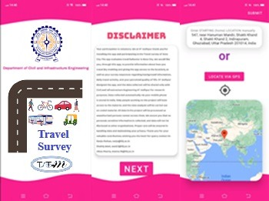
Background and Introduction
Rapidly urbanizing cities need accurate, real-time travel data for planning.
Traditional Surveys: Suffer from high costs, recall biases, and fail to capture dynamic travel
Smartphone-based surveys offer a powerful alternative for automated, detailed data collection.
Adoption in India is limited.
The barriers are human-centric: privacy concerns, digital literacy, and sustaining participation.

Slide 4
Objective
To examine the factors influencing individuals' willingness to participate in smartphone-based travel surveys.
To identify the key socio-demographic, experiential, and perception-based determinants of participation.
18th UMI Research Symposium Presentation
2

Slide 5
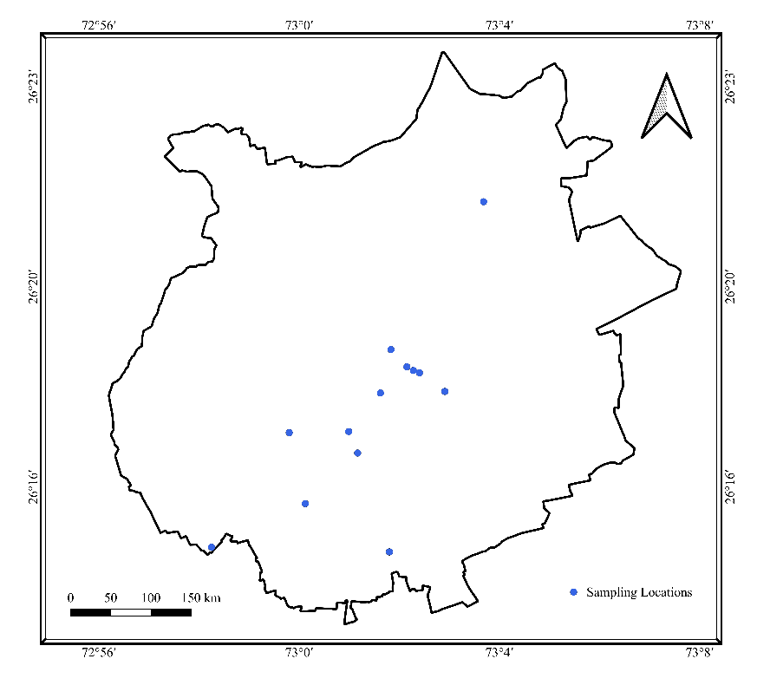
Data Description
Face-to-face questionnaire survey using systematic intercept sampling at diverse public locations
Final Sample: N = 330 valid responses from Jodhpur.
Figure 1. Spatial distribution of sampling locations in Jodhpur
Figure 2. Sample Characteristics

Slide 6
Methodology
The dependent variable - Participation Willingness," measured on a 5-point Likert scale and recoded into three ordinal categories: Not Willing, Neutral, and Willing.
A standard Ordinal Logistic Regression (OLR) model assumes "Proportional Odds" (PO).
A Brant test confirmed a significant violation of the PO assumption (p<0.05), making a standard OLR inappropriate for this data.
A Generalised Ordinal Logistic Regression (GOLOGIT) model was used.
A flexible model allowing the effect of specific variables to differ across the willingness thresholds

Slide 7
Results - Findings
Barriers (Increase odds of being less willing):
Students: Are 3.1 times more likely to be in a lower willingness category (vs. private employees). This may reflect time constraints/privacy.
Prior Survey Experience: Are 1.9 times more likely to be in a lower willingness category. This suggests potential "survey fatigue".
Facilitators (Decrease odds of being less willing):
Travel App Usage: Users of travel apps are significantly more willing.
App Source Trust: Each 1-unit increase in trust decreases the odds of being in a lower willingness category by 19.2%.
Reward Influence: Each 1-unit increase in reward influence decreases the odds of being in a lower willingness category by 28.7%.

Slide 8
Results - Findings
The GOLOGIT model revealed a non-parallel effect for Perceived Participation Value.
To Convince a Skeptic
(from "Not Willing" → "Neutral"):
Perceived value is highly effective. A 1-unit increase decreases the odds of remaining "Not Willing" by 53.9%
To Convince a Neutral Person
(from "Neutral" → "Willing"):
Perceived value is less effective (though still significant). A 1-unit increase decreases the odds of not being "Willing" by only 29.5%
Communicating the societal value of participation is most powerful for overcoming initial skepticism.

Slide 9
Conclusions
Key Findings:
Barriers: Student status and "survey fatigue" reduce willingness.
Facilitators: Digital familiarity (travel app use), trust in the source, and rewards all increase willingness.
Communicating the survey's value is the most effective tool against initial unwillingness.
Practical Implications:
Success hinges on trust-building and clear communication of benefits, not just app design.
Transparently communicate the societal value of participation.
Use targeted outreach and incentives for specific groups (e.g., students).
Limitations & Future Work:
Findings are from a single Tier-II city.
The 82% male sample is a major limitation. Future research must prioritize balanced gender representation.
Future work should compare this "stated willingness" with "actual participation".

Slide 10
References
Assemi, B., Jafarzadeh, H., Mesbah, M., & Hickman, M. (2018). Participants' perceptions of smartphone travel surveys. Transportation Research Part F: Traffic Psychology and Behaviour, 54, 338–348. https://doi.org/10.1016/J.TRF.2018.02.005
Banick, R. S., Regmi, S., & Sarma, N. (2021). Exploring smartphone data to estimate mobility in India.
Bayart, C., & Bonnel, P. (2012). Combining web and face-to-face in travel surveys: comparability challenges? Transportation, 39(6), 1147–1171. https://doi.org/10.1007/s11116-012-9393-x
Brant, R. (1990). Assessing Proportionality in the Proportional Odds Model for Ordinal Logistic Regression. Biometrics, 46(4), 1171. https://doi.org/10.2307/2532457
Gadziński, J. (2018). Perspectives of the use of smartphones in travel behaviour studies: Findings from a literature review and a pilot study. Transportation Research Part C: Emerging Technologies, 88, 74–86. https://doi.org/10.1016/J.TRC.2018.01.011
Harding, C., Faghih Imani, A., Srikukenthiran, S., Miller, E. J., & Nurul Habib, K. (2021). Are we there yet? Assessing smartphone apps as full-fledged tools for activity-travel surveys. Transportation, 48(5), 2433–2460. https://doi.org/10.1007/S11116-020-10135-7
Jäckle, A., Wenz, A., Burton, J., & Couper, M. P. (2022). Increasing Participation in a Mobile App Study: The Effects of a Sequential Mixed-Mode Design and In-Interview Invitation. Journal of Survey Statistics and Methodology, 10(4), 898–922. https://doi.org/10.1093/jssam/smac006
Lewis, A. R., Willcock, S., Casas, A., Kupiec-Teahan, B., Mendoza Sanchez, J., Anciano, F., Barrington, D. J., Dube, M., Hutchings, P., Karani, C., Llaxacondor, A., López, H., Mdee, A. L., Nou, K., Ofori, A. D., Riungu, J. N., Russel, K. C., Haque Tamal, M. E., Parker, A. H., & Bell, A. R. (2025). Realities of using self-administered smartphone surveys to solve sustainability challenges. Humanities and Social Sciences Communications, 12(1), 1–11. https://doi.org/10.1057/S41599-025-05305
Liu, X., & Koirala, H. (2012). Ordinal Regression Analysis: Using Generalised Ordinal Logistic Regression Models to Estimate Educational Data. Journal of Modern Applied Statistical Methods, 11(1), 242–254. https://doi.org/10.22237/jmasm/1335846000
Olson, K., Smyth, J. D., & Wood, H. M. (2012). Does Giving People Their Preferred Survey Mode Actually Increase Survey Participation Rates? An Experimental Examination. Public Opinion Quarterly, 76(4), 611–635. https://doi.org/10.1093/POQ/NFS024
Pucher, J., Korattyswaropam, N., Mittal, N., & Ittyerah, N. (2005). Urban transport crisis in India. Transport Policy, 12(3), 185–198. https://doi.org/10.1016/j.tranpol.2005.02.008
Safi, H., Assemi, B., Mesbah, M., & Ferreira, L. (2017). An empirical comparison of four technology-mediated travel survey methods. Journal of Traffic and Transportation Engineering (English Edition), 4(1), 80–87. https://doi.org/10.1016/J.JTTE.2015.12.003
Safi, H., Assemi, B., Mesbah, M., Ferreira, L., & Hickman, M. (2015). Design and Implementation of a Smartphone-Based Travel Survey. Transportation Research Record: Journal of the Transportation Research Board, 2526(1), 99–107. https://doi.org/10.3141/2526-11
Stopher, P. R., & Greaves, S. P. (2007). Household travel surveys: Where are we going? Transportation Research Part A: Policy and Practice, 41(5), 367–381. https://doi.org/10.1016/J.TRA.2006.09.005
Struminskaya, B., Lugtig, P., Keusch, F., & Höhne, J. K. (2020). Augmenting Surveys With Data From Sensors and Apps: Opportunities and Challenges. Social Science Computer Review. https://doi.org/10.1177/0894439320979951
Verreault, H., & Morency, C. (2018). Integration of a phone-based household travel survey and a web-based student travel survey. Transportation, 45(1), 89–103. https://doi.org/10.1007/S11116-016-9726-2
Verzosa, N., Greaves, S., & Ellison, R. (2017). Smartphone-based Travel Surveys: A Review. https://ses.library.usyd.edu.au/handle/2123/19540
Wani, S. A., Marazi, N., & Mir, M. S. (2025). Commuting in Cold Weather Geographies: How Weather-Related Public Transport Perceptions, Trip Attributes, and Socioeconomics Shape Mode Choice. Innovative Infrastructure Solutions. https://doi.org/10.1007/s41062-025-02154-z
Wani, S. A., & Mohan, R. (2025). Post-pandemic public transport resilience and mode shift dynamics in India. Transportation Research Part D: Transport and Environment, 147, 104968. https://doi.org/10.1016/j.trd.2025.104968
Wani, S. A., Pani, A., Mohan, R., & Bhowmik, B. (2025). Digital payment adoption in public transportation: Mediating role of mode choice segments in developing cities. Transportation Research Part A: Policy and Practice, 191, 104319. https://doi.org/10.1016/J.TRA.2024.104319
Williams, R. (2006). Generalized Ordered Logit/Partial Proportional Odds Models for Ordinal Dependent Variables. The Stata Journal, 6(1), 58–82. https://doi.org/10.1177/1536867X0600600104

Slide 11
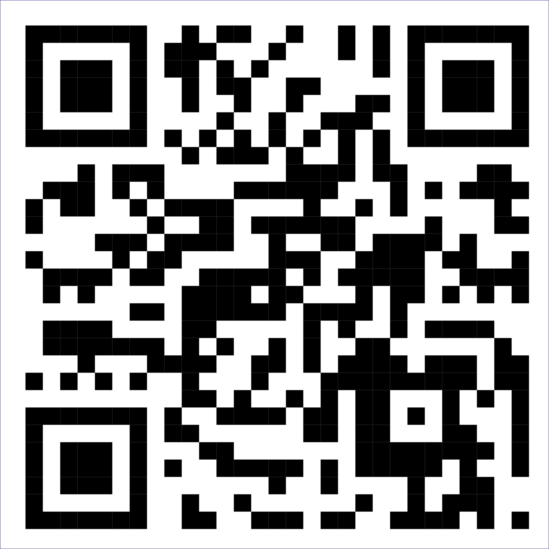
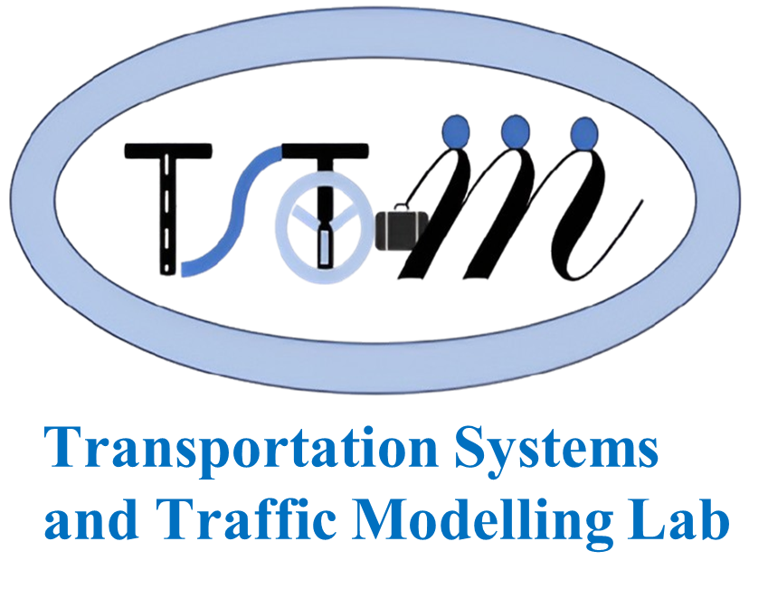
Thank You
Contact:
Shahiq Ahmad Wani, PhD Scholar, wani.1@iitj.ac.in;
Dr Ranju Mohan, Associate Professor, ranju@iitj.ac.in,
TSTM Lab, E1 Berm,
Department of Civil and Infrastructure Engineering,
IIT Jodhpur

Slide 12
Appendix: GOLOGIT Model
Table 1. GOLOGIT Model for Participation Willingness.
Predictor | Estimate | Std. Error | z value | p-value | Odds Ratio (Parallel / Threshold 1) | Odds Ratio (Threshold 2)
Threshold
Not willing | Neutral | 2.462 | 0.642 | 3.836 | < 0.001 *** | (11.731)
Neutral | Willing | 2.275 | 0.633 | 3.592 | < 0.001 *** | (N/A)
Parallel Effects
Employment_type_Student | 1.129 | 0.350 | 3.225 | 0.001 ** | 3.093 | 3.093
Research_survey_exp_Yes | 0.665 | 0.288 | 2.304 | 0.021 * | 1.944 | 1.944
Travel_apps_usage_Yes | -0.637 | 0.266 | -2.393 | 0.017 * | 0.529 | 0.529
App_source_trust | -0.213 | 0.103 | -2.065 | 0.039 * | 0.808 | 0.808
Reward_influence | -0.338 | 0.120 | -2.805 | 0.005 ** | 0.713 | 0.713
Age_group_Greater than 30 | 0.430 | 0.275 | 1.565 | 0.118 | 1.537 | 1.537
Gender_Female | 0.161 | 0.326 | 0.494 | 0.621 | 1.175 | 1.175
Employment_type_Other | 0.050 | 0.301 | 0.167 | 0.868 | 1.051 | 1.051
Smartphone_skills_Intermediate | -0.338 | 0.290 | -1.166 | 0.244 | 0.713 | 0.713
Smartphone_skills_Expert | 0.009 | 0.420 | 0.022 | 0.982 | 1.009 | 1.009
Non-Parallel Effects
Participation_value
Threshold 1 Effect | -0.774 | 0.120 | -6.469 | <0.001 *** | 0.461 | (N/A)
Threshold 2 Effect | -0.350 | 0.102 | -3.423 | 0.001 *** | (N/A) | 0.705
*** p < 0.001, ** p < 0.01, * p < 0.05

