Slide 1

18th Urban Mobility India Conference cum Exhibition 2025
Traffic Flow Modelling of Electric Vehicles in Urban Corridor Under mixed traffic scenario
Poorvi Patle, Master of Urban and Rural Planning, IIT Roorkee
Dr. Minal Chandra, Senior Scientist, CSIR-Central Road Research Institute, New Delhi
Dr. Ch. Ravi Sekhar, Chief Scientist, CSIR-Central Road Research Institute, New Delhi

Slide 2
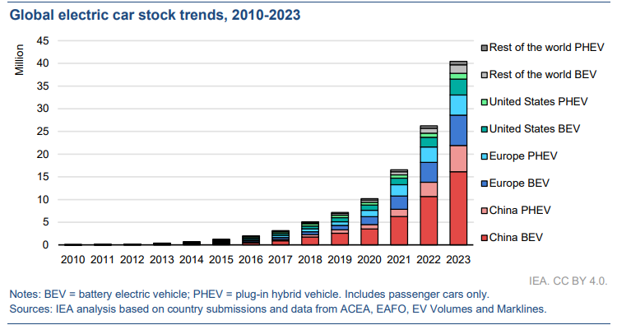
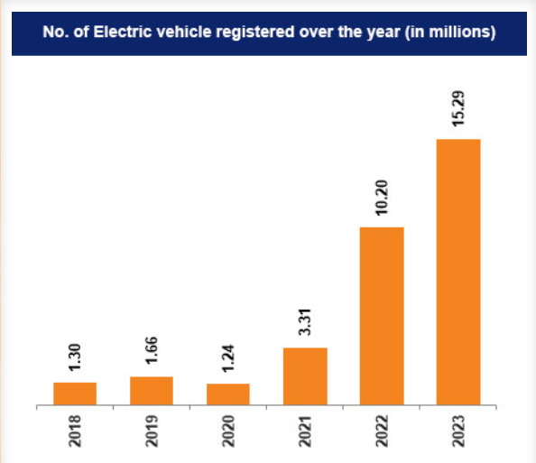
The Electric Revolution & The Research Problem
Rapid Global and National Growth
The adoption of electric vehicles (EVs) is expanding rapidly worldwide. In 2024, global sales surpassed 17 million, a 25% increase.
The rapid growth in electric car sales over the last five years has had a substantial impact on the worldwide car fleet: by the end of 2024, the electric car fleet would have reached about 58 million, accounting for around 4% of the total passenger car fleet and more than tripling the total electric car fleet in 2021.
The COP28 plan of action targets 58.3 million electric vehicle units by 2030, based on the current global rise in sales
According to the IBEF report on electric mobility in India, electric vehicles sales rose by 49.25% in 2023. And by 2030 i.e. in 7 years India wants to the percentage of sales of electric vehicles (EVs) to 30% for private automobiles, 70% for commercial vehicles, 40% for buses, and 80% for two- and three-wheelers which will result in 80 million EVs on Indian roadways
Source: IEA Global EV Outlook 2024
Source: PIB

Slide 3
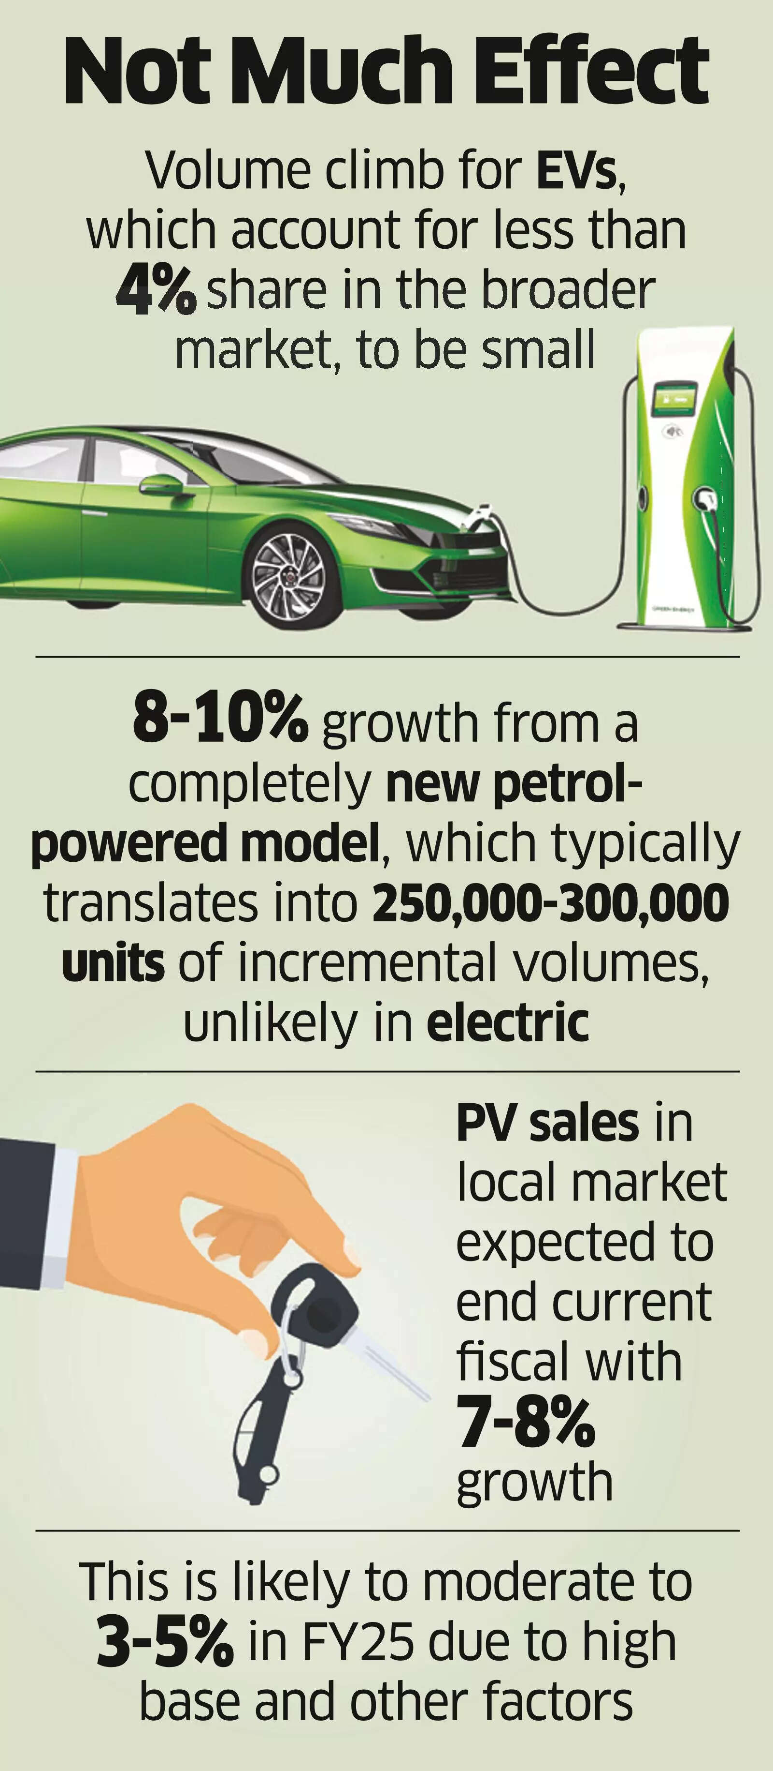
Objectives of the study
Analyze EV Influence
To examine how electric vehicles influence traffic flow and interact with conventional vehicles in a mixed traffic environment
Identify Research Gaps
To identify current gaps in research and infrastructure initiatives that may not meet the future needs of growing EV fleets
Estimate Passenger Car Units (PCUs)
To calculate dynamic PCUs for various EV types for better understanding their impact on roadway capacity and level of service
Explore Infrastructure Adaptation
To investigate the need for transport infrastructure like roads and signals to adapt to the unique behavior of EVs in diverse traffic.
Source: The Economic Times

Slide 4
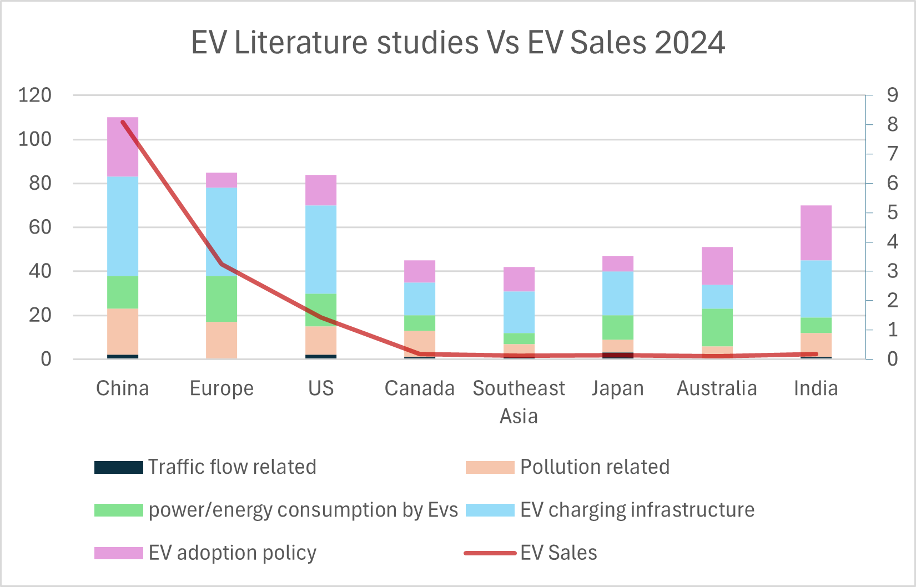
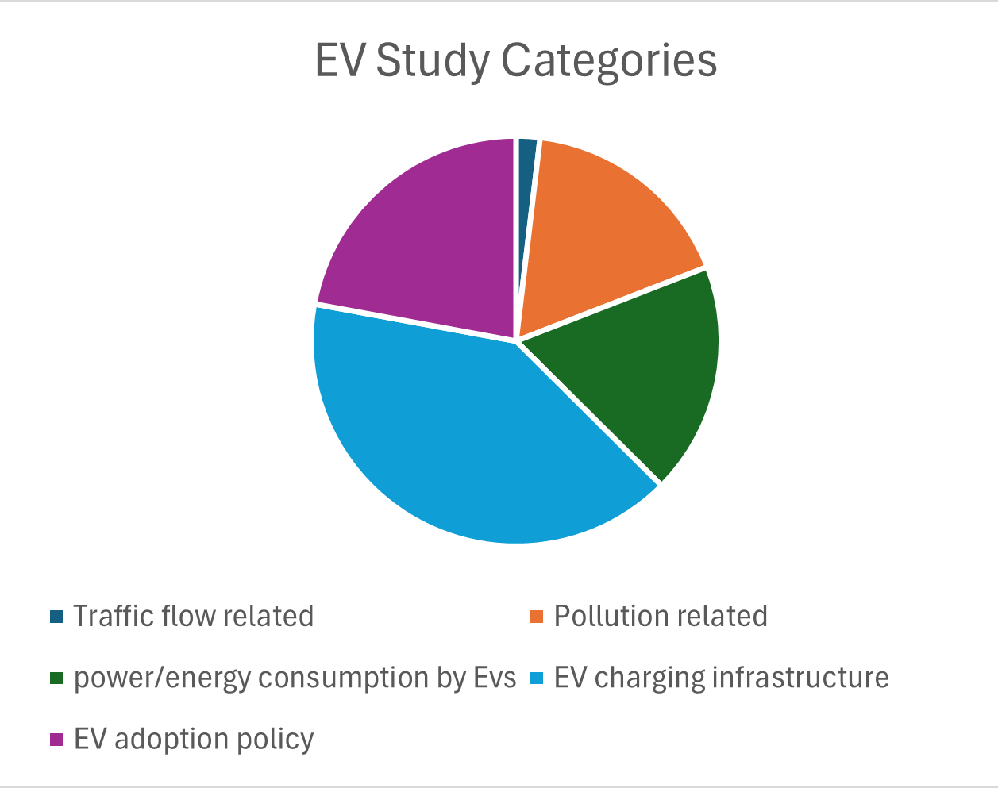
Where is the research focused? A Bibliographic Analysis
An Overlooked Area
A review of 534 research papers reveals a major focus on charging infrastructure (40.4%) and adoption policies. In stark contrast, the critical issue of how EVs impact traffic flow receives minimal attention, accounting for only 1.8% of studies.
This study directly addresses this significant research gap, shifting the focus from getting EVs on the road to understanding what happens once they are there.

Slide 5
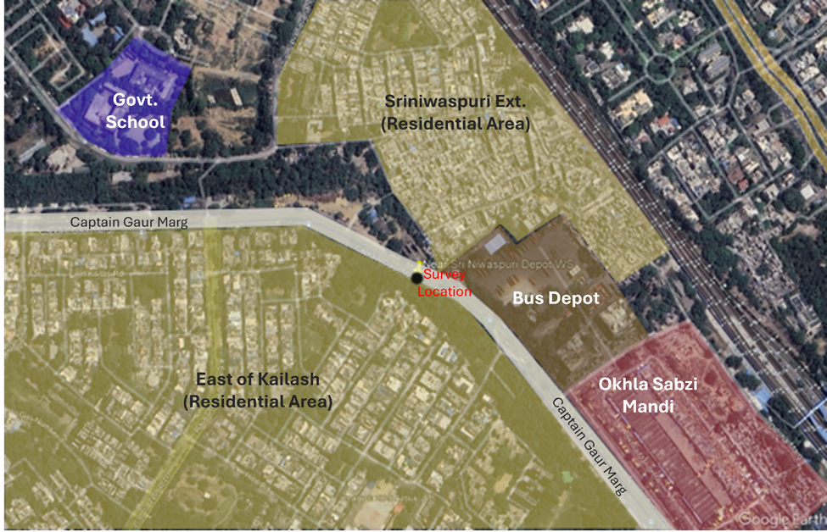
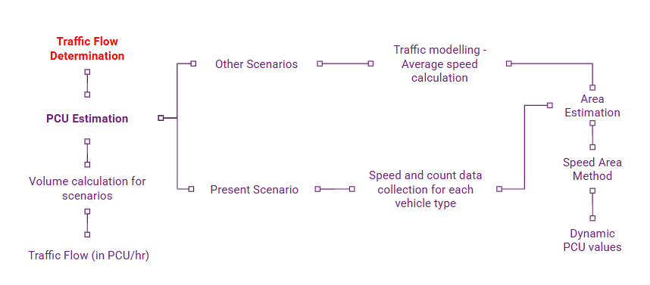
Methodology
Scenario Based Approach
Study area selection
To understand EV behavior, a field study was conducted on a 30-meter stretch of Captain Gaur Marg Road in Delhi, a location with diverse, mixed traffic. The process involved data collection, PCU estimation, and traffic flow determination across different scenarios.

Slide 6
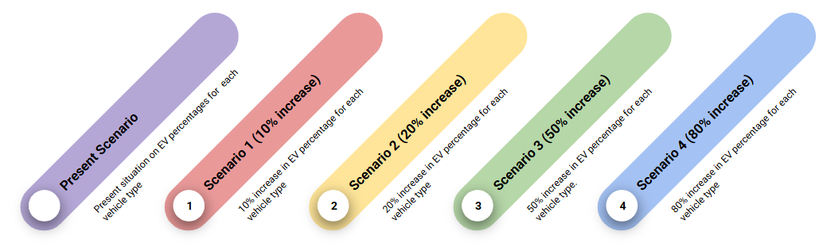
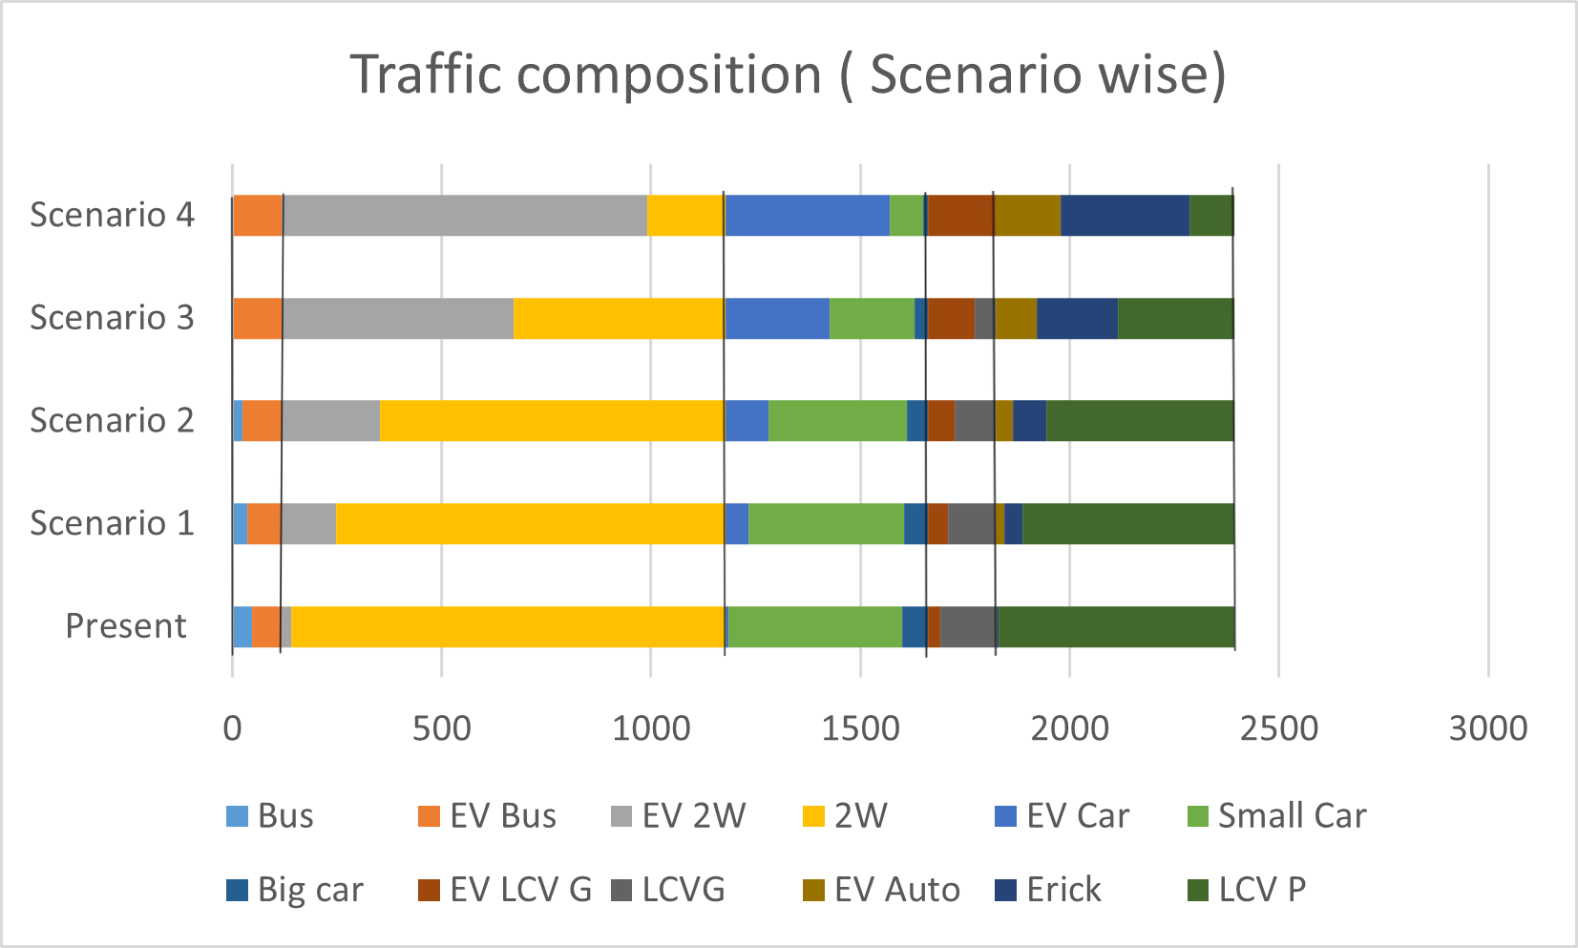
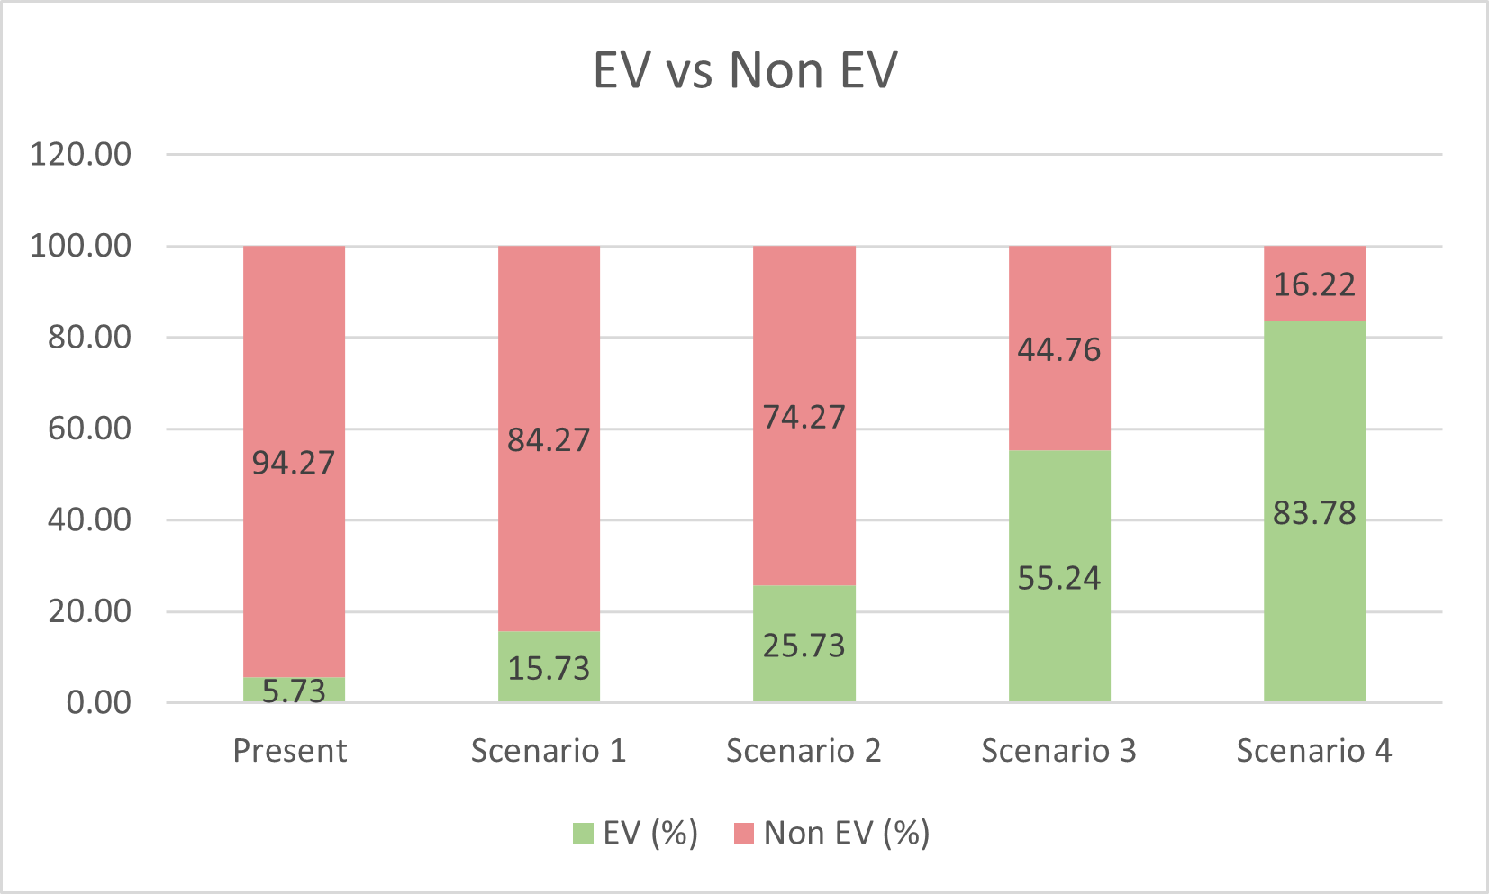
Methodology
Scenario Based Approach Defining Scenarios
The study analyzed a baseline 'Present Scenario' (5.73% EVs) and compared it against four hypothetical scenarios with progressively higher EV penetration, while keeping the total number of vehicles constant.
Scenario 1
A modest 10% increase in the proportion of EVs within each vehicle category.
Scenario 2
A 20% increase in the EV proportion, reflecting stronger adoption trends.
Scenario 3
A significant 50% increase, modeling a future with mature EV market share.
Scenario 4
An aggressive 80% increase, simulating a near-total transition to electric mobility.

Slide 7
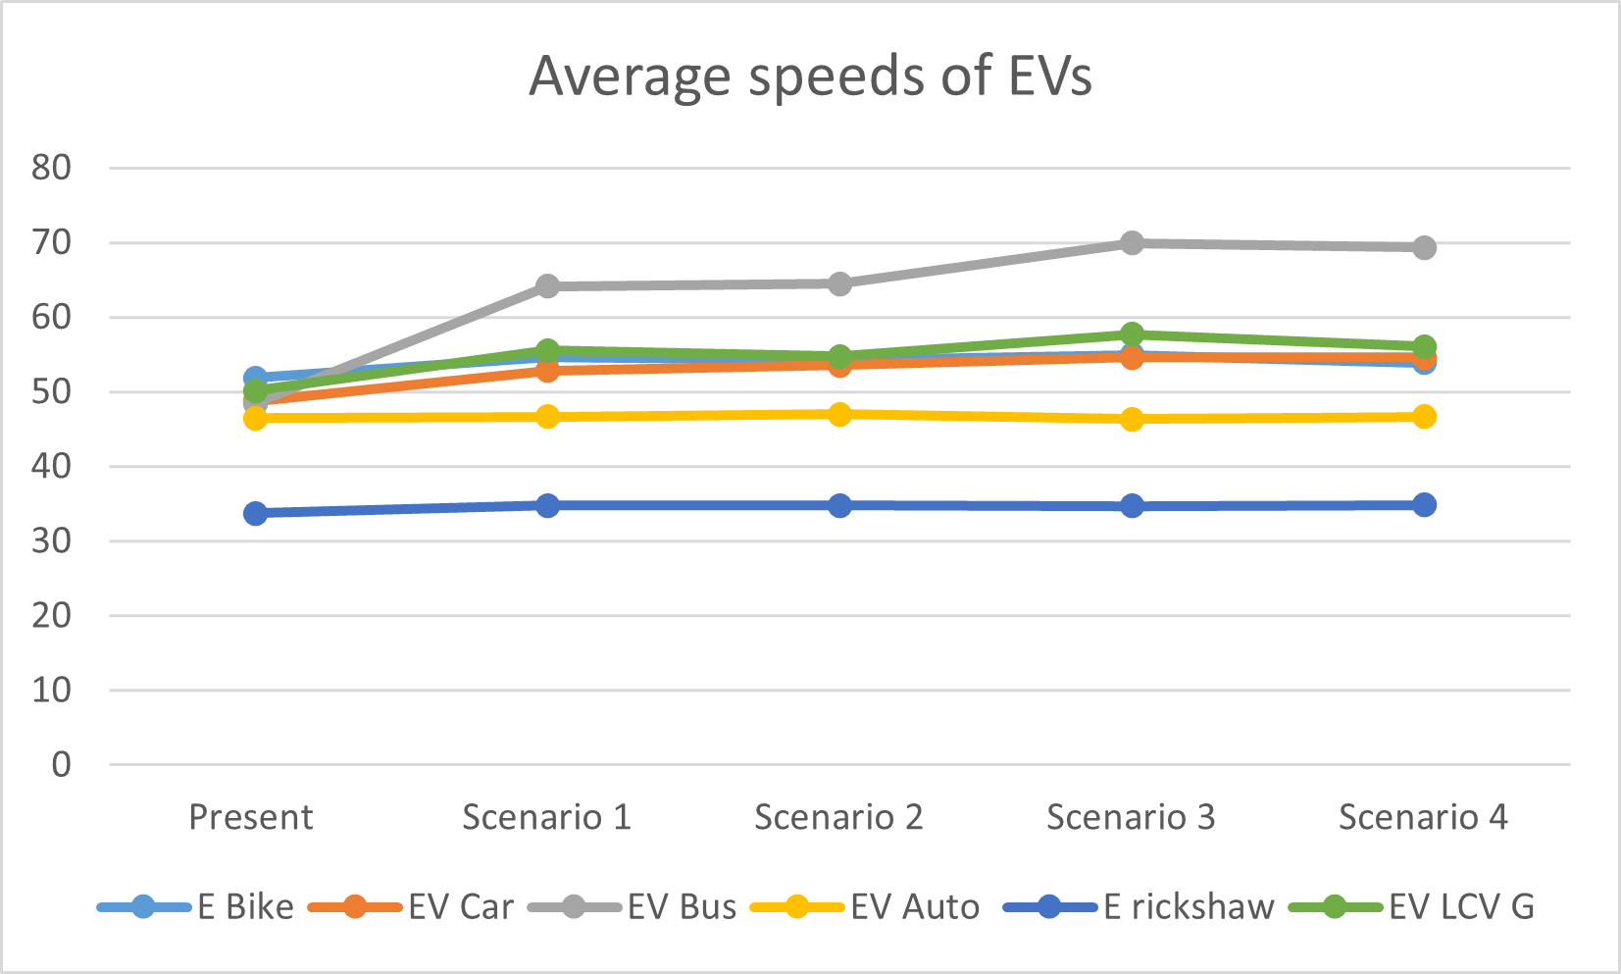
Results
Average Speeds Rise with More EVs
The speeds from present scenarios are used to determine the range for design speed of the vehicle types. Traffic modelling is performed to determine the average speeds of the vehicle types.
Traffic modeling showed a clear trend:
As the percentage of EVs in the traffic mix increases from the present day to Scenario 4 (highest EV %), the average speed of most EV types also increases.
EV buses show the most significant speed increase, while EV cars, two-wheelers, and goods vehicles also get little faster. This suggests EVs contribute to a smoother, faster-flowing traffic stream.

Slide 8











Analysis
Vehicle Type | EV |  | Non-EV
 | Description | Average Area(sq.m) | Description | Average Area(sq.m)
Two Wheeler |  | 1.391081 |  | 1.3338632
Car |  | 6.3625 |  | 5.8205555
Bus |  | 28.4425 |  | 23.6108
LCV G |  | 5.7 |  | 8.1023
LCV P (EV Auto) |  | 2.755155 |  | 3.4554
E- rick |  | 2.6683 | - | -
PCU Estimation
Firstly, the composition of traffic in all scenarios was defined. The total traffic volume count is kept same for all scenarios and compositions are varied.
Secondly the range for vehicle design speed is considered same for all scenarios. And the area of all vehicle types are studied.
Thirdly using traffic modelling average speeds for all vehicle type is estimated under each scenario. The base data from the present scenario was the input for traffic modelling. For traffic modelling several assumptions were made.
Lastly using the following formula (Speed-Area Method), PCUs for all vehicle types is estimated for each scenario.
PCUi = (Vc/Vi) / (Ac/Ai).
Vc and Vi are the average speeds of the passenger car and the vehicle type i respectively. Similarly, Ac and Ai are the areas.

Slide 9
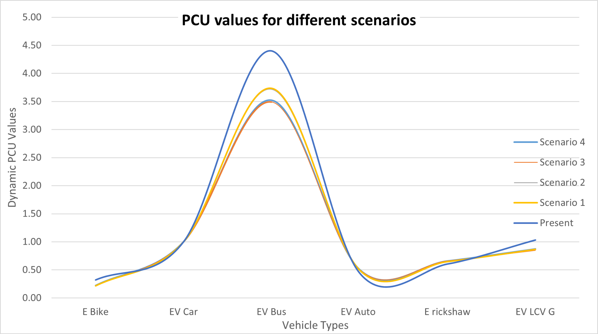
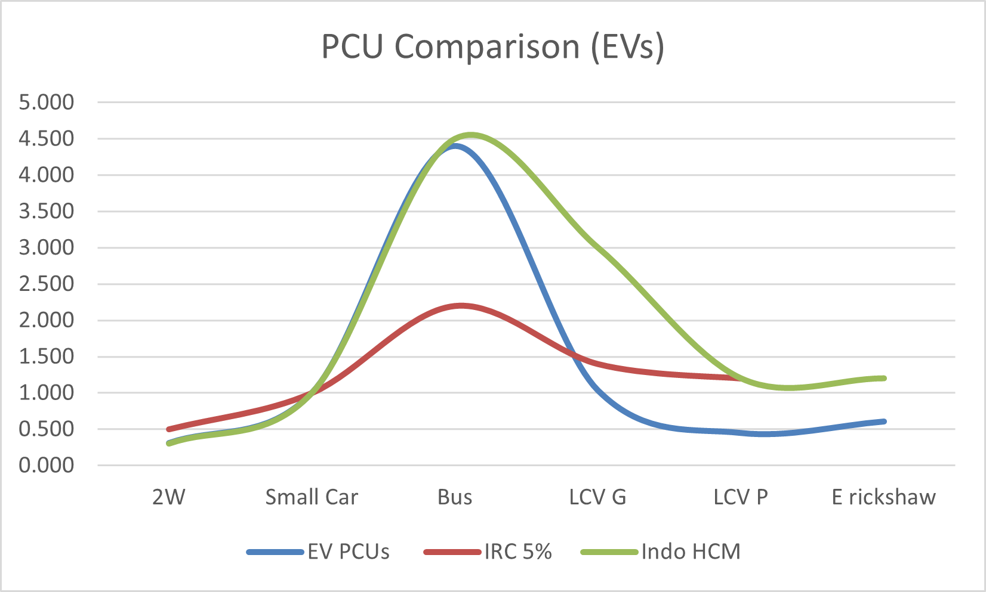
Results
The Impact of EVs (PCU) Changes with Volume
Passenger Car Unit (PCU) measures a vehicle's impact on traffic flow relative to a car (PCU=1). The analysis revealed that an EV's PCU isn't static; it changes based on how many of them are on the road and their speeds.
Key Insight: For EV Buses and LCV Goods, as their numbers increase, their individual impact on traffic (PCU) decreases significantly. This suggests they integrate more efficiently at higher volumes.
Comparison with guidelines
When compared to the conventional PCU values given in Indo HCM, there is a variance in values for buses and LCV goods.
This is most likely owing to evolutions in vehicle design, speed, and performance over time. Indo HCM, as the most recent version, is more accurate and relevant to the current situation.

Slide 10
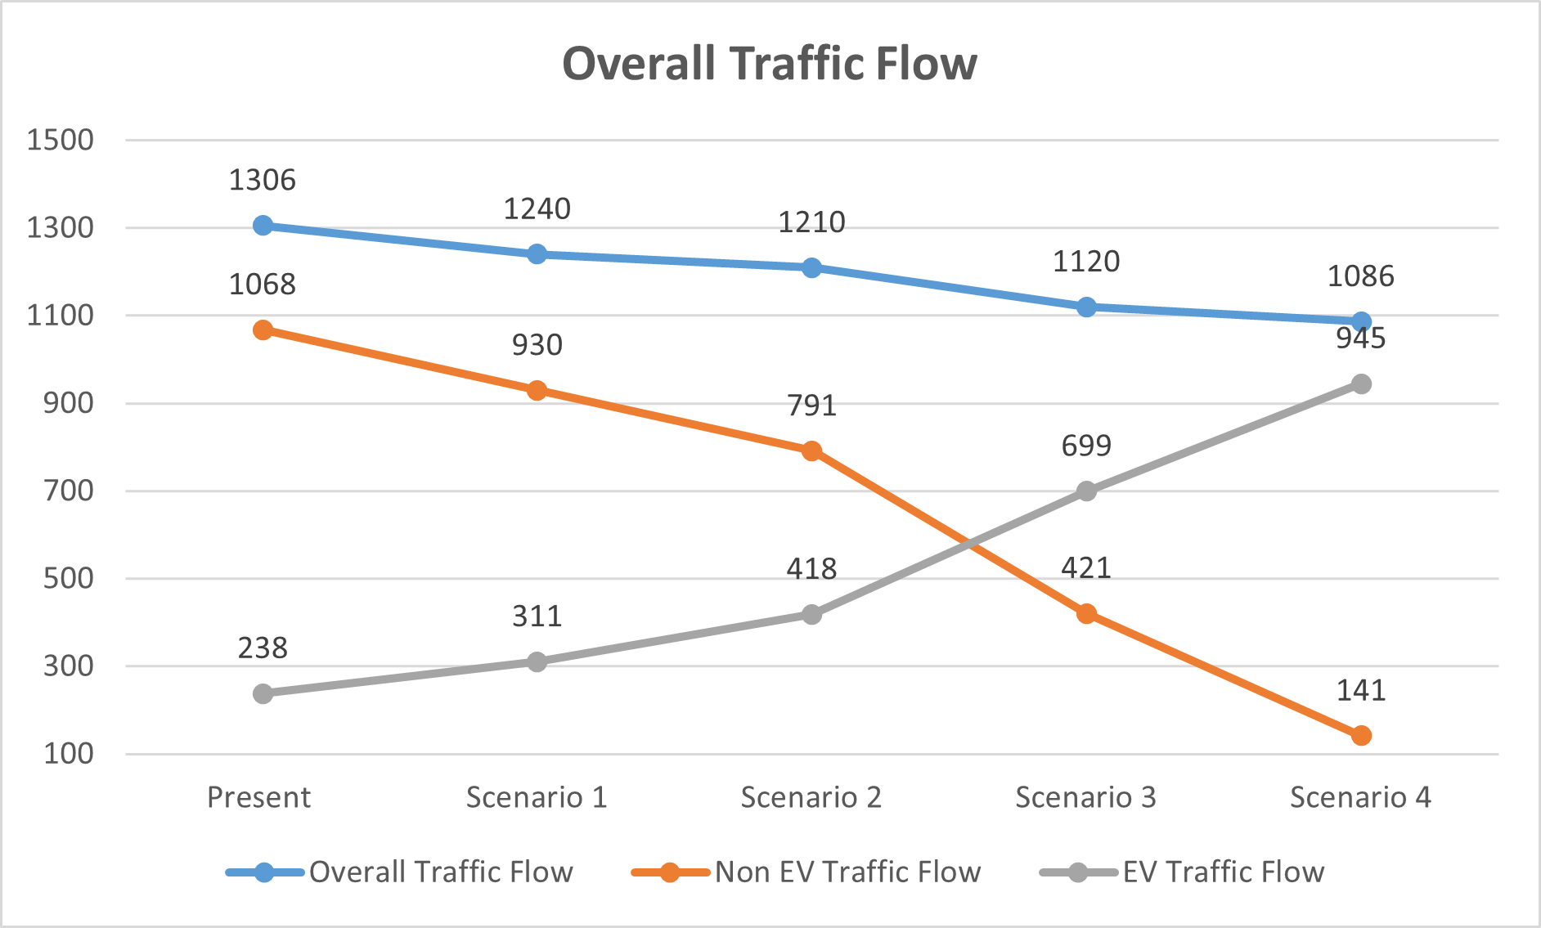
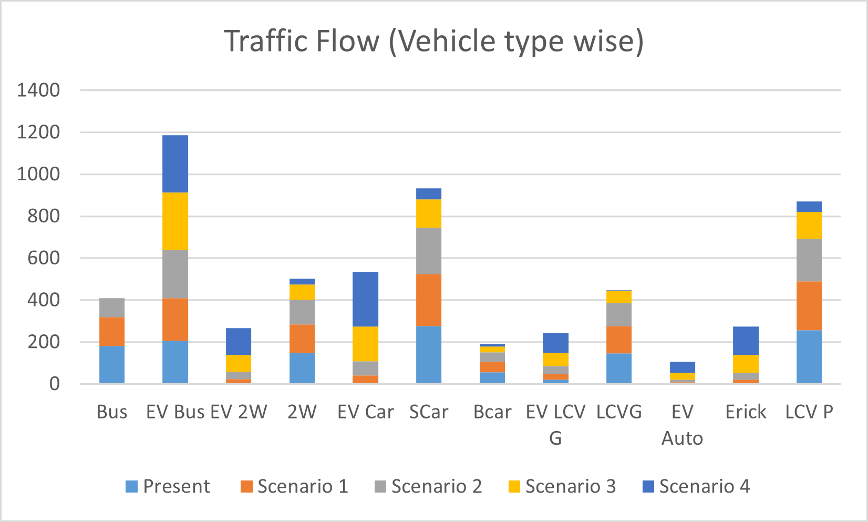
Results
Estimating Traffic Flow
The traffic flow is determined by calculating the volume per hour (in vehicle/hr) and then it is brought down to a single comparable unit i.e. PC/hr. The formula used was
Flow = ∑ PCU_{i}*Volume_{i} / hour where i is the vehicle type.
Overall Traffic Flow Paradoxically Decreases
A Counterintuitive Finding
Despite individual vehicles moving faster, the total traffic flow, measured in PCU per hour, decreases as the percentage of EVs increases.
With a 20% EV increase, total flow drops by 7%.
With an 80% EV increase, total flow drops by approximately 17%.
This suggests that while the traffic stream becomes faster, it may also become less dense.

Slide 11
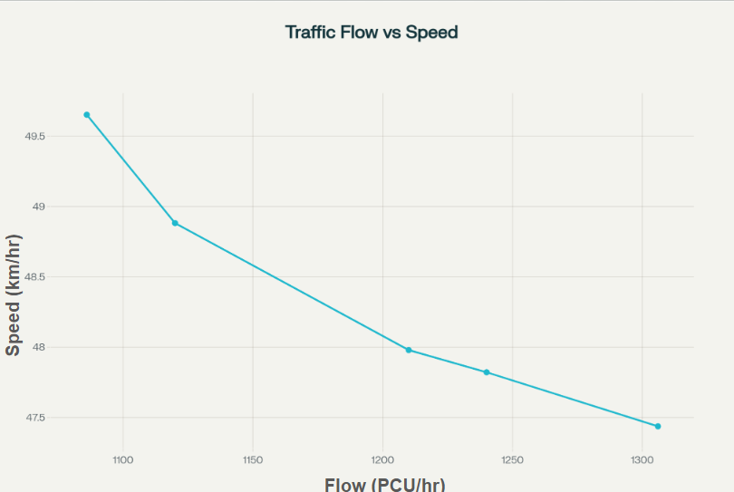
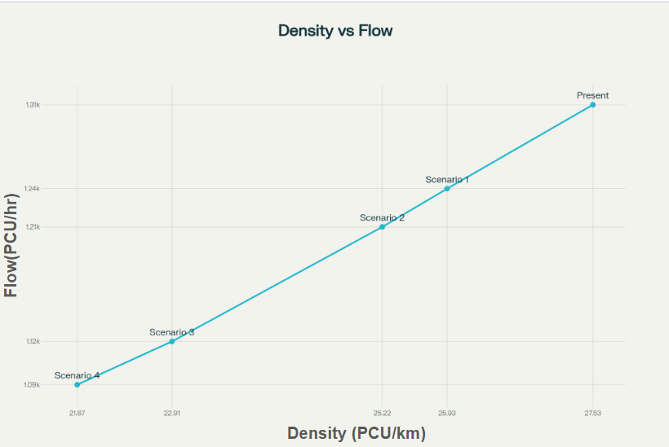
Results
The Core Relationship: Flow, Speed, and Density
An Inverse Relationship
The analysis revealed a fundamental shift in traffic dynamics as EVs become more common :
As EV percentage increases...
Traffic Flow (PCU/hr) ↓ Decreases
Traffic Density (PCU/km) ↓ Decreases
Stream Speed (km/hr) ↑ Increases
This indicates that a higher share of EVs creates a faster but less dense traffic environment, potentially altering the road's maximum capacity.

Slide 12
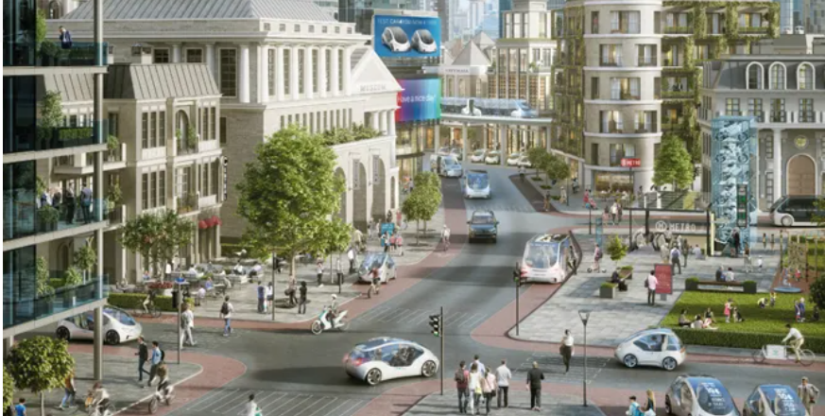
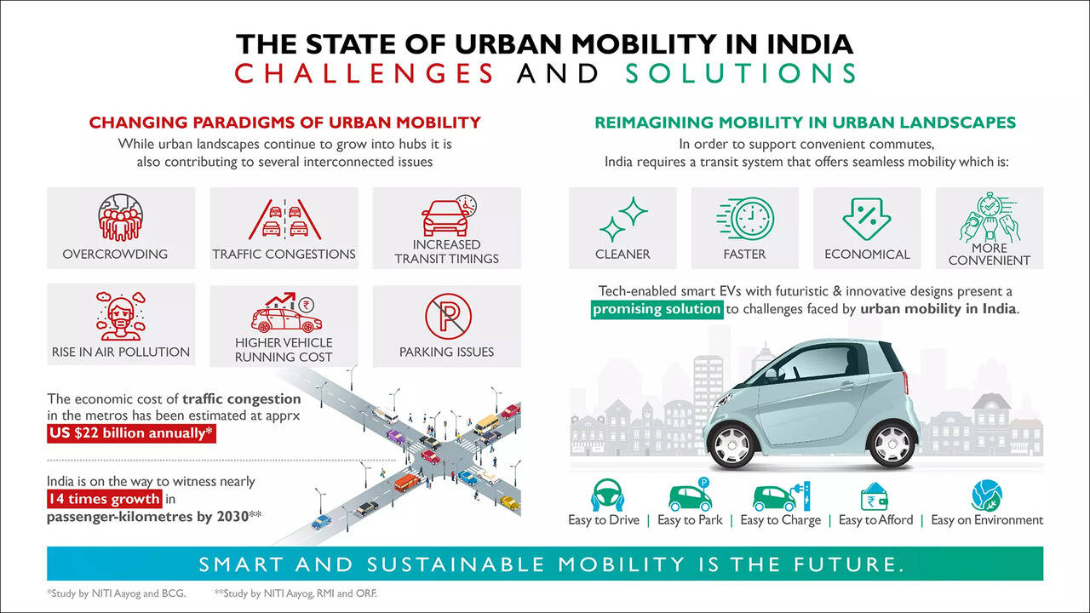
Actionable recommendations
Revise National Guidelines
Update IRC and Indo-HCM standards to include distinct, dynamic PCU values for various EV categories, acknowledging their unique behavior.
Update Urban Mobility Plans
Local authorities must revise Comprehensive Mobility Plans (CMPs) to account for evolving traffic patterns, considering the new flow data to recalculate route capacities and signal timings.
Inform Infrastructure Design
Incorporate findings on EV behavior into policies like 'Complete Street' design and 'Smart City' proposals to optimize intersection layouts and traffic control systems for a mixed fleet.
Conduct Further Research
More research is needed to directly model the impact on road capacity, level of service, and how different policy incentives for public vs. private EVs will shape future traffic composition.
Source: Niti Ayog and ORF

Slide 13
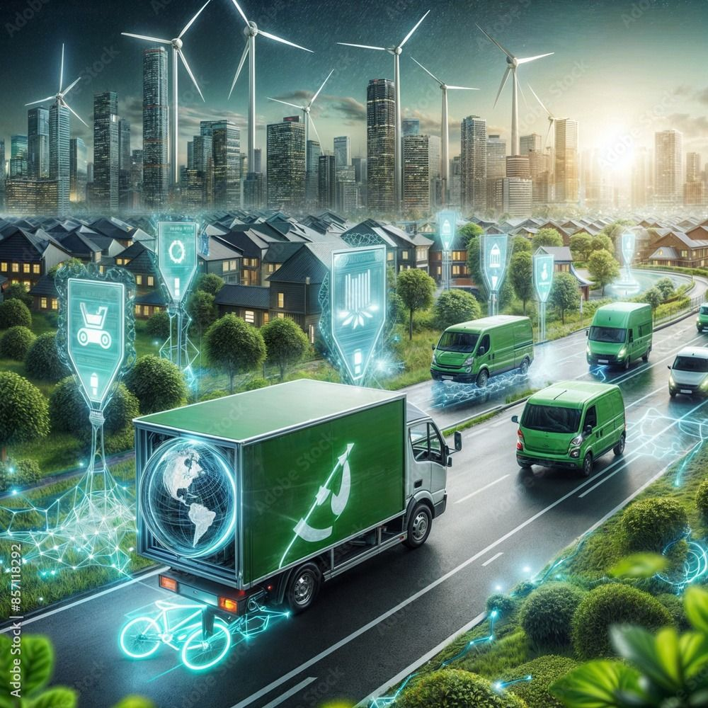
Conclusion
EVs accelerate traffic flow, leading to higher average stream speeds as their numbers grow.
The impact of an EV (its PCU value) is dynamic and generally lower than its non-EV counterpart, especially at higher volumes.
Higher EV concentration leads to a faster, but less dense, traffic stream, which paradoxically reduces total traffic flow (PCU/hour) in the studied conditions.
These changes will directly impact road capacity, level of service, and signal timing requirements in the future. Hence future studies must be done for measuring the impact on these factors.
As initiatives to promote electric vehicles in various vehicle categories are implemented, the proportion of EVs in traffic is likely to increase. To be prepared for changing traffic behaviour, it is critical to thoroughly research the scenario ahead of time.
It is also possible to investigate how differences in policy relating to electric mobility in public transit and private automobiles may affect traffic composition and behaviour in the future.

Slide 14
References
Energy Agency, I. (2024). Global EV Outlook 2024 Moving towards increased affordability. www.iea.org
Electric Vehicles: Electric Vehicle Industry in India and its Growth. (n.d.). India Brand Equity Foundation. https://www.ibef.org/industry/electric-vehicle
Jonas, T., Hunter, C. D., & Macht, G. A. (2022). Quantifying the Impact of Traffic on Electric Vehicle Efficiency. World Electric Vehicle Journal, 13(1). https://doi.org/10.3390/wevj13010015
IEA.2020. India 2020 Energy policy review. International Energy Review. https://www.iea.org/events/india-energy-policy-review-2020.
Chhikara, R., Garg, R., Chhabra, S., Karnatak, U., & Agrawal, G. (2021). Factors affecting adoption of electric vehicles in India: An exploratory study. Transportation Research Part D Transport and Environment, 100, 103084. https://doi.org/10.1016/j.trd.2021.103084
Raj, P., & Shankar, A. U. R. (2018). An Approach for Estimation of Passenger Car Unit Values of Vehicles Based on Influence of Neighboring Vehicles. https://www.researchgate.net/publication/322931158
Sharma, M., & Biswas, S. (2021). Estimation of Passenger Car Unit on urban roads: A literature review. In International Journal of Transportation Science and Technology (Vol. 10, Issue 3, pp. 283–298). Elsevier B.V. https://doi.org/10.1016/j.ijtst.2020.07.002
Ahmed, S., & Wang, S. (2024). Systematic review of the impacts of electric vehicles on evolving transportation systems. Digital Transportation and Safety, 3(4), 220–232. https://doi.org/10.48130/dts-0024-0020
Chandra, S., & Minal. (2019). Challenges of electric vehicle adoption in India. Indian Highways, 47(8). https://trid.trb.org/view/1649315
Chandra, M., Busch, P., Olguín, F. P., & Tal, G. (2025). Paths of progress: Forecasting global electric vehicle demand amidst demographic and economic growth. Transportation Research Part D Transport and Environment, 147, 104928. https://doi.org/10.1016/j.trd.2025.104928

