Slide 1


18th Urban Mobility India Conference cum Exhibition 2025
Inclusive Urban Street Navigation
of Persons with Visual Impairments (PVI)
in Non-Metro Indian Cities.
A Context-Specific Mobility Study.
Jinoj Mathidharan & Dr. Gaurav Raheja
Indian Institute of Technology (IIT),
Roorkee, India

Slide 2
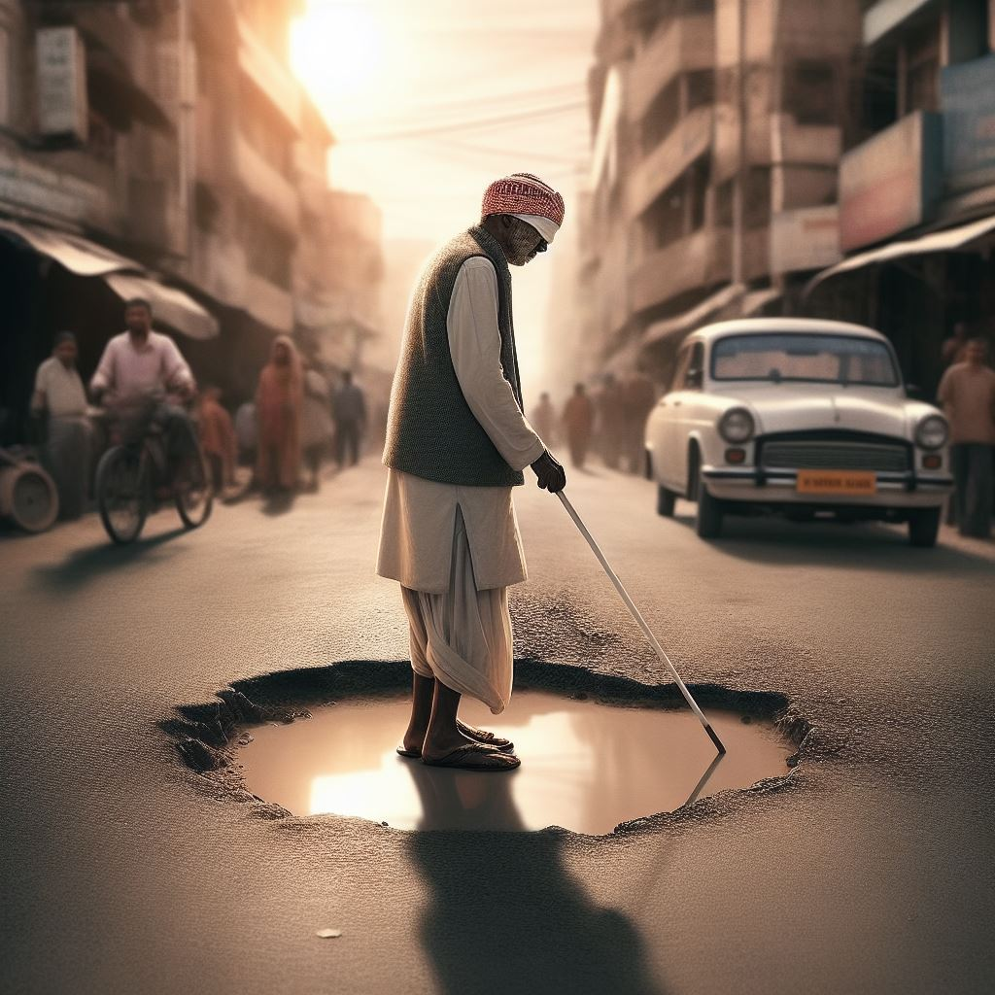
The disabled live in a transformed space
Golledge(1993)
AI-generated image

Slide 3
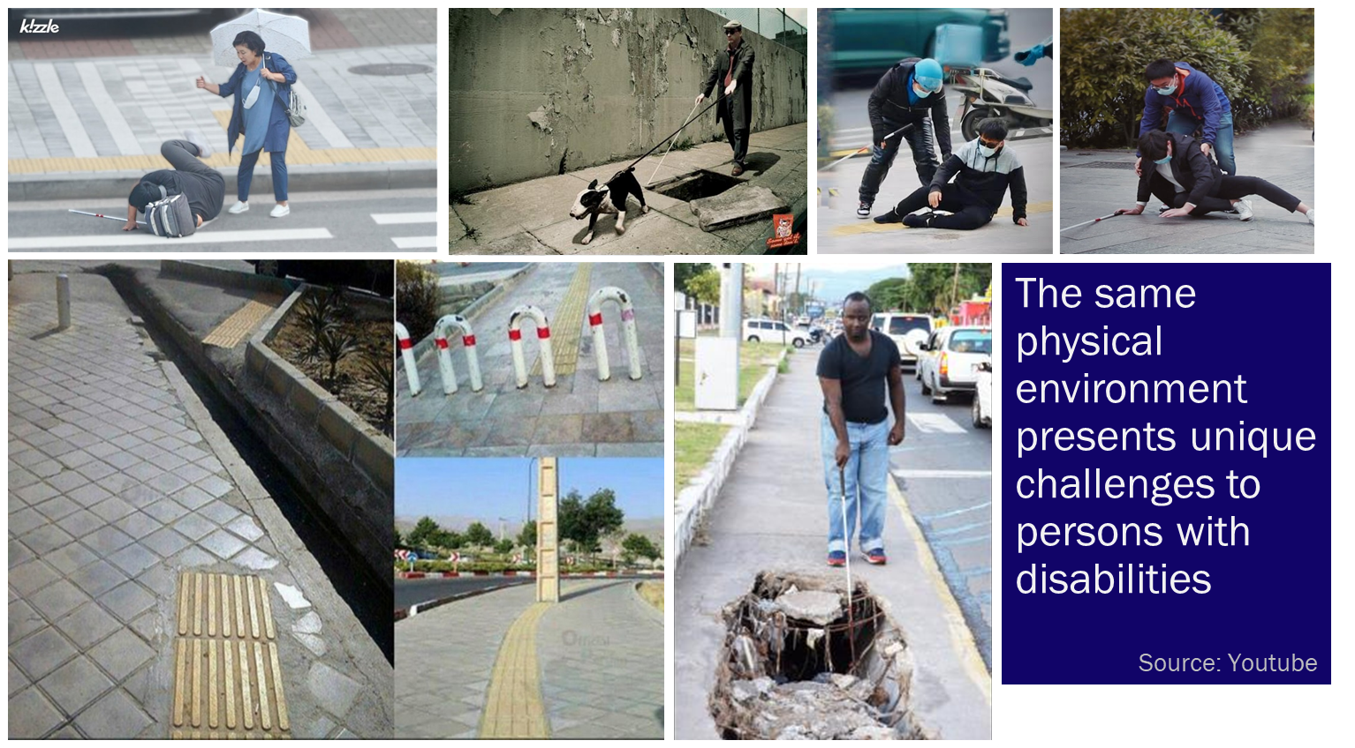

Slide 4
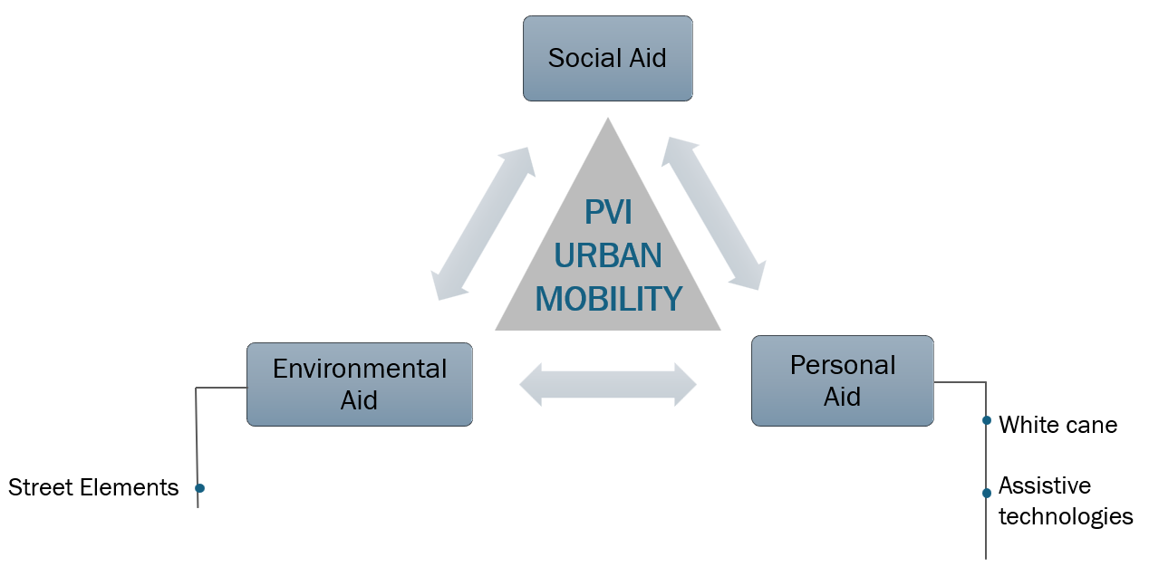
Co-travellers
Traffic police

Slide 5

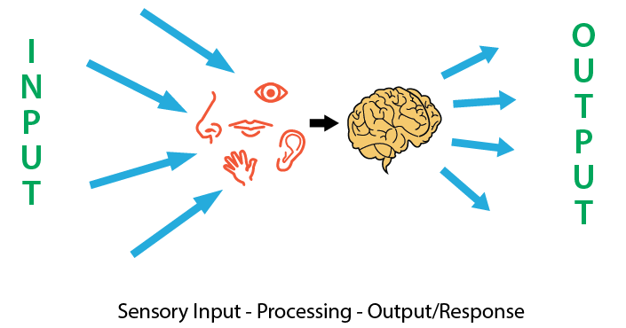
Vision: The dominant sense
Provides more information than all the other senses combined.
Streets have been designed with sight as the primary sense of comprehension.
Perception involves gathering, organising and making sense of information about the environment.
Reference:
Nagraj et al., 2021
Carmona, Heath, Oc, & Tiesdell, 2003

Slide 6







PVI urban street navigation happens with the help of perceptual sight function through a process of mind mapping creating sensory landmarks
haptic perception
sound perception
tactile clues
auditory clues
MIND MAPPING
Navigation using Perceptual Sight Function
Sensory Landmarks
THROUGH
CREATING
olfactory clues
visual clues
smell perception
colour perception
understand
identify

Slide 7
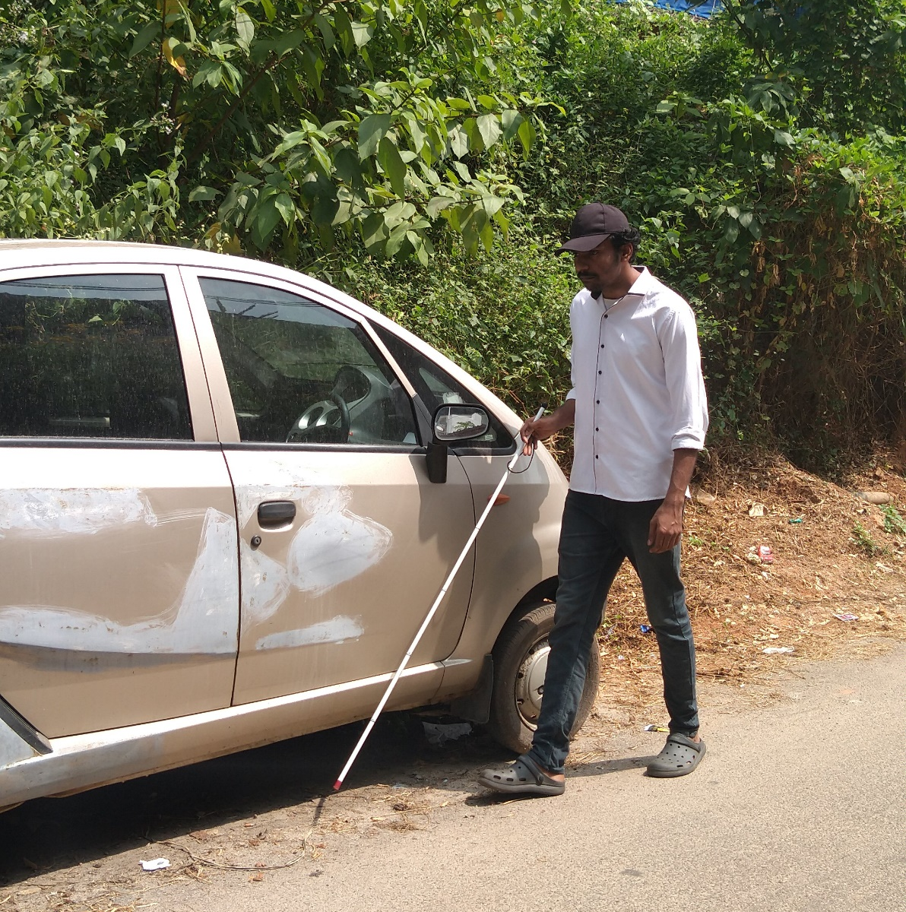
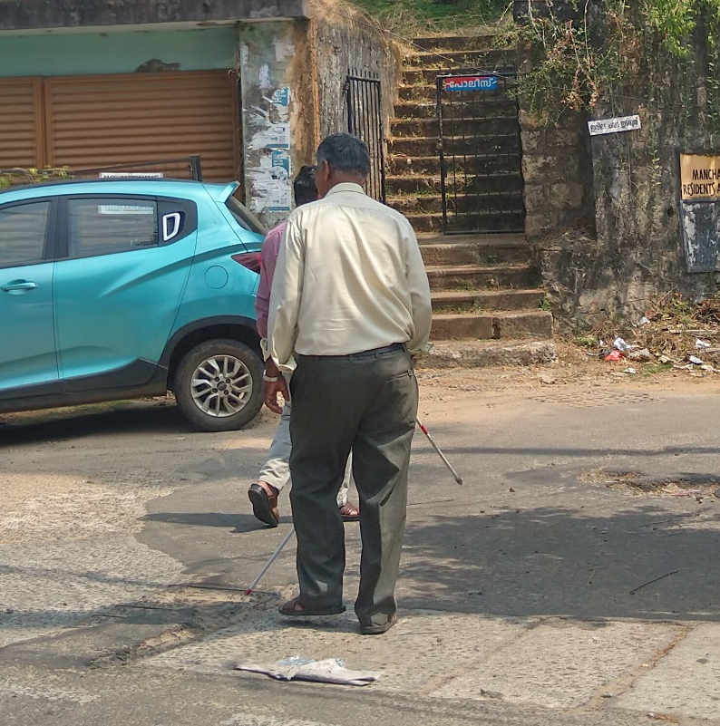
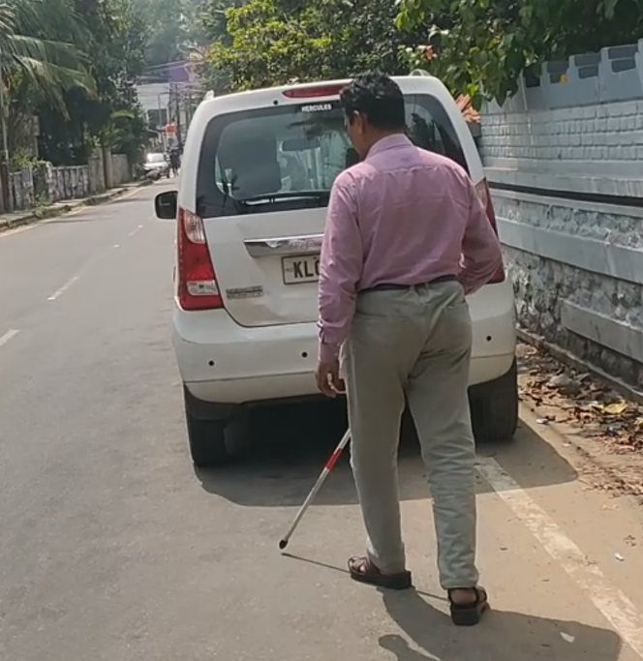
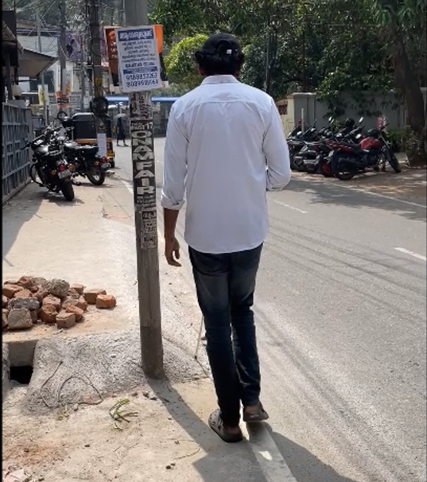
Issues with
PVI street navigation technique
PVI use physical elements on the street to navigate and orient themselves
Street elements fall short due to under-development or its improper execution and maintenance in the case of LMICs like India
Major threat to PVI’s movement is the presence of these same street elements.
Street elements act more as barriers for PVI navigation than as facilitators.

Slide 8
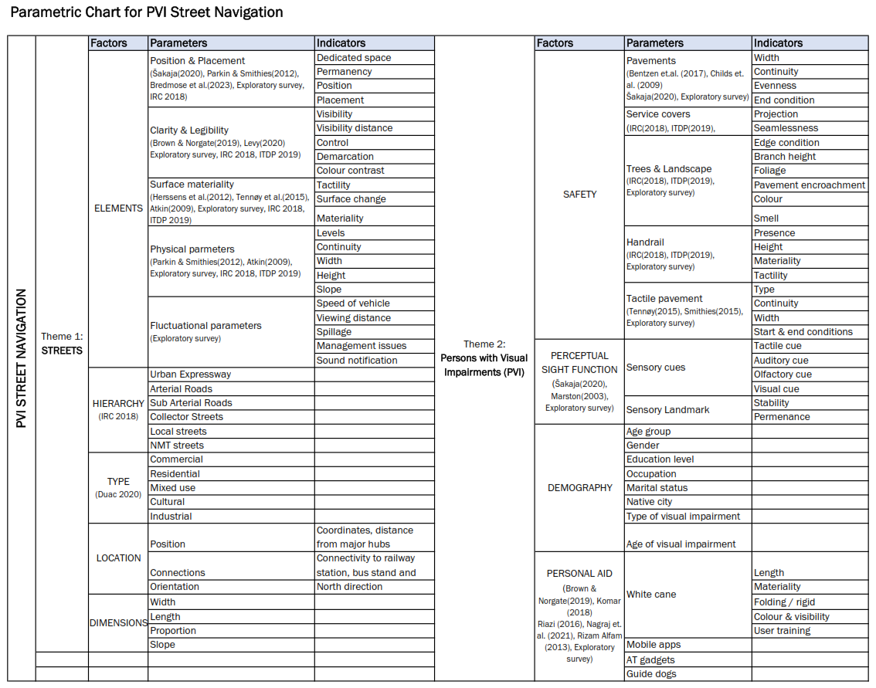
PARAMETRIC CHART
FOR PVI STREET NAVIGATION

Slide 9









Complexities of Indian Streets
Social and Cultural Dynamics
Traffic and Mobility
Urban Form and Spatial Structure
Economic Activities
Environmental Factors
Safety & Accessibility
Street Infrastructure
Indian
Streets

Slide 10


Blind
(4.95 million)
 | INDIA | KERALA
1961 | 5.6% | 5.1%
2001 | 7.5% | 10.5%
2011 | 8.6% | 12.6%
2031 | 13.1% | 20.9%
2051 | - | >25%
Globally, at least
2.2
People have visual impairment
Proportion of visual impairment due to unoperated eye diseases is higher in LMIC
25%
Visually impaired (35 million)
billion
Proportion of Elderly Population
Source: author, derived from various reports
Blind children (0.24 million)
Visually impaired Global population
Visually impaired Indian population
Visually impaired Indian population
Proportion of Youth Migration
Source: Murali Thummarakudi 2022
>25%
19.6%
26.1%
34.4%
Global
India
Kerala
2011
2021
2031
World report on vision, 2019
Old-age Dependency Ratio
Source: Kerala economic review 2021
Indian population:
Aged above 50 years
UD2024

Slide 11
The Study
Aim: To understand the lived experiences of PVI while navigating a tier 2 Indian street
Participants:
15 adults (10 males & 5 females) with severe visual impairments,
ages ranging from 18 to 60.
(National Association for the Blind Kerala)
Location:
Thiruvananthapuram, Kerala, INDIA
 | METHOD | DATA | TOOL | OUTCOME
Phase 1 | Exploratory Survey | Interview transcript | Semi-structured interview Focus group | Issues faced Street identification | Street navigation mind map
Phase 2 | Field Observation | Street Elements Street Parameters | Field diary Photography | Base map Street elements list
 | Participant Observation | Barriers & issues | Videography | Journey map Barrier map
 | Post- Observational Survey | Sensory clues for navigation | Semi-structured interview | Sensory landmark map

Slide 12
PARTICIPANT DETAILS
Sl. No. | Age | Gender | Educational Status | Occupation | Degree of Blindness | Age of Blindness | Reason of Blindness | Street for Field Observation
TP1 | 22 | M | Degree | Unemployed | Fully blind | By birth | Nerve problem | Law College Road
TP2 | 25 | M | +2 (Degree not completed) | Unemployed | Partially blind (85%) | From 18y of age | Retinitis Pigmentosa | Chara Chira Road
TP3 | 25 | M | PG | Unemployed | Partially blind (80%) | By birth | Vein issue | MG Road
TP4 | 21 | M | Degree | Unemployed | Partially blind (70%) | By birth | Nerve problem | Chara Chira Road
TP5 | 22 | F | Degree | Unemployed | Fully blind | By birth | Vein issue | Law College Road
TP6 | 25 | M | Degree | Unemployed | Fully blind | By birth | Retinitis Pigmentosa | Chara Chira Road
TP7 | 28 | M | Studying Degree (LLB) | Unemployed | Partially blind (60%) | By birth | Cataract | Law College Road
TP8 | 22 | F | Studying Degree | Unemployed | Fully blind | By birth | Nerve problem | CV Raman Pillai Road
TP9 | 23 | F | Degree | Unemployed | Partially blind (75%) | By birth | Nerve problem | CV Raman Pillai Road
TP10 | 21 | F | +2 | Unemployed | Fully blind | By birth | Don’t know | NA
TP11 | 22 | F | +2 | Unemployed | Partially blind (70%) | From 16y of age | Retinitis Pigmentosa | NA
TP12 | 35 | M | Degree | Employed (Govt. clerk) | Partially blind (80%) | From 18y of age | Retinitis Pigmentosa | NA
TP13 | 25 | M | Studying Degree (LLB) | Unemployed | Fully blind | By birth | Nerve problem | Law College Road
TP14 | 26 | M | Degree | Unemployed | Fully blind | By birth | Nerve problem | MG Road
TP15 | 25 | M | Degree | Unemployed | Partially blind (75%) | From 18y of age | Accident | MG Road

Slide 13
Facilitators Identified (from interview)
Elements | Count
Handrail | 7
Footpath | 6
People | 5
Curbs | 4
Zebra crossing | 4
Colour contrast | 4
Shops (sound & smell) | 3
Road surface | 2
Companion | 2
Street vendors | 1
Posts | 1
By-roads | 1
Smell of hotels | 1
Sound of drainage | 1
Nothing helps | 1
Barriers Identified (from interview)
Elements | Count
Unauthorized parking on roads | 7
Potholes on roads | 6
Uneven footpaths | 3
Stones | 3
Posts on footpaths | 3
Unexpected maintenance | 3
Broken pavements | 2
Tree branches on footpath | 2
Speeding vehicles | 2
Uneven slabs over drainage | 2
Crowd on front of shops & vendors | 2
Pits on footpaths | 2
Objects on footpaths | 2
Low electric/phone wires | 1
Speed bumps | 1
Tactile tiles | 1
Plants on road | 1
Vehicles parked on footpaths | 1
Dogs | 1
Interview Data
Specific Questions

Slide 14
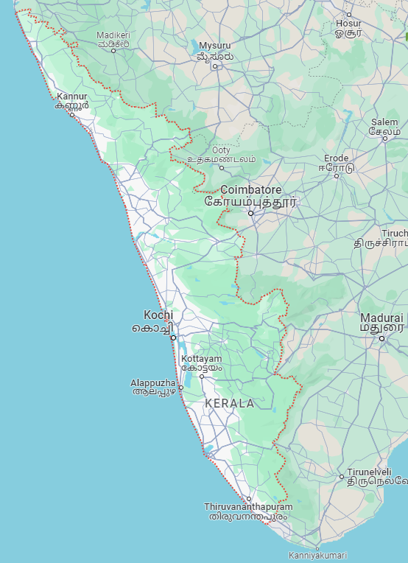
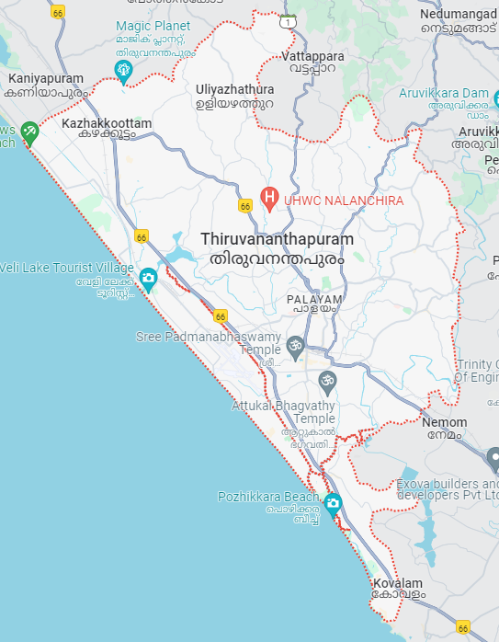
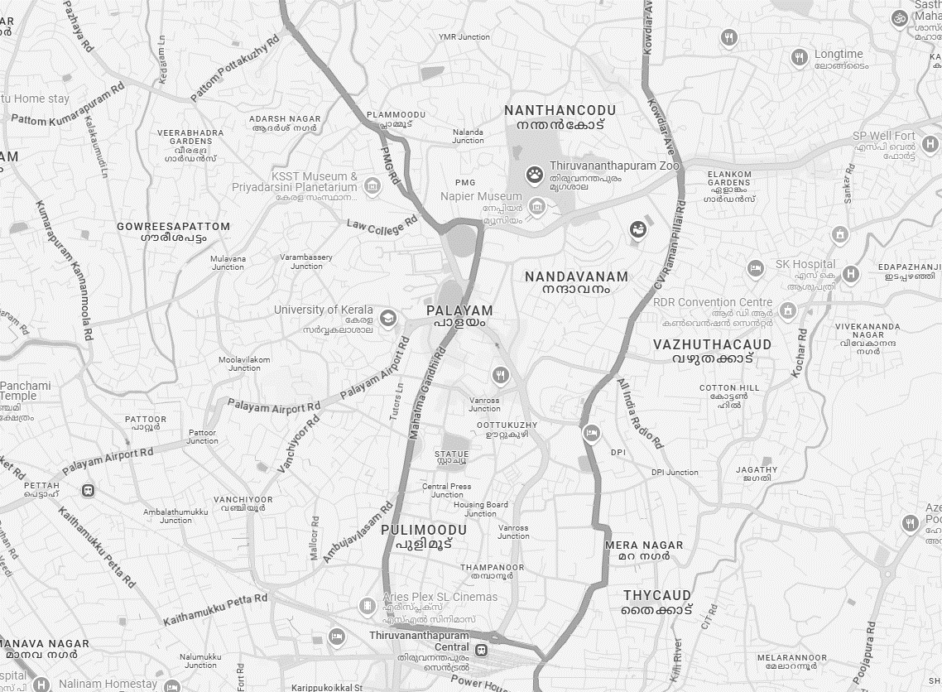
STREET DETAILS
Code | Name | Description | Road Hierarchy | Road Type | Location | Distance | No. of Participants
TS1 | Chara Chira Road | Plammoodu bus stop to NAB | Arterial + Tertiary | Mixed use (Residential / Commercial) | 4.5km from TVM CRS | 300 M | 3
TS2 | Law College Road | PMG bus stop to KFB | Arterial + Sub Arterial | Mixed use (Residential / Institutional) | 3.8km from TVM CRS | 600 M | 4
TS3 | M G Road | University College gate to Men’s hostel | Arterial | Mixed use (Residential / Commercial / Institutional) | 2.8km from TVM CRS | 650 M | 3
TS4 | C V Raman Pillai Road | Women’s College gate to private hostel | Arterial | Mixed use (Residential / Commercial / Institutional) | 2.3km from TVM CRS | 400 M | 2
Street Locations

Slide 15
TS1: CHARA CHIRA ROAD Journey distance: 300m Street Hierarchy: Arterial + Tertiary Street type: Mixed use (Residential + Commercial)
Code | Gender | Degree of Blindness | Age of Blindness | Journey Time | Speed
TP2 | Male | Partially blind | From 18 years of age | 7m 6sec | 0.7 m/s
TP4 | Male | Partially blind | By birth | 5m 20sec | 0.93 m/s
TP6 | Male | Fully blind | By birth | 7m 20sec | 0.68 m/s
TS2: LAW COLLEGE ROAD Journey distance: 600m Street Hierarchy: Arterial + Sub-Arterial Street type: Mixed use (Residential + Institutional)
Code | Gender | Degree of Blindness | Age of Blindness | Journey Time | Speed
TP1 | Male | Fully blind | By birth | 16m 27sec | 0.6 m/s
TP5 | Female | Fully blind | By birth | 18m 12sec | 0.55 m/s
TP7 | Male | Partially blind | By birth | 14m 05sec | 0.71 m/s
TP13 | Male | Fully blind | By birth | 15m 50sec | 0.63 m/s
TS3: MG ROAD Journey distance: 650m Street Hierarchy: Arterial Street type: Mixed use (Commercial + Institutional)
Code | Gender | Degree of Blindness | Age of Blindness | Journey Time | Speed
TP3 | Male | Partially blind | By birth | 11m 05sec | 0.97 m/s
TP14 | Male | Fully blind | By birth | 14m 00sec | 0.77m/s
TP15 | Male | Partially blind | From 18 years of age | 11m 55sec | 0.90 m/s
TS4: CV RAMAN PILLAI ROAD Journey distance: 400m Street Hierarchy: Arterial Street type: Mixed use (Residential + Commercial + Institutional)
Code | Gender | Degree of Blindness | Age of Blindness | Journey Time | Speed
TP8 | Female | Fully blind | By birth | 9m 15sec | 0.72 m/s
TP9 | Female | Partially blind | By birth | 7m 10sec | 0.93m/s

Slide 16
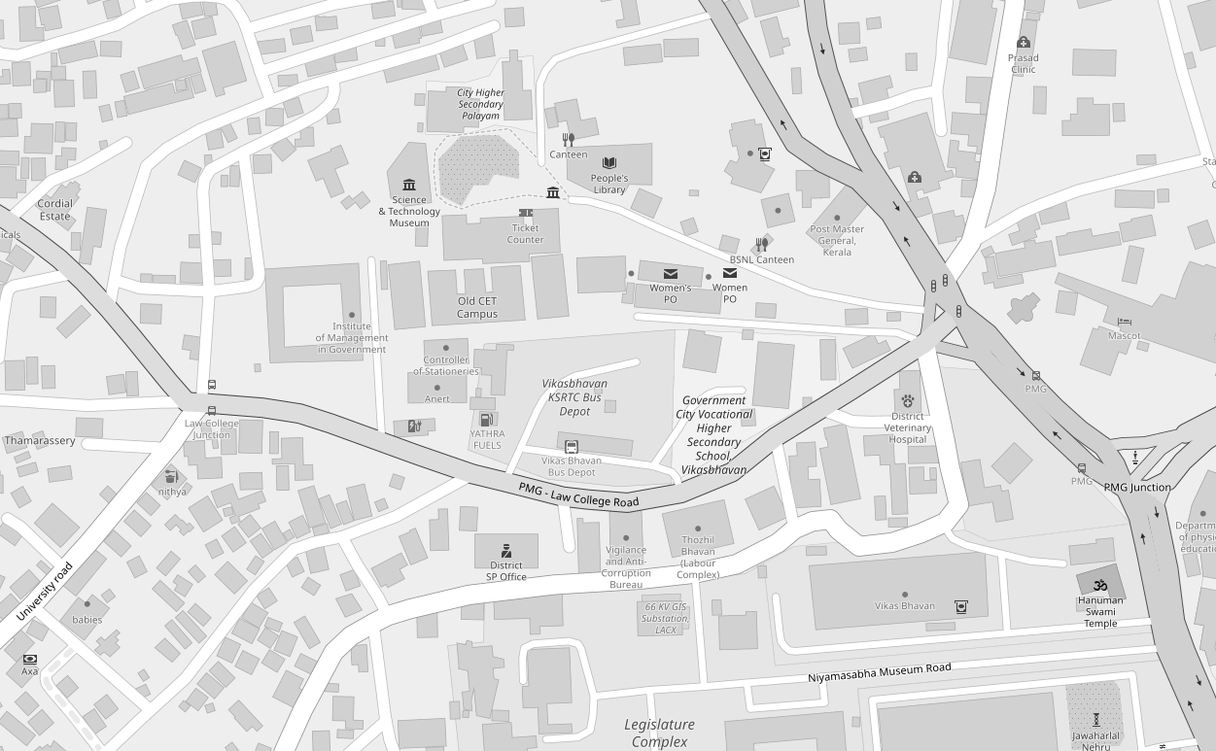
STREET DETAIL
Code | TS2
Name | Law College Road
Description | PMG bus stop to KFB
Road Hierarchy | Arterial + Sub Arterial
Road Type | Mixed use (Residential / Institutional)
Location | 3.8km from TVM CRS
Distance | 600m
No. of Participants | 4
KFB
BUS STOP
Street Map

Slide 17
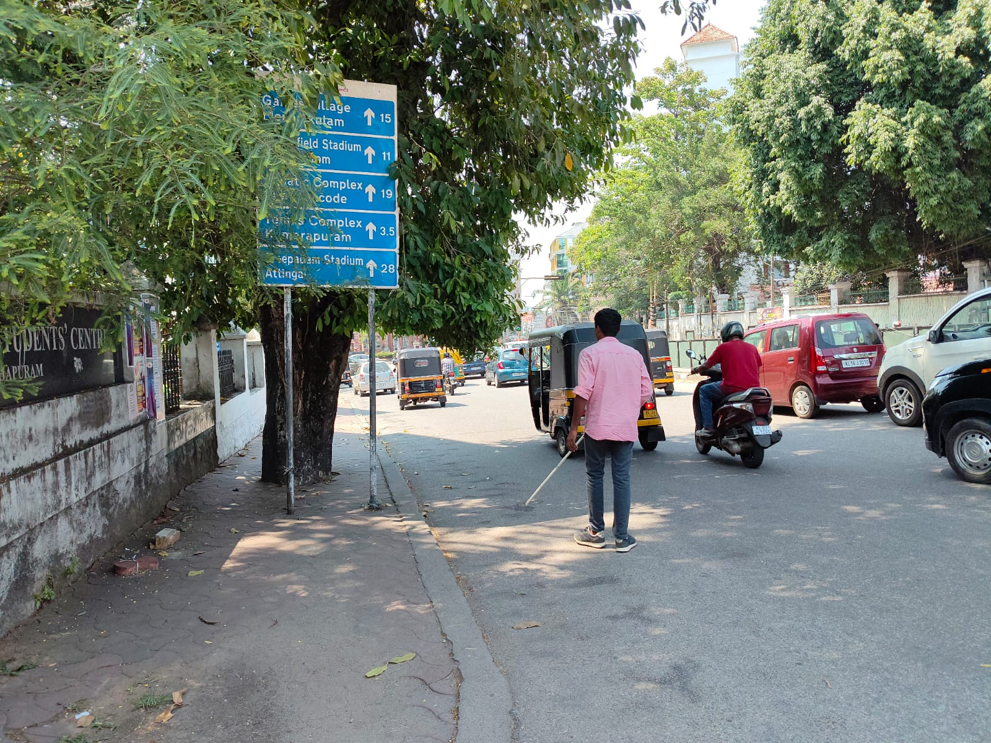
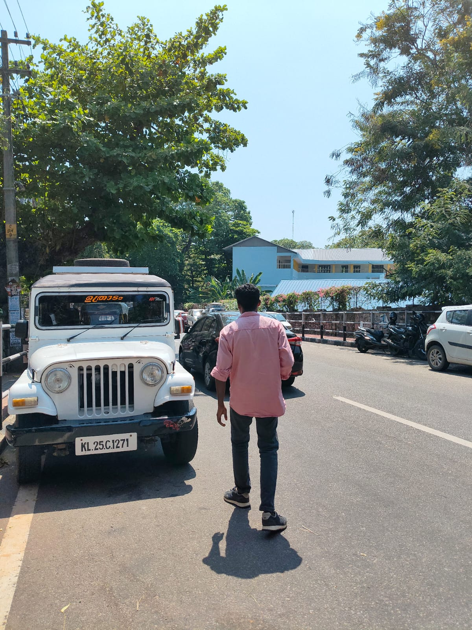
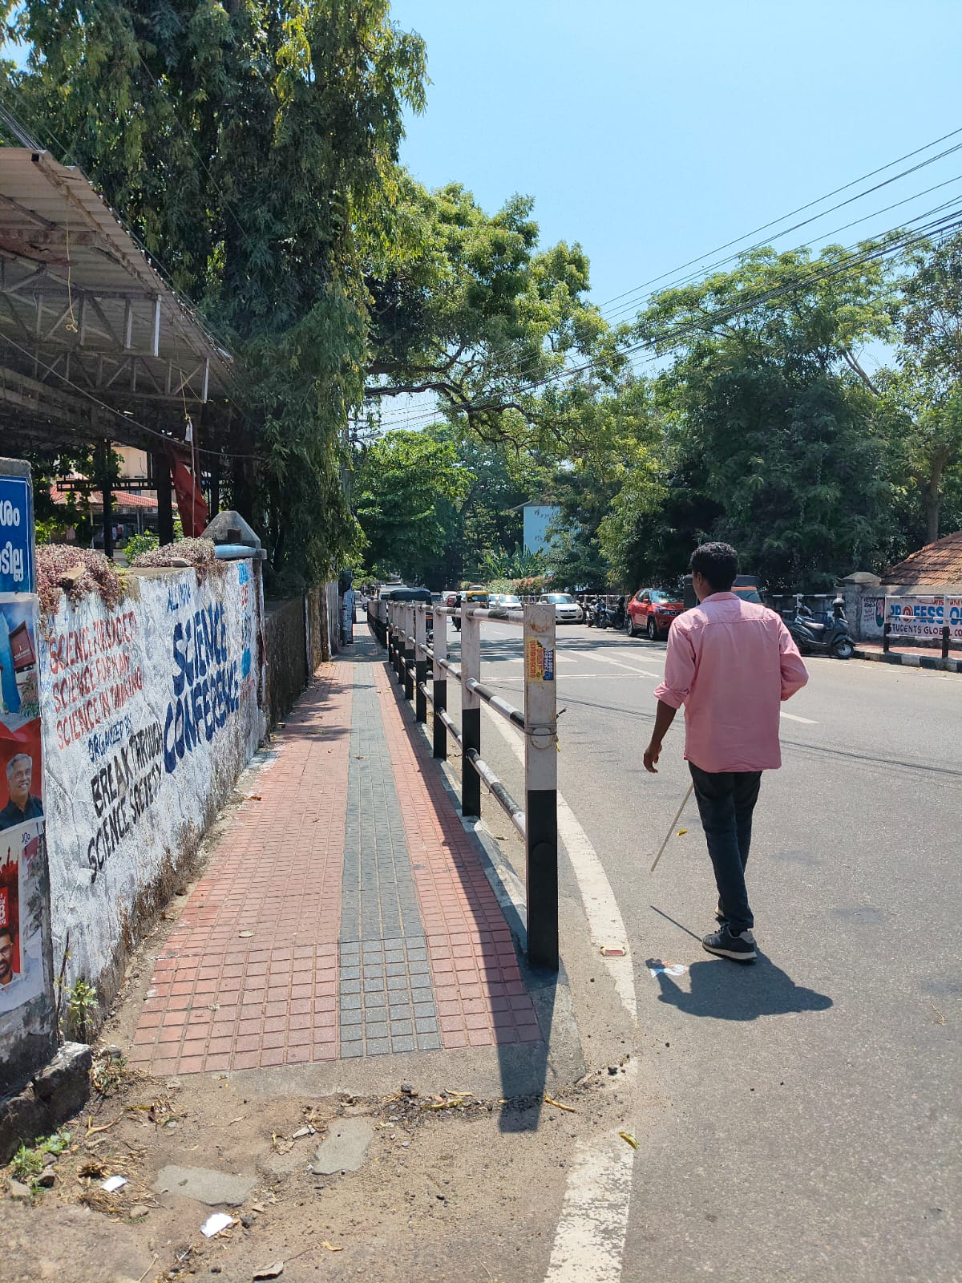
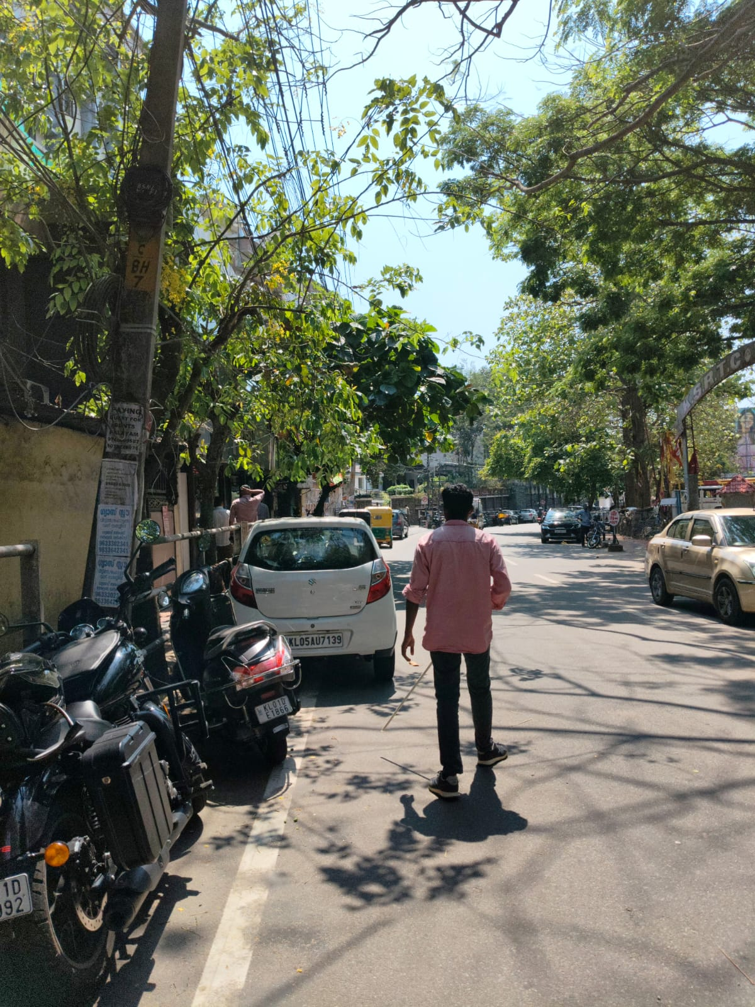
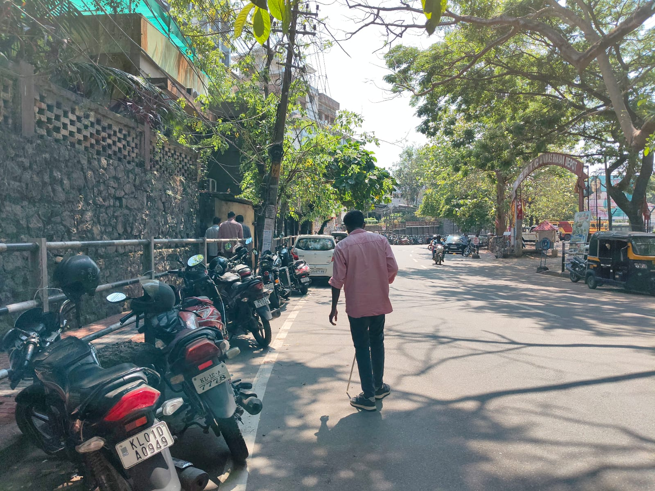
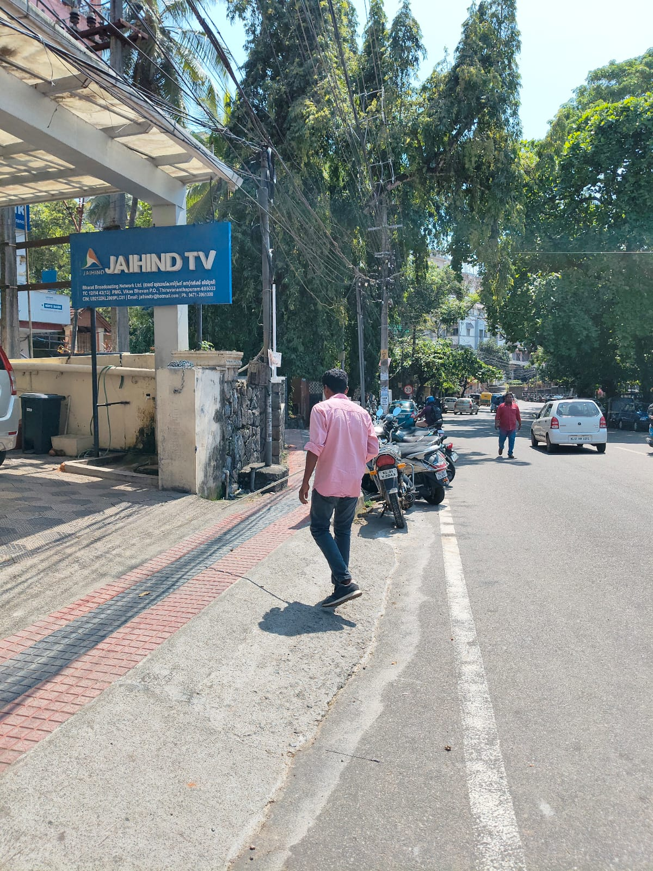
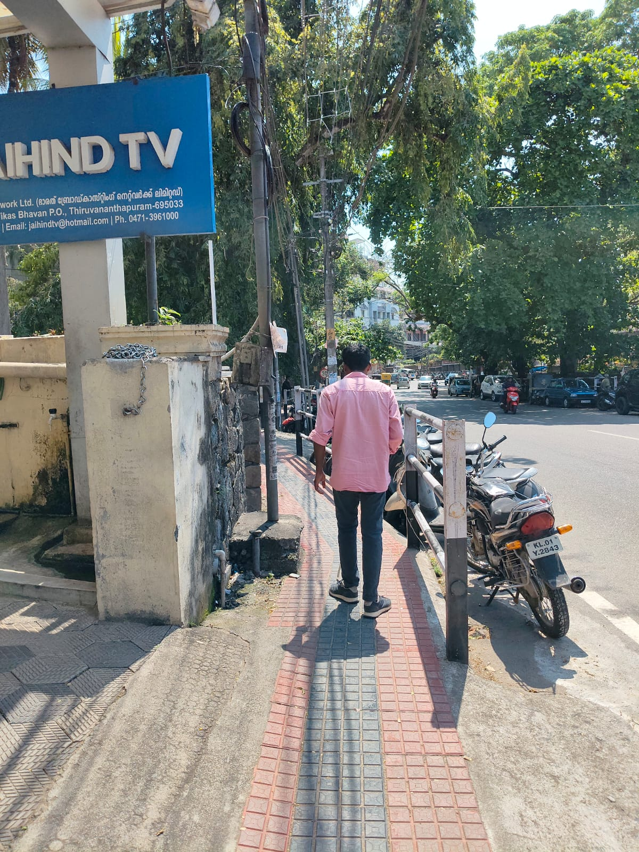
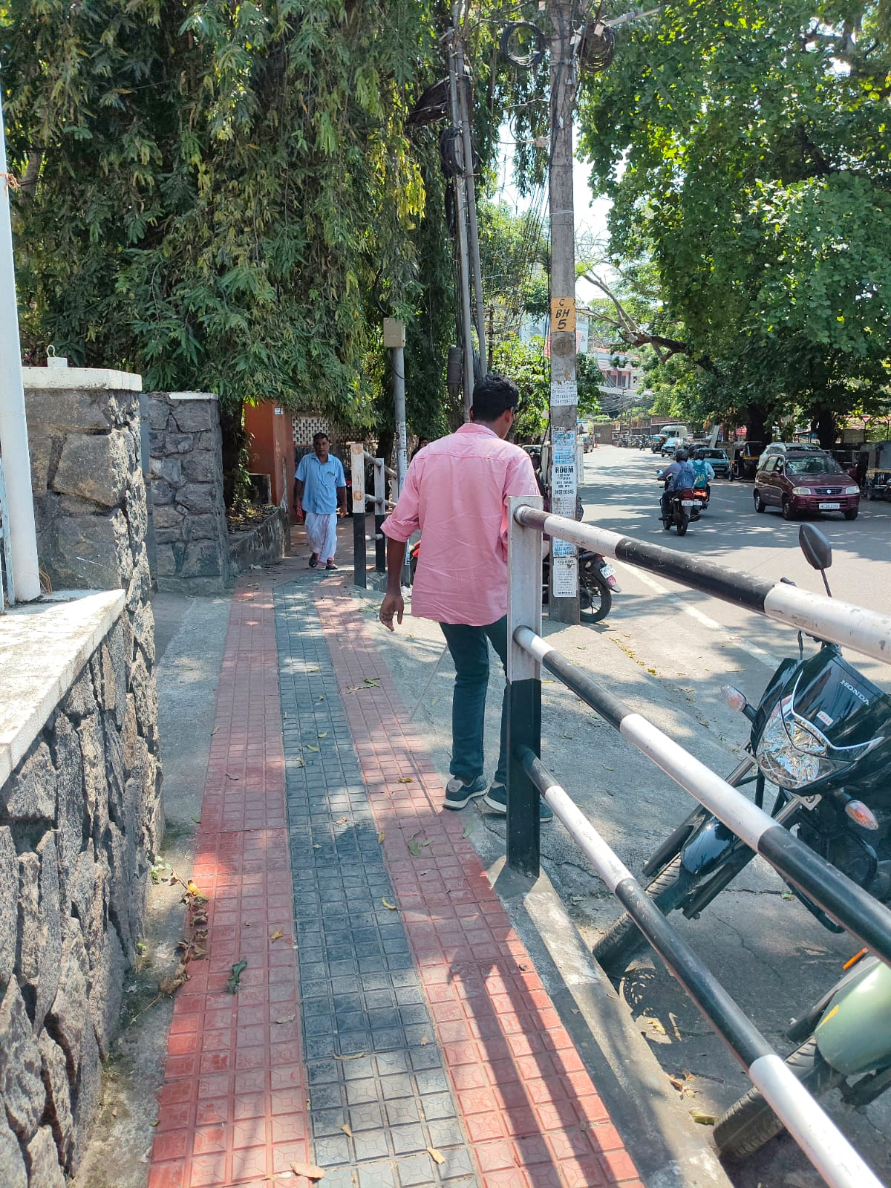
Participant Observation

Slide 18
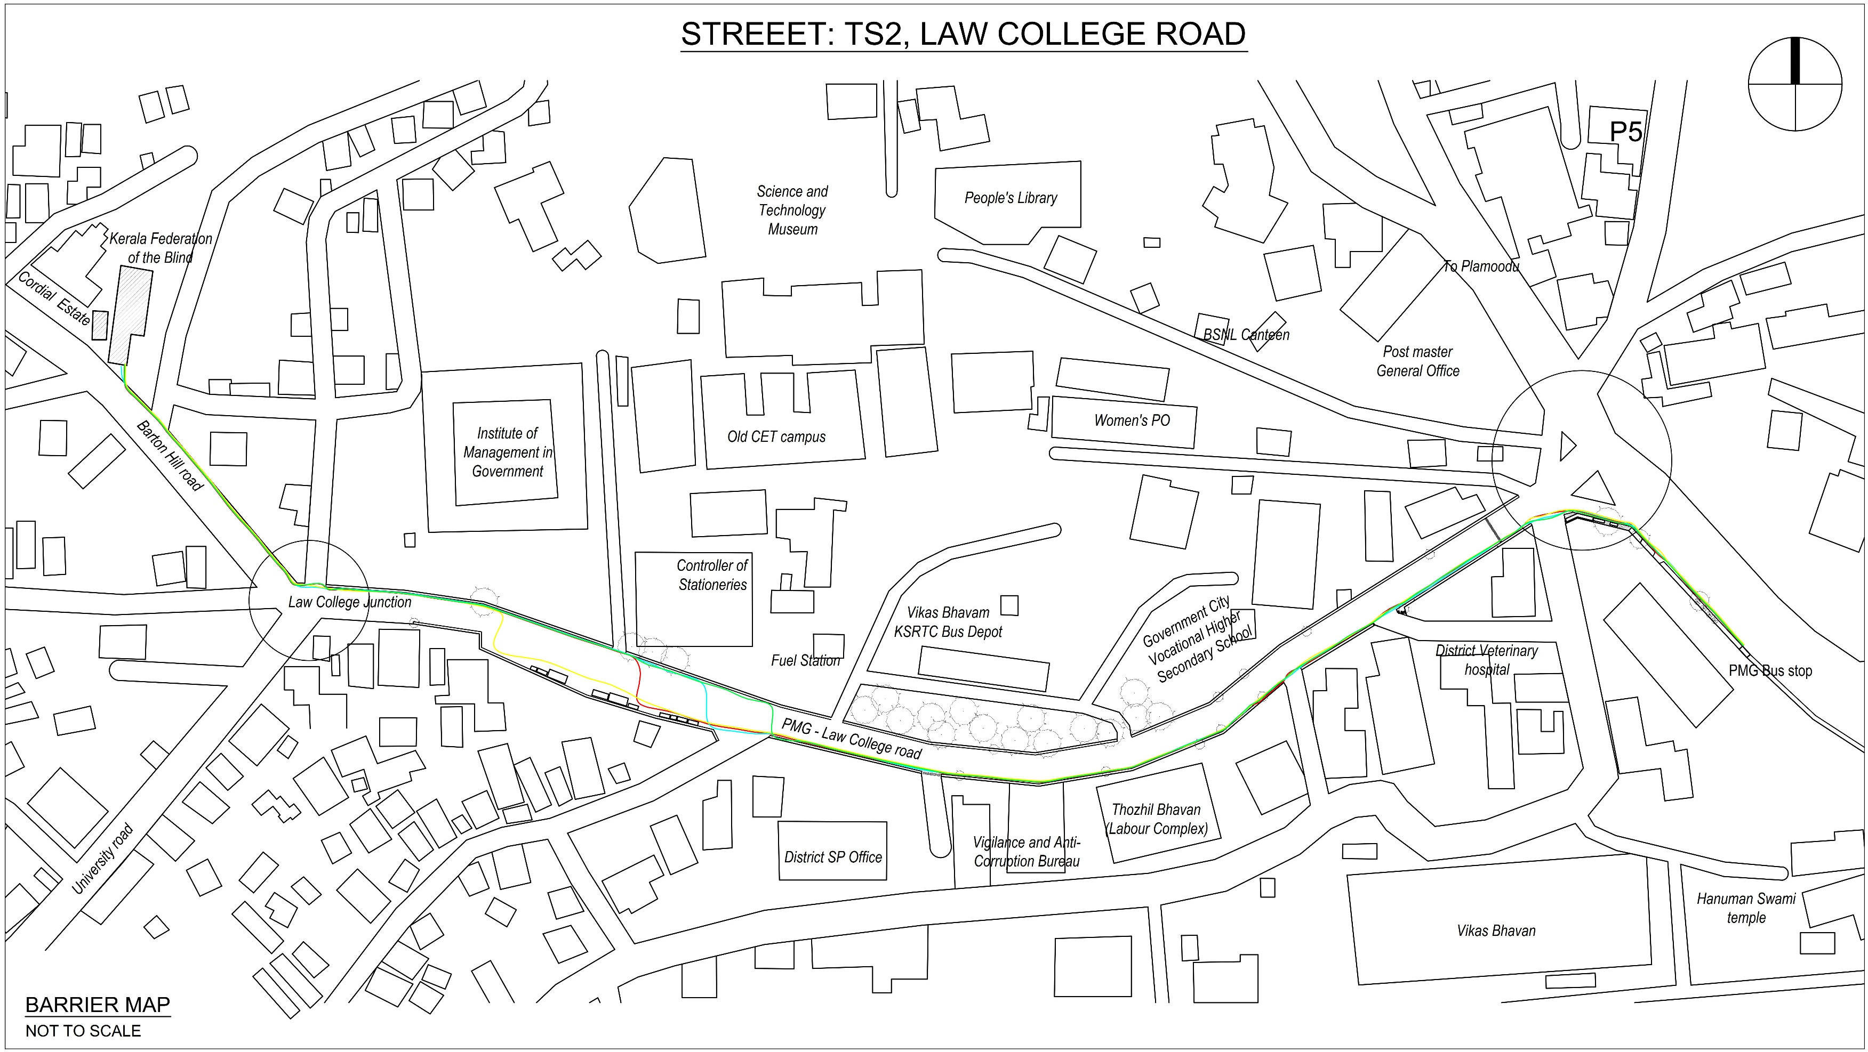

Slide 19
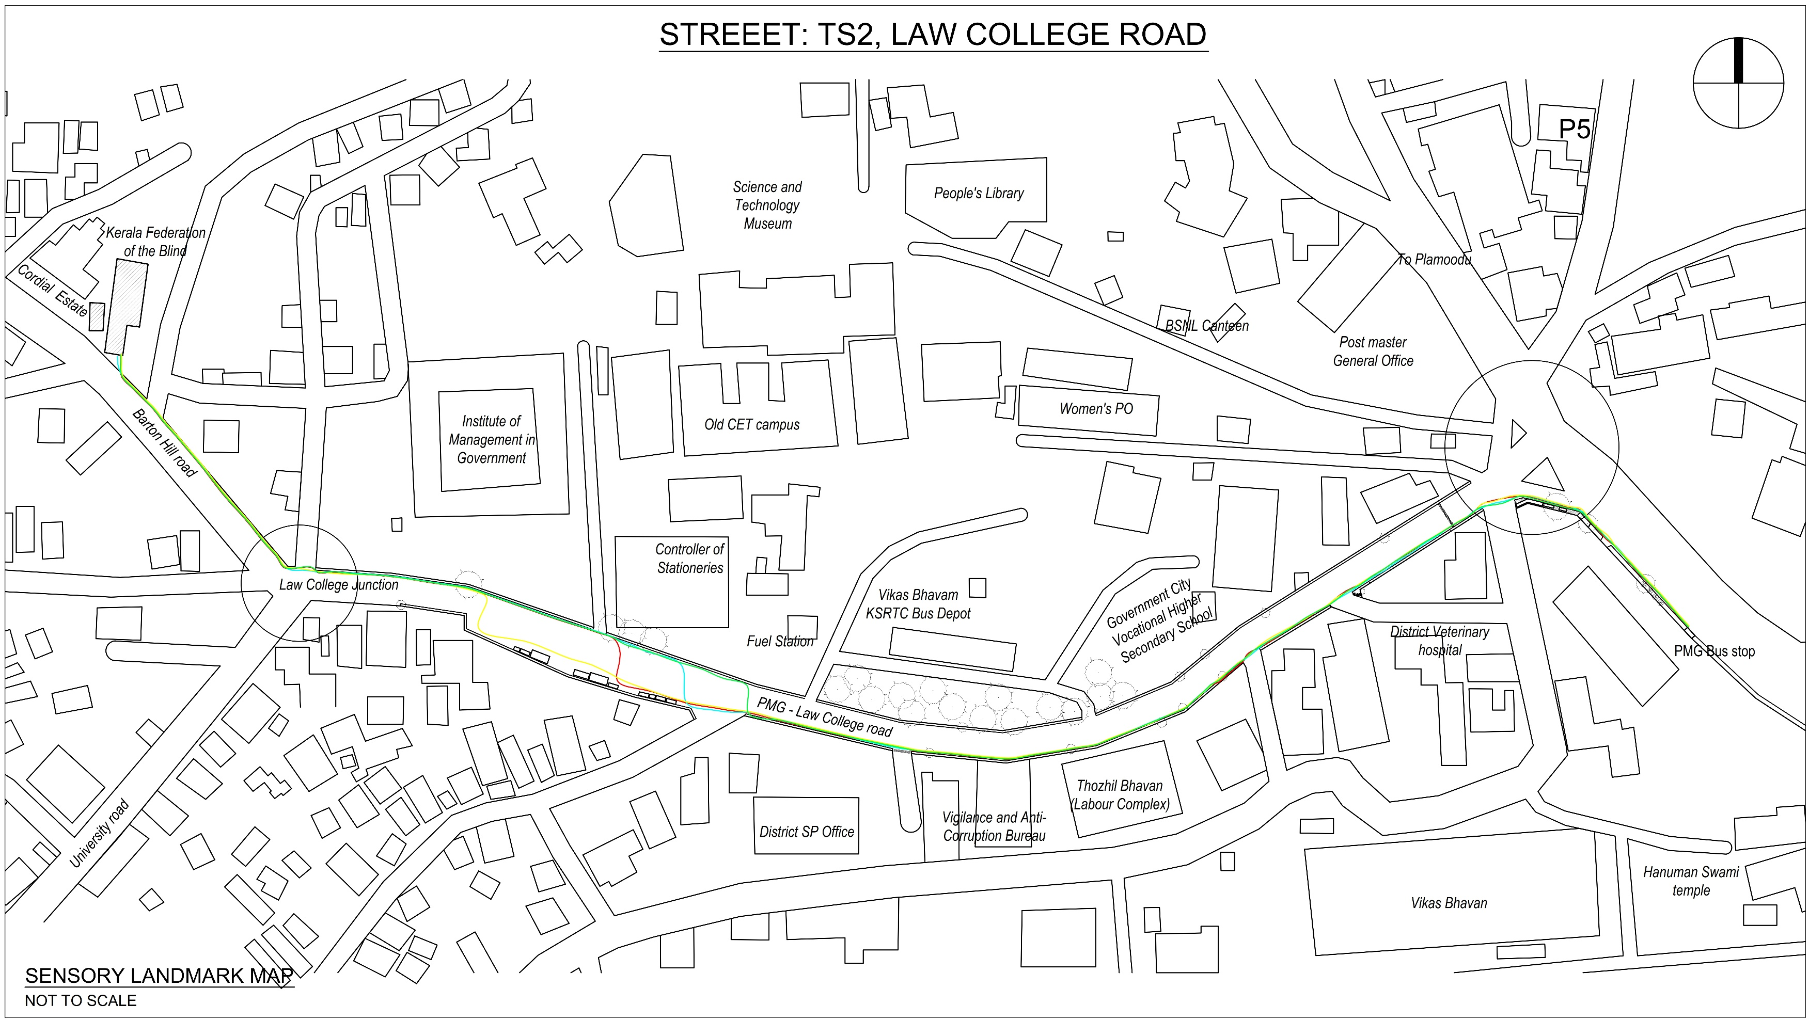

Slide 20
TS2: LAW COLLEGE ROAD
Street Components | Elements | Indicators | Observations
Carriage way | Vehicles | Speed, visibility | Speed: Vehicles moving towards Law College Jn. is faster than towards the other side as road is sloping down. Good visibility.
 | Crossing | Zebra line, visibility distance | Zebra line near PMG Jn. only. Visibility distance affected because of speed and curve at Jn.
 | On-road Parking | Dedicated space, surface change | Throughout the road especially near the offices. No surface change or markings.
 | Traffic lights | Sound notification, control, tactile notification | No traffic light for crossing the street.
 | Road tarring | Surface character, levels | Good tarring. Road sloping from PMG Jn. To Law college Jn.
Footpath | Curbs | Continuity, clarity | Not continuous, 30cm high, no colour highlight.
 | Curb ramps | Slope, tactile notification | Steeper than 45%. No tactile notification
 | Pavement (normal & tactile) | Width, tactile difference, levels, maintanance | Uses grip tiles with texture. Confuses PVI. White cane gets stuck. Width not sufficient. Concrete post projects into pavement. Ups and downs.
 | Handrails | Height, continuity, tactile notification | Ht: 120cm. Not continuous. Vertical design poses threat.
 | Fences | Height, continuity, tactile notification | NA
 | Signboards | Height, placement, colour contrast | Some placed on the footpath. Some dangerously protrudes onto pavement. Good colour contrast
 | Free-standing shop signboards | Height, placement, colour contrast | NA
 | Tables | Placement, permanance, colour contrast | NA
 | Chairs | Placement, permanance, colour contrast | NA
 | Benches | Placement, permanance, colour contrast | Placed out of walking area
 | Bollards | Colour contrast, clarity | NA
 | Bus stops | Entry, level difference, placement | At PMG. 45 cm higher than footpath (Road sloping down). Covers entire footpath

Slide 21
TS2: LAW COLLEGE ROAD
Street Components | Elements | Indicators | Observations
Street edge | Shop fronts | Spillage, legibility, colour contrast | No spillage on to footpath. No colour contrast
 | Steps/ramps | Spillage, legibility, colour contrast | No spillage onto footpath.
 | Public toilets | Placement, colour contrast | NA
 | Building façade | Tactile notification, continuity, elements | NA
 | Compound walls | Continuity, clarity | Not continuous.
 | Gates | Colour contrast, clarity | Since offices, gates are open during daytime
Infrastructure | Lamp posts / Electric posts | Placement, colour contrast | Placed on the footpath. Posts slant onto the footpath
 | Junction box | Placement, colour contrast | NA
 | Drains | Position, width, demarcation | Beneath the footpath
 | Drain slabs | Continuity, tactile notification, maintanance | NA
 | Manholes | Placement, level difference, tactile notification | Centre of road, NA
 | Waste bins | Placement, colour contrast | NA
 | Street vending kiosks / Street vending carts | Placement, colour contrast, permanance | Placed where road widens. Good colour contrast. Not permanent.
 | Drinking water fountains/taps | Placement, colour contrast | NA
Landscape | Trees | Position, height, colour contrast | Placed on the footpath, reducing footpath width. Branches spill onto footpath
 | Plant pots | Placement, colour contrast, permanance | NA
 | Hedges | Placement, height, spillage | NA
 | Lawns | Level difference, demarkation | NA

Slide 22
COMBINED OBSERVATIONS
Street Components | Elements | TS1 | TS2 | TS3 | TS4
Carriage way | Vehicles | Since the road is narrow, vehicles generally maintain an average speed. Good visibility. | Speed: Vehicles moving towards Law College Jn. is faster than towards the other side as road is sloping down. Good visibility. | Distinct carriageway. Speed regulated using traffic lights. Good visibility. | Distinct carriageway. Speed regulated using traffic lights. Good visibility.
 | Crossing | Zebra line only at Plammoodu Jn. No zebra crossing in Chara chira road. | Zebra line near PMG Jn. only. Visibility distance affected because of speed and curve at Jn. | Zebra line in all Jn. Good visibility distance | Zebra only in Jn. No intermediate crossing points. Good visibility distance
 | On-road Parking | Throughout the road especially near the Jn. No surface change or markings. Reduces width of street | Throughout the road especially near the offices. No surface change or markings. | Dedicated parking spaces provided. Marking on the road | Dedicated parking spaces provided. Marking on the road
 | Traffic lights | Traffic light on at Jn. No traffic light for crossing the Chara chira road. | No traffic light for crossing the street. | Traffic lights in junctions. But no control or notifications | Traffic lights in junctions. But no control or notifications
 | Road tarring | Uneven tarring. Had potholes. Lack of maintenance. | Good tarring. Road sloping from PMG Jn. To Law college Jn. | Good tarring. | Good tarring.
Footpath | Curbs | Not continuous, no colour highlight. | Not continuous, 30cm high, no colour highlight. | Footpath curb is continuous, but since PVI not walking on the carriageway, its not used. No guiding curb on the footpath. | Footpath curb is continuous, but since PVI not walking on the carriageway, its not used. No guiding curb on the footpath.
 | Curb ramps | No curb ramps for the most part. Curb ramp present is steeper than 40%. No tactile notification | Steeper than 45%. No tactile notification | No curb ramp. | No curb ramp.
 | Pavement (normal & tactile) | Pavement is broken, narrow, and ill-maintained. Slabs on top of the drainage act as a footpath at some distance and are difficult to walk on. | Uses grip tiles with texture. Confuses PVI. White cane gets stuck. Width not sufficient. Concrete post projects into pavement. Ups and downs. | Width not sufficient considering the pedestrian traffic | Width not sufficient considering the pedestrian traffic
 | Handrails | No handrails | Ht: 120cm. Not continuous. Vertical design poses threat. | Ht: 120cm. Not continuous. | Ht: 120cm. Not continuous.
 | Fences | NA | NA | NA | NA
 | Signboards | Some placed on the footpath. Some dangerously protrudes onto pavement. Good colour contrast | Some placed on the footpath. Some dangerously protrudes onto pavement. Good colour contrast | Some placed on the footpath reducing the width. Good colour contrast | Some placed on the footpath reducing the width. Good colour contrast
 | Free-standing shop signboards | NA | NA | NA | NA
 | Tables | NA | NA | NA | NA
 | Chairs | NA | NA | NA | NA
 | Benches | NA | Placed out of walking area | NA | NA
 | Bollards | NA | NA | NA | NA
 | Bus stops | At Plammoodu. | At PMG. 45 cm higher than footpath (Road sloping down). Covers entire footpath | At Palayam | At Jn.

Slide 23
COMBINED OBSERVATIONS
Street Components | Elements | TS1 | TS2 | TS3 | TS4
Street edge | Shop fronts | No spillage on to footpath. There is colour contrast and distinctive smell. | No spillage on to footpath. No colour contrast | Spillage of people happens in front of juice shops and tea vendor. | Spillage of people happens in front of juice shop. Spillage of parked and parking cars create issue
 | Steps/ramps | No spillage onto footpath. | No spillage onto footpath. | No spillage onto footpath. | No spillage onto footpath.
 | Public toilets | NA | NA | NA | NA
 | Building façade | NA | NA | NA | NA
 | Compound walls | Not continuous. No distinctive design | Not continuous. | Continuous. | Continuous.
 | Gates | Not continuous. No distinctive design | Since offices, gates are open during daytime | Since offices and institutions, gates are open during daytime | Since offices and institutions, gates are open during daytime
Infrastructure | Lamp posts / Electric posts | Placed on the footpath. Posts slant onto the footpath | Placed on the footpath. Posts slant onto the footpath | Placed on the footpath. Posts slant onto the footpath | Properly designed and placed at the centre of road
 | Junction box | NA | NA | NA | NA
 | Drains | Beneath the footpath | Beneath the footpath | NA | NA
 | Drain slabs | Not placed properly. Not maintained properly | NA | NA | NA
 | Manholes | Centre of road, NA | Centre of road, NA | Centre of road, NA | Centre of road, NA
 | Waste bins | NA | NA | NA | NA
 | Street vending kiosks / Street vending carts | NA | Placed where road widens. Good colour contrast. Not permanent. | Only one. Not permanent. Creates disturbance | NA
 | Drinking water fountains/taps | NA | NA | NA | NA
Landscape | Trees | NA | Placed on the footpath, reducing footpath width. Branches spill onto footpath | NA | Slanting and fallen branches create issues
 | Plant pots | NA | NA | NA | NA
 | Hedges | NA | NA | NA | NA
 | Lawns | NA | NA | NA | NA

Slide 24
RESULTS
COMBINED LIST OF BARRIERS IDENTIFIED
SL NO | BARRIERS | CONDITION | CATEGORY
1 | Speeding vehicle | When a PVI is forced to walk on the road because of the ill condition or non-availability of footpath, a speeding vehicle poses a threat as the visibility distance and time for both the PVI and the driver get reduced due to speed. | Design / Planning
2 | No Zebra crossing | Non-availability of Zebra crossing forces PVI to cross at random, increasing risk.. | Design
3 | Zebra crossing at curves | Zebra crossing at road curves reduces visibility distance for the driver. | Design
4 | Unauthorized parking on road | PVI tend to bump into unexpectedly parked vehicles. | Enforcement
5 | Potholes on road | When a PVI is forced to walk on the road because of the ill condition or non-availability of footpath, potholes makes PVI lose their balance, leading to accidents. | Maintenance
6 | Non-continuous curb | PVI uses curbs as a guiding and orienting element. When it is non-continuous, they lose orientation. | Design
7 | Curb height more than 15cm | Affects PVI while getting on to the footpath from road. | Design
8 | Steep curb ramps | Affects PVI while getting on to the footpath from road. | Design
9 | Broken and ill-maintained pavements on footpaths | Broken and ill-maintained pavements on footpaths makes PVI lose their balance, leading to accidents. | Maintenance
10 | Narrow pavement surface on footpaths | Reduces space for walking. PVI tends to hit other people or find it difficult to walk with a companion. | Design / Planning
11 | Textured pavement tiles | White cane gets stuck and gets tightened. Harsh on the legs. | Design
12 | Ups and down in pavements | PVI loses balance. | Design
13 | Handrail causing hazard | Sharp edges poses threat. | Design
14 | Signboards placed on footpath / protrudes onto footpath | PVI tend to bump into unexpectedly placed signboards. Head and face hit protruding signboards. | Design
15 | Bus stop covering entire footpath | Forces PVI to walk on the road where the Buses passes and stops making it dangerous. | Design
16 | Bus stop on higher platform | Getting on or off the Bus stop becomes challenging | Design
17 | Spillage of people in front of shops | PVI and their white cane tends to hit people. | Enforcement
18 | Parked and parking cars in front of shops | Makes walking in front of shops difficult. PVI hits the vehicles. | Enforcement
19 | Post placed on footpath / slanting onto footpath | PVI tend to bump into unexpectedly placed posts. Head and face hit slanting posts. | Design

Slide 25
RESULTS
COMBINED LIST OF BARRIERS IDENTIFIED
SL NO | BARRIERS | CONDITION | CATEGORY
20 | Drain slabs not placed and maintained properly | PVI’s feet and white cane slip into the drain pit. PVI lose balance and falls. | Maintenance
21 | Street vending kiosk reducing footpath width | Reduces space for walking. PVI tends to hit other people or find it difficult to walk with a companion. | Design / Planning
22 | Trees / branches / roots on footpath | PVI hits the trees. Reduces footpath width. Head and face hits branches. Trips on roots and falls. | Design / Maintenance
23 | Fallen branches on footpath | Unexpected objects on footpath reduces walking width, hits or trips on fallen branches. | Maintenance
24 | Stones | Trips on stones and falls. | Maintenance
25 | Unexpected maintenance | Trips and falls into the pit. | Maintenance
26 | Low electric/phone wires | Low wires hits PVI head and face. | Maintenance
27 | Speed bumps | PVI lose balance at unexpected and immediate ups and downs on road. | Design
28 | Plants on road | Lose orientation, lose balance, | Design
29 | Vehicles parked on footpaths | PVI and white cane hits the parked vehicles. Reduces footpath width. | Enforcement
30 | Dogs | Unknowingly steps on or hits with white cane. | Enforcement

Slide 26
RESULTS
COMBINED LIST OF FACILITATORS IDENTIFIED
SL NO | FACILITATORS | CONDITION | CATEGORY
1 | Distinct carriageway. | Distinctively demarcated footpath and carriageway helps PVI to orient and navigate themselves. | Design/Planning
2 | Regulated vehicle speed | In narrow streets where footpath is not available, regulated vehicle speed ensures PVI safety from accidents. | Planning
3 | Good visibility of vehicles | Straight streets and regulated vehicle speed ensures good visibility of vehicles for PVI leading to accident free street navigation. | Planning
4 | Zebra crossing with good visibility for vehicles | Zebra crossing with good and straight visibility for vehicles allows drivers to see PVI crossing and reduce speed or stop beforehand. | Planning
5 | Dedicated parking space with colour contrast markings and material difference on road | The material difference along with warning tiles allows PVI to avoid hitting the get bumped on to the parked vehicles. | Design
6 | Good and even road surface | Allows PVI easy, effortless and accident-less walking. | Execution
7 | Colour contrast for shops | Helps PVI to have a distinct image to create a sensory landmark. | Design
8 | Distinctive smell from shops | Helps PVI to have a distinct memory to create a sensory landmark. | Planning
9 | Street vending with distinctive colour / smell. | Helps PVI to have a distinct memory to create a sensory landmark. | Planning
10 | Handrail | Helps PVI to orient themselves while walking. Also stops them from falling onto the carriageway. | Design
11 | Footpath | Helps PVI to orient themselves while walking. Also stops them from falling onto the carriageway. | Design
12 | People | People act as social aid for street navigation.
13 | Curbs | Curbs help PVI to orient and navigate with the help of white cane. | Design
14 | Companion | Can guide PVI through street.
15 | Posts | Can act as a distinctive landmark if placed properly. | Design
16 | By-roads | Presence of by-roads can act as distinctive memory to create a sensory landmark. | Planning
17 | Sound of drainage | Helps PVI to have a distinct memory to create a sensory landmark. | Planning

Slide 27
The Way Forward
The study will be repeated in 2 more Tier 2 cities in Kerala:
Expected final count of 45-50 participants
Generalizability for the state of Kerala
Based on the conditions for facilitators & barriers,
developing context-specific recommendations for an
inclusive urban street design
Thank you!

