Slide 1



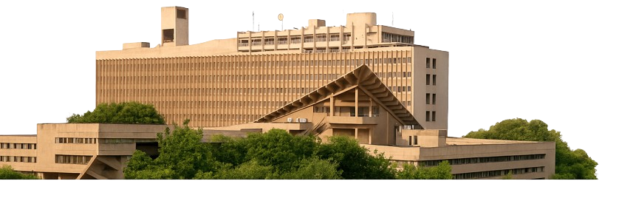
Data-Driven Classification of Urban Mobility Zones in Bangalore: Insights from Latent Class Cluster Analysis
7th - 9th November 2025 | Gurugram, Haryana.
Paper ID: 7455
Gongalla Vamsi Krishna¹, Mustansir Farooq¹
¹Indian Institute of Technology Delhi
vamsigongalla284@gmail.com, mustansir99@gmail.com

Slide 2

Contents
Study Context
Study Area
Study Objectives
Data Overview
LCCA Methodology
Results & Discussions
Policy Implications
Conclusions

Slide 3
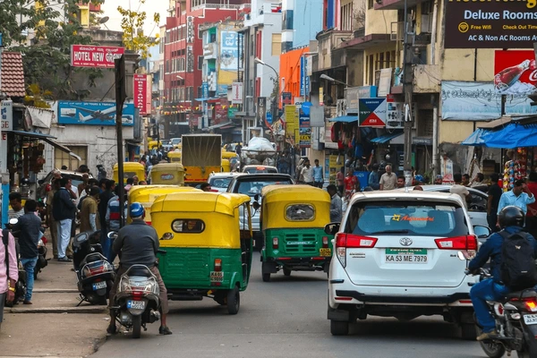
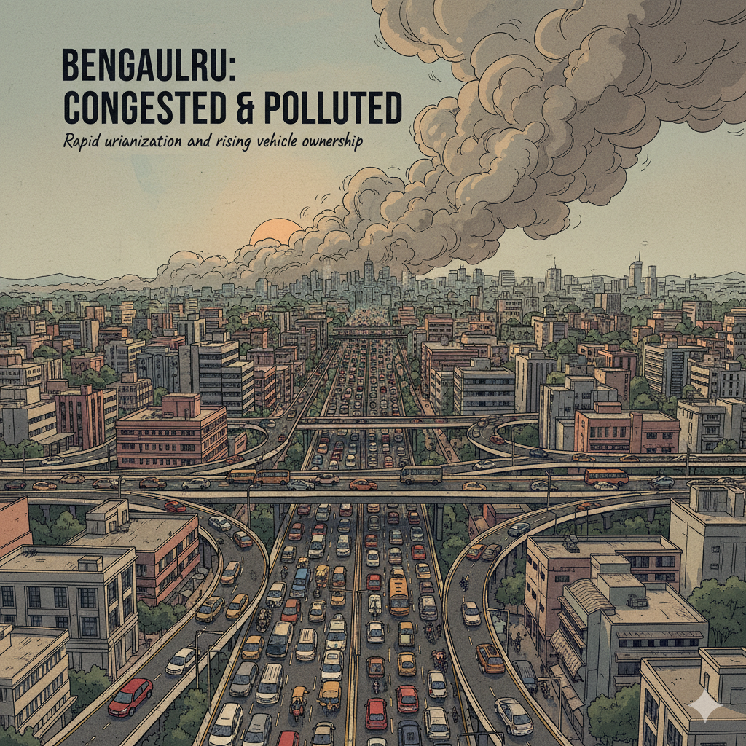
Context: Urban Mobility Challenges in Bangalore
Rapid urbanization and rising vehicle ownership have made Bengaluru one of India’s most congested and polluted cities
Severe traffic delays result in major losses in productivity, health, and economic performance (Akbar et al., 2018)
Transport congestion and environmental degradation together constrain the city’s accessibility and livability
Expanding road capacity alone fails to solve congestion due to induced demand (Duranton and Turner, 2011)
Integrated strategies emphasizing land-use, multimodal options, and demand management are essential
Built environment characteristics – density, diversity, and design (the “3Ds”) – critically shape travel behavior and mode choice (Cervero and Kockelman, 1997).
Recent Bengaluru studies stress on context-specific policies rather than uniform citywide solutions (Chen et al., 2024; Ghosh et al., 2022)

Slide 4
Study Area – Bengaluru, India
Bengaluru (Bangalore), capital of Karnataka, is a major IT hub experiencing rapid urban growth and rising vehicle ownership, causing significant traffic congestion.
Study centers on key traffic corridors and intersections representing diverse land use and travel patterns.
Includes seven strategic areas accounting for 81% of observations:
  Central commercial districts: M.G. Road, Indiranagar
  Residential & commercial zones: Koramangala, Jayanagar
  Fast-growing IT hubs: Electronic City, Whitefield
  Key northern junction: Hebbal, connecting to airport and highways
This area selection captures the full spectrum of traffic conditions from congested centers to expanding peri-urban tech corridors.

Slide 5
Study Objectives
This study addresses gaps by providing a detailed, data-driven understanding of urban mobility patterns in Bengaluru.
Using the open-source Bangalore Traffic Dataset, Latent Class Cluster Analysis (LCCA) is applied to classify mobility zones citywide.
Objectives:
Identify statistically distinct mobility zone types based on:
  Traffic volume, average speed, congestion level, pedestrian activity, incident rates, road capacity, and environmental factors.
  Examine correlations between covariates (e.g., road capacity, traffic incident exposure) and zone classification to explain zone characteristics.
  Derive practical policy recommendations for each zone type focusing on: Traffic management improvements, support for multimodal transport, and prioritization of pedestrian infrastructure.

Slide 6
Data Overview
The study uses 8,936 location-day records from Bangalore’s Traffic Pulse repository (Jan 2022–Aug 2024).
Data represent daily traffic volumes measured in Passenger Car Units (PCU) across major roads and intersections.
Total recorded volume: 261.25 million PCU, averaging 29,236 PCU per location-day record.
Traffic volumes standardized using IRC:106–1990 equivalence factors to ensure comparisons across motorized and non-motorized vehicles.
Dataset covers the post-COVID economic recovery phase, enabling analysis of evolving traffic patterns.
Variables (20 total), grouped into:
Core Traffic Metrics: Volume (PCU), average speed, travel time index, congestion %, road capacity utilization %.
Incident & Environmental: Traffic incidents, pollution index/CO₂ equivalent, public transport usage %.
Behavioral & Compliance: Traffic signal compliance %, pedestrian and cyclist counts.
Contextual: Parking usage %, weather conditions, construction presence, date, location details.

Slide 7
Data Characteristics
Variable |  | Value | Variable |  | Value
Traffic Volume (PCU/day) | Mean | 29236.05 | Parking Usage | Mean | 75.15
 | Std. dev | 13001.81 |  | Std. dev | 14.41
Average Speed (Kmph) | Mean | 39.45 | Area
 | Std. dev | 10.71 | Electronic City | Percentage | 6.18
Congestion Level (% delay) | Mean | 80.82 | Hebbal | Percentage | 10.63
 | Std. dev | 23.54 | Indiranagar | Percentage | 19.25
Pedestrian and Cyclist Count (count/day) | Mean | 114.53 | Jayanagar | Percentage | 13.13
 | Std. dev | 36.81 | Koramangala | Percentage | 15.26
Travel Time Index (ratio) | Mean | 1.58 | M.G. Road | Percentage | 16.80
 | Std. dev | 0.49 | Whitefield | Percentage | 10.54
Road Capacity Utilization | Mean | 92.03 | Yeshwanthpur | Percentage | 8.21
 | Std. dev | 16.58 | Weather Condition
Incident Reports (events/day) | Mean | 1.57 | Clear | Percentage | 60.72
 | Std. dev | 1.42 | Fog | Percentage | 10.73
Environmental Impact | Mean | 108.47 | Overcast | Percentage | 14.50
 | Std. dev | 26.00 | Rain | Percentage | 9.25
Public Transport Usage (% share of trips) | Mean | 45.08 | Windy | Percentage | 4.79
 | Std. dev | 20.22 | Roadwork and Construction Activity
Traffic Signal Compliance (% compliance) | Mean | 79.95 | No | Percentage | 90.13
 | Std. dev | 11.59 | Yes | Percentage | 9.87
Notes:
Average daily traffic volume: 29,236 PCU (SD = 13,002), showing high spatial-temporal variability.
Congestion and capacity utilization are high at 80.82% and 92.03%, respectively.
Travel time index: 1.58, indicating trips take 58% longer during peak times vs. free flow.
Moderate public transport use (45.08%) and considerable pedestrian/cyclist presence (114.53 average daily).
Data collected mostly in clear weather (60.72%), with notable disruption from rain (9.25%) and construction (9.87%).
This multi-dimensional, time-series dataset provides a robust foundation for analyzing Bengaluru’s urban mobility.

Slide 8
Latent Class Cluster Analysis (LCCA) Framework
LCCA identifies hidden groups in data using probability-based classification
It accounts for uncertainty and allows inclusion of covariates that explain cluster membership (Vermunt & Magidson, 2002; Masyn, 2013)
Increasingly used in transportation research to uncover behavioral and spatial heterogeneity (van’t Veer et al., 2023; Vallée et al., 2024)
For an observation with multiple indicators, the marginal likelihood combines prior class membership probabilities and class-specific densities.
Posterior probabilities of class membership are computed for each observation, enabling probabilistic classification.
Covariates may be included to explain class membership by modeling prior probabilities as a function of explanatory variables.
Model parameters are estimated via maximum likelihood using the Expectation-Maximization (EM) algorithm (implemented in Latent GOLD 6.1).
The optimal class number is selected based on minimum Bayesian Information Criterion (BIC) and maximum entropy for distinct class separation.

Slide 9

Latent Class Cluster Analysis Mode Specifications
Data Generation Assumption: Observed data $y_{i}$ arise from a mixture of $C$ latent classes.
Marginal Likelihood of observation $i$ with indicators $y_{i}$:
$$P\left(y_{i}\right)=\sum_{c=1}^{C}{π_{c}}f\left(y_{i}∣θ_{c}\right)$$
Where, $π_{c}$ is the prior probability of membership in class $c$, and $f\left(y_{i}∣θ_{c}\right)$ is the class-specific density.
For continuous indicators, class densities follow a multivariate normal distribution:
$$f\left(y_{i}∣θ_{c}\right)=𝒩\left(μ_{c} , Σ_{c}\right)$$
with mean vector $μ_{c}$ and covariance matrix $Σ_{c}$.
The posterior probability that $i$ belongs to class $c$ is:
$$P\left(c∣y_{i}\right)=\frac{π_{c}f\left(y_{i}∣θ_{c}\right)}{\sum_{c^{′}=1}^{C}{π_{c^{′}}}f\left(y_{i}∣θ_{c^{′}}\right)}$$
When covariates $x_{i}$ explain class membership, prior probabilities are modeled via a multinomial logistic regression:
Parameters $\left\{π_{c} , μ_{c} , Σ_{c} , β_{c}\right\}$ are estimated by maximum likelihood using the Expectation-Maximization (EM) algorithm.
Model selection for $C$ uses Bayesian Information Criterion (BIC) and entropy, balancing fit and classification clarity.

Slide 10
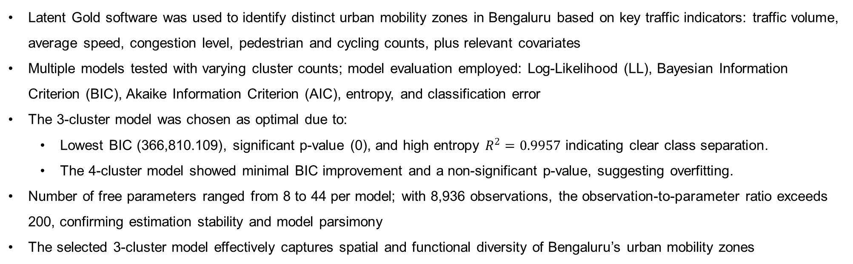
Model Implementation & Cluster Selection
Latent Gold software was used to identify distinct urban mobility zones in Bengaluru based on key traffic indicators: traffic volume, average speed, congestion level, pedestrian and cycling counts, plus relevant covariates
Multiple models tested with varying cluster counts; model evaluation employed: Log-Likelihood (LL), Bayesian Information Criterion (BIC), Akaike Information Criterion (AIC), entropy, and classification error
The 3-cluster model was chosen as optimal due to:
  Lowest BIC (366,810.109), significant p-value (0), and high entropy $R^{2}=0.9957$ indicating clear class separation.
  The 4-cluster model showed minimal BIC improvement and a non-significant p-value, suggesting overfitting.
Number of free parameters ranged from 8 to 44 per model; with 8,936 observations, the observation-to-parameter ratio exceeds 200, confirming estimation stability and model parsimony
The selected 3-cluster model effectively captures spatial and functional diversity of Bengaluru’s urban mobility zones
 | LL | BIC(LL) | AIC(LL) | Npar | p-value | Class.Err. | Entropy R²
1-Cluster | -216997.76 | 434068.30 | 434011.524 | 8 |  | 0 | 1.0000
2-Cluster | -193570.62 | 387295.91 | 387175.255 | 17 | 0 | 0.001 | 0.9953
3-Cluster | -183286.78 | 366810.10 | 366625.565 | 26 | 0 | 0.0014 | 0.9957
4-Cluster | -180394.22 | 361106.86 | 360858.44 | 35 | 1.1885 | 0.0177 | 0.9661
5-Cluster | -178884.44 | 358169.20 | 357856.897 | 44 | 8.6052 | 0.0252 | 0.9574

Slide 11
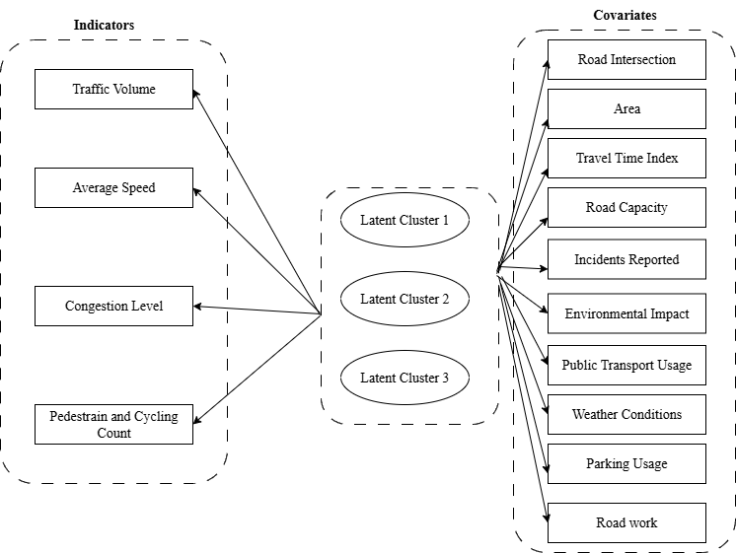
Latent Class Cluster Analysis Framework

Slide 12
LCCA Model Results
 | Cluster1 | Cluster2 | Cluster3 | Overall |  | Cluster1 | Cluster2 | Cluster3 | Overall
Indicators |  |  |  |  | Covariates
Traffic Volume | 41243.27 | 22935.19 | 11192.36 | 29229.89 | Area
Average Speed | 35.63 | 41.53 | 44.97 | 39.45 | Electronic City | 0.00 | 0.08 | 0.18 | 0.06
Congestion Level | 100.00 | 75.94 | 36.50 | 80.68 | Hebbal | 0.09 | 0.13 | 0.09 | 0.11
Pedestrain and cycling count | 99.82 | 100.01 | 199.65 | 114.58 | Indiranagar | 0.26 | 0.14 | 0.14 | 0.19
Covariates |  |  |  |  | Jayanagar | 0.08 | 0.19 | 0.11 | 0.13
Environmental Impact |  |  |  |  | Koramangala | 0.26 | 0.07 | 0.05 | 0.15
58.47 - 84.55 | 0.00 | 0.13 | 1.00 | 0.20 | M.G. Road | 0.24 | 0.11 | 0.11 | 0.17
84.55 - 99.16 | 0.00 | 0.48 | 0.00 | 0.20 | Whitefield | 0.04 | 0.16 | 0.15 | 0.11
99.17 - 112.5 | 0.10 | 0.38 | 0.00 | 0.20 | Yeshwanthpur | 0.01 | 0.12 | 0.18 | 0.08
112.5 - 130.9 | 0.45 | 0.01 | 0.00 | 0.20 | Incidents Reported
130.9 - 194.1 | 0.46 | 0.00 | 0.00 | 0.20 | 0 - 0 | 0.14 | 0.29 | 0.58 | 0.27
Mean | 132.49 | 95.87 | 72.38 | 108.46 | 01-01 | 0.26 | 0.29 | 0.32 | 0.28
Weather Condition |  |  |  |  | 02-02 | 0.28 | 0.20 | 0.07 | 0.21
Clear | 0.60 | 0.61 | 0.60 | 0.61 | 03-10 | 0.32 | 0.22 | 0.02 | 0.24
Fog | 0.11 | 0.11 | 0.10 | 0.11 | Mean | 2.01 | 1.47 | 0.53 | 1.57
Overcast | 0.14 | 0.14 | 0.15 | 0.15 | Travel Time Index
Rain | 0.09 | 0.09 | 0.10 | 0.09 | 1.000 - 1.193 | 0.00 | 0.31 | 0.48 | 0.20
Windy | 0.05 | 0.04 | 0.05 | 0.05 | 1.193 - 1.384 | 0.00 | 0.31 | 0.49 | 0.20
Parking Usage |  |  |  |  | 1.384 - 1.400 | 0.00 | 0.02 | 0.04 | 0.02
50.02 - 59.92 | 0.20 | 0.20 | 0.19 | 0.20 | 1.500 - 1.500 | 1.00 | 0.35 | 0.00 | 0.58
59.92 - 70.38 | 0.20 | 0.20 | 0.18 | 0.20 | Mean | 1.50 | 1.31 | 1.20 | 1.38
70.38 - 80.31 | 0.20 | 0.20 | 0.20 | 0.20 | Road Intersection
80.31 - 89.95 | 0.20 | 0.20 | 0.21 | 0.20 | 100 Feet Road | 0.13 | 0.07 | 0.07 | 0.10
89.96 - 100.00 | 0.19 | 0.20 | 0.22 | 0.20 | Anil Kumble Circle | 0.12 | 0.06 | 0.05 | 0.08
Mean | 74.93 | 75.04 | 76.16 | 75.16 | Ballari Road | 0.04 | 0.07 | 0.04 | 0.05
Public Transport |  |  |  |  | CMH Road | 0.13 | 0.07 | 0.07 | 0.10
10.01 - 23.88 | 0.20 | 0.20 | 0.20 | 0.20 | Hebbal Flyover | 0.05 | 0.06 | 0.04 | 0.05
23.90 - 38.41 | 0.20 | 0.20 | 0.20 | 0.20 | Hosur Road | 0.00 | 0.04 | 0.09 | 0.03
38.43 - 52.24 | 0.20 | 0.20 | 0.20 | 0.20 | ITPL Main Road | 0.02 | 0.07 | 0.07 | 0.05
52.25 - 66.00 | 0.20 | 0.20 | 0.20 | 0.20 | Jayanagar 4th Block | 0.04 | 0.10 | 0.05 | 0.06
66.00 - 79.98 | 0.20 | 0.20 | 0.21 | 0.20 | Marathahalli Bridge | 0.02 | 0.09 | 0.08 | 0.06
Mean | 44.89 | 45.24 | 45.24 | 45.09 | Sarjapur Road | 0.13 | 0.04 | 0.03 | 0.08
Road Capacity |  |  |  |  | Silk Board Junction | 0.00 | 0.04 | 0.09 | 0.03
18.74 - 85.94 | 0.00 | 0.13 | 1.00 | 0.20 | Sony World Junction | 0.14 | 0.03 | 0.03 | 0.08
85.98 - 99.96 | 0.00 | 0.15 | 0.00 | 0.06 | South End Circle | 0.04 | 0.09 | 0.06 | 0.07
100 - 100 | 1.00 | 0.72 | 0.00 | 0.74 | Trinity Circle | 0.12 | 0.05 | 0.06 | 0.08
Mean | 100.00 | 96.39 | 55.85 | 92.01 | Tumkur Road | 0.01 | 0.06 | 0.08 | 0.04
Roadwork |  |  |  |  | Yeshwanthpur Circle | 0.01 | 0.06 | 0.09 | 0.04
No | 0.90 | 0.91 | 0.89 | 0.90
Yes | 0.10 | 0.09 | 0.11 | 0.10

Slide 13
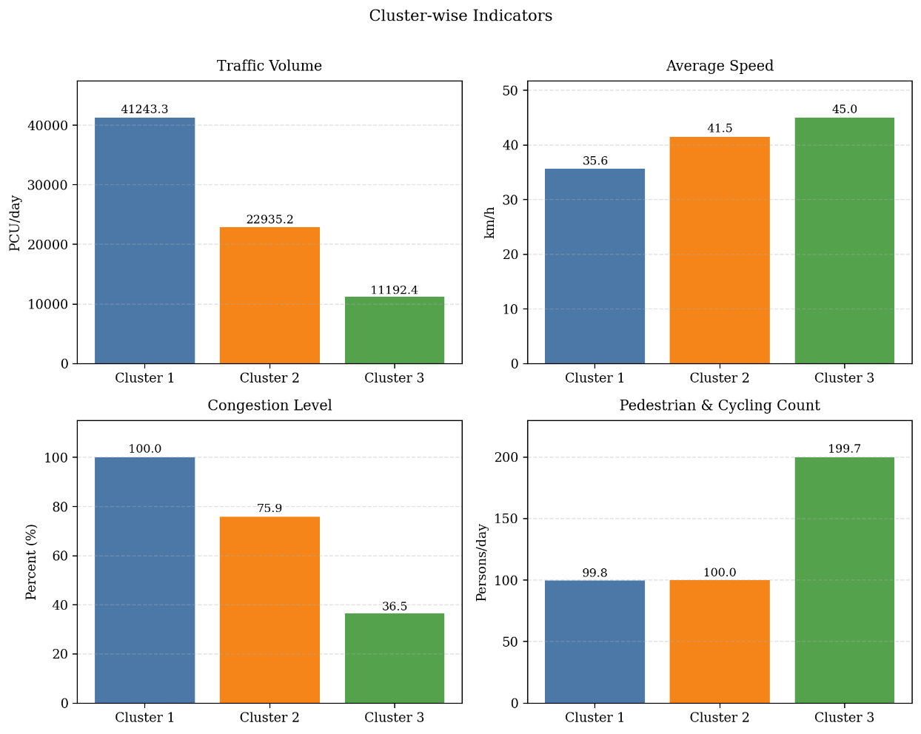
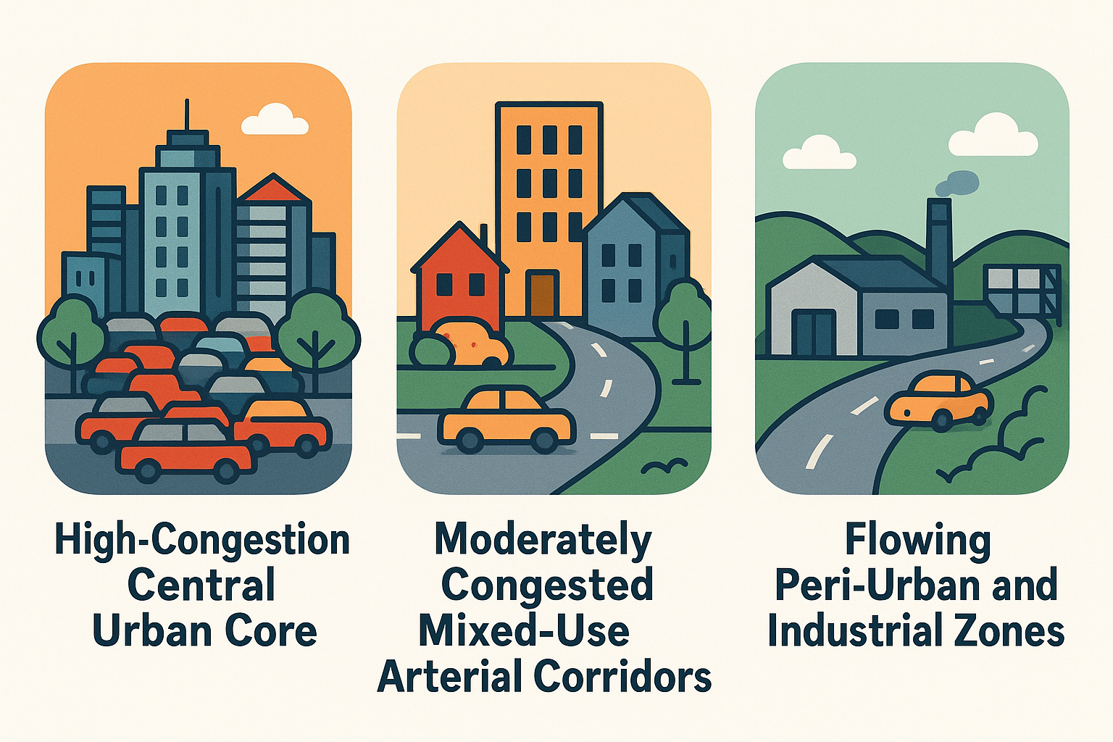
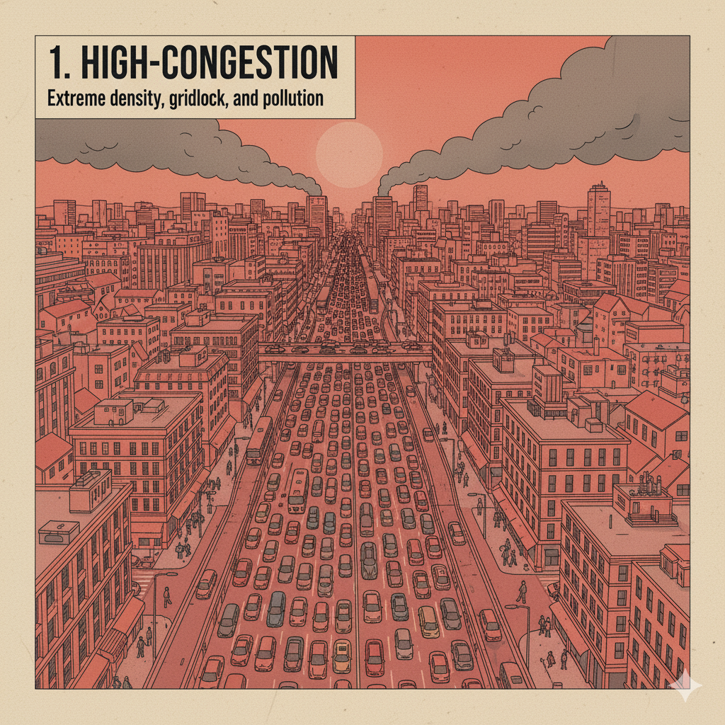
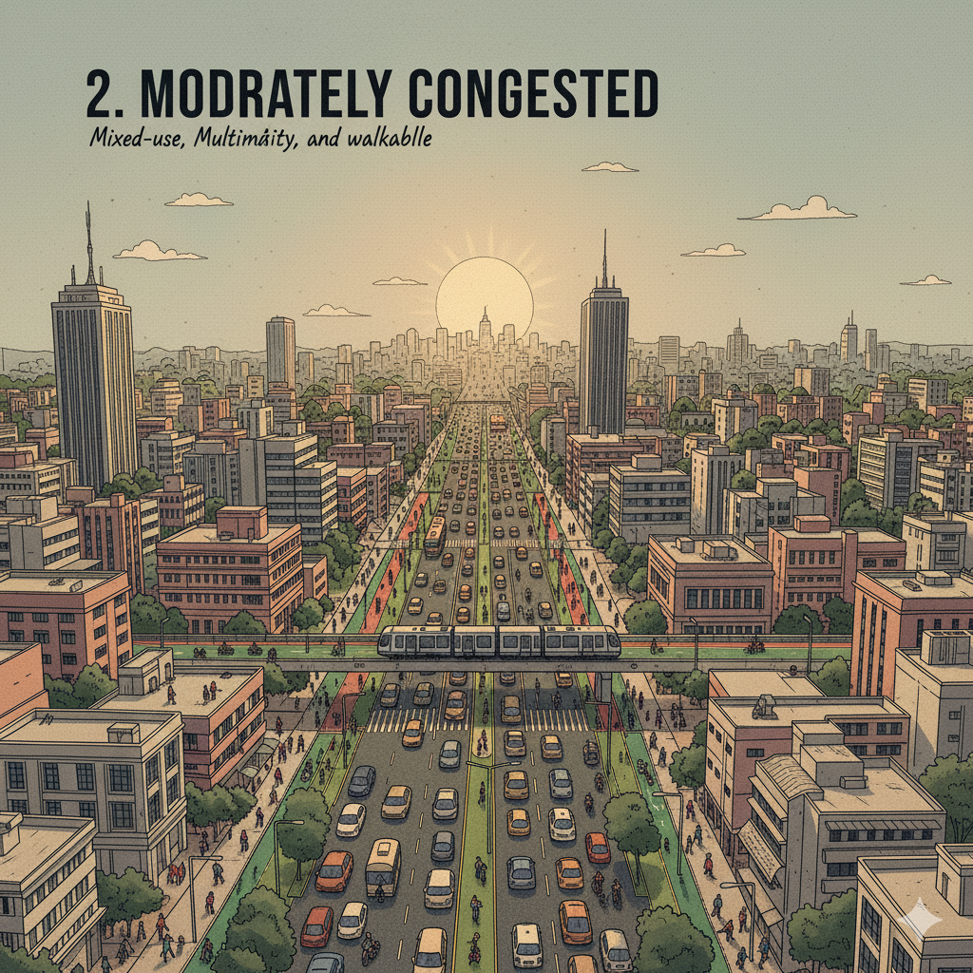
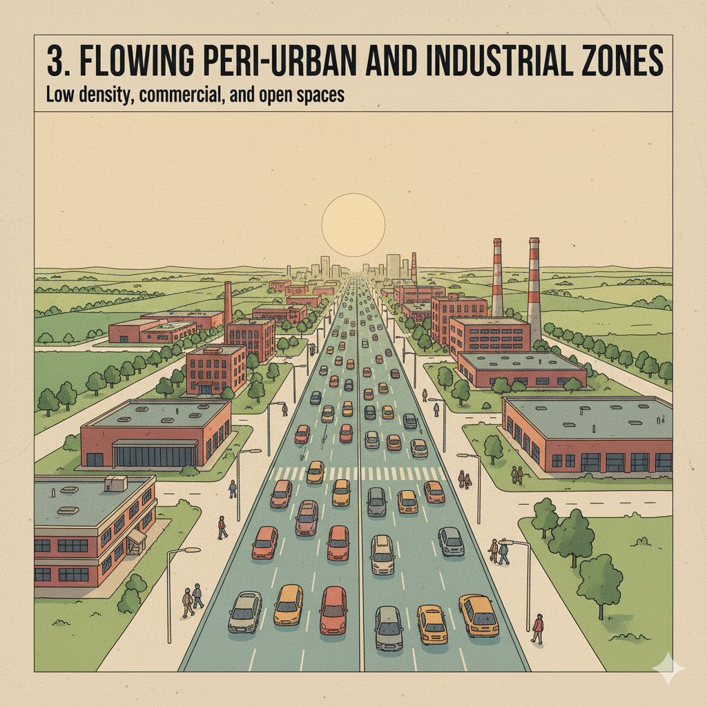
LCCA Model Results
High-Congestion Central Urban Core
Moderately Congested Mixed-Use Arterial Corridors
Flowing Peri-Urban and Industrial Zones
Cluster-wise indicators characteristics

Slide 14
Cluster 1 – High-Congestion Central Urban Core
Represents 43.8% of observed locations, covering Bangalore's densely populated central business districts
Characterized by the highest traffic volume (mean = 41,243 vehicles), nearly maximum congestion (mean congestion = 99.99%), and slow average speed (35.63 km/h)
Moderate pedestrian activity (mean = 99.82) occurs amid heavy vehicular traffic, indicating challenging conditions for non-motorized users
Key locations: Koramangala (26.5%), Indiranagar (25.8%), M.G. Road (24.3%), major commercial and entertainment hubs with high trip demand
Travel Time Index uniformly at 1.5 indicates peak travel times are 50% longer than free-flow conditions.
Highest environmental impact score (mean = 132.49), reflecting poor air quality from slow-moving traffic emissions.
Highest average traffic incident rate (mean = 2.01), due to complex, stop-and-go congestion conditions.
Road infrastructure operates at full capacity (mean road capacity utilization = 100%).
Roadwork less frequent here, likely due to disruptions it would cause in critical corridors.
Highlights urgent need for interventions: Enhancing public transit and non-motorized transport infrastructure
Implementing demand management measures such as congestion pricing

Slide 15
Cluster 2 – Moderately Congested Mixed-Use Arterial Corridors
Represents 41.5% of observed data, corresponding to major arterial roads and connectors feeding into Bengaluru’s central core.
Moderate traffic volume (mean = 22,935 vehicles), congestion level (mean = 75.94%), and improved average speed (41.53 km/h) compared to Cluster 1
Pedestrian usage remains significant, indicating active street life and multi-modal interactions
Spatially dispersed with strong links to residential and developing commercial nodes:
Key areas: Jayanagar (18.9%), Whitefield (16.1%), Yeshwanthpur (12.1%), Hebbal (12.7%).
Travel Time Index average of 1.31 indicates peak travel times about 31% longer than free flow, signaling moderate congestion
Environmental impact is notable but lower than Cluster 1 (mean = 95.87)
Traffic incidents are fewer (mean = 1.47) but remain a concern
Road capacity utilization is mixed: 72% of locations at full capacity, 28% below capacity, consistent with intermediate congestion
Opportunities for targeted interventions: Optimize traffic signal timing on arterial roads.
Improve intersection design (e.g., Jayanagar 4th Block, South End Circle).
Create dedicated lanes for high-occupancy vehicles or buses to enhance flow and encourage mode shift.

Slide 16
Cluster 3 – Flowing Peri-Urban and Industrial Zones
Comprises 14.7% of locations, mainly on city peripheries and industrial corridors
Lowest traffic volume (mean = 11,192 vehicles) and congestion level (mean = 36.50%)
Highest average speed at 44.97 km/h, reflecting free-flowing traffic conditions
Notably high pedestrian and cycling use (mean = 199.65), double that of other clusters, indicating dedicated pathways or less vehicle-pedestrian conflict
Key areas: Electronic City (18.2%), Yeshwanthpur (17.6%), Hosur Road (8.8%)
Travel Time Index mean of 1.20, implying only 20% longer peak travel times vs. free flow
Lowest environmental impact score (mean = 72.38), reflecting better emissions profile
Safest cluster: lowest incident rate (mean = 0.53) with 58% of locations reporting no incidents
Road capacity utilization well below limits (mean = 55.85%), indicating adequate infrastructure supply
Policy focus: Preserve these favorable conditions by preventing sprawl and car-centric development.
Promote transit-oriented development, especially in areas like Electronic City.
Invest in pedestrian and cycling infrastructure to maintain active transport levels.
Manage growth carefully to avoid future congestion.

Slide 17
Policy Implications Across Urban Mobility Zones
Cluster 1: High-Congestion Central Urban Core
Prioritize reducing vehicle dependency through enhanced public transit access.
Expand and improve non-motorized transport infrastructure for safer pedestrian and cycling environments.
Implement demand management strategies, including congestion pricing, to moderate traffic volumes.
Cluster 2: Moderately Congested Mixed-Use Arterial Corridors
Optimize traffic signal timing and redesign critical intersections to improve traffic flow.
Create dedicated lanes for buses and high-occupancy vehicles to encourage mode shift.
Targeted infrastructure upgrades in residential and commercial nodes to alleviate moderate congestion.
Cluster 3: Flowing Peri-Urban and Industrial Zones
Focus on preservation of free-flowing traffic conditions and active transport levels.
Promote transit-oriented development to manage growth without increasing congestion.
Invest in pedestrian and cycling infrastructure to sustain high usage and safety.
Overall Recommendation: Tailored, cluster-specific interventions are essential; a one-size-fits-all approach will fail to address diverse urban mobility challenges in Bengaluru effectively.

Slide 18
Conclusions
This study applied open-source traffic data and Latent Class Cluster Analysis (LCCA) to classify Bengaluru’s urban mobility into three distinct zones
Major differences were found across zones in traffic volume, speed, congestion, and pedestrian activity—moving beyond a one-dimensional traffic view to a nuanced typology
Cluster 1 (Urban Core): Highest volume (~41,243 vehicles/day), lowest speed (35.63 km/h), full road capacity (100%), severe congestion
Cluster 2 (Transitional Zones): Moderate congestion (75.93%) and speed (41.53 km/h), suitable for targeted transit and traffic signal improvements
Cluster 3 (Peri-Urban Zones): Highest pedestrian counts (~200/day), lowest congestion (36.5%), highest speed (44.97 km/h), indicating walkable, low-traffic areas
Highlights the need for targeted, zone-specific policies for effective and sustainable urban mobility
Future research could include topographic factors affecting traffic dynamics

Slide 19
References
Akbar, P., Couture, V., Duranton, G., & Storeygard, A. (2023). Mobility and congestion in urban India. American Economic Review, 113(4), 1083-1111.
Gogeri, I., Gouda, K. C., & ThippaReddy, A. S. (2024). Unravelling Bangalore's air quality during the second wave: Multifaceted analysis of COVID-19 lockdown impact. Natural Hazards Research, 4(4), 584-595.
Duranton, G., & Turner, M. A. (2011). The fundamental law of road congestion: Evidence from US cities. American Economic Review, 101(6), 2616-2652.
Cervero, R., & Kockelman, K. (1997). Travel demand and the 3Ds: Density, diversity, and design. Transportation research part D: Transport and environment, 2(3), 199-219.
Chen, L., Hasan, R., Jiang, Y., & Parkhomenko, A. (2024). Faster, taller, better: Transit improvements and land use policies. Journal of Development Economics, 171, 103322.
Ghosh, T., Kanitkar, T., & Srikanth, R. (2022). Assessing equity in public transportation in an Indian city. Case Studies on Transport Policy, 10(4), 2337-2349.
Pavez, M. L., Soza-Parra, J., & Herrera, J. C. (2025). Identifying representative weeks: A clustering analysis of urban dynamics based on public transport data. Cities, 165, 106094.
Zang, J., Jiao, P., Liu, S., Zhang, X., Song, G., & Yu, L. (2023). Identifying traffic congestion patterns of urban road network based on traffic performance index. Sustainability, 15(2), 948.
Liu, J., & Yuan, Y. (2024). Exploring dynamic urban mobility patterns from traffic flow data using community detection. Annals of GIS, 30(4), 435-454.
Vermunt, J. K., & Magidson, J. (2002). Latent class cluster analysis. Applied latent class analysis, 11(89-106), 60.
Masyn, K. E. (2013). Latent class analysis and finite mixture modeling. In T. D. Little (Ed.), The Oxford Handbook of Quantitative Methods, Volume 2: Statistical Analysis (pp. 551–611). Oxford University Press. https://doi.org/10.1093/oxfordhb/9780199934898.013.0025
Nylund-Gibson, K., & Choi, A. Y. (2018). Ten frequently asked questions about latent class analysis. Translational issues in psychological science, 4(4), 440.
van't Veer, R., Annema, J. A., Araghi, Y., de Almeida Correia, G. H., & van Wee, B. (2023). Mobility-as-a-Service (MaaS): A latent class cluster analysis to identify Dutch vehicle owners’ use intention. Transportation Research Part A: Policy and Practice, 169, 103608.
Vallée, J., Ecke, L., Barthelmes, L., & Vortisch, P. (2024). Drivers and Barriers to Public Transport Usage: Insights from Psychographic Profiles Using Latent Class Analysis. Transportation Research Record, 2678(10), 459-470.
Kriswardhana, W., & Esztergár-Kiss, D. (2025). Identifying latent mobility as a service preference segments among college students. European Transport Research Review, 17(1), 24.
Ramachandra, T. V., Aithal, B. H., & Sanna, D. D. (2012). Insights to urban dynamics through landscape spatial pattern analysis. International journal of applied earth observation and geoinformation, 18, 329-343.
Nair, D. J., Gilles, F., Chand, S., Saxena, N., & Dixit, V. (2019). Characterizing multicity urban traffic conditions using crowdsourced data. PLoS one, 14(3), e0212845.
Anapakula, K. B., & Eranki, G. A. (2021). Developing an index to evaluate the quality of pedestrian environment: Case study application in an Indian metro. Transportation research interdisciplinary perspectives, 11, 100406.
Karthik, P. N., Rathod, N., Yasodharan, S., Lobo, W., Sahadevan, A., Sundaresan, R., & Verma, P. (2023). Bus priority lane in Bengaluru: A study on its effectiveness and driver stress. Transport policy, 139, 39-62.
Guttikunda, S. K., Nishadh, K. A., Gota, S., Singh, P., Chanda, A., Jawahar, P., & Asundi, J. (2019). Air quality, emissions, and source contributions analysis for the Greater Bengaluru region of India. Atmospheric Pollution Research, 10(3), 941-953.
Apte, J. S., Messier, K. P., Gani, S., Brauer, M., Kirchstetter, T. W., Lunden, M. M., ... & Hamburg, S. P. (2017). High-resolution air pollution mapping with Google street view cars: exploiting big data. Environmental science & technology, 51(12), 6999-7008.
Anapakula, K. B., & Eranki, G. A. (2021). Developing an index to evaluate the quality of pedestrian environment: Case study application in an Indian metro. Transportation research interdisciplinary perspectives, 11, 100406.
Ton, D., Zomer, L. B., Schneider, F., Hoogendoorn-Lanser, S., Duives, D., Cats, O., & Hoogendoorn, S. (2020). Latent classes of daily mobility patterns: the relationship with attitudes towards modes. Transportation, 47(4), 1843-1866.

Slide 20


