Slide 1

18th Urban Mobility India Conference
& Expo 2025
Research Symposium 3: Paper ID: 1541
Priority Intervention of City Bus Service Quality Factors Using TOPSIS Analysis
Presented by
Jagannath Pattanaik
PhD Scholar
Centre for Transportation Systems (C-TRANS)
Indian Institute of Technology Roorkee
Co-authors
Co-authors
Prof. Shubhajit Sadhukhan
Associate Professor
Centre for Transportation Systems (C-TRANS)
Indian Institute of Technology Roorkee
Prof. Manoranjan Parida
Director
Central Road Research Institute (CSIR-CRRI)
Government of India

Slide 2

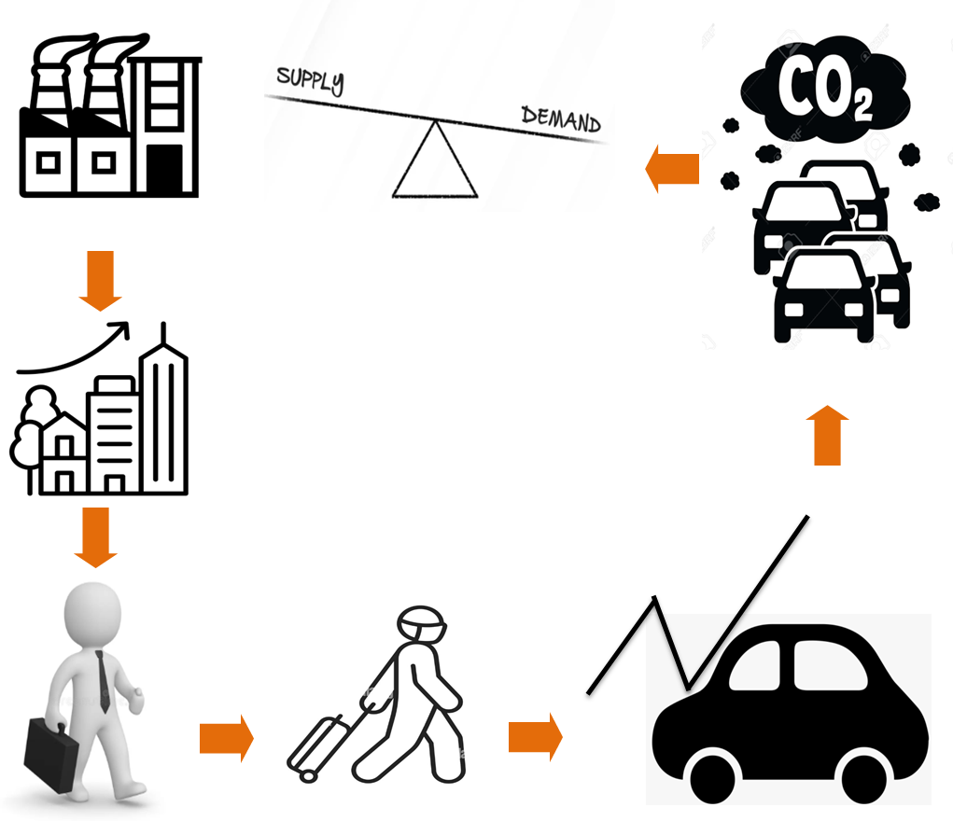
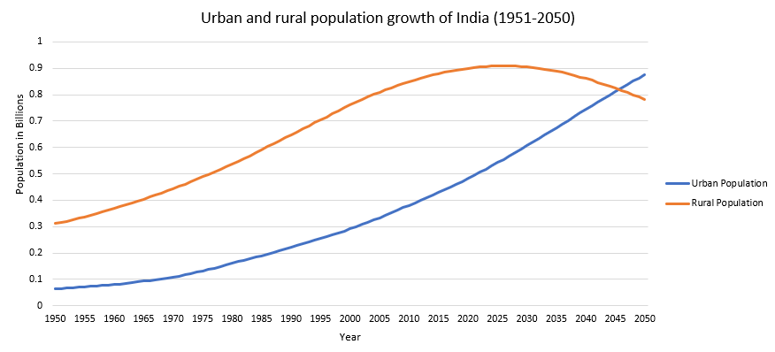
Introduction: Current Scenario
India
18%
36%
(Source: World Bank, 2021)
1950
2050
2

Slide 3

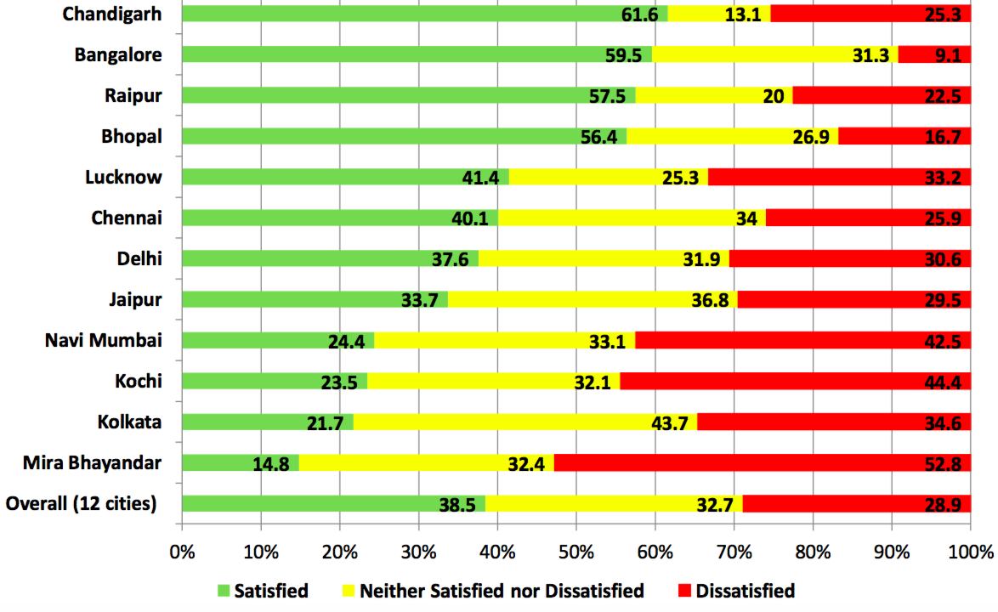
City Transit Systems: Current Scenario of India
Source: (MORTH,2022 & MOHUA, 2024)
3

Slide 4
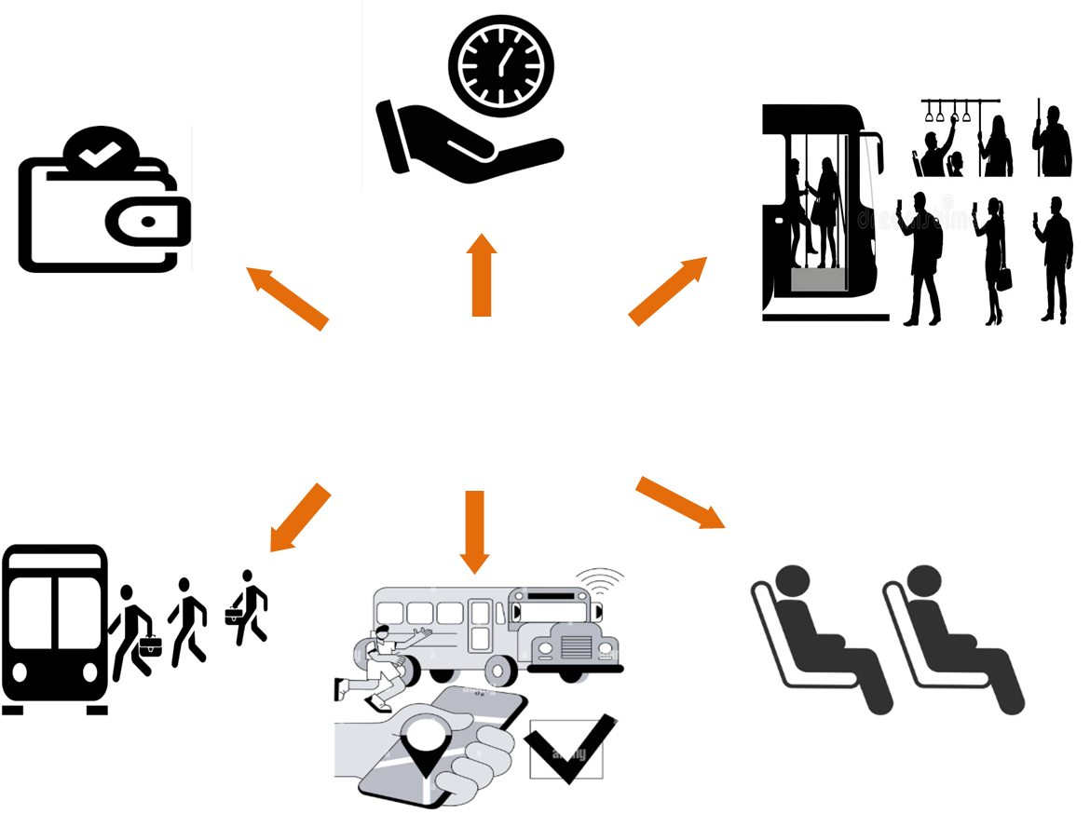
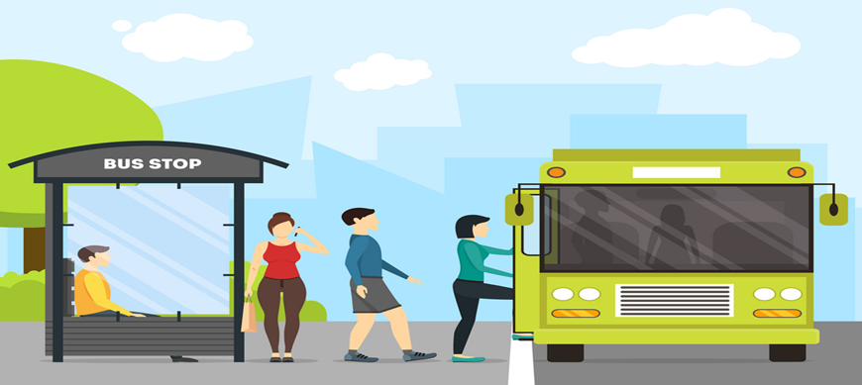
Need for a Qualitative study?
Bus Service Quality?
Time Savings
Delivered Quality
Perceived Quality
Which are more or less important, and which attributes are required with more priority and policy in terms of derived satisfaction?
Perceived service quality improves travel satisfaction.
Affordability
Safety
&
Security
Targeted Quality
Desired quality
Accessibility
Comfort
Reliability
Service provider perspective
Customer perspective
Service Quality(Cognitive)
Satisfaction(Affective)
(Bus quality management process)
4

Slide 5


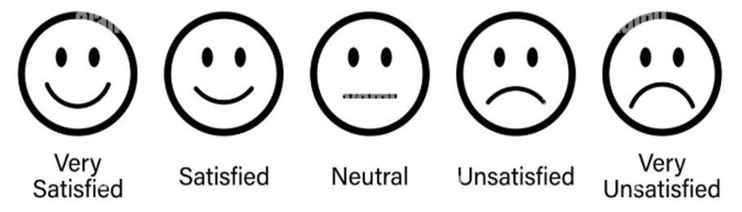
Objective
01
To identify user’s perspectives on disaggregate-level bus service quality attributes
02
To evaluate the derived satisfaction ranking on perception of bus service quality attributes
03
To identify the derived satisfaction ranking of bus service quality attribute for priority and policy
5

Slide 6
Literature Review: SQ Performance Evaluations
Authors | Year | Country | Transit Mode | Analysis Method
(Sun et al) | 2020 | China | Bus | Cluster Analysis, IPA
(De Ona et al ) | 2021 | Europe | Metro | Ordered Logit Model (OLM)
(Zhang et al) | 2019 | China | Bus | ordered probit model
(Zheng et al) | 2022 | Brazil | Metro | Ordinal logit regression (OLR) and Random forest (RF) analysis
(Kokalan et al) | 2020 | Turkey | Bus | EFA and CFA
(Atombo et al) | 2022 | Ghana | Metro | Structural Equation Modelling
(Kar et al) | 2022 | India | Metro | Revised IPA with Fuzzy C-Means Clustering
6

Slide 7
Literature Review: SQ Performance Evaluations Studies
Cost
On Board Information
Safety
Cleanliness
value
Service Hours
Comfort
Physical Accessibility
Behavior
Waiting Conditions
Travel Time
Punctuality
Frequency
Conditions
7

Slide 8
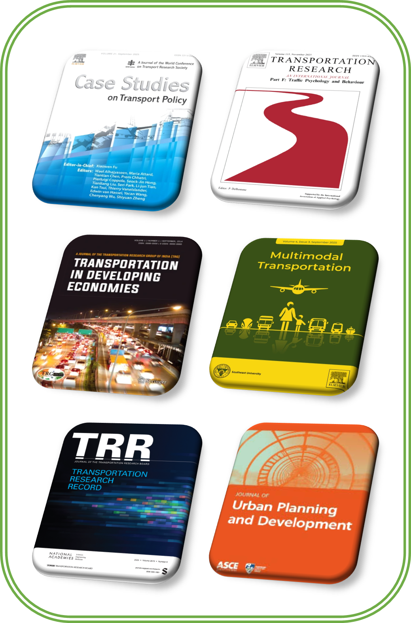
Identification of Service Quality Attributes
Web of Science, Google Scholar and Internet Browsing
Service quality, Bus, Metro, Public Transport, Perception, Important, Satisfaction and Expectations
906 Quality Attributes
Pilot Survey
56 Quality Attributes
Content Validations &
Thematic Clustering
Final 50 Bus Service Quality Attributes
8

Slide 9
Final Selection of Attribute
Code | Bus service quality attribute | Transit Mode | Reference
A1 | Bus Crowding & Overloading | Bus | (Deb and Ahmed, 2019; Mahmoud et al., 2014)
A2 | Vibration & noise | Public Transport/Bus | (Hadiuzzman et al., 2017; Mahmoud and Hine, 2013)
A3 | Crew member's behaviour | Public Transport/ Bus | (Jomnonkwao and Ratanavaraha, 2016; Rodriguez-Valencia et al., 2019; Sukhov et al., 2022)
A4 | Driver's riding quality | Bus | (Grujičić et al., 2014; Mouwen, 2015)
A5 | Seating comfort | Public Transport/ Bus | (Beraa and Maitrab, 2019; Dandapat and Maitra, 2015; Hensher, 2014; Kar et al., 2022a)
A6 | Comfortable Leg space | Bus | (Deepa et al., 2022; Watthanaklang et al., 2024)
A7 | Comfortable standing on board | Bus | (Deb et al., 2022b; Majumdar et al., 2020; Nikel et al., 2020)
A8 | Availability of seat | Public Transport/ Bus | (Aghajanzadeh et al., 2022; de Oña et al., 2016)
A9 | Condition of vehicle | Public Transport | (de Oña et al., 2021; Mugion et al., 2018; Ngoc Su et al., 2021b)
A10 | Waiting at no bus shelter stop | Bus | (Chowdhury et al., 2014; Wang et al., 2021)
A11 | Walking distance to a bus stop | Bus | (Maitra et al., 2013; Nikel et al., 2020)
A12 | Function of traffic signal | Public Transport/ Bus | (Gupta et al., 2022; Weng et al., 2023)
A13 | Condition of the sidewalk | Bus | (Roy and Basu, 2020b; Ruiz-Padillo and de Oña, 2024)
A14 | Message sign at a bus stop | Public Transport | (Chepuri et al., 2022; Sukhov et al., 2022)
A15 | Bus stop location design | Bus | (Basu et al., 2020; Mahmoud and Hine, 2016; Miao et al., 2019)
A16 | Crossing facility | Public Transport | (Kant et al., 2024; Prasad and Maitra, 2019; Sadhukhan et al., 2015)
A17 | Bus lane | Bus | (Bhattacharyya et al., 2019; Deveci et al., 2019)
A18 | Park and ride facility | Public Transport | (Kar et al., 2022a; Singh and Kathuria, 2023)
A19 | Infrastructure condition of shelter | Bus | (Mahmoud and Hine, 2016; Wu et al., 2020)
A20 | Convenient to get in/off | Public Transport | (de Oña et al., 2018; Nikel et al., 2020; Shen et al., 2016)
A21 | Transfer facility | Public Transport/ Bus | (Fairooz CHERANCHERY et al., 2018; Fu, 2022; Sadhukhan et al., 2016)
A22 | Easy purchasing of a ticket | Bus | (Fu et al., 2018; Sam et al., 2018)
A23 | Convenient to reach a bus stop | Bus | (Eldeeb and Mohamed, 2020b; Tanwar and Kumar Agarwal, 2025)
A24 | Easy tracking using mobile AAP | Ride-hailing/Bus | (Bhaduri and Goswami, 2023)
A25 | Accurate information | Public Transport/ Bus | (Choi et al., 2025)
9

Slide 10
Final Selection of Attribute (Contd.)
Code | Bus service quality attribute | Transit Mode | Reference
A26 | Pre-trip information | Public Transport/ Bus | (Fairooz CHERANCHERY et al., 2018; Rojo et
A27 | Availability route & network | Bus | (Bose and Pandit, 2020; Güner, 2018)
A28 | Provision of general information | Public Transport | (Ibraeva and Sousa, 2014; Zheng et al., 2022)
A29 | Waiting & transfer time | Public Transport | (Ansari Esfeh et al., 2022; Ogata et al., 2022)
A30 | In-vehicle time | Bus | (Bordagaray et al., 2014; Ji et al., 2019)
A31 | Total travel time | Public Transport/ Bus | (Prasad and Maitra, 2019; Ruiz-Padillo and de Oña, 2024; Tran-Thi et al., 2024)
A32 | Reliability of the service | Public Transport | (Börjesson and Rubensson, 2019; Esmailpour et al., 2020; Hsieh, 2023)
A33 | Operating hours | Public Transport | (Luo et al., 2023; Mahmoud and Hine, 2013)
A34 | Frequency of bus | Bus | (Chee et al., 2020; De Vos et al., 2022; Rong et al., 2022; Sen and Roy, 2025)
A35 | Speed of the bus | Bus | (Allen et al., 2019; González et al., 2019; Ye et al., 2022)
A36 | Cleanliness at bus stop | Bus | (Ong et al., 2023; Tuan et al., 2022b)
A37 | Cleanliness inside the bus | Public Transport/ Bus | (De Oña et al., 2013; Ismael and Duleba, 2021; Wang and Zhu, 2014)
A38 | Provision of Trashcans | Bus | (Sun et al., 2020)
A39 | Drinking water facility | Bus/Airport | (Basu et al., 2020; Liao et al., 2022)
A40 | Lighting conditions at a bus stop | Bus | (Ruiz-Padillo and de Oña, 2024; Zheng et al., 2021)
A41 | Ticket fare/monthly pass | Public Transport/ Bus | (Atombo and Dzigbordi Wemegah, 2021; Busco et al., 2021)
A42 | Safety at bus stop & board | Public Transport/ Bus | (Cheng et al., 2018; Hsieh, 2023; Nguyen-Phuoc et al., 2021)
A43 | Theft and snatching | Public Transport/ Airport | (Allen et al., 2020; Farazi et al., 2022)
A44 | Reckless driving of driver | Public Transport | (Agyeman and Cheng, 2020; Ong et al., 2023)
A45 | Provision of CCTV | Public Transport | (Bivina et al., 2019; Mesbah et al., 2022a)
A46 | Female safety and security | Public Transport/ Bus | (Mazzulla et al., 2024b; Zheng et al., 2022)
A47 | Reservation of women's seat | Public Transport | (Ojo, 2019)
A48 | Traffic Flow | Public Transport | (Magalhães and Rivera-Gonzalez, 2021; Sen and Roy, 2025)
A49 | Traffic density | Public Transport | (Bilişik et al., 2013; Bivina et al., 2019)
A50 | Traffic speed | Public Transport | (González et al., 2019; Kester S. Ong et al., 2024)
10

Slide 11
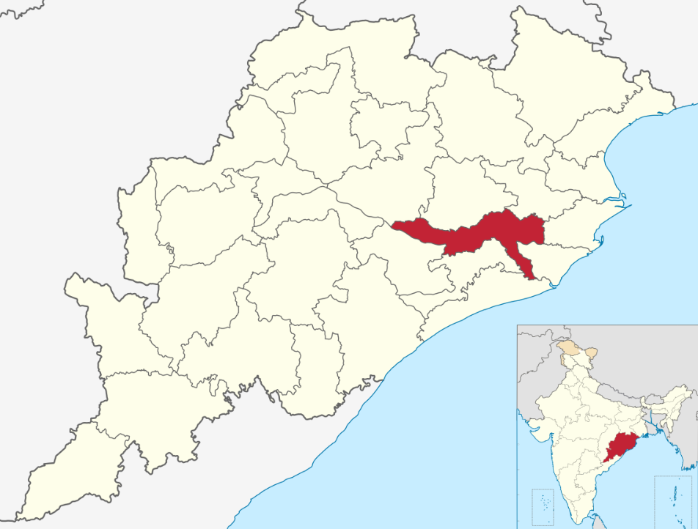
Study Area: Bhubaneswar
The urban city of Bhubaneswar is considered the study area for the existing study, which is located in the east coastal region of the Indian sub-continent and declared as the first smart city under the mission of ‘Smart city challenge’ by MOHUA, Government of India in the year 2015.
The city buses have been operated by CRUT since 2018 on 35 routes covering approximately 360 km.
The fleet comprises 510 units, with 300 actively operating in the Bhubaneswar urban region.
CRUT has achieved over 2 lakhs ridership in 2025 and owns the best city bus transportation system in India at 17th Urban Mobility Expo, 2024.
11

Slide 12
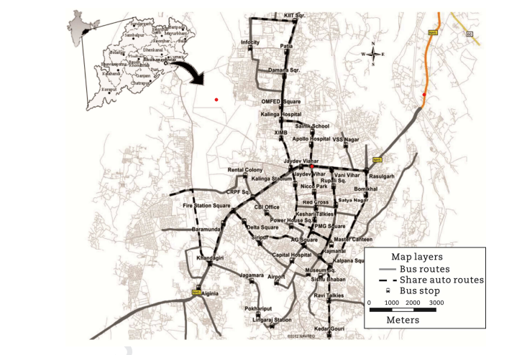
Methodology
Priority Intervention of City Bus Service Quality Factors Using TOPSIS Analysis
Review of Literature
Study Area Selection
Systematic Analysis
Content Analysis
Frequency Analysis
Identification of Disaggregate Level Attributes
User Perception survey
Survey Questionaries Development and Data Collection
Technique for Order of Preference by Similarity to Ideal Solution (TOPSIS)
Analysis of Data
Ranking Classification of Service Quality Attributes for Priority and Policy
Source: (CRUT,2020)
12

Slide 13
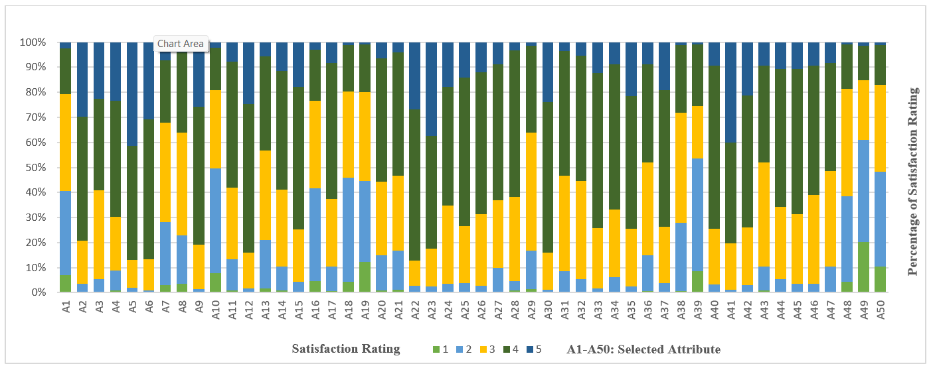
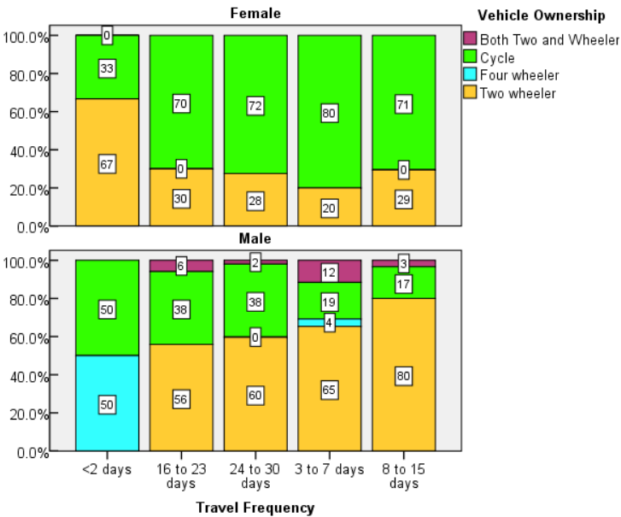
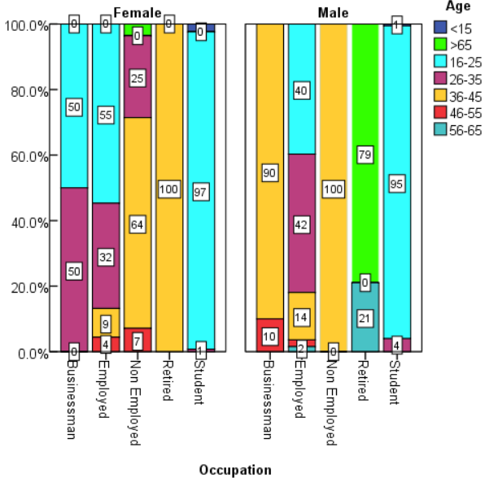

Descriptive Statistics
716 Samples
13

Slide 14
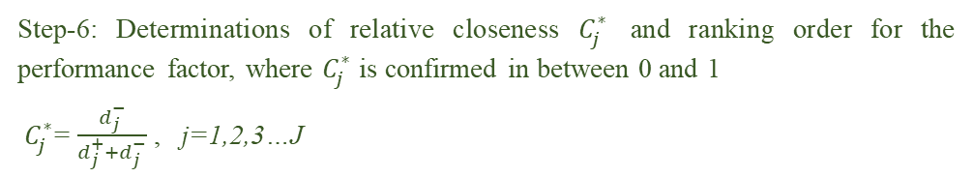
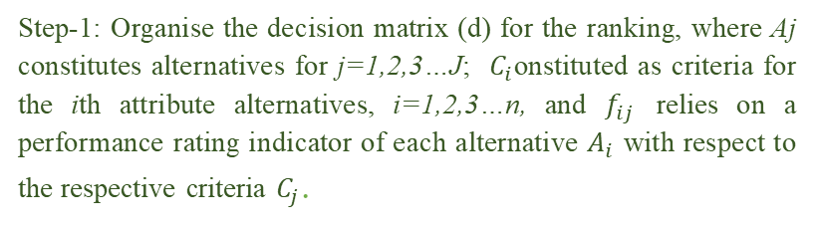
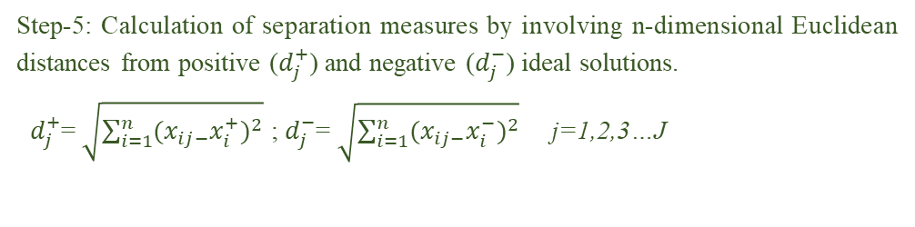
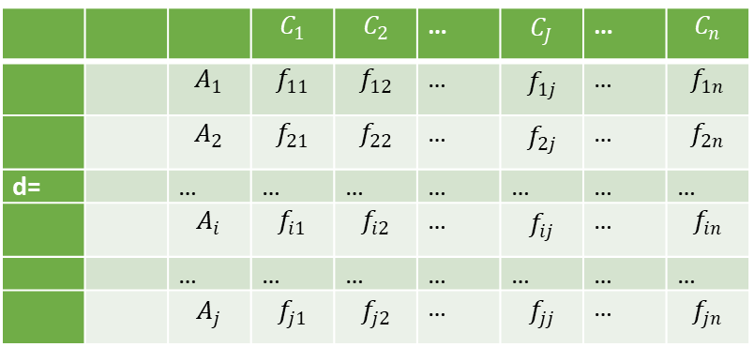
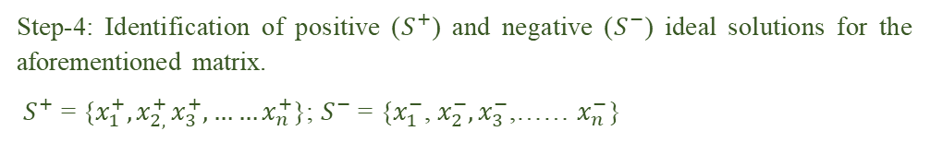
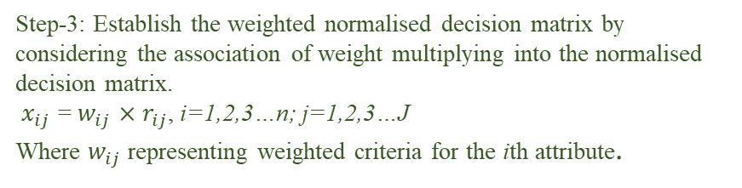
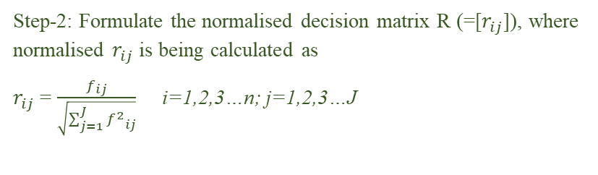
Technique for Order of Preference by Similarity to Ideal Solution (TOPSIS)
Step-1: Organise the decision matrix (d) for the ranking, where Aj constitutes alternatives for j=1,2,3…J; $C_{i}$onstituted as criteria for the ith attribute alternatives, i=1,2,3…n, and $f_{ij}$ relies on a performance rating indicator of each alternative $A_{i}$ with respect to the respective criteria $C_{j}$.
Step-3: Establish the weighted normalised decision matrix by considering the association of weight multiplying into the normalised decision matrix.
$x_{ij}$ = $w_{ij}$ $×$ $r_{ij}$, i=1,2,3…n; j=1,2,3…J Where $w_{ij}$ representing weighted criteria for the ith attribute.
 |  |  | $$C_{1}$$ | $$C_{2}$$ | … | $$C_{J}$$ | … | $$C_{n}$$
 |  | $$A_{1}$$ | $$f_{11}$$ | $$f_{12}$$ | … | $$f_{1j}$$ | … | $$f_{1n}$$
 |  | $$A_{2}$$ | $$f_{21}$$ | $$f_{22}$$ | … | $$f_{2j}$$ | … | $$f_{2n}$$
d= |  | … | … | … | … | … | … | …
 |  | $$A_{i}$$ | $$f_{i1}$$ | $$f_{i2}$$ | … | $$f_{ij}$$ | … | $$f_{in}$$
 |  | … | … | … | … | … | … | …
 |  | $$A_{j}$$ | $$f_{j1}$$ | $$f_{j2}$$ | … | $$f_{jj}$$ | … | $$f_{jn}$$
Step-4: Identification of positive ($S^{+}$) and negative ($S^{−}$) ideal solutions for the aforementioned matrix.
$S^{+}$ = {$x_{1}^{+},x_{2, }^{+}x_{3}^{+},……x_{n}^{+}$}; $S^{−}$ = {$x_{1}^{−}$, $x_{2}^{−},x_{3}^{−}$,…… $x_{n}^{−}$}
Step-5: Calculation of separation measures by involving n-dimensional Euclidean distances from positive ($d_{j}^{+}$) and negative ($d_{j}^{−}$) ideal solutions.
$d_{j}^{+}$= $\sqrt{\sum_{i=1}^{n}{{(x_{ij−}x_{i}^{+})}^{2}}}$ ; $d_{j}^{−}$= $\sqrt{\sum_{i=1}^{n}{{(x_{ij−}x_{i}^{−})}^{2}}}$ j=1,2,3…J
Step-2: Formulate the normalised decision matrix R (=[$r_{ij}$]), where normalised $r_{ij}$ is being calculated as
$r_{ij}$ = $\frac{f_{ij}}{\sqrt{\sum_{j=1}^{J}{{f^{2}}_{ij}}}}$ i=1,2,3…n; j=1,2,3…J
Step-6: Determinations of relative closeness $C_{j}^{∗}$ and ranking order for the performance factor, where $C_{j}^{∗}$ is confirmed in between 0 and 1
$C_{j}^{∗}$= $\frac{d_{j}^{−}}{d_{j}^{+}+d_{j}^{−}}$ , j=1,2,3…J
14

Slide 15
Analysis of Data & Results
Attribute | 1 | 2 | 3 | 4 | 5
Nature of Bus Crowding /Overloading | 50 | 241 | 277 | 130 | 18
vibration & noise inside a bus | 3 | 22 | 124 | 355 | 212
crew member's behaviour | 3 | 35 | 255 | 262 | 161
Driver's riding quality? | 7 | 56 | 154 | 331 | 168
Comfortable seats? (CC5) | 1 | 13 | 80 | 325 | 297
Comfortable Leg space | 0 | 6 | 90 | 399 | 221
standing while boarding | 21 | 181 | 284 | 179 | 51
Easy getting a seat | 25 | 138 | 295 | 229 | 29
Condition of the vehicle | 1 | 10 | 127 | 394 | 184
No shelter bus stop | 55 | 300 | 224 | 121 | 16
Walking distance to bus stops | 7 | 89 | 205 | 359 | 56
Traffic control measures (traffic lights on intersections, Marking) | 0 | 13 | 101 | 426 | 176
Sidewalk design | 13 | 138 | 256 | 268 | 41
presence of variable message signs at bus stops | 6 | 68 | 220 | 339 | 83
Bus Stops’ space, height design, location and visibility, etc.? | 1 | 31 | 149 | 407 | 128
Presence of a crossing a facility between opposite bus stops | 33 | 266 | 250 | 146 | 21
Performance of a bus lane stop in front of the bus shelter | 4 | 71 | 193 | 389 | 59
Presence Parking facility at the bus stop location | 31 | 297 | 248 | 131 | 9
Infrastructure conditions of Bus shelter | 88 | 231 | 255 | 136 | 6
How convenient are you to get in and Get off from the bus | 6 | 101 | 210 | 353 | 46
Transfer facility? | 9 | 112 | 213 | 352 | 30
Easy is to buy a MO bus ticket | 1 | 18 | 73 | 432 | 192
convenient to reach the bus stop | 3 | 15 | 108 | 322 | 268
Easily track the MO bus through the AAP | 3 | 23 | 223 | 339 | 128
15

Slide 16

Analysis of Data & Results (Contd.)
Accurate information Provision for travelling? | 2 | 26 | 163 | 423 | 102
Pre-trip information provision at the bus stop? | 2 | 18 | 205 | 406 | 85
Route and Network are sufficient | 2 | 69 | 194 | 387 | 64
General information at bus stops | 7 | 27 | 239 | 419 | 24
Waiting and transfer time | 11 | 110 | 337 | 247 | 11
In-vehicle time | 1 | 7 | 106 | 430 | 172
Total travel time? | 3 | 58 | 273 | 356 | 26
Reliability of the service | 0 | 38 | 281 | 358 | 39
Operating hours of MO buses | 0 | 13 | 172 | 443 | 88
Frequency of the MO Bus | 0 | 45 | 193 | 415 | 63
Speed of the MO bus | 0 | 17 | 165 | 379 | 155
Cleanliness at bus stop | 5 | 102 | 265 | 281 | 63
Cleanliness inside the bus | 2 | 25 | 161 | 390 | 138
Provision of Trashcans | 4 | 196 | 315 | 192 | 9
Drinking water facility | 61 | 322 | 150 | 177 | 6
Lighting conditions at bus stop | 1 | 22 | 159 | 467 | 67
ticket fare/monthly pass of MO Bus | 0 | 8 | 134 | 287 | 287
Feel safe at the bus stop & on board | 2 | 19 | 165 | 377 | 153
Safe from theft and snatching during onboard and at stop | 7 | 67 | 298 | 277 | 67
Driving carefully while reaching and starting from the stop | 1 | 38 | 206 | 395 | 76
CCTV in side bus | 0 | 25 | 200 | 415 | 76
Females safety | 0 | 25 | 255 | 369 | 67
women's seat reservation in MO bus | 0 | 74 | 273 | 309 | 60
Traffic flow when approach to the bus shelter? | 32 | 243 | 307 | 127 | 7
Rising of Traffic density at bus stop | 144 | 292 | 172 | 98 | 10
Traffic speed when approach to a bus stop | 75 | 270 | 249 | 114 | 8
16

Slide 17


Derived Satisfaction Rank
Attribute | S+ | S- |  | Rank
Traffic density at neighbourhood bus stops | 0.147 | 0.015 | 0.09 | 1
Infrastructure condition of shelter | 0.1 | 0.06 | 0.373 | 2
Traffic speed when passengers approach to a bus stop | 0.095 | 0.068 | 0.416 | 3
Drinking water facility | 0.091 | 0.077 | 0.456 | 4
Bus Crowding & Overloading | 0.099 | 0.091 | 0.48 | 5
Waiting at a no-shelter bus stop | 0.087 | 0.084 | 0.49 | 6
Crew member's behaviour | 0.149 | 0.149 | 0.5 | 7
Park and ride facility | 0.077 | 0.106 | 0.578 | 8
Crossing facility | 0.073 | 0.105 | 0.588 | 9
Traffic flow when a passenger approaches to bus shelter | 0.072 | 0.108 | 0.598 | 10
Comfortable standing on board | 0.06 | 0.12 | 0.666 | 11
Availability of seat | 0.057 | 0.119 | 0.675 | 12
Seating comfort | 0.076 | 0.162 | 0.68 | 13
Ticket fare/monthly pass | 0.074 | 0.162 | 0.686 | 14
Provision of Trashcans | 0.061 | 0.134 | 0.687 | 15
Convenient to reach a bus stop | 0.071 | 0.158 | 0.691 | 16
Easy tracking using mobile AAP | 0.066 | 0.152 | 0.697 | 17
Waiting & transfer time | 0.055 | 0.134 | 0.708 | 18
Condition of the sidewalk | 0.052 | 0.129 | 0.711 | 19
Comfortable Leg space | 0.064 | 0.158 | 0.713 | 20
Easy purchasing of a ticket | 0.06 | 0.154 | 0.722 | 21
Driver's riding quality | 0.055 | 0.144 | 0.725 | 22
Condition of vehicle | 0.058 | 0.154 | 0.728 | 23
Function of traffic signal | 0.057 | 0.155 | 0.731 | 24
In-vehicle time | 0.057 | 0.154 | 0.731 | 25
$$C_{j}^{∗}$$
17

Slide 18
Derived Satisfaction Ranking (Contd).
Transfer facility | 0.049 | 0.134 | 0.733 | 26
Theft and snatching | 0.051 | 0.141 | 0.735 | 27
Cleanliness at bus stop | 0.05 | 0.139 | 0.735 | 28
Safety at bus stop & board | 0.053 | 0.151 | 0.739 | 29
Speed of the bus | 0.054 | 0.153 | 0.74 | 30
Convenient to get in/off | 0.048 | 0.137 | 0.742 | 31
Cleanliness inside the bus | 0.052 | 0.15 | 0.744 | 32
Walking distance to a bus stop | 0.047 | 0.138 | 0.744 | 33
Message sign at a bus stop | 0.048 | 0.141 | 0.746 | 34
Total travel time | 0.049 | 0.144 | 0.746 | 35
Reservation of women's seat | 0.049 | 0.145 | 0.747 | 36
Provision of general information | 0.049 | 0.144 | 0.747 | 37
Bus stop location design | 0.051 | 0.15 | 0.747 | 38
Reliability of the service | 0.049 | 0.149 | 0.75 | 39
Bus lane | 0.047 | 0.142 | 0.752 | 40
Accurate information | 0.049 | 0.149 | 0.753 | 41
Female safety and security | 0.049 | 0.15 | 0.754 | 42
Availability route & network | 0.047 | 0.144 | 0.754 | 43
Pre-trip information | 0.049 | 0.149 | 0.754 | 44
Operating hours | 0.049 | 0.151 | 0.756 | 45
Reckless driving of driver | 0.048 | 0.148 | 0.756 | 46
Lighting conditions at a bus stop | 0.048 | 0.149 | 0.757 | 47
Provision of CCTV | 0.048 | 0.15 | 0.757 | 48
Frequency of bus | 0.047 | 0.148 | 0.758 | 49
Vibration & noise | 0.036 | 0.153 | 0.809 | 50
18

Slide 19
Policy Recommendations
Attribute | Policy direction | Intervention | Impact
Bus Crowding & Overloading | Adopt a high-occupancy fleet size during peak hours. | Identify a high-demand corridor, ensuring a high-capacity fleet size. | Comfortable standing and seating influence travel satisfaction during peak hours.
Crew member's behaviour | Implement soft skill program training . | Adopt a passenger feedback system using a QR code scan system. | Good behaviour influences passenger satisfaction, especially women.
Waiting at a no-shelter bus stop | Adopt well-constructed bus shelter at a no-shelter bus stop. | Identify no shelter zone and construct adequate shelter under the benches of a tree, ensuring no water leakage on rainy days. | Bhubaneswar is a hot and humid weather city and lacks shelter, which adversely affects users.
Infrastructure condition of shelter | Regular maintenance is required for most of the shelter roofs that have poor metal sheets, resulting in water leakage on rainy days. | Deploy authority monthly to check and conduct inspections of the bus shelter roof, floor, and benches, and display a chart. | During the rainy and summer season, the poor infrastructure condition of shelters affects bus users, hence maintenance is required.
Walking distance to a bus stop | CRUT should coordinate with Bhubaneswar Smart City Limited to improve the walkability of pedestrian paths, bicycle lanes, crossing points and adopt a feeder service to the bus stops. | Provide a well-maintained bus stop shelter within a walkable distance of less than 500m with a universally accessible design. | Improve the seamless connectivity and possibly reduce the use of personal vehicles for short trips.
Crossing facility | Lack of a crossing point at prime bus stop locations, the authority should be required to improve for bus user pedestrians. | Suitable major of traffic claiming by adopting foot over bridges and crossing points at bus stop locations. | Pedestrians safety is crucial for women and elderly persons.
Safety at bus stop & board | Implement gender inclusive safety measures using safe bus transit policy. | Install CCTV at the bus shelter, deploy police personnel during rush hours. | Prime factor for parents travelling with children, women and elderly people.
Drinking water facility | Implement safe drinking water facilities in all bus shelters in coordination with local bodies. | CRUT authority should follow the water demand of city bus users. | The most essential factor in summer also Bhubaneswar is a mostly hot and humid city.
Traffic density at neighbourhood bus stops | Enforcement/fine required illegal parking and encroachment at the neighbourhood bus stop shelter. | Relocate the bus stop shelter to less traffic-intensive areas. | A very common scenario is that most city bus stop shelter causes inappropriate bus stopping in the lane zone, resulting in buses not being visible due to encroachments and parking, which requires improvement.
Traffic speed when passengers approach to a bus stop | Required to improve traffic claiming measures. | Adopt crossing facilities and speed breakers/speed limitations at bus stop locations. | Improve traffic management, enhancing traffic safety for bus and pedestrian users.
19

Slide 20
References
1]. Agyeman, S., & Cheng, L. (2020). Analysis of barriers to perceived service quality in Ghana: Students’ perspectives on bus mobility attributes. Transport Policy, 99, 63–85. https://doi.org/10.1016/j.tranpol.2020.08.015
[2]. Aires, R. F. de F., & Ferreira, L. (2018). The rank reversal problem in multi-criteria decision making: A literature review. Pesquisa Operacional, 38(2), 331–362. https://doi.org/10.1590/0101-7438.2018.038.02.0331
[3]. Allen, J., Muñoz, J. C., & Ortúzar, J. de D. (2019). Understanding public transport satisfaction: Using Maslow’s hierarchy of (transit) needs. Transport Policy, 81, 75–94. https://doi.org/10.1016/J.TRANPOL.2019.06.005
[4]. Atombo, C., & Dzigbordi Wemegah, T. (2021). Indicators for commuter’s satisfaction and usage of high occupancy public bus transport service in Ghana. Transportation Research Interdisciplinary Perspectives, 11, 100458. https://doi.org/10.1016/J.TRIP.2021.100458
[5]. Basu, D., Roy, S., Maitra, S. R., & Majumdar, B. B. (2020). An assessment towards identifying improvement needs of urban bus stop infrastructure: Knowledge gained from Bhubaneswar. Transportation Research Procedia, 48, 3802–3813. https://doi.org/10.1016/j.trpro.2020.08.039
[6]. Bhaduri, E., & Goswami, A. K. (2023). Examining user attitudes towards ride-hailing services – A SEM-MIMIC Ordered Probit approach. Travel Behaviour and Society, 30, 41–59. https://doi.org/10.1016/J.TBS.2022.08.008
[7]. Bhattacharyya, K., Maitra, B., & Boltze, M. (2019). Implementation of Bus Priority with Queue Jump Lane and Pre-Signal at Urban Intersections with Mixed Traffic Operations: Lessons Learned? Transportation Research Record, 2673(3), 646–657. https://doi.org/10.1177/0361198119835810
[8]. Bilişik, Ö. N., Erdoǧan, M., Kaya, I., & Baraçli, H. (2013). A hybrid fuzzy methodology to evaluate customer satisfaction in a public transportation system for Istanbul. Total Quality Management and Business Excellence, 24(9–10), 1141–1159. https://doi.org/10.1080/14783363.2013.809942
[9]. Bivina, G. R., Gupta, A., & Parida, M. (2019). Influence of microscale environmental factors on perceived walk accessibility to metro stations. Transportation Research Part D: Transport and Environment, 67, 142–155. https://doi.org/10.1016/j.trd.2018.11.007
[10]. Bordagaray, M., dell’Olio, L., Ibeas, A., & Cecín, P. (2014). Modelling user perception of bus transit quality considering user and service heterogeneity. Transportmetrica A: Transport Science, 10(8), 705–721. https://doi.org/10.1080/23249935.2013.823579
[11]. Börjesson, M., & Rubensson, I. (2019). Satisfaction with crowding and other attributes in public transport. Transport Policy, 79, 213–222. https://doi.org/10.1016/j.tranpol.2019.05.010
[12]. Bose, T., & Pandit, D. (2020). Heterogeneity in perception of service quality attributes of bus transit across various user categories- A case of Kolkata. Transportation Research Procedia, 48, 2784–2799. https://doi.org/10.1016/j.trpro.2020.08.239
[13]. Cheng, X., Cao, Y., Huang, K., & Wang, Y. (2018). Modeling the Satisfaction of Bus Traffic Transfer Service Quality at a High-Speed Railway Station. Journal of Advanced Transportation, 2018. https://doi.org/10.1155/2018/7051789
[14]. Chepuri, A., Prasad Elluri, V., & Kumar Reddy Bijivemula, S. (2022). A study on bus user’s perception in selected Indian cities. Materials Today: Proceedings, 65, 3177–3184. https://doi.org/10.1016/J.MATPR.2022.05.370
[15]. Cheranchery, M. F., & Maitra, B. (2018). Investigating perception of captive and choice riders for formulating service standards of ordinary and premium buses in Indian cities. Transport Policy, 72, 89–96. https://doi.org/10.1016/j.tranpol.2018.10.002
20

Slide 21


