Slide 1
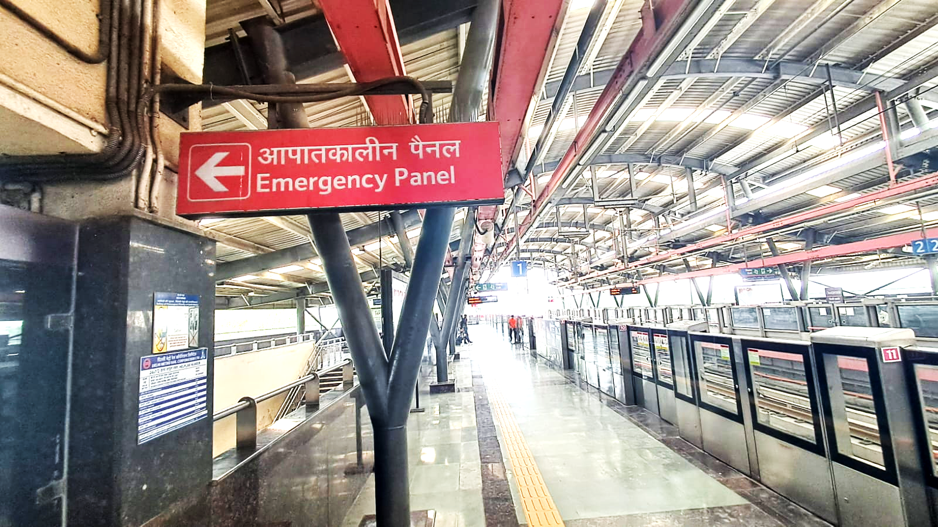
Research Domain: Inclusive and Accessible Architecture
Focus Area: Public Transport Infrastructure
18th Urban Mobility India Conference 2025, 8th Nov 2025
Assessing Accessibility and Barriers for Persons with Disabilities (PwDs) at Metro Stations: A Case Study Approach
Presented By:
Ar. Radhika G, Ar. Nandini B. Sharma, Prof. Dr. Bandana Jha
School of Planning and Architecture, New Delhi
Source: Authors filed visit Photo of Durgabai Deshmukh South Campus Metro Station

Slide 2
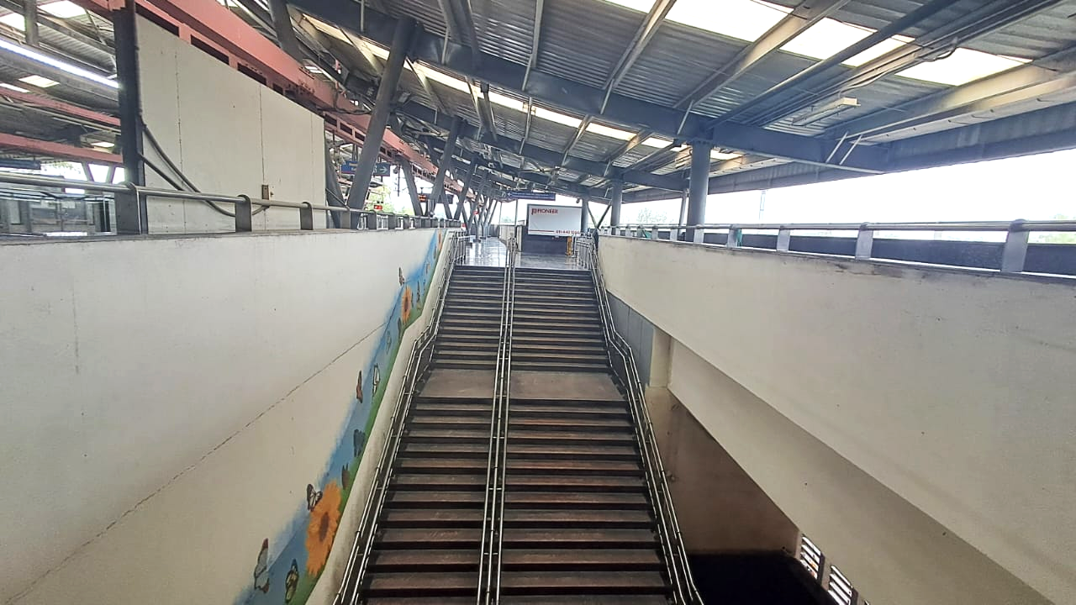
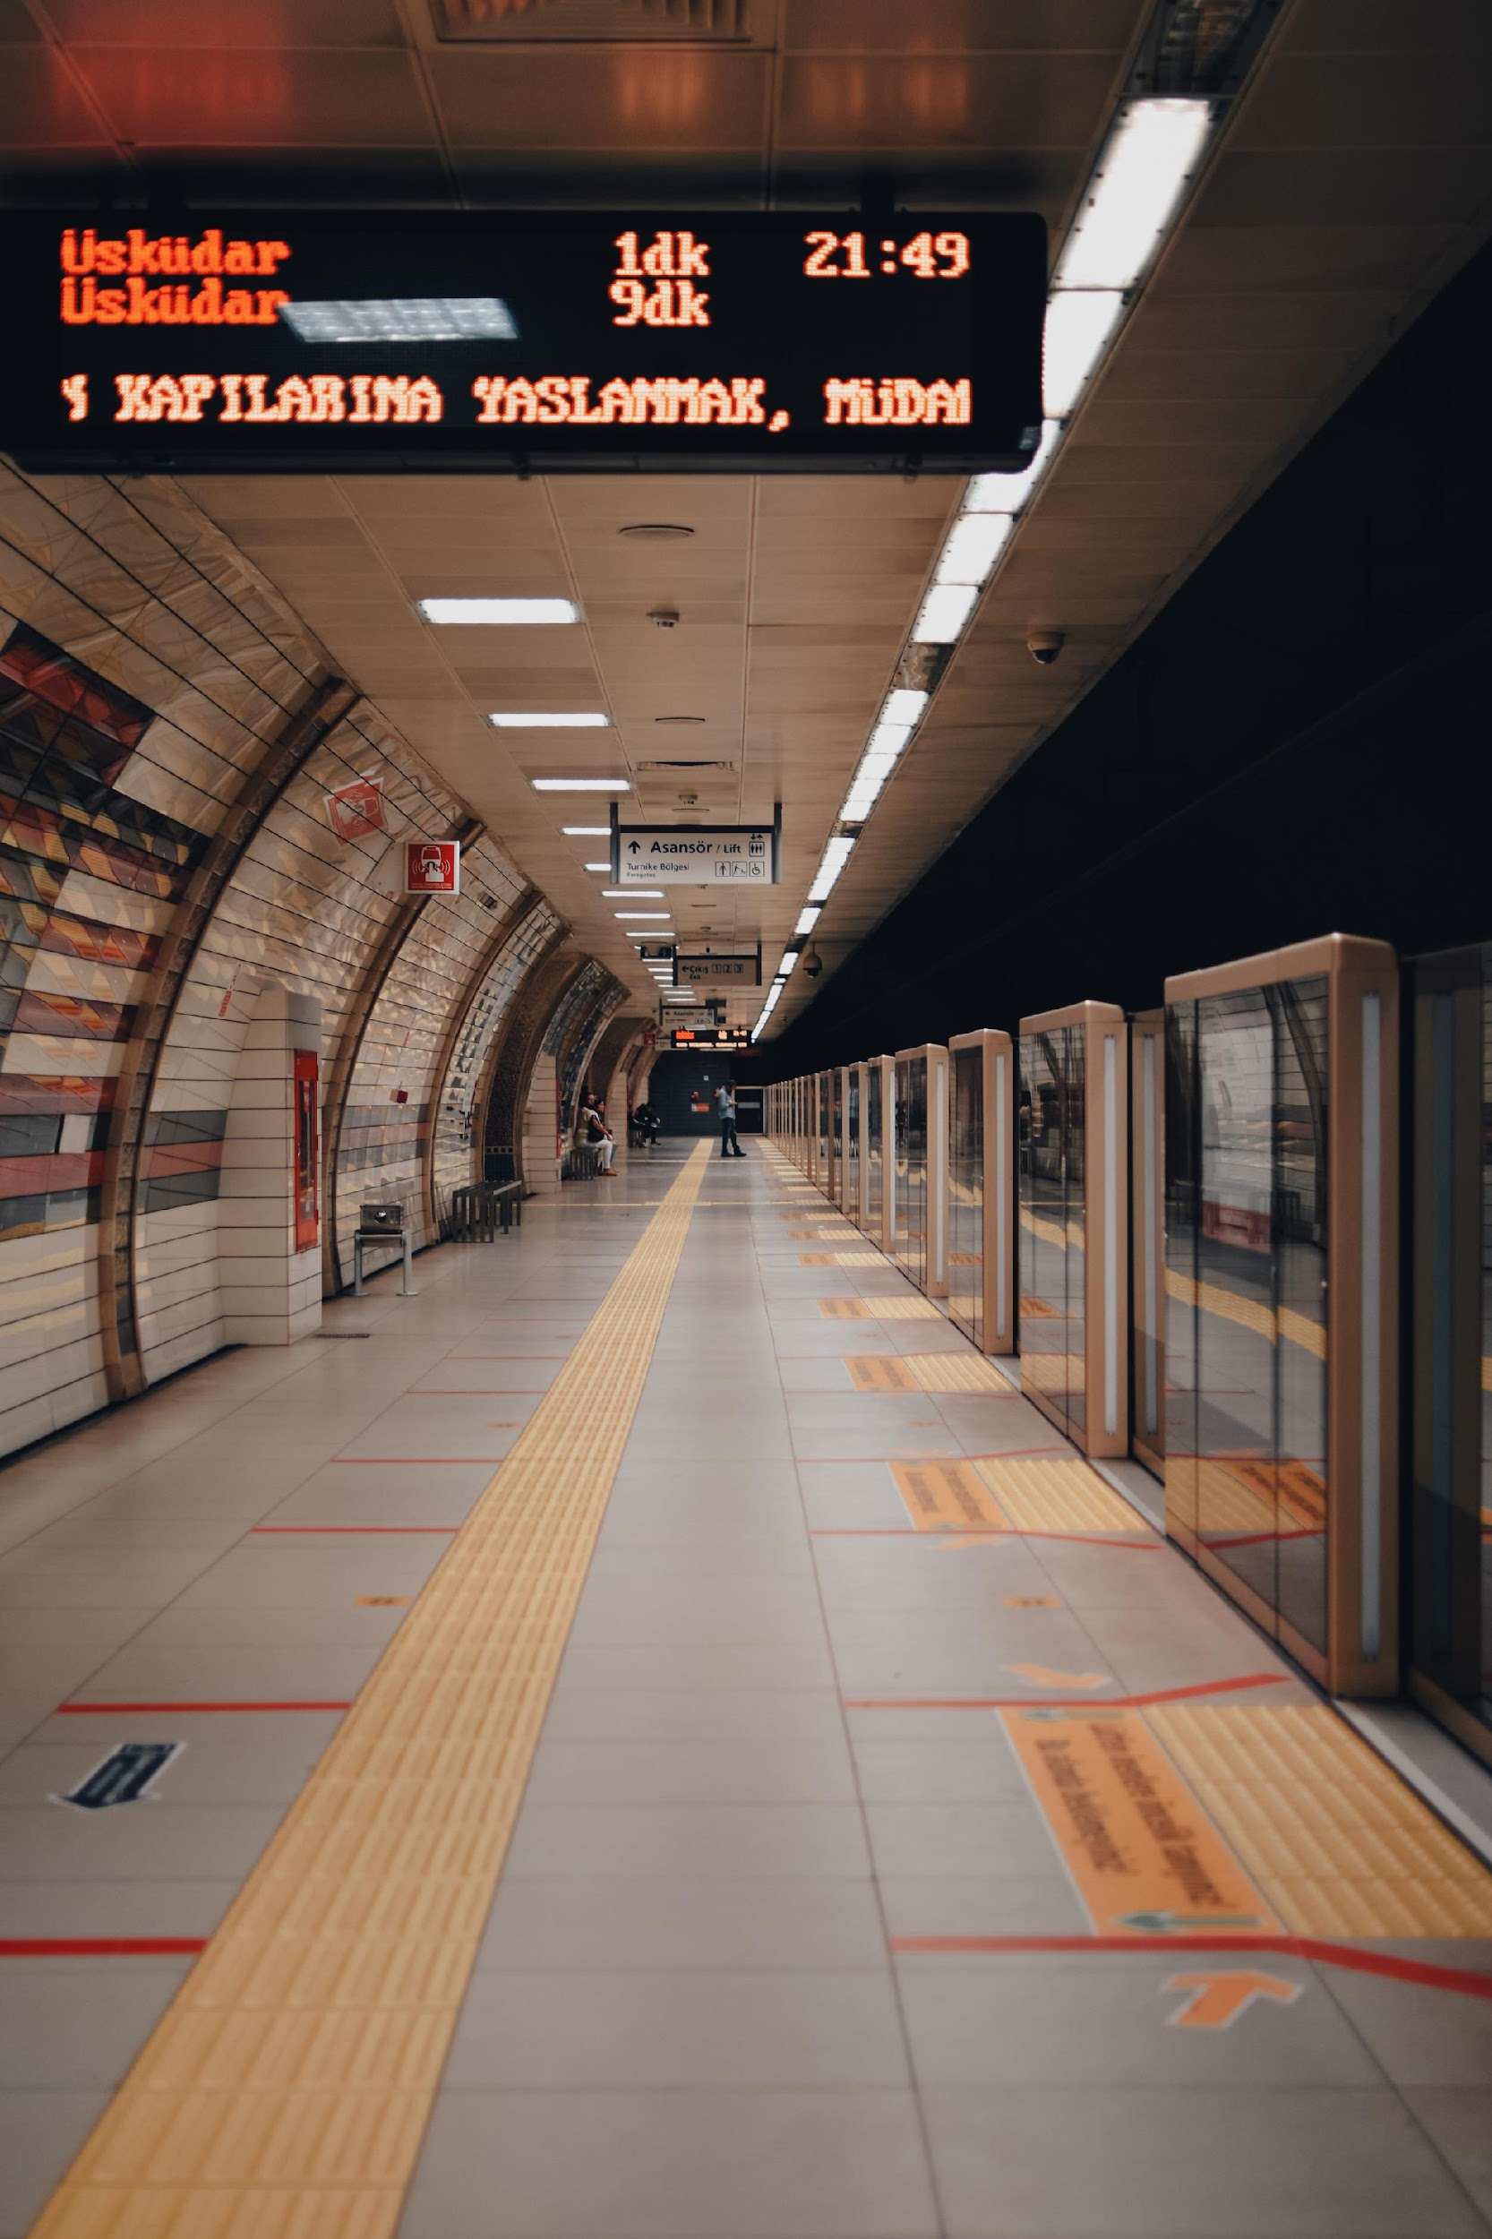
Introduction
Connecting Cities And Driving Sustainable Mobility :
The metro is often called the lifeline of a modern city. It's key to accessing education, health facilities, employment, and reducing reliance on personal vehicles. But for a significant part of Persons with diverse Disabilities (PwDs) population, Is this lifeline truly accessible? Lets understand our research study to know that.
Source: Authors filed visit Photo of a Metro Station
Problem Statement : Persons with disabilities (PwDs) often face environmental, sensory, and operational barriers. Accessibility is not just about physical ramps—it encompasses wayfinding, cognitive ease, sensory comfort, and social inclusion.

Slide 3
Phase 01
Research Background
Table : Comparison of Authors, their aim, objectives and research outcomes from the existing Literature study.
Author(s) | Aim | Objectives | Research Outcomes
Christopher (Kit) Mitchell, 2010 | To review international best practices for accessible public transportation for PwDs. | To provide a foundational framework for inclusive public transport, covering vehicle design, station infrastructure, and policy. | His work, a key resource for the United Nations Development Programme (UNDP), outlines essential elements of accessibility, emphasizing the need for comprehensive and coordinated approaches.
Ayse Nilay Evcil & S. Selhan Yalcın Usal, 2014 | To analyze the accessibility problems faced by wheelchair users in public transportation. | To conduct a case study on a metro bus system and identify specific physical barriers for wheelchair users. | They highlighted problems with physical barriers that obstruct wheelchair users, providing insights that are also relevant to metro systems. Their work emphasizes the importance of a user-centric perspective in design.
Evren Burak Enginoz & Hilal Savlı, 2016 | To examine the level of accessibility for disabled people at a specific metro station in Turkey. | To audit a metro station using an accessibility control list and gather feedback from PwDs about their travel experiences. | They found that despite existing regulations, the metro station did not reach the desired level of accessibility, particularly for visually impaired individuals. They stressed the need for better-trained professionals and increased public awareness.
Sara Rotenberg & Irfan Nooruddin, 2022 | To review the accessibility of Mumbai's transport networks and suggest improvements for the new metro construction. | To compare existing networks with global best practices and analyze how to integrate universal design into the new metro project. | They found significant inaccessibility in existing suburban rail, with fewer than 40% of stations being compliant. They concluded that the new metro should prioritize universal design, conduct consultations with PwDs, and train architects to avoid past mistakes.
Nitin Malhotra, 2023 | To analyze barriers to accessing rapid public transportation for visually impaired commuters. | To empirically study the embodied experiences of visually impaired individuals using the Delhi Metro. | The study identified subtle yet significant barriers in the Delhi Metro, such as inconsistent tactile paving and a lack of reliable auditory announcements, which hinder independent travel for the visually impaired.

Slide 4
Identified Gaps (Literature Study)
Existing research on the accessibility of metro stations for Persons with Disabilities (PwDs) has primarily focused on a few key areas, leaving several significant gaps such as :
Limited Scope of Disability: Over-reliance on studies focusing only on locomotor and visual disabilities. Need more focus on hearing and cognitive impairments.
Implementation Failure: Wide gap between Policy (RPwD Act, 2016) and Practice due to poor maintenance and inconsistent integration of infrastructure.
Non-Physical Barriers: Insufficient research on the complete user experience, including emotional, psychological, and social barriers (staff behavior). (lack of evidence based study)
Limited Comparative study : Lack of comparative studies across different metropolitan areas to analyse varying social, cultural and environmental influences. Instead one city related research study found.

Slide 5
Research Objectives
To identify and document accessibility features provided at metro stations.
To evaluate the usability and effectiveness of these features from the perspective of PwDs.
To categorize types of barriers (physical, sensory, cognitive, social).
To assess compliance with National Building Code (NBC 2016, Part 3) and Harmonised Guidelines 2021.
To suggest design interventions and policy recommendations for improving accessibility.
Research Questions
How accessible are metro stations catering person with diverse disabilities groups (mobility, visual, auditory, cognitive etc)?
What are the key barriers experienced in navigating stations?
Do the existing accessibility provisions align with universal design principles?
How can design modifications enhance independent mobility and dignity for all users?

Slide 6

5 Key Gaps identified in India’s current Accessibility Scenario
♿Expanded Recognition of Disabilities : There is a shift from the Persons with Disabilities Act, 1995 (which recognized 7 disabilities) to the Rights of Persons with Disabilities (RPwD) Act, 2016 (recognizing 21 categories of specified disabilities).
📊2011 census baseline: Recorded 2.68 crore PwDs (or 2.21% of the total population), conflicting with WHO estimates as 15%+. Also disability Categories officially enumerated only 8 categories of disability (In Seeing (Visual), In Hearing, In Speech, In Movement (Locomotor), Mental Retardation (now Intellectual Disability), Mental Illness, Any Other, Multiple Disability), This narrow list failed to capture most of the disabilities later recognized by the RPwD Act, 2016, such as Autism Spectrum Disorder, Specific Learning Disabilities, and Chronic Neurological Conditions.
🏛️Rajive Raturi SC Judgment (Nov 8, 2024) - The Supreme Court declared the recommendatory nature of existing accessibility guidelines (under RPwD Rule 15) as ultra vires (beyond the powers) of the RPwD Act, 2016. Directed the Central Government to formulate mandatory, non-negotiable rules for accessibility within three months (by early 2025). This moves accessibility from a "request" to a legally enforceable "right" with clear consequences for non-compliance.
Harmonized Guidelines & National Building Code (NBC) : The Harmonised Guidelines and Standards for Universal Accessibility in India, 2021 are the current framework, replacing the 2016 version. However, the SC judgment necessitates their ratification (or partial repeal/amendment) to officially convert persuasive sections into mandatory, enforceable rules. The Supreme Court's direction ensures that these non-negotiable accessibility standards will be legally incorporated into the National Building Code (NBC) 2016 and its subsequent revisions. No building plan can be sanctioned, and no completion certificate issued, if the plan does not adhere to the forthcoming mandatory rules.

Slide 7
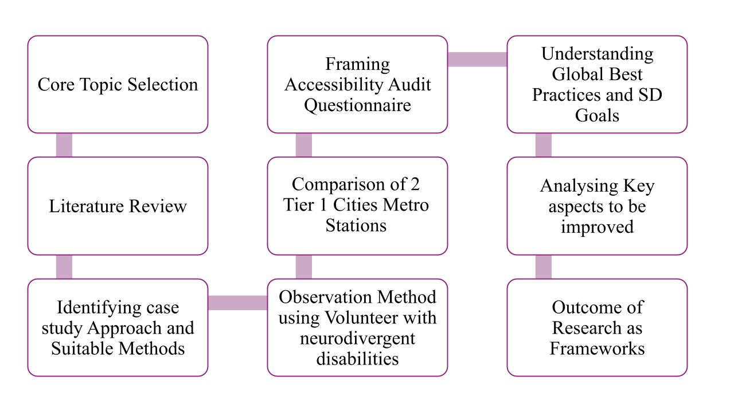
Methodology ( 3 Phases of assessments)
Approach: Case Study-based Qualitative (more focused) and Quantitative Assessment (future scope of study.
Phase 01
Phase 02
Phase 03
Methodology flowchart

Slide 8
Phase 02
Selection Criteria for Metro Stations
City | Station | Category / Context
Chennai | Airport Metro | Transport Hub
 | Little Mount | Residential/Commercial
Delhi | Delhi Cantt | Special School & Hospital
 | Durgabai Deshmukh South Campus | Office/Institutional
Tools Used
Audit Checklist
Observation
Matrix
User feedback
Survey
Based on Harmonised Guidelines (2021) and Universal Design Principles.
Recorded movement, comfort, waiting time, and independence.
Collected responses from diverse PwDs (visual, mobility, hearing, cognitive).
Limitations:
Future research phases will specifically examine high-congestion accessibility using the baseline
findings as comparative framework.
Photographic
documentation
Accessibility Scale
To visually map barrier points and good practices.
Scoring each parameter on a -point accessibility scale.

Slide 9

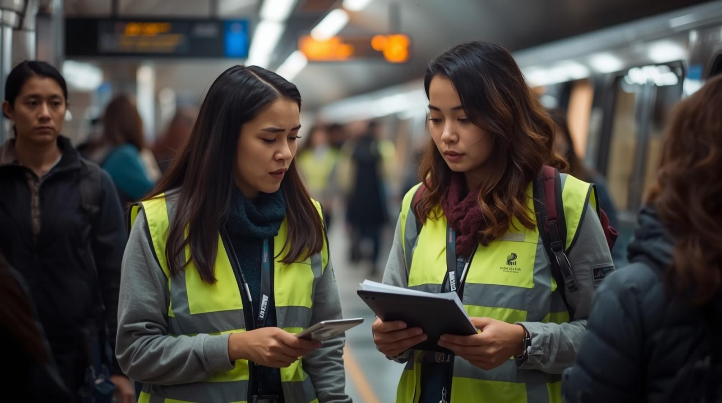
Phase 02
Parameters of Assessments
Audit Checklist (Researchers)
Physical Accessibility
Ramps, elevators, tactile flooring, handrails, seating zones.
Sensory Accessibility
Lighting uniformity, acoustic comfort, tactile & auditory cues.
Wayfinding and Communication
Signage visibility, contrast, language, Braille integration, PA systems.
Cognitive and Behavioural ease
Clarity of layout, predictability, assistance availability
Source: created using canvatool ai by author depicting 2 researchers auditing Metro Stations
Social and Safety aspects
Staff responsiveness, emergency procedures, sense of inclusion.
Data Analysis: Compliance scoring, barrier mapping, and experiential feedback synthesis.

Slide 10
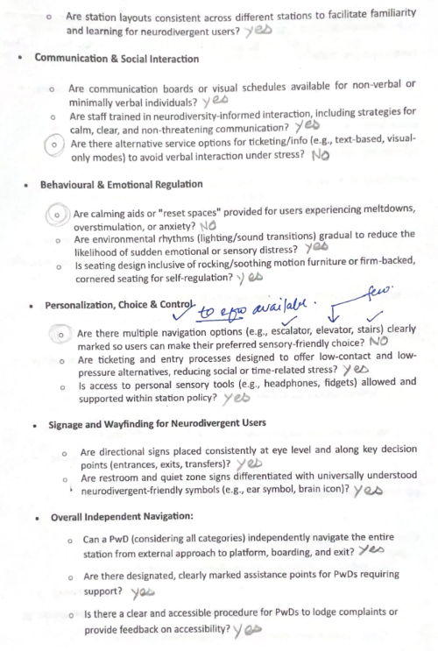
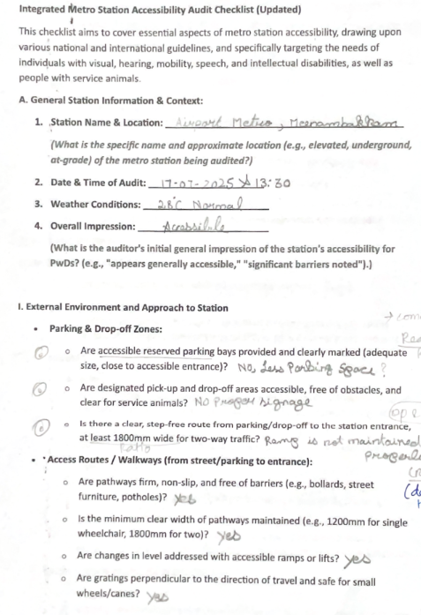
Phase 02
Metro station audit checklist Sample
Physical Accessibility
Source: Authors prepared questionnaire by analysing parameters from literature, existing national and international guidelines and best practices

Slide 11
Phase 03
Design needs of autistic and intellectually disabled individuals (Literature study)
Navigating public transportation presents unique obstacles for people with invisible disabilities, especially those with Intellectual Disability (ID) and Autism Spectrum Disorder (ASD).
These conditions involve sensory sensitivities, cognitive processing differences, and communication difficulties, yet they go unnoticed in metro accessibility planning
(Baric et al., 2024; Hall, 2016).
MacLennan et al. (2021) and Marco et al. (2011) note the absence of quiet zones as a barrier to emotional regulation.
Participatory and co-designed methods with neurodivergent travellers reveal that small-scale, targeted samples can effectively improvements in sensory adjustments.
Loud announcements, flickering lights, and crowded areas can trigger sensory overload in autistic individuals, and the lack of quiet zones can hinder emotional regulation.
Signage is often text-heavy and lacks pictograms, and staff training to assist neurodivergent commuters is often insufficient.
Current metro infrastructure often fails to incorporate universal design principles that
consider sensory differences.

Slide 12
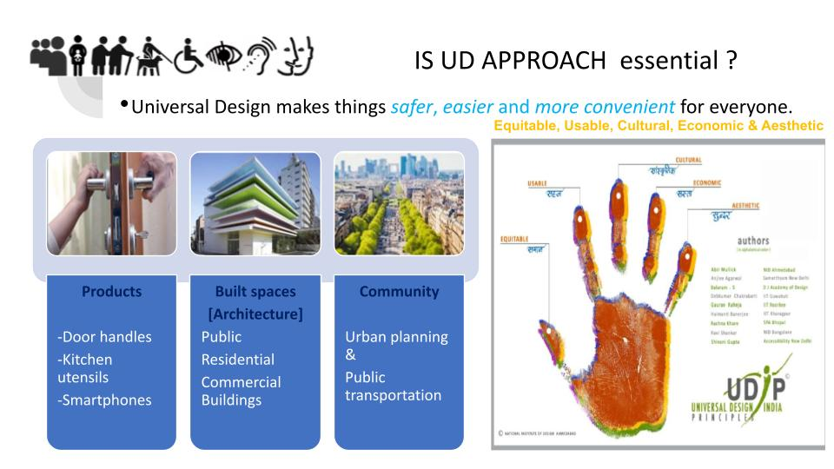
Ronald Mace: The American architect and product designer who coined and popularized the term "Universal Design“. The Working group that developed the Seven Principles of Universal Design (1997)
# Difference between Negotiable and Nonnegotiable standards:
Non-negotiable: Fixed requirements like safety standards.
Negotiable: Features customizable based on user preferences.

Slide 13
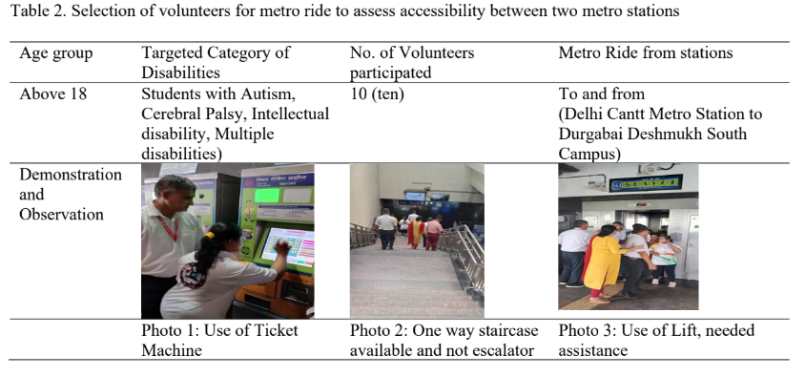
Phase 03
Pilot Testing : (Volunteers)
Neurodivergent Advisors
Onsite Demonstrations
Assisted along with volunteers who helped authors to navigate and showcase the task
Orientation to goals, station layout overview with pictorial mapping of different zones (accessibility, safety etc)
Observations of Volunteers
Participant self ratings
Aided by visual documentation, which included images, observational notes
Data was captured in the form of time-stamped observer notes,
Source: Authors filed visit Photo of a Metro Station

Slide 14
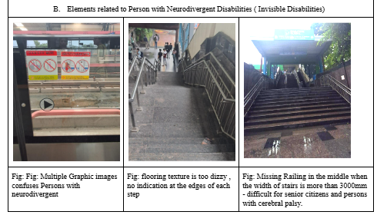
Durgabai Deshmukh South Campus, Delhi
Source: Authors filed visit Photo of Durgabai Deshmukh South Campus Metro Station

Slide 15
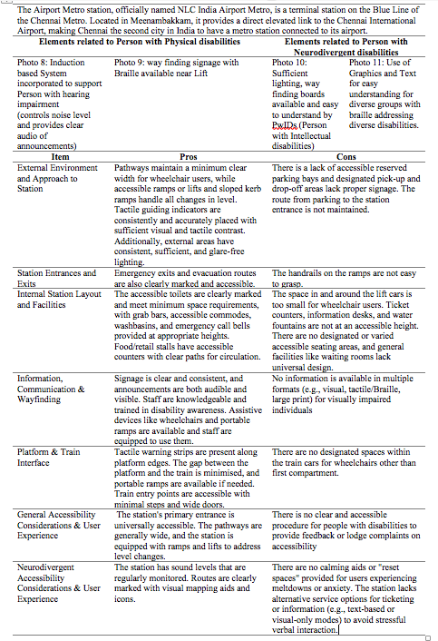
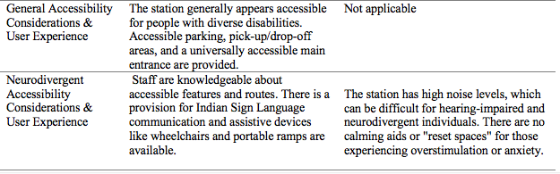
Chennai Metro Stations : Findings of Invisible Disabilities
The Chennai Airport
Pros
Cons
The Little Mount
Pros
Cons

Slide 16
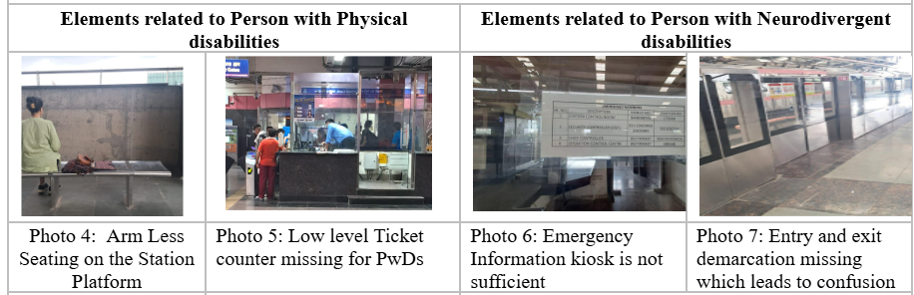
Phase 02
D1
Delhi Cantt. Metro Station – Key Findings
The Delhi Cantt Metro Station is located on the Pink Line and is an elevated station near Brar Square and the Delhi Cantonment Railway Station. The surrounding area is primarily a serene and green military cantonment. The station is a key transit point connecting to various parts of Delhi and is approximately 2.4 km from the main Delhi Cantonment area.
Source: Authors filed visit Photo of a Delhi Cantt Metro Station, Use of Photography documentation tool

Slide 17
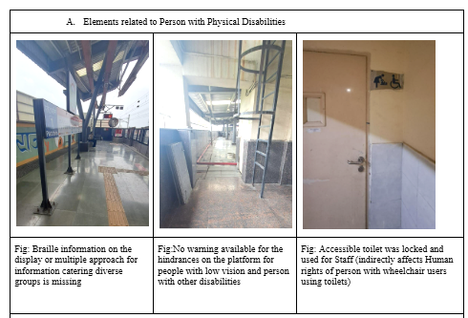
Phase 02
D2
Durgabai Deshmukh South Campus :
The Durgabai Deshmukh South Campus Metro Station is an elevated station on the Pink Line of the Delhi Metro. The station is located near the South Campus of the University of Delhi, specifically close to Sri Venkateswara College.
Source: Authors filed visit Photo of Durgabai Deshmukh South Campus Metro Station

Slide 18
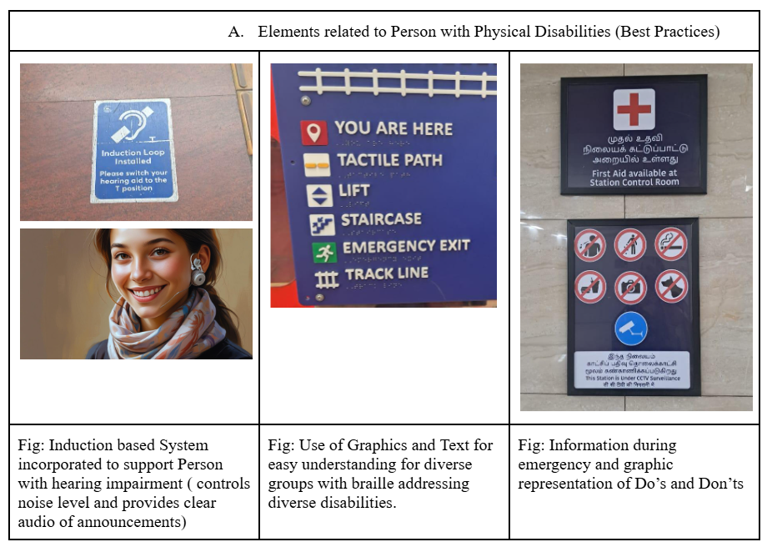
Phase 02
C1
Chennai Airport Metro Station:
The Airport Metro station, officially named NLC India Airport Metro, is a terminal station on the Blue Line of the Chennai Metro. Located in Meenambakkam, it provides a direct elevated link to the Chennai International Airport, making Chennai the second city in India to have a metro station connected to its airport.
Source: Authors filed visit Photo of Chennai NLC India Airport Metro Station

Slide 20
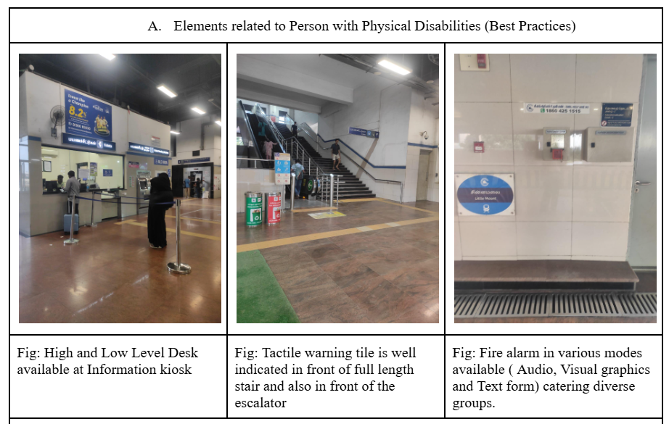
Phase 02
C2
The Little Mount : Site Overview and Key Findings
The Little Mount Metro Station is an elevated station on the Blue Line of the Chennai Metro. Opened in September 2016, it serves the neighbourhoods of Guindy and Saidapet. It serves as a transport hub that connects different types of areas, including residential neighbourhoods, educational institutions like Anna University, and commercial areas with offices and hotels.
Source: Authors filed visit Photo of Little Mount Metro Station

Slide 21
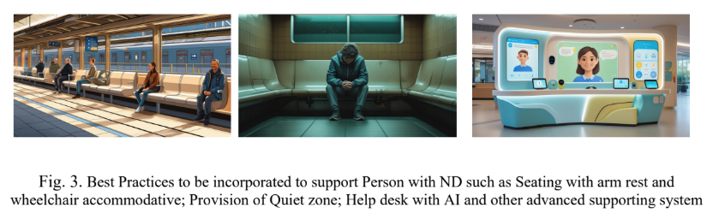
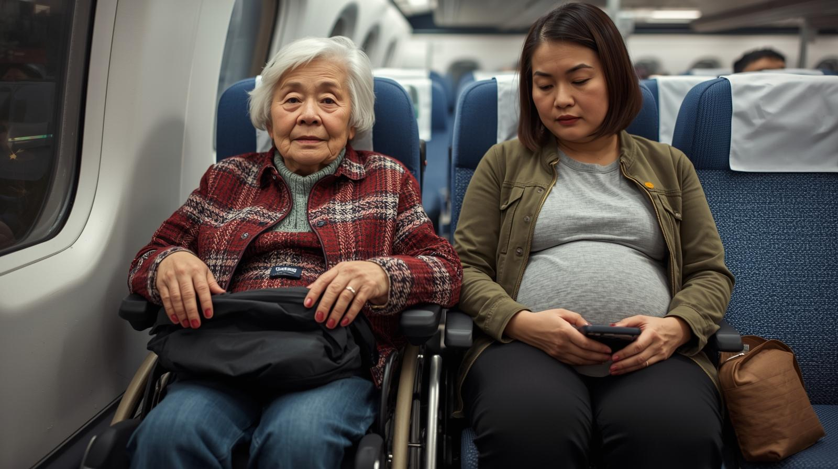
Comparative Analysis (Delhi vs. Chennai) & Best Practices
Comparative audits reveal both progress and deficiencies.
Parameter | Delhi | Chennai
Physical Accessibility | Moderate | Better
Signage & Wayfinding | Poor | Fair
Communication Systems | Weak | Good
Sensory Environment | Overstimulating | Partly Controlled
Neurodivergent Inclusion | Absent | Minimal
Source: AI Image created by Authors using Canva tool to propose a solution

Slide 22
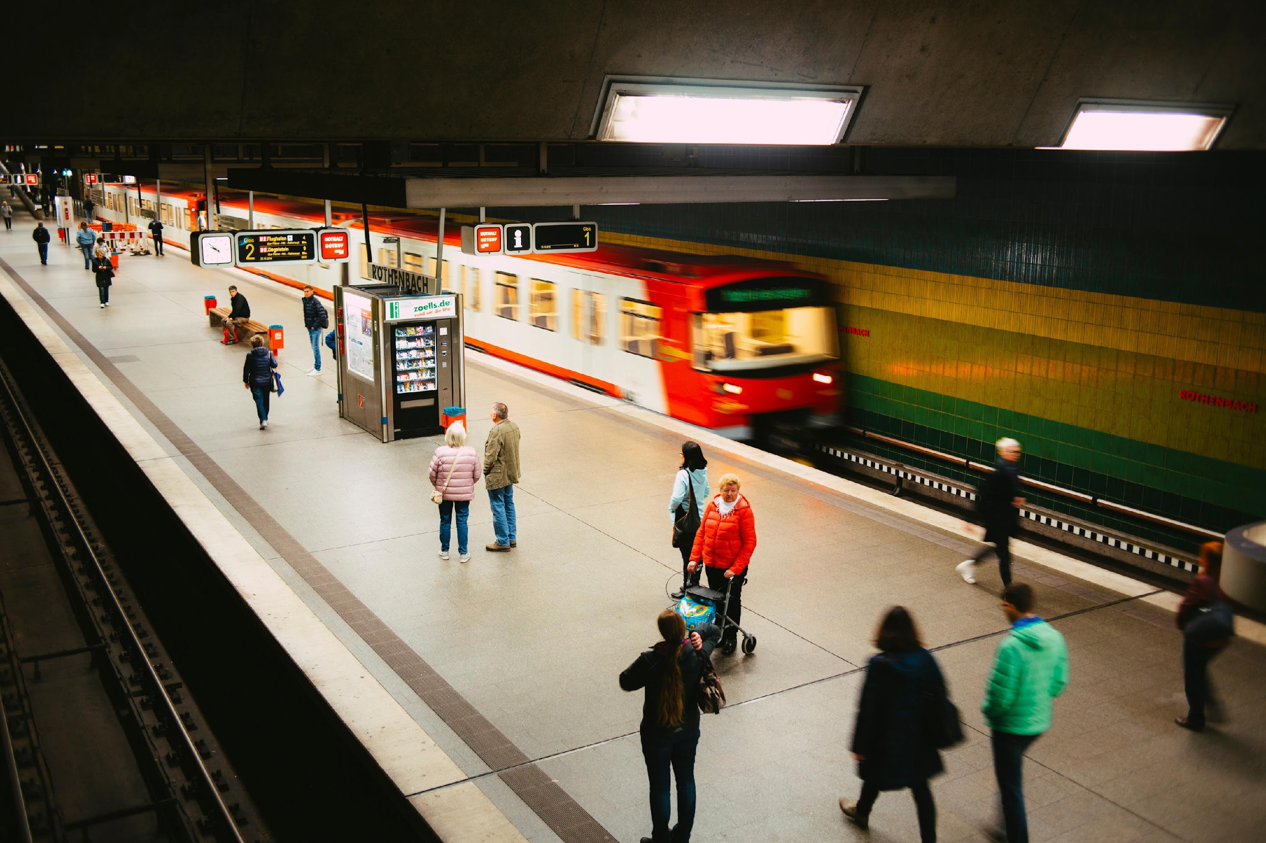
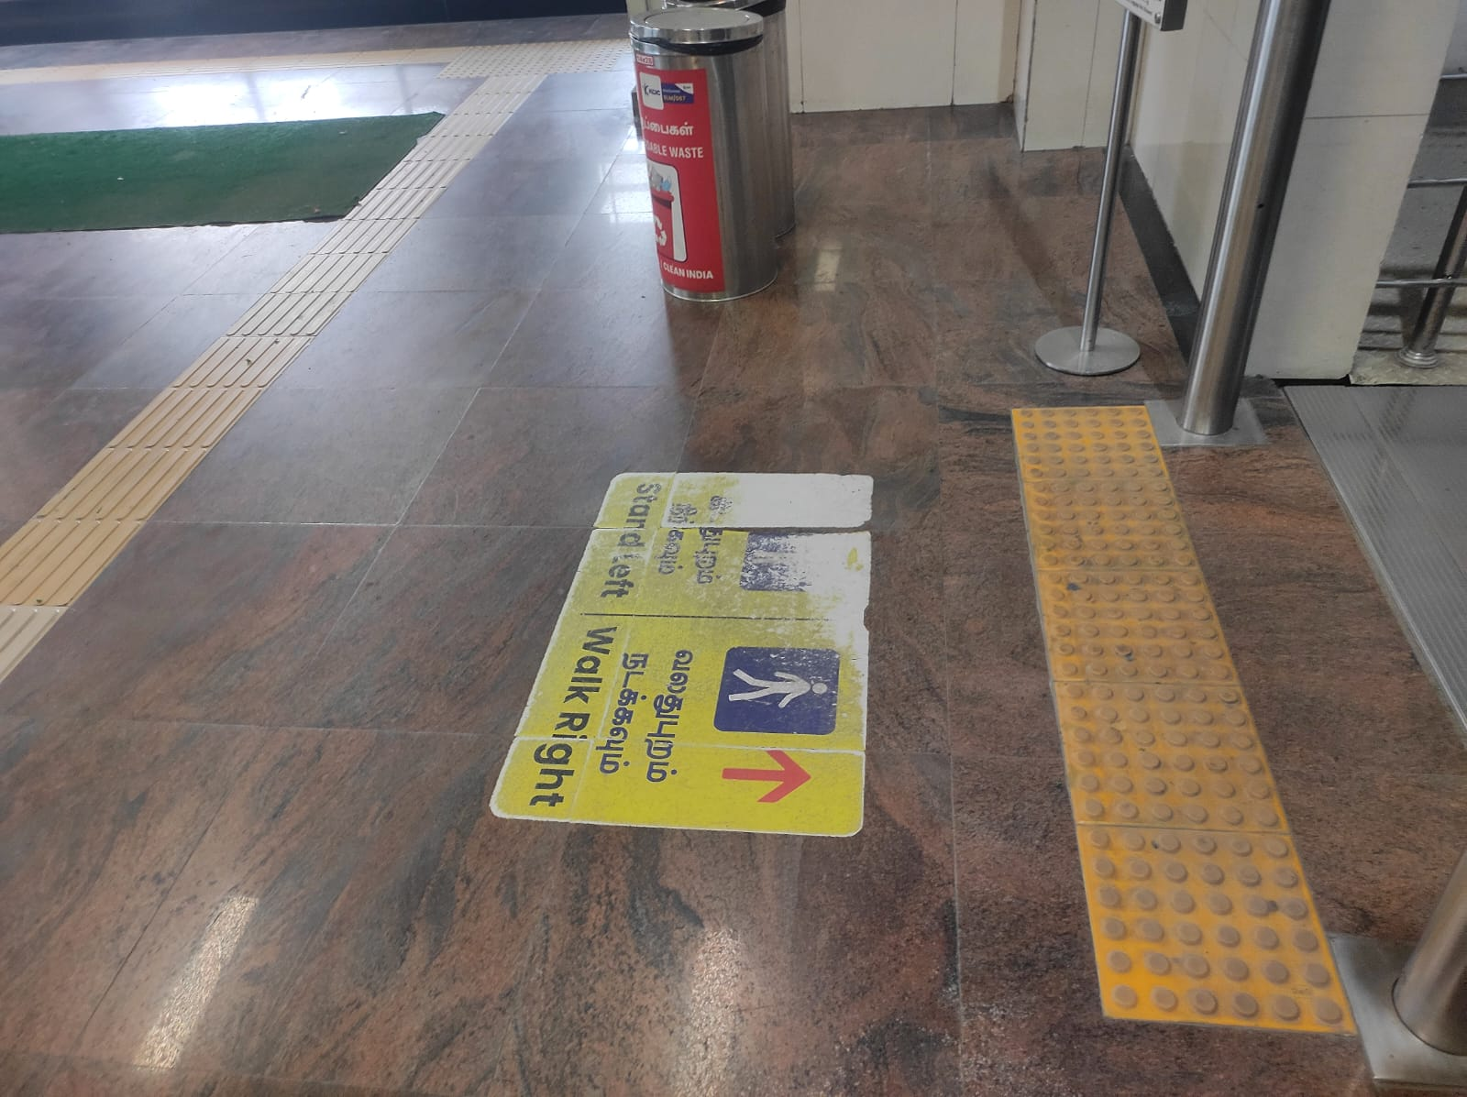
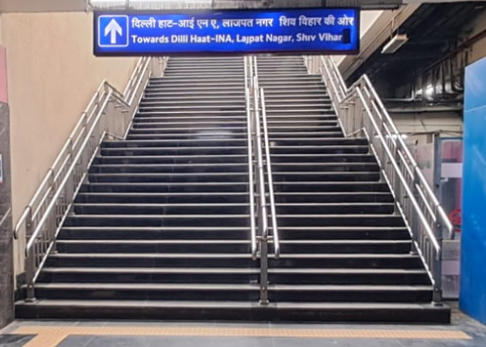
Key Conclusions
Chennai
Persistent accessibility gaps remain across India’s metro systems despite national policies and the presence of Harmonised Guidelines (2021) and NBC 2016.
# Delhi Metro (Pioneer in Metro Accessibility) : Established the foundational infrastructure for inclusion in the Indian metro landscape continues to face challenges with step-free pathways, inconsistent signage, and unsafe platform–train interfaces.
# Chennai Metro shows stronger compliance — tactile signage, accessible ticket counters.
However in both the stations, beyond physical accessibility , there is a need and mandatory to include sensory, cognitive, and neurodivergent dimensions, which are often neglected in practice.
Delhi
Source: Authors filed visit Photos of Metro Stations

Slide 23
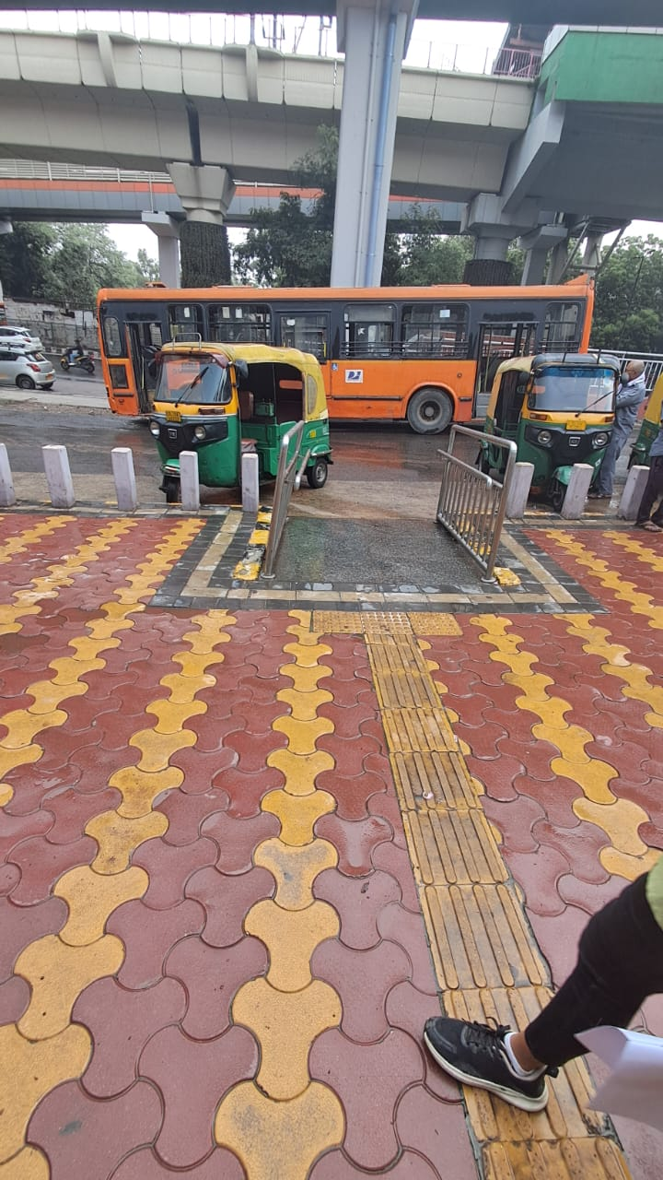
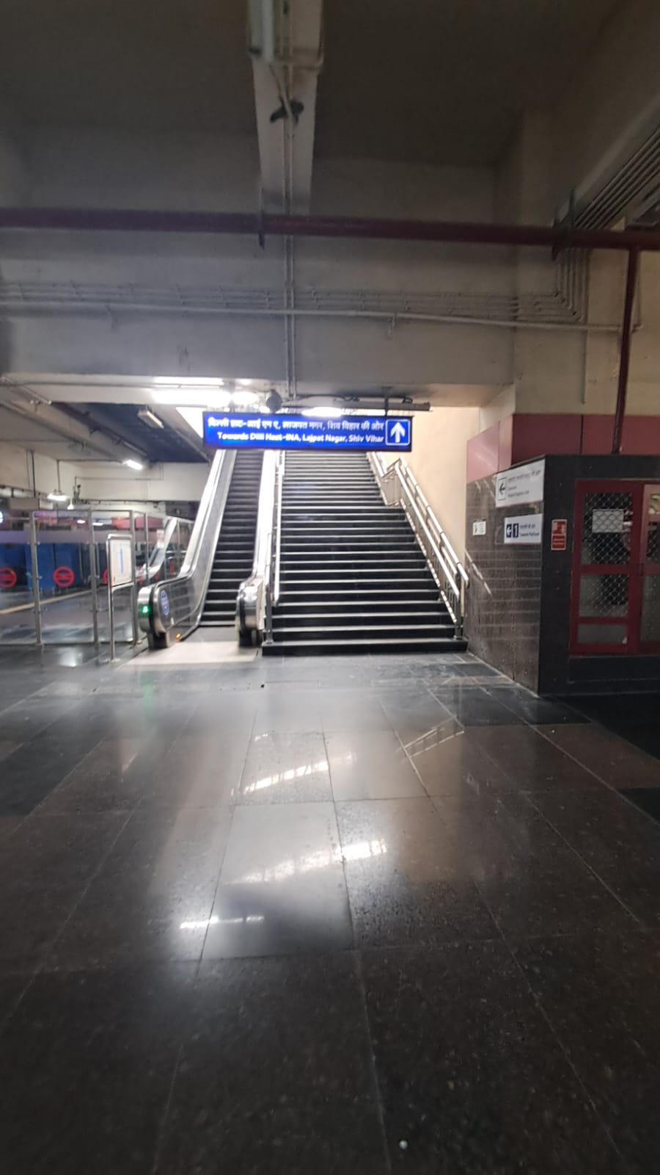
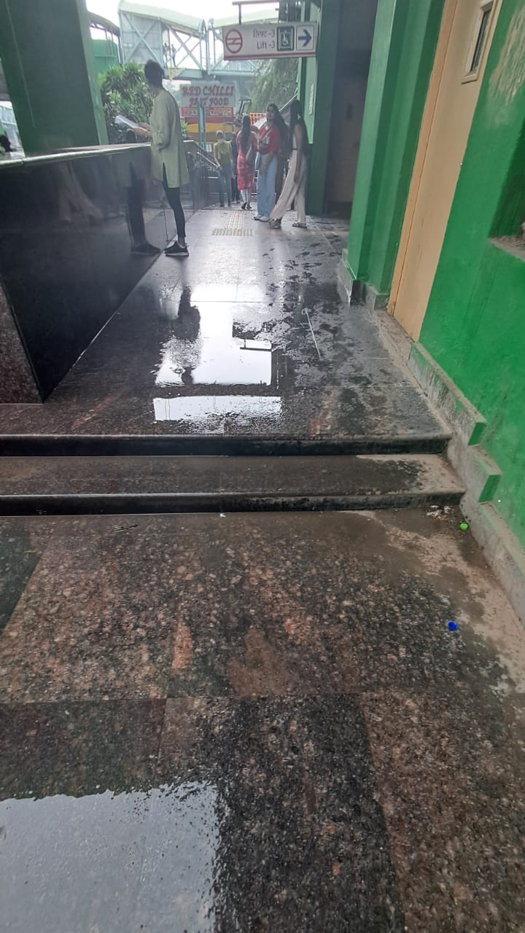
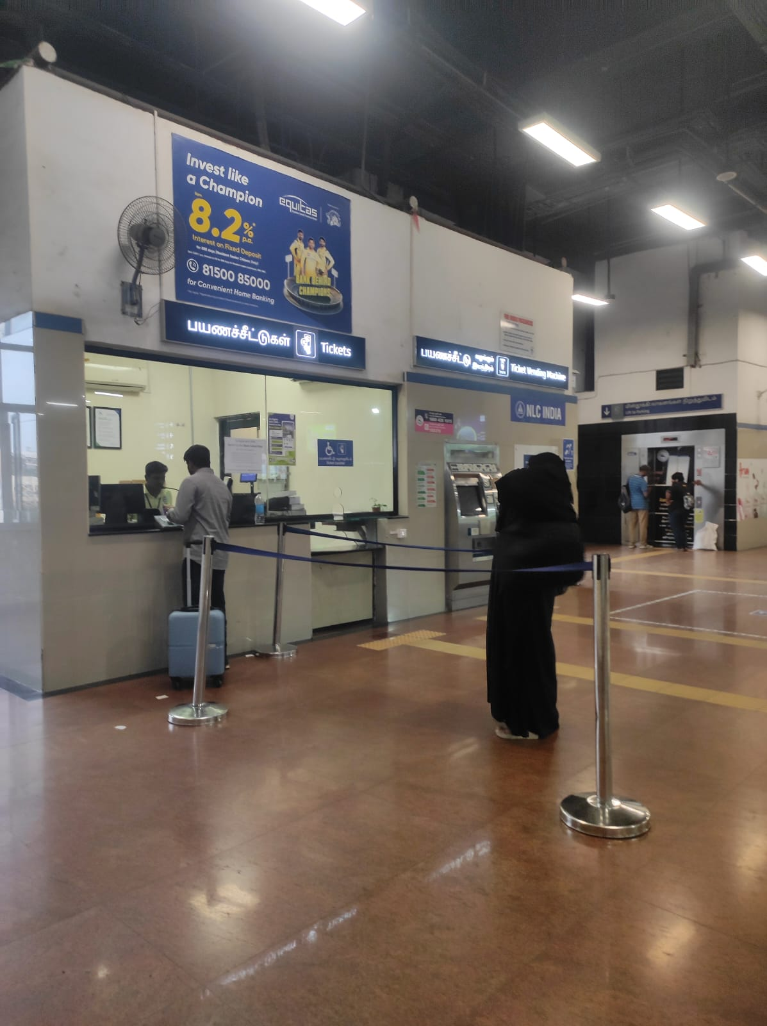
Recommendations
Provide accessible drop-off zones and step-free, continuous pathways with tactile guiding surfaces.
Ensure ramps, doors, and entrances follow universal design standards with proper slopes and handrails.
Use non-slip flooring and maintain consistent tactile paths across all circulation areas.
Install ticket counters, vending machines, and water points at dual heights for wheelchair accessibility.
Include designated seating with armrests and supportive options at platforms and waiting zones.
Equip lifts and staircases with Braille buttons, audible floor indicators, continuous handrails, and warning tiles.
Introduce quiet zones, color-coded signage, and controlled lighting and acoustics for neurodiverse users.
Establish a formal feedback mechanism to collect user inputs and accessibility concerns.
Provide staff training on disability and neurodiversity awareness to ensure inclusive service delivery.
Source: Authors filed visit Photos of Metro Stations

Slide 24
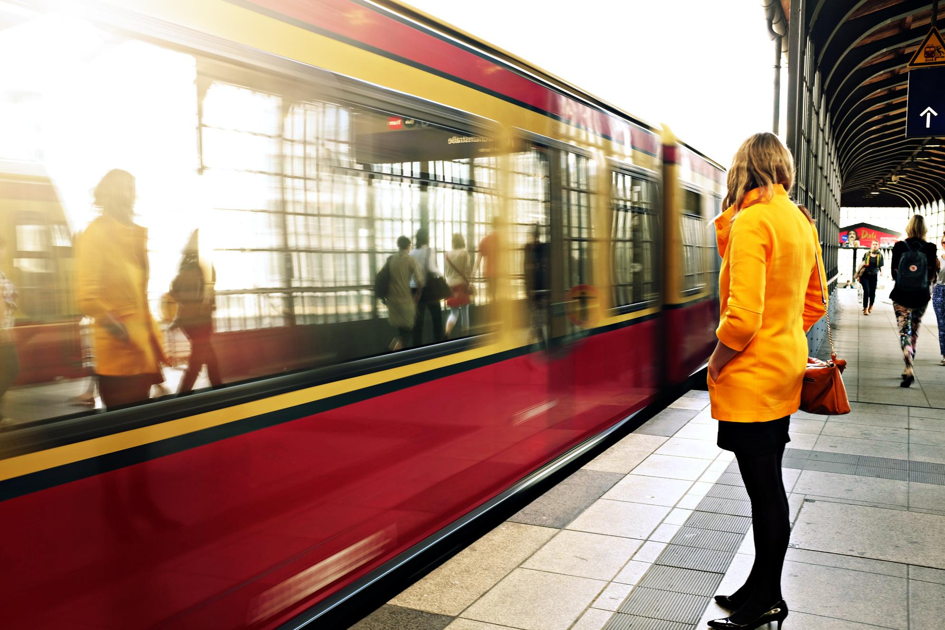
Discussion and Implications :
Accessibility extends beyond ramps & lifts — includes sensory, emotional, cognitive dimensions.
Lack of neurodivergent-friendly design leads to anxiety & dependence.
Framework must integrate universal design and sensory design principles.
Findings call for policy enforcement, training, and participatory audits.
Source: Internet for reference

Slide 25
References
Baric, V. B., Ranada, Å. L., & Berg, J. (2024). The whole journey chain with public transport for people with
autism spectrum disorder and attention deficit hyperactivity disorder – a scoping review. Transport Reviews,
44(6), 1136–1160.
Bezyak, J. L., Sabella, S., Hammel, J., McDonald, K., Jones, R. A., & Barton, D. (2019). Community participation and public transportation barriers experienced by people with disabilities. Disability and Rehabilitation, 42(23), 3275–3283.
Census of India. (2011). Disabled Population in India. Retrieved from http://censusindia.gov.in/2011census/dchb/DCHB_A/07/0708_PART_A_DCHB_AMBALA.pdf
Deka, D., Feeley, C., & Lubin, A. (2016). Travel Patterns, Needs, and Barriers of Adults with Autism Spectrum Disorder. Transportation Research Record Journal of the Transportation Research Board, 2542(1), 9–16.
Enginöz, E. B., & Şavlı, H. (2016). Examination of accessibility for disabled people at metro stations. ICONARP International Journal of Architecture and Planning, 4(1), 34–48.
Evcil, A. N., & Yalçın Usal, S. (2014). Wheelchair Users' Accessibility Problems in Public Transportation-Case of Metro Bus. Iconar International Journal of Architecture and Planning, 2(1), 70-81.
Falkmer, M., Barnett, T., Horlin, C., Falkmer, O., Siljehav, J., Fristedt, S., Lee, H. C., Chee, D. Y., Wretstrand, A., & Falkmer, T. (2015). Viewpoints of adults with and without Autism Spectrum Disorders on public transport. Transportation Research Part A Policy and Practice, 80, 163–183.
Finnigan, K. A. (2024). Sensory Responsive Environments: A Qualitative Study on Perceived Relationships between Outdoor Built Environments and Sensory Sensitivities. Land, 13(5), 636.
Hall, S. A. (2016). Community Involvement of Young Adults with Intellectual Disabilities: Their Experiences and Perspectives on Inclusion. Journal of Applied Research in Intellectual Disabilities, 30(5), 859–871.

Slide 26
Kawathekar, K., Bahadure, P., & Bakde, V. (2024). Literature Review on Metro Public Transport Accessibility Optimization by Walking, Cycling and using Non-motorized Vehicles in Indian Cities. Library Progress International, 44(3).
MacLennan, K., O’Brien, S., & Tavassoli, T. (2021). In our own words: the complex sensory experiences of autistic adults. Journal of Autism and Developmental Disorders, 52(7), 3061–3075.
Malhotra, N. (2023). "Deconstructing Barriers to Access Rapid Public Transportation for Commuters with Visual Impairment: A Study of Embodied Experiences in Delhi Metro-Train." Journal of Namibian Studies, 38(S1), 434-448.
Mandhani, J., Nayak, J. K., & Parida, M. (2023). Should I travel by Metro? Analyzing the service quality perception of elderly and physically disabled passengers in Delhi, India. Transportation Research Record Journal of the Transportation Research Board, 2677(9), 265–278.
Marco, E. J., Hinkley, L. B., Hill, S. S., & Nagarajan, S. S. (2011). Sensory Processing in Autism: A review of Neurophysiologic Findings. Pediatric Research, 69(5 Part 2), 48R-54R.
Mitchell, C. (2010). "A Review of International Best Practice in Accessible Public Transportation for Persons with Disabilities." United Nations Development Programme (UNDP).
Mostafa, M. (2008). AN ARCHITECTURE FOR AUTISM: CONCEPTS OF DESIGN INTERVENTION FOR THE AUTISTIC USER. International Journal of Architectural Research: Archnet-IJAR, 2(1)189–211.
Mwaka, C. R., Best, K. L., Cunningham, C., Gagnon, M., & Routhier, F. (2024). Barriers and facilitators of public transport use among people with disabilities: a scoping review. Frontiers in Rehabilitation Sciences
Rapp, A., Cena, F., Castaldo, R., Keller, R., & Tirassa, M. (2018). Designing technology for spatial needs: Routines, control and social competences of people with autism. International Journal of Human-Computer Studies, 120, 49–65.
Rotenberg, S. & Nooruddin, I. (2022). "Getting on Track: Accessibility Policy and the Design of the Mumbai Metro." The Journal of Public Space, 7(2), 29-40. DOI: 10.32891/jps.v7i2.1482.
The Gazette of India. (2016). The Rights of Persons with Disabilities Act, 2016.
United Nations. (2006). Convention on the Rights of Persons with Disabilities.
World Health Organization and World Bank. (2011). World Report on Disability.

Slide 27
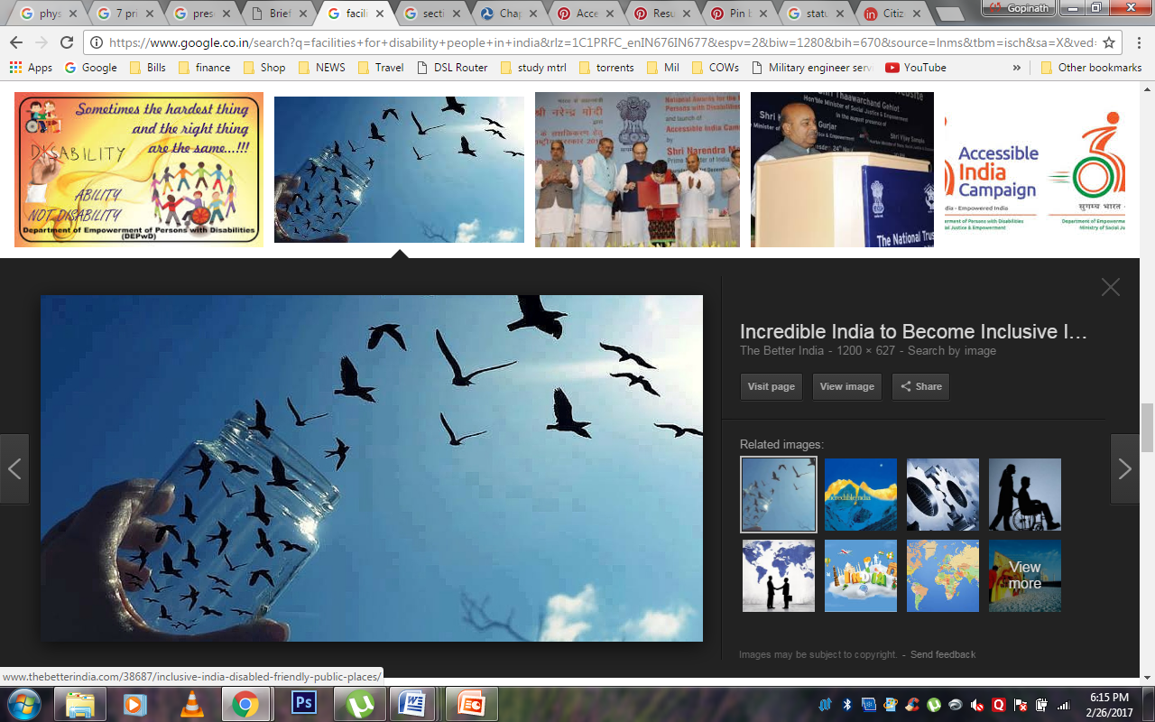




Thank you so much !
+91 8396018019
School of Planning and Architecture, New Delhi
radhika.phd383arch24@spa.ac.in
+91 9650535343
School of Planning and Architecture, New Delhi
nandini.phd295arch22@spa.ac.in
+91 9999497574
School of Planning and Architecture, New Delhi
bandana.jha@spa.ac.in

