Slide 1
Future Cities & Innovative Mobility Solutions
Puneet Srivastava
Managing Director – Signalling
and Infrastructure at Alstom India

Slide 2
Agenda
Demand for Mobility & Challenges
Opportunities across Rail Operator value chain
Digital Solutions for key segments of value chain
AI enabling the future state of Digital Solutions

Slide 3
01
Demand for Mobility & Challenges

Slide 4
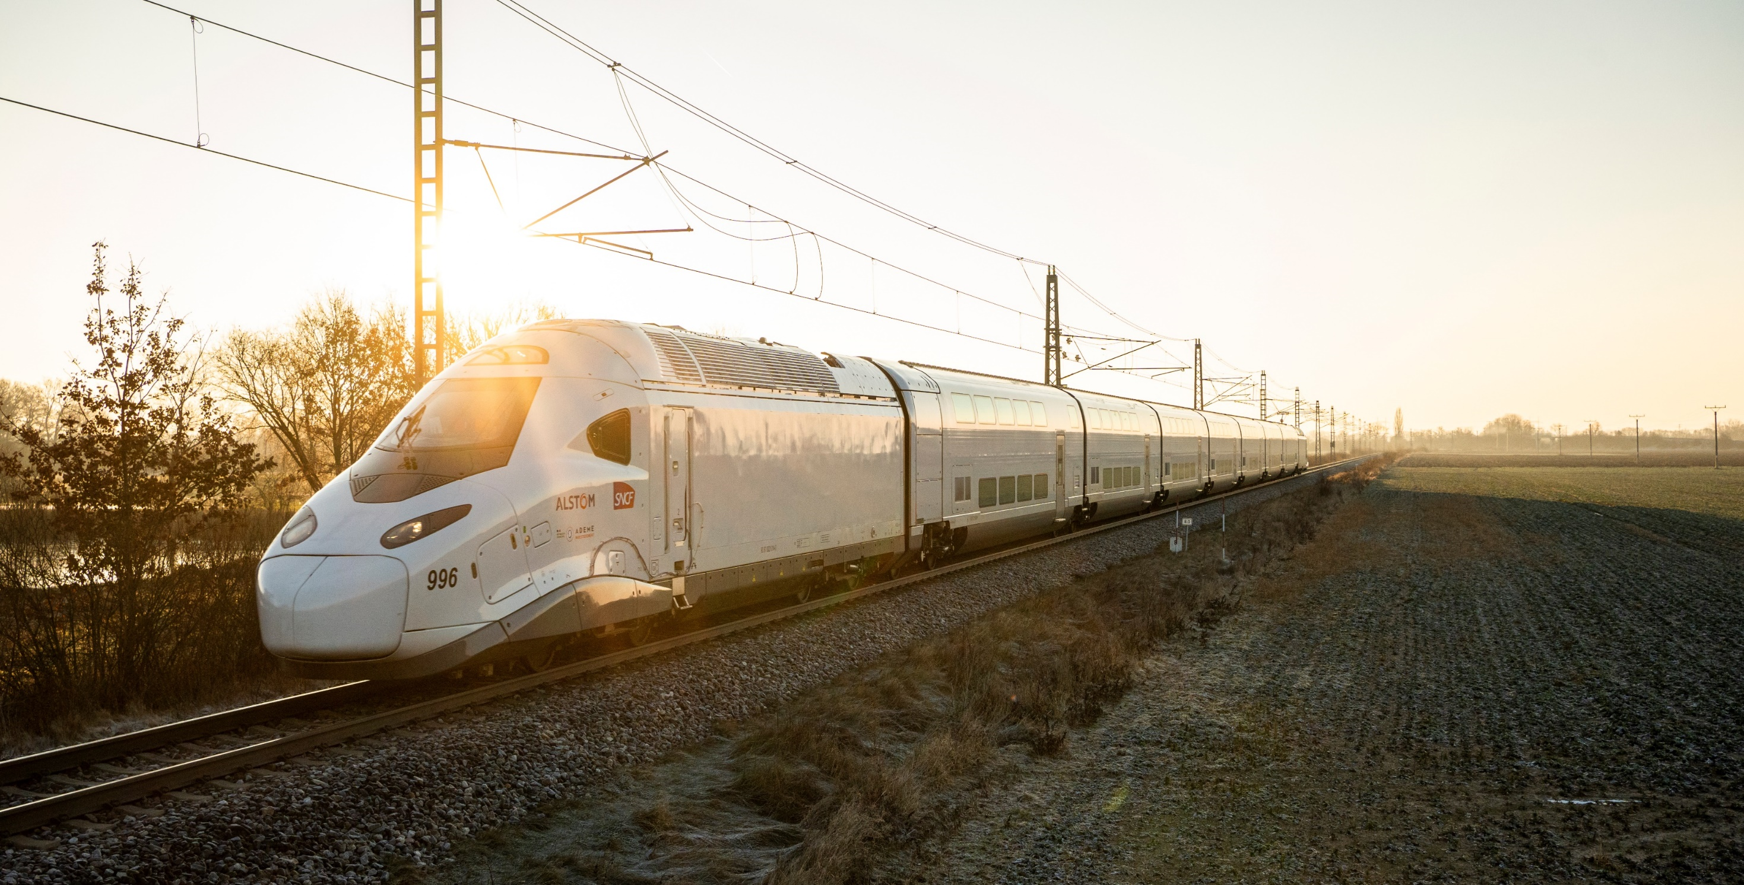




Rail demand growing 2X by 2050
+ 75% of the world’s population live in cities
Paradigm shift – regulatory standardisation, prices pressure & climate change
Global demand for Mobility is growing & evolving in a challenging context

Slide 5
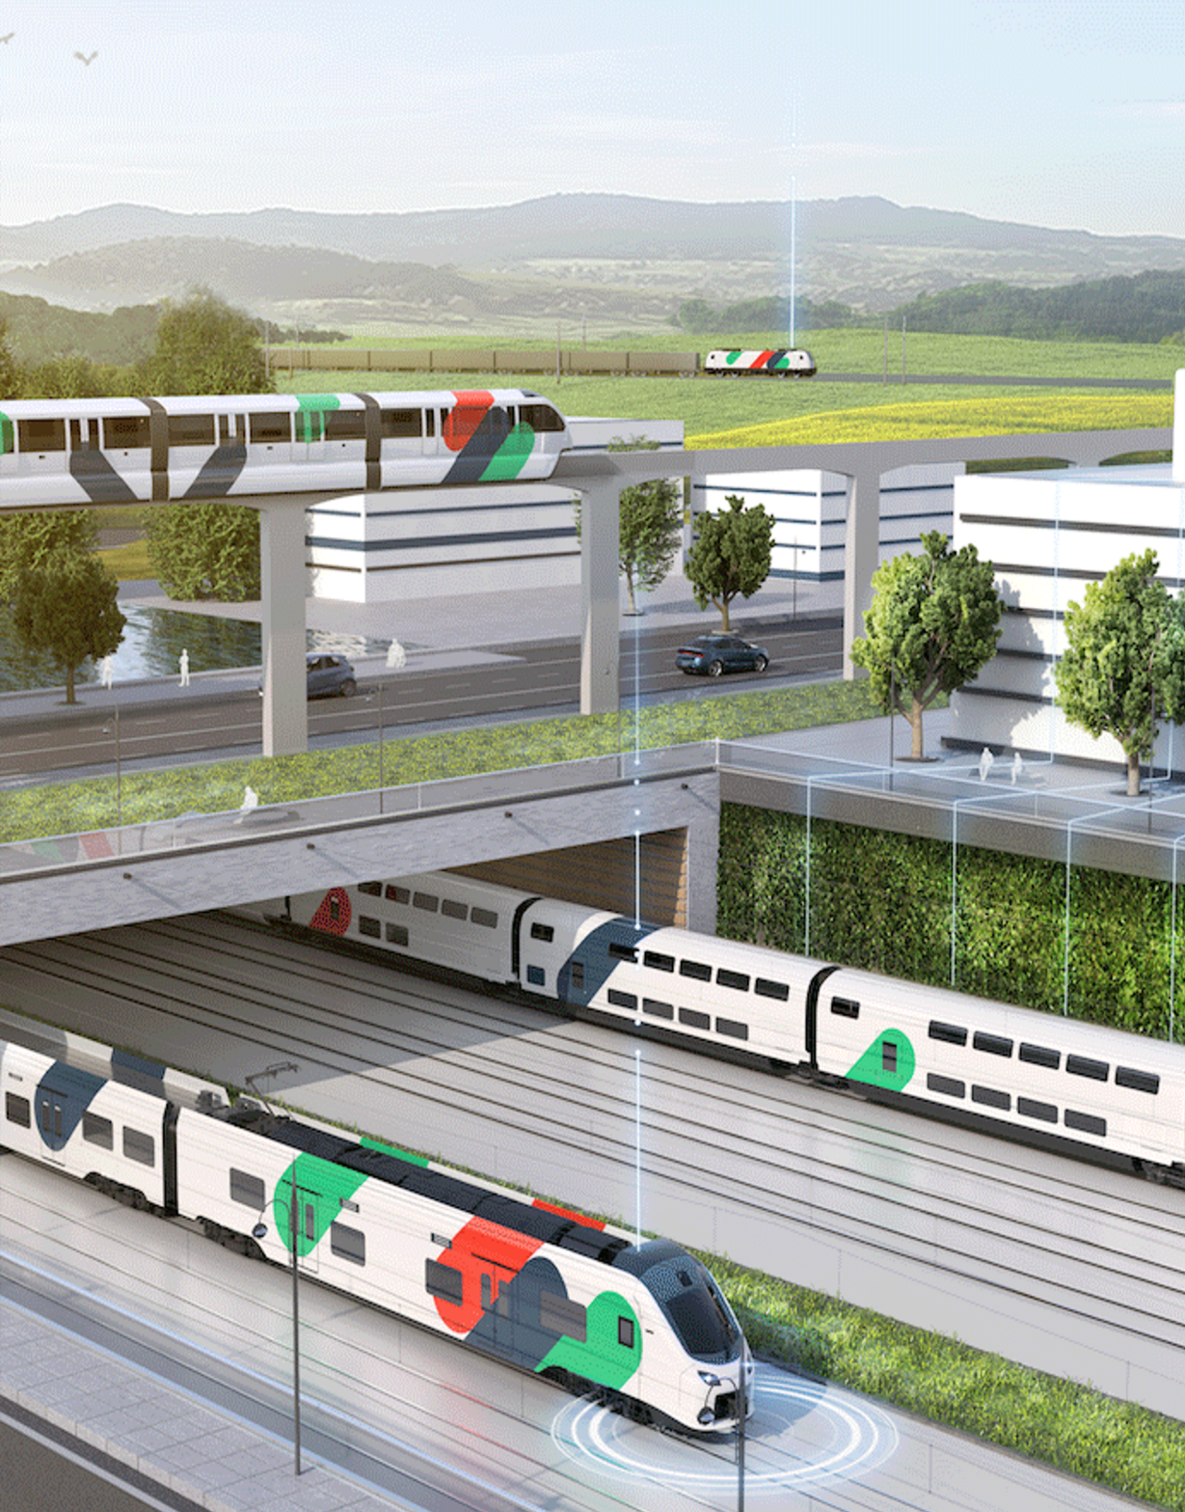



To answer tomorrow’s mobility challenges and needs, Rail digitisation is a must!
Increased capacity
Improved Efficiency
Enhanced Experience
Improved availability to maximize capacity
Interval reduction
Interruptions / downtime minimized
Shorter headways enabled
Performance & reliability boosted
Operational costs optimized – reduced CAPEX for hardware, improved productivity, eco operations
Real time incident management
Overall security improved
Information reliability
Personalized journey
More sustainable and efficient railway system achieved at a fraction of the cost of building new infrastructure

Slide 6
02
Opportunities across Rail Operator value chain

Slide 7

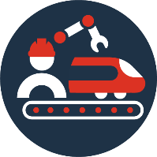


Key Segments - Operations, Maintenance & Passenger Experience
Operations
Maintenance
Passenger Experience
Digitalisation for lean and cost-effective operations
Digitalisation for increased asset performance and minimized lifecycle costs
Digitalisation for a seamless and future-proof passenger experience
Digital foundations
Digital enablers for secure software-driven systems

Slide 8
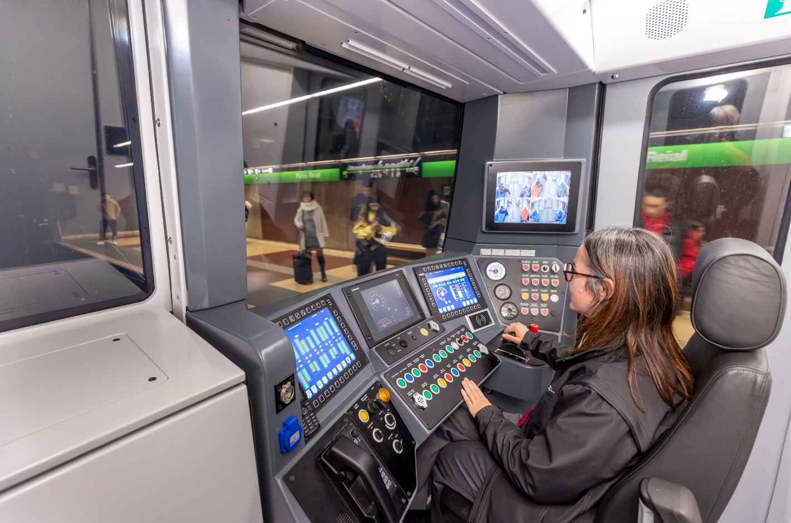
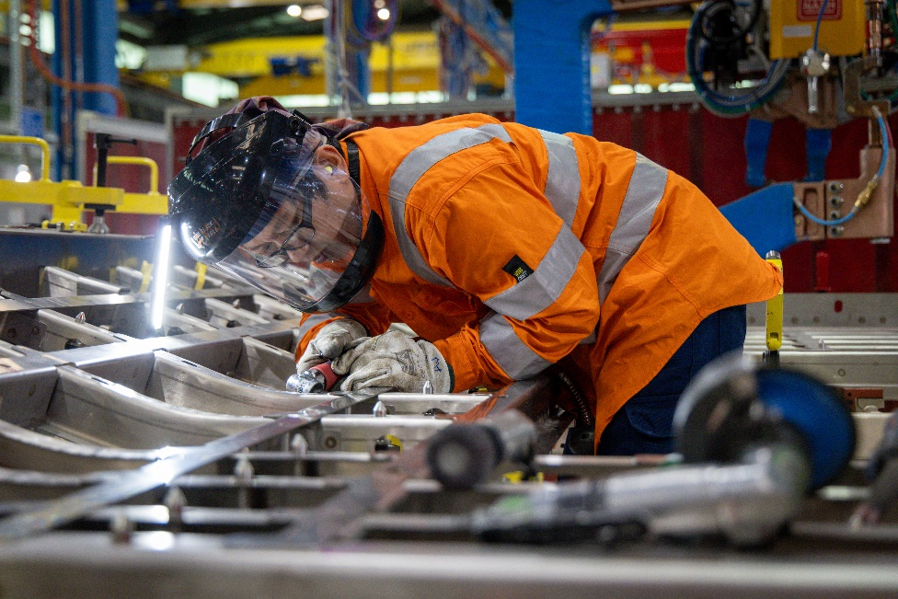
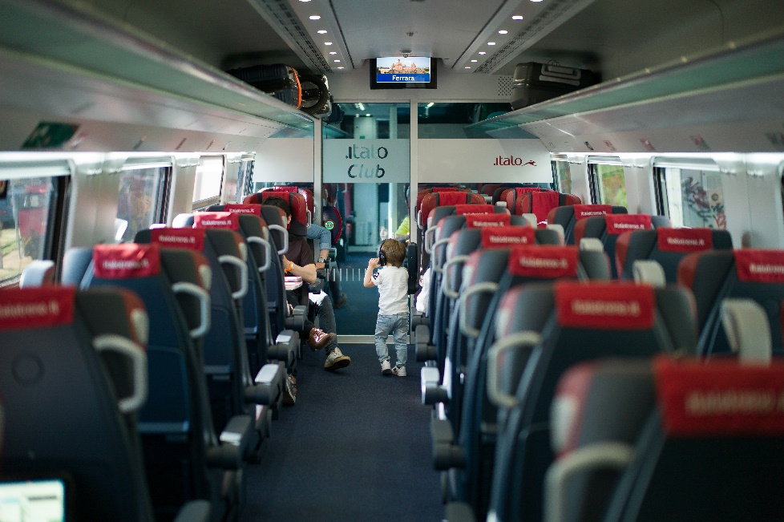
Typical digital solutions covering the entire rail value chain
Operations
Maintenance
Passenger experience
Traffic management and fleet administration
Driving assistance
Energy management
Remote and driverless operations
Incident and security management
Passenger flow and multimodal orchestration
Planning and service order management
Inventory and spare parts management
Configuration management
Inspection
Asset monitoring and diagnostics
Field service and support
Passenger information and announcements
Infotainment and advertising
Internet on board
Inclusive mobility
Passenger feedback management

Slide 9
03
Digital Solutions for key segments of value chain

Slide 10
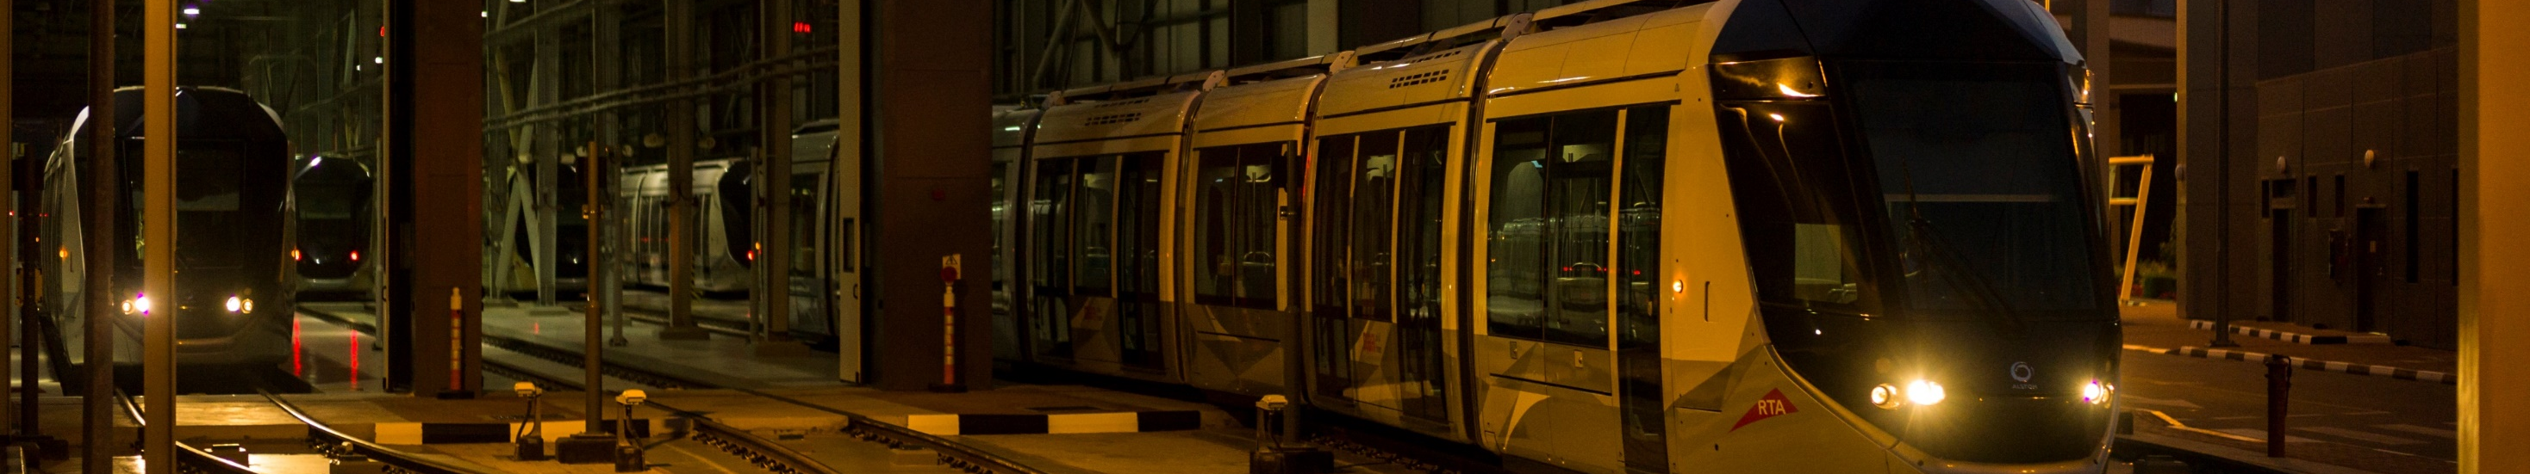




Digitalisation for lean and cost-effective operations
Operations
Non-productive time reduction
Energy consumption optimization
Operations continuity
Operations efficiency
Leverage remote and autonomous train capabilities to reduce non-productive time
Remote train wake up
Remote software updates
Automatic testing
Driverless to depot …
Use continuous monitoring to enable accurate energy forecasting, capitalise on an eco-operations and asset autoregulation to adhere to forecast and reduce consumption
Eco driving
Energy metering
Eco parking
…
Exploit smart and real-time detection tools to speed up decision making, minimise resolution time through advanced training and remote assistance
Smart CCTV
Real time asset monitoring
Remote diagnostic and visualization
AR/VR simulators …
Leverage dynamic traffic and fleet management systems, from train preparation to maintenance handover to maximise asset utilisation and team productivity
Dynamic scheduling
Driving assistance
SCADA
…

Slide 11
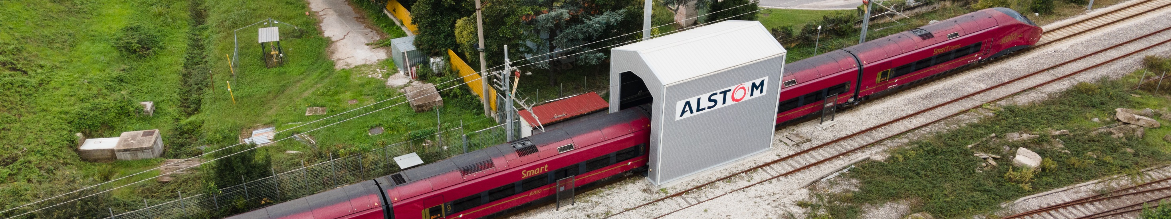


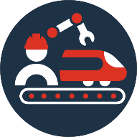

Digitalisation for increased assets performance & minimized lifecycle costs
Maintenance
Improved diagnostic reliability
Augmented competencies
Increased on field efficiency
Integrated workflow orchestration
Leverage combination of AI, railway engineering & data science at the service of condition based & predictive capabilities to maximize assets availability while minimizing maintenance costs over time
Leverage immersive technologies (AR/VR, simulators…) for real conditions trainings and dedicated resources (remote assistance, 24/7 support) to empower operational teams and lift them up to the next level no matter their starting point
Deploy automation (assets inspections, automatic recovery…) & remote (software update & upgrades, remote diagnostic) capabilities to favour in situ / during operations maintenance and avoid train immobilization
Leverage set of augmented maintenance services through fully integrated processes & tools ecosystem enabling automated & simplified workflows management (planification, provisioning, …)

Slide 12
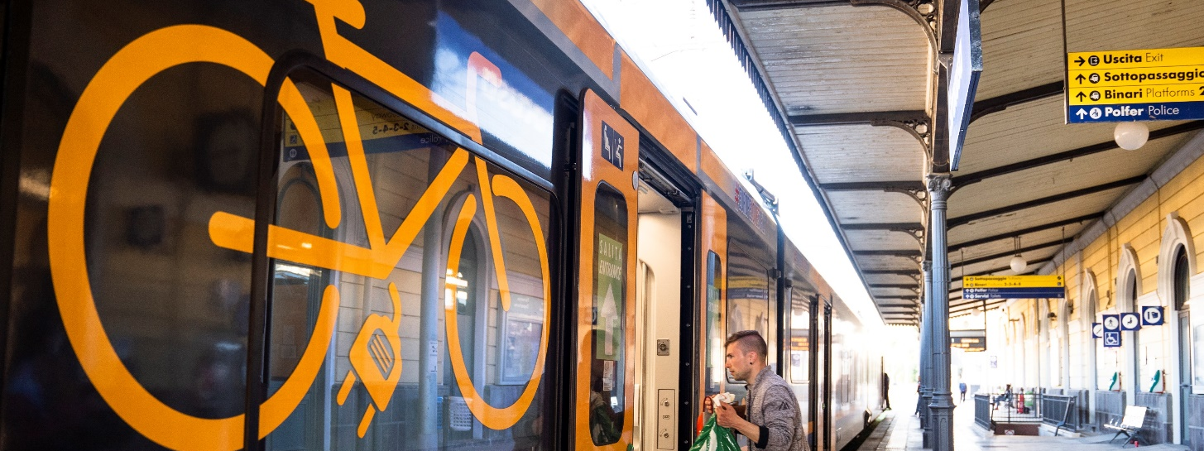
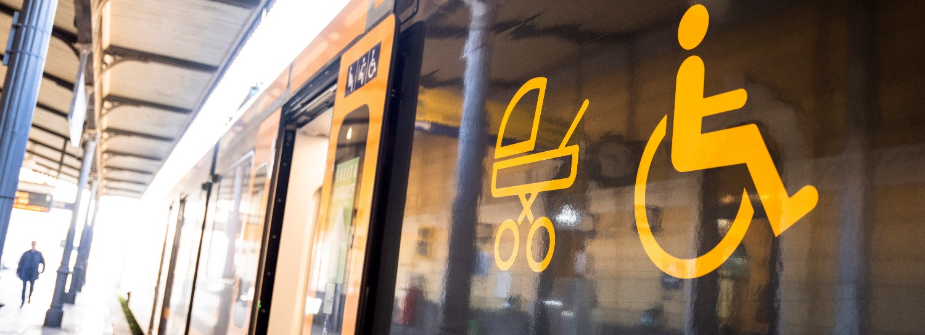




Digitalisation for a seamless and future-proof passenger experience
Passenger XP
Information reliability
Personalized journey
Connected experiences
Environment safety & comfort
Leverage easily configurable data flow orchestration and multi-source/display management capabilities to ensure transmission of relevant and consistent information
Automatic passenger information flows orchestration
PAPIS systems
Leverage real-time insights to push personalized content and smoothen passengers’ door-to-door journey
Passenger counting
Passenger flow management
Dynamic content / media management
Leverage multiple connectivity technologies to provide high-performance systems and secure quality of services even in the most challenging conditions
Internet on board
Internet in station
Single sign on…
Use continuous overwatch solutions. improved decision-making and reactivity to constantly enhance passenger experience
Smart live CCTV
Comfort systems remote control
Social listening & sentiment analysis
Feedback management …

Slide 13
04
AI enabling the future state of Digital Solutions

Slide 14





High Value Creation with Data Science and AI
Rolling Stock
 reliability
➔ energy consumption
Measurable impact
AI-Driven
solutions
Services
➔ maintenance cost
➔ train inspection intervals
Signalling
downtime
➔ energy efficiency
Quality
 availability
 troubleshooting

Slide 15
Data is everywhere
Energy data
Maintenance data
Infrastructure data
Asset data
Signaling data
MOBILITY
DATA
Rolling Stock data
Environment data
Passenger data
Journey data
Ticketing
City data
Operation data
CCTV data
At Alstom, we ensure rigorous compliance with GDPR and relevant AI regulations, prioritizing data security and cybersecurity across our systems through dedicated teams and comprehensive training, to protect the integrity of our data and operations

Slide 16
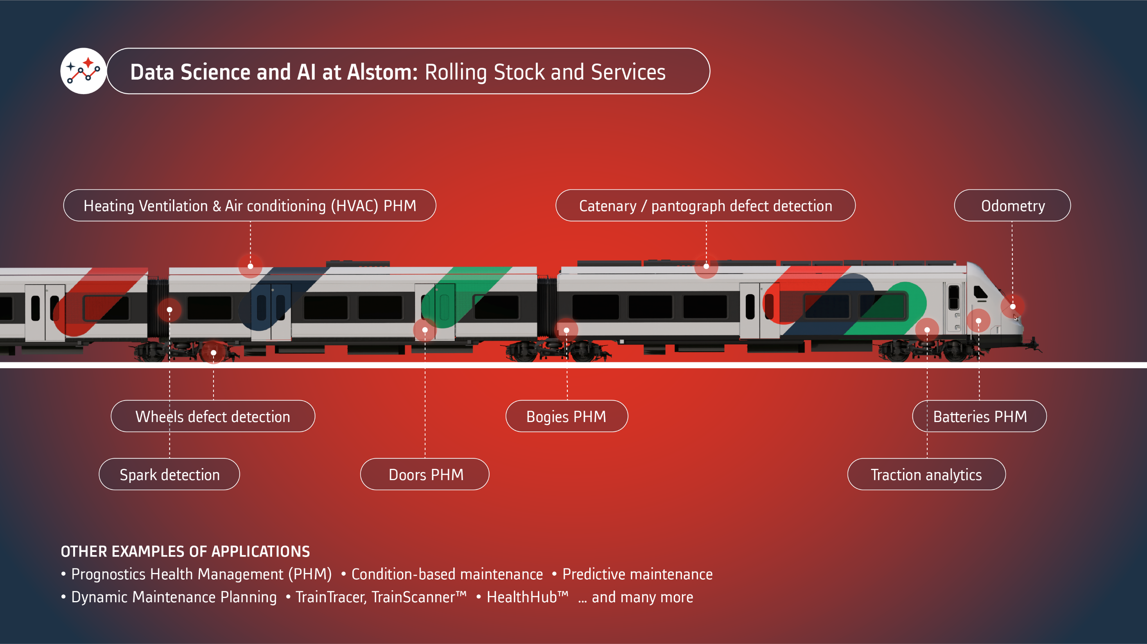

Slide 17
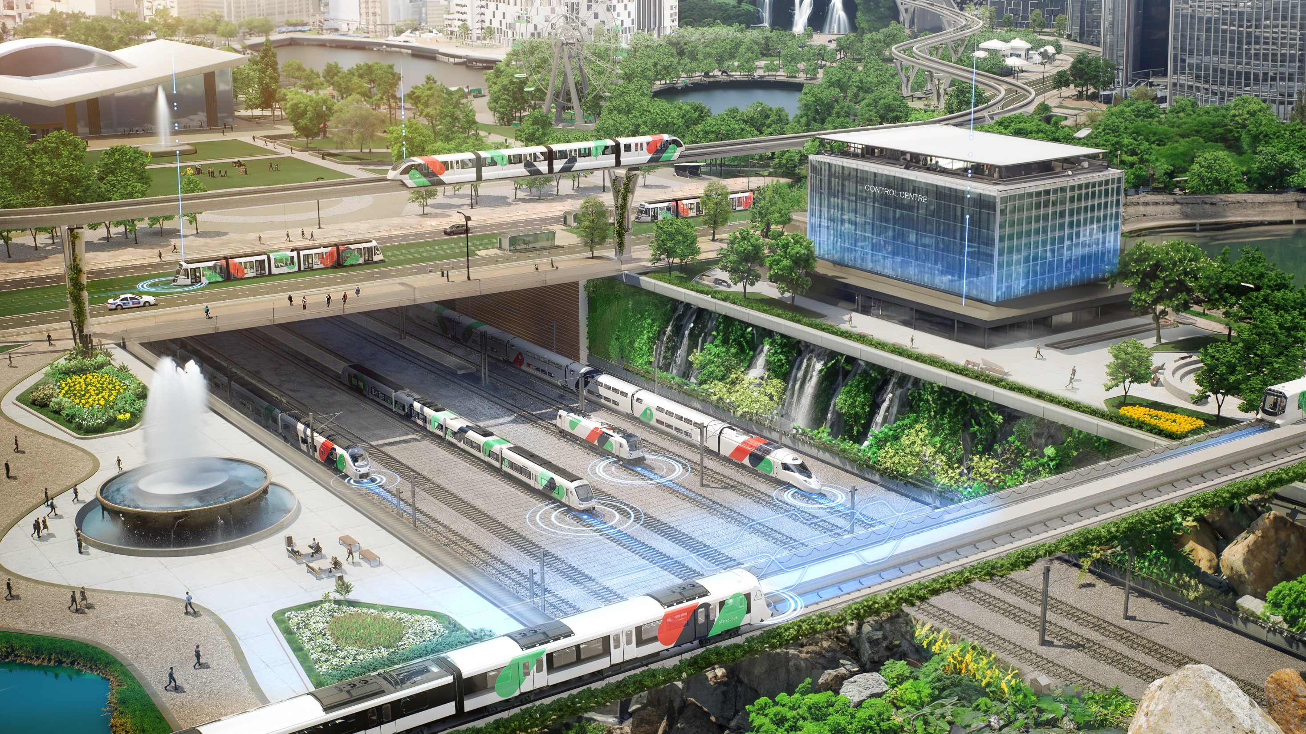

Data Science and AI at Alstom: Signalling and Infrastructure
Signalling logs analytics
Communication-based Train Control(CBTC)
Communication-based train control (CBTC)
radio analytics
Wayside diagnostics and prognostics
Signalling logs analytics
Wayside Diagnostics and prognostics

Slide 18
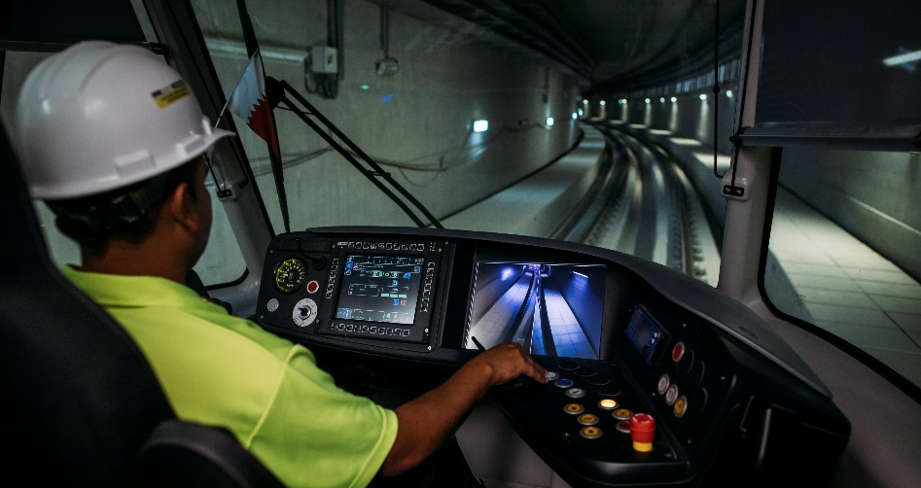
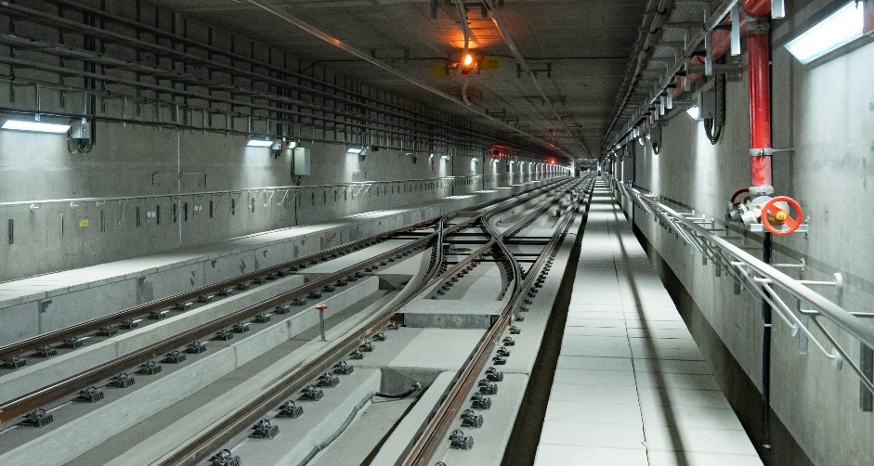
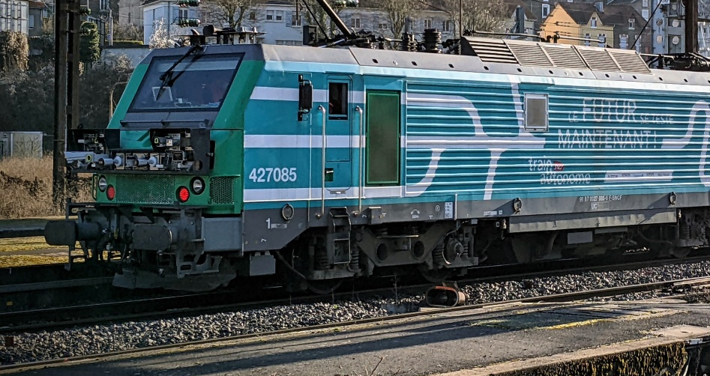
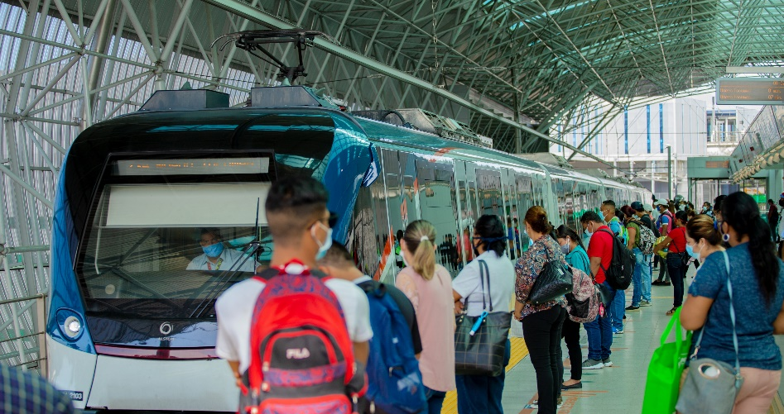
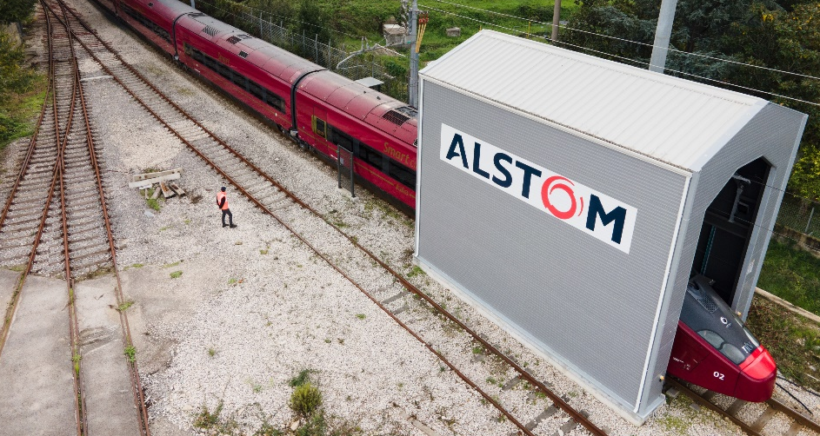
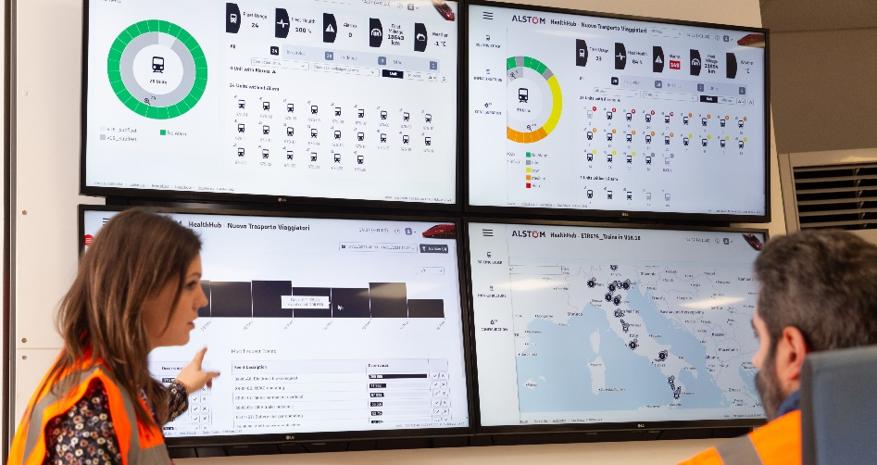
We as a global leader, enhancing railway operations with artificial intelligence
Radio monitoring
Rail infrastructure
Computer Vision
Radio monitoring
Rail infrastructure
Computer vision
Passenger Flow Management
Passenger flow management
Health Management
Dynamic Maintenance
Health management
Dynamic maintenance
Notes:
Hopefully, I was able to convinced you on power of using the AI and Data science for railway operations, I am ready to take some questions. Thank you!

