Slide 1



A Unified Framework for Traffic State Prediction and Class-Wise Speed Estimation in Mixed Traffic Conditions
Paper I.D: 8805
Dr. Abirami Krishna Ashok
Dr.Bhargava Rama Chilukuri

Slide 2
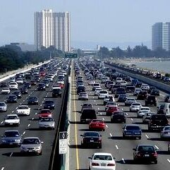
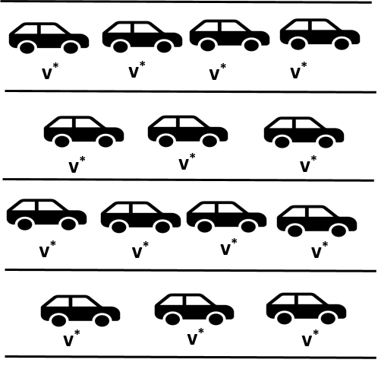
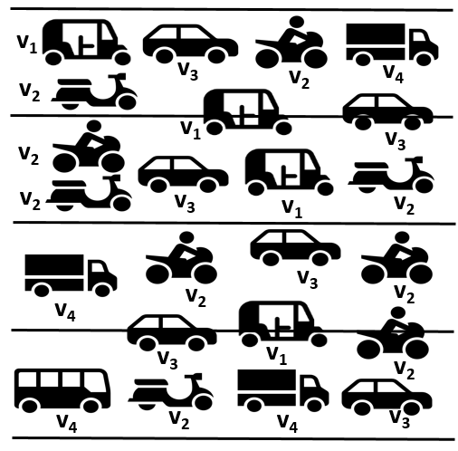
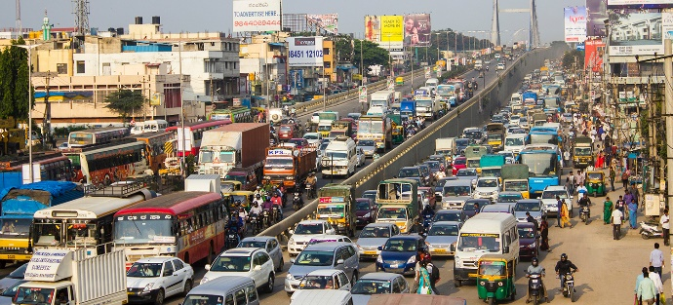
Motivation: Homogeneous vs. Mixed Traffic
Introduction | Background | Methodology | Results | Contributions | Applications
State := f(v*)
State:= f(v₁,v₂,v₃,…,v_{n})
Mixed traffic
Seepage of smaller vehicles
Kinematic disparities
Substantial lateral movement
Staggered following
Traffic state estimation (TSE): Inference of steady state traffic conditions using variables such as
  Flow, Density, Speed, , Travel Time, etc., for midblocks
  Queue length, Delay, etc., for intersections
Need for mixed traffic conditions state characterisation, estimation, and prediction that captures vehicle class-specific behaviours and features

Slide 3
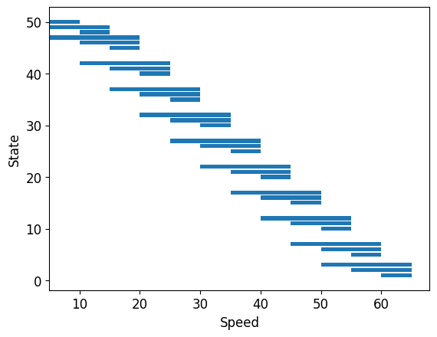
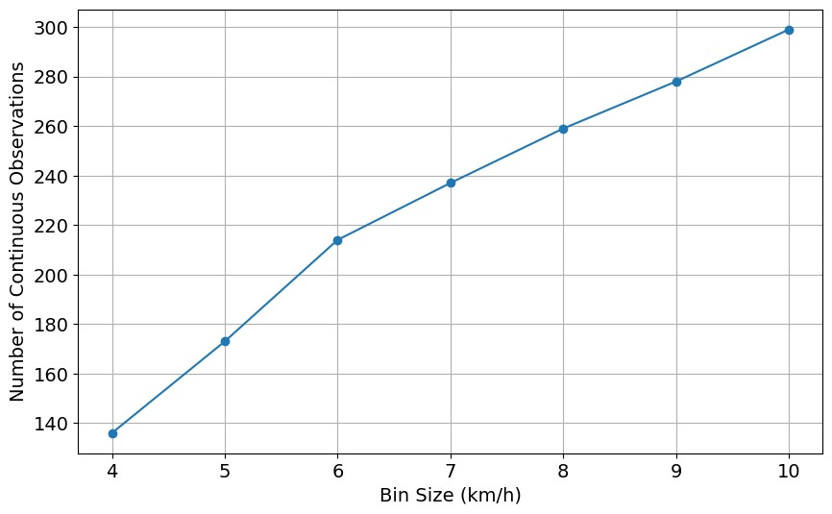
Conceptual Background
Introduction | Background | Methodology | Results | Contributions | Applications

Slide 4
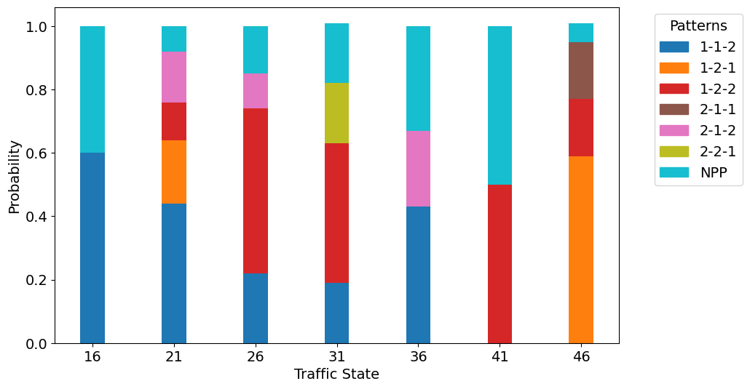
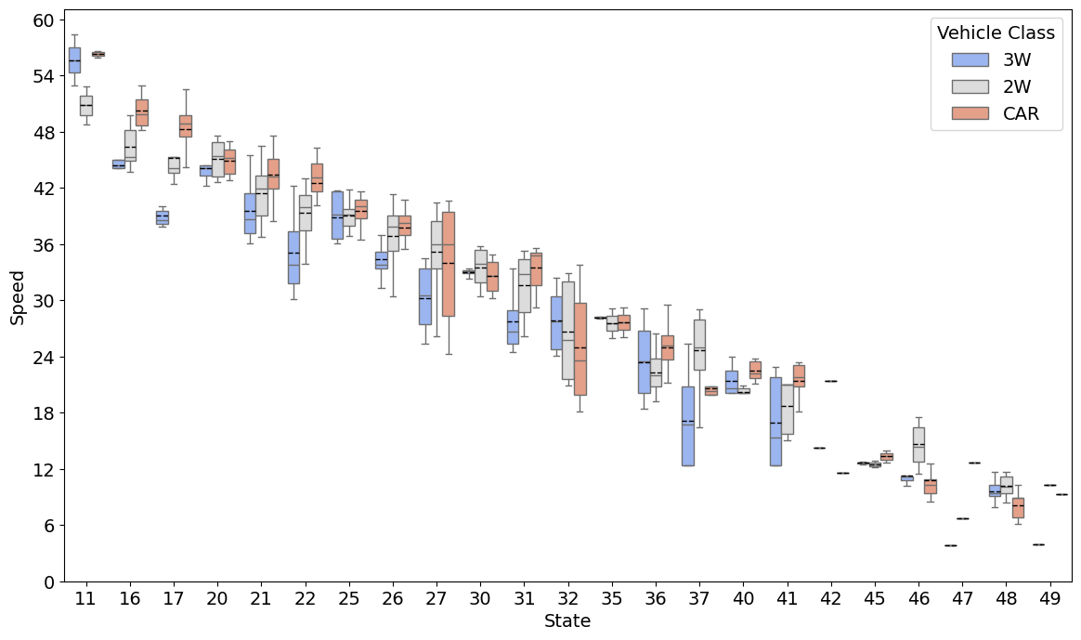
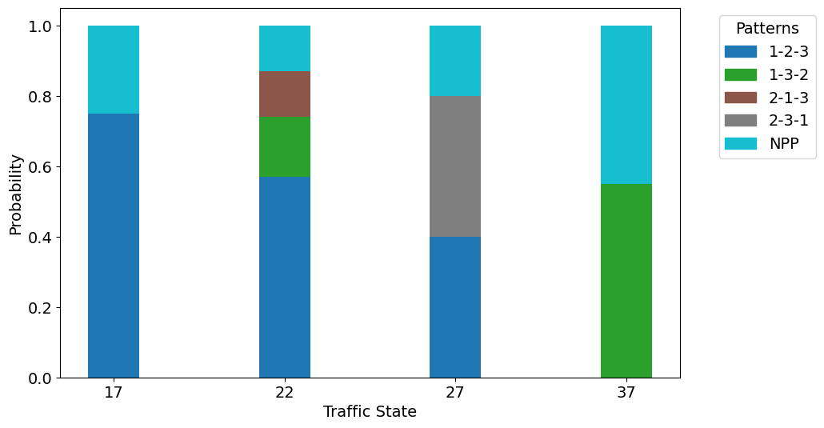
Analysis of observed speed patterns
Introduction | Background | Methodology | Results | Contributions | Applications
U | # of traffic states | Configuration | Possible combinations | Total patterns
1 | 12 | (3) | 12 * 1 | 12
2 | 11 | (1,2), (2,1) | 11*6 | 66
3 | 10 | (1,1,1) | 10*6 | 60
Total |  |  |  | 138
U=2
U=3

Slide 5
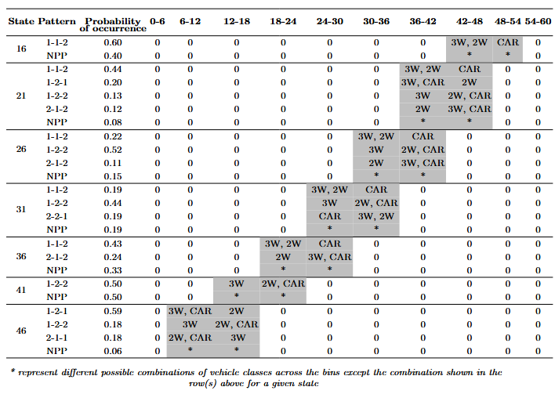
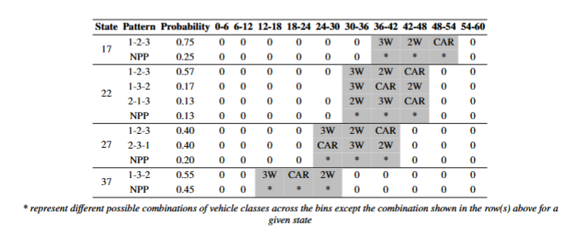
Class-bin probabilities for Predominant Patterns (PP)
Introduction | Background | Methodology | Results | Contributions | Applications
Class-bin probabilities for U=2
Class-bin probabilities for U=3

Slide 6
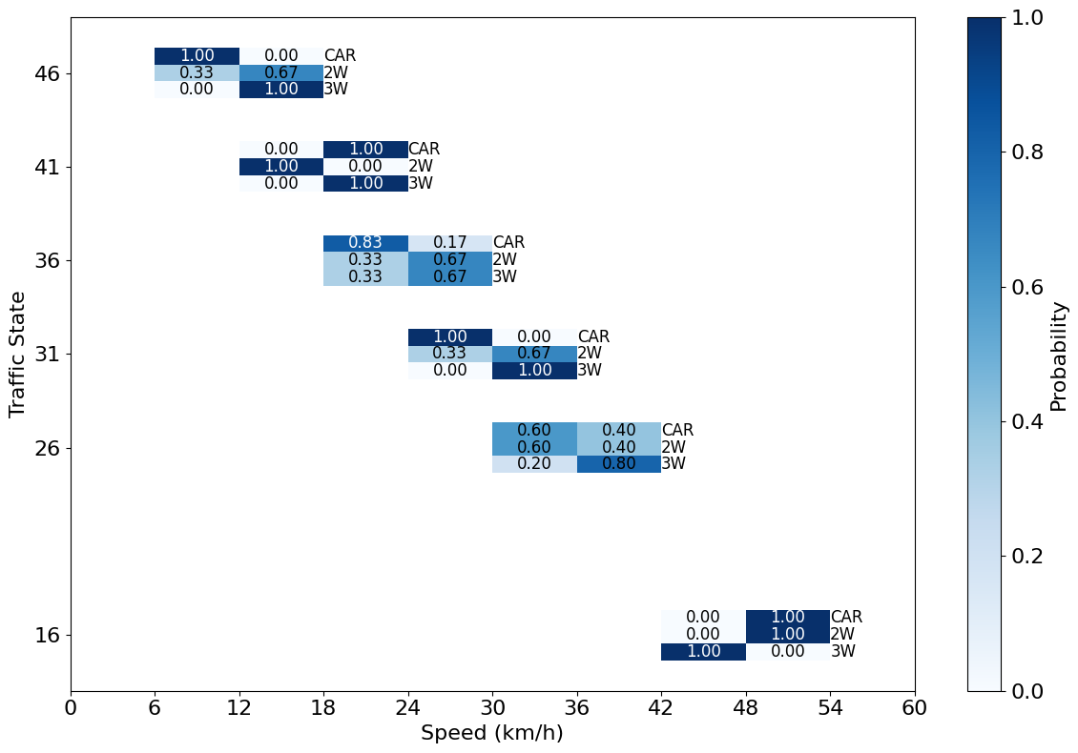
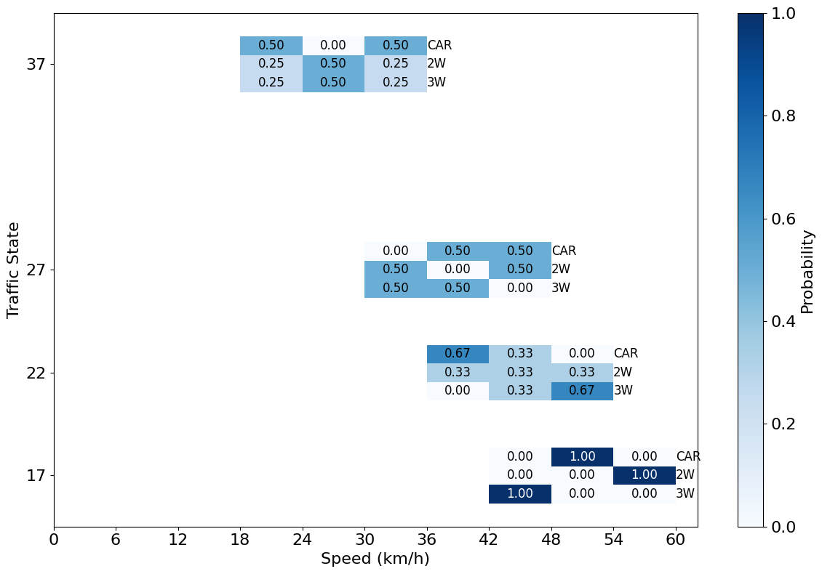
Class-bin probabilities for Non-Predominant Patterns (NPP)
Introduction | Background | Methodology | Results | Contributions | Applications
Class-bin probabilities for U=2
Class-bin probabilities for U=3

Slide 7
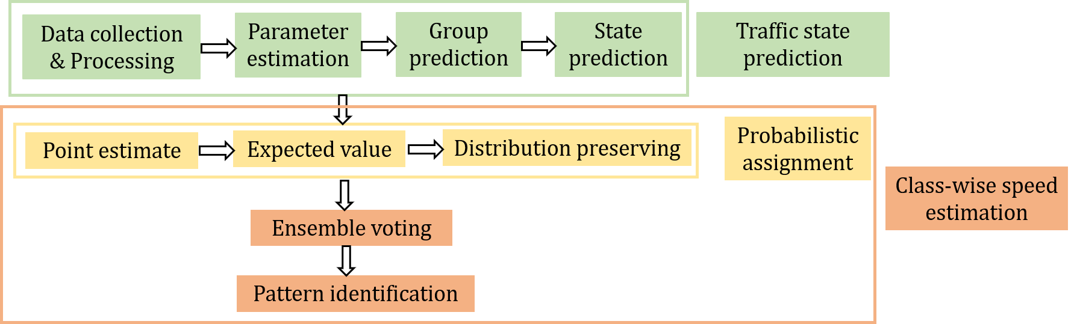
Class-wise Speed Estimation Methodology
Introduction | Background | Methodology | Results | Contributions | Applications

Slide 8
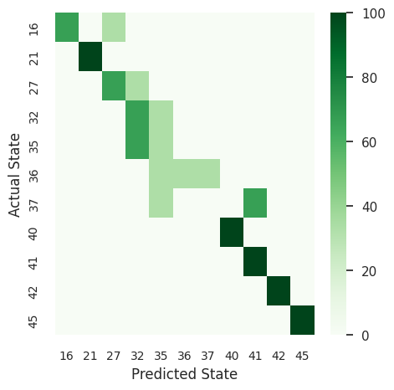
State prediction
Introduction | Background | Methodology | Results | Contributions | Applications
Model performance:
70 %
0.68
Overall accuracy
Macro F1 score

Slide 9
Class-wise speed estimation approaches
Introduction | Background | Methodology | Results | Contributions | Applications
1
Point Estimate (Joint Maximum a Posteriori, MAP)
Pattern with highest probability
1-1-2
2
Expected Value Rounding (EV)
3W: (0.43*21) + (0.24*27) + (0.33*25.02) = 23.77 kmph
2W: (0.43*21) + (0.24*27) + (0.33*25.02) = 23.77 kmph
CAR: (0.43*27) + (0.24*27) + (0.33*22.02) = 25.36 kmph
Vehicle class | Expected speed | Expected bin | Expected bin index
3W | 23.77 | 18-24 | 1
2W | 23.77 | 18-24 | 1
CAR | 25.36 | 24-30 | 2
3
Distribution-Preserving (DP) Allocation
Vehicle class | Bin 1 | Bin 2
3W | 0.43+0+(0.33*0.33) =0.54 | 0+0.24+(0.33*0.67) =0.46
2W | 0.43+0.24+(0.33*0.33)=0.78 | 0+0+(0.33*0.67)=0.22
CAR | 0+0+(0.33*0.83)=0.27 | 0.43+0.24+(0.33*0.17)=0.73

Slide 10
Analysis of Estimation Approaches Across Representative States
Introduction | Background | Methodology | Results | Contributions | Applications
State | Point Estimate | Expected Value | Distribution Preserving | Ensemble Voting
16 | 1-1-2 | 1-1-2 | 1-1-2 | 1-1-2
21 | 1-1-2 | 1-1-2 | 1-1-2 | 1-1-2
36 | 1-1-2 | 1-1-2 | 1-1-2 | 1-1-2
41 | 1-2-2 | 1-1-2 | 1-2-2 | 1-2-2
27 | 1-2-3 | 1-3-2 | 1-2-3 | 1-2-3
37 | 1-3-2 | 1-3-2 | 1-3-2 | 1-3-2

Slide 11
Key Contributions
Introduction | Background | Methodology | Results | Contributions | Applications
1
3
Class-wise Inference from Raw Data
Developed a probabilistic model to infer class-wise speeds (2W, 3W, cars) from unclassified vehicle-level data.
Bridges the gap between raw, mixed traffic data and class-sensitive insights for planning and operations.
Unified Modelling Framework
Integrated Clustering (GMM) + Prediction (Linear Regression, MLP) + Probabilistic Mapping.
Explicitly captures vehicle-class heterogeneity, overcoming traditional lane-based, homogeneous assumptions.
Multi-Method State Identification
Proposed and evaluated 3 complementary approaches:
→ Point Estimation (direct interpretability)
→ Expected Value (smooths variability)
→ Distribution-Preserving (retains probability shape)
Adopted an ensemble voting strategy to yield a robust, consensus traffic state.
Dual-Level Representation
Linked aggregate traffic states with class-specific speeds, providing:
→ Macro-level flow insights and
→ Micro-level vehicle-class behavior.
Enhances interpretability and real-world operational relevance.
2
4

Slide 12

Integration into ITS
Introduction | Background | Methodology | Results | Contributions | Applications
1
Adaptive Signal Control
  Adjust signal phases/cycles based on predicted states.
  Enable class-based priority (e.g., buses, freight vehicles).
Congestion Pricing or Demand Management
  Use class-specific speeds and congestion probabilities for dynamic pricing.
  Implement access control during severe congestion.
Traffic Simulation and Control Evaluation
  Feed class-wise speed distributions into real-time simulation models.
  Evaluate and optimize signal control and routing strategies.
Traveler information Systems
  Integrate near-term class-wise speed forecasts into route guidance tools.
  Enhance information accuracy and traveler trust.
2
3
4
Source: Google images

Slide 13

Turning traffic data into meaningful mobility insights.
Thank You
Dr.Abirami Krishna Ashok
Senior Project Officer
The MInT Colloborative Space, IIT Madras
Abirami.K@themint.space

