Slide 1
Spatial Optimization of Humanitarian logistics during Flood : Identification of Parameters

Slide 2
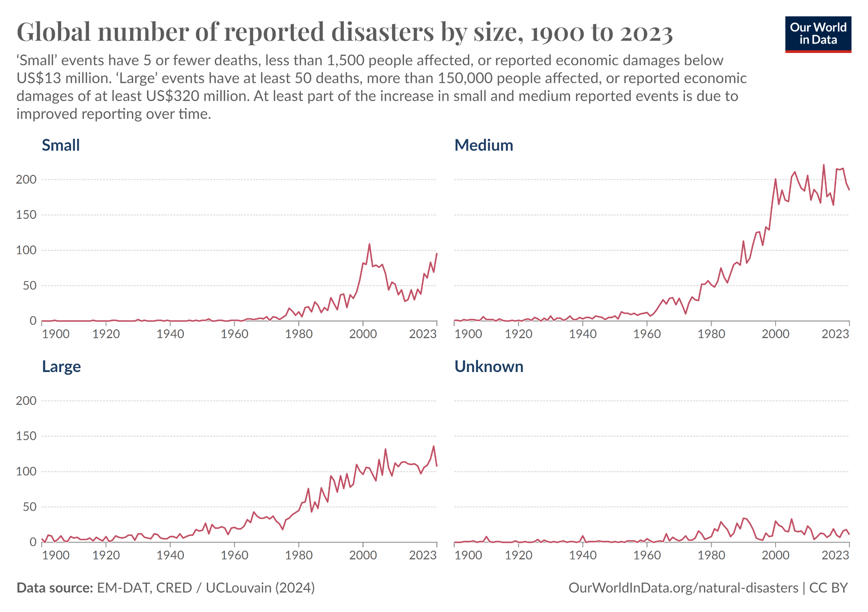
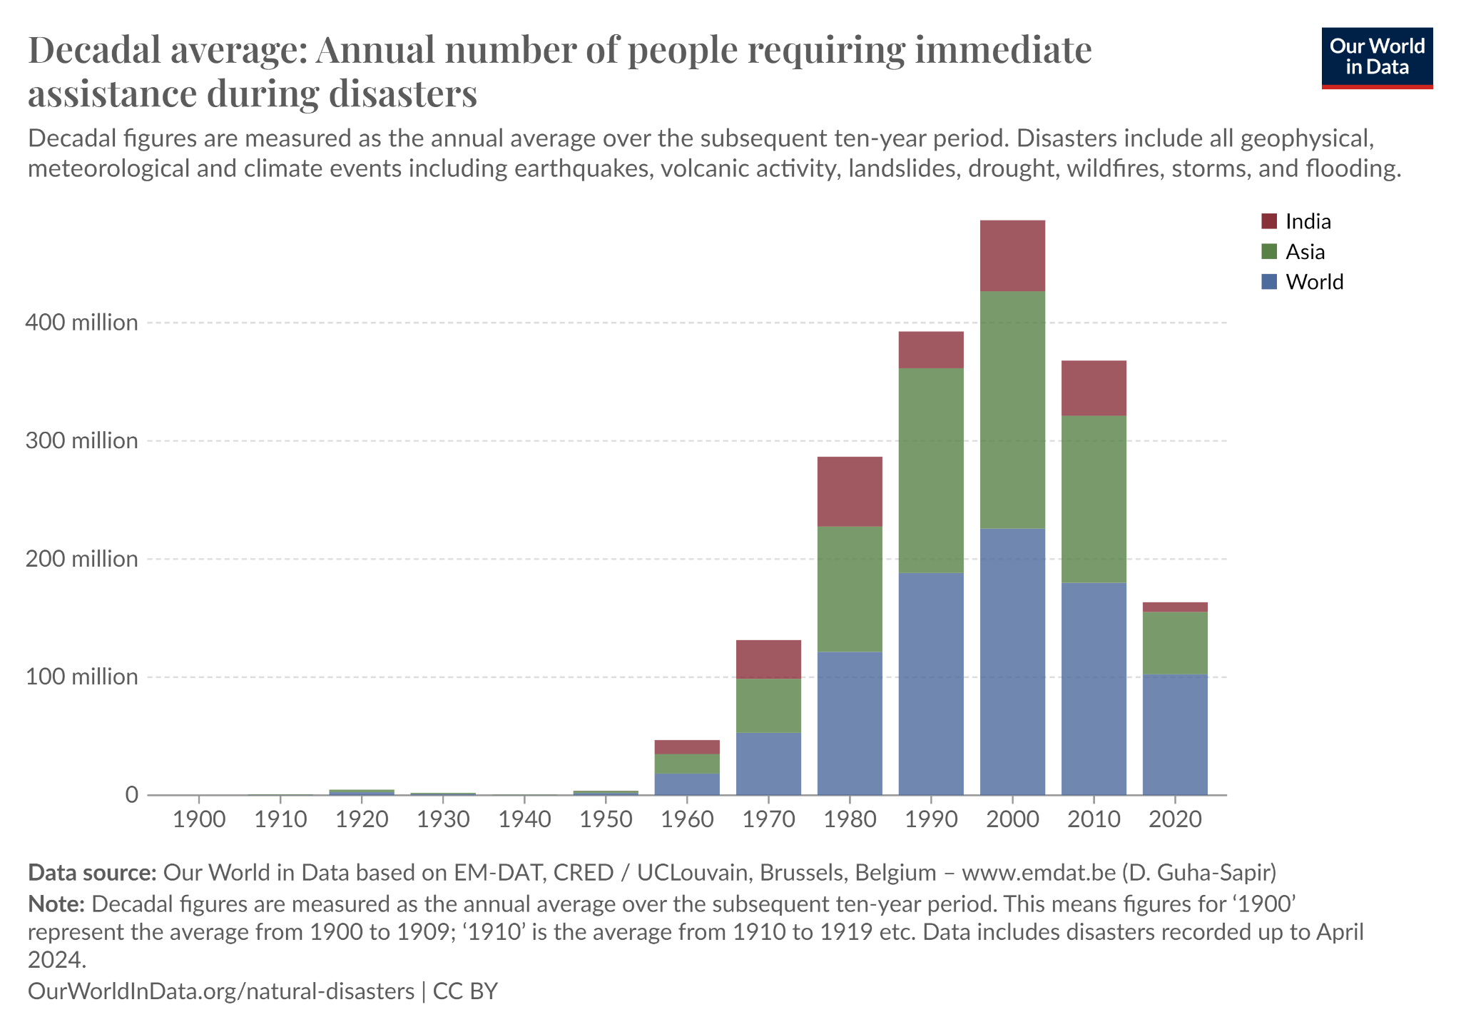
NEED OF THE STUDY
Definitions
Synopsis
Methodology
Literature
Scenario
Analysis
Result
Figure 1: Global Number of reported disasters by size,1900 to 2023
Figure 2 : Annual number of people requiring immediate assistance during disasters
With the increasing number and severity of global disasters, effective humanitarian logistics is crucial. As more people are affected and economic losses rise, it’s vital to ensure that aid reaches those in need quickly and efficiently.

Slide 3




PROBLEM STATEMENT
Definitions
Synopsis
Methodology
Literature
Scenario
Analysis
Result
In humanitarian logistics, getting aid to disaster-affected areas quickly is often slowed down by inefficient planning and poor use of space. This issue is common in places that face frequent disasters, where supplies don’t reach those in need fast enough. The research will solve this problem by identifying parameters for spatial optimization of humanitarian logistics to help plan aid distribution more effectively, using different tools and models to improve decision-making. This is important because faster aid can save lives and reduce suffering. The main beneficiaries will be people affected by disasters and the organizations delivering help.

Slide 4
AIM
OBJECTIVES
Definitions
Synopsis
Methodology
Literature
Scenario
Analysis
Result
To identify the parameters for spatial optimization of Humanitarian Logistics during Flood
1. Study of various scenarios,existing optimization models and solutions for the spatial optimization of Humanitarian Logistics.
2. Identification of the Scenario and Refinement of Parameters for its Spatial optimization.
3. Prioritization of parameters for the Identified Scenario.

Slide 5
DETAILED METHODOLOGY
Definitions
Synopsis
Methodology
Literature
Scenario
Analysis
Result
Studying
Humanitarian Logistics
Literature Review
Objective 1
Humanitarian Supply Chain
Phases of Intervention
Optimization Models
Disasters Types
Identifying
Scenario
Literature Review
Type of Intervention
Type of Problem
Type of Model
Disaster
Case Study
Objective 2
Identifying
Parameters
Geospatial
Disaster Specific
Operational
Demand Supply
Delphi Method
Refining
Refinement
Prioritisation
Objective 3
Final Set of Parameters
Source : Author Generated

Slide 6
SCOPE OF THE STUDY
LIMITATIONS
Definitions
Synopsis
Methodology
Literature
Scenario
Analysis
Result
The study focuses on how government agencies manage humanitarian logistics, specifically in flood relief operations, excluding private sector involvement. It examines land-based logistics,concentrated on the last mile delivery in the response phase and does not include other transportation modes.
1. The study focuses exclusively on how government agencies manage humanitarian logistics, excluding private companies and commercial logistics.
2. It considers only land-based transportation logistics, excluding other modes or multimodal transportation systems.
3. The research is limited to last-mile delivery operations within a specific flood relief scenario identified through the study.

Slide 7
SEARCH METHODOLOGY FOR LITERATURE REVIEW
Definitions
Synopsis
Methodology
Literature
Scenario
Analysis
Result
Search in Google Scholar
Search Criteria : Keywords
17,600 Research papers
Filtered by
Humanitarian Logistics
Year
Disaster Management
Relevance,Language
Humanitarian Supply Chain
Number of Citations
Filtered by
1940 Research papers
Search Criteria : Keywords
3030 Research Papers
Location Allocation
Optimization Model
Vehicle Routing
Spatial Optimization
Location Routing
Last Mile Delivery
Location Routing
Filtered by Year,Relevance,Language
Selection of Relevant articles after reading title,abstract
287 Research Papers
109 Research Papers
Figure 7 : Search Methodology for Literature Review
Source : Author Generated

Slide 8
LITERATURE REVIEW
Definitions
Synopsis
Methodology
Literature
Scenario
Analysis
Result
109 Research Papers
33
Background Study
47
Optimization Models
29
Parameters Identification
Inferences from Literature Review
Background Study
Optimization Models
Scenario Identification
Humanitarian Logistics
Type of Model
Spatial Optimization
Research Gap
Phase of Intervention
Disaster Management
Type of Problem
Disaster
Source : Author Generated
https://docs.google.com/spreadsheets/d/14hFag_M1AAcAu6e2V_i3AVrKueekAM7BBB0i68OCREM/edit?usp=sharing

Slide 9
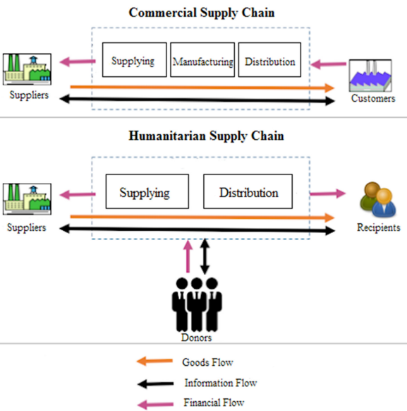
HUMANITARIAN LOGISTICS
Definitions
Synopsis
Methodology
Literature
Scenario
Analysis
Result
DEFINITION : Humanitarian logistics can be simply defined as a branch of logistics dealing with logistical aspects of a disaster management system, including various activities such as procuring, storing, and transporting food, water, medicine, and other supplies as well as human resources, necessary machinery and equipments, and the injured before and after disasters have struck. [Logistics Operations and Management, 2011]
Lack of preparedness | Mobilising affected people from conflict zones
Procurement | Degradation of critical infrastructure
Transportation execution | Information and communication
Timely delivery | Limited collaboration
Shortage of logistics experts | Donations
Demand forecasting | Needs versus loss-based relief
Size of the relief chain | Financial resources mobilisation
Security issues | Political issues
Assessment and appeal | Sociocultural issues
Stock asset management | Reconstruction challenges
Human resources mobilisation
KEY STAKEHOLDERS
Government
The Military
Donors
NGOs
Beneficiaries
International Alliances
Media
Key Stakeholders[12],[16]
Commercial supply chain vs Humanitarian Supply Chain[24]
Challenges during Disasters[4],[18]
Source : Kori, H., Bhuriya, V. K., & Bhatt, A. K. (2023). A study on humanitarian logistics. International Journal of Creative Research Thoughts (IJCRT), 11(3), a144. https://www.ijcrt.org

Slide 10
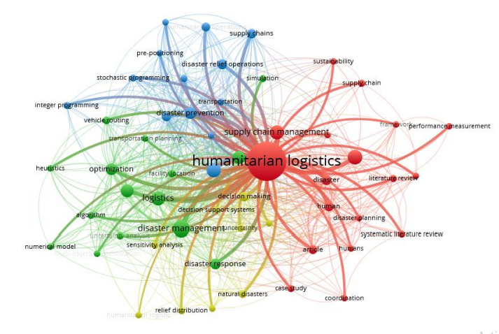
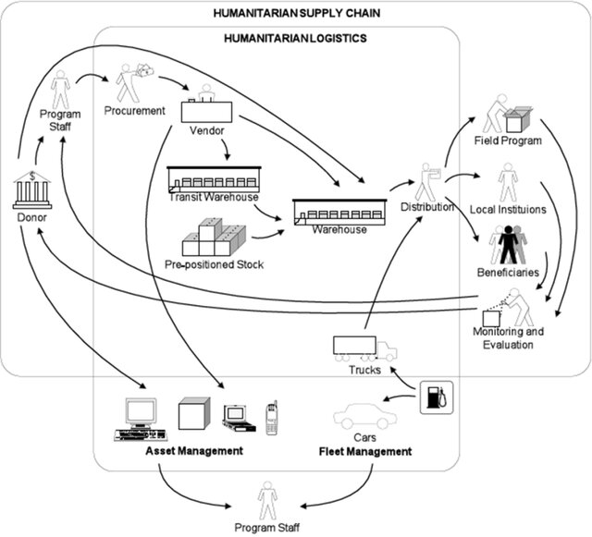
HUMANITARIAN SUPPLY CHAIN
Definitions
Synopsis
Methodology
Literature
Scenario
Analysis
Result
Keyword Co - Occurrence Network[17]
STAGES OF HUMANITARIAN SUPPLY CHAIN
Supply Acquisition and Procurement
Prepositioning and Warehousing
Transportation
Stages of Humanitarian Supply Chain[2]
Humanitarian Supply Chain[78]
Source : Viagi, A. F. (2016). Humanitarian supply chain risk management (HSCRM). ResearchGate. Retrieved from https://www.researchgate.net/publication/301778552

Slide 11
OPTIMIZATION MODELS
Definitions
Synopsis
Methodology
Literature
Scenario
Analysis
Result
OPTIMIZATION MODELLING is approach used to find the best solution to a problem from a set of possible choices, considering specific constraints and objectives.
Types of Optimization Models
Model Based on Mathematical Analysis
Model Based on Biological Intelligence
Components
Functions
Objectives
This is the function that needs to be optimized.
Multi-Objective,Non Linear
Analytical Mathematics,Linear
Constraints
Limit the possible values for the Decision variables
Traditional,Social, economic and ecological objectives
Role of Planner
Parameters
The solution to the optimization problem is the set of values of the decision variables for which the objective function reaches its optimal value.
No flexibility
Spatial Optimization
Source : Fei, H., Li, Q., & Sun, D. (2017). A survey of recent research on optimization models and algorithms for operations management from the process view. Advances in Operations Research. https://doi.org/10.1155/2017/7219656

Slide 12
RESEARCH GAP
Definitions
Synopsis
Methodology
Literature
Scenario
Analysis
Result
“ The integration of spatial models in optimization frameworks is crucial for addressing the complex logistics challenges in humanitarian contexts. However, many existing models fail to incorporate real-world conditions and the perspectives of decision-makers, which limits their practical applicability ”
(Rodríguez-Espíndola et al., 2023).
“ Current humanitarian logistics optimization models often lack rigorous integration of spatial parameters, which are crucial for addressing real-world challenges in disaster response. The absence of mixed methods research designs that incorporate spatial data into optimization models further highlights this gap “
(Baharmand et al., 2022).
Total Number of Research Papers | Number of Spatial Models | Number of Logistics Models
76 | 6 | 70

Slide 13
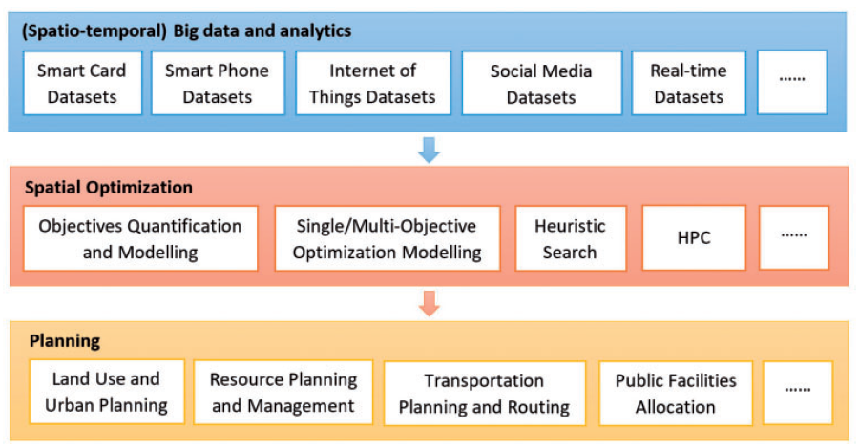
SPATIAL OPTIMIZATION
Definitions
Synopsis
Methodology
Literature
Scenario
Analysis
Result
Spatial Optimization is concerned with maximizing or minimizing an objective related to a problem of geographic nature, such as route selection, location-allocation modeling, spatial sampling and land-use allocation among others.
Tool | Purpose | Examples
ArcGIS | GIS-based spatial analysis | Mapping shelters, route optimization
QGIS | Open-source GIS for planning | Relief center siting, routing studies
AnyLogic | Simulation and GIS integration | Disaster logistics modeling
MATLAB | Mathematical modeling | Aid distribution network design
Python (e.g., Pyomo, NetworkX) | Custom optimization scripts | Last-mile delivery, route planning
Google OR-Tools | Open-source routing and scheduling | Vehicle routing for aid delivery
Gurobi | Advanced optimization solver | Relief center placement
Lingo/LINDO | Linear programming for logistics | Resource allocation and routing
Table 1 : A paradigm for spatial optimization enabled planning in the era of big data
Table 1 : Tools used for Spatial Optimization
Source : Li, W., Liu, Y., & Goodchild, M. F. (2020). Big data, spatial optimization, and planning. *Environment and Planning B: Urban Analytics and City Science*. https://doi.org/10.1177/2399808320935269

Slide 14
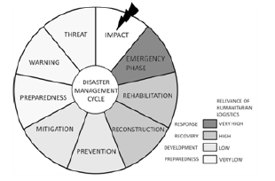
PHASES OF INTERVENTION
Definitions
Synopsis
Methodology
Literature
Scenario
Analysis
Result
1.Mitigation Phase
3.Response Phase
Minimising the effects of disaster
Minimising the damage caused by a disaster
Coordination of Humanitarian Supply Chain
Installing relief centers
Delivery of relief goods
2.Preparedness Phase
4.Recovery Phase
Planning how to respond
Returning the Community to normal
Figure 14 : Relevance of Humanitarian Logistics in Disaster Management Cycle
Installing warehouses
Restoration of structures
Prepositioning
Debris Removal
Location Allocation Problem
Vehicle Routing Problem
Location Routing Problem
Last Mile Delivery
Integrated Problem for Location Allocation and Vehicle Routing
Source : Xu, H., Fang, D., & Jin, Y. (2018). Emergency Logistics Theory, Model and Method: A Review and Further Research Directions.

Slide 15
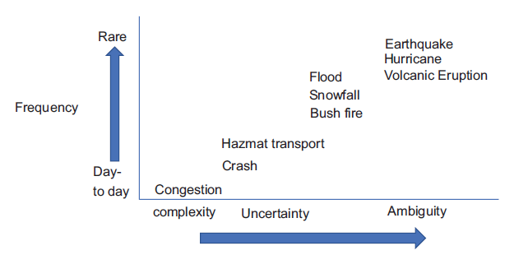
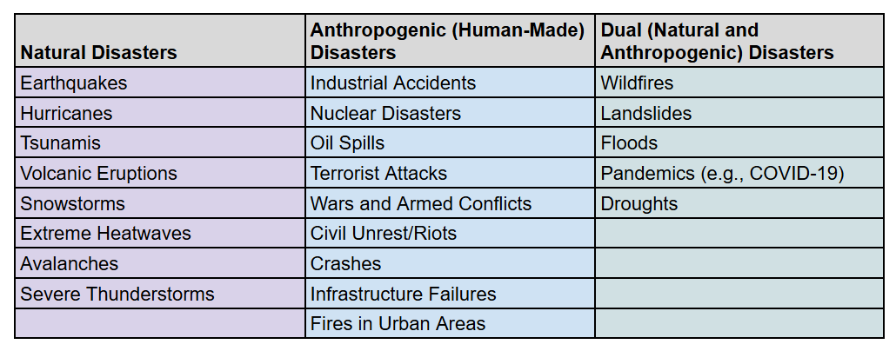
DISASTER IDENTIFICATION
Definitions
Synopsis
Methodology
Literature
Scenario
Analysis
Result
TYPES OF DISASTERS
Classification of risks related to city logistics. [27]
Classification of disaster based on cause
Source : Author Generated from Literature Review
Source : Author Generated from Literature Review
https://docs.google.com/spreadsheets/d/14hFag_M1AAcAu6e2V_i3AVrKueekAM7BBB0i68OCREM/edit?usp=sharing

Slide 16
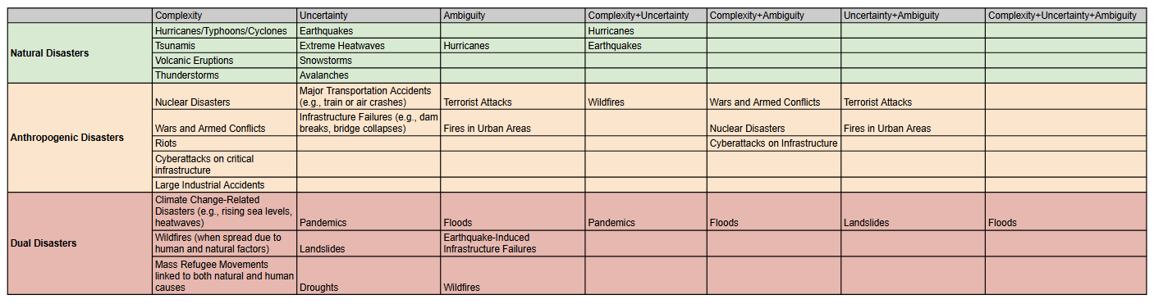
DISASTER
Definitions
Synopsis
Methodology
Literature
Scenario
Analysis
Result
Complexity
Complexity + Uncertainty
Complexity + Uncertainty + Ambiguity
Flood
Uncertainty
Complexity + Ambiguity
Ambiguity
Uncertainty + Ambiguity
Source : Author Generated from Literature Review
https://docs.google.com/spreadsheets/d/14hFag_M1AAcAu6e2V_i3AVrKueekAM7BBB0i68OCREM/edit?usp=sharing

Slide 17
IDENTIFIED SCENARIO
Definitions
Synopsis
Methodology
Literature
Scenario
Analysis
Result
Type of Optimization Model
Spatial Optimization
Phase of Intervention
Response Phase
Type of Problem
Location Routing Problem
Disaster
Flood
Source : Source : Author Generated from Literature Review
https://docs.google.com/spreadsheets/d/14hFag_M1AAcAu6e2V_i3AVrKueekAM7BBB0i68OCREM/edit?usp=sharing

Slide 18
BASIC FRAMEWORK FOR SPATIAL OPTIMIZATION
Definitions
Synopsis
Methodology
Literature
Scenario
Analysis
Result
Data Preparation
Spatial Analysis
Formulation of Logistics Model
Identification of Parameters for the Identified Scenario
Sensitivity Analysis
Scenario Testing
Spatial Visualisation
Solution Algorithms
Mapped facility locations and optimized routes
Heatmaps of flood severity and aid demand
Graphs showing cost and time savings from optimization
Source : Author Generated From Case Studies and Literature Review

Slide 19
METHODOLOGY FOR PARAMETERS IDENTIFICATION
Definitions
Synopsis
Methodology
Literature
Scenario
Analysis
Result
Identification of Parameters from Existing Models
Categorization of the Identified Parameters
Set of Parameters
Spatial Analysis
Logistics Model
Disaster Specific Models
Geospatial
Operational
Location Allocation
Disaster Specific
Demand Supply
Vehicle Routing
Location Routing
Delphi Method
Expert Survey
Selection of Experts
Prioritised Set of Parameters
Survey Design
Iterations
Prioritisation Model
Analysis
Source : Author Generated from Literature Review
https://docs.google.com/spreadsheets/d/14hFag_M1AAcAu6e2V_i3AVrKueekAM7BBB0i68OCREM/edit?usp=sharing

Slide 20
SELECTION OF EXPERTS
Definitions
Synopsis
Methodology
Literature
Scenario
Analysis
Result
Sl.No | Field of Expertise | Name | Experience
1 | Disaster Response | K.Aswakumar | 20
2 |  | Gokuldas A M | 1
3 |  | Dr.Abbas Vallikkunnu | 12
4 | Disaster Management | Arya Narendran | 8
5 |  | Pradeep G S | 15
6 |  | Dr. Sreeja S Nair | 24
7 |  | Tanushree Verma | 20
8 | Transportation Engineers/Planner | Kaalimuthu Manikyam | 26
9 | Urban Planners | Prof.Anurup.K | 10
10 |  | Bharath J Warrier | 2
11 |  | Gautam Jayan | 2
12 | Researchers | Prithvijith V S Nair | 4
13 |  | R. S. Vishnu | 2
14 |  | Ajay A P | 1
15 | Logistics Coordinators | Shency Augustine | 13
Criteria For Selection
Disaster Response Manager(from NGOs, government agencies)
Transportation Engineers/Planners
Urban Planners
Researchers(focused on optimization, logistics, or spatial planning)
Source : Author Generated
https://docs.google.com/spreadsheets/d/14hFag_M1AAcAu6e2V_i3AVrKueekAM7BBB0i68OCREM/edit?usp=sharing

Slide 21
ITERATION 1
ITERATION 2
ITERATION 3
Definitions
Synopsis
Methodology
Literature
Scenario
Analysis
Result
Validation of Parameters
Identification of Gaps
15 Experts Validated
Geospatial
Operational
Location of Natural Barriers
Available Communication Facilities
Analysis of Delphi Data
Literature Review
Source : Author Generated

Slide 22

ANALYSIS OF DELPHI DATA
Definitions
Synopsis
Methodology
Literature
Scenario
Analysis
Result
Refinement of Parameters
F-ratio less than or equal to 1 is desirable.
21 Parameters
Prioritisation of Parameters
F test scores
Average Weight Score
High Priority: Parameters with the highest Weighted Score and low F-Test value.
Medium Priority: Parameters with high Weighted Score, but higher F-Test values (indicating more variability).
Low priority: Parameters with lower Weighted Score and higher F-Test values.
Source : Shah, H. A., & Kalaian, S. A. (2009). Which is the best parametric statistical method for analyzing Delphi data? Journal of Modern Applied Statistical Methods, 8(1), 226–232. https://doi.org/10.22237/jmasm/1241137140

Slide 23
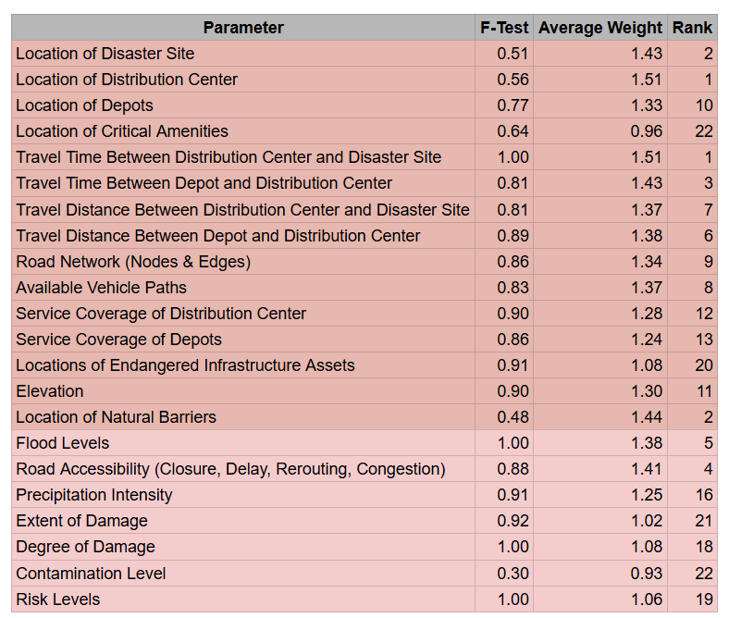
PRIORITISATION OF PARAMETERS
Definitions
Synopsis
Methodology
Literature
Scenario
Analysis
Result
High Priority (Rank 1 to 7)
Location of Distribution Center
Travel Time Between Distribution Center and Disaster Site
Travel Time Between Depot and Distribution Center
Flood Levels
Road Accessibility (Closure, Delay, Rerouting, Congestion)
Travel Distance Between Distribution Center and Disaster Site
Travel Distance Between Depot and Distribution Center
Source : Author Generated
https://docs.google.com/spreadsheets/d/14hFag_M1AAcAu6e2V_i3AVrKueekAM7BBB0i68OCREM/edit?usp=sharing

Slide 24
PRIORITISATION OF PARAMETERS
Definitions
Synopsis
Methodology
Literature
Scenario
Analysis
Result
Medium Priority (Rank 8 to 14)
Available Vehicle Paths
Location of Disaster Site
Road Network (Nodes & Edges)
Elevation
Service Coverage of Distribution Center
Service Coverage of Depots
Risk Levels
Low Priority (Rank 15 and below)
Location of Critical Amenities
Precipitation Intensity
Degree of Damage
Extent of Damage
Location of Natural Barriers
Locations of Endangered Infrastructure Assets
Contamination Level
Degree of Damage
Source : Author Generated
https://docs.google.com/spreadsheets/d/14hFag_M1AAcAu6e2V_i3AVrKueekAM7BBB0i68OCREM/edit?usp=sharing

Slide 25
FUTURE RESEARCH DIRECTIONS
CONCLUSION
Definitions
Synopsis
Methodology
Literature
Scenario
Analysis
Result
Improvement of Last mile delivery logistics
Developing Spatial Optimization Model
Integration of real time information
Integration of Spatial models in optimization
Testing through Simulations
Improve decision making
Validating with Stakeholders
Effective Resource Allocation
Integration of Multimodal transportation
Long term disaster preparedness
Adapting to other Disasters

Slide 26
REFERENCES
[1] Batarlienė, N., & Bazaras, D. (2023). Solutions to the Problem of Freight Transport Flows in Urban Logistics. Applied Sciences (Switzerland), 13(7). https://doi.org/10.3390/app13074214
[2] Cao, Y., & Jiang, H. (2021). Research on emergency logistics management based on Intelligent Supply Chain. E3S Web of Conferences, 235. https://doi.org/10.1051/e3sconf/202123503056
[3] Chalaris, M. (n.d.). SMART CITIES: THEIR ROLE IN PROTECTION FROM NATURAL AND MAN-MADE DISASTERS. https://www.researchgate.net/publication/338229829
[4] Choi, T. M. (2021). Risk analysis in logistics systems: A research agenda during and after the COVID-19 pandemic. In Transportation Research Part E: Logistics and Transportation Review (Vol. 145). Elsevier Ltd. https://doi.org/10.1016/j.tre.2020.102190
[5] Chowdhury, P., Paul, S. K., Kaisar, S., & Moktadir, M. A. (2021). COVID-19 pandemic related supply chain studies: A systematic review. Transportation Research Part E: Logistics and Transportation Review, 148. https://doi.org/10.1016/j.tre.2021.102271
[6] Cleophas, C., Cottrill, C., Ehmke, J. F., & Tierney, K. (2019). Collaborative urban transportation: Recent advances in theory and practice. European Journal of Operational Research, 273(3), 801–816. https://doi.org/10.1016/j.ejor.2018.04.037
[7] Daud, M. S., Mat, M. S., #1, D., Shah, M. Z., Hussein, M., Nasir#, M. E., Abdullah, R., Kassim, R., Mohd, #5, Suliman, S., Rosli, M., & #7, S. (2016a). Humanitarian logistics and its challenges: The literature review. In Int. J Sup. Chain. Mgt (Vol. 5, Issue 3). https://www.researchgate.net/publication/309261867
[8] Delle Donne, D., Alfandari, L., Archetti, C., Ljubić, I., Ljubic, I., & Ljubi, I. (2021). Freight-on-Transit for urban last-mile deliveries: A Strategic Planning Approach Freight-on-Transit for urban last-mile deliveries: A Strategic Planning Approach. 2021. ï¿¿hal-03457899ï¿¿ FREIGHT-ON-TRANSIT FOR URBAN LAST-MILE DELIVERIES: A STRATEGIC PLANNING APPROACH Freight-on-Transit for urban last-mile deliveries: A Strategic Planning Approach. https://essec.hal.science/hal-03457899
[9] Ding, Z., Xu, X., Jiang, S., Yan, J., & Han, Y. (2022). Emergency logistics scheduling with multiple supply-demand points based on grey interval. Journal of Safety Science and Resilience, 3(2), 179–188. https://doi.org/10.1016/j.jnlssr.2022.01.001
[10] Fihun, N., & Biloshevska, O. (n.d.). Features and prospects of logistic humanitarian approach to the formation of the supply chain. In AN INTERNATIONAL QUARTERLY JOURNAL-2016 (Vol. 5, Issue 1).
[11] Ge, J., Li, X., Wu, Z., Sun, Y., & Kanrak, M. (2022). The Distribution of Emergency Logistics Centers under the COVID-19 Lockdown: The Case of Yangtze River Delta Area. Sustainability (Switzerland), 14(17). https://doi.org/10.3390/su141710594

