Slide 1
Future Cities and Innovative Mobility Solutions
Some reflections on:
Integration
Prioritization
Simplification
Green and Blue
Examples from Small and medium-sized cities
07. November 2025
Armin Wagner/GIZ

Slide 2
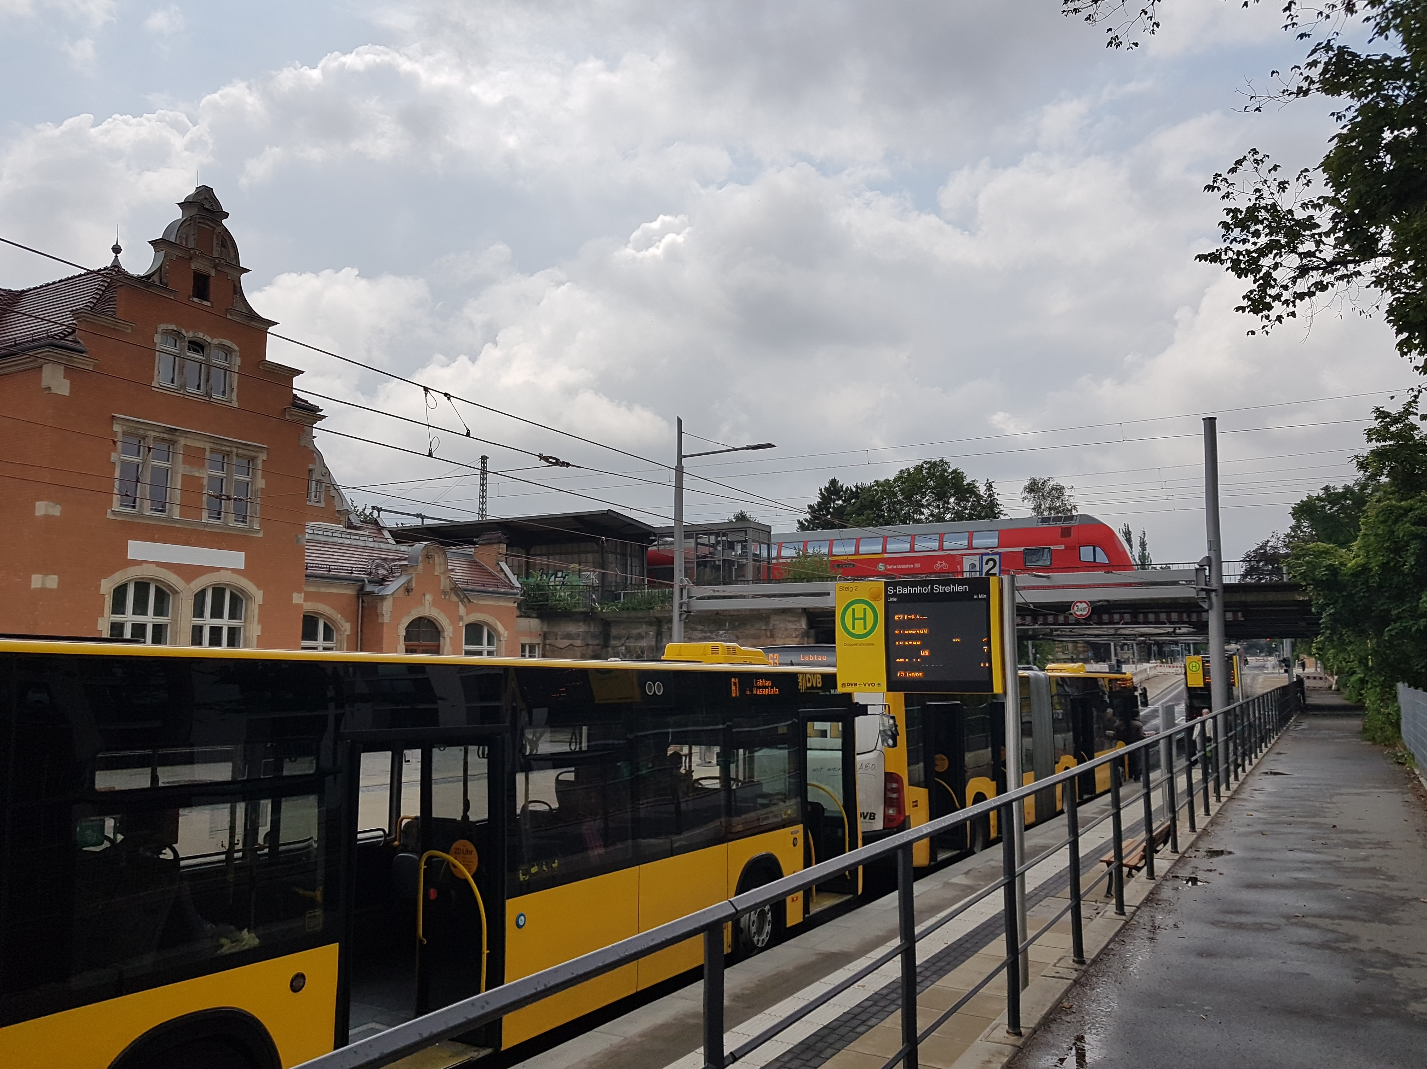
Integration Public Transport + Public Transport Prioritization

Slide 3
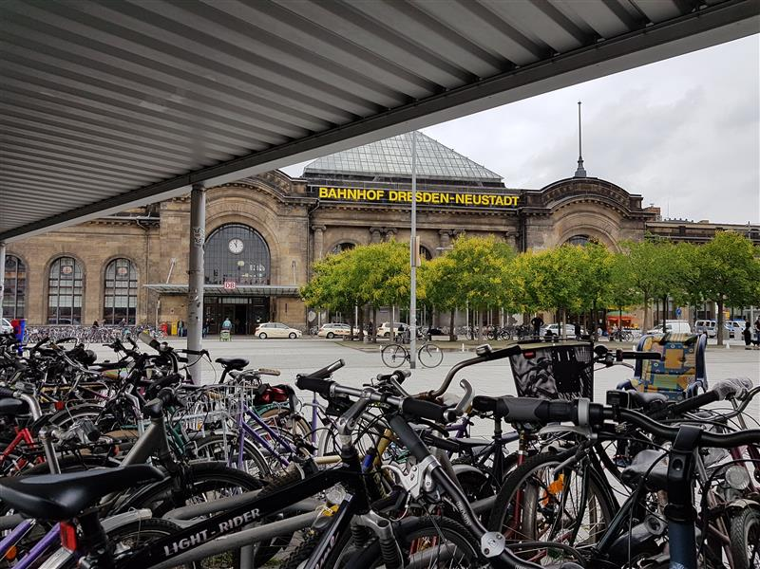
Integration Public Transport + Bicycles

Slide 4
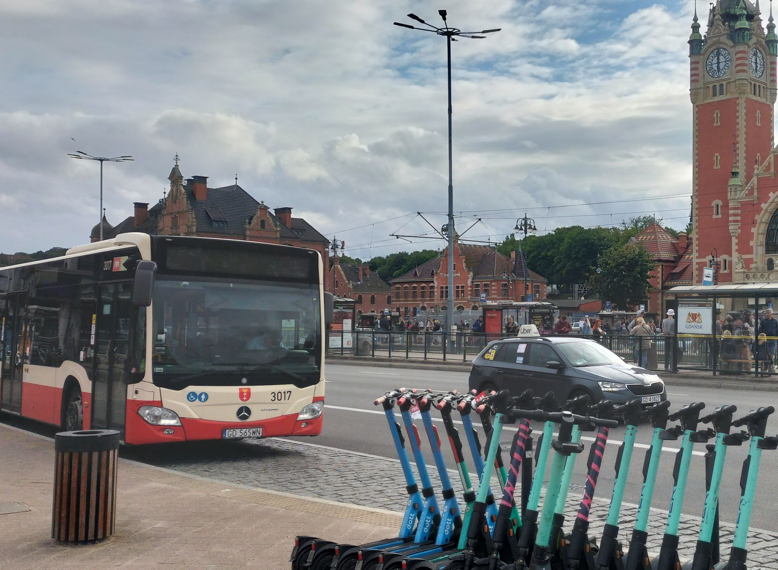
Integration Public Transport + Shared Mobility

Slide 5
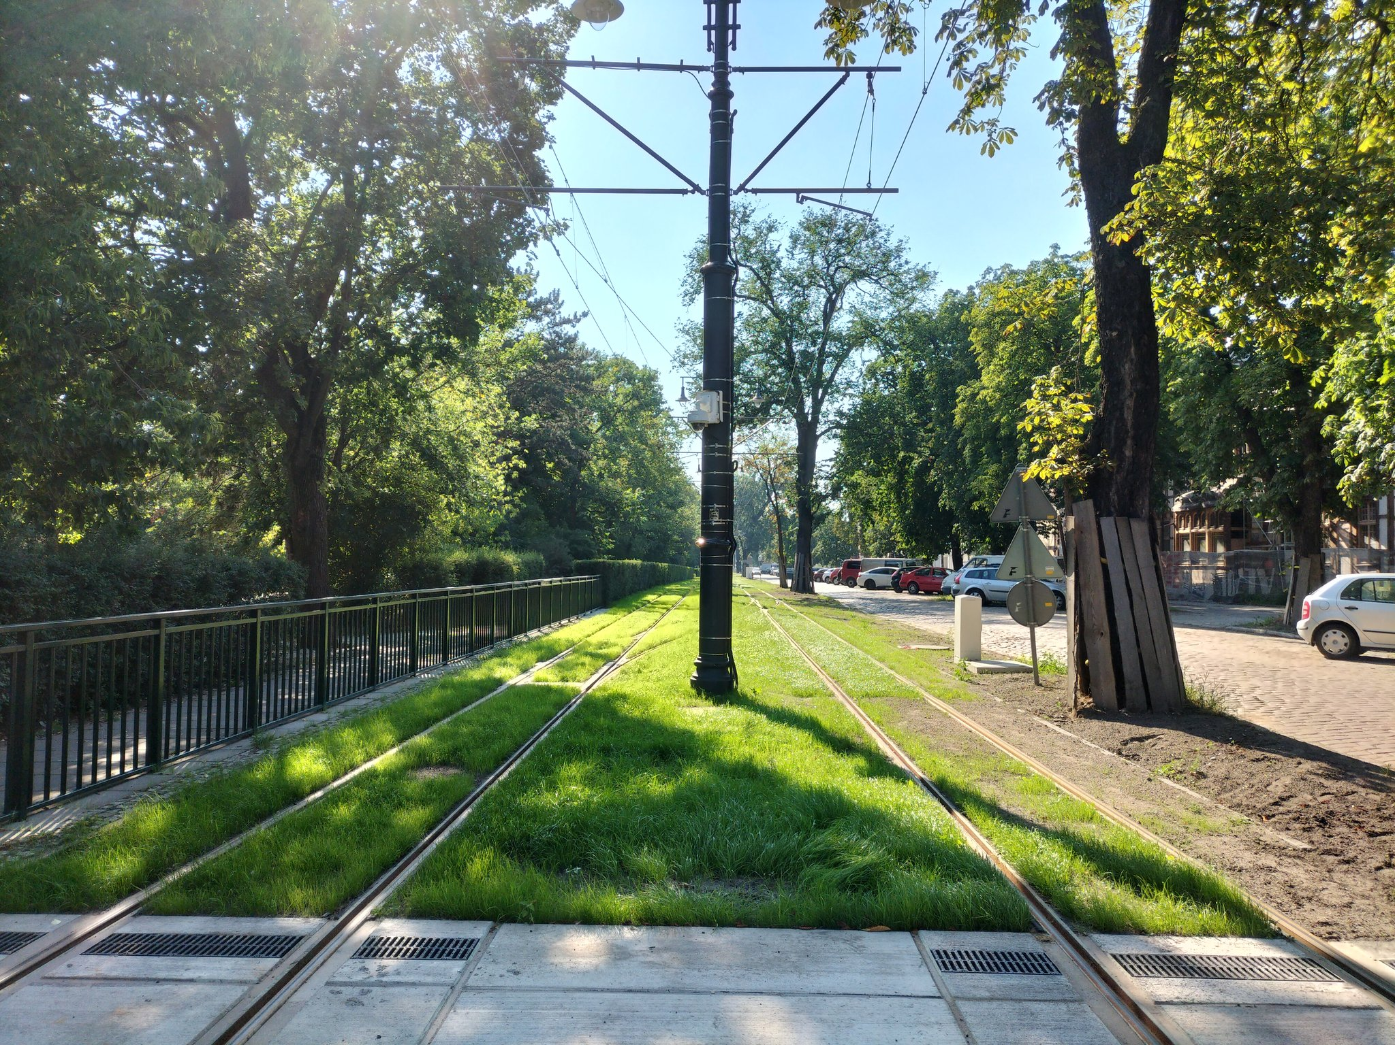
Prioritization of Public Transport + Green Infrastructure

Slide 6
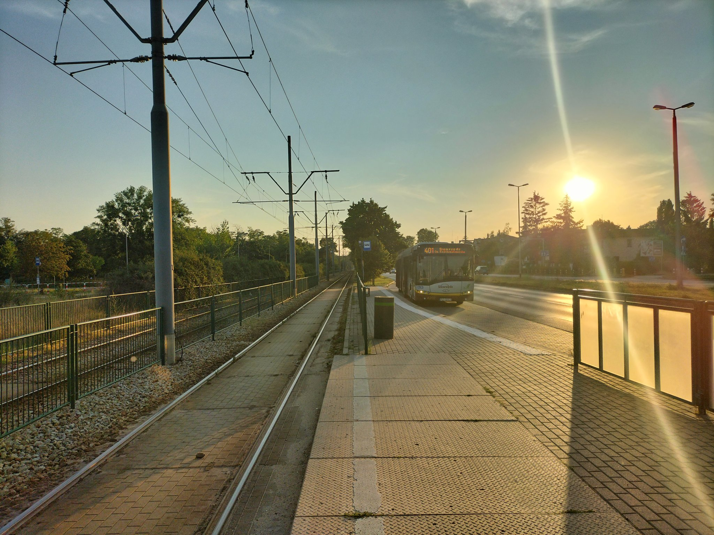
Prioritization through separation / Integration

Slide 7
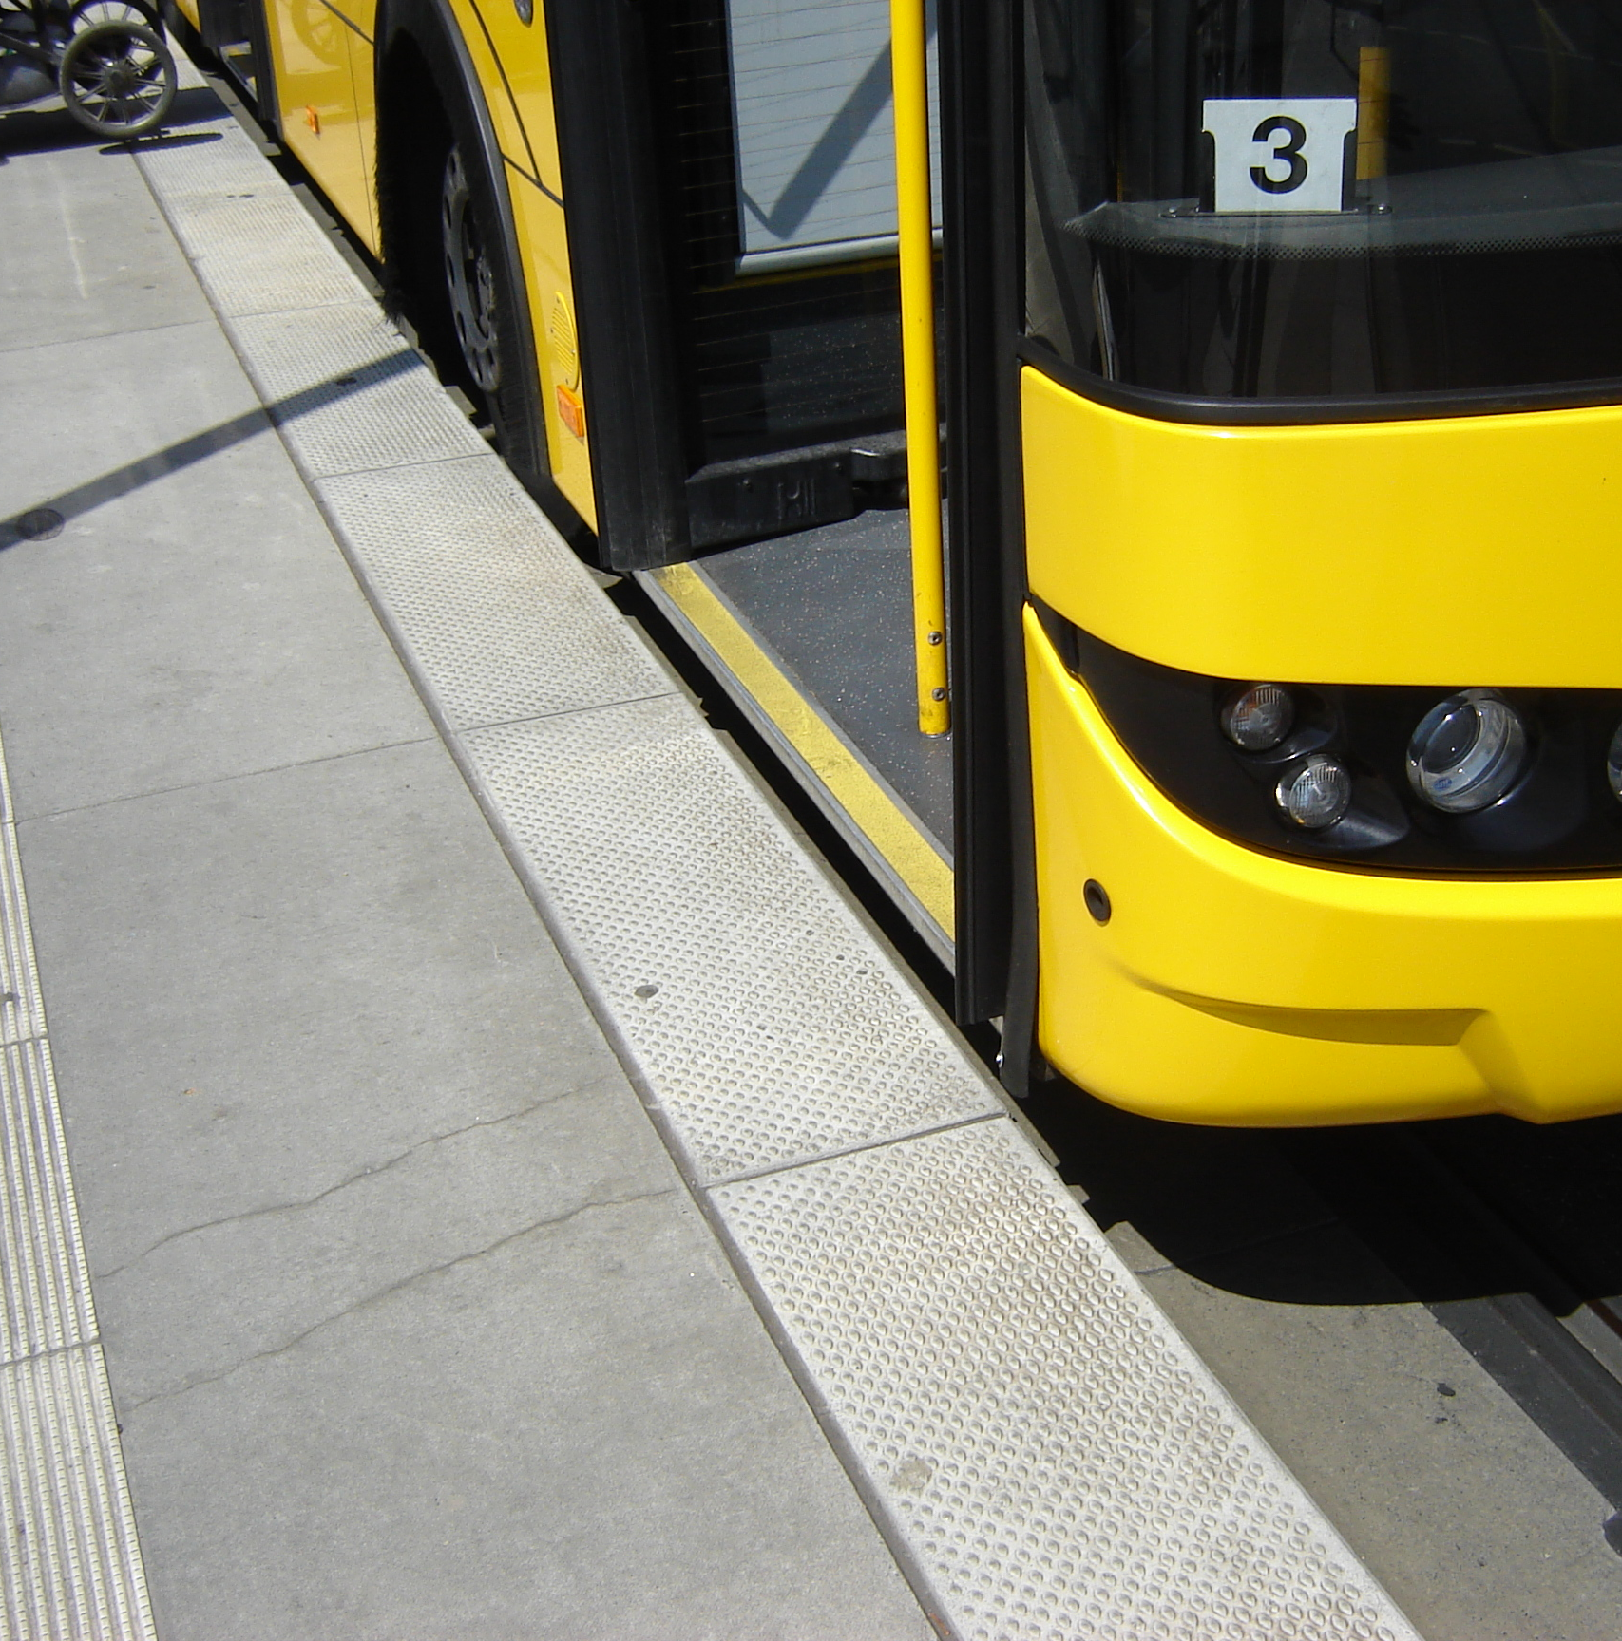
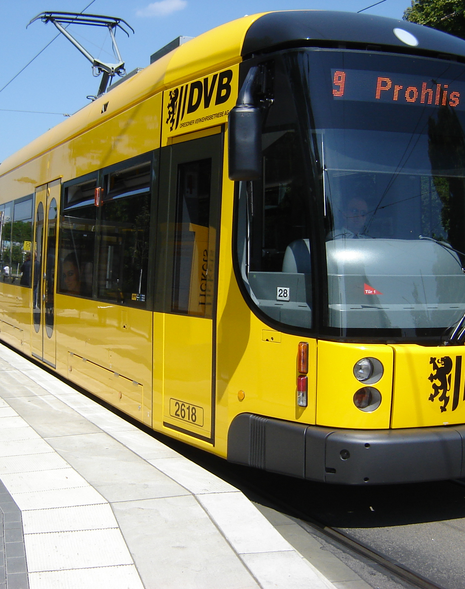
Accessibility and Performance

Slide 8
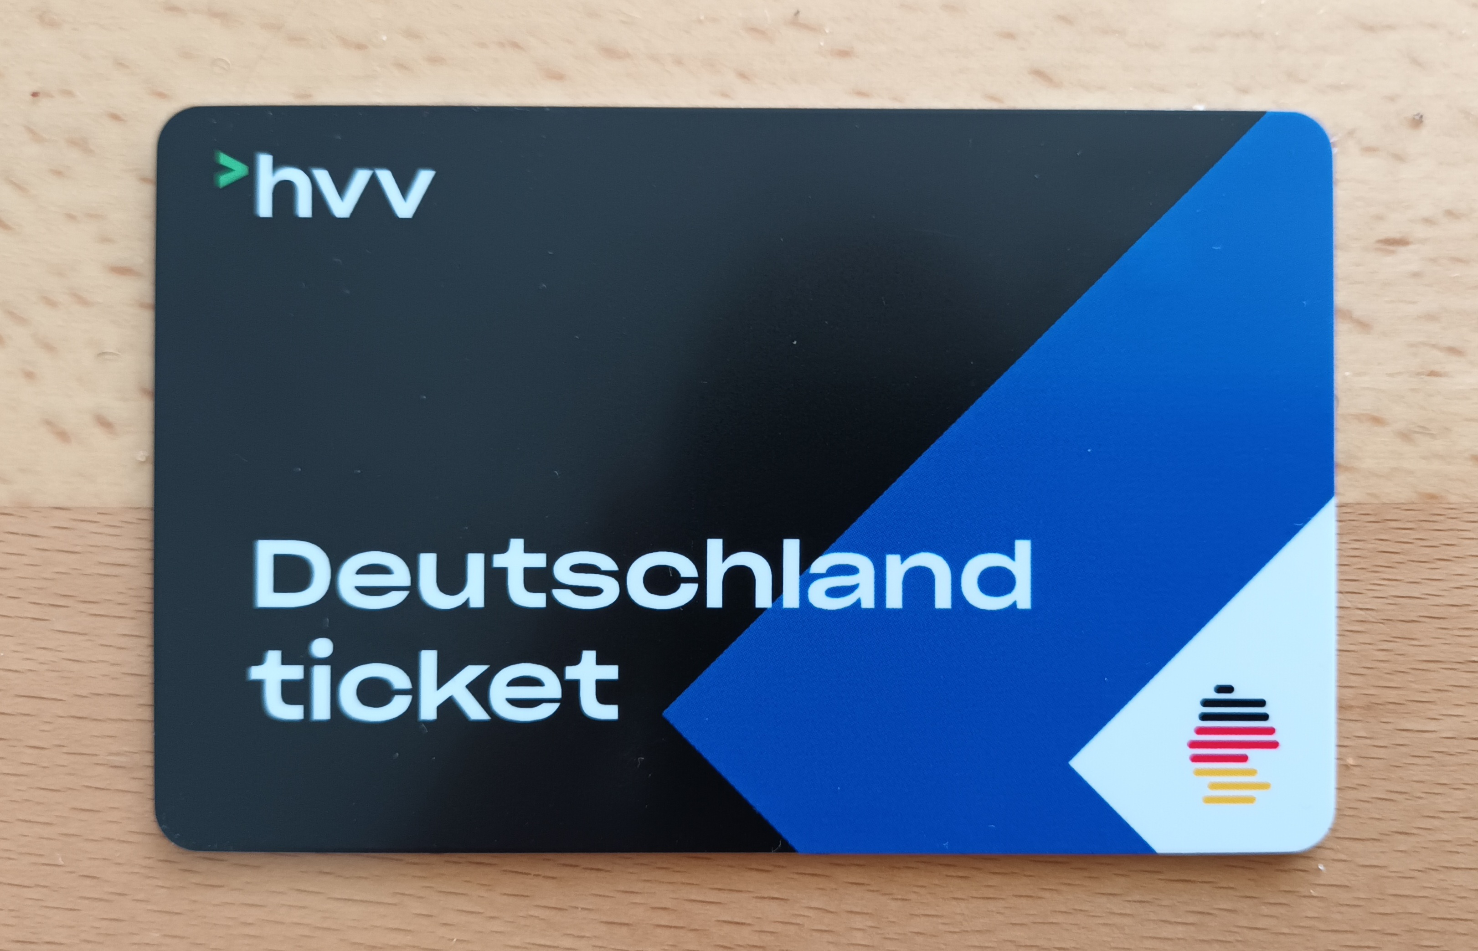
Ticket+Fare Integration and Simplification
By MissyWegner - Own work, CC BY-SA 4.0, https://commons.wikimedia.org/w/index.php?curid=131019259

Slide 9
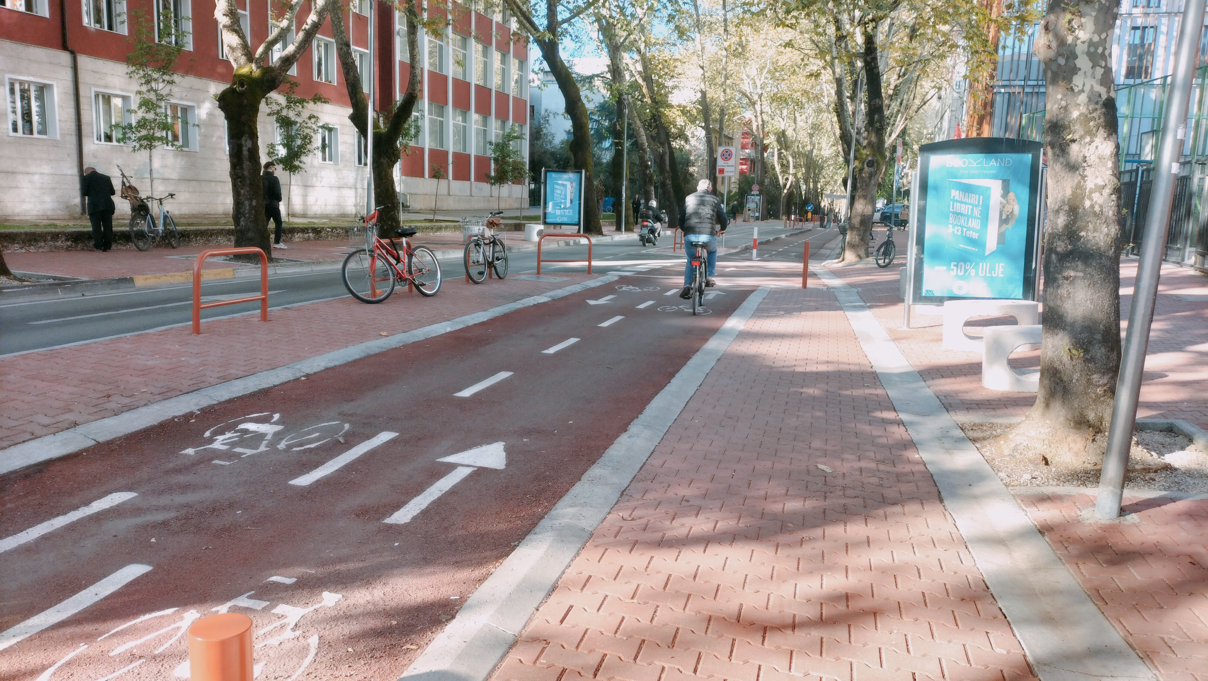
Ticketing Integration and Simplification
Public Space and Cycling Promotion
By MissyWegner - Own work, CC BY-SA 4.0, https://commons.wikimedia.org/w/index.php?curid=131019259

Slide 10
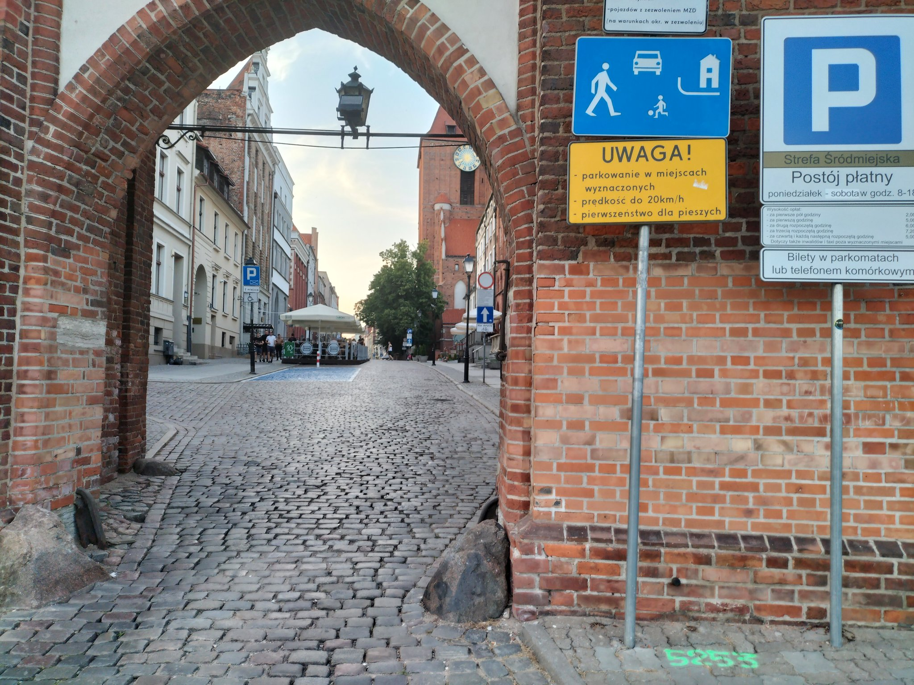
Pedestrianisation and Parking Management

Slide 11
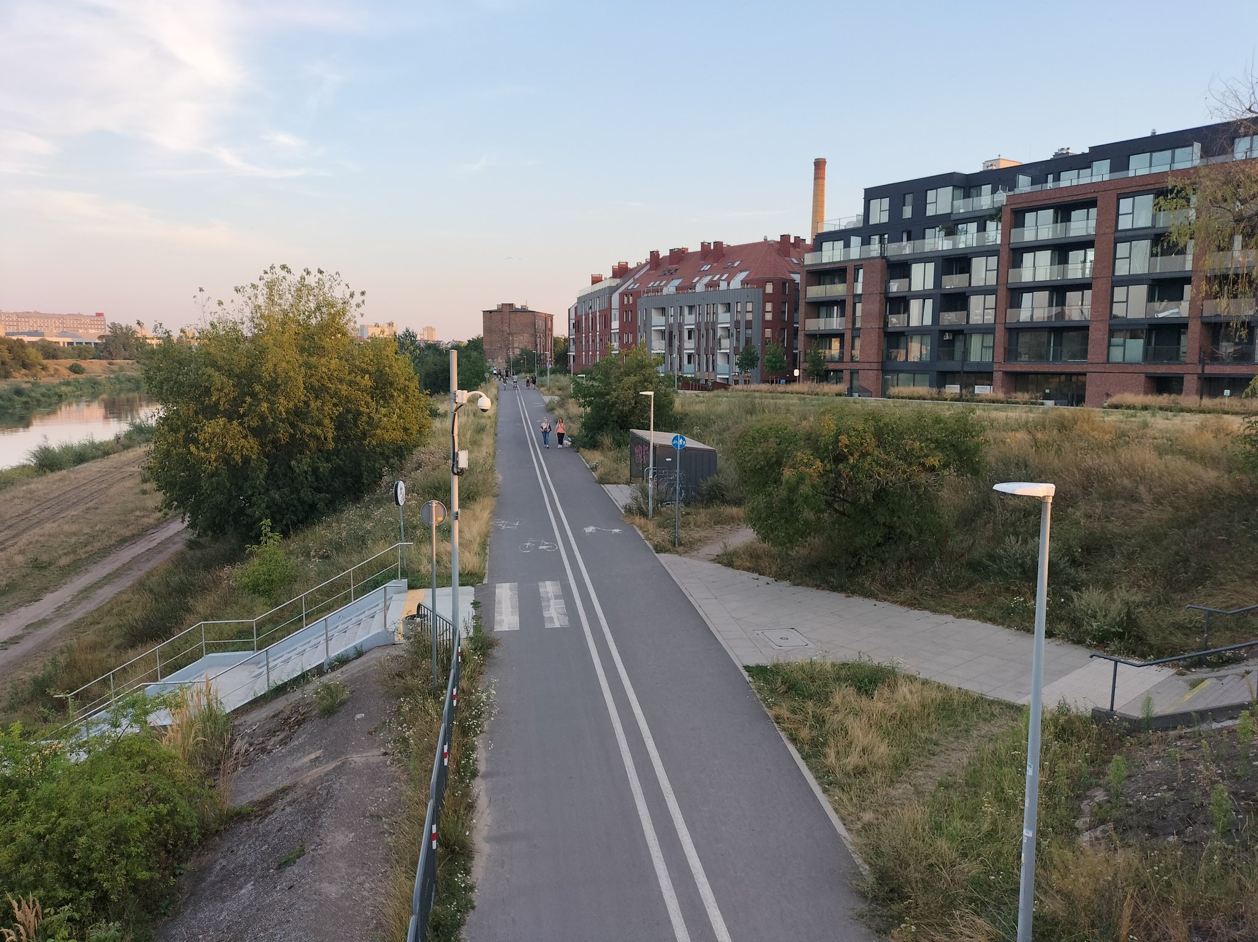
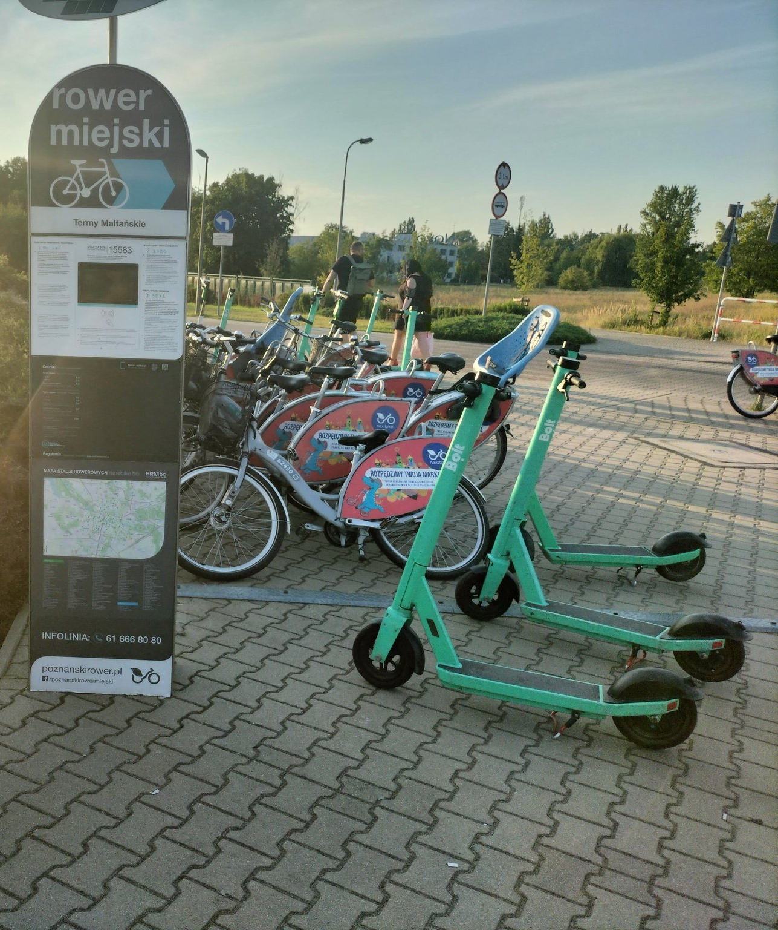
Cycling + Shared Mobility +Green/Blue Infrastructure

Slide 12
Focus is not only on advanced technology, but also on human-centered planning.
Understand who the mobility solutions serve and what to prioritize for the greatest impact.
Ensure seamless integration between public transport systems, shared mobility, and urban infrastructure.
Improve accessibility for all users — including the elderly, people with disabilities, and underserved communities.
Simplify travel experiences through smart ticketing, clear information, and efficient network design.
Balance innovation with sustainability, equity, and urban community needs.

Slide 13
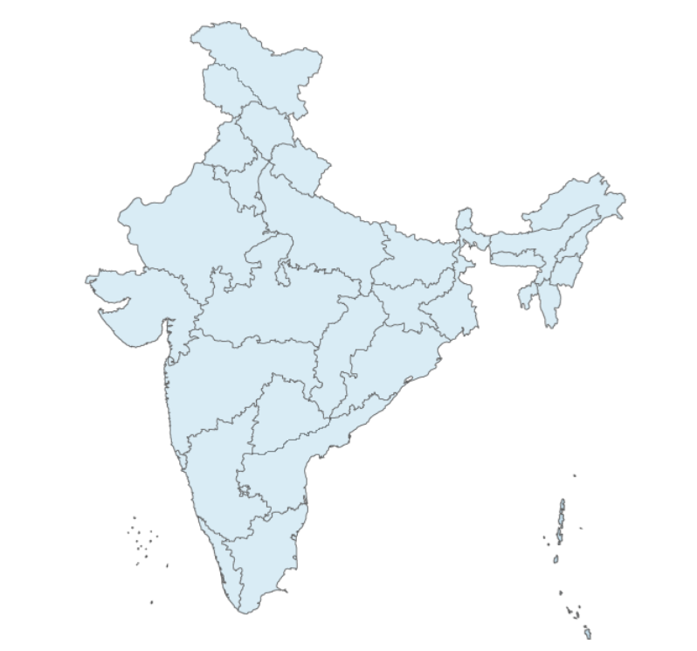

Selected activities in India, GIZ on behalf of BMZ
Shillong
Walking and Cycling
Rajkot and Trivandrum
GTFS feeds support to city buses for real time tracking
Mysore
Voice-guided assistive technology for visually impaired passengers
Rajkot
Journey Planning App for Rajkot City Buses
Surat
E-Bus Optimization tool
Gender and inclusion lab
2nd life batteries@bus depot
Bhubaneswar
Safe routes to school
Trivandrum
E-Bus Optimization tool
Kochi
Digital Dashboard for Metro Connect e-buses for efficiency enhancement and daily operations
Walkable cities
Bengaluru
Green Urban Mobility Innovation Living Lab
Legal disclaimer: This geographical map is for informational purposes only and does not constitute recognition of international boundaries or regions; GIZ makes no claims concerning the validity, accuracy or completeness of the maps nor assumes any liability resulting from the use of the information therein.

Slide 14
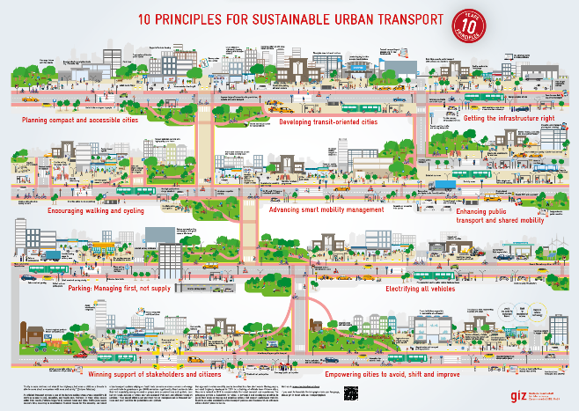
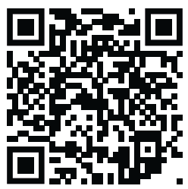
Moving people, not cars
Download:
https://changing-transport.org/ publications/10-principles-poster_sut_giz/
Avoid
Shift
Improve

Slide 15
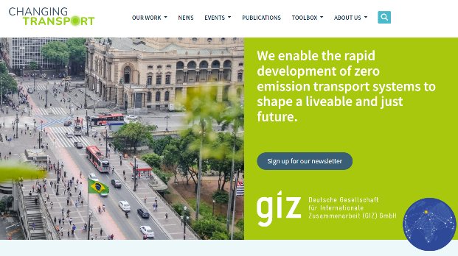
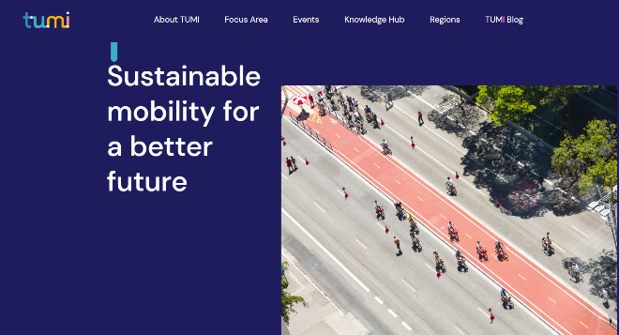
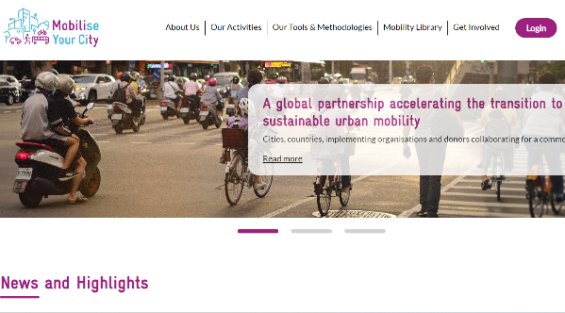
Changing Transport with focus on climate change, MRV, freight and vehicles, etc: https://changing-transport.org/
Transformative Urban Mobility Initiative (TUMI) with focus on urban mobility: https://transformative-mobility.org/
MobiliseYourCity with focus on SUMPs and NUMPs: https://www.mobiliseyourcity.net/

Slide 16
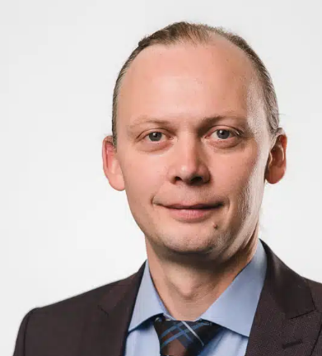
Thank you
Armin Wagner
Senior Advisor
Sustainable Mobility
Armin.Wagner@giz.de
https://www.linkedin.com/in/urbanarmin/

