Slide 1
Presentation in the 18th Urban Mobility India Conference cum Exhibition 2025
TOWARDS EQUITABLE AND GREEN MOBILITY: AN ISA-BASED ASSESSMENT OF PEDESTRIAN INFRASTRUCTURE
Author:
Sakshi Sharma
Research Scholar, IIT Roorkee
Co-Authors:
Dr. Rajat Rastogi
Professor, IIT Roorkee
Dr. Debasis Basu
Associate Professor, IIT Bhubaneshwar

Slide 2
Walking: Sustainable and Eco-friendly transportation mode
Suitable for short distances up to 1.5 km
May not be suitable for all travel scenarios
But a cheap mode providing last-mile connectivity
Walking as a Sustainable Transportation System
Accessibility
Ecological Consciousness
Health
Equity & Practicality
Quality of pedestrian infrastructure in Indian cities remains inconsistent
WHY???
Major reason:
Fragmented design, poor maintenance, and inadequate user feedback mechanisms

Slide 3
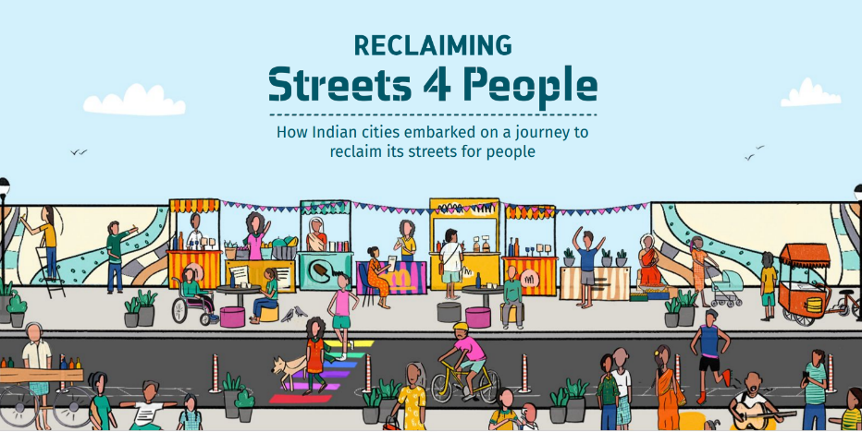


Walking as a Sustainable Transport Mode in India
Various initiatives to improve infrastructure and encourage people to shift to walking
Source: smartnet.niua.org/
However, issues relating to urban design and lack of regular maintenance have proved to be a hinderance in ensuring long-term effectiveness of the facility (Prasad and Alizadeh, 2020).
It is therefore necessary to identify and prioritize the areas of improvement in the existing infrastructure in order to achieve sustainability goals.
Identify emerging issues such as wear and tear, changing land use patterns, or evolving user needs, allowing timely interventions that maintain service quality (Tzamakos et al., 2025).

Slide 4
A Review of Past Studies and Objective of the Current Study
Performance Evaluation Techniques adopted in past
MCDM Techniques
(Li et al., 2021; Wey and Chiu, 2013)
Regression Methods
(Rodriguez-Valencia et al., 2022)
Stated Preference Techniques
(Kelly et al., 2011)
Index Development
(Minhas and Poddar, 2017; Rahul and Verma, 2018)
Focus on one dimension of data at a time, i.e., based on either the importance of the attributes, or satisfaction with the current condition
Rational identification of intervention areas requires integration of both the present in-service condition as well as the importance of facility attributes (Sum et al., 2019)- considered in Importance- satisfaction Analysis
Objective: To formalize a methodology to identify the attributes of pedestrian infrastructure based on the perception of the users, and to identify the attributes demanding immediate attention for improvement of the facility based on Importance-satisfaction analysis (ISA) coupled with Weighted Least Squares (WLS) regression.

Slide 5
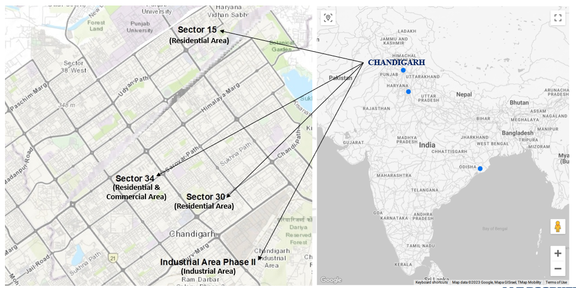
Study Area
Chandigarh: A well-planned North Indian city with an interconnected network of roads.
V-7 category - primarily intended for pedestrian movement
The resources for further improvement of walking infrastructure should be allocated based on priority areas of intervention to ensure efficiency.
Therefore, four sectors, which serve as the prime areas of their respective land uses (residential, industrial, and mixed-use), have been selected for the collection of user perception data.
The selected locations experience a significant footfall of pedestrians from nearby locations as well.

Slide 6
Selection of Attributes
Overall Satisfaction: Pedestrian Facility
(OS)
Sidewalk Continuity (SC)
Universal Design (UD)
Universal Accessibility: Connectivity (UAC)
Universal Accessibility: Tactile Paver (UATP)
Surface Condition (SC)
Cleanliness (CL)
Shaded Path (SP)
Sidewalk Width (SW)
Rest Area (RA)
Guard Rails (GR)
Illumination (IL)
Surveillance (SUR)
Washroom Availability (WA)
Crossing Facility Width (CW)
Crosswalk Pavement Markings, Signs and Signalization (CWPS)
Notes:
A thorough review of the literature was carried out to identify the attributes.

Slide 7
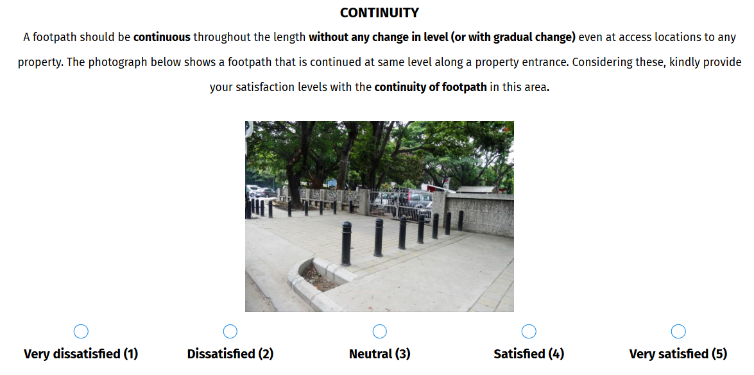
Questionnaire Development
A survey instrument was designed using survey platform ‘QuestionPro”
Level of satisfaction using 5-point Likert Scale.
Demographic data and socio-economic details of the respondents.
Example of Question in Questionnaire
Notes:
For easy and accurate understanding, the questionnaire provides a brief explanation of the attributes along with a pictorial representation.

Slide 8
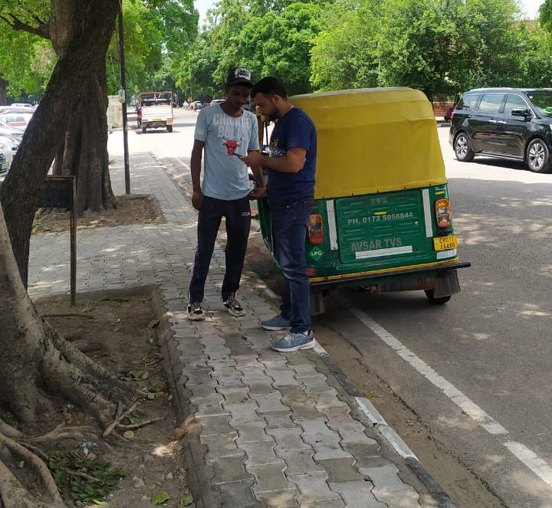
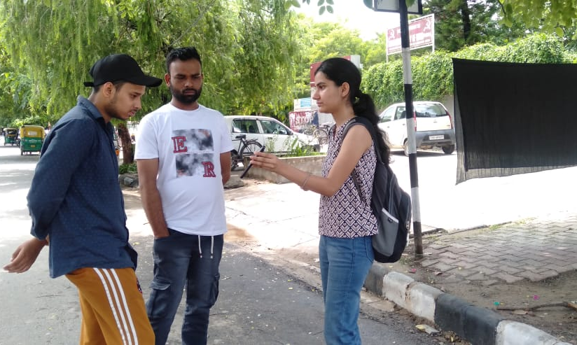
Data Collection, Extraction and Cleaning
Face-to-face interviews using smart phones and tablets
Random Sampling approach
Eligibility criteria: frequency of walking is at least once a week
554 complete responses collected
Outlier Detection using Inter-quartile range method:
k-value for mild outliers and extreme outliers is 1.5 and 3, respectively.
inter-quartile range for data based on first and third quartile: 2
24 responses identified as outliers
Number of usable samples: 530

Slide 9
Sample Characteristics

Slide 10
Derived Importance of Pedestrian Attributes
Metric of Derived Importance: Standardized Beta coefficients using Weighted Least Square Regression (in SPSS)
Reliability Analysis leads to exclusion of attributes ‘Universal Accessibility: Tactile Pavers’ and ‘Guard Rails along Sidewalk’ as these reduced the internal consistency of satisfaction responses (Cronbach’s α < 0.8)
Reliability Analysis: Cronbach’s alpha value after exclusion of attributes- 0.806
Collinearity Diagnostics: Variance Inflation Factor below threshold value, i.e. 5 for all attributes suggests no multicollinearity.
Regression analysis was performed to calculate derived importance of the considered attributes

Slide 11
Derived Importance of Pedestrian Attributes
The model can explain 72% of the variation in user satisfaction with the bicycle infrastructure
Model | R | R-Square | Adjusted R-Square | Error of Estimate
1 | 0.849ª | 0.720 | 0.705 | 1.401
a Predictors: (Constant), SW, SC, UD, UAC, SUC, CL, SP, RA, IL, SUR, WA, CW, CWPS
b Dependent Variable: Overall Satisfaction
c Weighted Least Squares Regression - Weighted by weight
Model | Unstandardized Beta Coefficients | Standardized Beta Coefficients (Derived Importance) | t-value | Significance value
Constant | 0.037 |  | 0.216 | 0.019
SW | 0.215 | 0.225 | 3.561 | 0.000
SC | 0.186 | 0.212 | 3.696 | 0.026
UD | 0.015 | 0.015 | 0.287 | 0.000
UAC | -0.043 | -0.049 | -1.041 | 0.015
SUC | 0.250 | 0.246 | 4.670 | 0.000
CL | 0.197 | 0.225 | 4.212 | 0.012
SP | -0.010 | -0.011 | -0.260 | 0.022
RA | 0.110 | 0.116 | 2.771 | 0.003
IL | -0.033 | -0.037 | -0.794 | 0.004
SUR | 0.092 | 0.090 | 1.998 | 0.033
WA | -0.014 | -0.019 | -0.521 | 0.022
CW | 0.020 | 0.030 | 0.458 | 0.034
CWPS | 0.021 | 0.026 | 0.409 | 0.015

Slide 12
Importance Satisfaction Analysis
Identifies the critical attributes by using importance and satisfaction scores for improving the services.
Max-min normalization technique: Normalization of importance and satisfaction scores to a uniform scale.
Attributes | Satisfaction Ratings |  | Derived Importance |  | Discrepancy (Norm Sat – Norm Imp)
 | Observed Satisfaction Scores | Normalized Satisfaction Scores | Calculated (Std. Beta Coefficients) | Normalized Importance
SW | 3.59 | 0.632 | 0.225 | 0.929 | -0.297
SC | 3.16 | 0.440 | 0.212 | 0.885 | -0.445
UD | 3.69 | 0.676 | 0.015 | 0.217 | 0.459
UAC | 2.38 | 0.096 | -0.049 | 0.000 | 0.096
SUC | 2.90 | 0.326 | 0.246 | 1.000 | -0.674
CL | 3.49 | 0.586 | 0.225 | 0.929 | -0.343
SP | 3.70 | 0.682 | -0.011 | 0.129 | 0.553
RA | 2.17 | 0.000 | 0.116 | 0.559 | -0.559
IL | 3.36 | 0.530 | -0.037 | 0.041 | 0.489
SUR | 2.88 | 0.316 | 0.090 | 0.471 | -0.155
WA | 4.42 | 1.000 | -0.019 | 0.102 | 0.898
CW | 3.01 | 0.373 | 0.030 | 0.268 | 0.106
CWPS | 2.45 | 0.124 | 0.026 | 0.254 | -0.130
Plotted in ISA Graph
Notes:
Positioning of axes:
Quadrant Models: Scale-centered Quadrant Model (center of the response scale) and the Data-centered Quadrant Model (based on mean or median of observations) (Martilla and James, 1977). Limitations: due to issues like low discriminative power and disutility
Diagonal Model: divides the graph into upper triangular area and lower triangular area (Sethna, 1982).
Limitations: Model had interpretation issues which led to confusion when placing the attributes in various quadrants.

Slide 13
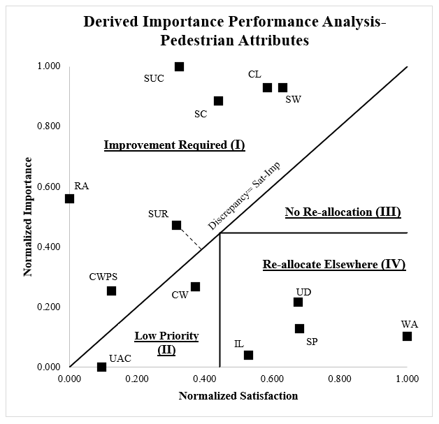
Importance Satisfaction Analysis- Hybrid Approach (Abalo et al., 2007)
Hybrid ISA approach (Abalo et al., 2007): combines the Quadrant model and the Diagonal model to overcome their individual limitations and splits the graph into four areas (defining the basis of priority of resource allocation).
Optimal Condition: No discrepancy, i.e. Satisfaction = Importance
Notes:
Concept of ‘Discrepancy’ which is a measure of the difference between the importance and satisfaction of attributes.
The importance and satisfaction of each attribute should be equal for ‘no discrepancy’ condition, which is the optimal condition.
A negative discrepancy indicates importance is greater than satisfaction (upper triangle) and hence resource allocation should be done to these attributes as a priority.

Slide 14
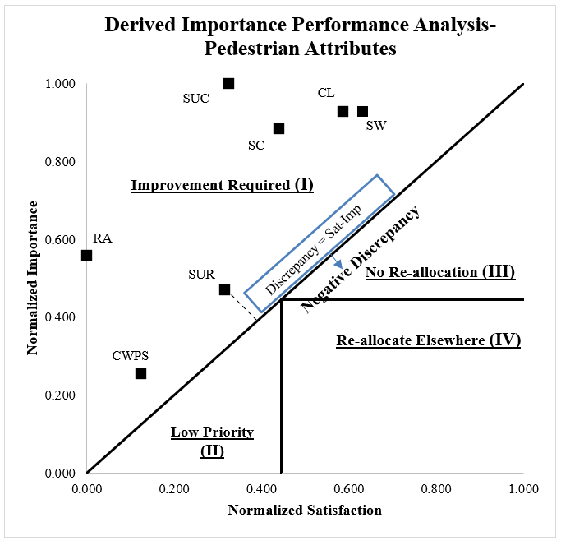
Resource Allocation: Priority I
(High Importance, Low Satisfaction)
1. Surface Condition: Lack of regular maintenance leads to wear and tear of the pedestrian paths. Potholes, cracks, and unpaved surface at certain locations may be the reason for low satisfaction of respondents.
4. Cleanliness: Unpleasant sidewalk often results from irregular maintenance. In some areas, open drains, overflowing bins and poor waste disposal practices may be the reason for low satisfaction among pedestrians.
5. Sidewalk Width: Poor initial design, road widening projects or space being taken up by utilities, poles, signboards, often reduce the effective width available for use by pedestrians.
2. Rest Area: Few or no designated resting spots along long walking stretches, inadequate or uncomfortable design of seats, and placement at inconvenient locations
3. Surface Continuity: Fragmented walking network due to interruptions, missing segments and sudden changes in elevation force the pedestrians to step up and down from the sidewalks thereby causing low satisfaction.
7. Crosswalk Pavement Markings, Signs and Signalization: Reflects gaps in both visibility and functionality of control measures on a pedestrian crossing facility. Faded markings, or placement at locations with low driver compliance, obstructed or unclear signage, and inadequate design or absence of signals.
6. Surveillance: Low satisfaction due to absence of CCTV coverage, limited police patrolling, or inactive surveillance system. Even in areas where these facilities exist, poor-maintenance or non-functionality may cause low satisfaction with the facility.

Slide 15
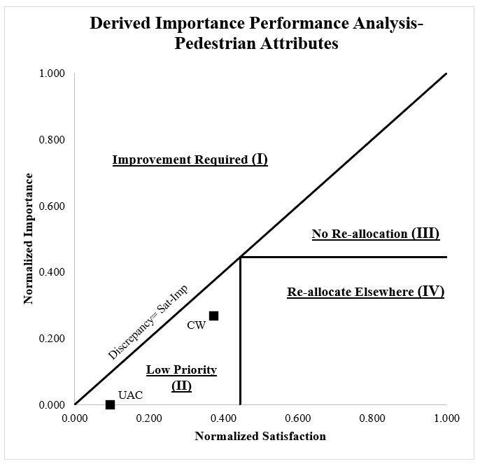
Resource Allocation: Priority II
(Low Importance, Low Satisfaction)
Low Importance, Low Satisfaction
Despite having positive discrepancy, the attributes in this segment require remedial measures: ‘Crossing Facility Width and ‘Universal Accessibility: Connectivity’.
Performance of the attributes is below the desired standards, especially considering the needs of local users such as the elderly and differently abled pedestrians.
Non-uniform provisions across different segments, e.g. lack of adequate width, continuous connections and supportive features such as ramps.
Limited functionality because of poor surface quality, obstructions and inadequacy in design thereby reducing their overall effectiveness.

Slide 16
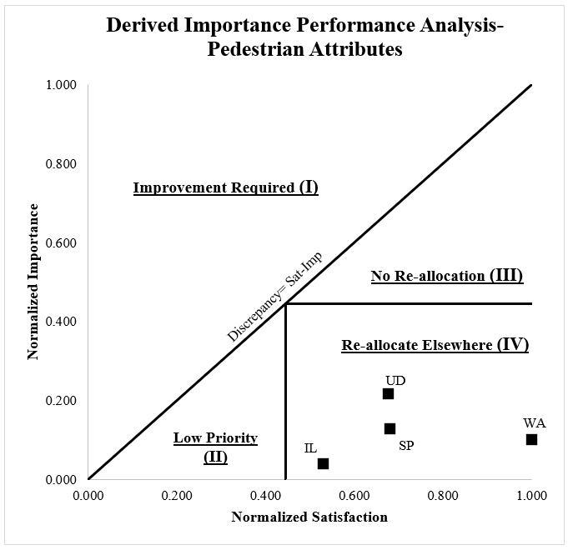
Resource Allocation: Priority III (High Importance, High Satisfaction) and Priority IV (Low Importance, High Satisfaction)
High Importance, High Satisfaction
Indicates that the facility performance is satisfactory.
However, as per the ISA analysis no attributes were found falling in this segment.
Low Importance, High Satisfaction
‘Universal Design’, ‘Shaded Path’, ‘Illumination’, and ‘Washroom Availability and Satisfaction’:
Users do not consider these attributes to be as important as others; however, they are highly satisfied with the present service in these aspects.
Though a part of the resources dedicated to maintaining these attributes can be allocated towards improvement of other attributes, but a certain level must be maintained for optimal satisfaction.

Slide 17
Conclusions
The ISA-based prioritization provide a structured basis for evidence-based decision-making in pedestrian infrastructure planning and maintenance.
City agencies can directly use the derived importance and satisfaction values to prepare attribute-specific improvement plans.
Installing well-designed rest areas with seating and shade, particularly near markets and bus stops, will improve inclusivity for elderly and mobility-challenged users.
The attributes identified as “high importance–low satisfaction” (e.g., Surface Condition, Continuity, Cleanliness) can be incorporated into annual maintenance budgets or short-term action plans, ensuring that limited resources are directed to high-impact areas.
Authorities should prioritize a citywide maintenance and retrofit program to repair cracked or uneven sidewalks, ensure regular cleaning, and remove encroachments that reduce effective walking width.
The continuity of sidewalks should be restored by addressing gaps caused by driveways or unpaved segments, and surveillance measures (CCTV coverage, police patrolling, and lighting upgrades) must be strengthened along high-footfall corridors to enhance perceived safety.

Slide 18
Conclusions
These findings can be integrated into existing urban street audit protocols, where the score obtained by each attribute can be tracked over time to evaluate the effectiveness of interventions thus creating path for development of a diagnostic tool for infrastructure improvement under various schemes.
The study’s novelty lies in demonstrating how WLS-derived importance can strengthen ISA outcomes for infrastructure evaluation in data-constrained, heterogeneous urban contexts, typical of developing countries.
Future studies can also benefit from exploring non-linear methods for importance estimation to compare interpretability and accuracy.
Limitations: The analysis is based on data from a single city Chandigarh, which may limit the generalizability of results to cities with different urban forms, socioeconomic contexts, or climatic conditions.
Limitations: Although the sample size (n = 530) was adequate for the statistical methods used, expanding the dataset across multiple cities or zones would enhance model robustness.

Slide 19
Thank You!

