Slide 1
EARLY WARNING SYSTEM FOR CROWD MANAGEMENT IN MASS RELIGIOUS GATHERINGS
Urban Mobility India Conference- 2025
Authors:
Aswana B (MTech Student, Indian Institute of Science)
Dr. Nipun Choubey (Former PhD Student, Indian Institute of Science)
Prof. (Dr.) Ashish Verma (Professor, Indian Institute of Science)

Slide 2
AGENDA
 | Problem Context
 | Research Gaps
 | Aim & Objectives
 | Methodology
 | Model Comparison
 | Forecast Results
 | Risk Anticipation
 | Transferability Test
 | Warning Module
 | Conclusion
01
06
02
07
03
08
04
09
05
10

Slide 3
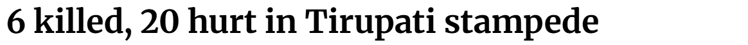
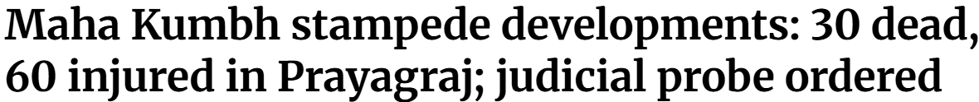
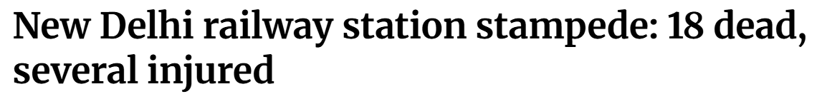
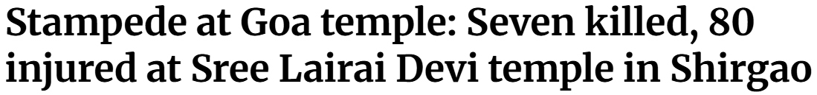
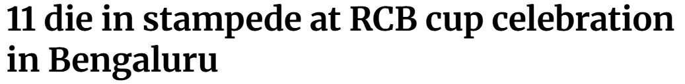
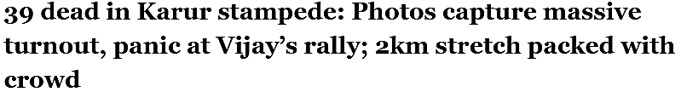
PROBLEM CONTEXT
Fatalities Due to Religious Stampede in India
(Year: 2000 - 2025)
Injuries Due to Religious Stampede in India
(Year: 2000 - 2025)
Source: The Hindu
(Source: Various News Article)

Slide 4
RESEARCH GAPS
AIM
OBJECTIVES
Reliance on Simulated Dataset
To develop an efficient early warning system to enhance crowd safety during mass religious gatherings
To establish a framework to accurately forecast crowd parameters
Predominant Focus on Low-Density Scenarios
To anticipate crowd risk based on forecasted crowd parameters
Absence of Integrated Prediction and Warning Systems
To develop a model for generating warnings based on the anticipated risk
Lack of Context-Specific Models

Slide 5

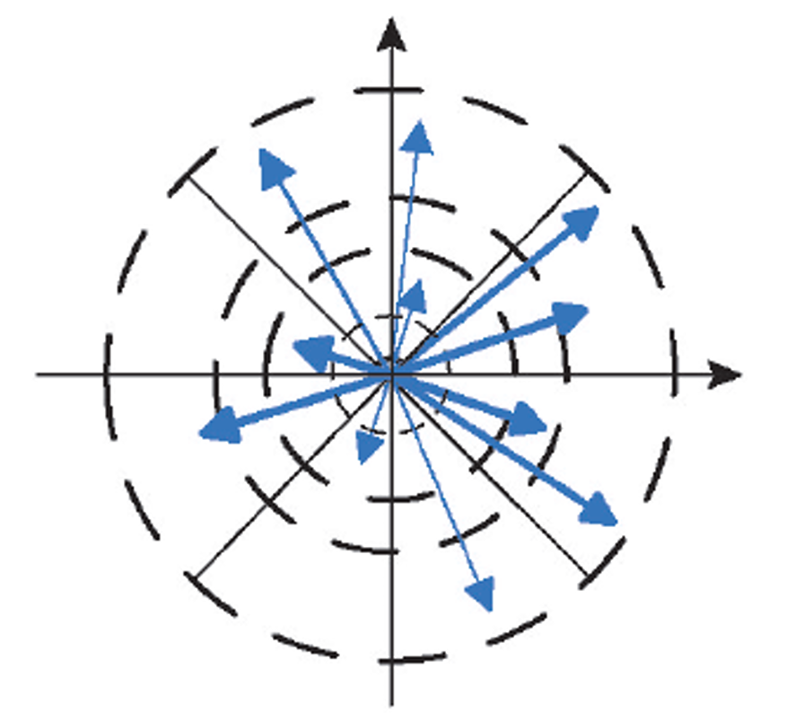
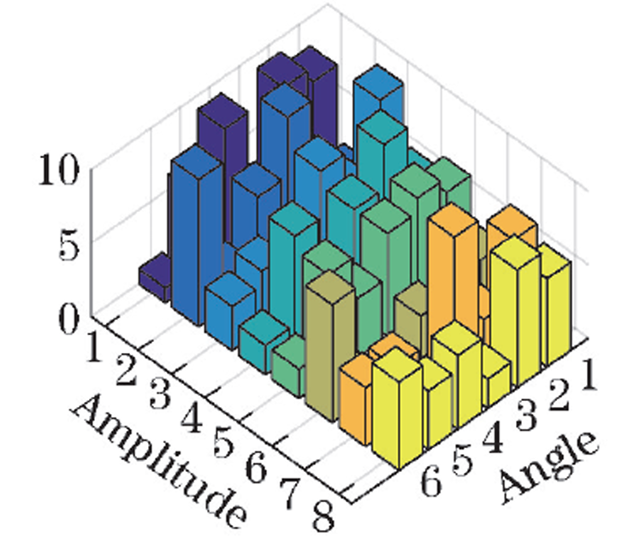
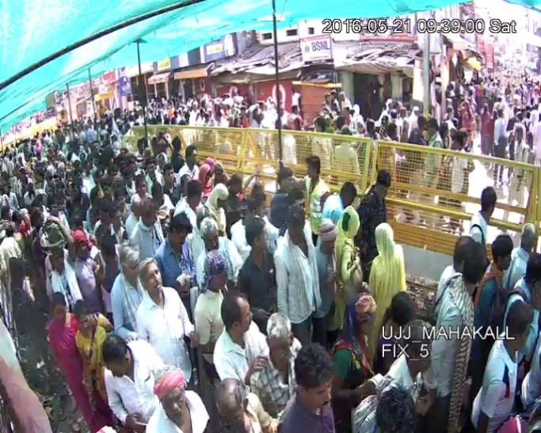
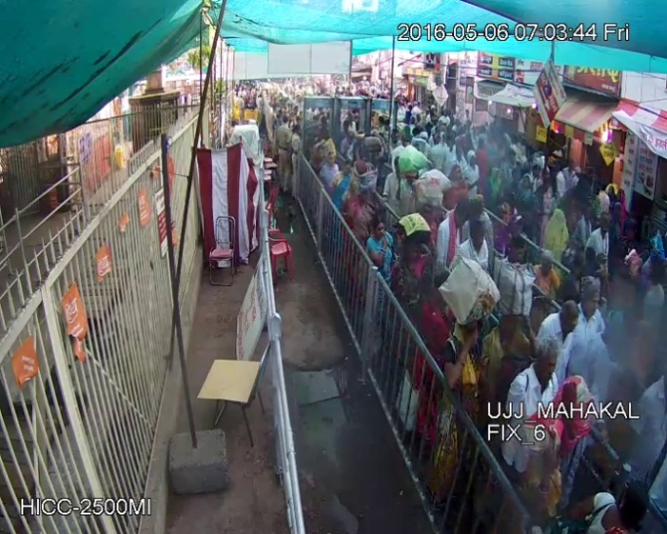
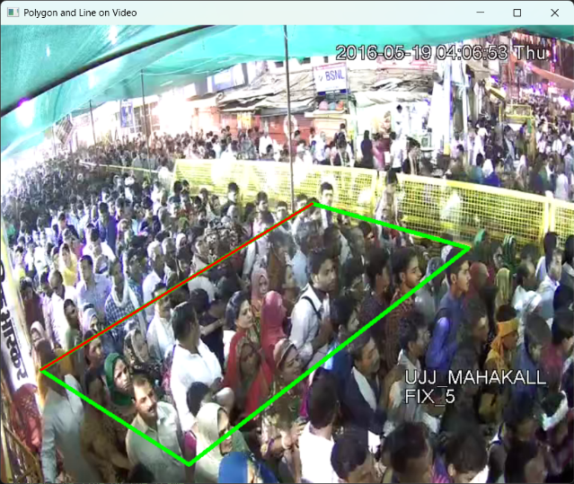
METHODOLOGY
ENTROPY EXTRACTION
DATA COLLECTION
CCTV Video Data
58 hours of CCTV from 2016 Kumbh Mela
Study Area: Mahakal Mandir
Parameter Extraction
Global optical flow vectors
Amplitude and angle quantization of optical flow vectors
2D optical flow vector histograms
Source: Naik K K (2023), “Entropy-based Crowd Risk Prediction”, MTech Thesis, IISc Bangalore, India.
DENSITY & FLOW EXTRACTION
Parameter Forecasting
Risk Anticipation
Warning Generation
Primary Study Area
Secondary Study Area
Time Series of Crowd Parameters on Day 1
Source: Verma, A. (2019), “The Kumbh Mela Experiment: Measuring and understanding the dynamics of mankind’s largest crowd”, Project Final Report, IISc Bangalore, India.
Time Series of Crowd Parameters on Day 1
Source: Choubey, N. (2025). Sensing, Analysing and Simulating Heterogeneous Unstructured Crowds in Mass Religious
Gatherings (Doctoral dissertation).

Slide 6
METHODOLOGY
FORECASTING MODELS
A Random Forest classifier was employed to classify crowd conditions into Low, Medium, and High-risk levels.
The model was trained on labelled video clips from the 2016 Kumbh Mela, where experts assigned risk levels based on crowd behaviour.
The performance was evaluated by comparing risk levels from actual and forecasted data using a confusion matrix, precision, recall, and F1 score.
A red blinking overlay was used on CCTV frames to visually alert operators during high-risk conditions, ensuring quick attention with minimal computational load.
CCTV Video Data
Statistical Methods
Simple Moving Average
Auto Regressive
Auto Regressive Integrated Moving Average
Seasonal Auto Regressive Integrated Moving Average
Parameter Extraction
Parameter Forecasting
Deep Learning & Machine Learning Methods
Long Short Term Memory
Bidirectional Long Short Term Memory
Gated Recurrent Units
Support Vector Regression
Look-Back Window
Forecast Horizon
Risk Anticipation
Warning Generation
Source: Choubey N., Naik K., Verma A., M Danny Raj, Subramanian G. (2024). "Assessing the impact of video-based crowd entropy on crowd risk estimation in mass religious gatherings", Transportation in Developing Economies(under review).

Slide 7
MODEL COMPARISON
 |  | SMA | AR | ARIMA | SARIMA | LSTM | BiLSTM | GRU | SVR
Look-Back Window | 10 | 2.469 | 2.598 | 3.57 | 3.009 | 2.829 | 2.575 | 2.532 | 2.778
 | 20 | 2.553 | 2.633 | 2.94 | 2.801 | 2.549 | 2.78 | 2.598 | 2.774
 | 30 | 2.446 | 2.651 | 2.664 | 2.704 | 2.884 | 2.645 | 2.525 | 2.99
 | 40 | 2.175 | 2.74 | 2.625 | 2.631 | 2.857 | 3.058 | 2.396 | 2.984
 | 50 | 2.399 | 2.64 | 2.68 | 2.621 | 3.248 | 2.693 | 2.553 | 3.388
 | 60 | 2.185 | 2.675 | 2.344 | 2.535 | 3.331 | 2.889 | 3.149 | 3.06
Variation of MAPE with different look-back window sizes for Entropy

Slide 8
SELECTED FORECASTING MODEL
Final Model Architecture for GRU Model
Hyperparameters | Entropy | Density | Flow
GRU Layer 1 | 40 | 48 | 32
GRU Layer 2 | 40 | - | -
Dense Output Layer | 1 | 1 | 1
Batch Size | 60 | 55 | 55
Learning Rate | 1e-3 | 1e-4 | 1e-4
Epoch | 100
Early Stopping Patience | 3
Loss Function | Mean Squared Error

Slide 9
FORECAST RESULTS- ENTROPY
Actual vs Forecasted values for Entropy
Forecasting Error Metrics for Entropy

Slide 10
FORECAST RESULTS- DENSITY
Actual vs Forecasted values for Density
Forecasting Error Metrics for Density

Slide 11
FORECAST RESULTS- FLOW
Actual vs Forecasted values for Flow
Forecasting Error Metrics for Flow

Slide 12
RISK ANTICIPATION
Anticipated Risk | Actual Risk
 |  | Low | Medium | High
 | Low | 43 | 7 | 0
 | Medium | 10 | 25 | 0
 | High | 0 | 0 | 0
0
25
50
Confusion Matrix for Primary Study Area
Classification metrics
Source: Choubey N., Naik K., Verma A., M Danny Raj, Subramanian G. (2024). "Assessing the impact of video-based crowd entropy on crowd risk estimation in mass religious gatherings", Transportation in Developing Economies(under review).

Slide 13
TRANSFERABILITY TEST- ENTROPY
Actual vs Forecasted values for Entropy
Forecasting Error Metrics for Entropy

Slide 14
TRANSFERABILITY TEST- DENSITY
Actual vs Forecasted values for Density
Forecasting Error Metrics for Density

Slide 15
TRANSFERABILITY TEST- FLOW
Actual vs Forecasted values for Flow
Forecasting Error Metrics for Flow

Slide 16
RISK ANTICIPATION
Anticipated Risk | Actual
 |  | Low | Medium | High
 | Low | 2 | 3 | 0
 | Medium | 2 | 41 | 0
 | High | 0 | 0 | 0
0
25
50
Confusion Matrix for Secondary Study Area
Classification metrics
Source: Choubey N., Naik K., Verma A., M Danny Raj, Subramanian G. (2024). "Assessing the impact of video-based crowd entropy on crowd risk estimation in mass religious gatherings", Transportation in Developing Economies(under review).

Slide 17
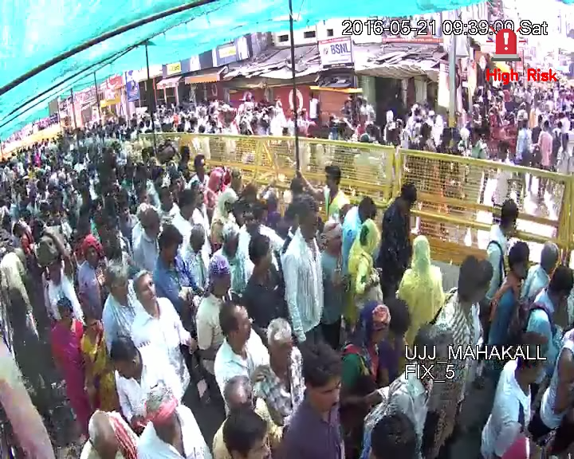
WARNING MODULE

Slide 18
CONCLUSION
FUTURE SCOPE
Developed and evaluated a time-series-based EWS for crowd risk anticipation
Real-Time Deployment
Used real data from 2016 Kumbh Mela focusing on entropy, density, and flow
Cross-Event Validation
IoT Integration & Sensor Fusion
GRU-based model showed strong generalization and responsiveness
Incorporation of Mesoscopic & Microscopic Features
Risk anticipation captured 80-90% of actual risk levels
Validation Using Real High-Risk Events
Warning module accurately triggered high-risk alerts, proving real-world utility
Model Advancement
Framework is transferable across different high-density environments
Optimized Alerting Mechanisms

Slide 19
Thank You!
Questions?

Slide 20
REFERENCES
Alahi, A., Goel, K., Ramanathan, V., Robicquet, A., Fei-Fei, L., & Savarese, S. (2016). Social LSTM: Human trajectory prediction in crowded spaces. Proceedings of the IEEE Computer Society Conference on Computer Vision and Pattern Recognition, 2016-December, 961–971. https://doi.org/10.1109/CVPR.2016.110
Anzengruber, B., Pianini, D., Nieminen, J., & Ferscha, A. (n.d.). LNCS 8238 - Predicting Social Density in Mass Events to Prevent Crowd Disasters. https://doi.org/10.1007/978-3-319-03260-3_18
Choubey, N., & Naik, K. Assessing the impact of video-based crowd entropy on crowd risk estimation in mass religious gatherings. (Under Review)
Bamaqa, A., Sedky, M., Bosakowski, T., Bakhtiari Bastaki, B., & Alshammari, N. O. (2022). SIMCD: SIMulated crowd data for anomaly detection and prediction. Expert Systems with Applications, 203. https://doi.org/10.1016/j.eswa.2022.117475
Cai, J., Zhang, Y., Yang, L., Cai, H., & Li, S. (2020). A context-augmented deep learning approach for worker trajectory prediction on unstructured and dynamic construction sites. Advanced Engineering Informatics, 46. https://doi.org/10.1016/j.aei.2020.101173
Determe, J. F., Singh, U., Horlin, F., & De Doncker, P. (2021). Forecasting Crowd Counts with Wi-Fi Systems: Univariate, Non-Seasonal Models. IEEE Transactions on Intelligent Transportation Systems, 22(10), 6407–6419. https://doi.org/10.1109/TITS.2020.2992101
Gayathri, H., Aparna, P. M., & Verma, A. (2017). A review of studies on understanding crowd dynamics in the context of crowd safety in mass religious gatherings. In International Journal of Disaster Risk Reduction (Vol. 25, pp. 82–91). Elsevier Ltd. https://doi.org/10.1016/j.ijdrr.2017.07.017
Gayathri, H., Gulhare, S., & Verma, A. (n.d.). Understanding Crowd Dynamics in Processions during Mass Religious Gatherings A case study of Shahi Snan in Kumbh Mela. https://doi.org/10.17815/CD.2020.76
Gulhare, S., Verma, A., & Chakroborty, P. (2018). Comparison of Pedestrian Data of Single File Movement Collected from Controlled Pedestrian Experiment and from Field in Mass Religious Gathering. Collective Dynamics, 3. https://doi.org/10.17815/cd.2018.16
Harding, P. J., Gwynne, S. M. V., & Amos, M. (2010). An early warning method for crush. http://arxiv.org/abs/1008.2160
Harihara Subramanian, G., & Verma, A. (2022). Crowd risk prediction in a spiritually motivated crowd. Safety Science, 155. https://doi.org/10.1016/j.ssci.2022.105877
Helbing, D., Johansson, A., & Al-Abideen, H. Z. (2007). Dynamics of crowd disasters: An empirical study. Physical Review E - Statistical, Nonlinear, and Soft Matter Physics, 75(4). https://doi.org/10.1103/PhysRevE.75.046109
Illiyas, F. T., Mani, S. K., Pradeepkumar, A. P., & Mohan, K. (2013). Human stampedes during religious festivals: A comparative review of mass gathering emergencies in India. In International Journal of Disaster Risk Reduction (Vol. 5, pp. 10–18). https://doi.org/10.1016/j.ijdrr.2013.09.003
Johansson, A., Helbing, D., Al-Abideen, H. Z., & Al-Bosta, S. (2008). FROM CROWD DYNAMICS TO CROWD SAFETY: A VIDEO-BASED ANALYSIS (Vol. 13, Issue 4). https://doi.org/10.1142/S0219525908001854
Liu, S., Zhu, Z., Cheng, Q., & Zhang, H. (2016, December). Analysis and design of public places crowd stampede early-warning simulating system. In 2016 International Conference on Industrial Informatics-Computing Technology, Intelligent Technology, Industrial Information Integration (ICIICII) (pp. 210-213). IEEE. 10.1109/ICIICII.2016.0058
Makinoshima, F., & Oishi, Y. (2022). Crowd flow forecasting via agent-based simulations with sequential latent parameter estimation from aggregate observation. Scientific Reports, 12(1). https://doi.org/10.1038/s41598-022-14646-4
Moussaïd, M., Kapadia, M., Thrash, T., Sumner, R. W., Gross, M., Helbing, D., & Hölscher, C. (2016). Crowd behaviour during high-stress evacuations in an immersive virtual environment. Journal of the Royal Society Interface, 13(122). https://doi.org/10.1098/rsif.2016.0414
Poon, K. H., Wong, P. K. Y., & Cheng, J. C. P. (2022). Long-time gap crowd prediction using time series deep learning models with two-dimensional single attribute inputs. Advanced Engineering Informatics, 51. https://doi.org/10.1016/j.aei.2021.101482
Rai, A., Verma, A., & Chakroborty, P. (n.d.). ScienceDirect Crowd Dynamics of a Rural Group in a Mass Religious Gathering: A Case Study of Kumbh Mela-2016, India-review under responsibility of WORLD CONFERENCE ON TRANSPORT RESEARCH SOCIETY. https://doi.org/10.1007/978-981-99-7976-9_11
Reactive and Proactive Anomaly Detection in Crowd Management Using Hierarchical Temporal Memory. (2022). International Journal of Machine Learning and Computing, 12(1). https://doi.org/10.18178/ijmlc.2022.12.1.1072
Singh, U., Determe, J. F., Horlin, F., & Doncker, P. De. (2020). Crowd Forecasting Based on WiFi Sensors and LSTM Neural Networks. IEEE Transactions on Instrumentation and Measurement, 69(9), 6121–6131. https://doi.org/10.1109/TIM.2020.2969588
Zhao, G., Li, C., Xu, G., He, F., & Zhang, J. (2021). A high-density crowd state judgment model based on entropy theory. PLoS ONE, 16(September). https://doi.org/10.1371/journal.pone.0255468

