Slide 1


Slide 2


NON FARE REVENUE AND VALUE CAPTURE FINANCING
Prospects and Challenges for Indian Public Transport
Gautam Patel
Principal Consultant
Coordinates

Slide 3




VCF – CONCEPTUAL FRAMEWORK
VALUE CREATION
Increasing potential value of under-used asset as a result of public infrastructure
VALUE REALISATION
Subsequent investment to ensure potential asset value increase is realized
VCF
VALUE RECYCLING
Reinvestment of acquired monetary into same of other infrastructure projects
VALUE CAPTURE
Acquisition of proportion of the value increased, for
local investment

Slide 4
VCF POLICY AND REGULATORY FRAMEWORK
National Urban Transport Policy
Value Capture Financing Policy
TOD Policy
Metro Rail Policy 2017
CENTRAL LEVEL
MoHUA
Metro Act 2009
Land Value Tax
Fees for changing land use (Agri. – Non-Agri.)
Betterment Levy
Development charges (Impact Fees)
Transfer of Development Rights
Premium on relaxation of rules for additional FSI
Vacant Land Tax
Tax increment financing
Land Acquisition and Development
Land Pooling System
Property Tax
Fees for regularizing unauthorized development
Land Conversion Act
Land Revenue Act
Municipalities or Municipal Corporation Act
Development Authority Act
Town/ Country Planning Act
Building Tax Act
Urban Land Tax Act
TOD Notifications
UMTA Act
UTF Act
Zoning Regulations
STATE
LEVEL
Haryana State TOD Policy
Delhi TOD Policy
CITY
LEVEL
Ahmedabad Comprehensive Development Plan 2021
Policy part of Naya Raipur Development Plan-2031
POLICIES
LEGISLATION/ ACTS
TOOLS

Slide 5
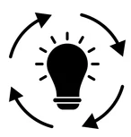



VCF POLICY - (Ministry of Housing & Urban Affairs, Central Govt. 2017)
Value Capture Finance (VCF) policy aims to encourage use of appropriate VCF Method for generating resources for both new and existing infrastructure projects
Methods of Value Capture Financing
Steps for Project-based VCF
S.No. | Value Capture Method | Scale of Intervention
1 | Land Value Tax | Area-based
2 | Fees for changing land use (Agri. – Non-Agri.) | Area/ Project-based
3 | Betterment Levy | Area/ Project-based
4 | Development charges (Impact Fees) | Area-based
5 | Transfer of Development Rights | Area/ Project-based
6 | Premium on relaxation of rules for additional FSI | Area (Road, Railways)/ Project (Metro)
7 | Vacant Land Tax | Area-based
8 | Tax increment financing | Area-based
9 | Land Acquisition and Development | Area/ Project-based
10 | Land Pooling System | Area/ Project-based
Frame Project Objectives
Check enabling rules and regulations for VC in the State. Propose new VCF tools if required
Project Initiation
1
Check project area of influence
Analyze the Land value impact (as part of DPR)
Identify stakeholders who will benefit
Planning
2
Identify VC methods for project funding & its structure
Prep. of Agreements/ MoU between State Govt./ ULB and Central Govt. if needed
Design &
Strategy
3
Implementation of VC methods
Managing of Funds
Regular monitoring and evaluation of project progress
Execution &
Operation
4
Source: Value Capture Finance Policy Framework, MoUD, 2017

Slide 6
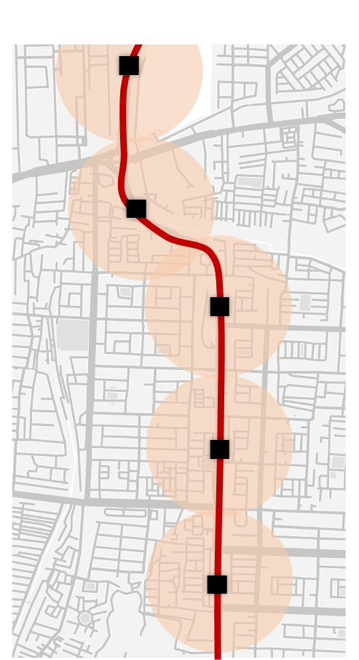
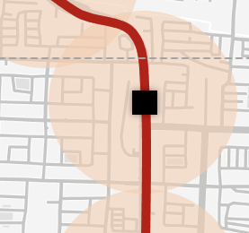
NATIONAL TOD POLICY AND METRO RAIL POLICY BY MOHUA, 2017
National Transit Oriented Development (TOD) Policy, 2017 encourages cities to develop high-density mixed-use zones in the influence areas of the transit corridors such as metros, BRTS etc.
Value Capture Financing is one of the tools used in the policy to support the TOD
Private Land
Example
Land 1
+ Public Investment
Land 1
= Land Value + FSI
% of Increase in value to be captured for fund public projects implemented by Govt.
Land Value Tax
One Time Betterment Levy
Development Charges or Impact Fees
Transfer of Development Rights etc.
Influence Zones
Metro Rail Policy, 2017 encourages adoption of VCF by making it an integral part of the Project Submission in line with TOD Policy.
Financial benefits from metro influence zones to be sent to SPV/ Agency implementing metro projects
Mechanisms
Metro Stations
Metro Transit Corridor
TOD Fund

Slide 7
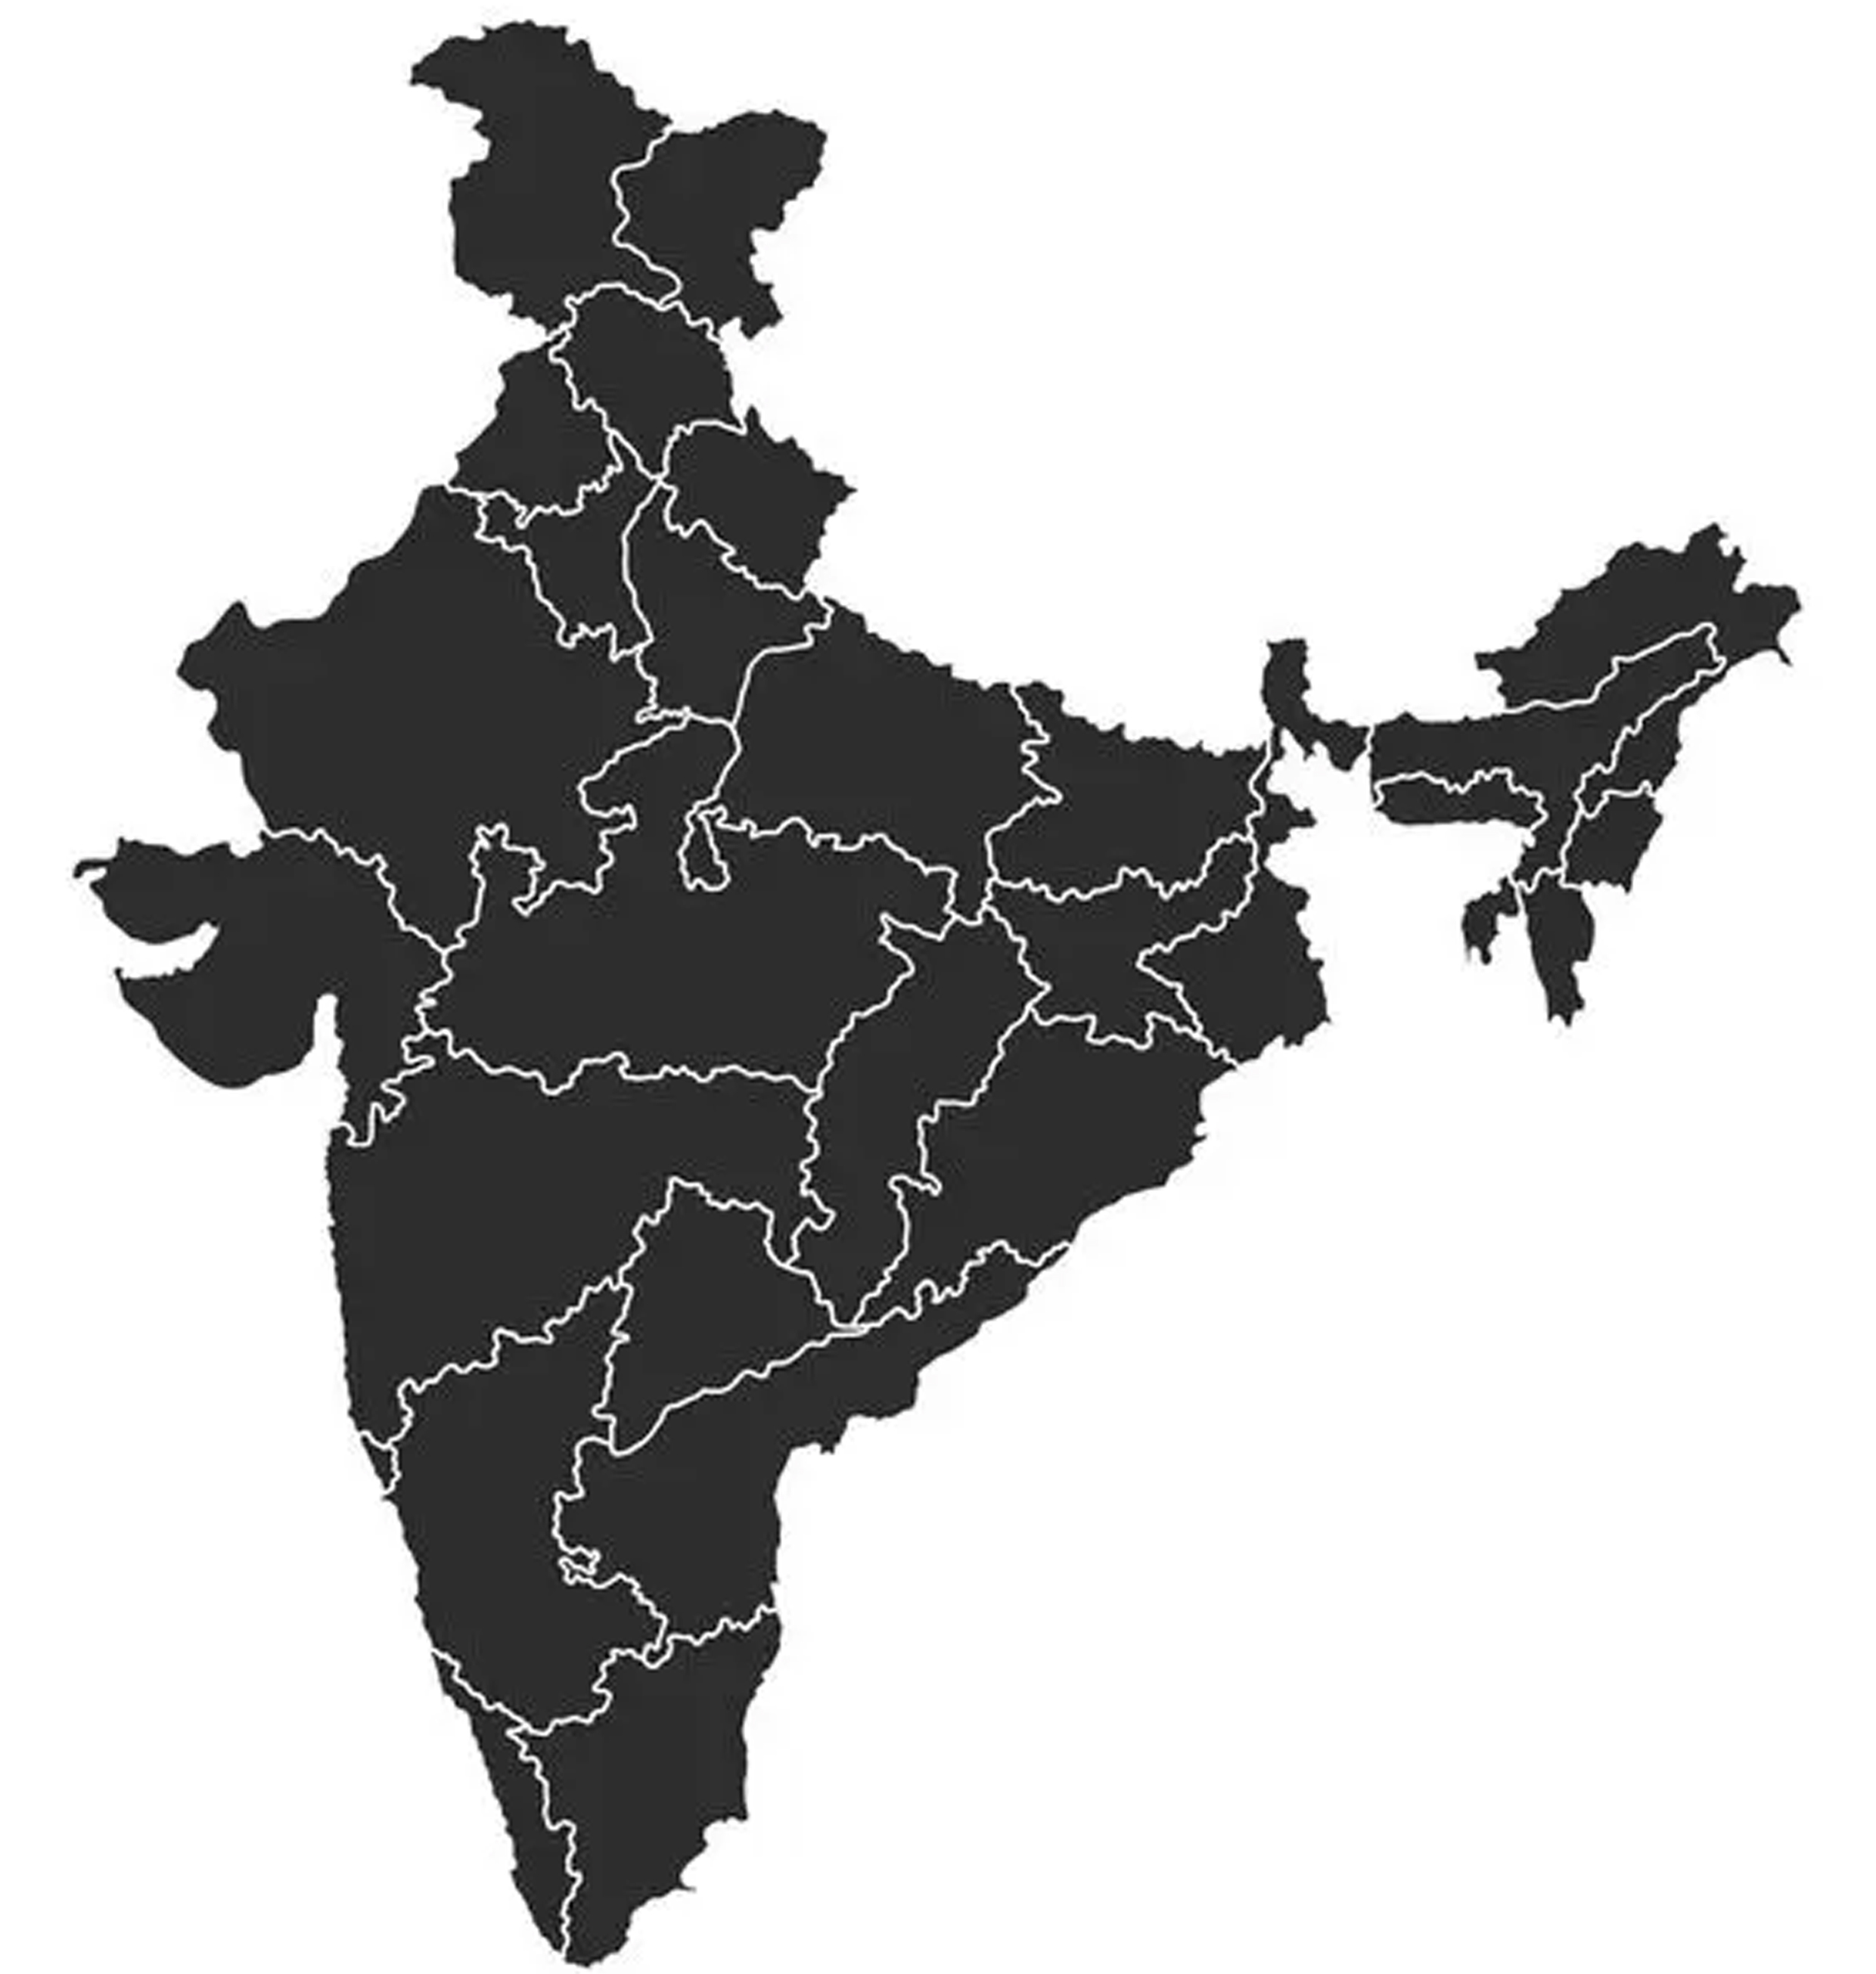
SEVERAL VCF INSTRUMENTS ALREADY BEING USED
S.No. | Value Capture Method | Legend
1 | Urban Land Tax/ Land Value Tax
2 | Tax on Conversion of Land
3 | Betterment Levy
4 | Development Charge/ Impact Fees
5 | TDR and Incentive FSI
6 | Premium on Relaxation of Rules or Additional FSI
7 | Charge for Regularisation of Unauthorised Development
8 | Vacant Land Tax
9 | Property Tax
10 | Additional Cess/ Surcharge on New Building Permits
11 | Land Acquisition and Development
12 | Town Planning Schemes (TPS)/ Land Pooling/ Land Readjustment
13 | Joint Development
HIMACHAL
PRADESH
PUNJAB
DELHI
ARUNACHAL PRADESH
UTTARAKHAND
SIKKIM
HARYANA
BIHAR
ASSAM
RAJASTHAN
UTTAR
PRADESH
NAGALAND
MEGHALAYA
MADHYA PRADESH
GUJARAT
WEST BENGAL
TRIPURA
MIZORAM
MAHARASHTRA
ODISHA
KARNATAKA
GOA
ANDHRA PRADESH/ TELANGANA (Before Division)
TAMIL NADU
Source: 1) Value Capture Finance Policy Framework, MoUD, 2017
2) Prerna V Mehta, Webinar on TOD in Indian Cities, Financing Land Value Capture , WRI
KERALA

Slide 8
Non-Fare Revenue Contribution in selected metros
City | 2023-24
 | Non-Fare Revenue (INR Crore) | % of Non-fare Revenue to the Total Revenue
Delhi | 770 | 18%
Chennai | 104 | 28%
Bangalore | 50 | 8%
Kochi | 51 | 34%
Note: Non-fare revenue only includes
Rental and Lease Income
Consultancy Income
Parking Fees
Non fare revenue limited to only areas within the metro’s jurisdiction. There is no VCF.

Slide 9
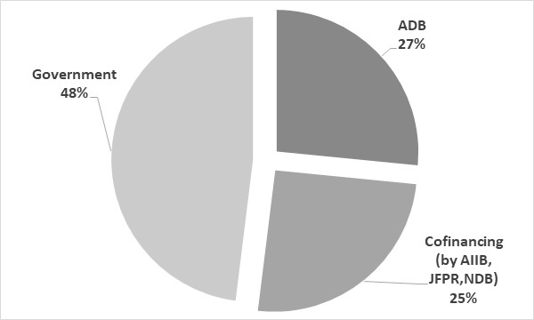
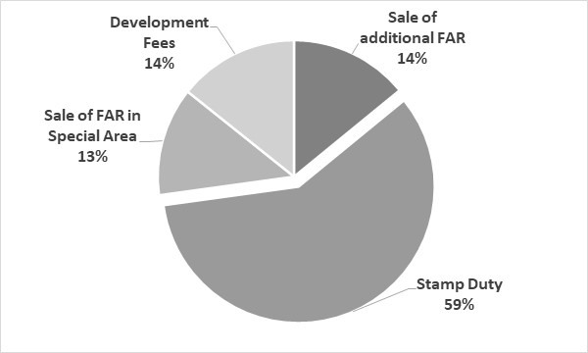
DELHI – MEERUT RRTS
Alignment
Length and number of Stations
Implementation model
Delhi – Ghaziabad – Meerut
68 km and 15 Stations
Government SPV
Funding Pattern (USD mn)
VCF Estimates for next 30 years (USD mn)
Total Estimated Project Cost : Rs 35,000 Cr approx
Total Estimated VCF : Rs 10,000 Cr approx
Source: Report of Committee on innovative methods of revenue generation for implementation of Regional Rapid Transit System (RRTS)
Source: ADB report Report and Recommendation of the President
to the Board of Directors for Delhi –Meerut RRTS

Slide 10
DELHI – MEERUT RRTS: VCF MECHANISM
Sr. no. | VCF Tools | Concerned Agencies | Geographical Coverage | Modality | Applicable regulation
1 | Sale of Additional FAR | Government of Uttar Pradesh | Radius 1500 mtr around the station (TOD Zone) | Sale of additional FAR of 1 at 40% (Group Housing) or 60% (Commercial) of prevailing land prices. | Amendment of Planning norms, Zoning regulations and building bye-laws for mixed use and TOD- 2015
2 | Sale of Additional FAR in special area | Gaziabad Development Authority and Meerut Development Authority | Within Special Mixed Use Development areas identified by the Authority
3 | Additional Development Fee | Gaziabad Development Authority and Meerut Development Authority | Entire Jurisdiction of the concerned authorities | 25% additional Development fee on new development in the plot size > 10,000 sq.mt | Uttar Pradesh Urban Planning and Development (Assessment, Levy and Collection of Development Fee) Rules 2014
4 | Additional Stamp Duty | Gaziabad Development Authority and 2) Meerut Development Authority | Entire Jurisdiction of the concerned authorities | Additional 1% on the existing stamp duty. | The Uttar Pradesh Urban Planning and Development Act, 1973

Slide 11
VALUE CAPTURE PRACTICE IN PUNE
PMC has leased 86,000 sqm of land in city centre to Mahametro for commercial property development.
2 stations have been selected: Civil court & Swargate
Property development
Surcharge on stamp duty
Amendment in MMCA Act, 2018 to levy additional stamp duty (1%) in notified cities
All additional revenue generated from the stamp duty will be transferred to the SPV through the state government.
Additional FSI at premium shall be provided on the basis of road widths in the TOD zone @ 30-50% of market value.
All revenue from additional FSI shall be shared 50-50 with the ULB & SPV
Additional FSI in TOD Zone
Period | Income from sale of additional FSI by PMC in TOD zone (INR crore ) | Amount Transferred to Metro SPVs (INR crore) | Amount Transferred to Metro SPVs (INR crore)
Line 1 & 2 (MahaMetro) | Line 1 & 2 (MahaMetro)
2019 to 2022 (4 years) | 90 | 45
Line 3 (PMRDA line) | Line 3 (PMRDA line)
2021-2022 (2 years) | 45 | 22.5

Slide 12
PUNE METRO LINE 3 (PPP- VGF) -VALUE CAPTURE PROVISIONS
  1
  2
  3
Property development at Earmarked land Parcels
Property development over Stations
Sell of unutilised TDR generated out of stations
Rights of Commercial Property Development at Two land Parcels
Balewadi – 4.75 ha
Maan – 18.20 ha
Total : 23 Ha
Rights to lease of property for a period of 60 years. (35 years extendable for additional 25 years)
Unutilised development potential i.e. TDR generated out of stations can be sold as per applicable laws and regulations
Commercial Property Development is permitted upto 4 floors above the Platform (60,000 sq ft per station)
Rights to lease of property for a period equivalent to Concession Period

Slide 13



BARRIERS TO VCF IN INDIA
METHODS OF VALUE CREATING
BARRIERS
RECOMMENDATIONS
Aligning PT to best capture demand
Integrating PT and Urban Planning
Multimodal Integration
Affordable/ integrated fares
Last mile connectivity and accessibility
Lack of joint planning between metro and city planning authorities
No detailed enforceable mechanism to distribute revenue to support PT projects
Incomplete and partially implemented planning regulations
Mandating ULB, Bus-based PT agencies’ participation (PTAs) in metro planning
Incentivizing ULBs and PTAs for integration
Improved TOD Zoning
Providing efficient last mine connectivity
Forming UMTA-like institutions for PT T- ransport Fund (a single state level fund + city level) with enforceable mechanism for collection, deposition and distribution of funds

Slide 14
STATE LEVEL TOD POLICIES ARE STILL INCOMPLETE
Planning, Regulatory & institutional framework
Finance & funding methods
Risk management/ Market
No integration between ULB & SPV at metro planning stage.
TOD notifications/policies at the state level are not sufficiently developed. They lack the following
  Local Area Planning Guidelines
  Plot amalgamation guidelines
  Building form regulations
  Other detailed DCR to aid mobility and integration
  Clear revenue sharing mechanisms
Cities should implement multiple VCF methods rather tha focus on just one or two (like sale of addn FAR)
Focus on value capture from other than Land Value also important.
Even additional FSI would require structured & conducive TOD regulations which attract people & developers.
Real estate market study should be integral to TOD planning
Undeveloped or partially developed DCR and unclear revenue sharing / prioritisation of Value Distribution hinders market development
Importance of implementing value capture at right time

Slide 15
THANK YOU

