Slide 1
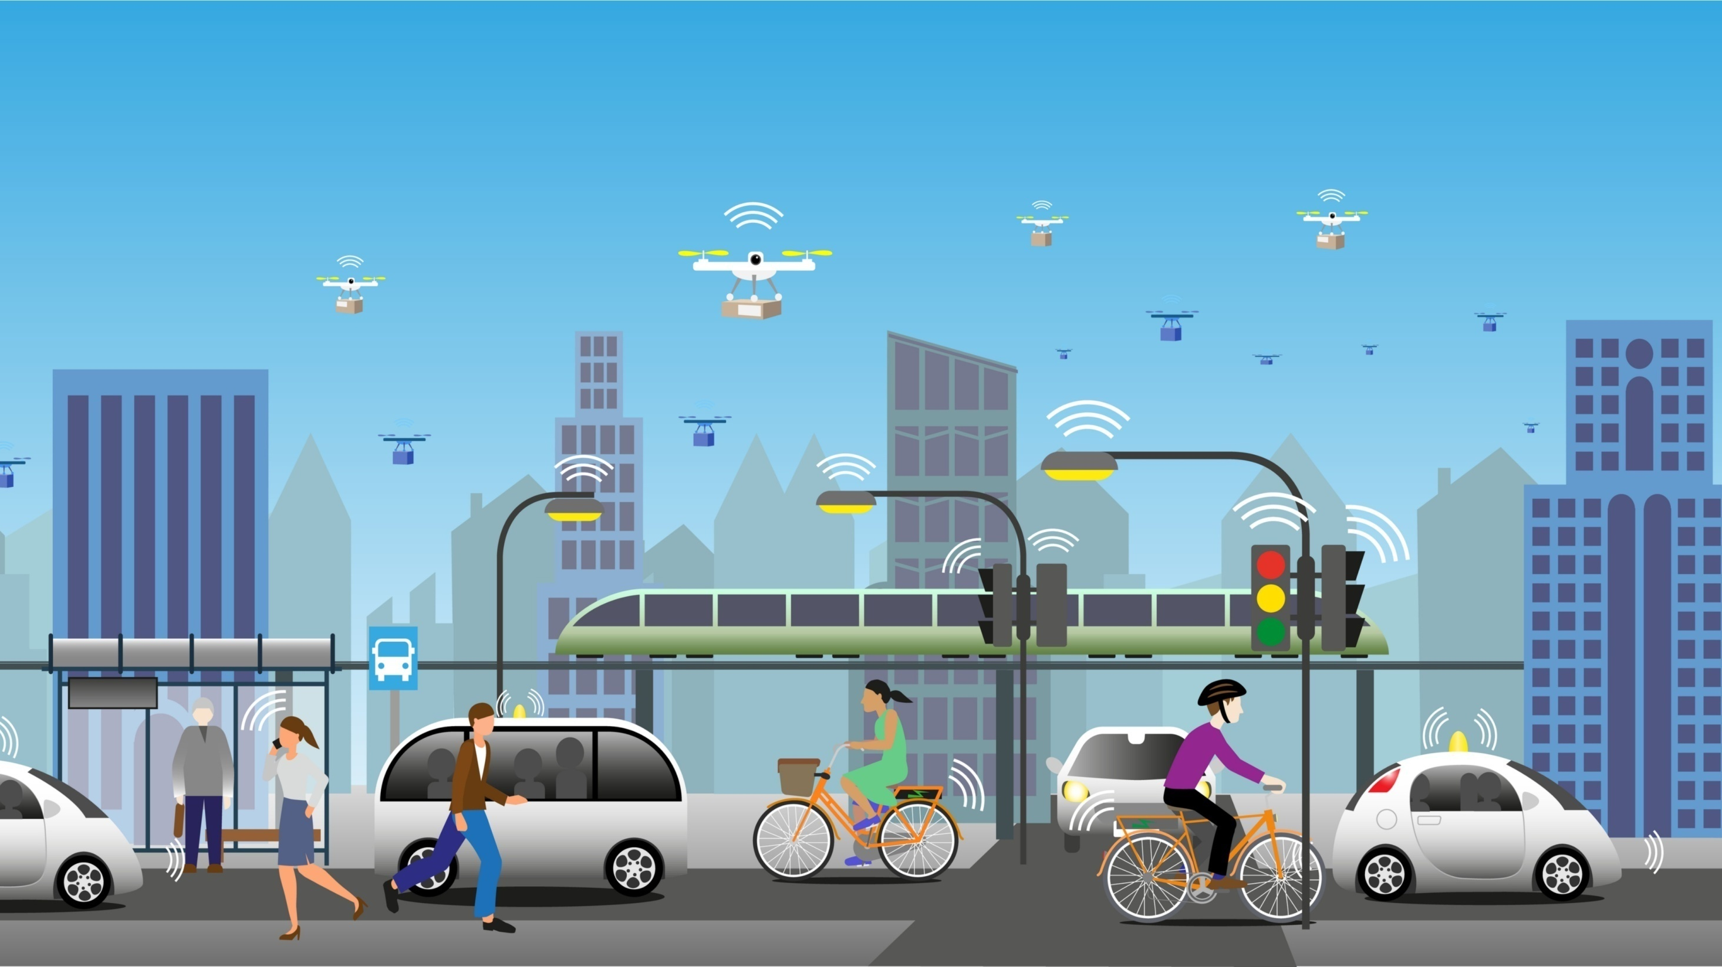




18th Urban Mobility India Conference cum Exhibition 2025
Reconnecting Urban Spaces: A Strategic Approach to Tramways through Heritage Route Mapping (A Case of Kolkata)
Presenting Author: Ritam Samanta, Department of Transport Planning, SPA Bhopal
Co-Author: Dr. Mayank Dubey (Assistant Professor), Department of Transport Planning, SPA Bhopal
Paper ID: 3233

Slide 2
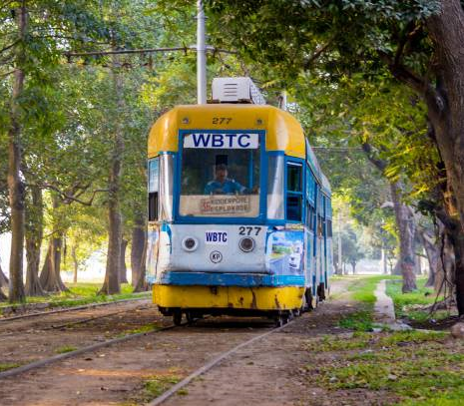
CONTENT
Background & Need of the Topic
Research Design
Methodology
Literature Study
Case Study
Study Area
Site Visit & Data Collection
Data Analysis
Proposals
Conclusion & Recommendations
1
2
3
4-6
7
8
9
10-15
16
17
Reconnecting Urban Spaces: A Strategic Approach to Tramways through Heritage Route Mapping (A Case of Kolkata)

Slide 3
1
Background & Need of the Topic
3233
An Overview - Trams were first introduced in India during the colonial era in the late 19th century. The first tram service in India started in Kolkata in 1873
History of Indian Cities - Other cities in India soon follows Kolkata’s lead with tram network were established in Bombay (Mumbai) in 1874
In present days, all the tram networks are closed in most of the cities except Kolkata
Tram
Sl. No. | City | Opening Year | Closing Year
1 | Kolkata | 1873 | Running
2 | Mumbai | 1874 | 1964
3 | Nasik | 1889 | 1933
4 | Chennai | 1895 | 1953
5 | Kanpur | 1907 | 1933
6 | Kochi | 1907 | 1963
7 | Delhi | 1908 | 1963
8 | Bhavnagar | 1926 | 1947
Tram
Source: Indian Journal of Spatial Science Autumn Issue 10(2) 2019 pp.59 - 64
Source https://wbtc.co.in/ https://mtp.indianrailways.gov.in/
Reconnecting Urban Spaces: A Strategic Approach to Tramways through Heritage Route Mapping (A Case of Kolkata)

Slide 4


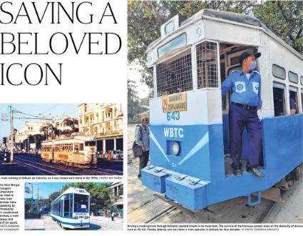
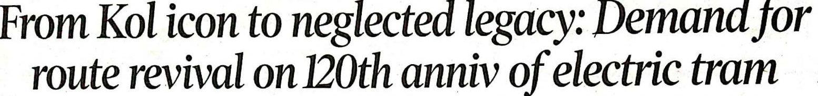


2
Research Design
3233
W H Y T R A M W A Y S ?
Aim
To explore the opportunities of tramway operation in context of both sustainability aspects and heritage considerations
Source: Times of India (Author : Managing director (India) for the International Council on Clean Transportation (ICCT)
Source : Times of India
Source : Calcutta Tram Users Association (CTUA)
Objectives
Research Questions
To identify the reasons for the progressive degradation of Kolkata's tram system
To examine the existing conditions and problems of the tram routes
To analyze all attributes in order to conduct a Gap analysis of the system that needs improvements
To propose Planning Framework for KMC area by Integration of Heritage Route Mapping
What caused decline for Tram in Kolkata?
What is the present role of Tram in Kolkata?
What are the alternatives of tram in Kolkata?
Reconnecting Urban Spaces: A Strategic Approach to Tramways through Heritage Route Mapping (A Case of Kolkata)

Slide 5
3
Methodology
3233
Stage: 01
Selection of Topic
Identifying the need of the study
Formulation of research questions, aim, objectives, scope and limitation
Objective 01 : To identify the reasons for the progressive degradation of Kolkata's tram system
History of World-wide Tramway System & Indian Tramway System
Case Studies on development of tramways world wide
Technical details of tramway System
Previously conducted research and initiatives on Kolkata tramway
Transport Scenario and development of Kolkata Tramway
Literature Review of Tramway
Stage: 02
Objective 02 : To examine the existing conditions and problems of the tram routes
Primary Data
Photographic Survey
Road Inventory Survey
On Board PT Survey
Boarding & Alighting Survey
Secondary Data
Detailed route map (Existing & Closed)
Passenger data of Bus, ferry, metro
Stage: 03
Site Visit and Data Collection
Stakeholder’s Interview
User Perception Survey (Roadside Interview & Google Forms)
Objective 03 : To analyze all attributes in order to conduct a Gap analysis of the system that needs improvements
Stage: 04
Data Analysis
SWOT analysis of tramway System through stakeholder interview
Analysis and mapping of road infrastructure along tram routes
Observing and mapping heritage and tourist places, educational institutions, commercial centers etc.
Application of Multi-Parameter Decision-Making Techniques to Evaluate the Built Heritage
Proposals & Recomm-endations
Objective 04 : To propose Planning Framework for KMC area by Integration of Heritage Route Mapping
Stage: 05
Heritage Route mapping – Dedicated tram routes for tourists and local citizens which connects integral heritage parts of the city
Conclusions
Future Scope of the Study
Reconnecting Urban Spaces: A Strategic Approach to Tramways through Heritage Route Mapping (A Case of Kolkata)

Slide 6
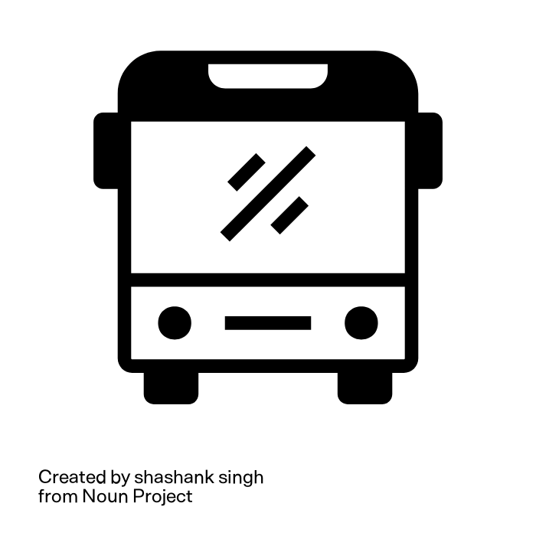
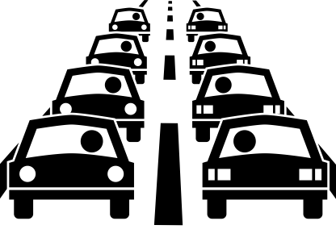
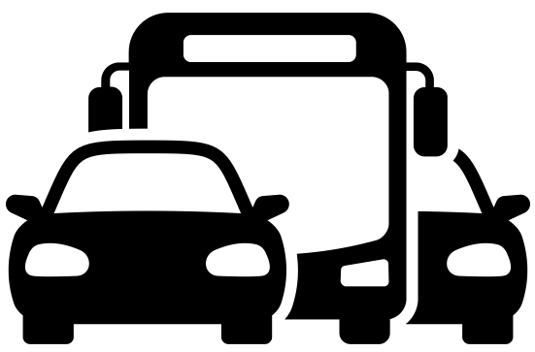



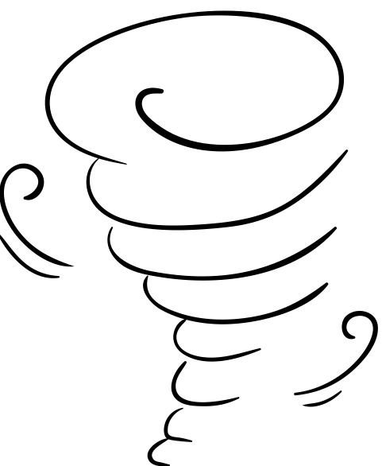
4
Literature Study
3233
Q1. What caused decline for Tram in Kolkata?
In 1973, Howrah Bridge to Company Bagan, Burrabazar to Nimtala line route closed
In 1982, Sealdah to Lebutala route closed
In 2009, Shyam bazar to Galiff Street route closed
In 1992, Esplanade with Planetarium route closed when an initial fleet of 40 buses introduced
In 2006, Mominpur to Behala route closed
In 2016-18, Park Circus, Sealdah-Moulali route
closed
Lack of
Infrastructure
Construction of Metro line
Construction of Flyover
Cyclone
Bus Service Introduced
Excessive Traffic Load
Other Mass Transport Mode
In 1971, Howrah to Bandhaghat and Shibpur line was closed
In 1978, Esplanade with Hazra Park was closed
In 1980, Esplanade to Jatin Das Park was closed
In 2011, Joka to Behala Line was closed
In 1981, Esplanade with Lal bazar route closed.
In 2004, Gariahat depot to its crossing route closed.
In 2020, The iconic route Khidirpur with Esplanade closed.
Source: https://wbtc.co.in/tram-service
DOI:10.15680/IJIRSET.2016.0505120
Reconnecting Urban Spaces: A Strategic Approach to Tramways through Heritage Route Mapping (A Case of Kolkata)

Slide 7
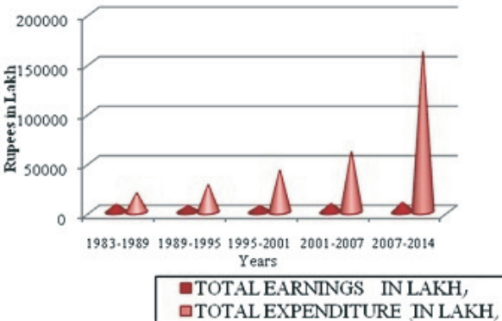
5
Literature Study
3233
Q2. What is the present role of Tram in Kolkata?
Earnings & Expenditure
Source: https://wbtc.co.in/tram-service
Source: Indian Journal of Spatial Science Autumn Issue, 10(2) 2019 pp 59 - 64
In 1969, Kolkata Tramway had track length of 70.74 Km
Presently, only 3 routes operational with track length of 20 Km
The daily ridership also rapidly decreased (from 1.6 lakh passengers per day in 2008 to merely 15000 passengers per day, as of 2022)
The expenditure is rising continuously, throughout the time whereas the income is quite disappointing
the expenditure is more than 30 times of income during (2007-2014)
Reconnecting Urban Spaces: A Strategic Approach to Tramways through Heritage Route Mapping (A Case of Kolkata)

Slide 8
6
Literature Study
3233
Q3. What are the alternatives of tram in Kolkata?
A survey asking questions was carried out among Kolkata residents and tram users. A total 132 responses received.
** Tram should operational in new routes also in Kolkata?
** Tram should removed from Kolkata?
Source: Primary Survey by Author
Source: Primary Survey by Author
“Tram is an alternative way out to establish sustainable mobility. In Kolkata, Tram is an emotional heritage too. World is moving towards zero emission and sustainable mobility concept - "Tram is one of the solution“
- Tram user on Tollygunge – Ballygunge (Route 24/29) route
“Tram network should be spreaded. It may not be the older ones but the modernized technology can be supported as it is very accessible.”
- Tram user on Gariahat- Shyambazar route
66.60% of Kolkata residents firmly agreed that trams should operational in new routes also.
88.90% of Kolkata residents firmly agreed that trams should not be withdrawn from the city.
Reconnecting Urban Spaces: A Strategic Approach to Tramways through Heritage Route Mapping (A Case of Kolkata)

Slide 9
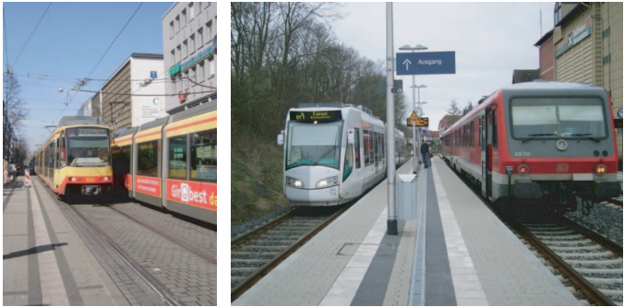


7
Case Study
3233
Tram–Train Systems in Germany (Karlsruhe & Kassel)
Bi-Directional Trams in Poland
Bi-directional tram on a route with switch-back terminals at both ends
Locating tram stops only one side
Mitigating the Negative Effects of Maintenance/Upgrading Works on a Tram Network
A : Karlsruhe City Center
B : Regio Tram Kassel meets heavy rail
Source: Journal of the Transportation Research Board, No. 2275
Source: https://doi.org/10.3390/en15155685
Learning:
The “tram–train” approach is designed to solve this problem by linking urban tram and regional heavy railway infrastructure
The linkage provides a direct connection between the city center and its suburbs, which helps reduce travel time and increase efficiency
Learning:
A switch-back terminal is all that is required for a Bi-Directional tram to turn around instead of a tram loop
Bi-Directional Tram is useful when there is not enough space for a tram loop
Reconnecting Urban Spaces: A Strategic Approach to Tramways through Heritage Route Mapping (A Case of Kolkata)

Slide 10
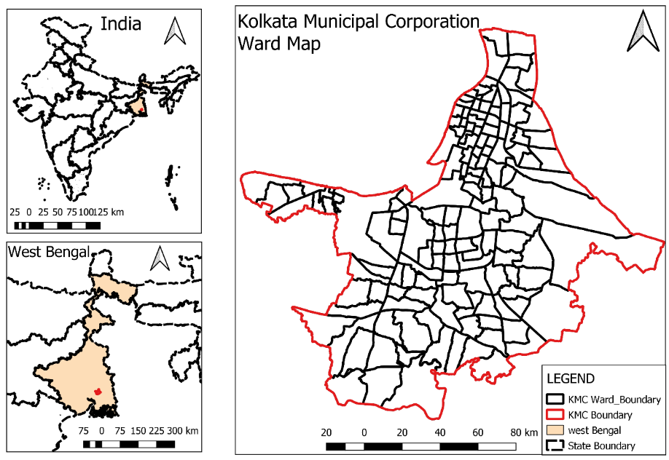
8
Study Area
3233
Total Area : 205 sq. km
Total no. of Ward : 144
Population: 44,96,694 (according to 2011 Census)
Population Density: 21,935/ sq. km.
Projected Population in 2021: Above 6 million
Source: Author Generated
Reconnecting Urban Spaces: A Strategic Approach to Tramways through Heritage Route Mapping (A Case of Kolkata)

Slide 11
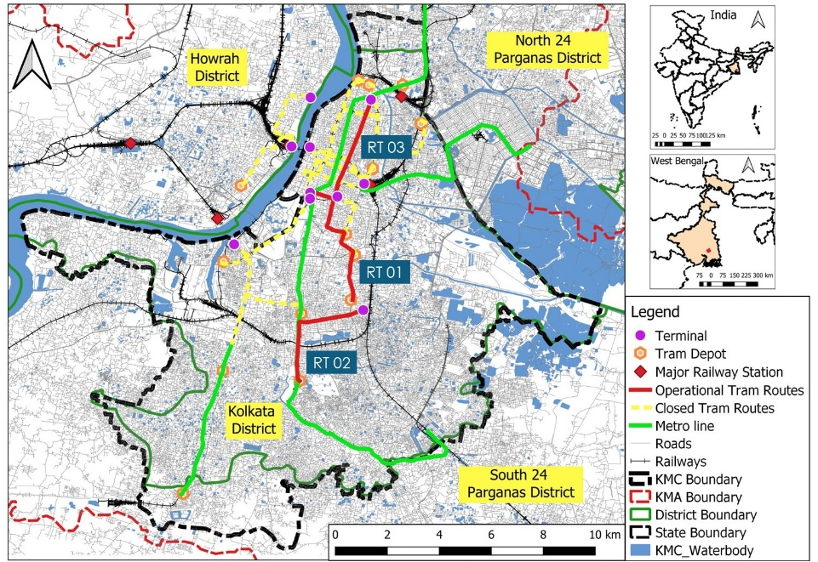
9
Site Visit & Data Collection
3233
Stakeholder Interview (Expert) – 03
Stakeholder Interview (Individual Industry Professional) – 05
User Perception Survey (Roadside Interview)– 35
User Perception Survey (Through Google Forms) – 44
Road Network Inventory Survey – 9 Tram Routes
On Board Public Transport Survey – 53
Currently Operational Routes –
3 Routes
RT 01 - 8.45 Km
RT 02 - 6 Km
RT 03 - 5.90 Km
Source: Author Generated
Reconnecting Urban Spaces: A Strategic Approach to Tramways through Heritage Route Mapping (A Case of Kolkata)

Slide 12
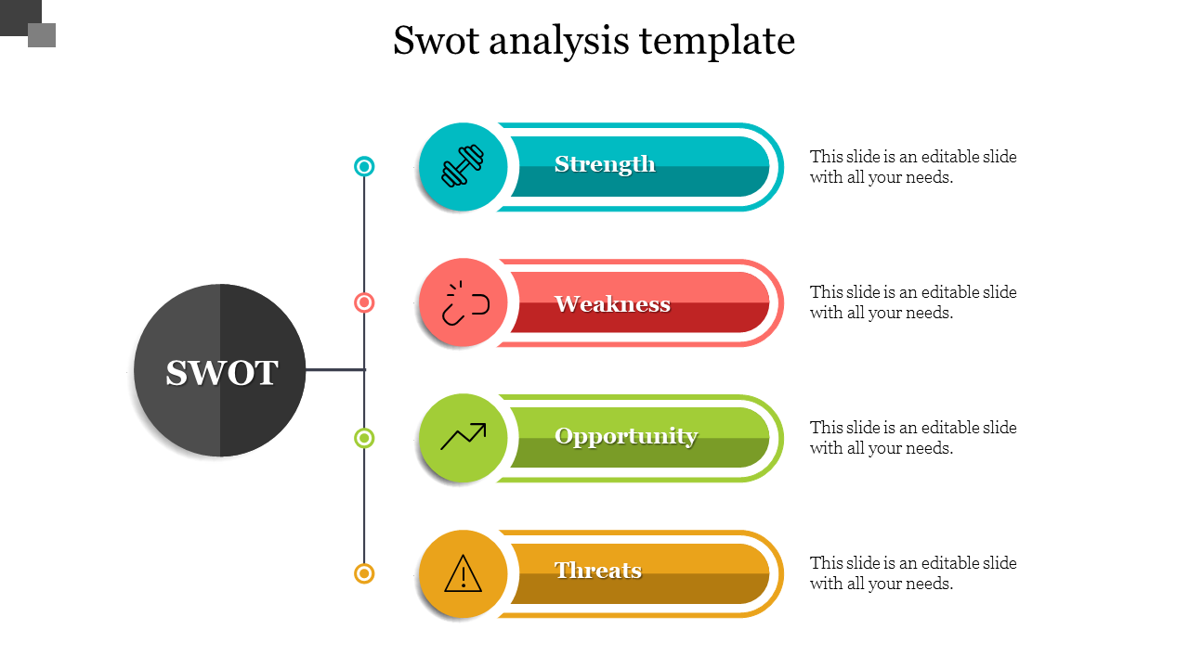
10
Data Analysis
3233
SWOT Analysis Through Stakeholder Interview
“It is the only sustainable mode of transport presently available in the city. Tramways are being researched by other foreign nations in an effort to improve their viability as a means of transportation. India contemplates that as well.”
- Subham Pramanick (Senior Research Fellow)
Sustainable Transport
Net Zero Emission Zone
Affordable Fare Structure
Lack of Governance
Absence of City Master Plan
Not Profitable
Poor Frequency
“The primary issue is that the city does not have a master plan. The one that was created in the past was flawed and the modal split did not take into account the current situation.”
- Dr. Utpal Roy (Associate Professor)
Priority Treatment
Heritage Route Mapping
Replacement of other modes where road width is minimum
“If speed is increased, then definitely tram should replace bus/auto/mini bus where road width is minimum.”
- Ar. Diptiman Samanta (Principal Architect)
“Increased no of vehicles leading to congestion in roadways which leads to slow speed of tram.”
- Ar. Sumon Gupta (Principal Architect)
Excessive cost of Electricity
Congestion on the road
Source: Primary Survey by Author
Reconnecting Urban Spaces: A Strategic Approach to Tramways through Heritage Route Mapping (A Case of Kolkata)

Slide 13
11
Data Analysis
3233
Application of Multi Criteria Decision Making Techniques to Evaluate Heritage Sites
Total Listed Site - 121
Evolution of Heritage Structures/Areas
Site List
Heritage Monuments | 6
Heritage Building | 30
Theatre | 5
Recreational Area | 10
Library | 2
Temple | 5
Zoo | 1
Museum | 5
Police Station | 1
Ferry Ghats | 6
Church | 9
Post Office | 1
Bridge | 2
School & College | 18
Cemetery | 4
Urban Suqare | 3
Urban Street | 2
Administrative Office | 7
Market | 3
Mosque | 1
Total | 121
Historical Significance
Architectural Significance
Integrity
Socio Economic Significance
Proximity
Age of Structure
Aesthetic Value
Condition of Structure
Community Association
Distance from existing Tram line
Historical Importance
Construction Style
Functionality
Tourism Potential
Distance from existing Tram Depot/Terminal
Grey Relational Analysis (GRA) for Ranking of Parameters:
List of Experts :
Dr. Utpal Roy (Associate Professor), Dept. of Geography, University of Calcutta
Ar. Sumon Gupta (Architect & Planner), Aakriti, Kolkata
Subham Pramanick, (Senior Research Fellow) Dept. of Geography, Ballygunge Science College
Indranil Maity (Research Assistant), Dept. of Geography, Ballygunge Science College
Ranking by Experts
Grey Relational Coefficient
Parameters | GRG | RANK
Socio Economic Significance | 0.5 | 3
Architectural Significance | 0.6833 | 2
Proximity | 0.35 | 5
Integrity | 0.45 | 4
Historical Significance | 0.9167 | 1
Normalized Value
Deviation Sequence
Source: Author Generated
Reconnecting Urban Spaces: A Strategic Approach to Tramways through Heritage Route Mapping (A Case of Kolkata)

Slide 14
12
Data Analysis
3233
Weightage distribution among Parameters and Sub-Parameters using Rank Sum Method (RSM)
Weightage has been divided using Rank Sum Method (RSM), and it is distributed among 5 parameters.
Then weightages are equally distributed among sub parameters under each criterion.
Parameter | Weightage (Parameter) | Sub Parameter | Weightage (Sub Parameter)
Historical Significance (P1) | 0.33 | Age of the Structure (P11) | 0.165
 |  | Association Involved (P12) | 0.165
Architectural Significance (P2) | 0.27 | Aesthetic value (P21) | 0.135
 |  | Style of Construction (P22) | 0.135
Socio Economic Significance (P3) | 0.2 | Community Association (P31) | 0.1
 |  | Tourism Potential (P32) | 0.1
Integrity (P4) | 0.13 | Condition of Structure (P41) | 0.065
 |  | Functionality (P42) | 0.065
Proximity (P5) | 0.07 | Distance from existing tram line (P51) | 0.035
 |  | Distance from existing tram Depot/Terminal (P52) | 0.035
Rank Sum Method
Parameter | Rank | Reverse Rank | Weightage
Historical Significance (P1) | 1 | 5 | 0.33
Architectural Significance (P2) | 2 | 4 | 0.27
Socio Economic Significance (P3) | 3 | 3 | 0.20
Integrity (P4) | 4 | 2 | 0.13
Proximity (P5) | 5 | 1 | 0.07
By Using Rank Sum |  | 15 | 1.00
Source: Author Generated
Reconnecting Urban Spaces: A Strategic Approach to Tramways through Heritage Route Mapping (A Case of Kolkata)

Slide 15
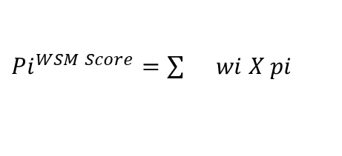
13
Data Analysis
3233
Rating Classification of Sub-Parameter & Estimating Score of Heritage Sites using Weighted Sum Method (WSM)
Rating of Built Heritage (5 – Likert Scale)
Sl. No. | Sub - Parameter | Very Good (1.00) | Good (0.75) | Fair (0.50) | Poor (0.25) | Very Poor (0.00)
1 | Age of the Structure (P11) | 1700-1800 | 1800-1900 | 1900-1990 | Post 1990 | None
2 | Association Involved (P12) | International | National | Regional | Local | None
3 | Aesthetic value (P21) | Exceptional Architectural Detail | Notable Style of Architecture | Average Detailing | Poor Detailing | Absence of details
4 | Style of Construction (P22) | Unique style | Well designed & notable design | Absence of Notable style | Poorly designed | Not well designed, unique and notable
5 | Community Association (P31) | The structure has a solid historical association with public use | The structure has a strong historical association However, the structure no longer serves as an essential part of the community | The structure has a limited historical association with the neighborhood | The local community knows the structure | No community association in terms of its function or age.
6 | Tourism Potential (P32) | Internationally Important | Nationally Impprtant | Regionally Important | Locally Important | Has potential fortourist destination
7 | Condition of Structure (P41) | No maintenance required | Small amount restoration required | It needs quite a bit of work | Extensive repairs and restoration required | Not viable to retain the property
8 | Functionality (P42) | The structure has maintained its original function | Adaptive reuse | function has changed | function completely changed | Structure is in abandoned state
9 | Distance from existing tram line (P51) | (0-5) Km | (6-10) Km. | (11-15) Km. | (16-20) Km. | More than 20 Km.
10 | Distance from existing tram Depot/Terminal (P52) | (0-10) Km | (11-20) Km | (21-30) Km | (31-40) Km | More than 40 Km
To get the rank of all heritage sites, the Weighted Sum Method (WSM) is used to calculate each structure's score. It is calculated by using the following equation,
$Pi^{WSM Score}=\sum{}wi X pi$
Where,
wi = relative weight of parameter or sub-Parameter
pi = performance value of each structure
Source: Author Generated
Reconnecting Urban Spaces: A Strategic Approach to Tramways through Heritage Route Mapping (A Case of Kolkata)

Slide 16
14
Data Analysis
3233
Rating of Heritage Sites through WSM Method
Sl. No. | Main Parameter | Historical Significance (P1) |  | Architectural Significance (P2) |  | Socio Economic Significance (P3) |  | Integrity (P4) |  | Proximity (P5) |  | WSM Score | Rank
 | Sub Parameter | Age of the Structure (P11) | Association Involved (P12) | Aesthetic value (P21) | Style of Construction (P22) | Community Association (P31) | Tourism Potential (P32) | Condition of Structure (P41) | Functionality (P42) | Distance from existing tram line (P51) | Distance from existing tram Depot/Terminal (P52)
 | Weightage Value | 0.165 | 0.165 | 0.135 | 0.135 | 0.1 | 0.1 | 0.065 | 0.065 | 0.035 | 0.035
1 | Victoria Memorial | 0.75 | 1.00 | 1.00 | 1.00 | 1.00 | 1.00 | 1.00 | 1.00 | 1.00 | 1.00 | 0.95875 | 1
2 | Fort William | 1.00 | 1.00 | 0.75 | 0.75 | 1.00 | 1.00 | 1.00 | 0.75 | 0.50 | 0.50 | 0.88125 | 9
3 | Howrah Bridge | 0.75 | 1.00 | 1.00 | 1.00 | 1.00 | 1.00 | 1.00 | 0.75 | 0.75 | 0.50 | 0.91625 | 4
4 | Princep Ghat | 1.00 | 0.50 | 0.50 | 0.75 | 1.00 | 1.00 | 0.75 | 1.00 | 0.75 | 0.75 | 0.78250 | 24
5 | Birla Planetorium | 0.50 | 0.50 | 1.00 | 1.00 | 1.00 | 1.00 | 0.25 | 1.00 | 0.75 | 0.75 | 0.76875 | 26
6 | St. Paul Cathedral | 1.00 | 1.00 | 0.75 | 1.00 | 1.00 | 1.00 | 1.00 | 1.00 | 0.75 | 0.75 | 0.94875 | 2
7 | Shahid Minar | 1.00 | 0.75 | 0.50 | 0.75 | 1.00 | 0.75 | 1.00 | 1.00 | 1.00 | 1.00 | 0.83250 | 15
8 | Raj Bhawan | 1.00 | 1.00 | 1.00 | 1.00 | 1.00 | 0.75 | 1.00 | 0.75 | 0.75 | 0.75 | 0.94125 | 3
9 | Sovabazar Rajbari | 1.00 | 0.50 | 0.75 | 0.75 | 1.00 | 1.00 | 1.00 | 0.50 | 0.75 | 0.50 | 0.79125 | 20
10 | Writers Building | 1.00 | 0.75 | 1.00 | 1.00 | 1.00 | 0.75 | 0.75 | 0.75 | 1.00 | 0.75 | 0.89250 | 6
11 | Dhurjoti Bhawan | 0.50 | 0.25 | 0.50 | 0.50 | 0.50 | 0.50 | 0.50 | 0.25 | 1.00 | 1.00 | 0.47750 | 96
12 | Gouriya Math | 0.75 | 0.25 | 0.50 | 0.50 | 1.00 | 0.75 | 0.75 | 0.25 | 0.75 | 0.75 | 0.59250 | 69
13 | Rameswar Siva Temple | 0.50 | 0.25 | 0.25 | 0.00 | 0.25 | 0.25 | 0.75 | 0.00 | 0.50 | 0.50 | 0.29125 | 120
14 | Putul Bari | 0.50 | 0.25 | 0.50 | 0.50 | 0.25 | 0.25 | 0.00 | 0.25 | 0.50 | 0.50 | 0.36000 | 111
15 | Star Theatre | 1.00 | 0.25 | 0.50 | 0.75 | 0.75 | 1.00 | 0.25 | 0.25 | 1.00 | 1.00 | 0.65250 | 58
16 | Bangiya Sahitya Parishad | 1.00 | 0.50 | 0.50 | 0.50 | 1.00 | 1.00 | 0.50 | 0.75 | 0.75 | 0.50 | 0.70750 | 42
17 | Scottish Church Collegiate School | 1.00 | 0.50 | 0.50 | 0.50 | 0.75 | 1.00 | 0.75 | 0.50 | 1.00 | 0.75 | 0.70000 | 43
18 | Ahiritolla Ghat | 1.00 | 0.50 | 0.25 | 0.00 | 0.25 | 0.75 | 0.50 | 0.50 | 0.75 | 0.50 | 0.49000 | 95
19 | Manik Bose's Ghat | 0.75 | 0.25 | 0.25 | 0.00 | 0.25 | 0.50 | 0.25 | 0.00 | 0.50 | 0.50 | 0.32500 | 117
20 | Nimtala Burning Ghat | 1.00 | 0.50 | 0.25 | 0.50 | 0.75 | 1.00 | 0.50 | 0.00 | 0.50 | 0.50 | 0.59125 | 72
21 | Durgeswar Siva Temple | 1.00 | 0.25 | 0.00 | 0.50 | 0.25 | 1.00 | 0.25 | 0.00 | 0.50 | 0.25 | 0.44125 | 103
22 | Lohia Matri Seva Sadan | 1.00 | 0.25 | 0.50 | 0.50 | 0.75 | 0.00 | 0.25 | 0.50 | 0.50 | 0.25 | 0.49125 | 94
23 | Jorasanko Thakurbari | 1.00 | 0.75 | 0.50 | 0.75 | 1.00 | 0.50 | 1.00 | 1.00 | 1.00 | 0.50 | 0.79000 | 21
24 | Rabindra Kanan | 0.75 | 0.25 | 0.00 | 0.00 | 0.75 | 1.00 | 0.25 | 0.00 | 0.50 | 0.50 | 0.39125 | 107
25 | Christ Church | 1.00 | 0.25 | 0.50 | 0.50 | 0.75 | 1.00 | 0.50 | 0.50 | 1.00 | 0.75 | 0.64250 | 60
Source: Author Generated
Reconnecting Urban Spaces: A Strategic Approach to Tramways through Heritage Route Mapping (A Case of Kolkata)

Slide 17
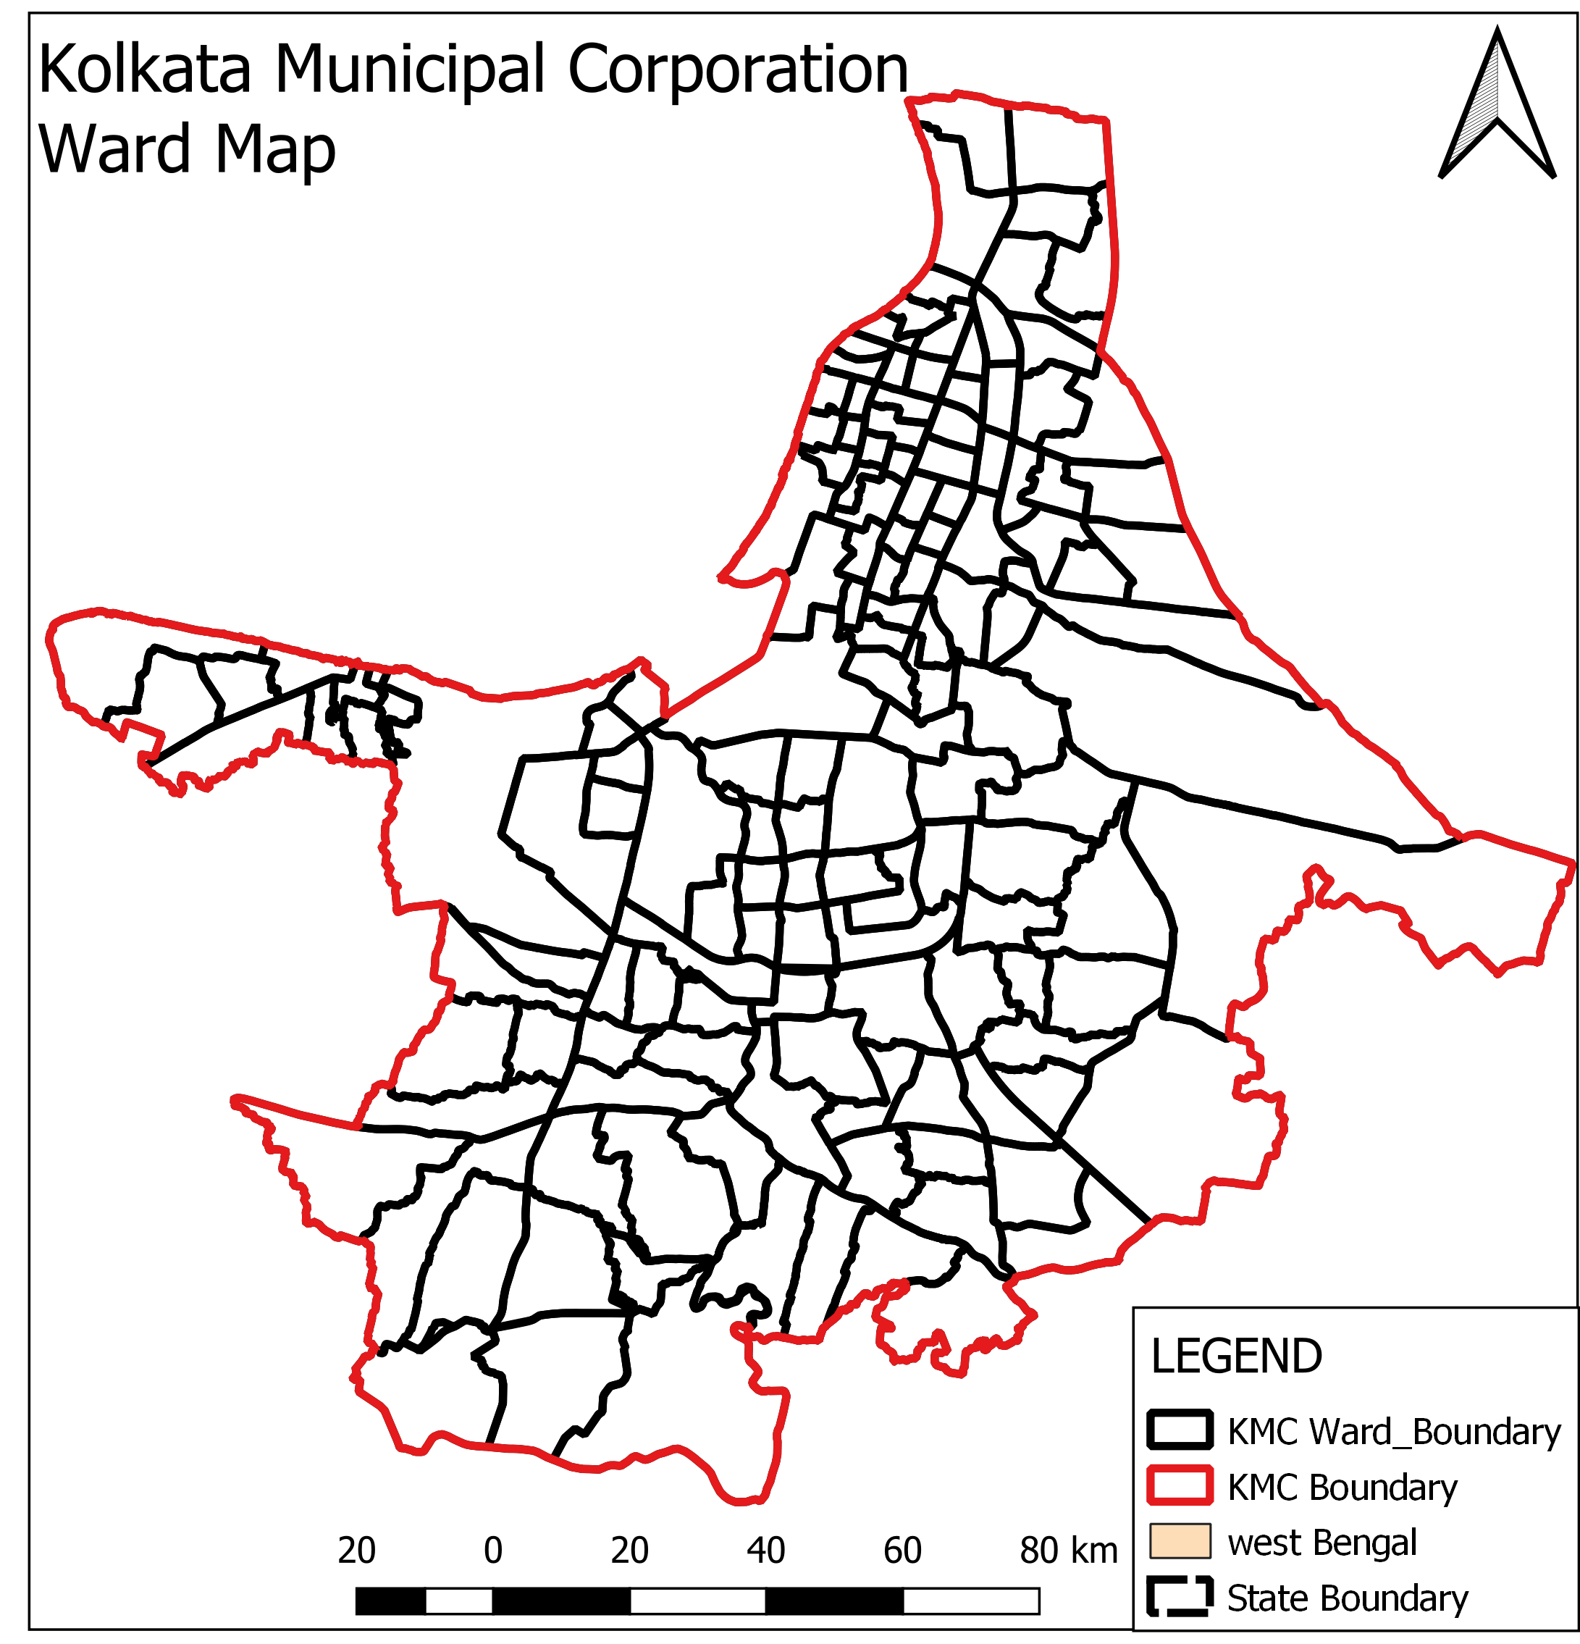
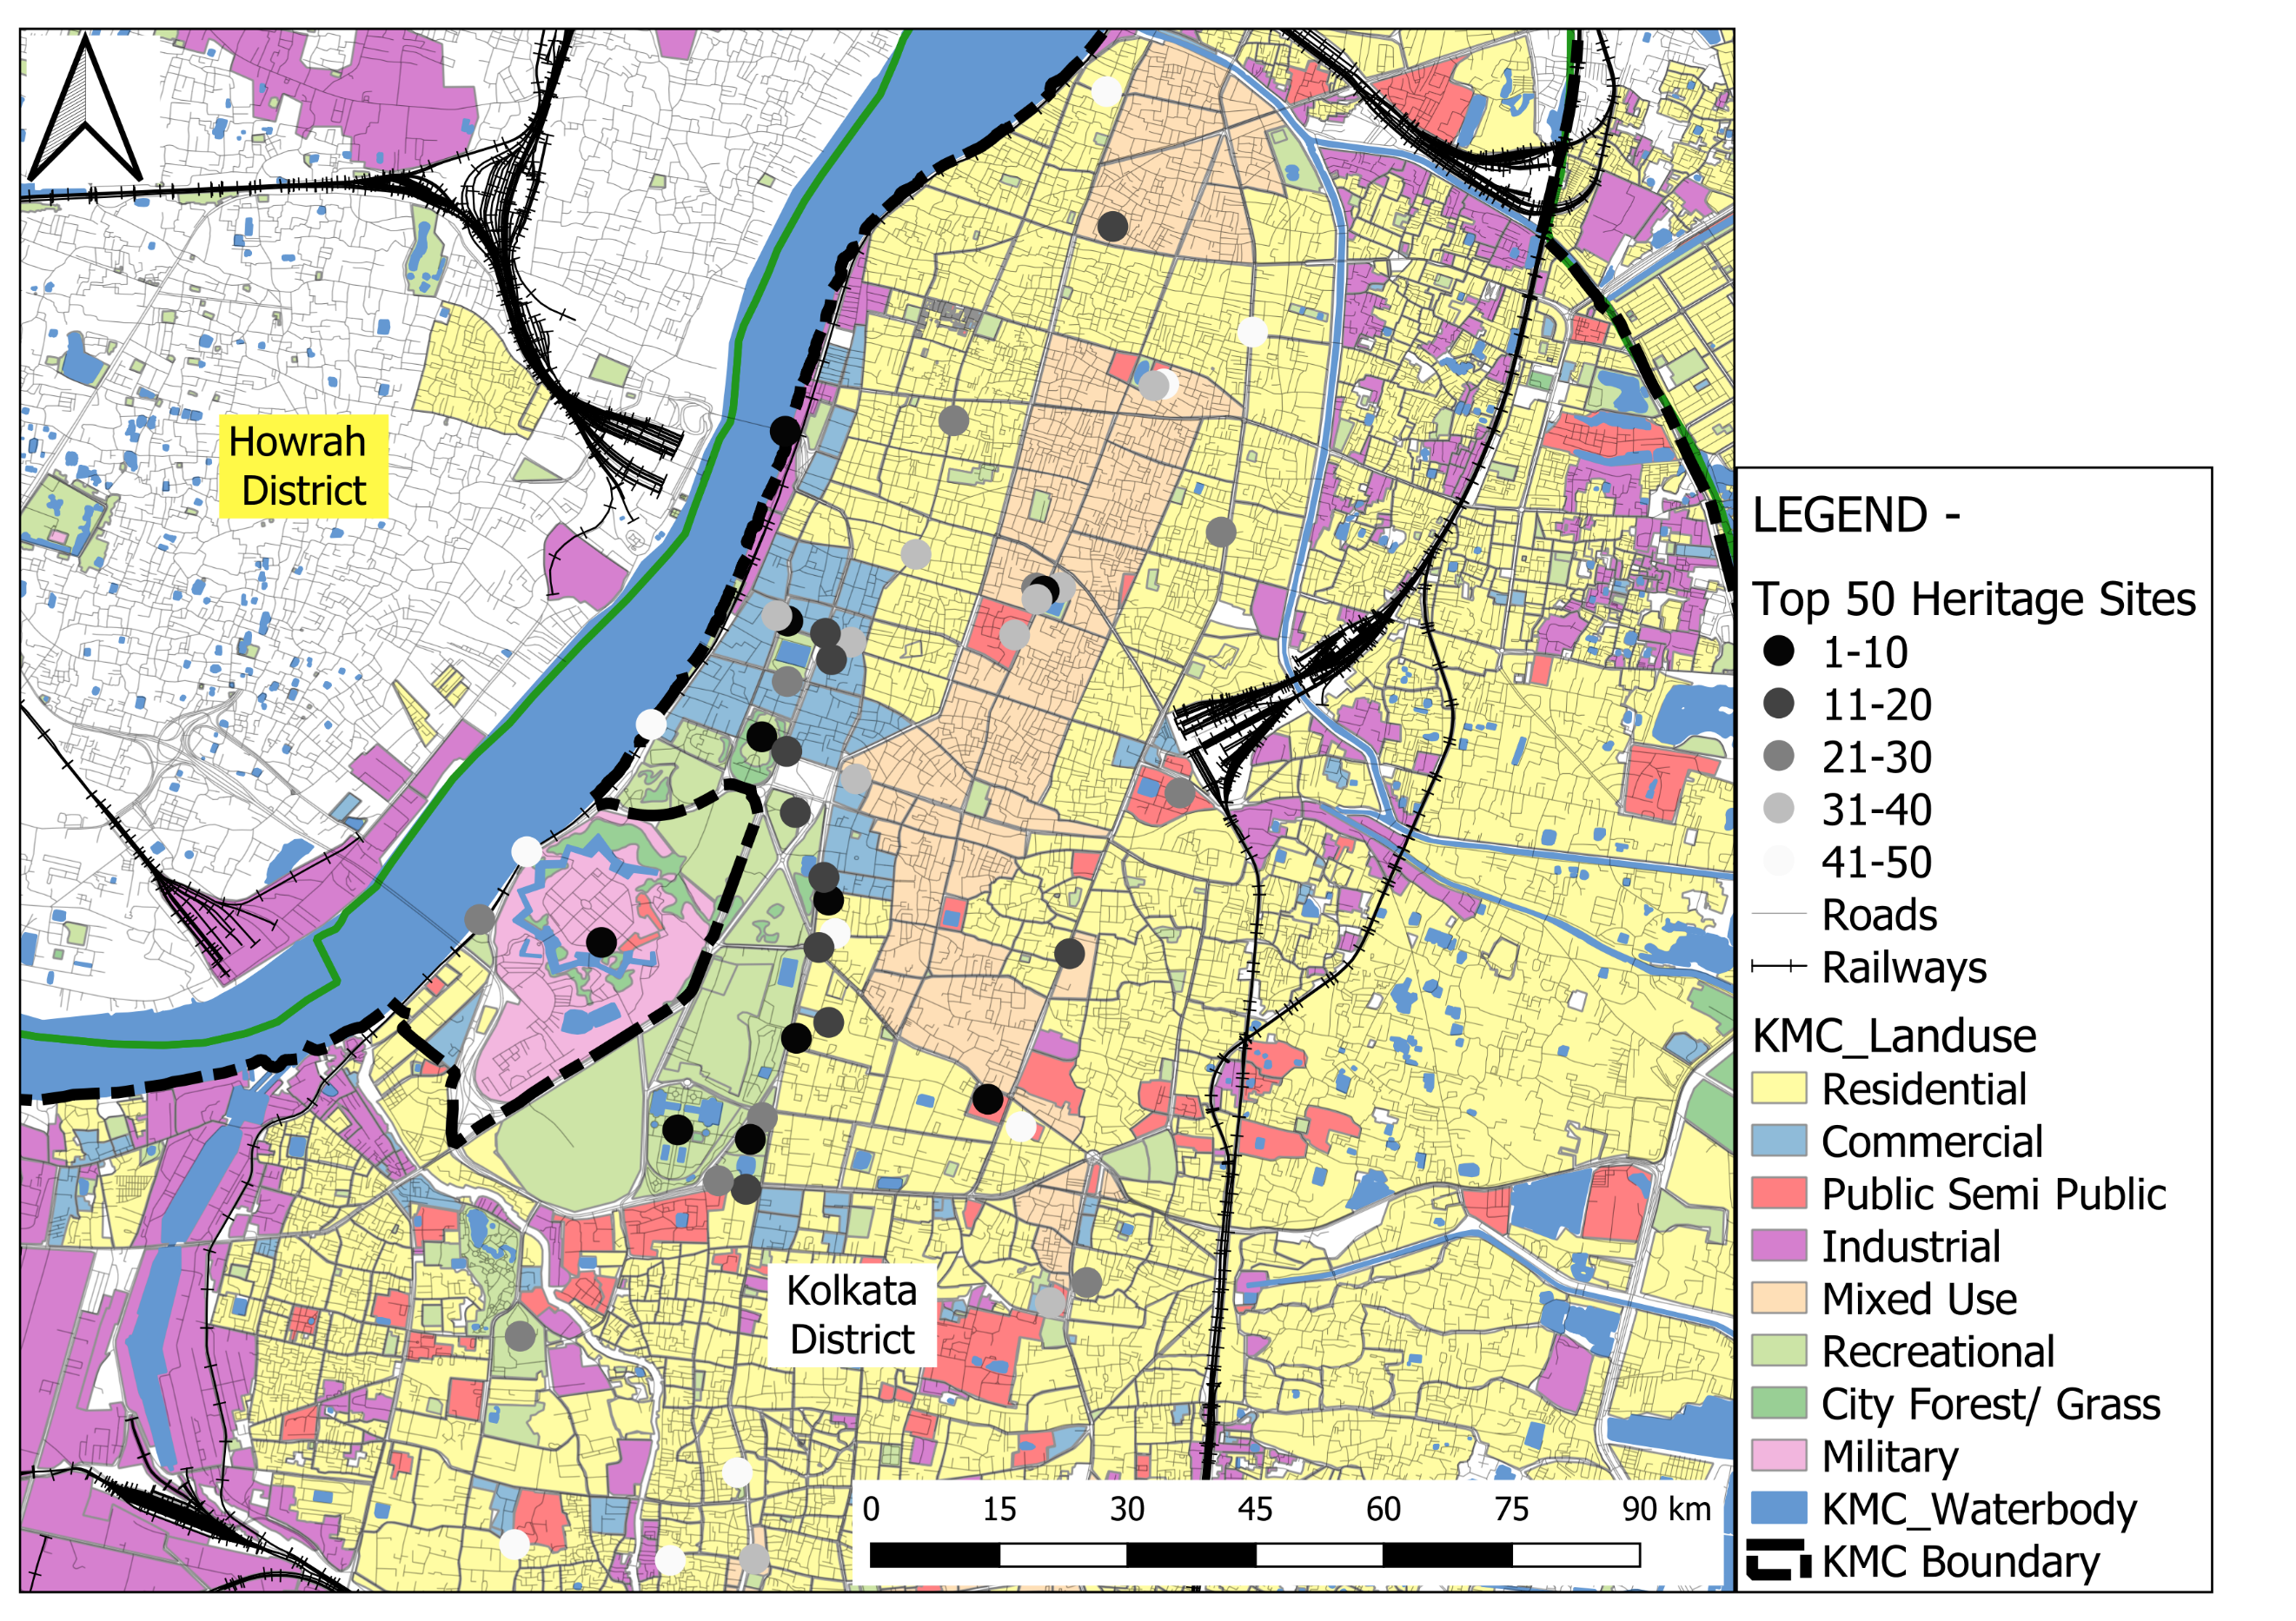
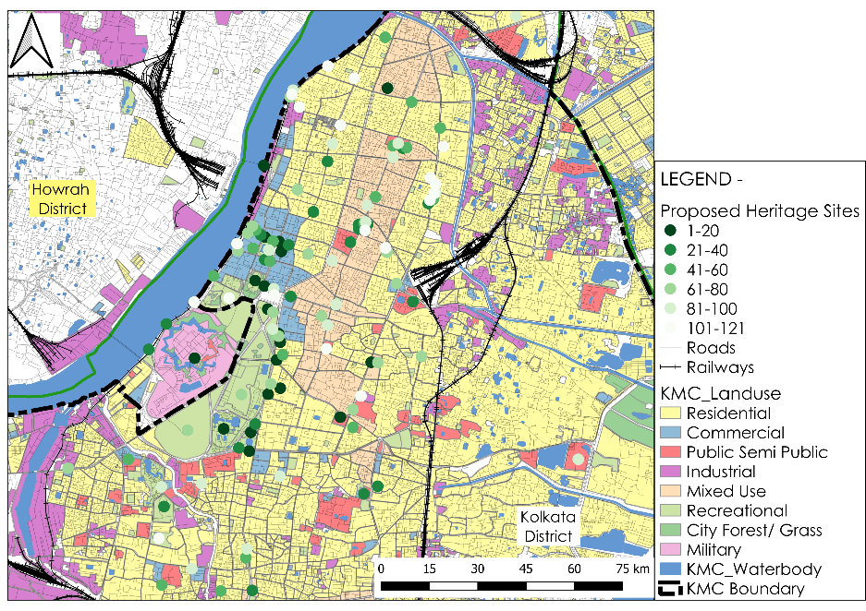
15
Data Analysis
3233
Scenario Development
Scenario 01 - Selecting a corridor which have top 50 Heritage sites
Scenario 02 - Selecting a corridor which have max. Heritage sites
Source: Author Generated
Source: Author Generated
Parameters to be considered for Scenario development :
Suitable ROW
% of ROW Use
Heritage Site Coverage
% of route along Metro Corridor
Selection of Best Corridor
Land Use
Route Length
Avoiding Flyover & Major Junction
Existing & New Tram Lines
Reconnecting Urban Spaces: A Strategic Approach to Tramways through Heritage Route Mapping (A Case of Kolkata)

Slide 18
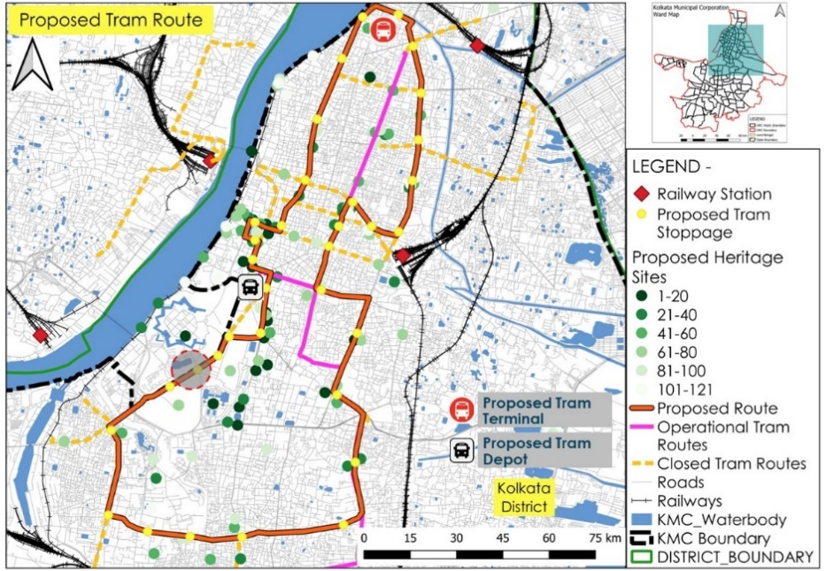

16
Proposals
3233
Comparison Table of Heritage Routes
S No | Parameters |  | Tram line in Both Direction (Scenario 01) |  |  | Tram line One Direction Only (Scenario 2)
 |  |  | Option 01 | Option 02 | Option 03 | Option 04 | Option 05 | Option 06
1 | Suitable ROW (Range) (In Mts.) |  | (12-36) | (15-32) | (14-45) | (16-45) | (14-45) | (17-36)
2 | % of ROW Use |  | (17-42)% | (14-33)% | (11-29)% | (4-12.5)% | (4-14)% | (6 -12)%
3 | Major Land Use Covered | Residential
 |  | Commrercial
 |  | PSP
 |  | Industrial
 |  | Mixed Use
 |  | Recreational
 |  | City Forest
 |  | Military
4 | Route Length (Km) |  | 10 | 14.8 | 14.4 | 28.5 | 31 | 25.5
5 | % of route along Metro Corridor |  | 33% | 32% | 13% | 6.60% | 3.50% | 22%
6 | Existing & New Tram Lines | Existing Tram Line (Km) | 5.6 | 8.2 | 8.9 | 24.9 | 13.6 | 15.8
 |  | New Tram Lines (Km) | 4.4 | 6.6 | 5.5 | 3.6 | 17.4 | 9.7
7 | Heritage Site Coverage (Close Proximity)(500mts. Walking Distance) |  | 23 | 22 | 13 | 79 | 58 | 57
8 | Avoiding Flyover & Major Junction | Flyover | 0 | 2 | 1 | 3 | 1 | 0
 |  | Major Junction | 2 | 3 | 2 | 2 | 0 | 1
Source: Author Generated
Most Preferable
Average
Least Preferable
Proposed Tram Route
Length (KM) | Tram Stops | Layover Time (Min.) | Total Halt Time (MIn.) | Running Time (Min.) | Journey Time (Min.) | Min. Calculated Headway (Min.) | Proposed Headway (Min.)
28.5 | 35 | 10 | 35 | 85 | 120 | 10 | 15
Source: Author Generated
Reconnecting Urban Spaces: A Strategic Approach to Tramways through Heritage Route Mapping (A Case of Kolkata)

Slide 19



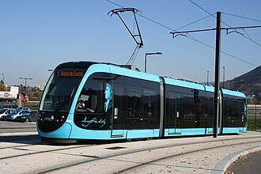
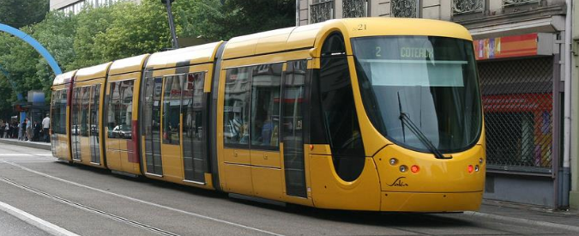

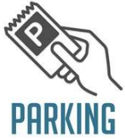
17
Conclusion & Recommendations
3233
Financial Aspects
Govt Funds
Global Funds
AMRUT 2.0 are designed to provide critical grants for infrastructure projects that improve urban mobility and sustainability
ADB offer financial assistance, technical expertise, and guidance on implementing PPP models for tram and LRT systems
The Ministry of Housing and Urban Affairs operates Urban Transport Development Fund (UTDF), which provides financial assistance for urban transport projects
IFC provide advisory services, financing, and expertise in structuring and implementing PPPs for tram and LRT projects
Planning Aspects
Technical Aspects
Route Termination & Remapping of Bus Routes
This strategic process involves reorganizing existing bus lines to complement and optimize the new tram network
Increase Parking Charges
In Kolkata’s context, CAF Urbos models and Citadis X02 (Second Generation) models can be used
The base price for a single Citadis tram unit ranged from approximately €2 million to €4 million (17 – 33 crore Indian rupees), depending on the specific configuration
In different phases of the routes, cars are parked on street, blocking existing Tram lines. High parking charge can be a proper solution to tackle this issue
Reconnecting Urban Spaces: A Strategic Approach to Tramways through Heritage Route Mapping (A Case of Kolkata)

Slide 20
References
3233
Ansar Tausif Ahmed, Ajmira Khatun . (May 2016). Tramways System - A Case Study of Kolkata. 8134-8138. https:// DOI:10.15680/IJIRSET.2016.0505120
Lorenzo Naegeli, Ulrich Weidmann, and Andrew Nash . (2021). Checklist for Successful Application of Tram–Train Systems in Europe. Transportation Research Record: Journal of the Transportation Research Board, No. 2275, Transportation Research Board of the National Academies, Washington, D.C., 2012, pp. 39–48. https:// DOI: 10.3141/2275-05
Graham Currie and Amer Shalaby . (2007). Success and Challenges in Modernizing Streetcar Systems Experiences in Melbourne, Australia, and Toronto, Canada. Transportation Research Record: Journal of the Transportation Research Board, No. 2006, Transportation Research Board of the National Academies, Washington, D.C., 2007, pp. 31–39. https:// DOI: 10.3141/2006-04
Krystian Pietrzak and Oliwia Pietrzak . (August 2022). Tram System as a Challenge for Smart and Sustainable Urban Public Transport: Effects of Applying Bi-Directional Trams. Energies 2022, 15, 5685. https://doi.org/10.3390/ en15155685
Niklas Arvidsson1 , Michael Browne. (2013). A review of the success and failure of tram systems to carry urban freight: the implications for a low emission intermodal solution using electric vehicles on trams. European Transport \ Trasporti Europei (2013) Issue 54, Paper n° 5, ISSN 1825-3997
Yves Boquet. (2020). The renaissance of tramways and urban redevelopment in France. 21 (1), pp.5-18. ff10.1515/mgrsd-2017-0005ff. ffhal-01957503f
Vukan R. Vuchic. (2018). Urban Public Transportation System. 1-20. https://www.eolss.net/sample-chapters/C05/E6-40-02-02.pdf
Subham Pramanick, Dr. A K M Anwaruzzaman, Dr. Utpal Roy. (2019). A Profile of Tramways in Kolkata - A Sustainable Urban Public Transport. Indian Journal of Spatial Science Autumn Issue 10(2) 2019 pp. 59 – 64. https://www.researchgate.net/publication/336085491
Barbara Schmucki. (2015). On the trams - Women, men and urban public transport in Germany. 60-72. https://eclass.uoa.gr/modules/document/file.php/PHS380/Gender%20and%20Tramways.pdf
Professor Oindrila Dey. (December 2017). Back on Track: The Tramways of Kolkata. 2-77. https://dip.flame.edu.in/projects/back-on-track-the-tramways-of-kolkata/
Eshita Boral. (July 2012). TRAMWAYS – An eco – friendly mode of mass transportation: a case of Kolkata. Journal of Arts, Science & Commerce E-ISSN 2229-4686 ISSN 2231-4172. 64-71. https://www.researchgate.net/publication/332727918
https://wbtc.co.in/tram-service
Reconnecting Urban Spaces: A Strategic Approach to Tramways through Heritage Route Mapping (A Case of Kolkata)

