Slide 1


Headway Optimization for Public Transport using
Genetic Algorithm
Author Name : Priya Dharshini M
Guide / Co- Author Name. : Arvind Manickam

Slide 2
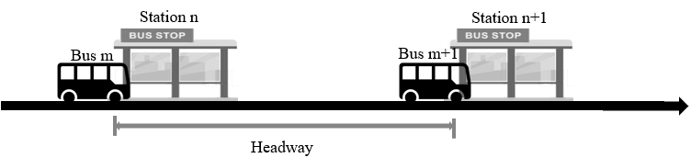
INTRODUCTION
What is Headway Optimization and why do we need it ?
Urban transport networks are becoming increasingly complex due to rapid urbanization, population growth, and rising travel demand.
Inefficient transit network planning combined with poorly managed headways leads to increased travel times, and reduced accessibility, negatively impacting economic productivity and quality of life (Ortúzar & Willumsen, 2011).
Headway Optimization refers to the process of adjusting the headway of a public transportation systems to enhance efficiency, minimize costs, and improve service quality for passengers.
Optimization techniques are used to improve transit network performance by identifying the best frequencies for routes and schedules to serve a given demand with the limited number of buses.
For the functioning of an effective network, Headway Optimization is essential.
Ceder, A. (2016). Public transit planning and operation: modeling, practice and behavior. CRC press, Urban bus Transit route network design using genetic algorithm by S. B. Pattnaik; S. Mohan,:z and V. M. Tom3

Slide 3
Need for the study
How are bus networks typically planned?
How are the headways planned?
Fixed routes : Based on historic Travel pattern and future projections
Assigned equally across routes
Adjusted based on driver availability, not actual ridership
Administrative decisions
Allotting equal buses in all routes
Rarely optimized dynamically with actual Origin-Destination (OD) demand
Assumptions of uniform demand
Disadvantages in this practice
1
Mismatch between Demand and Supply
2
Inefficient fleet utilization
3
Passenger dissatisfaction
High-demand corridors remain underserved
Low-demand routes may get excessive service
Wasted operational cost on underutilized routes
Missed opportunities to serve more passengers on busy routes
Low reliability, overcrowding in some areas, and empty buses in others
To address these challenges effectively, it is essential to optimize the bus network frequencies in alignment with actual travel demand and operational constraints.

Slide 4
Research approaches
Optimization problems can be solved in many different way, below mentioned are some papers which has dealt with optimization problem in different ways
Research paper Information | Methodology | Objective function
Optimizing Urban Road Networks for Resilience Using Genetic Algorithms CHENG, Xueyi CHE, Chang(2024) | Multi Objective optimization framework using genetic algorithm. | Total travel time , Addition budget constraints, and the number of bottlenecks involved
Public Transportation Network Design and Frequency Setting: Pareto Optimality through Alternating-Objective Genetic Algorithms Theocharis Vlachopanagiotis, (2021) | Pareto optimal solution using Genetic algorithm - satisfy the demands of both the transportation network user as well as its operator while attempting to find near-optimal solutions. | User benefit maximization, operator cost minimization, maximization of network capacity.
Optimal Transit Route Network Design Problem with Variable Transit Demand: Genetic Algorithm Approach Wei Fan and Randy B. Machemehl (2015) | A multi objective nonlinear mixed integer model is developed using Genetic Algorithm | Sum of user cost, operator cost, and unsatisfied demand costs
Integrated Multimodal Transit Route Network Design with Feeder Systems Anu Sachan, Tom Mathew (2019) | Combination of routes using Meta Heuristic techniques. | Total Travel time , User cost

Slide 5
Comparing the objective variables in different cases
S.No | Author | Year | Objective | Decision Variable
1 | Pattnaik et al. | 1998 | total cost | Route, frequency
2 | Deb & Chakroborty | 1998 | passenger wait time | Arrival time and departure time
3 | Gundaliya et al. | 2000 | total cost | Route, frequency
4 | Chien et al. | 2001 | total cost | Route, headway
5 | Kalaga | 2001 | crowding level | Route, frequency
6 | Chakroborty | 2001 | total waiting time (passenger) | Arrival time and departure time
7 | Bielli | 2002 | multi | Route, frequency
8 | Shrivastava & Dhingra | 2006 | total cost | Route, frequency
9 | Chakroborty & Diwedi | 2002 | multi | Route
10 | Chien | 2003 | total cost | Route, headway, stop spacing
11 | Tom and Mohan | 2003 | total cost | Route, frequency
12 | Ngamchai & Lovell | 2003 | total cost | Route, frequency
13 | Agrawal & Mathew | 2004 | total cost | Route, frequency
14 | Kidwai | 2005 | passenger wait time + crowding | Route, frequency
15 | Zhao & Zeng | 2006 | coverage,transfer,user cost | Route, frequency
16 | Kaun | 2006 | total cost | Route, frequency
17 | Verma & Dhingra | 2006 | total cost | Route, headway
18 | Shrivastava & O’Mahony | 2006 | total cost | Route, frequency
19 | Wang and Lin | 2010 | operator cost ,passenger travelling cost | Route, frequency, capacity , headway
20 | Chew and Lee | 2012 | passenger cost | Route
Most studies address network or headway optimization within the framework of a mode choice model. However, solving the optimization problem in the absence of such a model remains a significant challenge.

Slide 6
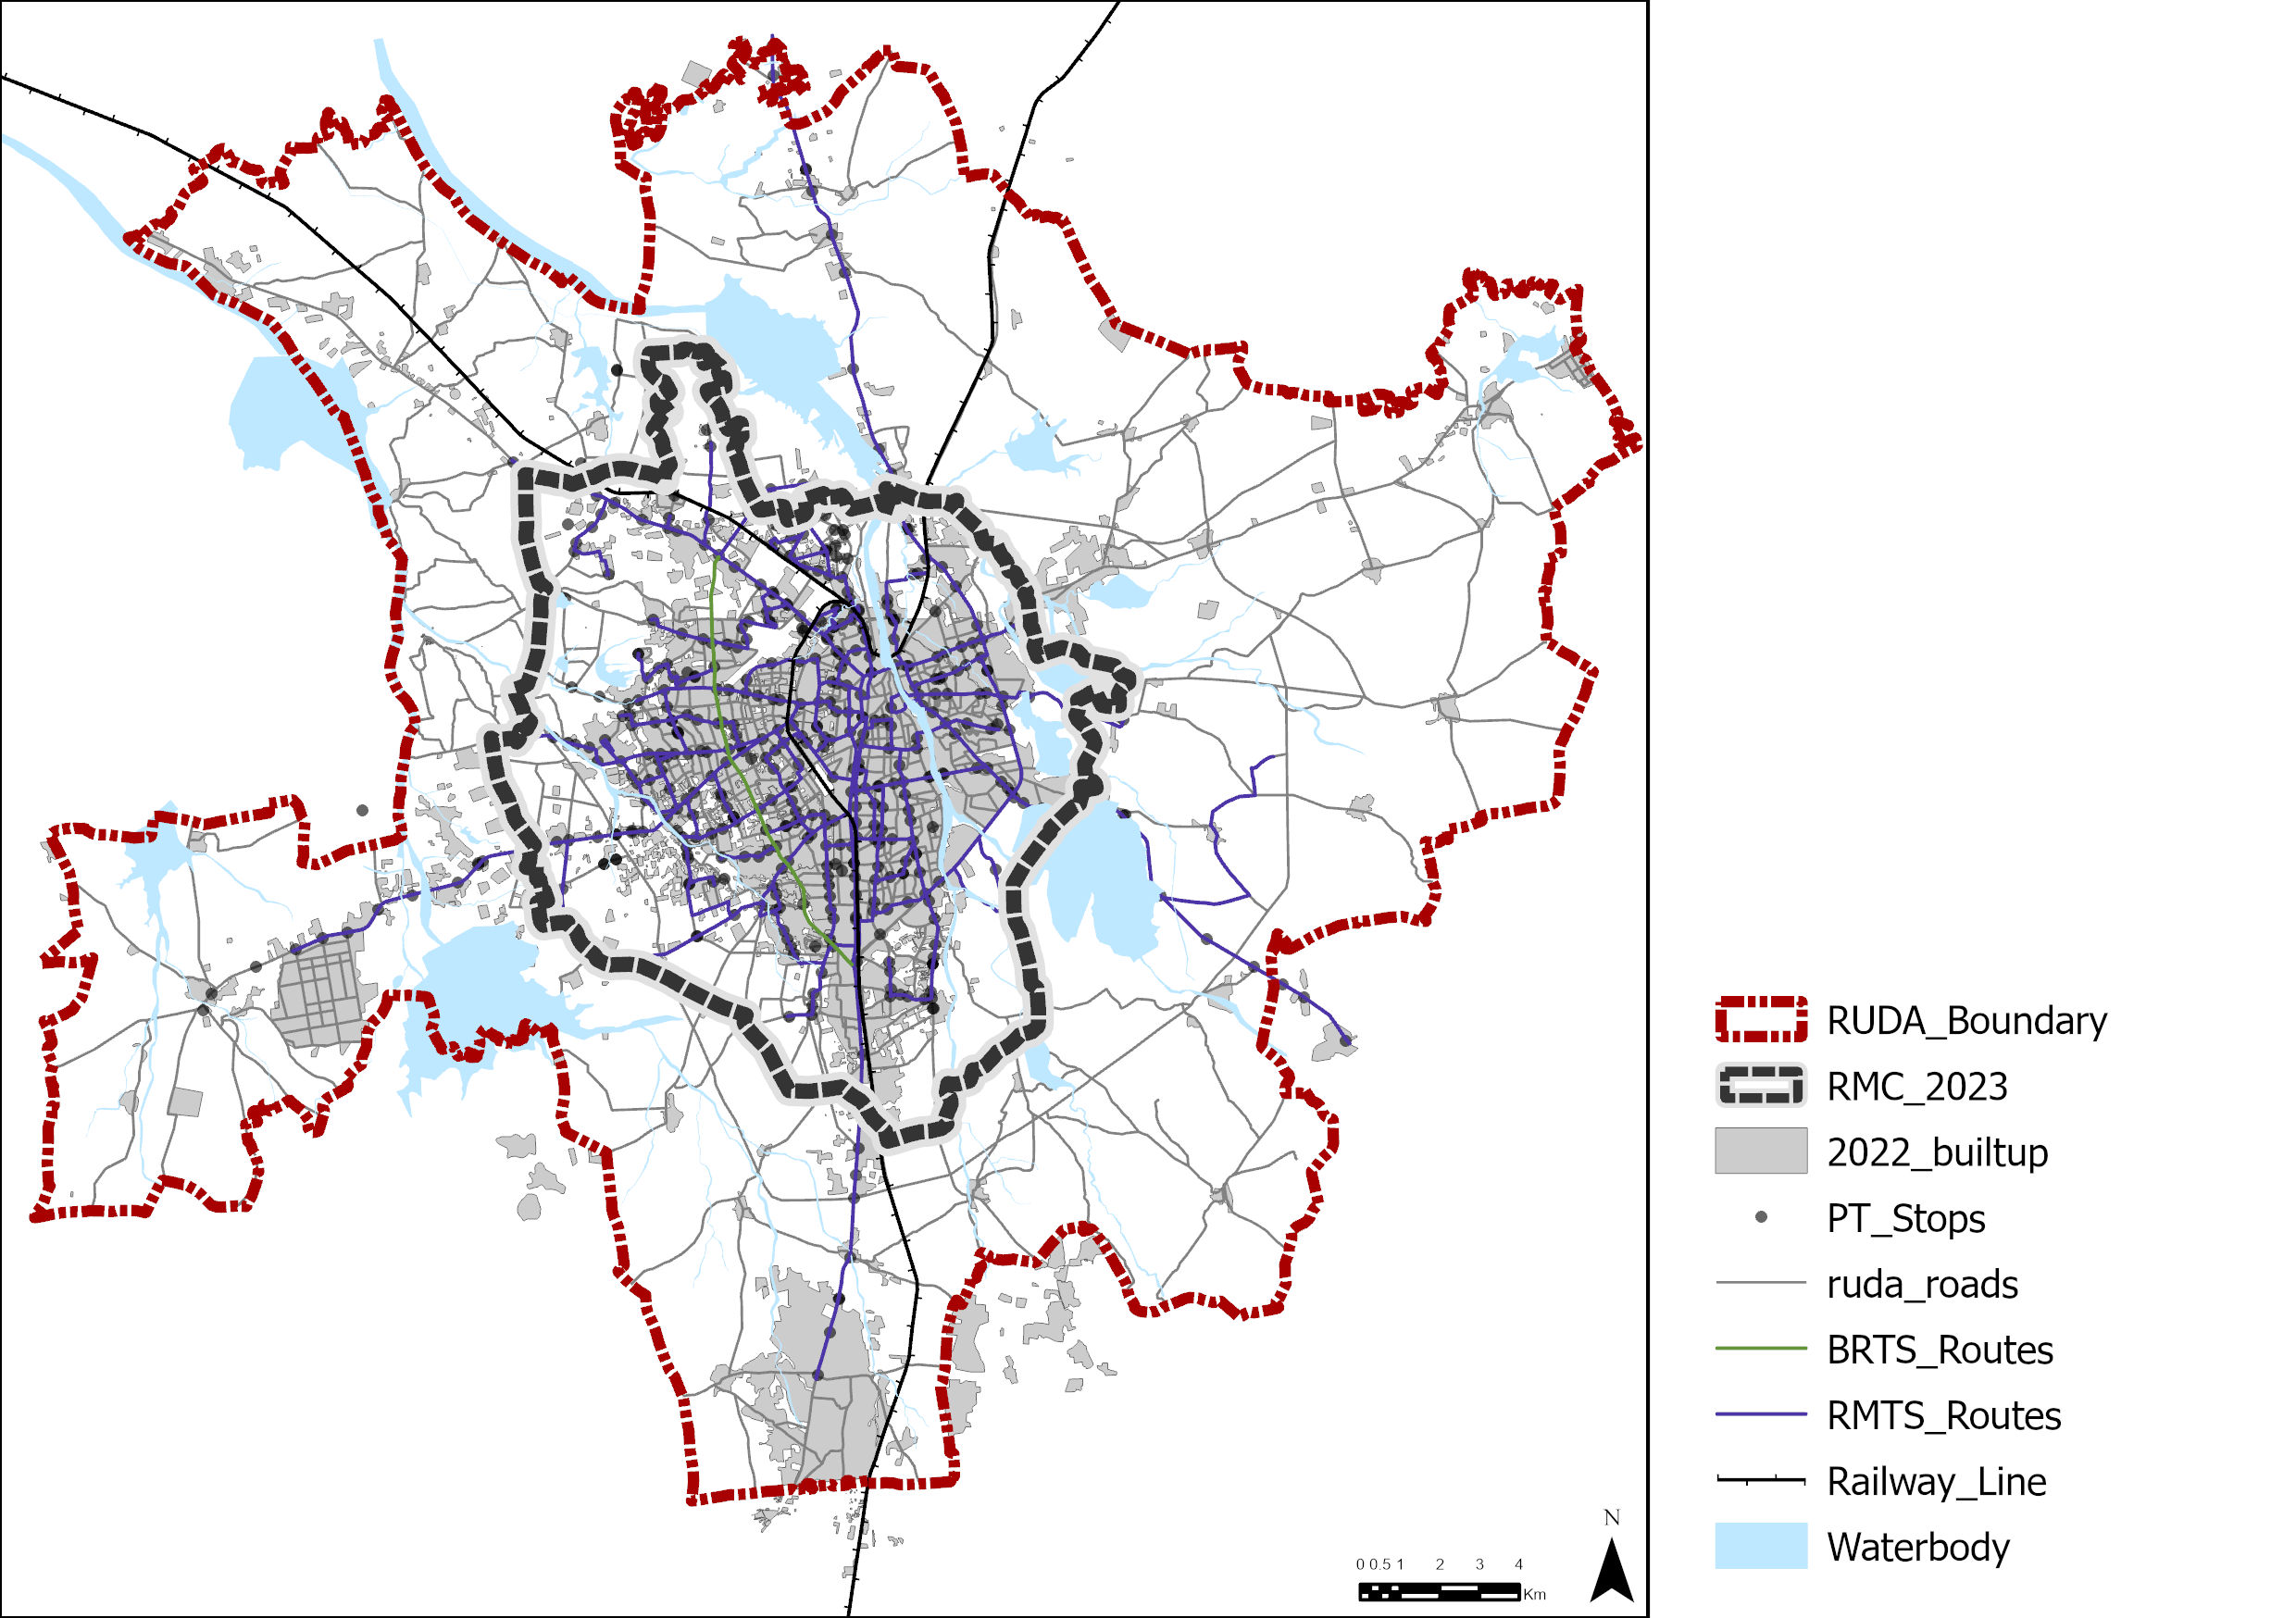
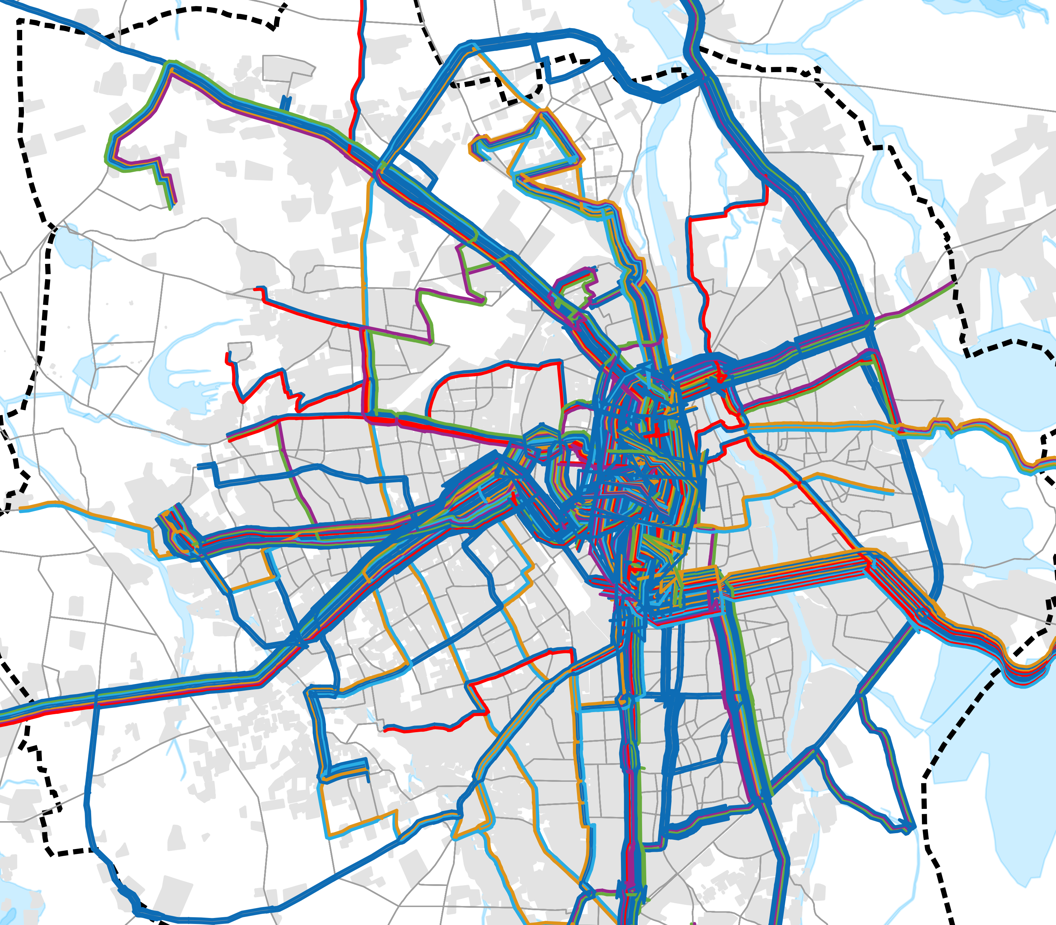
Case City - Rajkot
RUDA Area : 690 sq.km
150ft Jamnagar
Road Crossing
RUDA Population :20,58,930
Fleet Size
Ev buses: 150
CNG buses: 100
PM E bus seva : 100
Total : 350 buses
Madhapar
Chowk
5
6
Existing Network length
RMC - 231.6 km
RUDA - 26.4 km
Saurashtra
University
Existing PT Network length
39% of all operating routes have a headway greater than 75 minutes.
4
Criteria | Data
Operational Fleet | 117
Total capacity | 45
Load factor | 0.87
Coverage | 167 sq.km
Within RMC | 73%
Within RUDA | 10%
Headway Range | No. of Routes | Proportion of Routes
<=15 mins. | 1 | 2%
15-30 mins. | 0 | 0%
30-45 mins. | 6 | 12%
45-60 mins. | 13 | 27%
60-75 mins. | 10 | 20%
>75 mins. | 19 | 39%
Total | 49 | 100%
Aji
Dam
1
3
Everest
Park
2
Nanda
Hall
Source : 3rd semester studio

Slide 7
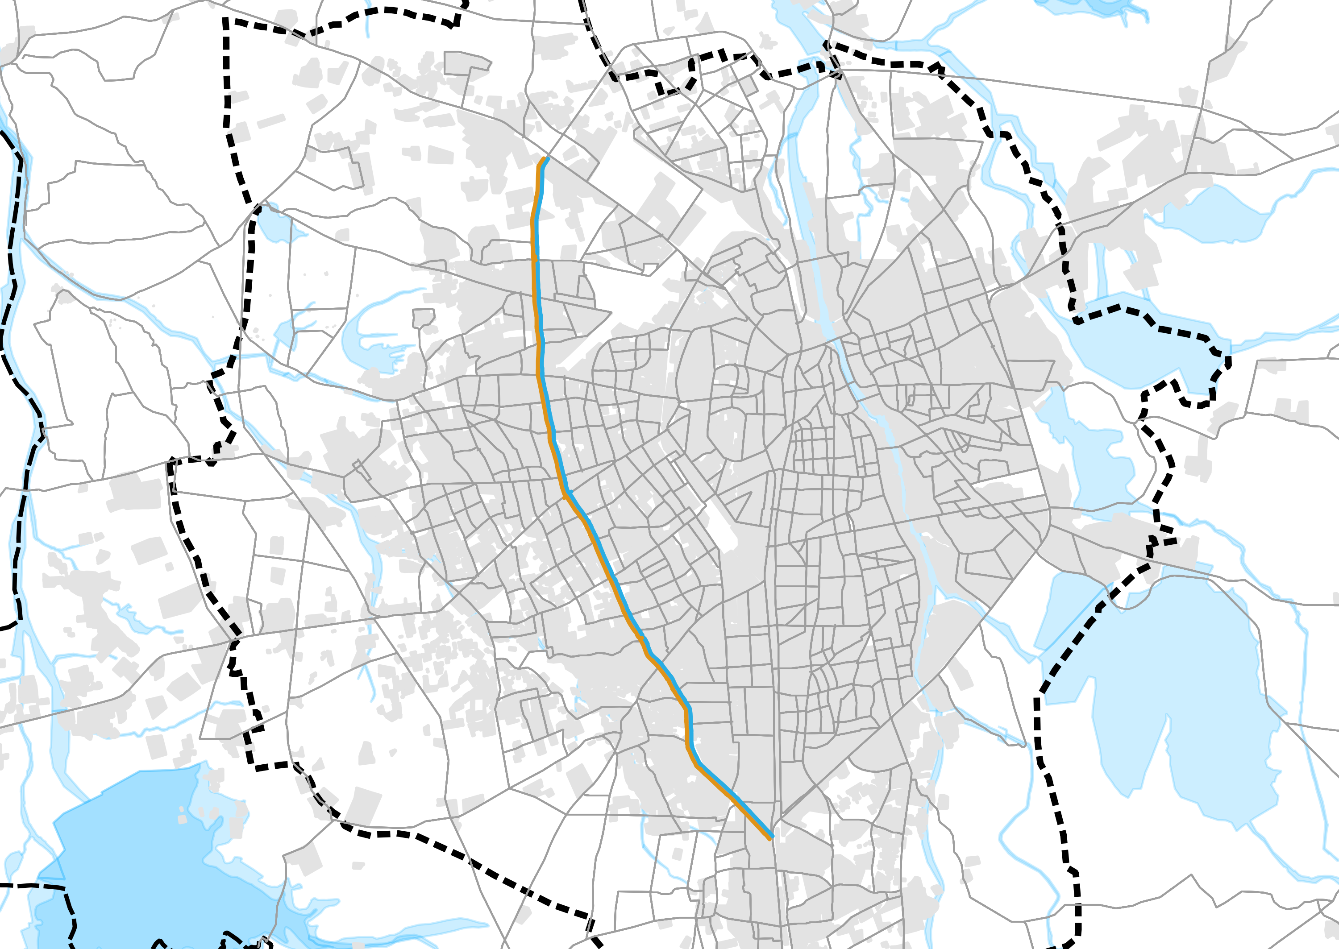
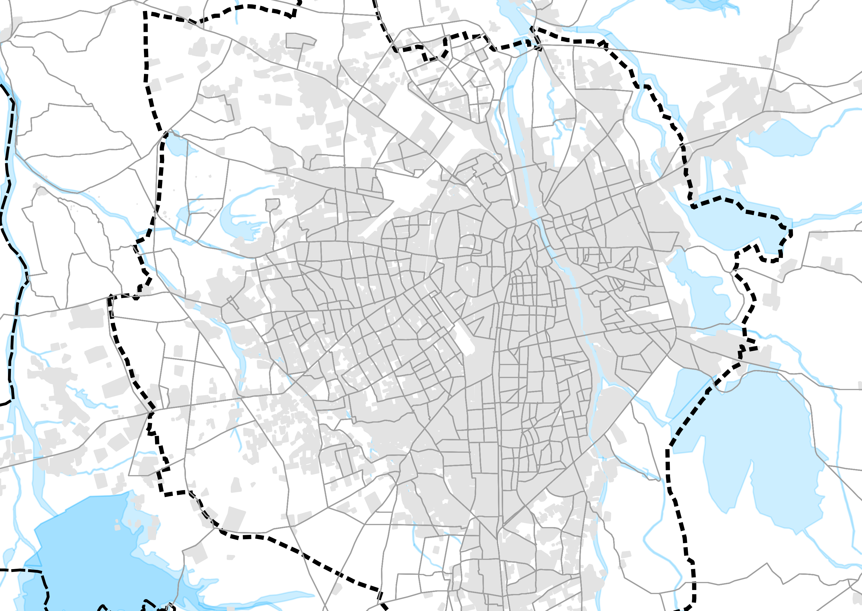
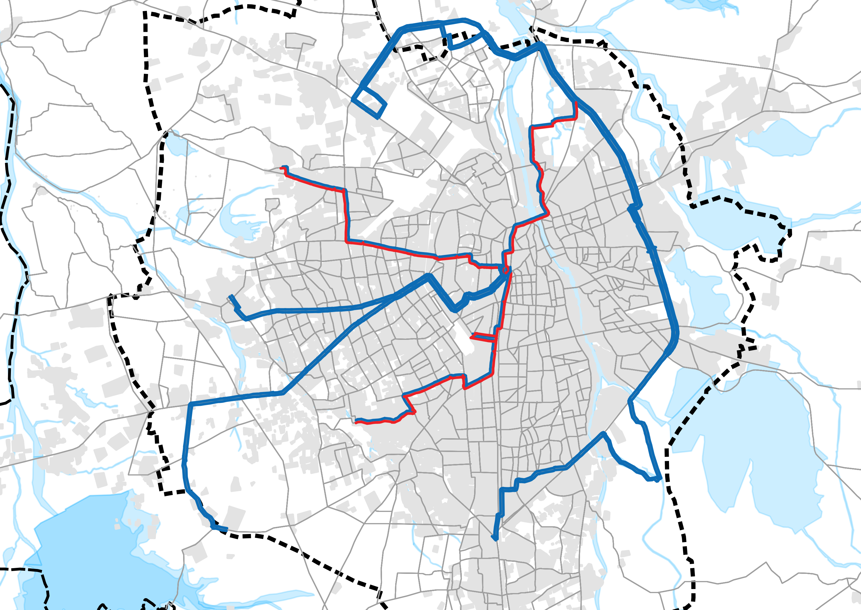
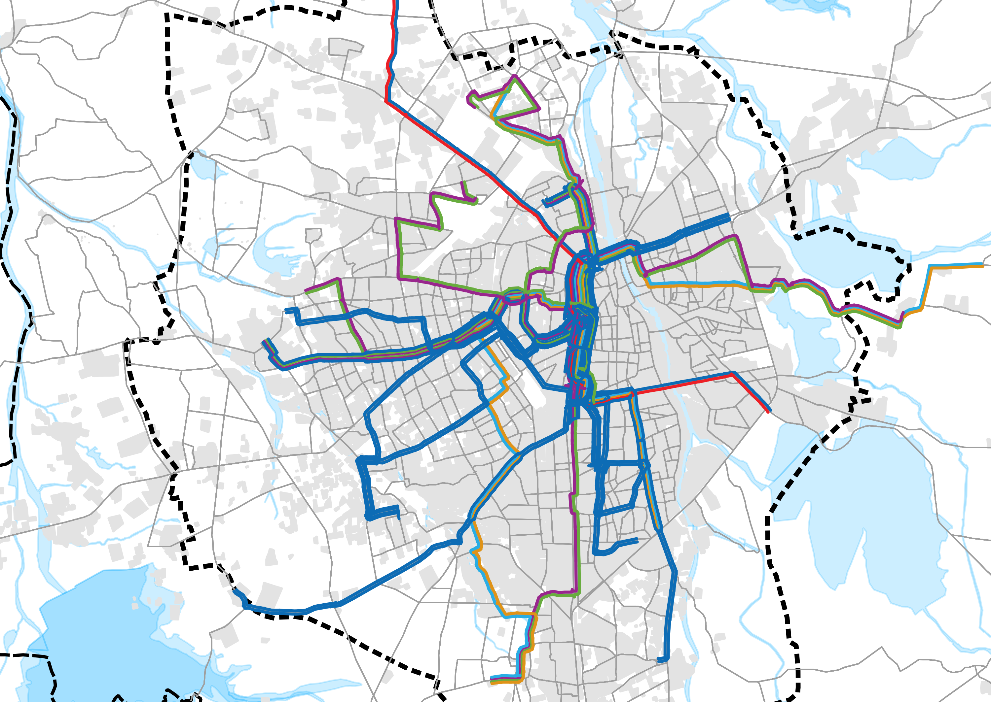
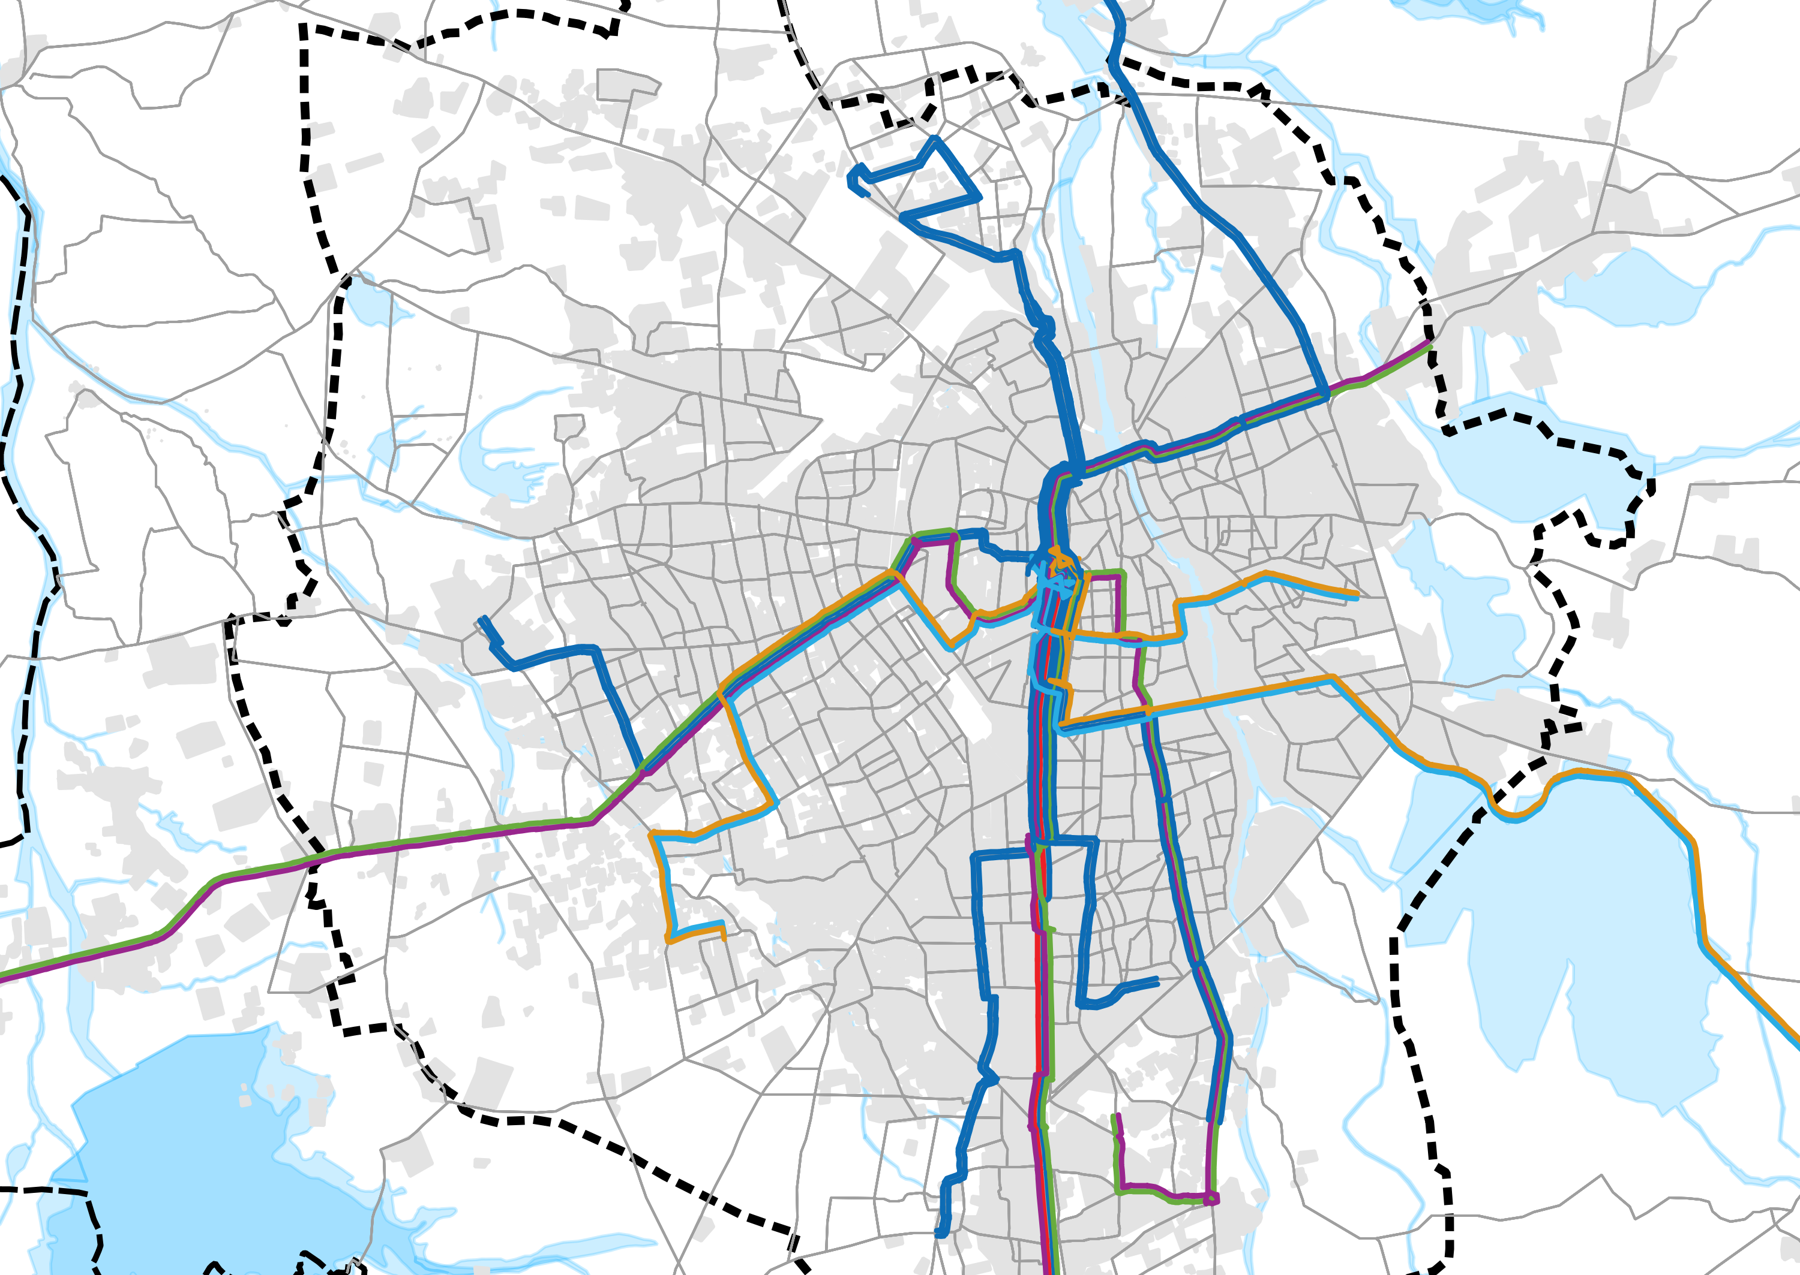
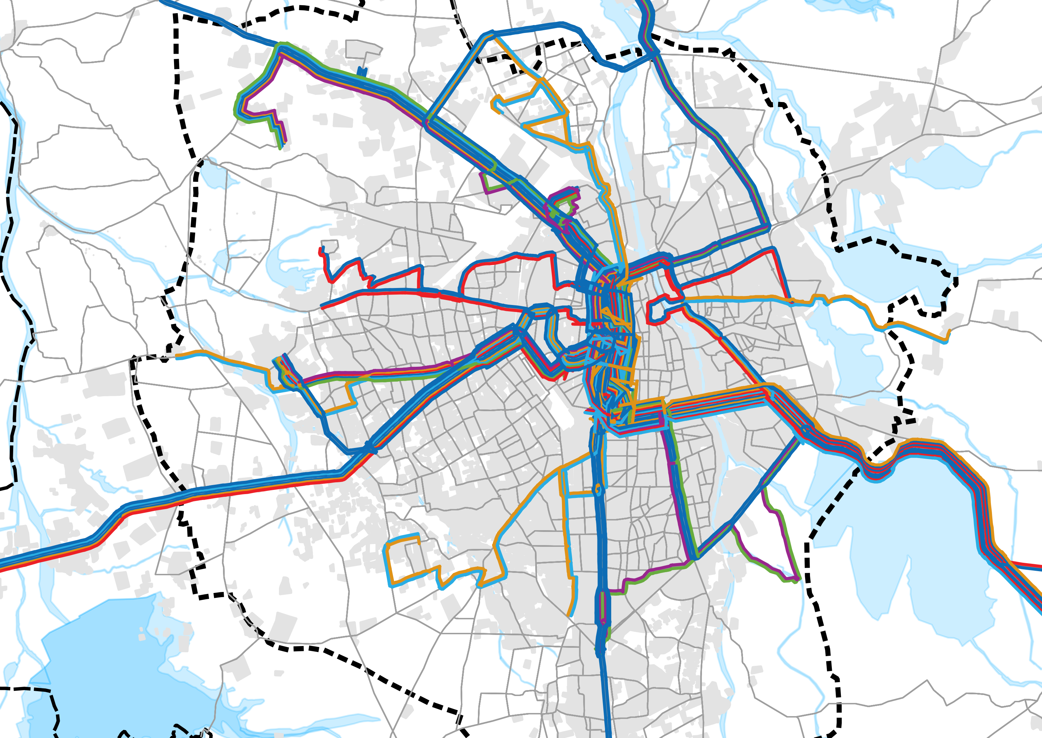
Headway Distribution across the routes
150ft Jamnagar
Crossing
150ft Jamnagar
Crossing
150ft Jamnagar
Crossing
Ghanteshwar
Santoshinagar
Ghanteshwar
Santoshinagar
Ghanteshwar
Santoshinagar
Madhapar
Madhapar
Madhapar
Greenland
Chowk
Greenland
Chowk
Greenland
Chowk
Raiya
Raiya
Raiya
Saurashtra
University
Trikon
Baug
Saurashtra
University
Trikon
Baug
Saurashtra
University
Trikon
Baug
KKV Hall
Aji Dam
KKV Hall
Aji Dam
KKV Hall
Aji Dam
Galaxy
Chowk
Galaxy
Chowk
Galaxy
Chowk
Mavdi
Mavdi
Mavdi
Vavdi
Kothariya
Vavdi
Kothariya
Vavdi
Kothariya
Govt. Engg. College
Gondal
Govt. Engg. College
Gondal
Govt. Engg. College
Gondal
Hdw <= 15 mins.
No. of Routes = 1
15 mins. < Hdw <= 30 mins.
No. of Routes = 0
30 mins. < Hdw <= 45 mins.
No. of Routes = 6
150ft Jamnagar
Crossing
150ft Jamnagar
Crossing
150ft Jamnagar
Crossing
Ghanteshwar
Santoshinagar
Ghanteshwar
Santoshinagar
Ghanteshwar
Santoshinagar
Madhapar
Madhapar
Madhapar
Greenland
Chowk
Greenland
Chowk
Greenland
Chowk
Raiya
Raiya
Raiya
Saurashtra
University
Trikon
Baug
Saurashtra
University
Trikon
Baug
Saurashtra
University
Trikon
Baug
KKV Hall
Aji Dam
KKV Hall
Aji Dam
KKV Hall
Aji Dam
Galaxy
Chowk
Galaxy
Chowk
Galaxy
Chowk
Mavdi
Mavdi
Mavdi
Vavdi
Kothariya
Vavdi
Kothariya
Vavdi
Kothariya
Govt. Engg. College
Gondal
Govt. Engg. College
Gondal
Govt. Engg. College
Gondal
45 < Hdw <= 60 mins.
No. of Routes = 13
60 < Hdw <= 75 mins.
No. of Routes = 10
Hdw > 75 mins.
No. of Routes = 19
Source : 3rd semester studio

Slide 8
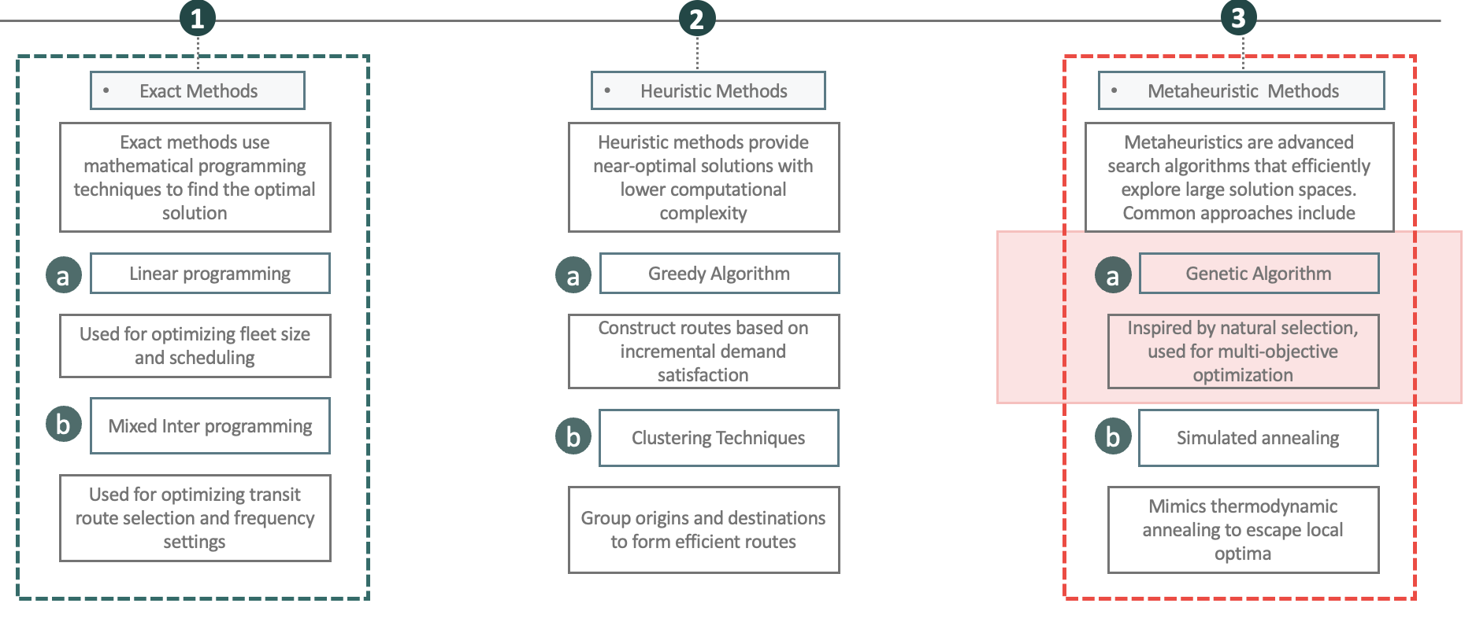
Introduction
Aim
The objective of this research is to optimize the headway of the existing transit network for urban public transport systems specially BUS , with a specific focus on improving the service quality of the cities’ PT Network.
Objectives
Conduct a comprehensive literature review and develop a methodology for evaluating bus route networks.
Formulate a simplified objective function, Document limitations of such model.
Collect data for the case city chosen to evaluate the transit network.
Apply a Genetic Algorithm (GA) to determine the optimal solution.
Expected outcomes
Traditional optimization methods, such as linear programming and heuristic techniques, struggle with large-scale, multi-objective problems.
To overcome these limitations, Genetic Algorithms (GAs) have emerged as a powerful tool for transit network optimization
Determined Objective Functions
Optimized Headway for existing network of the case city.
Limitations and Suggestions for Further Research

Slide 9
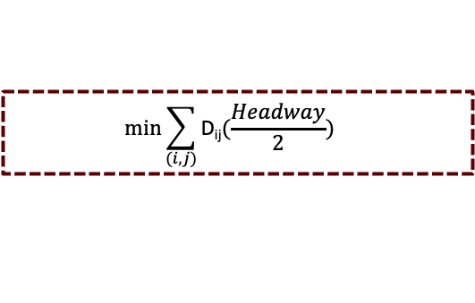
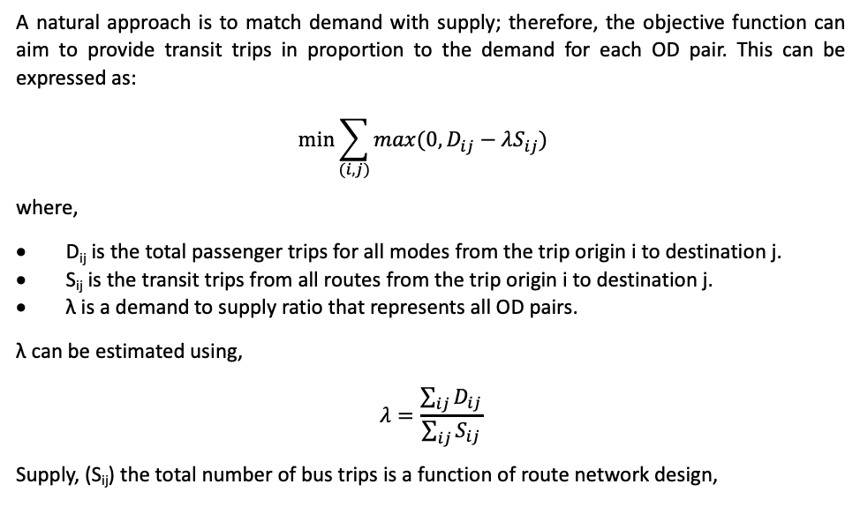
Fitness function
What is an Objective function? (Fitness function)
An objective function is a mathematical expression that quantifies the goals of the optimization problem. It represents the criteria that the optimization algorithm seeks to minimize or maximize
Objective Function 01
Objective Function 02
A natural approach is to match demand with supply; therefore, the objective function can aim to provide transit trips in proportion to the demand for each OD pair. This can be expressed as:
$$min\sum_{(i,j)}{{max({0, D}_{ij}−λS_{ij})}^{}}$$
where,
D_{ij} is the total passenger trips for all modes from the trip origin i to destination j.
S_{ij} is the transit trips from all routes from the trip origin i to destination j.
λ is a demand to supply ratio that represents all OD pairs.
λ can be estimated using,
$$λ=\frac{\sum_{ij}{D_{ij}}}{\sum_{ij}{S_{ij}}}$$
Supply, (S_{ij}) the total number of bus trips is a function of route network design,
To better reflect user experience and service quality, a new objective function is formulated.
The focus now shifts to minimizing the total waiting time across the network, offering a more service-oriented optimization lens.
Objective:
Minimize the total passenger waiting time at the origin, proportional to the headway of bus services on each OD pair.
Key Inputs:
OD-wise passenger demand.
Route-wise bus frequency and headway (derived from buses allocated).
$$min\sum_{(i,j)}{\text{D}\text{ij}{(\frac{Headway}{2})}^{}}$$
where,
D_{ij} is the total passenger trips for all modes from the trip origin i to destination j.
Headway is related to bus trips per OD
Constraints:
Subject to a fixed fleet size constraint, where the total number of buses available for allocation across all routes remains constant.
Limitations:
Does not estimate how many passengers will be converted to public transport ridership.

Slide 10
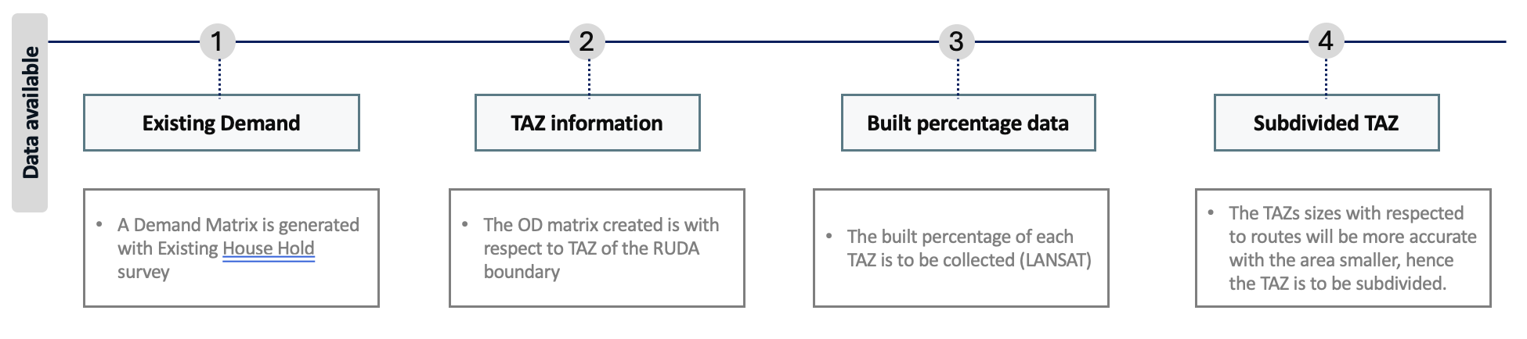
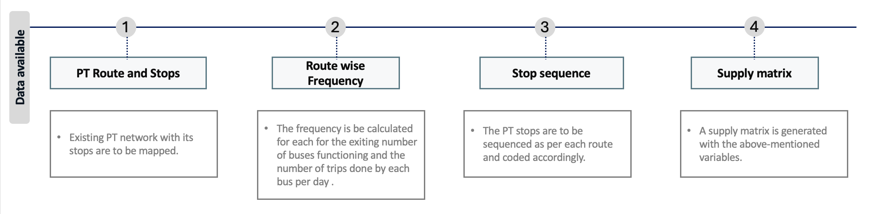
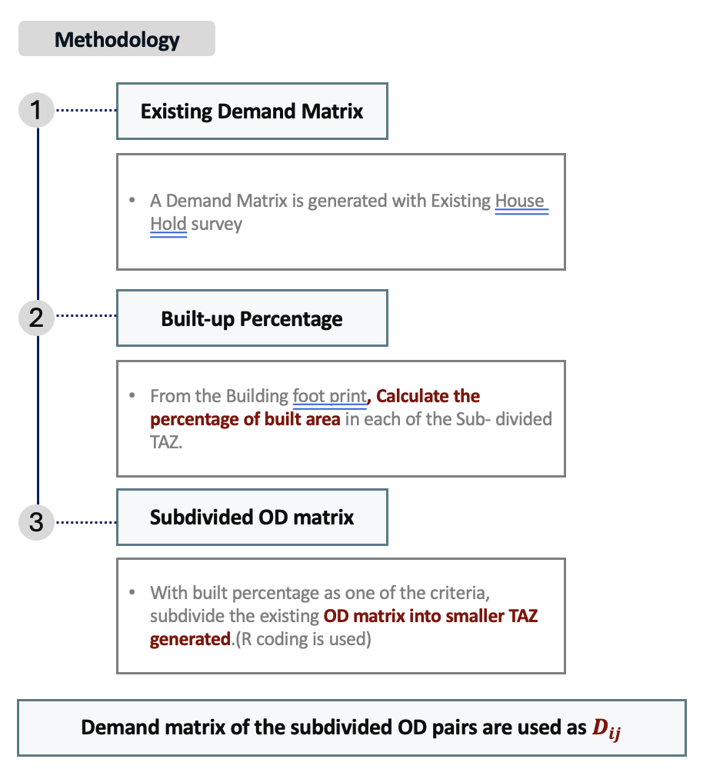
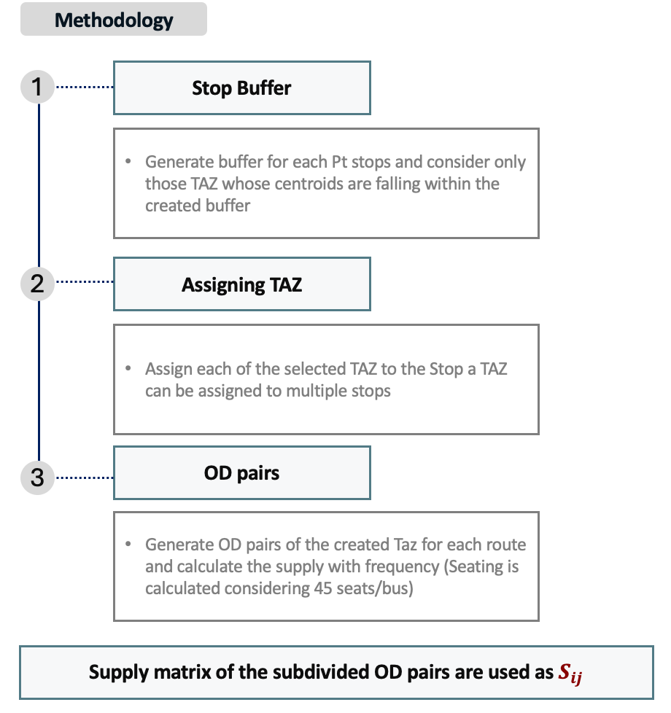
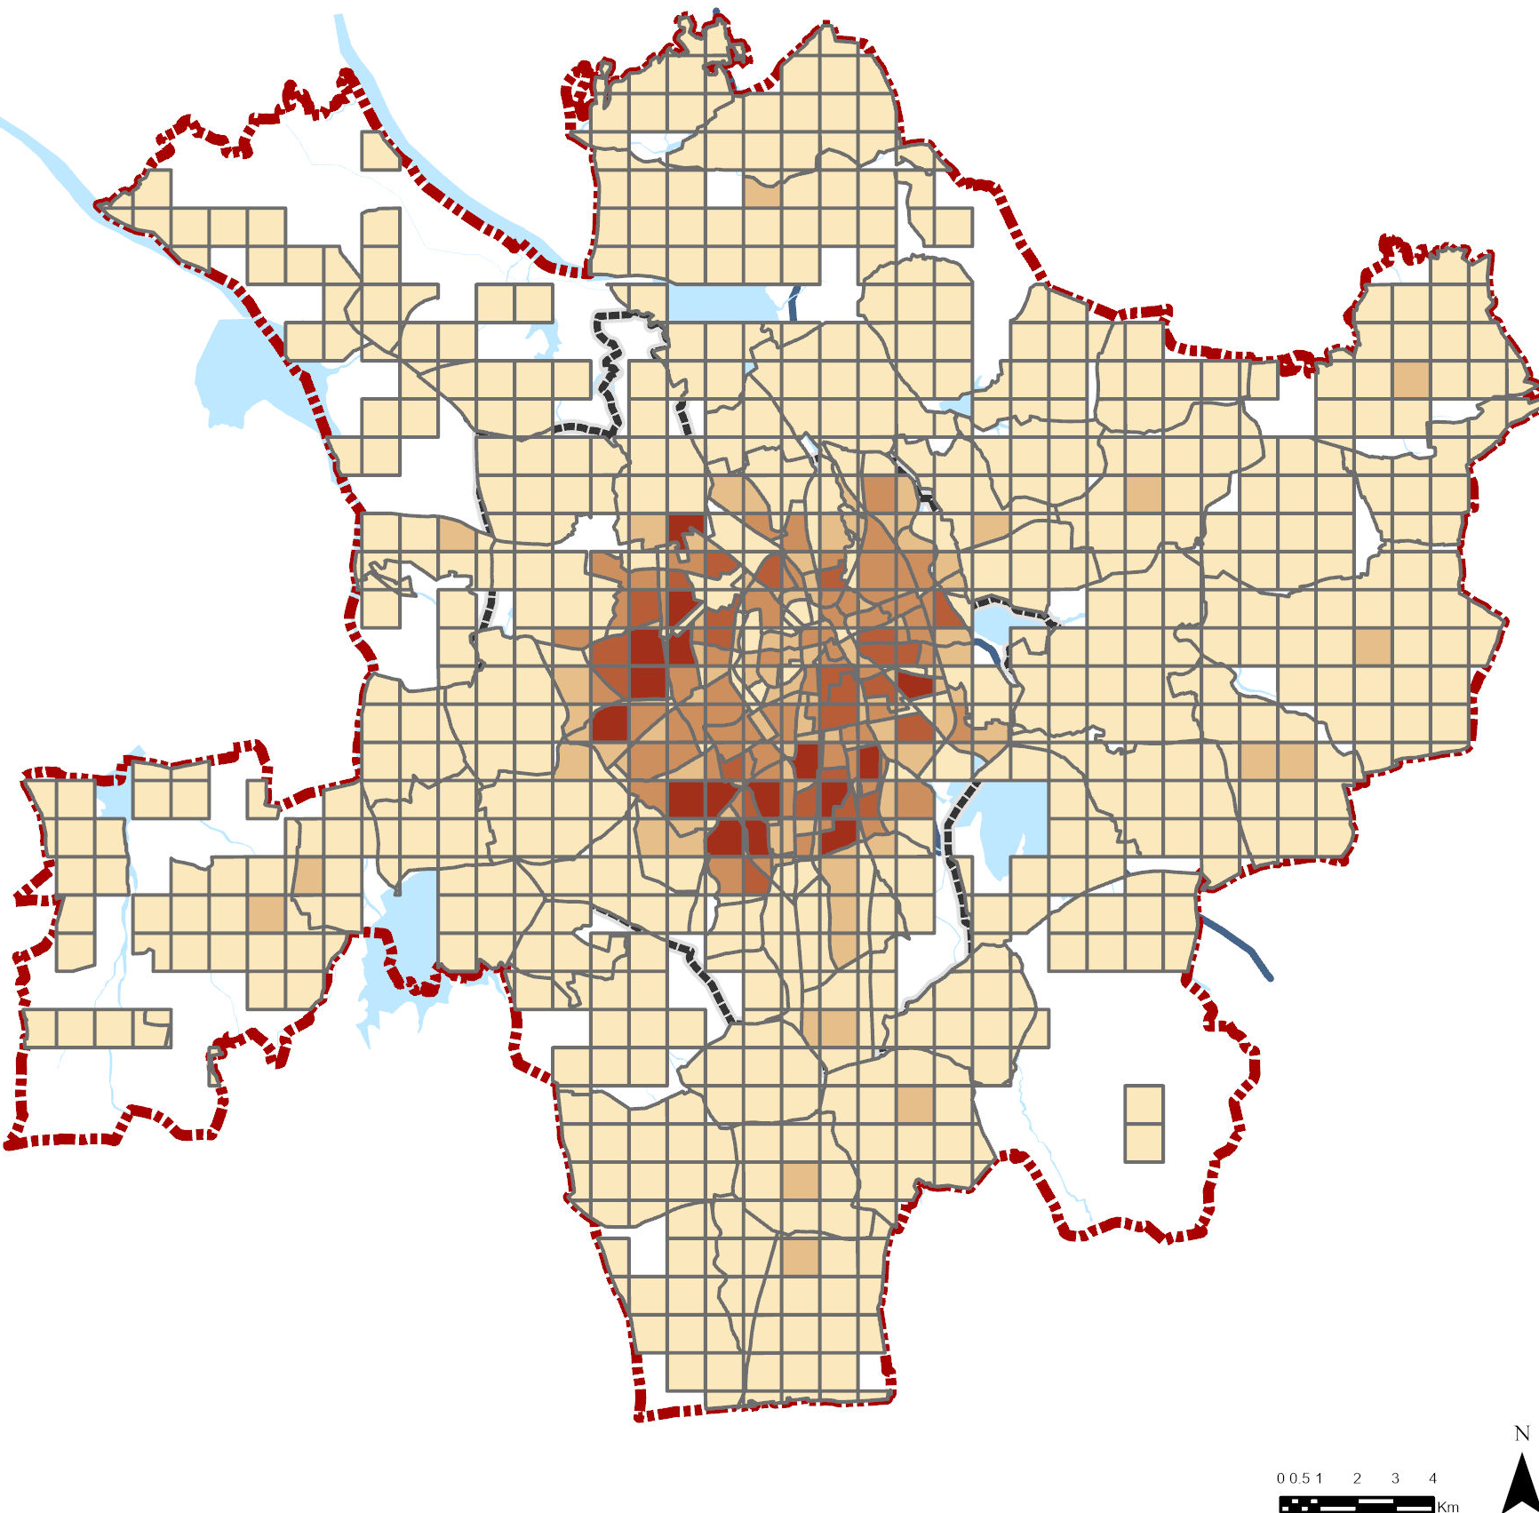
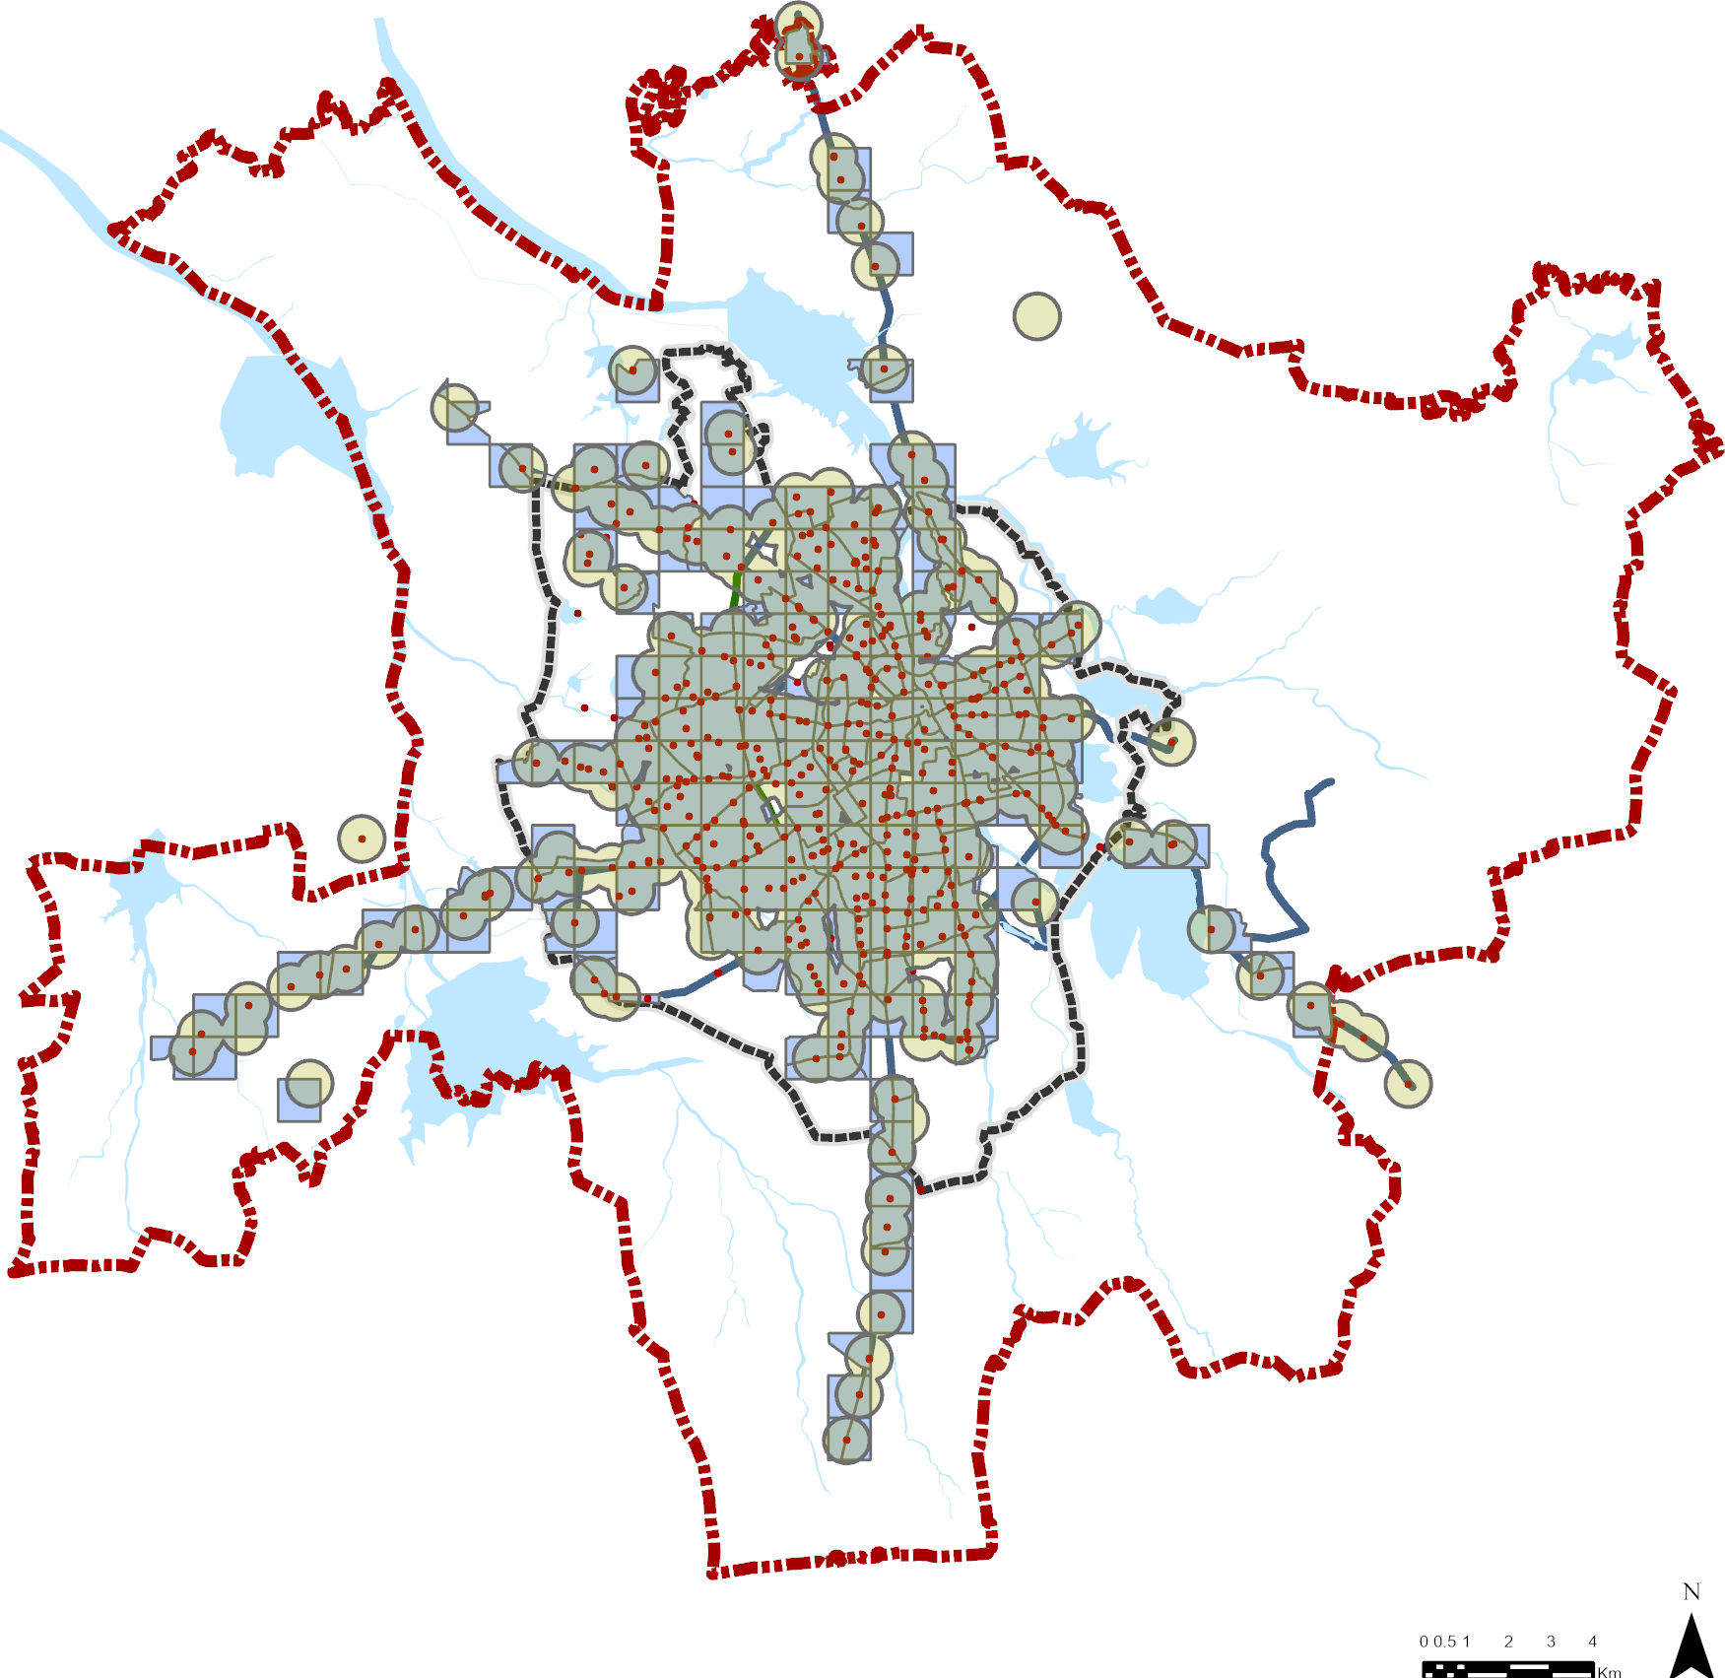
Fitness Function
Dij is the total passenger trips for all modes from the trip origin i to destination j.
S_{ij} is the transit trips from all routes from the tri p origin i to destination j.
OD_Pairs | Demand
510006_510006 | 13
414003_414002 | 8
414003_414007 | 9
414003_404008 | 1
OD_Pairs | Supply
510006_510006 | 1.3
414003_414002 | 1.3
414003_414007 | 1.3
414003_416001 | 1.4

Slide 11
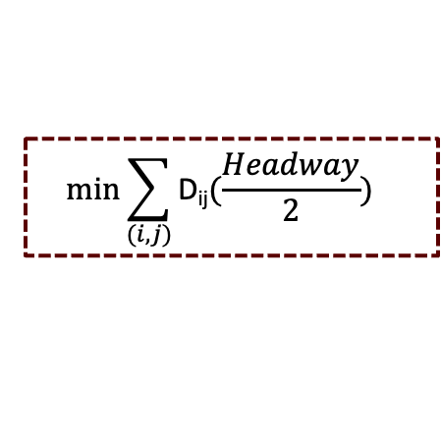
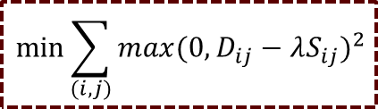
Genetic Algorithm in Headway Optimization
What is Genetic Algorithm?
Genetic Algorithms (GAs) are a type of evolutionary algorithm.
In transit network optimization, they are used to find the best Route Structures, Frequencies by iteratively improving a set of potential solutions
Constrains & Assumptions
Population generation
Fitness evaluation
Convergence
Generate a population of randomly allotted buses to the existing route networks, each with a unique set of frequencies.
Using the Objective function, evaluate each route network.
Subject to a fixed fleet size constraint, where the total number of buses available for allocation across all routes remains constant.
The proposed fleet size is 350. considering 90% fleet utilization 315 buses are taken in for further calculations.
Stage where no improvements can be made
$$min\sum_{(i,j)}{{max({0, D}_{ij}−λS_{ij})}^{2}}$$
No
$$min\sum_{(i,j)}{\text{D}\text{ij}{(\frac{Headway}{2})}^{}}$$
Mutation
Cross-Over
Selection
Yes
Randomly change
Add/remove a stop, or
Change frequency.
Mix two route networks to create new ones by:
Swapping routes,
Mixing route segments, or
Exchanging frequencies.
Choose the best-performing Networks to create offspring.
Terminate with Optimal solution
Best possible solutions is obtained.

Slide 12
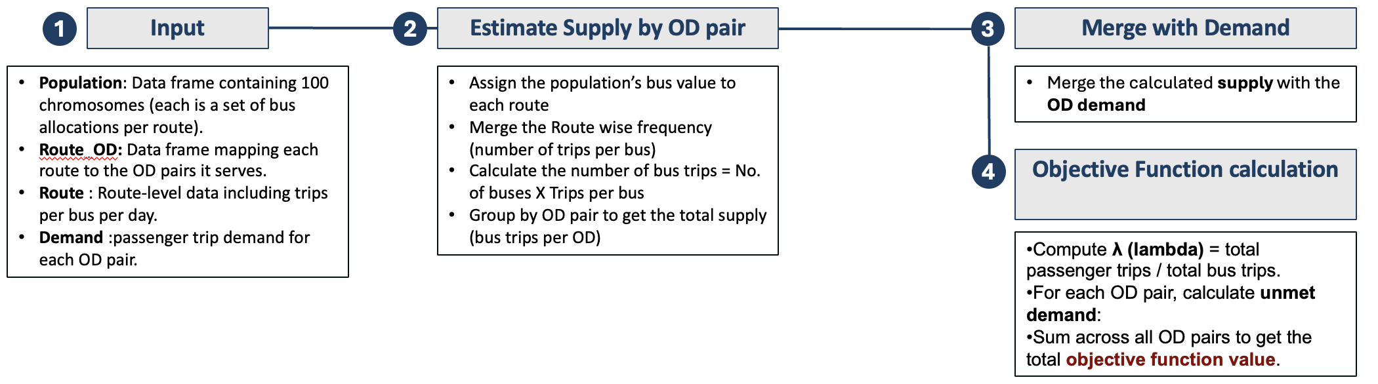
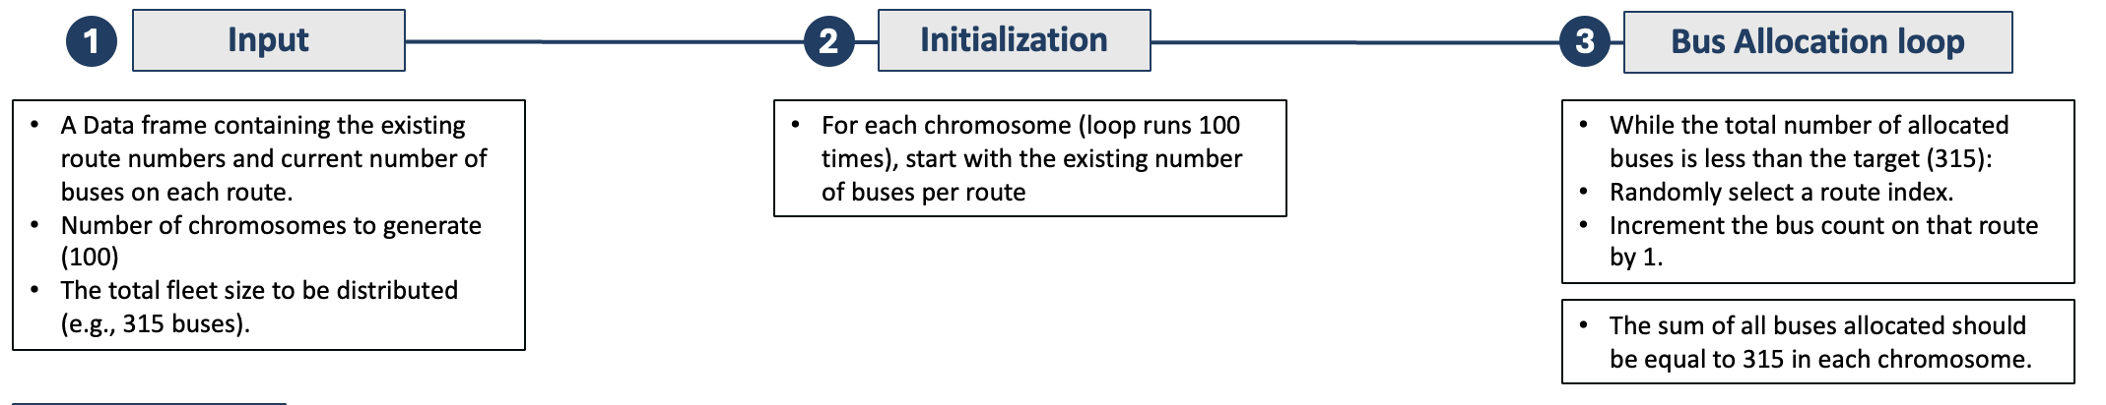
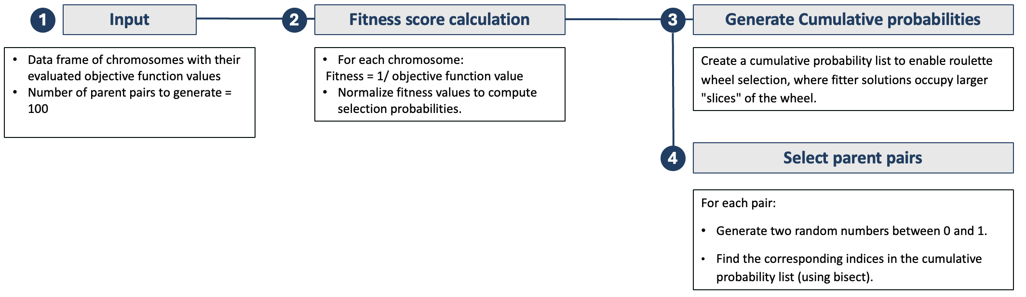
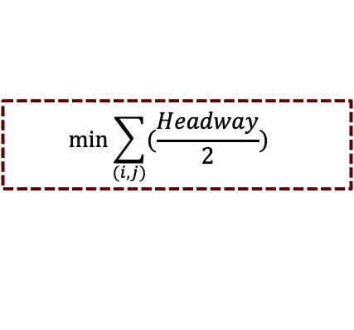
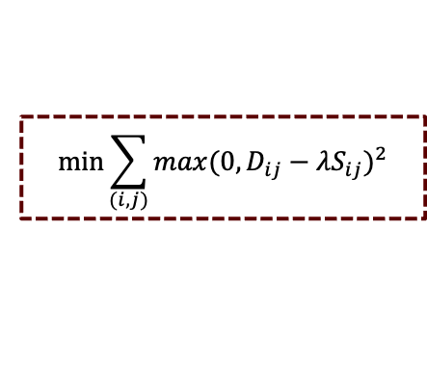
Genetic Algorithm- Methodology
Population Generation
Fitness Function
Generate a population of randomly allotted buses into the existing route network.
To guide the genetic algorithm’s evolution, each chromosome (i.e., a bus allocation solution) must be evaluated for how well it meets public transport demand. This is done using an objective function based on supply-demand gaps at the
OD (Origin-Destination) level.
To create the initial population of chromosomes for the genetic algorithm, a custom Python function was developed. Each chromosome represents a possible way of allocating 315 buses across existing transit routes.
Total number of buses = 315
Existing routes = 50
Size of the population = 100
A data frame of 100 chromosomes with randomly allotted buses to each of its route is obtained.
A list of sorted chromosomes in ascending order of the Objective function. (Top 100 retained.)
Selection
The best-performing chromosomes must be selected as parents for the next generation. This step implements a selection strategy using roulette wheel selection.
$$min\sum_{(i,j)}{{max({0, D}_{ij}−λS_{ij})}^{2}}$$
$$min\sum_{(i,j)}{{(\frac{Headway}{2})}^{}}$$
Index pairs representing parent chromosomes is generated.

Slide 13
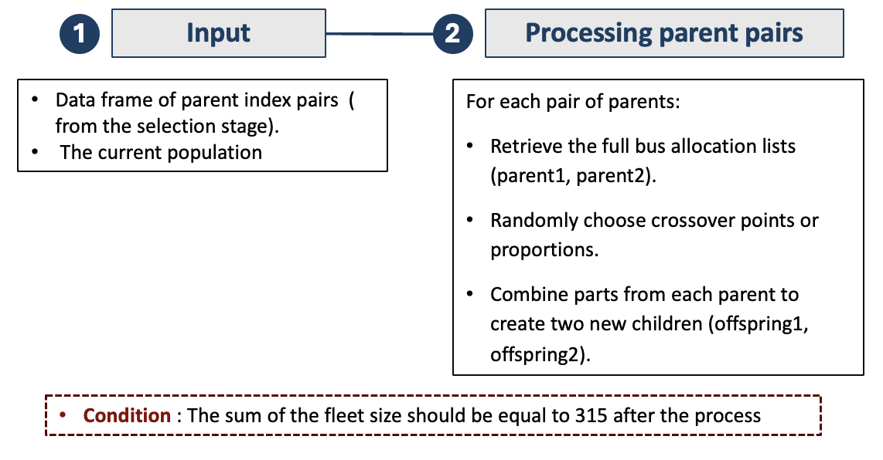
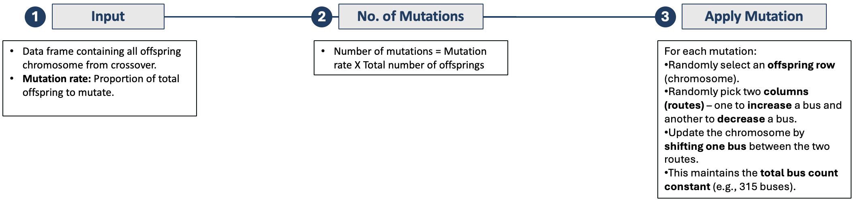
Genetic Algorithm- Methodology
Crossover
Mutation
After selecting high-performing parent chromosomes, the crossover step creates new offspring by combining features (bus allocations) of two parents.
To prevent the genetic algorithm from converging prematurely to suboptimal solutions, the mutation step introduces small random changes to some offspring. This keeps the solution space explored more broadly.
Data frame with offspring , 2 for each parent pair
Returns the modified offspring with small changes applied to promote diversity
Fitness Function Loop
The genetic algorithm evolves a better bus allocation plan over multiple iterations, guided by fitness-based selection, crossover, and mutation. Each cycle refines the population toward minimizing the objective function.
Fitness evaluation
Selection
Cross-Over
Evaluate each chromosome using the objective function
Filter the top 100 performing solutions
Generate offspring from selected parents using the randomized crossover method.
Use roulette wheel selection to choose parent chromosomes based on fitness.
Population update
Mutation
Combine the top 100 pairs and the new offspring to form the next generation
Apply random reallocation of buses in 5% of the offspring to maintain genetic diversity.

Slide 14
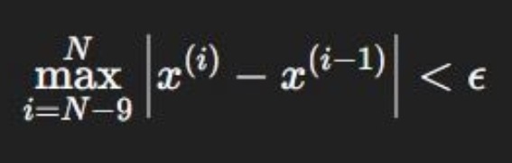
Results and Conclusions- Scenario 01- Demand & Supply Gap
The graph is plotted for every 10th iteration
The objective function value has decreased from 121994 to 117079 over 262 iterations
The convergence is achieved in the 262nd iteration. The convergence is reached when the change in objective function value becomes negligible between iterations.
Let x be the value at iteration i. convergence is defined over the last 10 iterations as:
Where:• N= current iteration number• €= a small threshold (e.g., 1 × 10-6)• The max ensures none of the last 10 steps changed significantly.

Slide 15
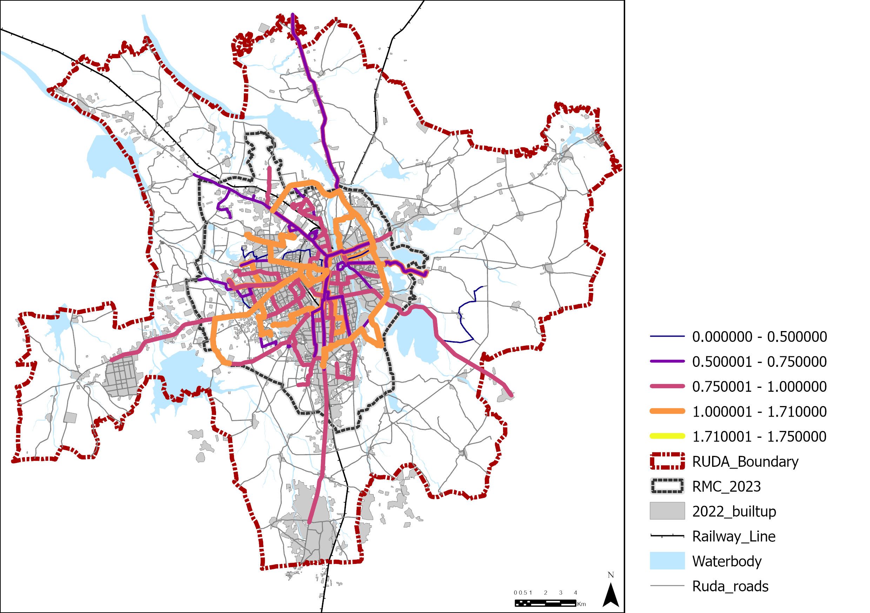
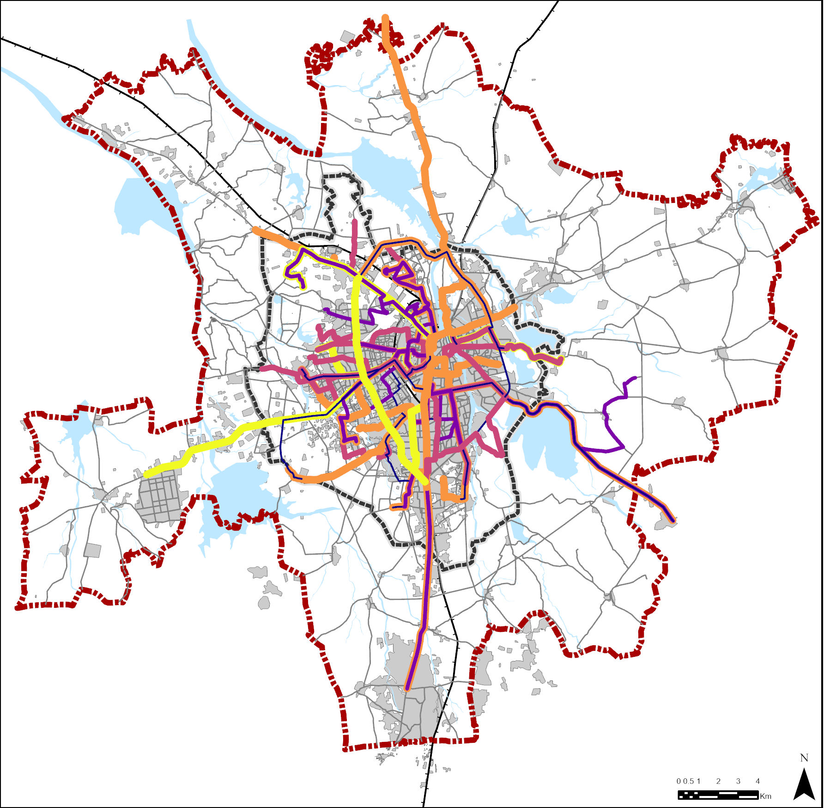
Comparing frequencies of Existing and Optimized route sets

Slide 16
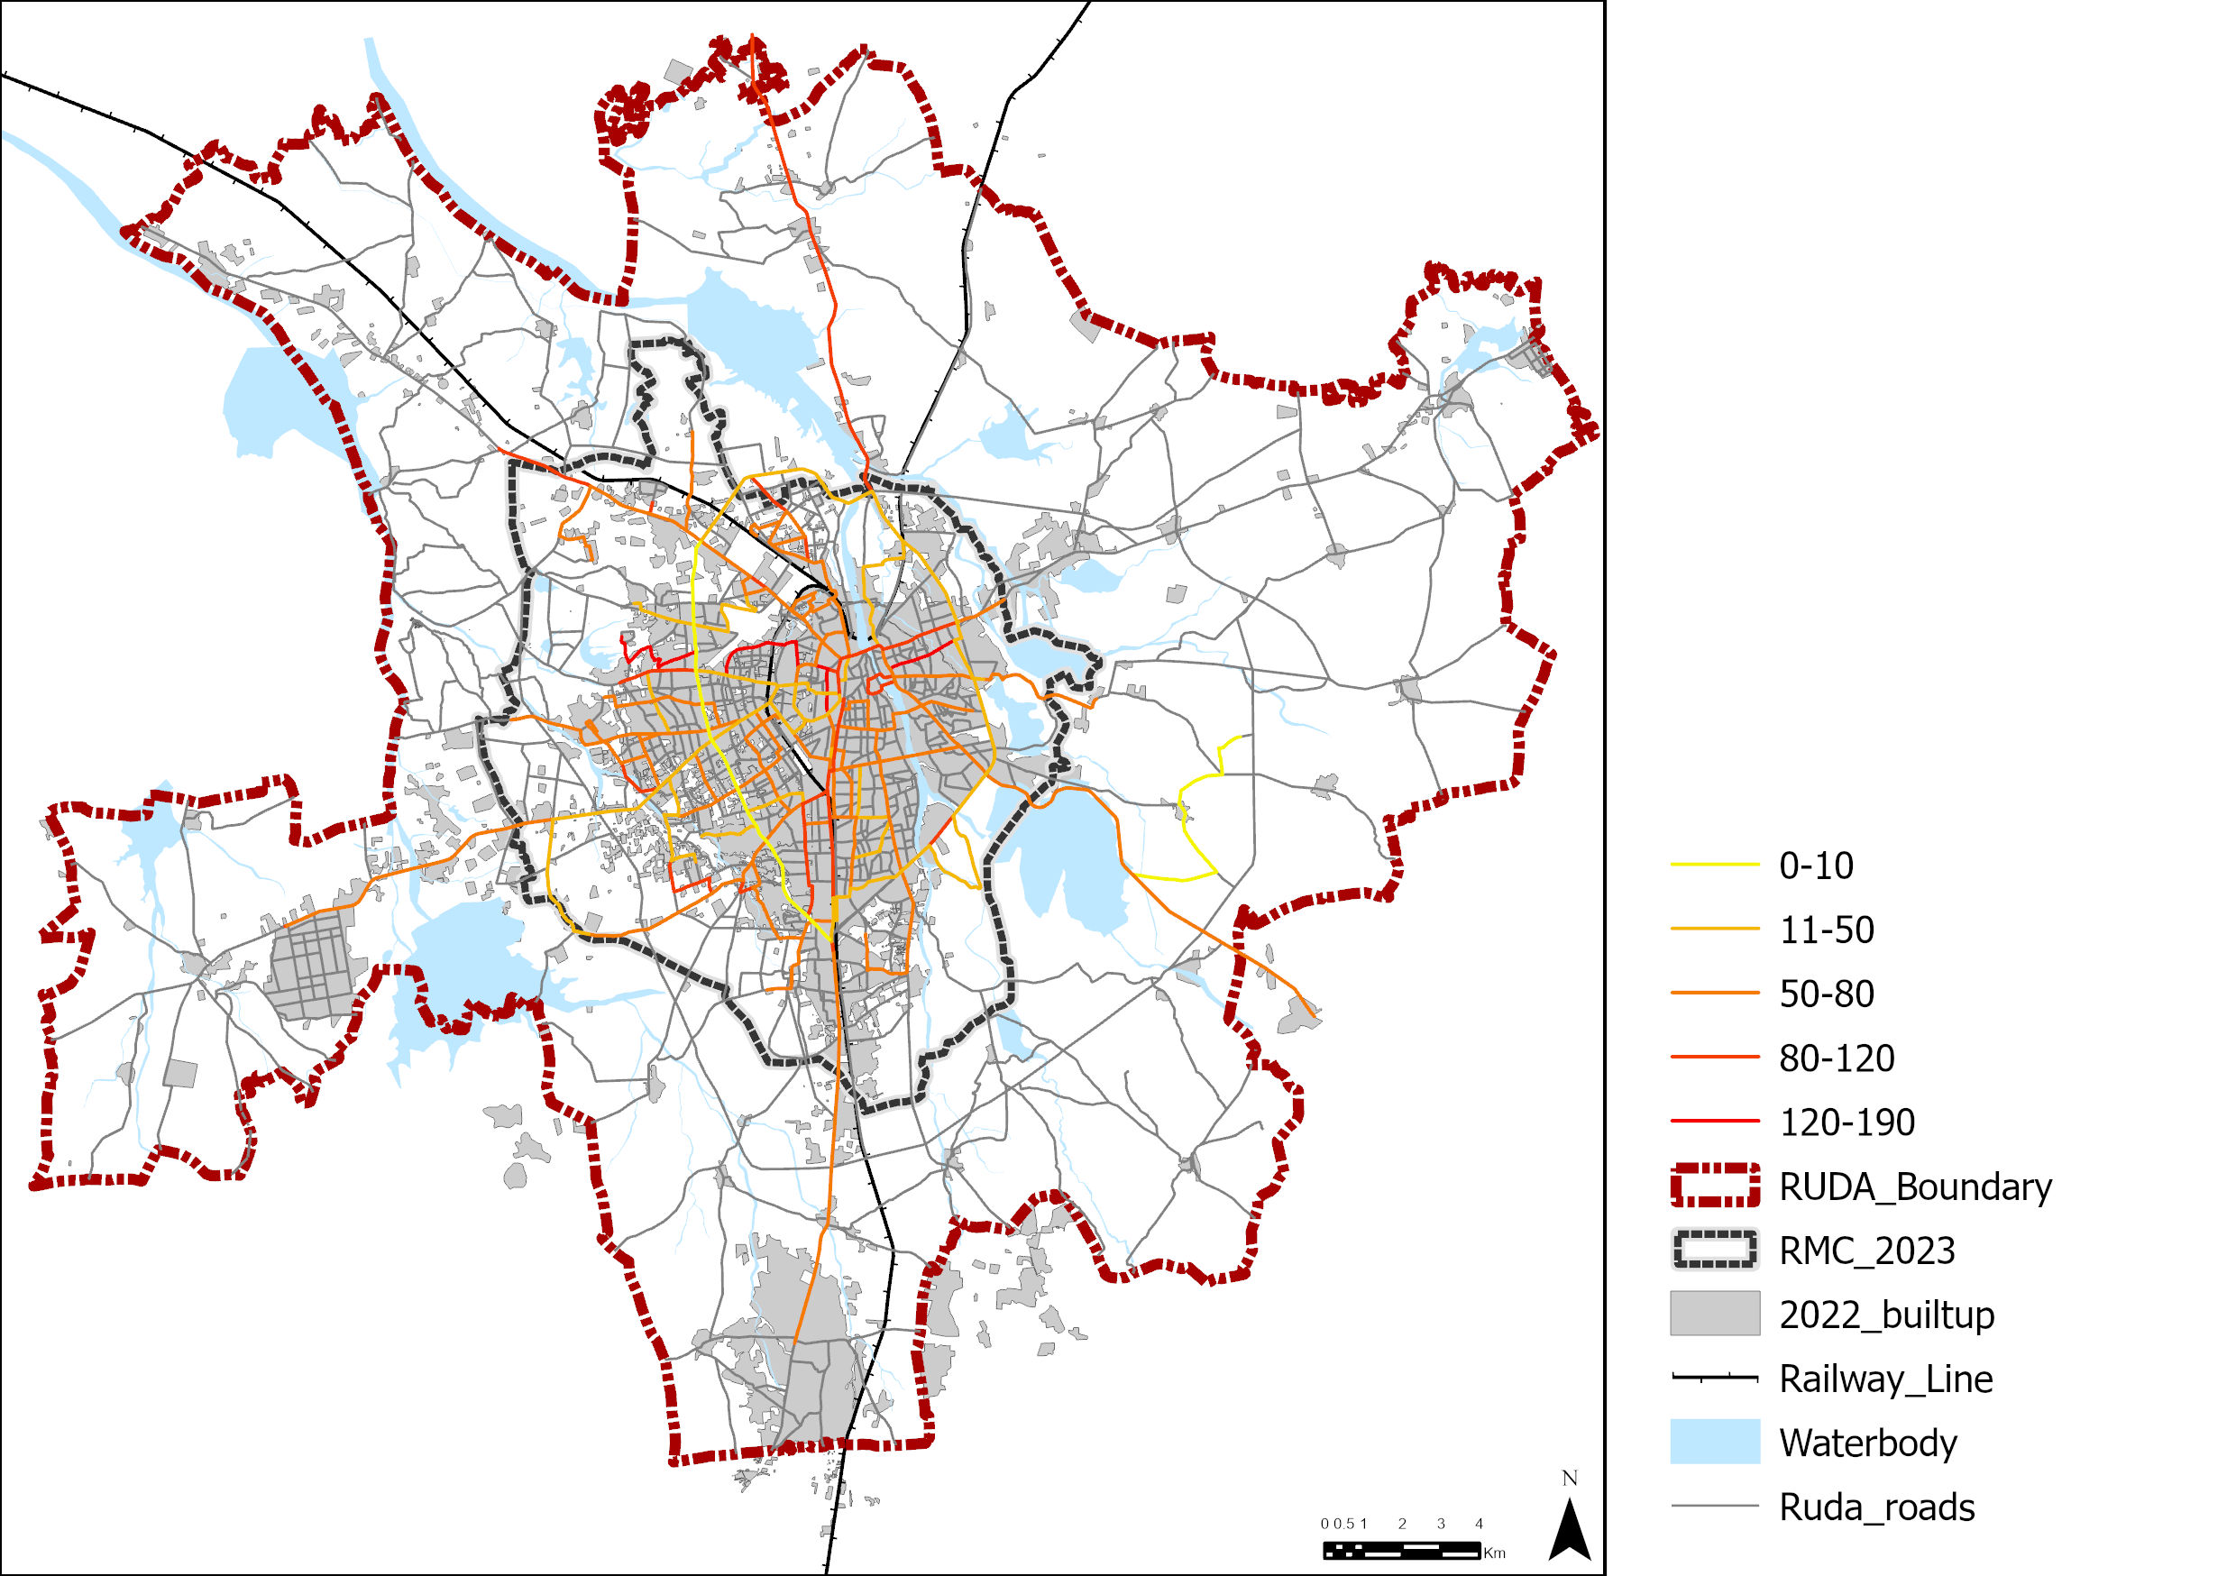
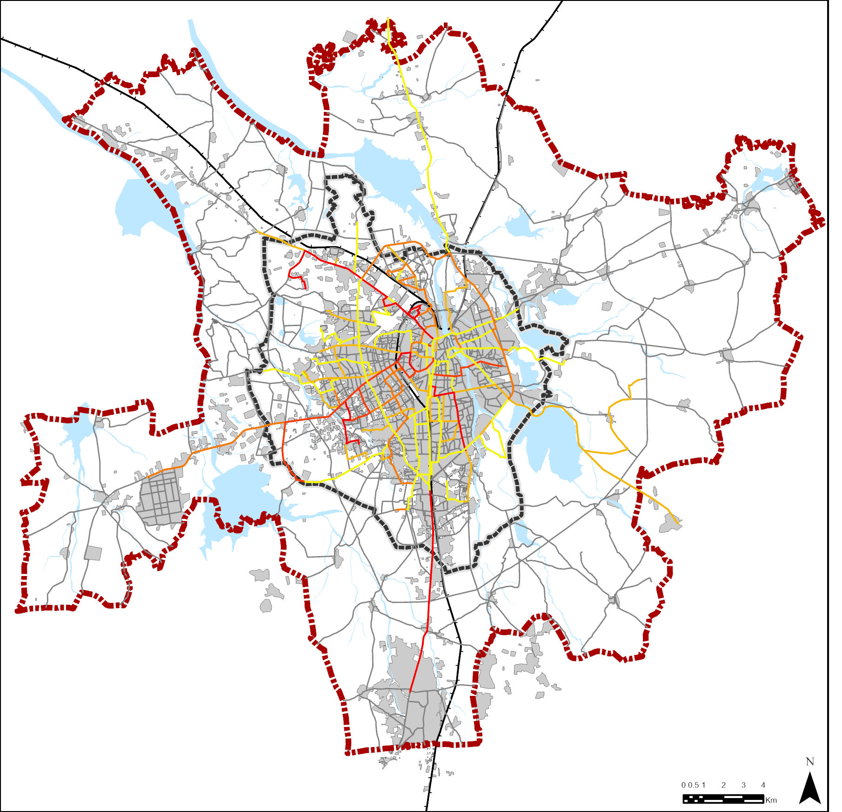
Comparing headways of Existing and Optimized Route sets

Slide 17
Results and Conclusion- Scenario 02- Waiting Time
The graph is plotted for every 10th iteration
The objective function value has decreased from 285380 to 209666 mins over 168th iterations.
Let x be the value at iteration i. convergence is defined over the last 10 iterations as:
Where:• N= current iteration number• €= a small threshold (e.g., 1 × 10-6)• The max ensures none of the last 10 steps changed significantly.
The convergence is achieved in the 168th iteration. The convergence is reached when the change in objective function value becomes negligible between iterations.

Slide 18
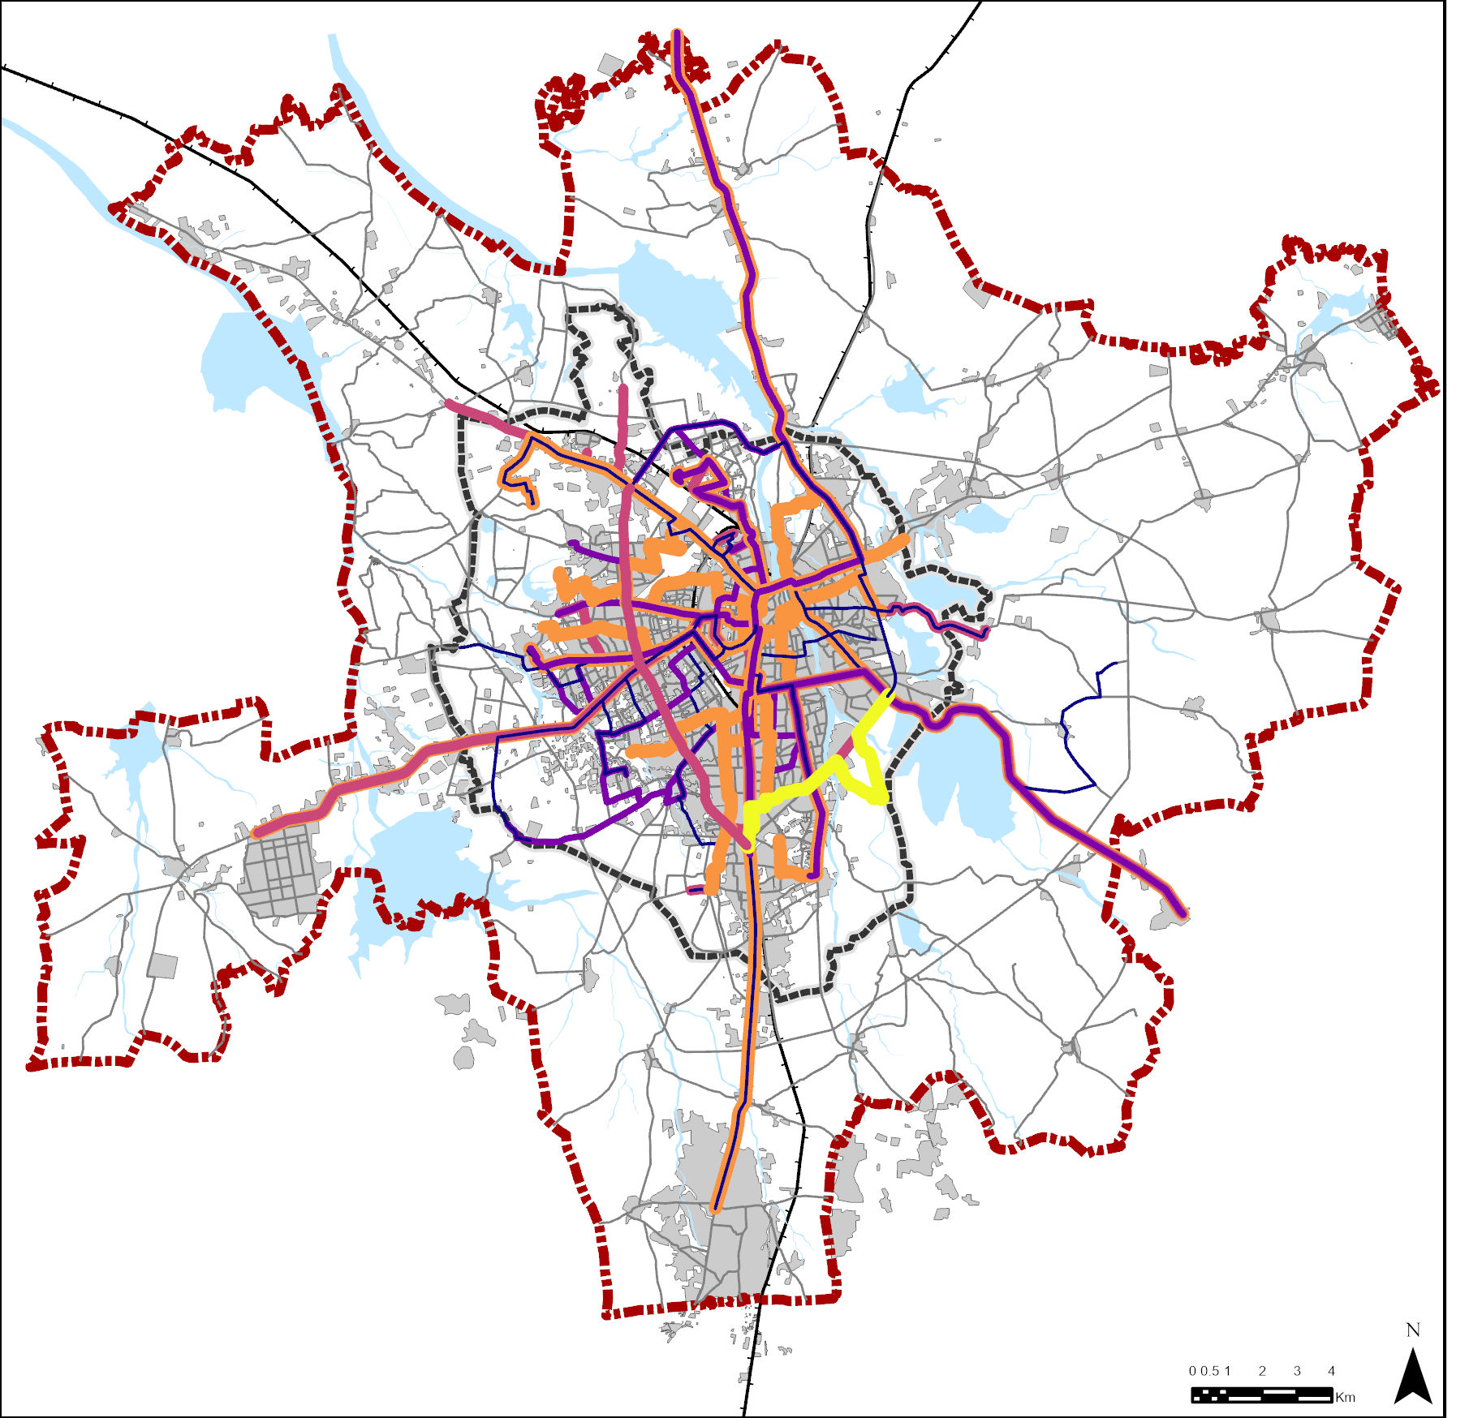
Comparing Waiting time and Frequency

Slide 19
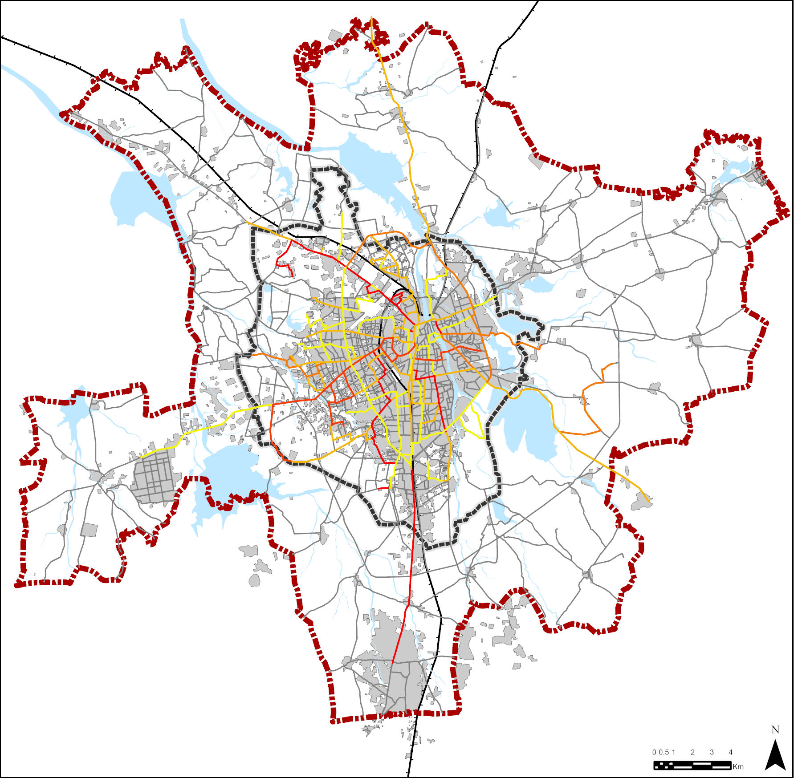
Comparing headways of Existing and Optimized Route sets

Slide 20
Way Forward and Bibliography
1
Integrate Route Network Optimization
References
    Ceder, A. (2007). Public Transportation Systems: A Transit Planning Handbook.
    Chakroborty, P., Deb, K., and Srinivas, B. (1998). Network-Wide Optimal Scheduling of Transit Systems Using Genetic Algorithms. In Computer- Aided Civil and Infrastructure Engineering (Vol. 13).
    Cheng, X., Che, and Chang. (2024). Optimizing Urban Road Networks for Resilience Using Genetic Algorithms. Online) Published By SOUTHERN UNITED ACADEMY OF SCIENCES PRESS, 2(6).
https://doi.org/10.5281/zenodo.14032011
    Deb, K., and Pratihar, D. (2011). Multi-Objective Optimization Using Evolutionary Algorithms.
    Johar, A., Jain, S. S., and Garg, P. K. (2016a). Transit network design and scheduling using genetic algorithm – a review. An International Journal of Optimization and Control: Theories & Applications (IJOCTA), 6(1), 9–22. https://doi.org/10.11121/ijocta.01.2016.00258
    Johar, A., Jain, S. S., and Garg, P. K. (2016b). Transit network design and scheduling using genetic algorithm – a review. An International Journal of Optimization and Control: Theories & Applications (IJOCTA), 6(1), 9–22. https://doi.org/10.11121/ijocta.01.2016.00258
    Juan de Dios Ortúzar, and Luis G. Willumsen. (2011). Modelling Transport (4th ed).
    Ministry of housing and Urban affairs. (2023).
    Pattnaik, S. B., Mohan, ; S, and Tom, V. M. (n.d.). URBAN Bus TRANSIT ROUTE NETWORK DESIGN USING GENETIC ALGORITHM.
    Sachan, A., and Mathew, T. (2018). ScienceDirect Integrated Multimodal Transit Route Network Design with Feeder Systems-review Sadrsadat, H., Poorzahedi, H., Haghani, A., and Sharifi, E. (n.d.). Bus Network Design Using Genetic Algorithm.
    TRANSPORT Application of Genetic Algorithms in Design… 75. (n.d.).
Extend the model to generate new route configurations (not limited to existing ones).
Use spatial demand clusters and heuristics to create an initial population of routes.
Apply genetic algorithm to optimize both route structure and bus allocation simultaneously.
2
Real-time or Dynamic Scheduling
Extend model to account for time-dependent demand (peak vs off-peak).
Optimize headway dynamically across different time windows.
3
Incorporate a Mode Choice Model
Current model assumes fixed PT demand due to absence of mode shift behavior.
Future work can integrate a mode choice model (e.g., logit-based) to estimate how service quality improvements affect demand.
Enables a more realistic feedback loop between supply and demand.
4
Environmental and Cost Analysis
Evaluate the emission impact or cost efficiency of optimized plans.

