Slide 1


Paper ID : 9789
The Blind Spot in Conventional Transport Models: A Critical Literature Review on Commute and Subjective Well-being
Author: Ann Das¹, Ashish Verma ², Aruna Sivakumar ³
¹ Research Scholar, Department of Civil Engineering, IISc Bangalore
² Prof., Department of Civil Engineering, IISc Bangalore
³ Prof., Department of Civil and Environmental Engineering, Imperial College London, London, UK

Slide 2
Outline
Introduction
Motivation
Aim
Literature review across globe
Global Learnings & trends
Reflections

Slide 3



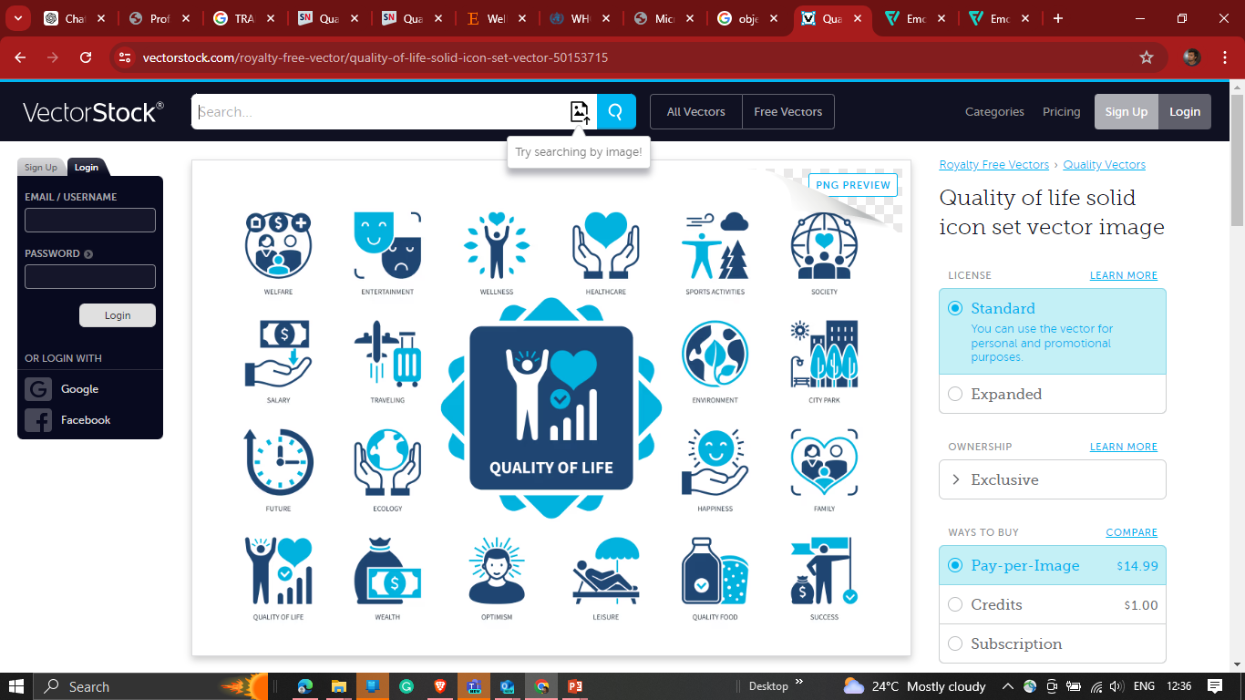


Introduction to Well-being
Quality of life is defined by the WHO as “individuals' perceptions of their position in life in the context of persons' physical health, psychological state, level of independence, social relationships, personal beliefs and their relationships to salient features of the environment.
Based on theoretical concept defined by Felce & Perry (1995)
Objective Aspects
Subjective Aspects
Personal values & aspirations
Well-being is a positive state experienced by
individuals. It refers to the overall state of
how individuals experience and evaluate their lives.
Hedonic well-being: focuses on pleasure attainment and pain avoidance, typically measured through happiness, life satisfaction, and affect balance.
Eudaimonic well-being : emphasizes meaning, self-realization, and living in accordance with one’s true self and values (Ryff, 1989; Deci & Ryan, 2008).
Transportation Strategies Affect QOL
3
3

Slide 4
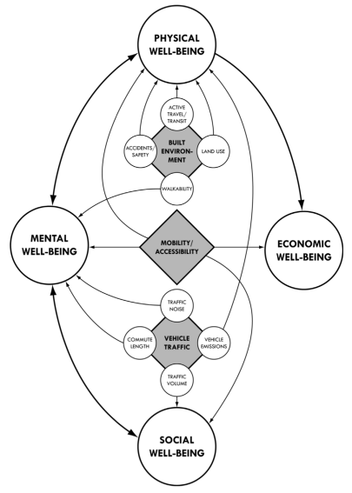
How can we translate well-being into transportation ?
Targeting to improve the QOL through transportation
By studying four factors in consideration of three components of the transportation system
Built Environment
Mobility/Accessibility
Vehicle traffic
Refers to fitness, energy and absence of illness
Conceptual framework:
Linking transportation to Quality of Life (QOL)
Financial resources, access to employment
Psychological health, mood and self-perception
Level of community involvement, personal relationship
Source: Richard J et al., (2016)

Slide 5
Is this translation of well-being to transportation important?
QOL is a function of both the level of human needs met and the extent to which individuals or groups are satisfied with this level.
(Costanza et al., 2007)
How users perceive the fulfilment of their needs through transportation ?
Subjective Well-being
How one feel about how things are met ? How one evaluate life or experience over time?
Satisfaction/Happy/ Sad
Human needs/ Opportunities
Job
Recreation
Socialising
Fitness
Finance/Income
Human needs/ Opportunities are met
through transportation
Built Environment
Travel attributes
Quality of environment
Freedom
How needs are met ?
Error term
Policy
Travel behaviour and Travel behavioural shift
Traditional Transportation Choice Modeling

Slide 6
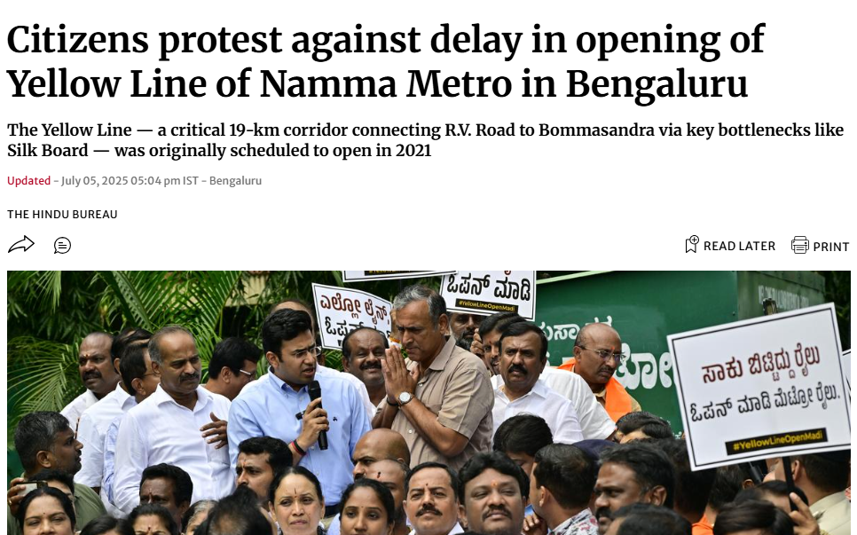
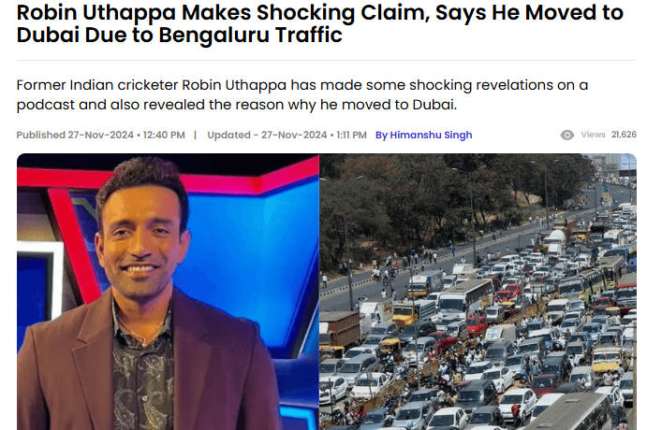
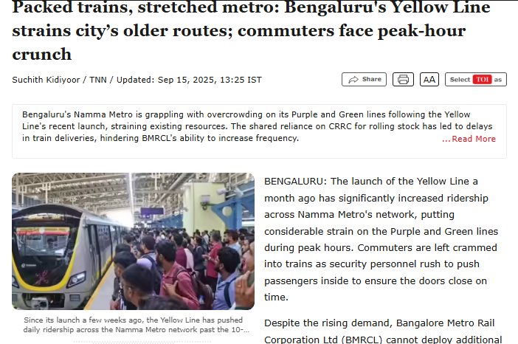

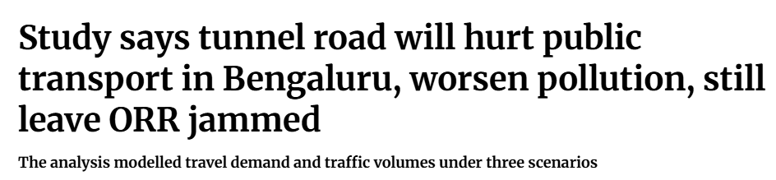

Motivation

Slide 7
Is this translation of well-being to transportation important?
QOL is a function of both the level of human needs met and the extent to which individuals or groups are satisfied with this level.
Source: Costanza et al., 2007
Mixed approach of QoL
Human needs/ Opportunities are met
through transportation
Built Environment
Travel attributes
Quality of environment
Freedom
How users perceive the fulfilment of their needs through transportation ?
Human needs/ Opportunities
Job
Recreation
Socialising
Fitness
Finance/Income
Subjective Well-being
How one feel about how things are met ? How one evaluate life or experience over time?
Satisfaction/Happy/ Sad
How needs are met ?
People centric policy
Travel behaviour and Travel behavioural shift
Mixed approach of Transportation Choice Modeling

Slide 8
Aim
To establish the importance of subjective well-being in transport by synthesizing evidence on how modes, built environments, congestion, and delays affect individuals.
To identify gaps in current research and provide recommendations for future studies.

Slide 9
Literature Review
A review of current studies & Research gaps

Slide 10
Literature review both Social and Mental wellbeing dimension
Author(s), Year, SA | Research Focus | Method | Key Variables / Factors | Key Findings & Implications | Limitations
Mouratidis (2025) Athens (Greece) & Oslo (Norway) | Examines how car ownership relates to subjective well-being subjective WB across life domains | Linear Mixed Models + Regression | Subjective well-being (life satisfaction, happiness, anxiety); Health; Life domains (social relationships, leisure, vacations) | Car ownership ↑ WB in car-dependent cities; public transport users ↑ WB in transit cities → Plan car-free alternatives & context-based design | Small urban sample; cross-sectional bias
Lättman et al. (2025) Dortmund (Germany), Genoa (Italy), Gothenburg (Sweden) | Walking satisfaction across Europe & psychological drivers | ANOVA + OLS regression | STS: Cognitive Evaluation, Positive Activation, Positive Deactivation); Walking Motivations (BRWQ: Intrinsic, Extrinsic etc.); Accessibility to local destinations; Social Norms | Recreational walkers ↑ satisfaction; urban accessibility & safety ↑ WB → Walkable cities & amenity design | Uneven samples; online recruitment
He et al. (2025) Hong Kong, China | Examines how long commutes affect work-life balance (WLB) and subjective well-being (SWB) | Mixed-methods SEM + Thematic analysis | Commute duration, travel satisfaction, WLB, SWB (emotional, social, psychological), residential location, | Long commute ↓ SWB; job–housing balance & tele-work ↑ WB → Plan mixed-use housing | Car user bias; pandemic timing
Paydar & Fard (2025) Temuco, Chile | Examines how Social & built env. → active travel & SWB | Hierarchical Regression + EFA | Attitudes: towards active modes,car Subjective well-being (DV 2): Two items – life satisfaction + happiness (Likert scale). SocialCompanionship,, accessibility, safety | Walking ↑ WB; cycling ↑ with income → Design context-sensitive urban policies for equity | Cross-sectional; limited context

Slide 11
Author(s), Year, SA | Research Focus | Method | Key Variables / Factors | Key Findings & Implications | Limitations
Tran et al. (2024) Japan | Examines Travel mode & activities → SWB (affective & cognitive) | SEM | Activities by mode, travel time by mode, SWB dimensions (affective & cognitive), car access, COVID-19 worry, problem-solving style | Public transport ↑ cognitive WB, ↓ affective; active travel ↑ belonging → Integrate mobility & social WB | Online bias; cross-sectional
Richa et al. (2024) Luxembourg; | Examines how commuting satisfaction (CS) influences SWB and Telework | SEM + multi-group | Independent: Commuting satisfaction.Mediators: Satisfaction with time-use, leisure, health, job, relationships, residence.Moderator: Frequency of telework.Dependent: Subjective well-being. | Hybrid (2–3 days) ↑ SWB; TUS strong mediator → Flexible work policies & time-use balance | Self-selection bias; Luxembourg sample
Zhu et al. (2019) China | Examines how Commute time & urbanization → SWB | Ordered Probit Model | Independent: Commuting time and mode.Mediators: Job satisfaction, family satisfaction.Controls: Age, gender, income, education, marital status, hukou, city urbanization rate. | Longer commute ↓ SWB; walk/cycle ↑ WB → Improve non-motorized infrastructure | Cross-sectional
Mouratidis (2021) Norway | Investigates the relationship between commute satisfaction, subjective well-being (SWB), and travel satisfaction | MLM + SEM | Commute satisfaction (STS), commute duration, mode, residential satisfaction, urban density, life satisfaction, social well-being. | Shorter commutes ↑ satisfaction; public transport lowest → Compact urban design | High-income bias

Slide 12
Author(s), Year, SA | Research Focus | Method | Key Variables / Factors | Key Findings & Implications | Limitations
Herman & Larouche (2021), Canada | Explores associations between commuting mode (active, public, passive) and subjective well-being (SWB) and work-life balance (WLB), | Logistic Regression | Dependent variables: self-rated health, mental health, life satisfaction, stress, WLB, workaholism. | Active commuting ↑ WB; public transit ↓ life satisfaction → Gender-sensitive planning | Cross-sectional
Stanley et al. (2021), Melbourne, Australia | To develop framework to monetize changes in wellbeing: subjective, affective, and eudaimonic, in relation to social exclusion and transport disadvantage, in CBA | Ordered Logit (OL) and Generalised Ordered Logit (GOL) | Subjective WB: Personal Wellbeing Index (0–10) Affective WB: PANAS (Positive Affect) Eudaimonic WB: Ryff Scale (Self-acceptance, Growth, Relations) | Bridging social capital ↑ WB → Integrate social inclusion in transport policy | Outdated 2008 data
Liang & Ye (2019) Melbourne, Sydney & Brisbane, Australia | Impact of Commute behaviour → absenteeism & performance | NB Regression + Ordered Logit + SEM | Mediators: Health, commuting satisfaction.Outcomes: Absenteeism (days missed), Job performance (WHO HPQ). | Longer commutes ↓ health & productivity → Promote short-distance commutes | Self-reported bias; underrep. cyclists
Margareta et al. (2017), Sweden | Impact of travel satisfaction → emotional WB & life satisfaction | PLS-SEM | Independent: Satisfaction with Travel (STS – cognitive and affective components).Mediators: Emotional Well-being (EWB).Dependent: Life Satisfaction (SWLS) | Active modes ↑ STS & EWB; public transit ↓ WB → Prioritize active travel & comfort | Cross-sectional; recall bias

Slide 13
Quality of Life (QoL) Studies in the Indian Transportation Context
Author(s) & Year | Study Area / Context | Methodology / Analytical Framework | Why This Method Was Used | Methodological Limitations
Allirani & Verma (2025) A Novel Transportation Quality of Life Index Framework | Bengaluru Metropolitan Region (BMR), India | Analytic Hierarchy Process (AHP) + Rank Order Centroid (ROC) + Composite Index | To construct a comprehensive Transportation Quality of Life Index (TQoLI) integrating mobility, accessibility, environment, and health for sustainable transport evaluation. | Temporal changes not captured; does not incorporate subjective commuter experience.
Allirani & Verma (2024) Development of Level of Service Criteria for Pedestrianized Urban Street | Church Street, Bengaluru, India | K-Means Clustering (objective PLOS) + Ordered Logit Model (perceived PLOS) | To derive quantitative and qualitative Level of Service (LOS) thresholds for pedestrianized corridors based on flow metrics and perceived satisfaction. | Ordered logit assumes proportional odds; clustering lacks temporal adaptability; limited event-period data.
Allirani, Verma & Dumka (2024) Framework for Assessment of Pedestrianization Impacts on QoL | Church Street, Bengaluru, India | Composite Index Model integrating Objective (PCA) + Subjective (ORM) measures | To assess livability and environmental improvements post-pedestrianization through combined perception and physical metrics. | Linear aggregation oversimplifies multidimensional interrelations; PCA components may lose interpretability.
Sarkar et al. (2023) Urban Environment and Mental Well-being Assessment | India (multi-city expert network) | Delphi Method + Correlation and Factor Analysis | To determine priority environmental parameters influencing mental well-being using iterative expert consensus and statistical clustering. | Expert-driven, not public perception-based; geographical imbalance in expert selection; findings are context-sensitive and may not extend nationally.
Anand & Pujara (2024) Towards Anxiety-Alleviating Streetscape Design: Literature Review | Conceptual—applied to Indian urban design context | Systematic Literature Review (PRISMA Protocol) | To systematically synthesize theoretical and empirical literature on urban design and anxiety alleviation. | No empirical validation within Indian context; limited integration of behavioral or physiological data; narrative synthesis only, lacking quantitative evidence.

Slide 14
Global Empirical Evidence on Transport-Related Quality of Life and Well-Being
Mouratidis (2021); Fyhri & Hjorthol (2021)
Delbosc et al. (2020)
Du & Sun (2025); Wang & Liu (2022); Wang et al. (2020); Yiran Fan et al. (2021)
Bergstad & Gärling (2019); Lättman et al. (2025); Margareta et al. (2017)
Hook et al. (2021)
Richa et al. (2024)
Lättman et al. (2025); Stutzer & Frey (2008)
Mattson et al. (2021)
Legrain et al. (2015)
Choi, Ko & Guensler (2021)
Herman & Larouche (2021)
Mouratidis (2025)
Tran et al. (2024)
Lättman et al. (2025)
Huyen & Carrel (2021); Han Dong & Zhang (2019)
Mattson et al. (2021)
Zhu et al. (2019)
Yao Du & Guibo Sun (2024);
He et al. (2025)
Guzman et al. (2023)
Allirani & Verma (2025)
Paydar & Fard (2025)
South America - 2 cities
Australia - 4 cities
Liang & Ye (2019)
North America -5 cities
Asia - 6 cities
Europe – 9 cities
Delbosc & Currie (2011); Stanley et al. (2021)

Slide 15
Summary of evidences
1. Walking & Cycling (Active Modes)
Consistently associated with higher physical, mental, and emotional well-being.
Boosts mood, autonomy, and social connectedness through physical activity and environmental contact.
Seen in Sweden, Germany, Chile, USA, Japan, and Vietnam.
Barriers: safety concerns, poor infrastructure, and cultural stigma reduce satisfaction.
3. Car Use
Provides comfort, security, and flexibility, improving satisfaction in car-dependent regions (e.g., Athens).
In transit-oriented cities (e.g., Oslo, Portland), links to lower SWB, frustration, and social isolation.
Longer commutes increase stress and reduce work–life balance (e.g., Hong Kong).
Overall trend
Active and sustainable modes → higher hedonic (enjoyment) and eudaimonic (purpose, mastery) well-being.
Motorized and congested modes → lower satisfaction, stress, and reduced autonomy.
Context matters: Cultural norms, infrastructure quality, and accessibility shape how modes influence well-being.
Emerging shift: Need for transport policies that balance efficiency with human well-being.
2. Public Transport (Bus, Metro, Train)
Offers affordability and accessibility, especially for vulnerable groups.
However, crowding, delays, and loss of control often decrease travel satisfaction and autonomy.
Seen in UK, Hong Kong, Vietnam, Japan, and North America.
Older adults and low-income users are particularly affected by service reductions.
4. Two-Wheelers / Motorbikes
Offer freedom and flexibility (common in Asian cities like Hanoi, Japan).
But exposure to accidents and pollution negatively impacts both physical and mental well-being.
Users report mixed satisfaction — flexibility vs. safety trade-offs.

Slide 16
Take away and reflections
Bridges a Critical Gap – Moves beyond travel time and cost to include mental, social, and emotional well-being in transport research.
Human-Centric Approach – Recognizes commuting as a lived experience, not just a mobility task.
Introduces Mixed-Method Evidence – Integrates psychometric tools with objective parameters for a more complete understanding of travel impacts.
Contextualizes Global Theories to India – Adapts well-being concepts to mixed traffic, informal modes, and cultural diversity unique to Indian cities.
Policy Relevance – Provides a framework to embed well-being indicators into transport appraisal and planning models.
Supports Sustainable Development Goals (SDGs) – Aligns with SDG 3 (Health & Well-being) and SDG 11 (Sustainable Cities & Communities).
Empowers Decision-Makers – Offers evidence for designing people-first, equitable, and resilient transport systems.

Slide 17

“When we design cities for speed, we move vehicles;
when we design for well-being, we move people, we move happy commuters”

